Slide 1
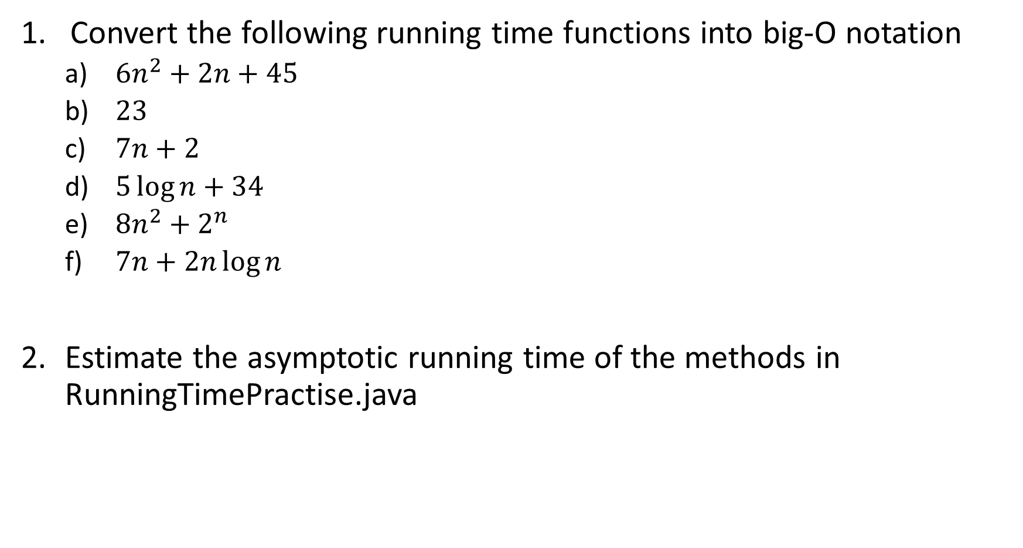
Convert the following running time functions into big-O notation
$6n^{2}+2n+45$
$23$
$7n+2$
$5\log{n}+34$
$8n^{2}+2^{n}$
$7n+2n\log{n}$
Estimate the asymptotic running time of the methods in RunningTimePractise.java

Slide 2
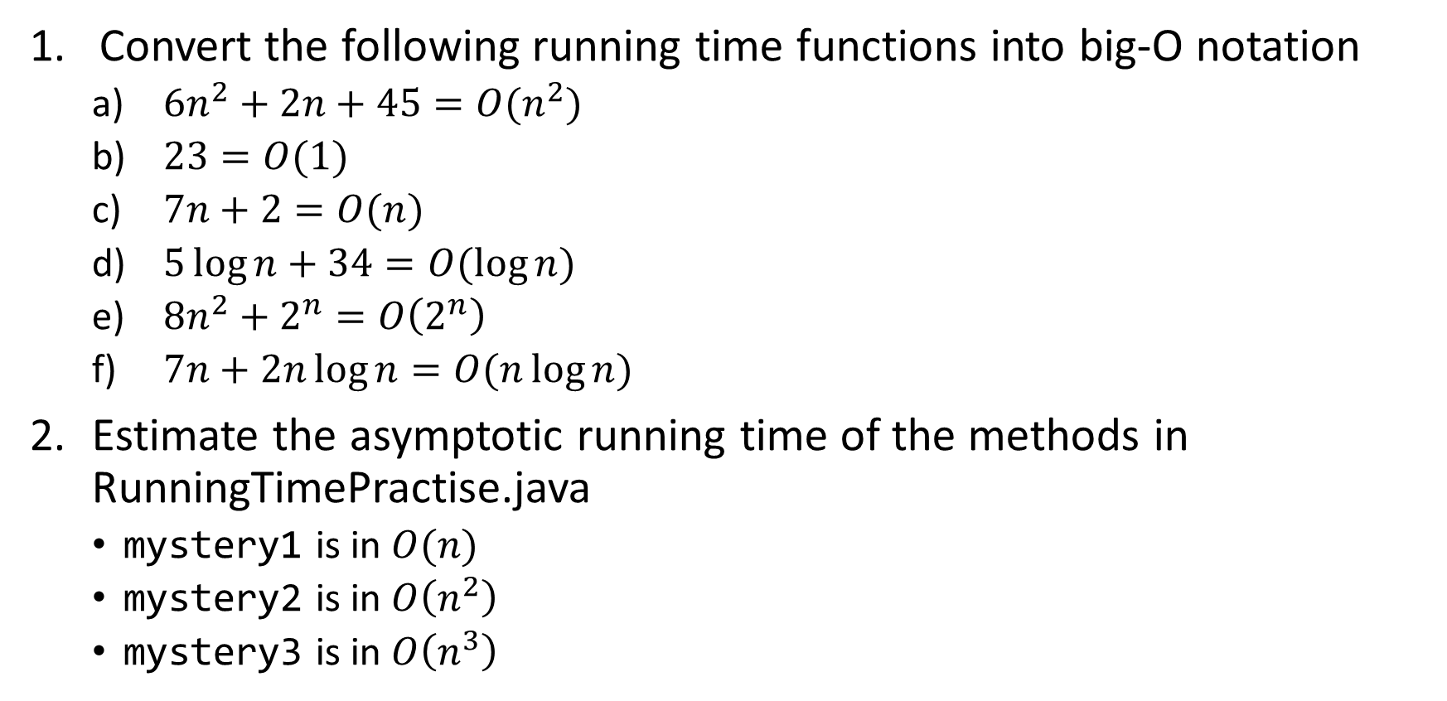
Solutions:
Convert the following running time functions into big-O notation
$6n^{2}+2n+45=O(n^{2})$
$23=O(1)$
$7n+2=O(n)$
$5\log{n}+34=O(\log{n})$
$8n^{2}+2^{n}=O\left(2^{n}\right)$
$7n+2n\log{n}=O(n\log{n})$
Estimate the asymptotic running time of the methods in RunningTimePractise.java
mystery1 is in $O(n)$
mystery2 is in $O\left(n^{2}\right)$
mystery3 is in $O\left(n^{3}\right)$

