Slide 1
1. Introduction
Lecture slides for What Can Be Computed?

Slide 2
Main objective of the course
We would like to understand what can be computed:
In principle (i.e. undecidability/uncomputability: computability theory)
Efficiently/in practice (i.e. complexity theory)

Slide 3
 | tractable problems | intractable problems | uncomputable problems
Description:
Computable in theory:
Computable in practice:
Example:

Slide 4
 | tractable problems | intractable problems | uncomputable problems
Description: | can be solved efficiently | method for solving exists but is hopelessly time-consuming | cannot be solved by any computer program
Computable in theory: | ✓ | ✓ | ✗
Computable in practice: | ✓ | ✗ (?) | ✗
Example: | shortest route on a map | Decryption | finding all bugs in computer programs

Slide 5
Why study the theory of computation?
It is useful
When using computers to solve problems, it’s often important to understand whether a given problem is computable and/or tractable.
If it’s not tractable, is there a suitable variant or approximation that is tractable?
How do we compare the efficiency and effectiveness of proposed methods for solving the problem?
Certain specific techniques have practical applications, including reductions, regular expressions, and automata theory
The theory of computation is beautiful and important
We can more fully understand computer science as an intellectual discipline

Slide 6
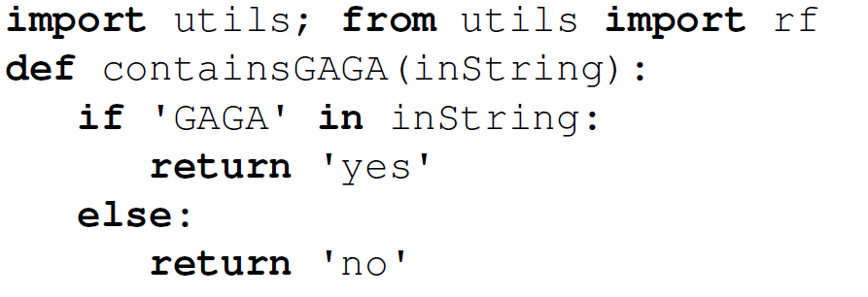
Some Python basics
utils package provided with WCBC online resources
rf function reads a file from disk. It is imported explicitly because we use it so often.
“def” defines a function, similar to a procedure or method in other languages.
The “in” operator does “the right thing” on many datatypes. Here it tests for the presence of a substring in another string.
Use a single or double quotes for strings.
No curly braces “{ }”. Blocks are defined by indentation.

Slide 7
Suggested practice and demos, at home or in class:
Run containsGAGA.py on inputs typed in by the user, then using input read from a file
Create a new program that searches for another string
Create more sophisticated programs, for example:
return “yes” if the input contains “GAGA” but not “TATA”

