Slide 1
2. Some impossible programs
Lecture slides for What Can Be Computed?

Slide 2
Proof by contradiction
The next two slides give an overview, but we won't cover this in detail during class.
Instead, imagine how you would prove to a small child that there is no largest number.

Slide 3
Proof by contradiction
Follows a familiar human thought pattern:
S = statement we would like to prove false e.g. “I bought the milk on Monday”
C = consequence that follows from S being true e.g. “I was in town on Monday”
T = a fact that is known to be true, but contradicts C e.g. “I was out of town on Monday”
Reasoning pattern: If S were true, then C would be true, but that’s impossible because T is true and T contradicts C. So S must be false. e.g. “if I bought the milk on Monday, then I was in town on Monday, but I was out of town on Monday, so I could not have bought the milk on Monday.”

Slide 4
Proof by contradiction (2)
A direct proof by contradiction always shows that some given statement is false.
To prove a statement is true, you must first assume its opposite
Example:
“We wish to prove that all zurgles are yellow. Suppose not, and argue for a contradiction. Thus, we may assume the existence of a non-yellow zurgle Z.” [And now continue, showing that Z’s existence contradicts a known fact.]

Slide 5
Programs can analyze other programs, and they can analyze themselves
A program analyzing another program:
>>> countLines(rf('containsGAGA.py'))
A program analyzing itself:
>>> countLines(rf('countLines.py'))

Slide 6
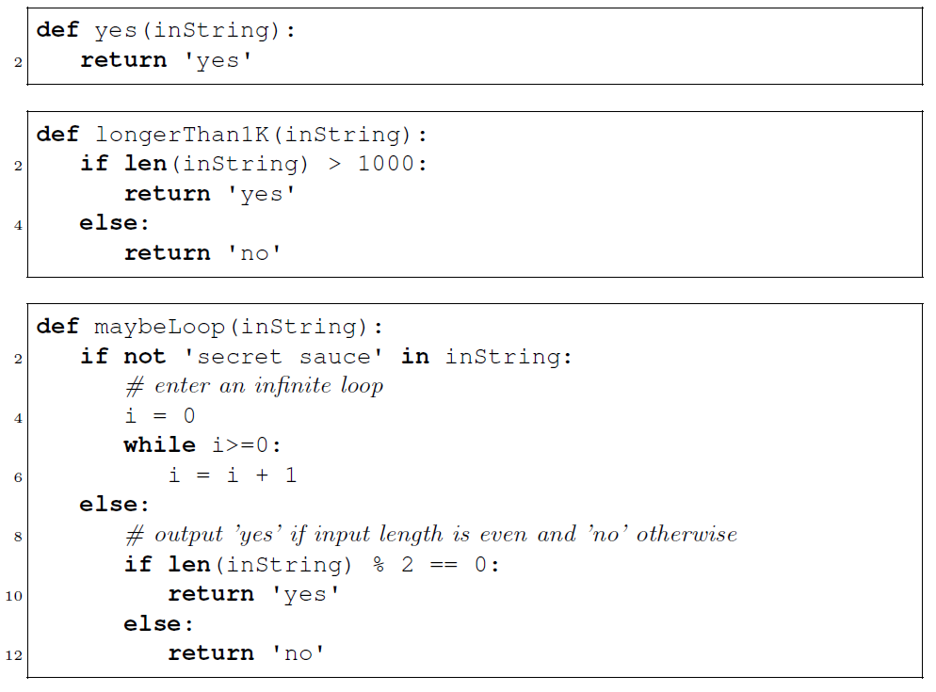
Some example decision programs we will need:

Slide 7
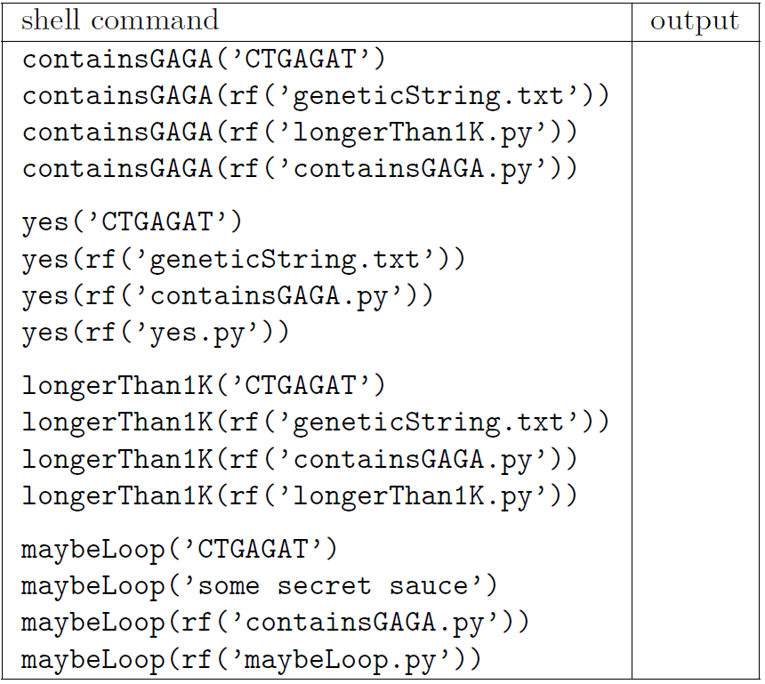
Fill in this table on the handout

Slide 8
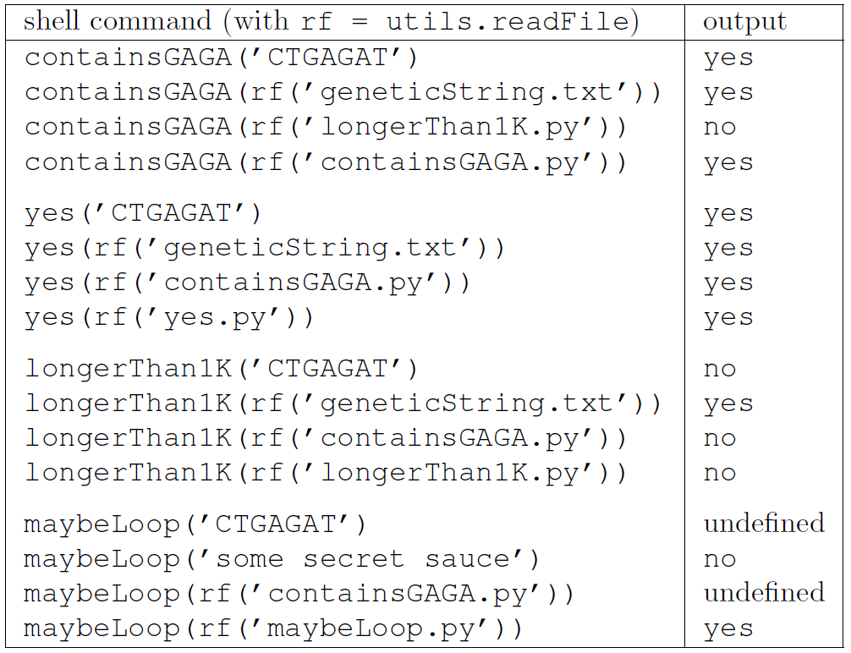
Solutions for programs analyzing other programs

Slide 9
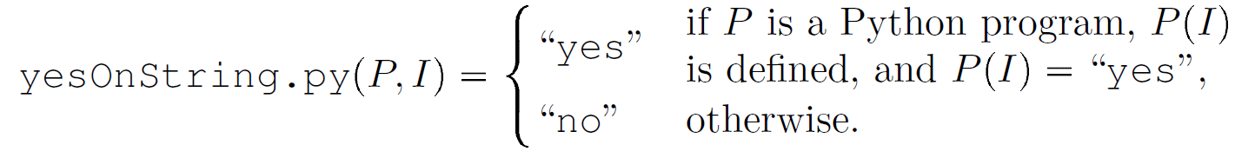
Definition of yesOnString.py

Slide 10
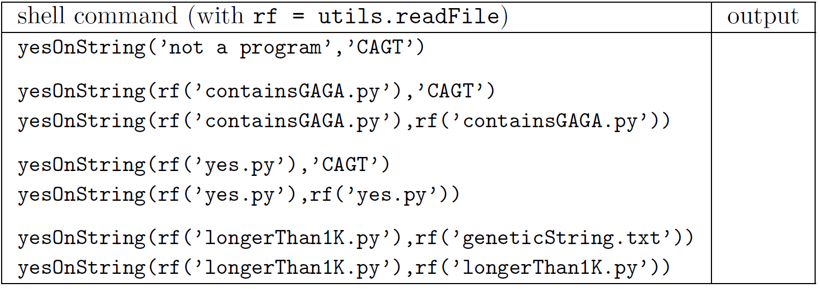
Fill in this table on the handout

Slide 11
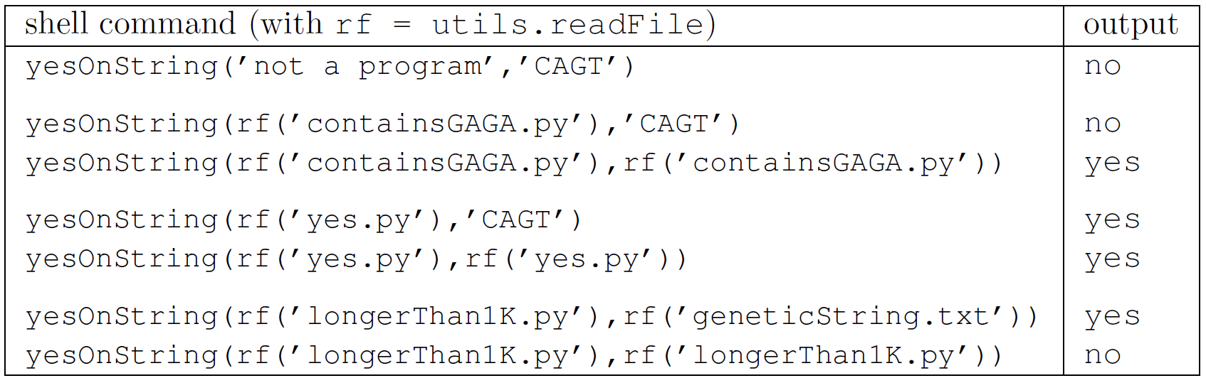
Solutions for yesOnString.py:

Slide 12
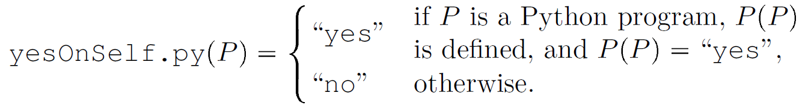
Definition of yesOnSelf.py

Slide 13
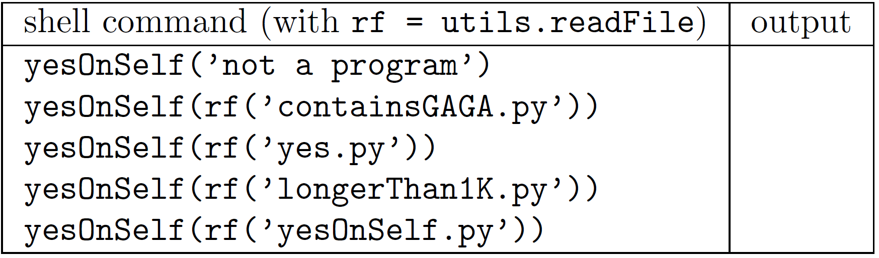
Fill in this table on the handout

Slide 14
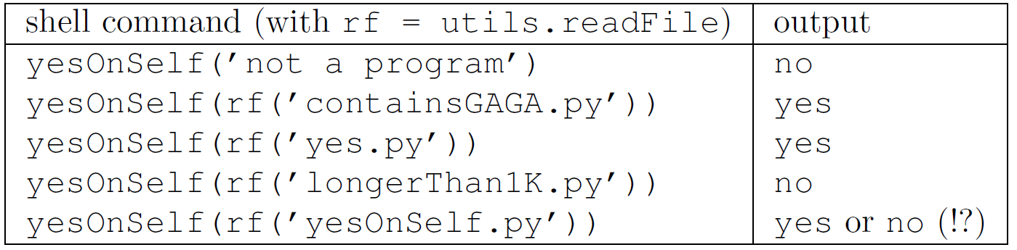
Solutions for yesOnSelf.py:

Slide 15
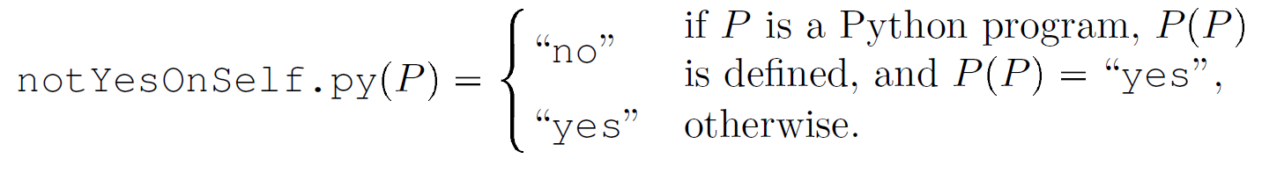
notYesOnSelf.py reverses yesOnSelf.py

Slide 16
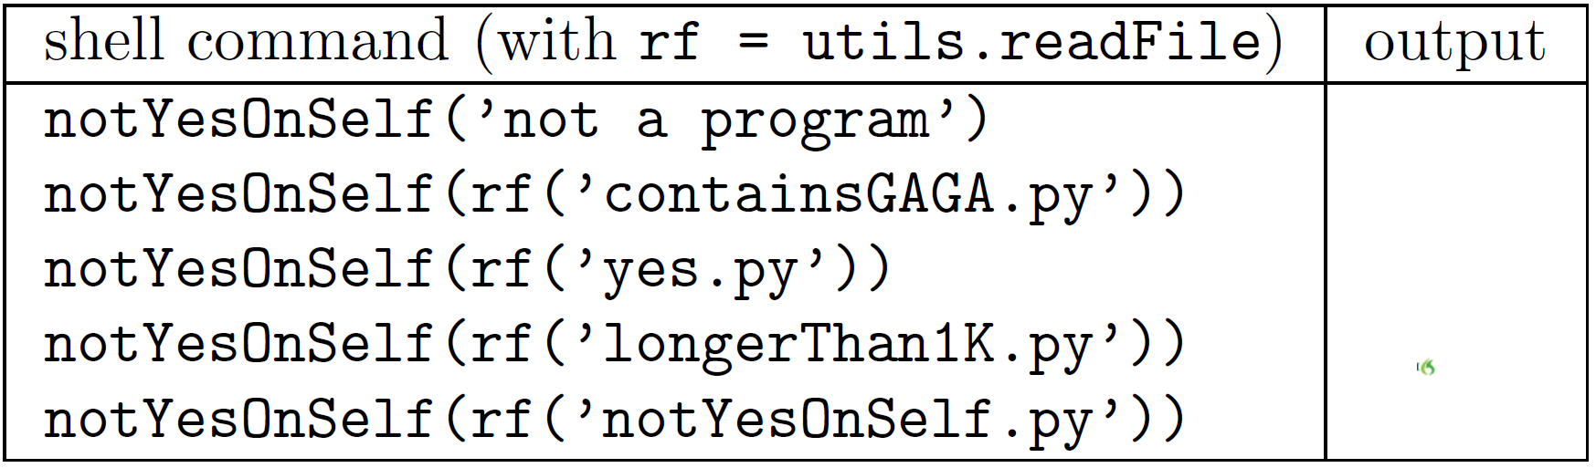
Suggestion: use the earlier results to fill in the bottom table on the handout

Slide 17
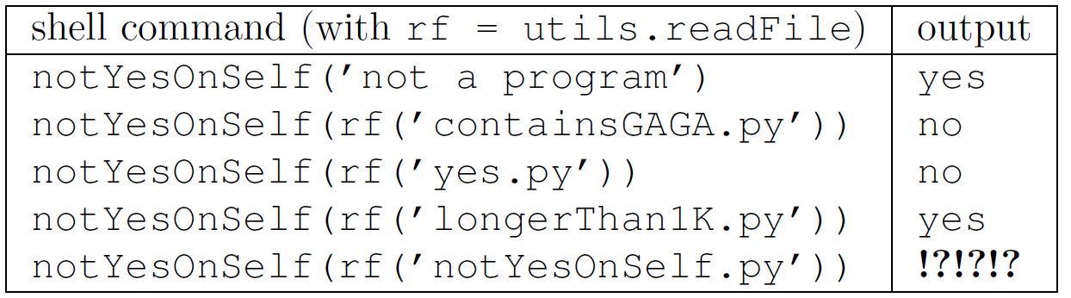
Solutions for yesOnSelf.py and notYesOnSelf.py :
No output is correct here…
… therefore, notYesOnSelf.py cannot exist!

Slide 18
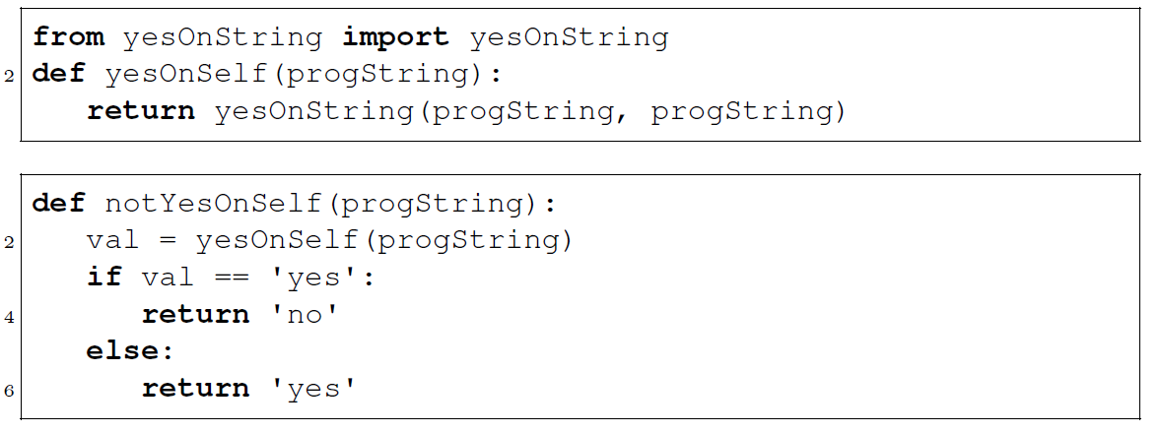
If yesOnString.py existed, we could create notYesOnSelf.py

Slide 19
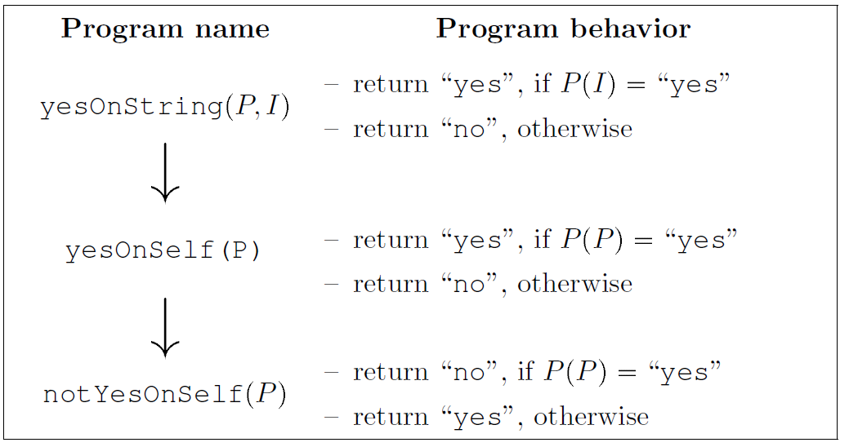
Therefore, yesOnString.py can’t exist either
Proof:
Assume yesOnString.py exists
Create notYesOnSelf.py as on previous slide (and summarized here)
This contradicts the impossibility of notYesOnSelf.py

Slide 20
The next two slides are explained only briefly during class. Please study the textbook to understand the details.

Slide 21
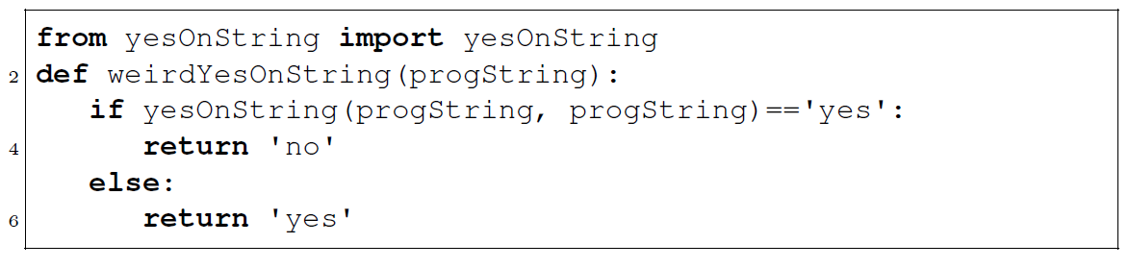
By combining many tricks into one program, a much briefer proof is possible
Proof that yesOnString.py doesn’t exist:
Assume yesOnString.py exists
Create weirdYesOnString.py as above
Observe that weirdYesOnString.py produces a contradiction when given itself as input (it outputs “yes” if and only if it outputs “no”)

Slide 22
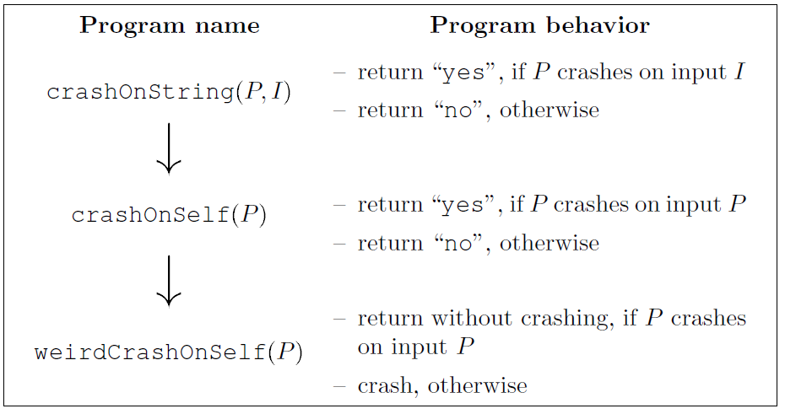
Similar reasoning shows that no program can correctly predict, for all possible inputs, whether other programs will crash
Proof that crashOnString.py doesn’t exist:
Assume crashOnString.py exists
Create weirdCrashOnSelf.py as shown
Observe that weirdCrashOnSelf.py produces a contradiction when given itself as input (crashes if and only if it doesn’t crash)

Slide 23
Be careful to interpret the “impossibility of bug-finding programs” correctly
It is true that no program P can correctly predict, for all programs Q, whether Q will crash
However, P might work correctly on many inputs
Software companies and academic researchers invest great effort in doing exactly this: developing programs P that work efficiently and correctly on useful classes of software

