Slide 1
4. What is a computational problem?
Lecture slides for What Can Be Computed?

Slide 2
Informal idea: a computational problem is something we want to solve using a computer program
Example: the computational problem SortWords
Input: A list of words separated by whitespace,
e.g. banana grape banana apple
Solution: A sorted version of the input list,
e.g. apple banana banana grape
A problem receives some input, also called the instance of the problem
To solve the problem, a computer program has to find one of the solutions corresponding to the given input
There may be zero, one, or multiple solutions

Slide 3
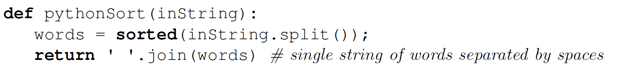
SISO program solving SortWords
builtin Python function sorted returns a sorted copy of the input
builtin Python function join takes an array of strings and joins them together using the given separator. Examples:
'xyz'.join(['a', 'b', 'c']) → 'axyzbxyzc'
' '.join(['a', 'b', 'c']) → 'a b c'

Slide 4
For formal definition of computational problems, we need some definitions:
Graphs
Trees and rooted trees
Alphabets
Strings
Languages

Slide 5
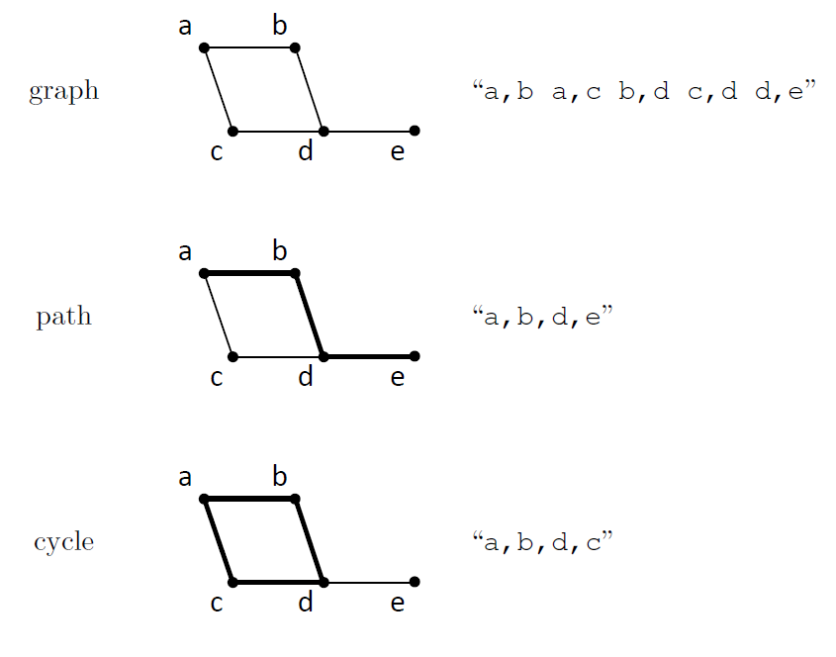
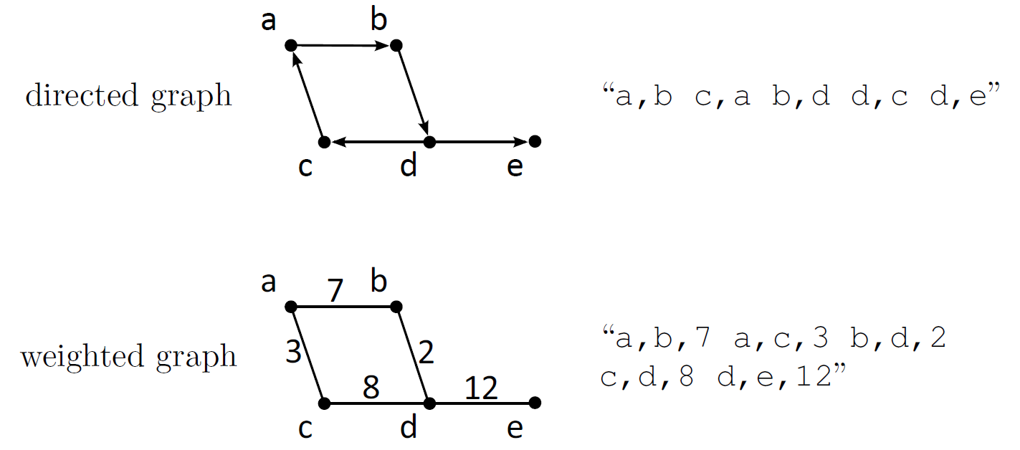
Graphs, paths, and cycles
When used as input or output for computer programs, mathematical objects such as graphs and paths are converted into ASCII using any reasonable convention

Slide 6
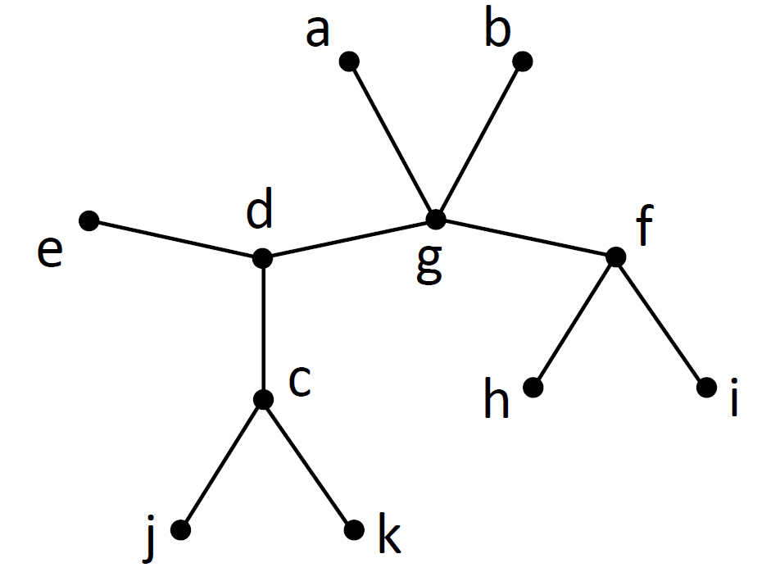
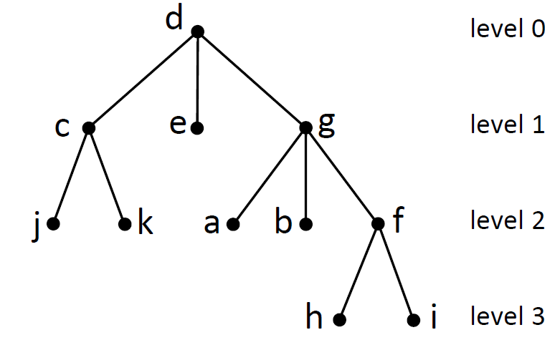
Trees and rooted trees
A tree is a graph with no cycles
A rooted tree is a tree with a designated root node

Slide 7
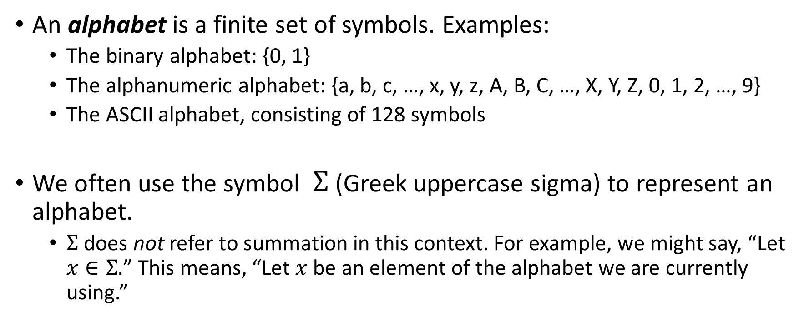
Alphabets
An alphabet is a finite set of symbols. Examples:
The binary alphabet: {0, 1}
The alphanumeric alphabet: {a, b, c, …, x, y, z, A, B, C, …, X, Y, Z, 0, 1, 2, …, 9}
The ASCII alphabet, consisting of 128 symbols
We often use the symbol $Σ$ (Greek uppercase sigma) to represent an alphabet.
$Σ$ does not refer to summation in this context. For example, we might say, “Let $x∈Σ.$” This means, “Let $x$ be an element of the alphabet we are currently using.”

Slide 8
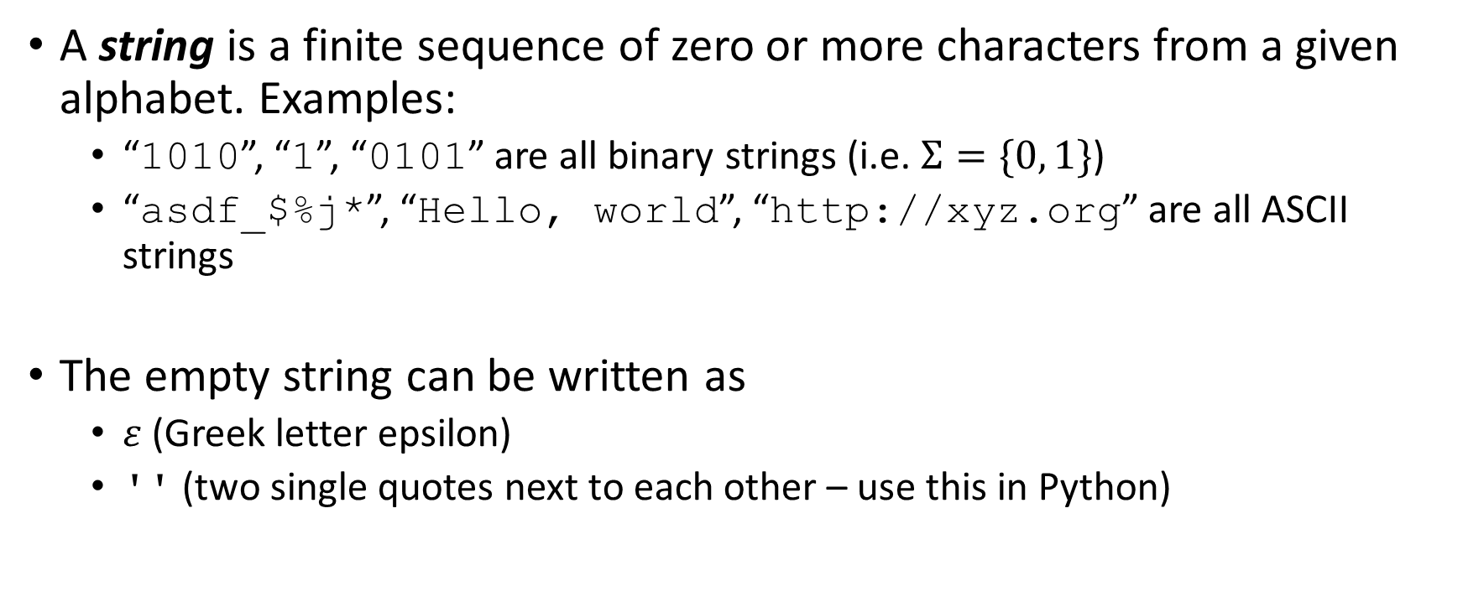
Strings
A string is a finite sequence of zero or more characters from a given alphabet. Examples:
“1010”, “1”, “0101” are all binary strings (i.e. $Σ=\{0, 1\}$)
“asdf_$%j*”, “Hello, world”, “http://xyz.org” are all ASCII strings
The empty string can be written as
$ε$ (Greek letter epsilon)
'' (two single quotes next to each other – use this in Python)

Slide 9
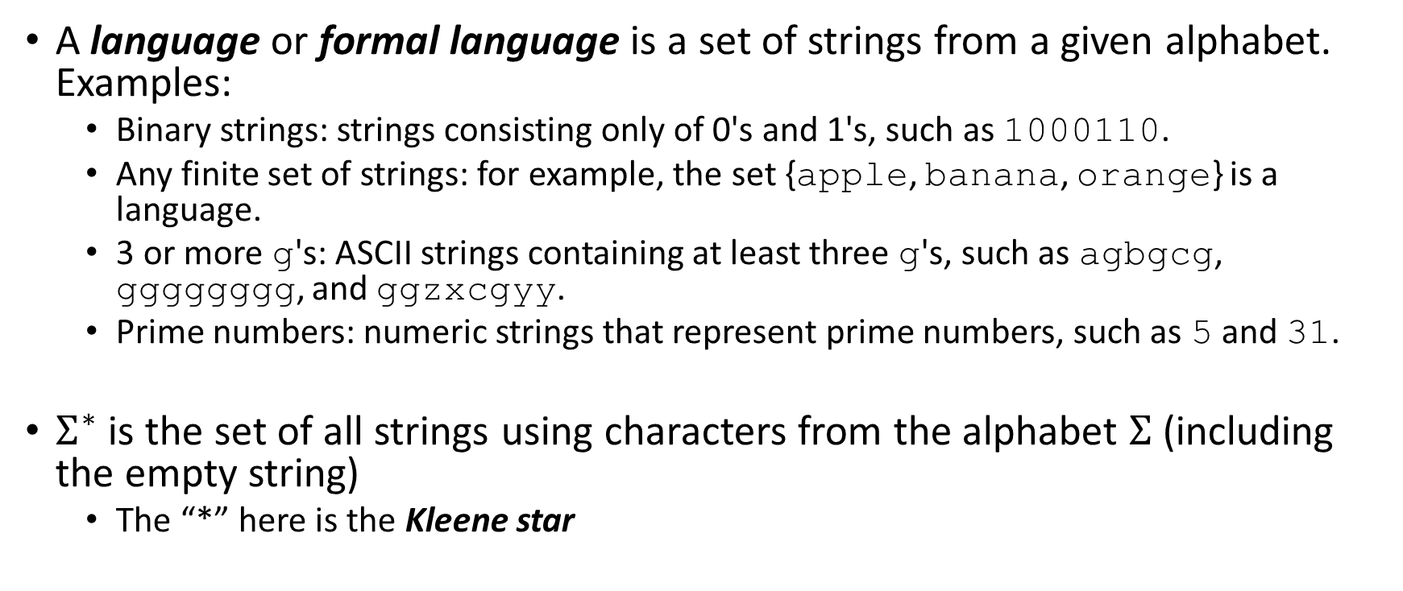
Languages (or formal languages)
A language or formal language is a set of strings from a given alphabet. Examples:
Binary strings: strings consisting only of 0's and 1's, such as 1000110.
Any finite set of strings: for example, the set {apple, banana, orange} is a language.
3 or more g's: ASCII strings containing at least three g's, such as agbgcg, gggggggg, and ggzxcgyy.
Prime numbers: numeric strings that represent prime numbers, such as 5 and 31.
$Σ^{∗}$ is the set of all strings using characters from the alphabet $Σ$ (including the empty string)
The “*” here is the Kleene star

Slide 10
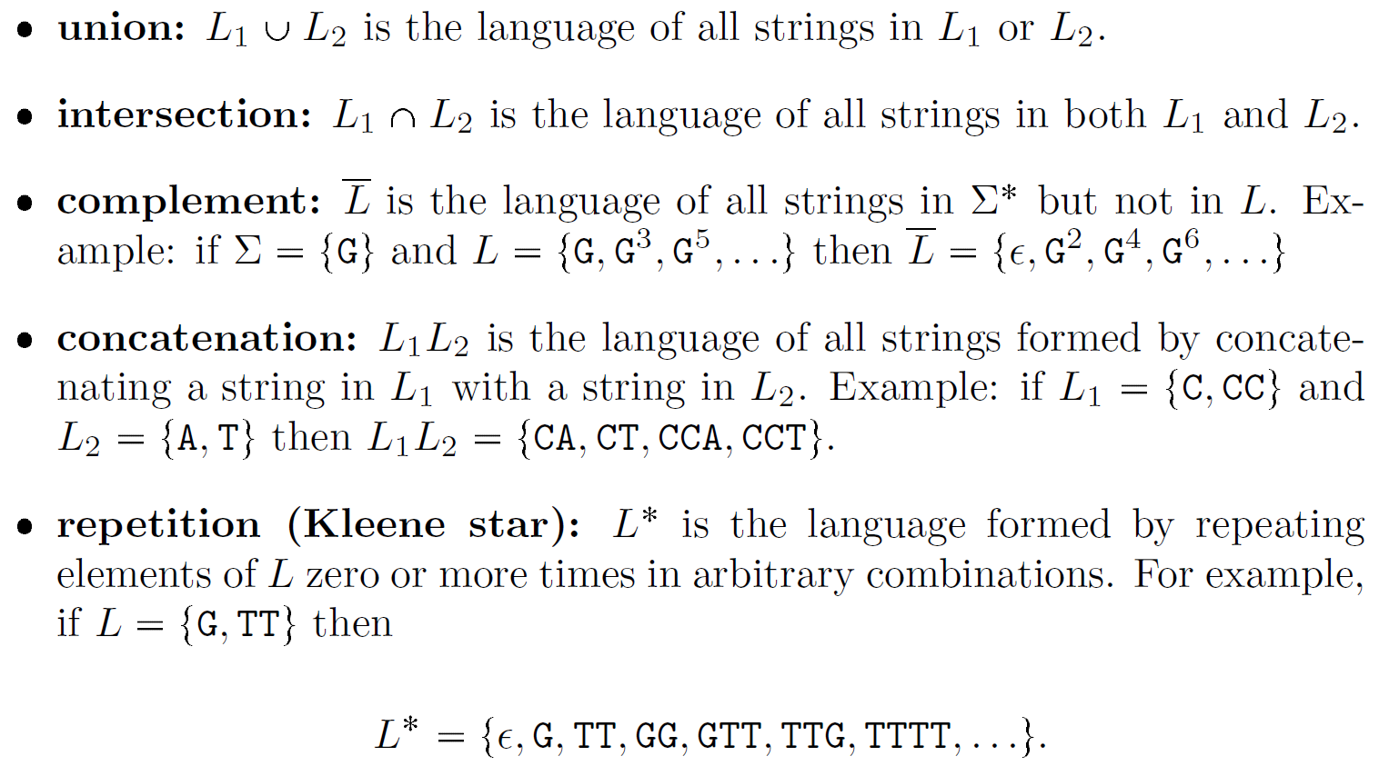
Operations on languages

Slide 11
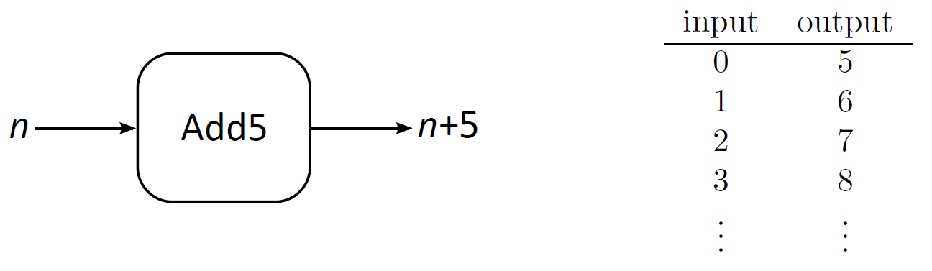
Recall: mathematical functions map a given input to a given output

Slide 12
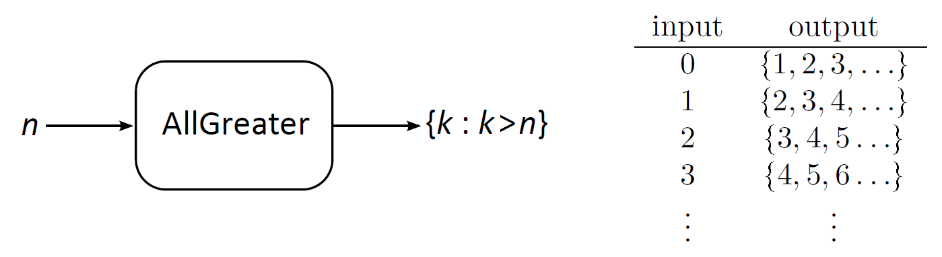
The output of a function can be a set

Slide 13
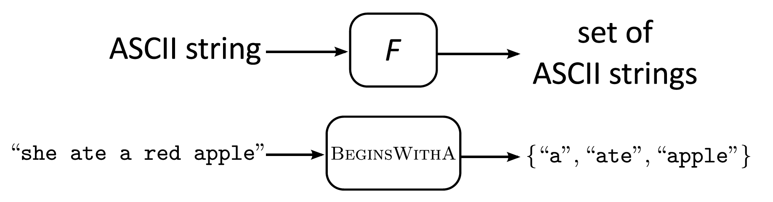
A computational problem is a function that maps ASCII strings to sets of ASCII strings
Because computational problems are really functions, we denote them with letters like F, G, H.
Letters like P and Q will always represent computer programs, not computational problems.

Slide 14
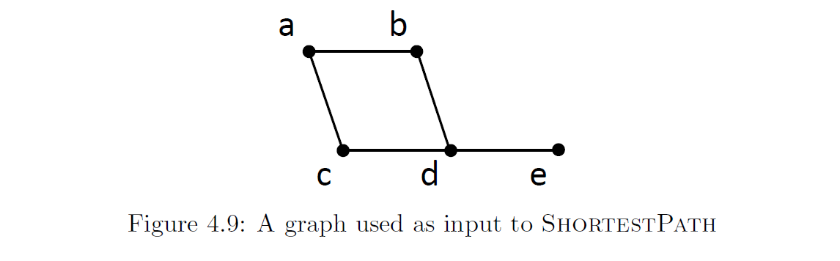
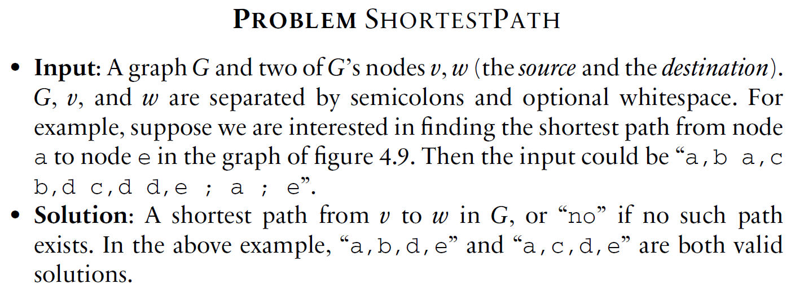
ShortestPath provides a good example of a computational problem
By convention, the solution is “no” whenever the input is invalid or incorrectly formatted

Slide 15
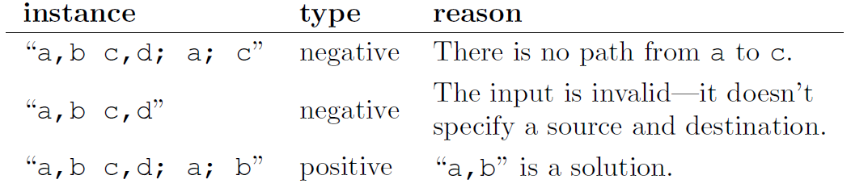
Positive and negative instances
An instance of a problem is negative if the only element of its solution set is “no”
Otherwise, the instance is positive
Examples for ShortestPath:

Slide 16
Important types of computational problems
search problem: find a solution with a given property that can be true or false
optimization problem: find a solution with the maximum or minimum value of some numerical property
threshold problem: find a solution so that the value of some numerical property is above a given threshold
function problem: every instance has exactly one solution (so solution sets are all singletons)
decision problems: every solution is either “yes” or “no”

Slide 17
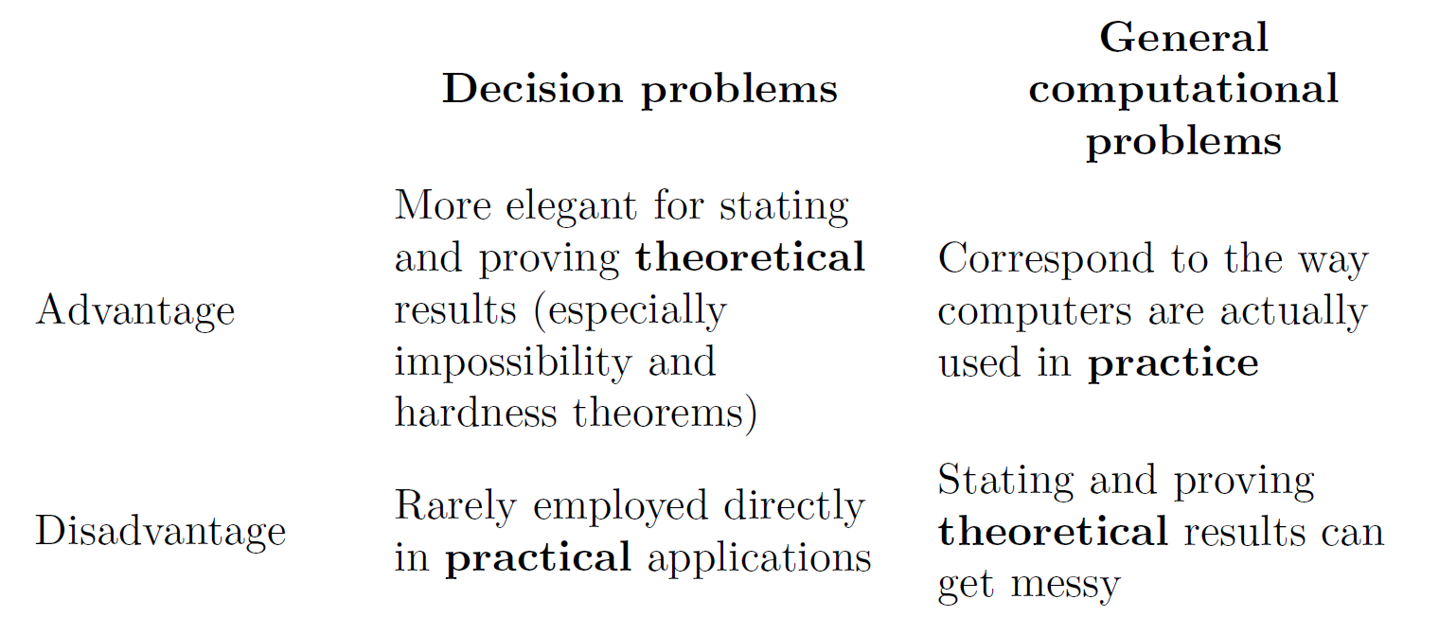
Decision problems are especially important in theoretical computer science

Slide 18
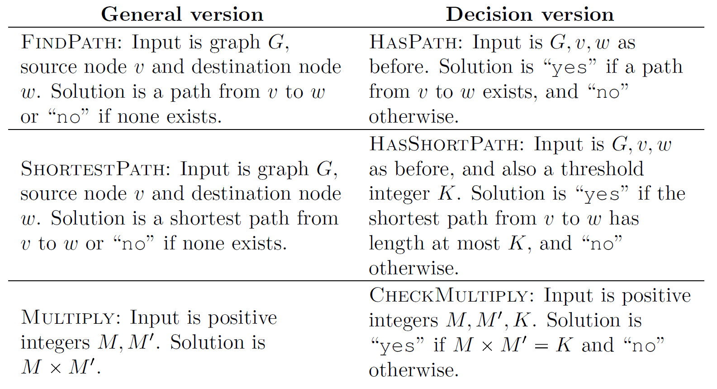
It’s usually easy to convert between decision problems and general problems while retaining the “essence” of the problem

Slide 19

We can allow multiple input strings, because it’s easy to convert to a single input if desired
Encode as single string (ESS):
e.g. the pair (“CAGA”, “AAT”) becomes “4 CAGAAAT”
Decode from single string (DESS):
e.g. “4 CAGAAAT” becomes (“CAGA”, “AAT”)

Slide 20
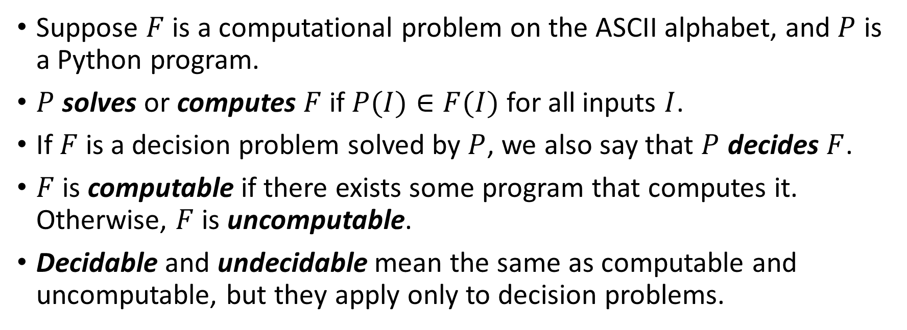
Definition of solve, compute, decide, computable, decidable
Suppose $F$ is a computational problem on the ASCII alphabet, and $P$ is a Python program.
$P$ solves or computes $F$ if $P(I)∈F(I)$ for all inputs $I$.
If $F$ is a decision problem solved by $P$, we also say that $P$ decides $F$.
$F$ is computable if there exists some program that computes it. Otherwise, $F$ is uncomputable.
Decidable and undecidable mean the same as computable and uncomputable, but they apply only to decision problems.

Slide 21
Examples: which of the following problems are computable, decidable, uncomputable, undecidable?
YesOnString
CrashOnString
ShortestPath
HasShortPath
Multiply

Slide 22
Examples: which of the following problems are computable, decidable, uncomputable, undecidable?
YesOnString – uncomputable and undecidable
CrashOnString – uncomputable and undecidable
ShortestPath – computable
HasShortPath – computable and decidable
Multiply – computable

Slide 23
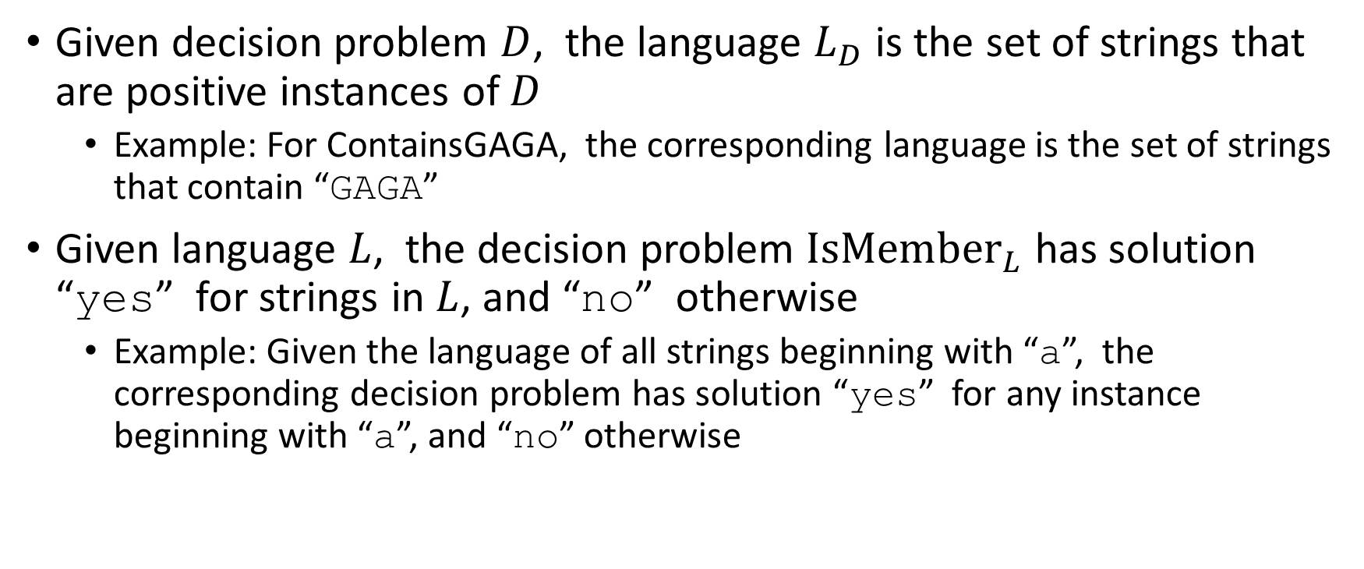
Decision problems are equivalent to the question of membership in a language
Given decision problem $D$, the language $L_{D}$ is the set of strings that are positive instances of $D$
Example: For ContainsGAGA, the corresponding language is the set of strings that contain “GAGA”
Given language $L$, the decision problem ${IsMember}_{L}$ has solution “yes” for strings in $L$, and “no” otherwise
Example: Given the language of all strings beginning with “a”, the corresponding decision problem has solution “yes” for any instance beginning with “a”, and “no” otherwise

Slide 24
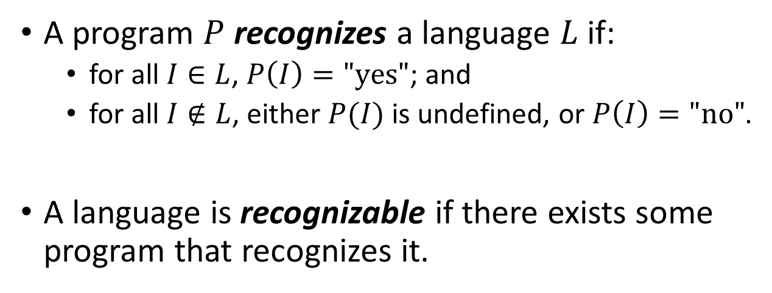
Definition of recognize and recognizable
Key difference between recognize and decide: recognizing can be undefined on negative instances.
A program $P$ recognizes a language $L$ if:
for all $I∈L$, $P\left(I\right)="yes"$; and
for all $I∉L$, either $P(I)$ is undefined, or $P\left(I\right)="no"$.
A language is recognizable if there exists some program that recognizes it.

Slide 25
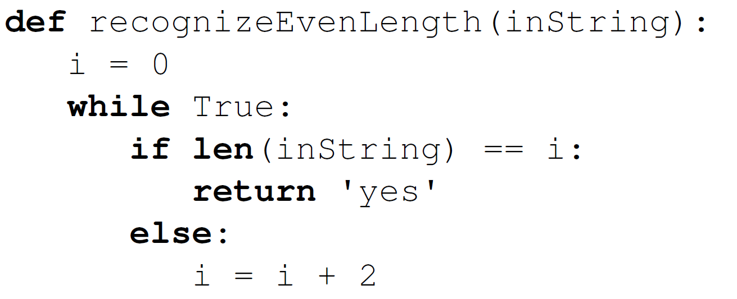
Example of a program that recognizes but does not decide a problem
Later in the course, we will see more interesting examples.

