Slide 1
1. Turing machines
Lecture slides for What Can Be Computed?

Slide 2
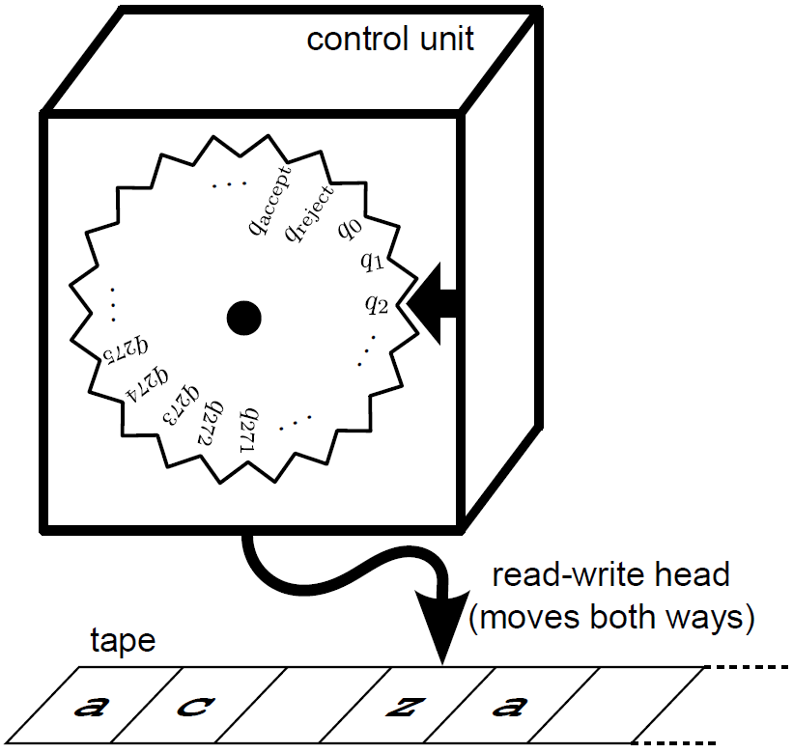
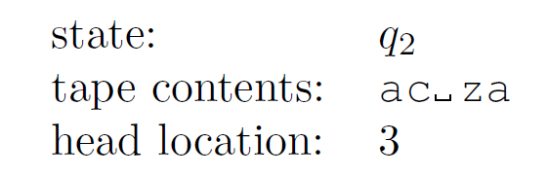
A Turing machine is a simple, hypothetical device for performing computations
mathematical view
practical view

Slide 3

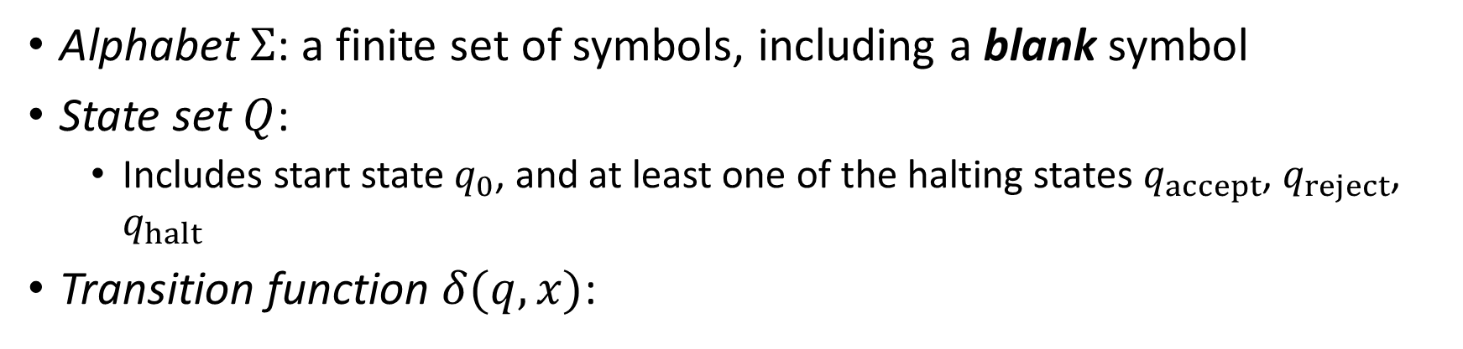
Formally, a Turing machine consists of an alphabet, a state set and a transition function
Alphabet $Σ$: a finite set of symbols, including a blank symbol
State set $Q$:
Includes start state $q_{0}$, and at least one of the halting states $q_{accept}$, $q_{reject}$, $q_{halt}$
Transition function $δ(q,x)$:
new state
new symbol
current state
direction of head movement
(left, right, stay)
scanned symbol

Slide 4
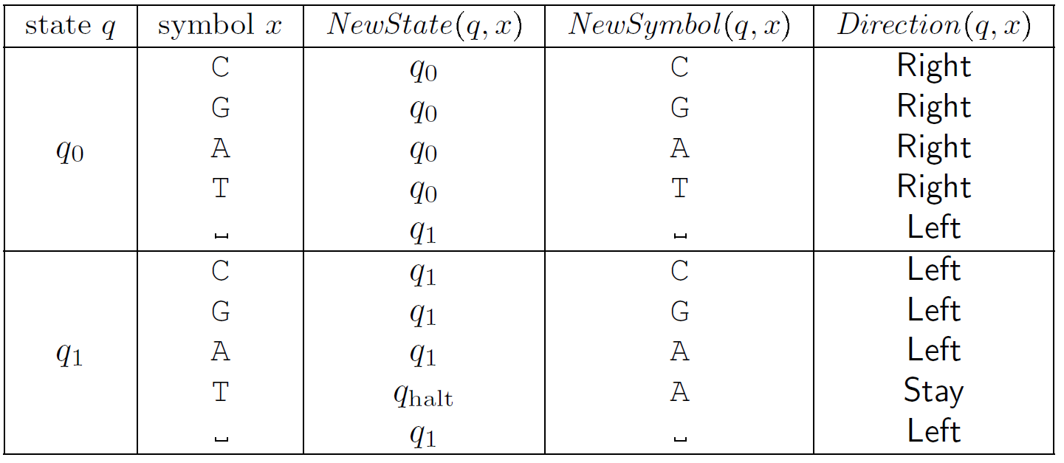
Example: what does the Turing machine with this transition function do?

Slide 5
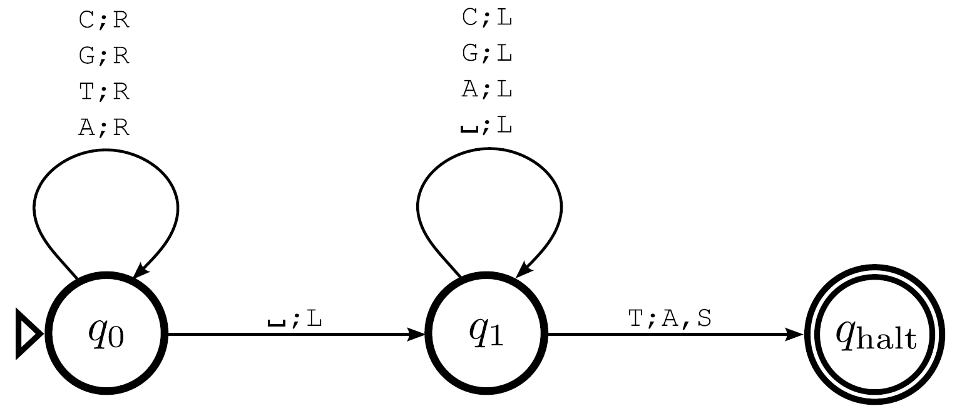
Turing machines are easier to understand via state diagrams
same machine as previous slide, but much easier to understand
Suggestion: create this machine in JFLAP and experiment with it

Slide 6
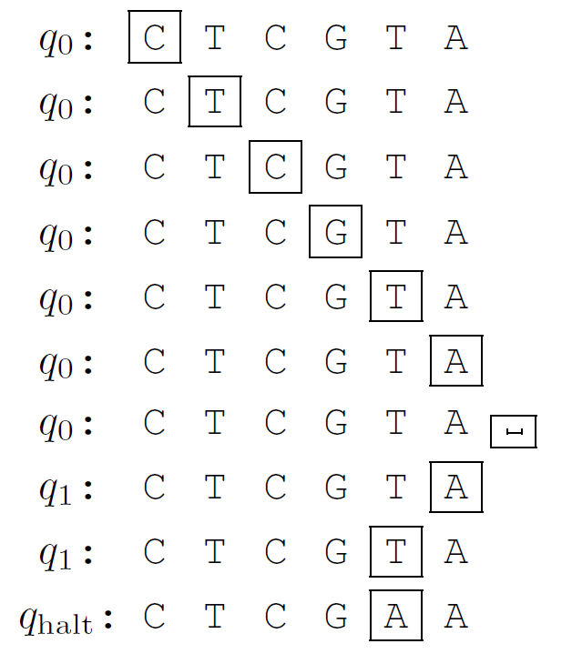
A complete computation for the lastTtoA machine

Slide 7
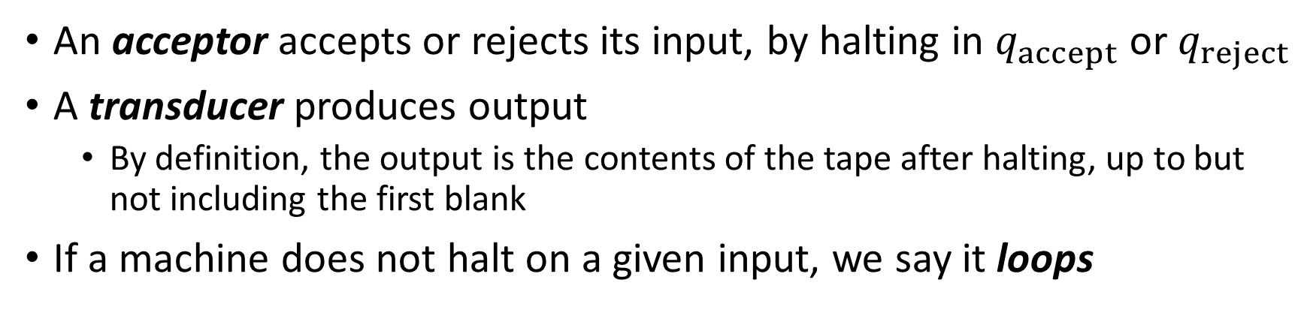
Turing machines can act as acceptors, transducers, or both
An acceptor accepts or rejects its input, by halting in $q_{accept}$ or $q_{reject}$
A transducer produces output
By definition, the output is the contents of the tape after halting, up to but not including the first blank
If a machine does not halt on a given input, we say it loops

Slide 8
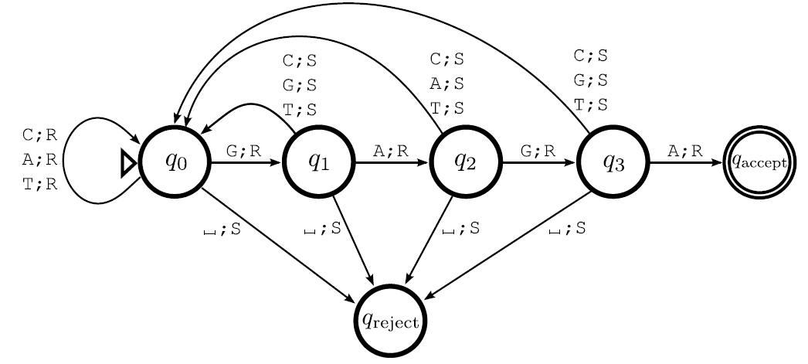
Example of acceptor: containsGAGA

Slide 9
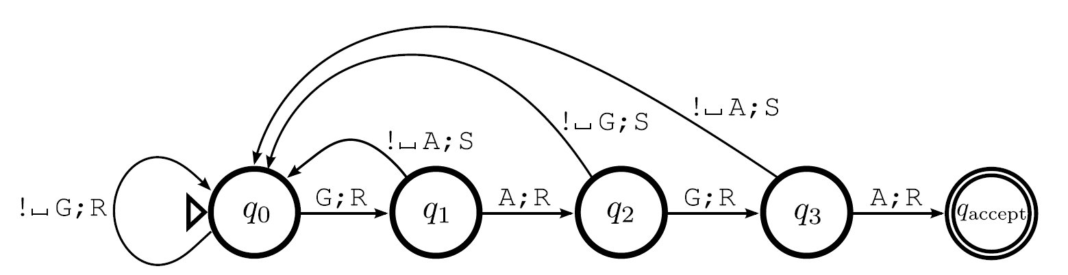
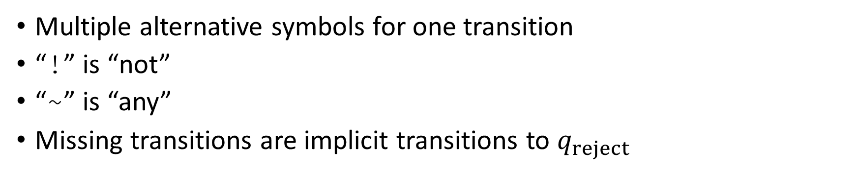
Same example with abbreviated notation
Multiple alternative symbols for one transition
“!” is “not”
“~” is “any”
Missing transitions are implicit transitions to $q_{reject}$

Slide 10
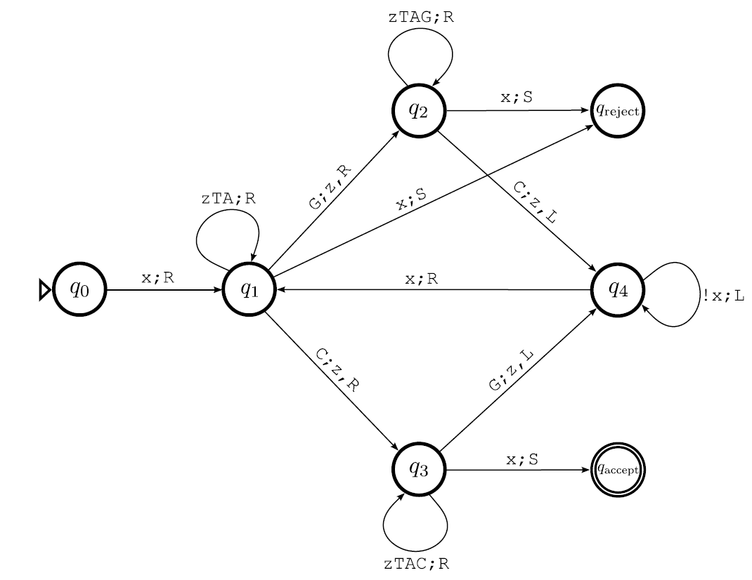
A more complex example: moreCsThanGs
This machine uses some important techniques. Read about them in the text.

Slide 11
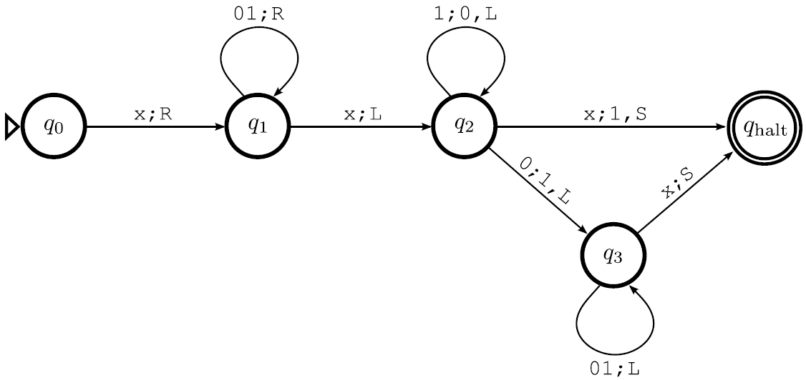
Turing machines can do arithmetic! Example: binary incrementer

Slide 12
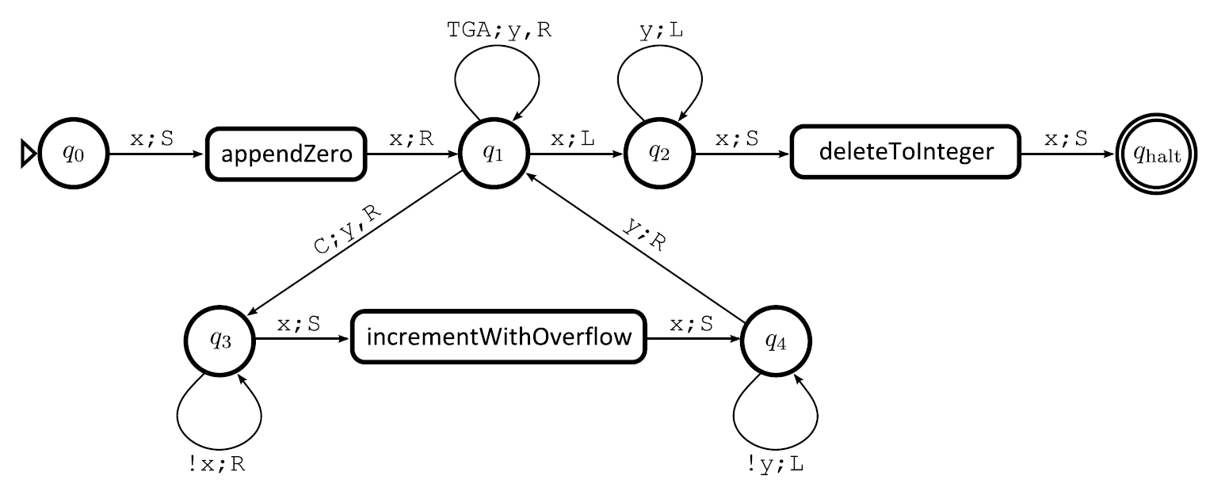
Sophisticated example with building blocks: countCs

Slide 13
Turing machines can do anything that a modern computer or programming language can do
Key idea in proving this: simulation
Simulation is used in many areas of computer science
Example: every time a Java program is run, the host computer simulates a hypothetical computer called the “Java virtual machine” (JVM)
We will describe a sequence of simulations
In each simulation, a simple machine or computer simulates a more complex one
Eventually, we achieve simulation of a Python program by a Turing machine

Slide 14
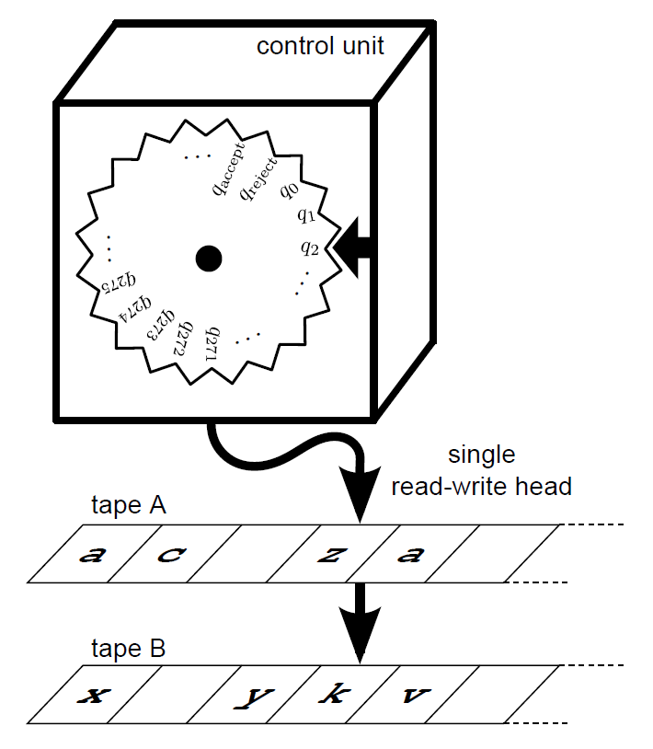
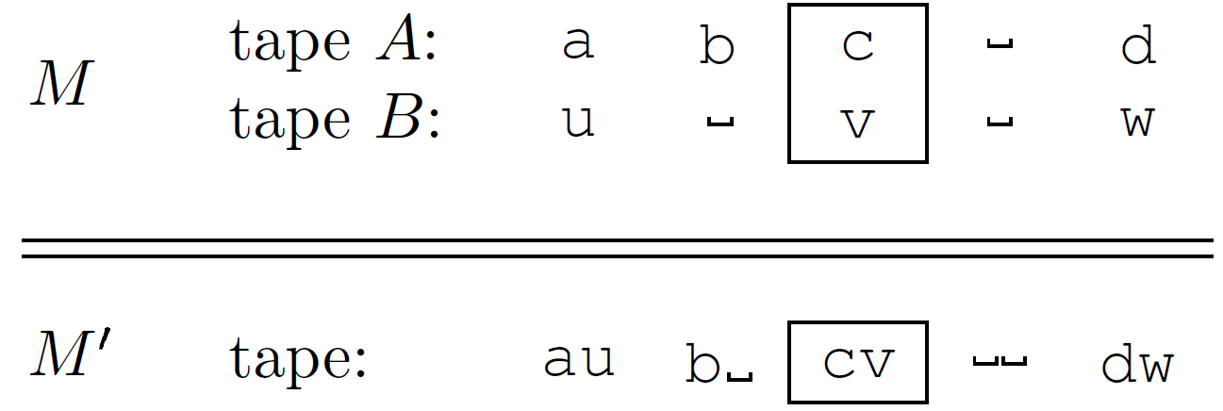
Simulation 1: two tapes, single head

Slide 15
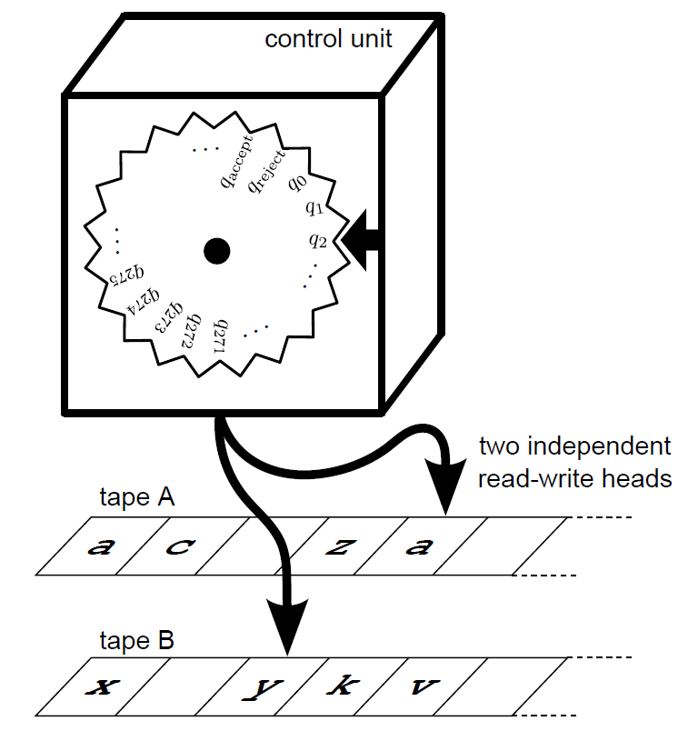
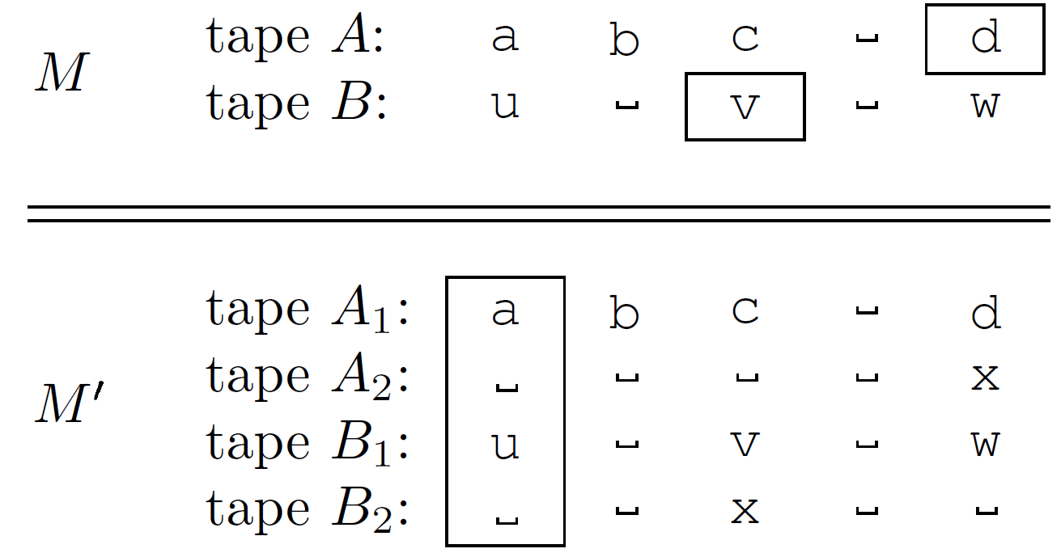
Simulation 2: two tapes, two heads

Slide 16
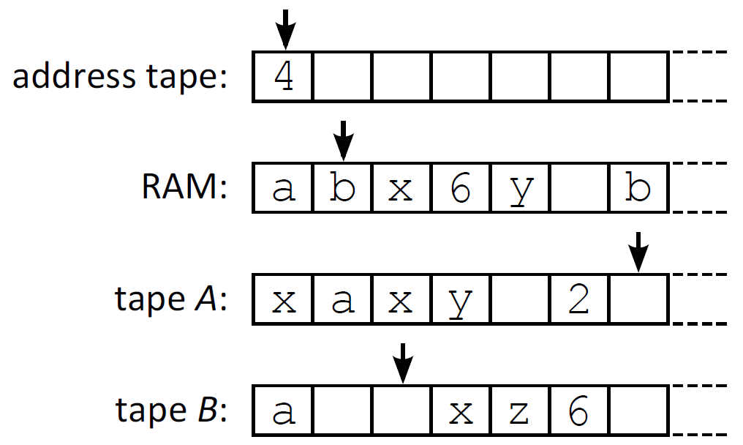
Simulation 3: random-access Turing machine

Slide 17
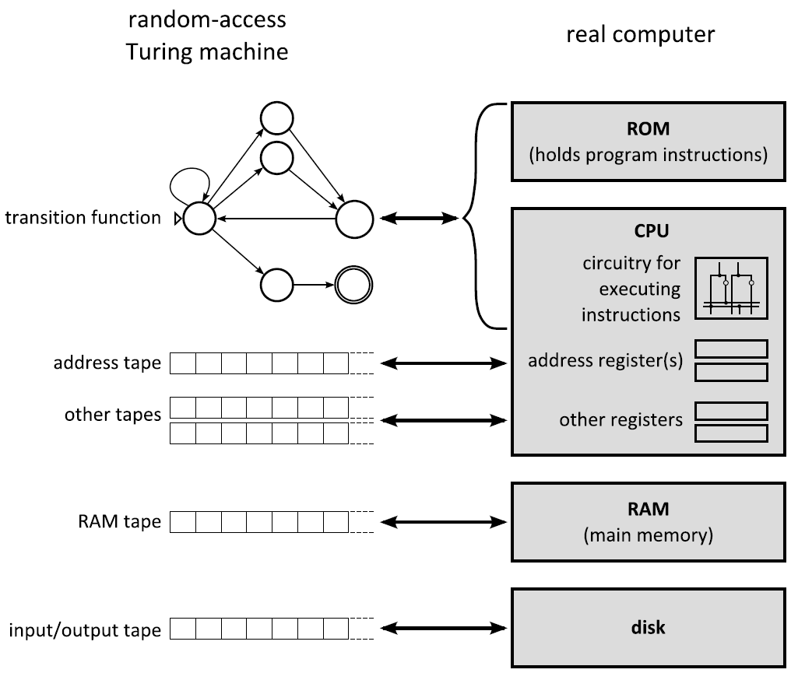
Simulation 4: real computer

Slide 18
Simulation 5: Python program
Trivial – real computers can run Python programs

Slide 19
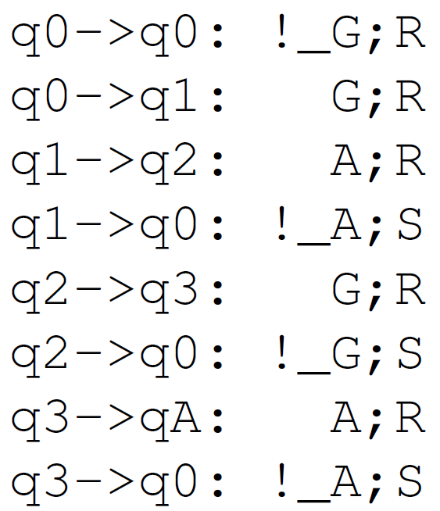
Going back the other way: simulating a Turing machine with Python
Agree on an ASCII format for representing Turing machines
Use as input to the simulateTM.py Python program
Suggestion: write your own simulateTM.py
Or consult the provided simulateTM.py
Suggestion: experiment with running simulateTM.py on various inputs, e.g.

Slide 20
Caveat: real-world computers are not quite equivalent to Turing machines, because real computers have finite memory
But we can still simulate any halting Turing machine computation on a real computer
A halting computation uses only a finite amount of memory

Slide 21
Classical computers can simulate quantum computers
Quantum computers use special components that can speed up certain algorithms
But a classical computer can simulate a quantum computer with as much accuracy as desired
As with many of our other simulations, the simulation could require much more time than the original computation

Slide 22
All known computers are Turing-equivalent
Computational models are Turing-equivalent if they can solve the same set of problems
The amount of time required for the computation is irrelevant
The simulations described earlier show that Python programs, real classical computers, real quantum computers, and Turing machines are all Turing-equivalent
(with the caveat that the real-world computers must be equipped with sufficient memory for any given halting computation)
This fact is closely related to the Church-Turing thesis, which we return to towards the end of the course

