Slide 1
6. Universal Turing machines and computer programs
Lecture slides for What Can Be Computed?

Slide 2
Big picture so far…
First big idea of the course: there exist undecidable/uncomputable problems
Second big idea of the course: there exist universal computers — computers that can simulate any other computer or program

Slide 3
Some important experiments:
Different ways of doing the same computation (make sure you can explain each one):
>>> simulateTM(rf(’containsGAGA.tm’), ’TTGAGATT’)
>>> containsGAGA(’TTGAGATT’)
Now we introduce yet another way of doing the same computation:
>>> universal(rf(’containsGAGA.py’), ’TTGAGATT’)
Try it for yourself. What do you think this does? How do you think it works?
What is the difference between the above three methods of doing the same computation?

Slide 4
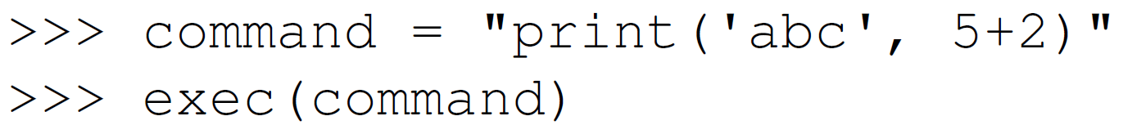
The Python exec function executes strings of Python

Slide 5
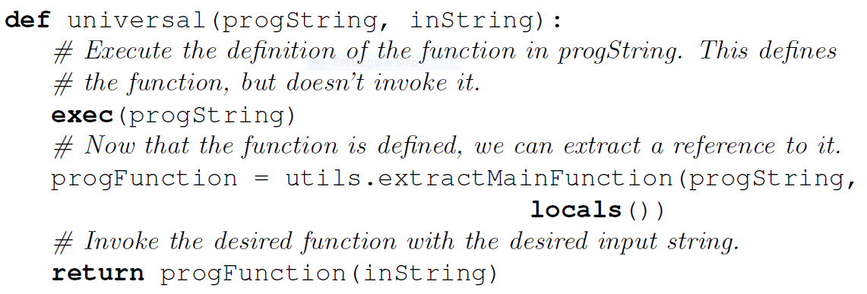
We can use exec to write a universal Python program that executes other Python programs
Examples (what do these output?):

Slide 6
Universal Turing machines exist too
High-level argument:
Any Python program can be converted to a Turing machine (see previous chapter)
We just saw the universal Python program universal.py
Therefore, universal.py can be converted into an equivalent Turing machine, which is universal by definition
See the textbook for additional details, since for complete correctness are universal Turing machine should receive only one parameter
Universal Turing machines can be constructed explicitly
Alan Turing gave a suitable construction in his 1936 paper
Minsky published a 7-state, 4-symbol universal Turing machine in the 1960s

Slide 7
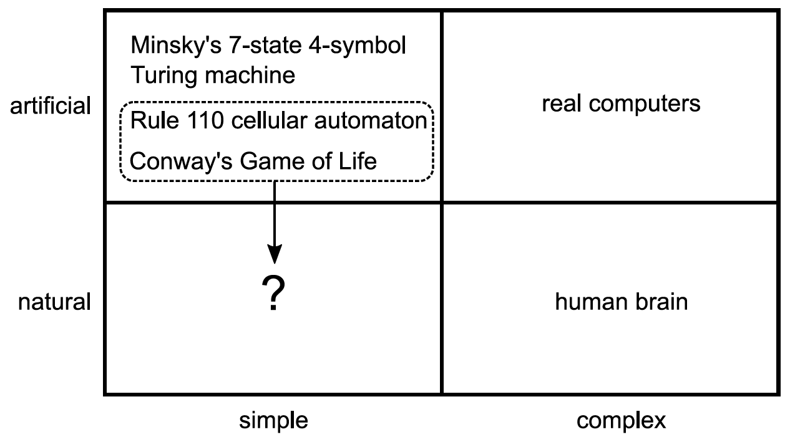
Universal computation occurs in the real world

Slide 8
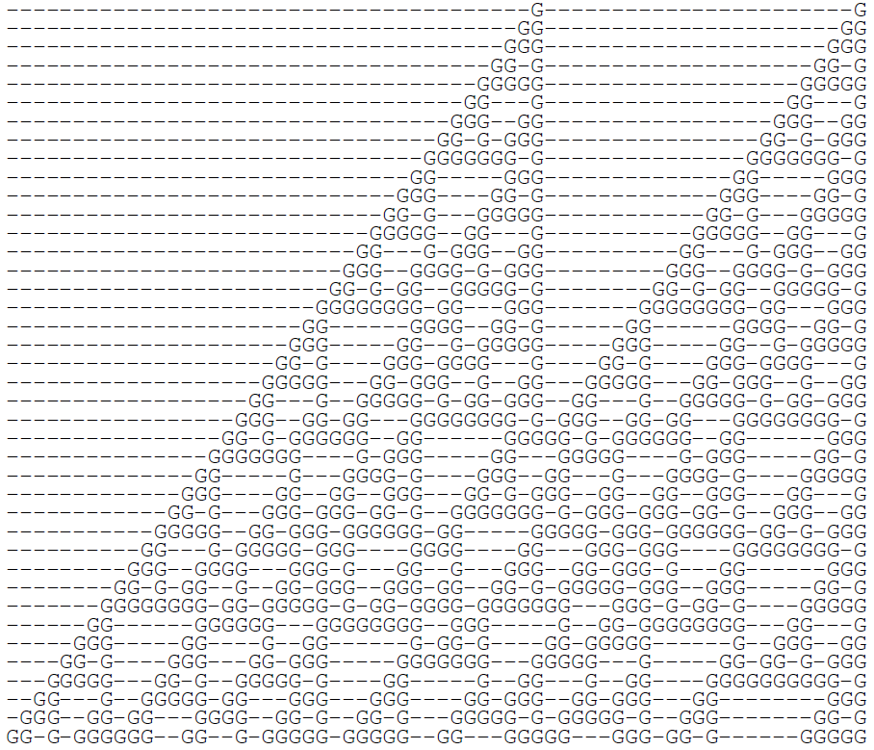
The “rule 110 automaton” is a famous example of universal computation resulting from extremely simple rules
See rule110.py for details

Slide 9
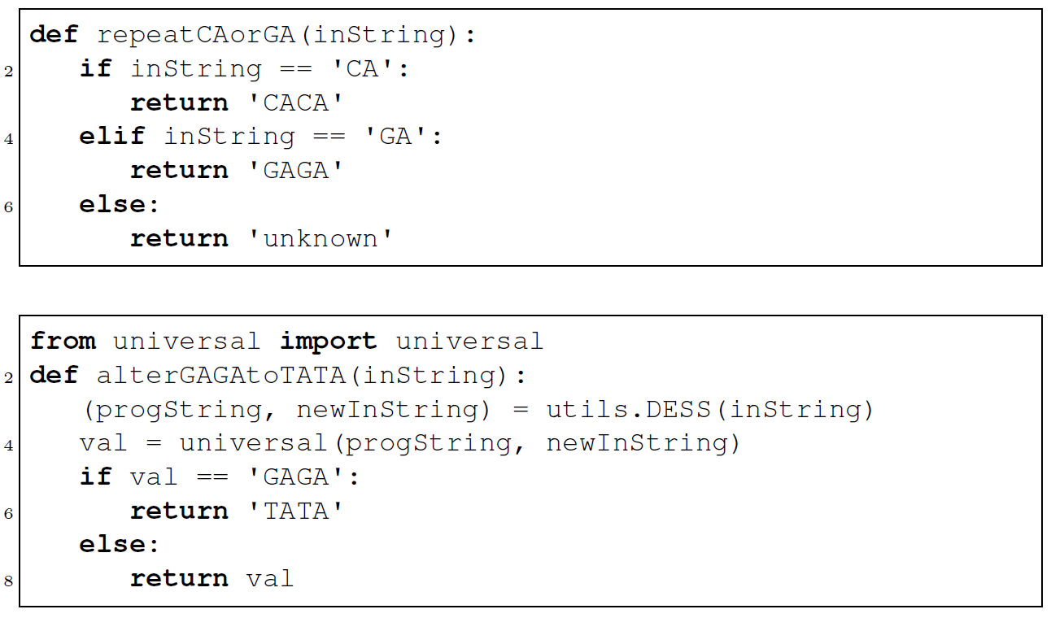
Using a universal program, we can alter the effects of other programs in real time

Slide 10
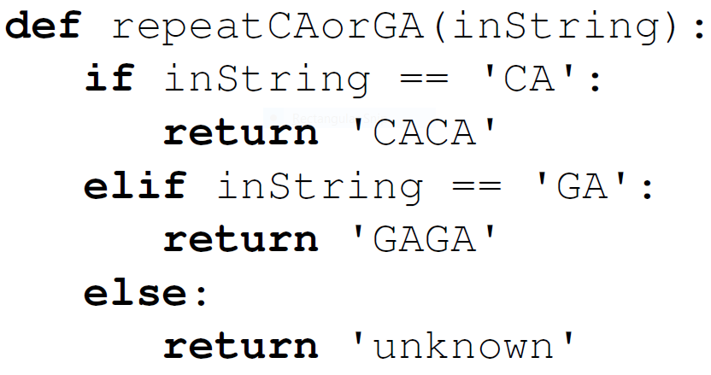
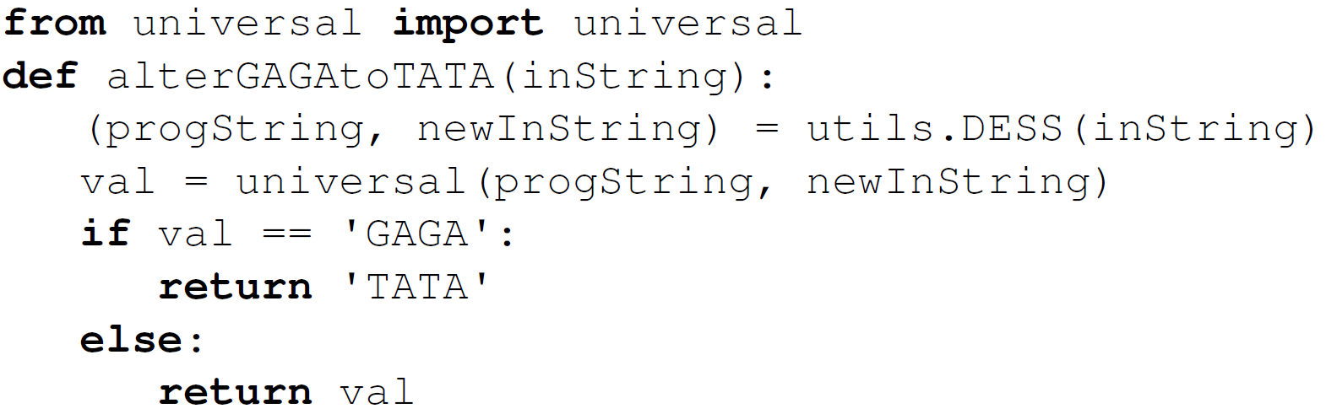
Test your understanding. What do the following produce?
>>> alterGAGAtoTATA(utils.ESS(rf('repeatCAorGA.py'), 'CA'))
>>> alterGAGAtoTATA(utils.ESS(rf('repeatCAorGA.py'), 'GA'))

Slide 11
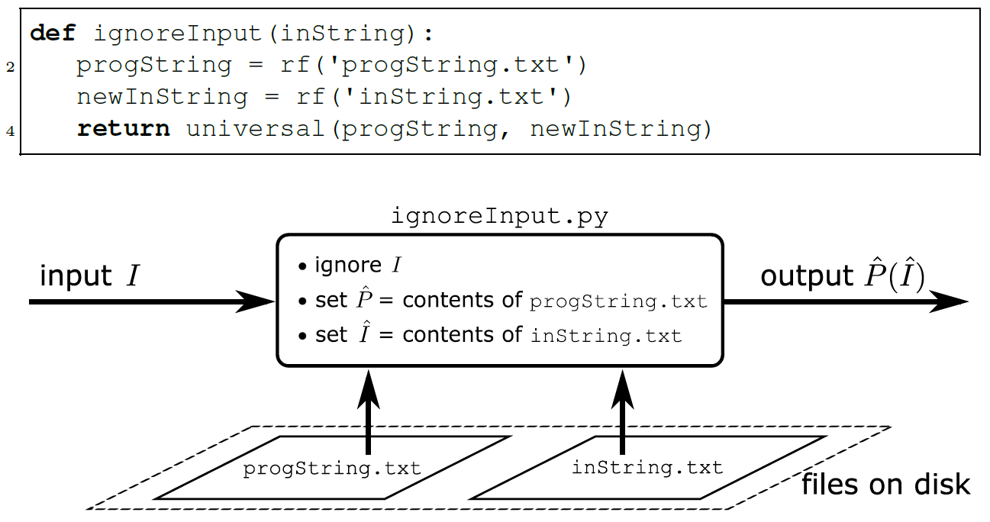
The “ignore input” trick will be important in later chapters

Slide 12
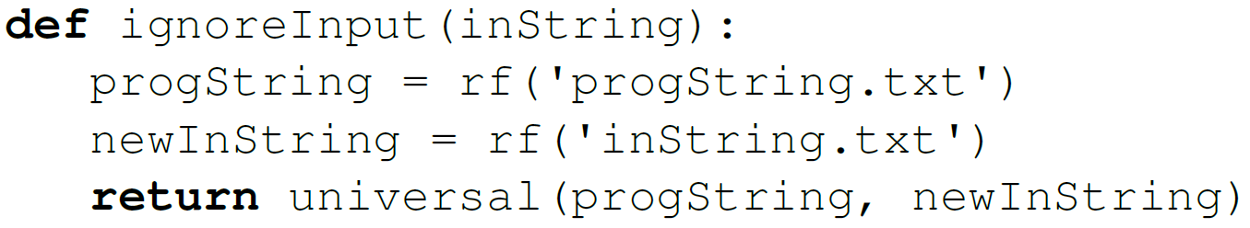
Test your understanding. What does the following sequence of statements produce?
>>> x = rf('containsGAGA.py')
>>> utils.writeFile('progString.txt', x)
>>> utils.writeFile('inString.txt', 'GGGGAAACTT')
>>> ignoreInput('GAGAGA')

Slide 13
Some decision problems are recognizable but undecidable
Recognizable means there’s a program that
Always terminates with the right answer (“yes”) on positive instances
Is never wrong on negative instances
May enter an infinite loop on negative instances
Example: YesOnString and CrashOnString are recognizable but undecidable

Slide 14
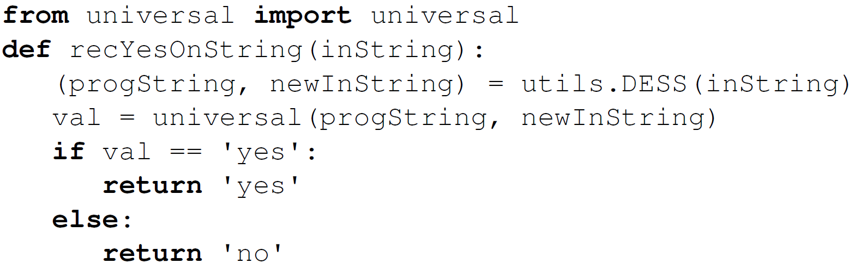
YesOnString is recognizable. Here’s a program that recognizes it:
Test your understanding: why does this program not also decide YesOnString?

