Slide 1
7. Turing reductions
Lecture slides for What Can Be Computed?

Slide 2
Review of important concepts from previous chapter (alter… and ignoreInput):
What is the output of each of the following commands?
alterGAGAtoTATA(utils.ESS('def f(S): return S', 'CAGT'))
alterGAGAtoTATA(utils.ESS('def f(S): return S', 'GAGA'))
alterGAGAtoTATA(utils.ESS('def f(S): return S+S', 'GA'))
alterGAGAtoTATA(utils.ESS('def f(S): return S+S', 'GAGA'))
What is the output of the following sequence of commands?
>>> prog = rf('longerThan1K.py')
>>> utils.writeFile('progString.txt', prog)
>>> utils.writeFile('inString.txt', 'abcdefghij')
>>> ignoreInput(5000*'x') # param is a string containing 5000 x's

Slide 3
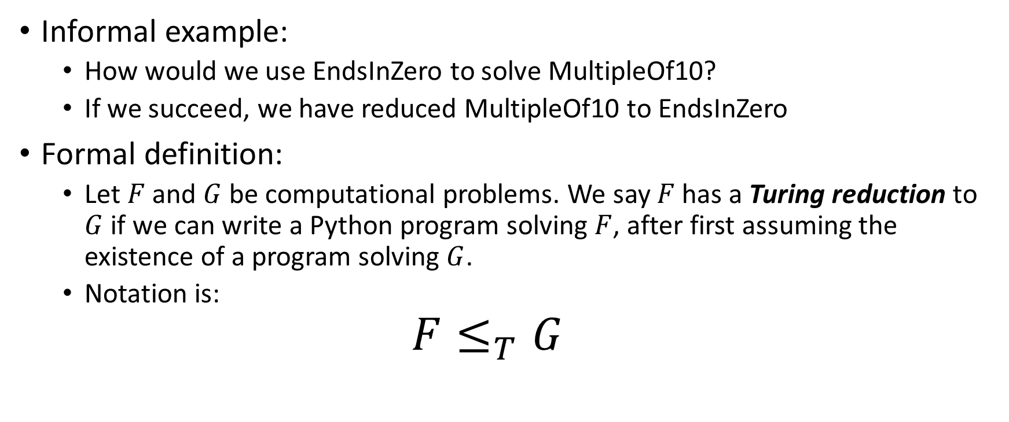
A reduction (or Turing reduction) tells us we can use one problem to solve another problem
Informal example:
How would we use EndsInZero to solve MultipleOf10?
If we succeed, we have reduced MultipleOf10 to EndsInZero
Formal definition:
Let $F$ and $G$ be computational problems. We say $F$ has a Turing reduction to $G$ if we can write a Python program solving $F$, after first assuming the existence of a program solving $G$.
Notation is:
$$F≤_{T}G$$

Slide 4
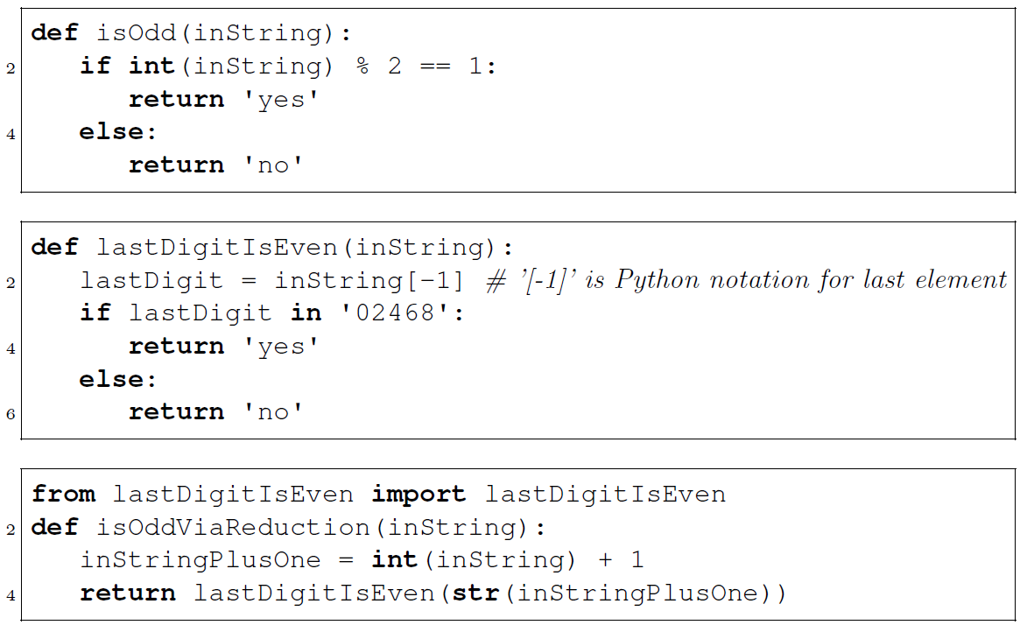
Example of a Turing reduction
Reduces isOdd to lastDigitIsEven

Slide 5
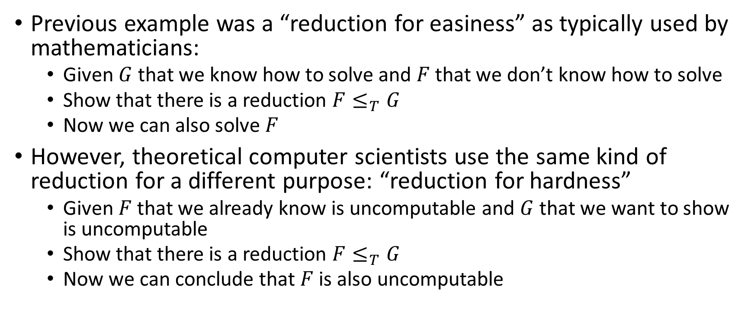
Main use of reductions for us: prove that a problem is hard (e.g. uncomputable)
Previous example was a “reduction for easiness” as typically used by mathematicians:
Given $G$ that we know how to solve and $F$ that we don’t know how to solve
Show that there is a reduction $F≤_{T}G$
Now we can also solve $F$
However, theoretical computer scientists use the same kind of reduction for a different purpose: “reduction for hardness”
Given $F$ that we already know is uncomputable and $G$ that we want to show is uncomputable
Show that there is a reduction $F≤_{T}G$
Now we can conclude that $F$ is also uncomputable

Slide 6
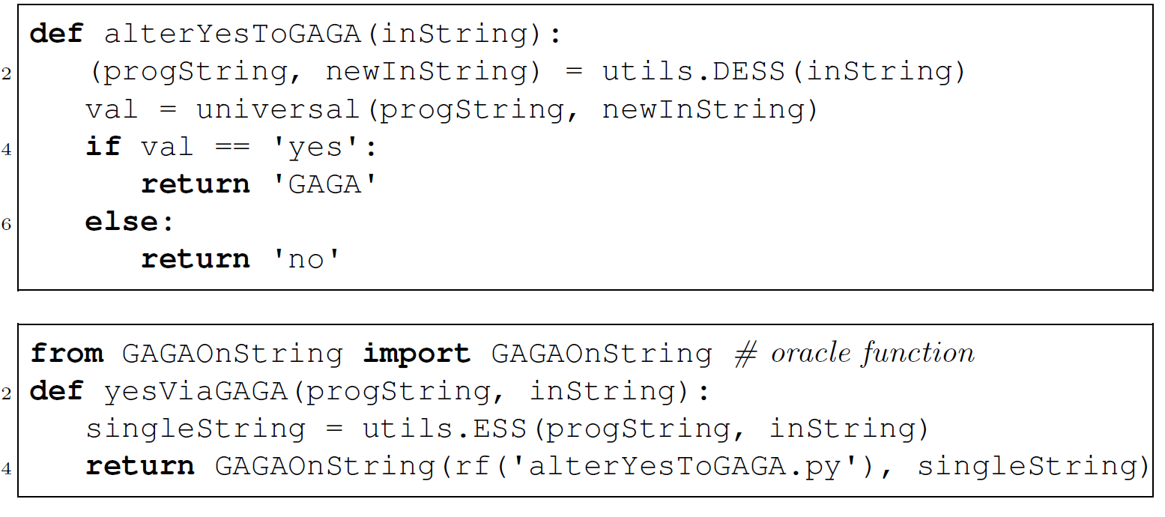
Our first reduction for hardness: YesOnString reduces to GAGAOnString

Slide 7
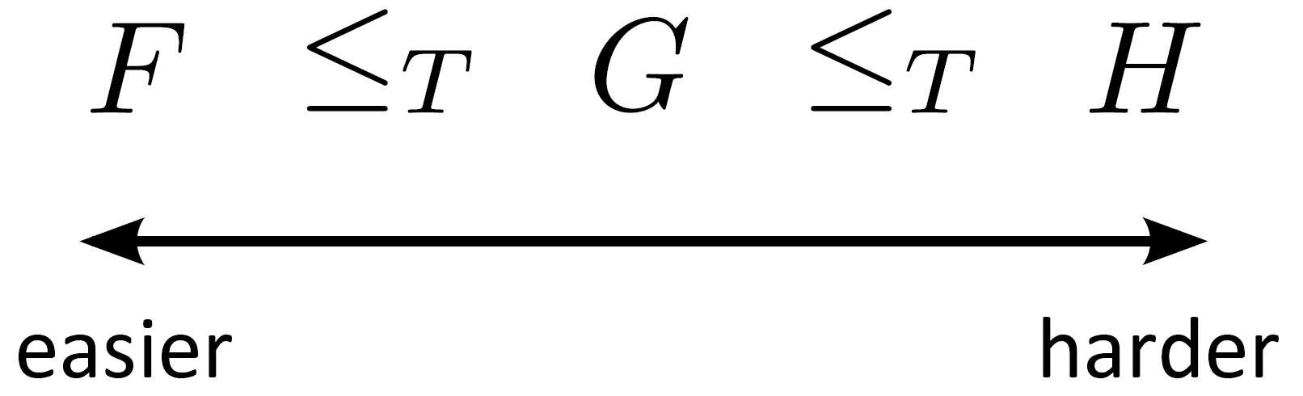
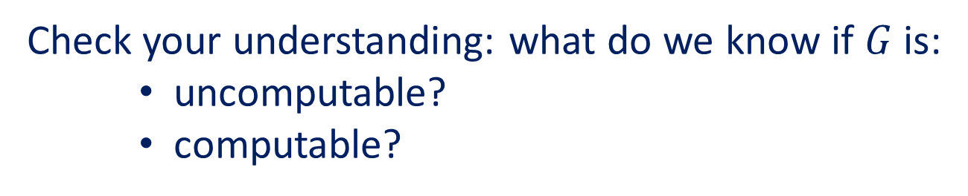
Think of Turing reductions as ordering problems according to “hardness”
Check your understanding: what do we know if $G$ is:
uncomputable?
computable?

Slide 8
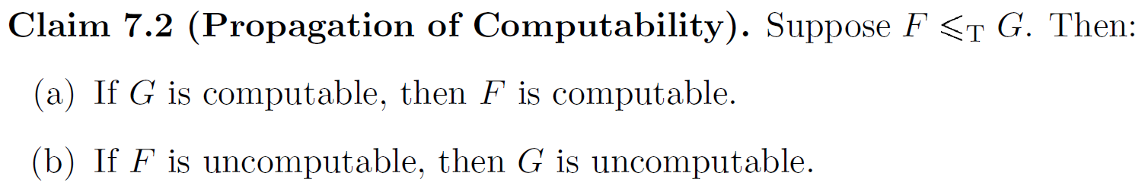
The ordering according to hardness has some obvious consequences

Slide 9
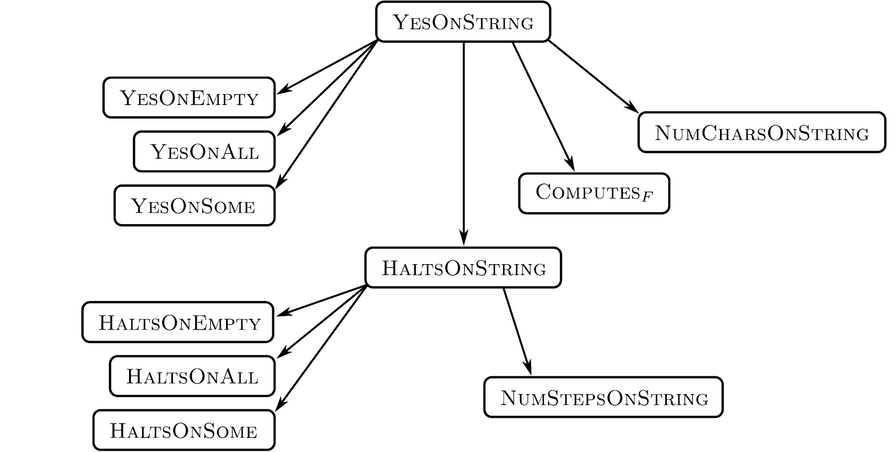
We can use reductions to prove that many problems are uncomputable

Slide 10
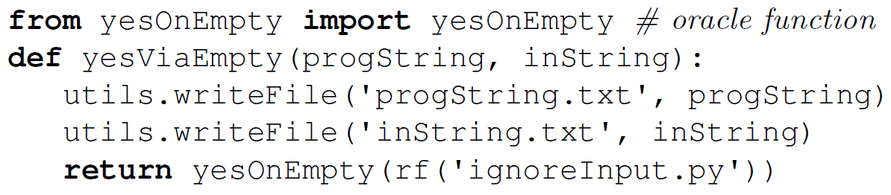
The “ignore input” trick can be used for many Turing reductions
Example: reduction from YesOnString to YesOnEmpty
Check your understanding: why is this a correct reduction?

Slide 11
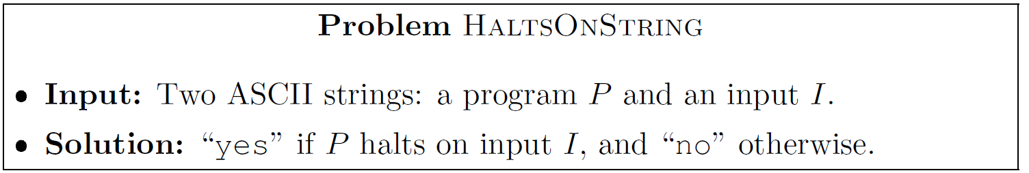
Several variants of the halting problem are famous and important examples of undecidable problems
HaltsOnEmpty, HaltsOnAll, HaltsOnSome are defined similarly.

Slide 12
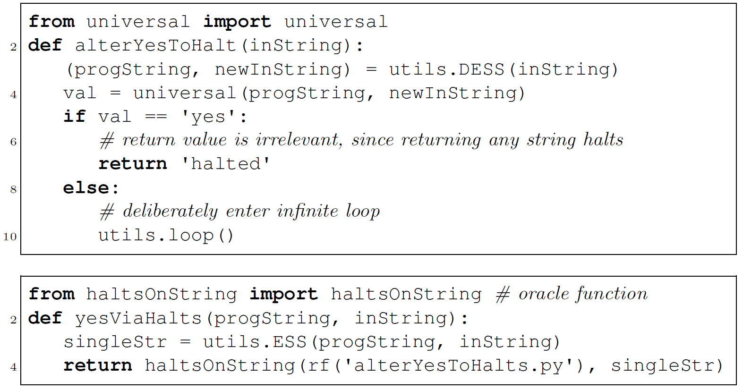
We can prove HaltsOnString is undecidable by reducing from YesOnString

Slide 13
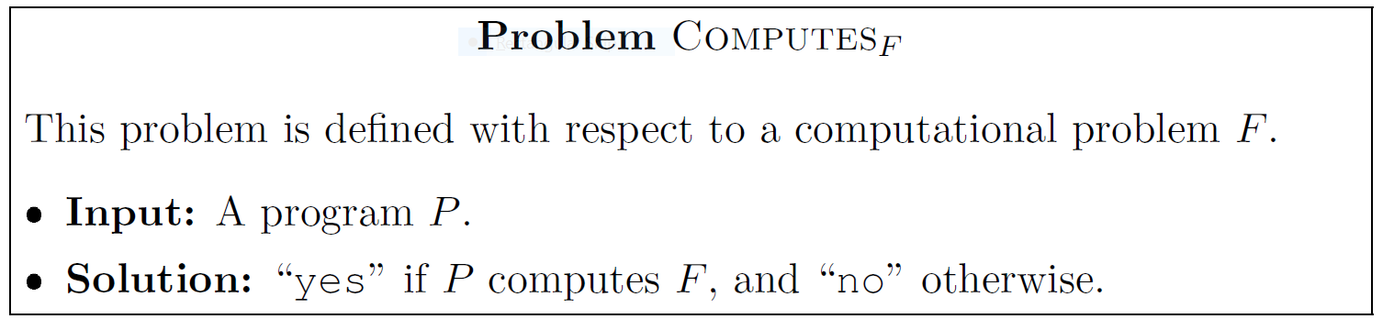
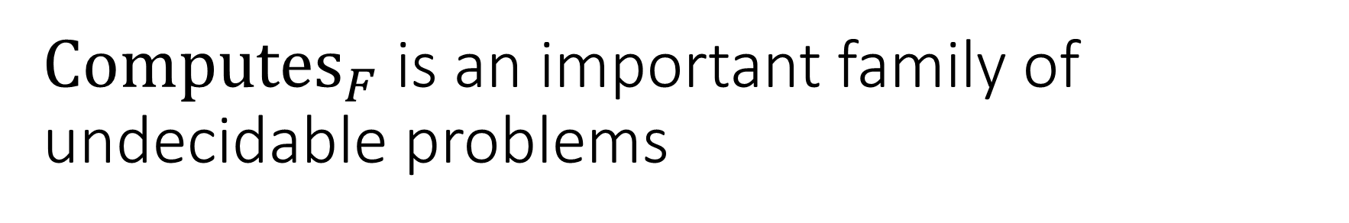
${Computes}_{F}$ is an important family of undecidable problems

Slide 14
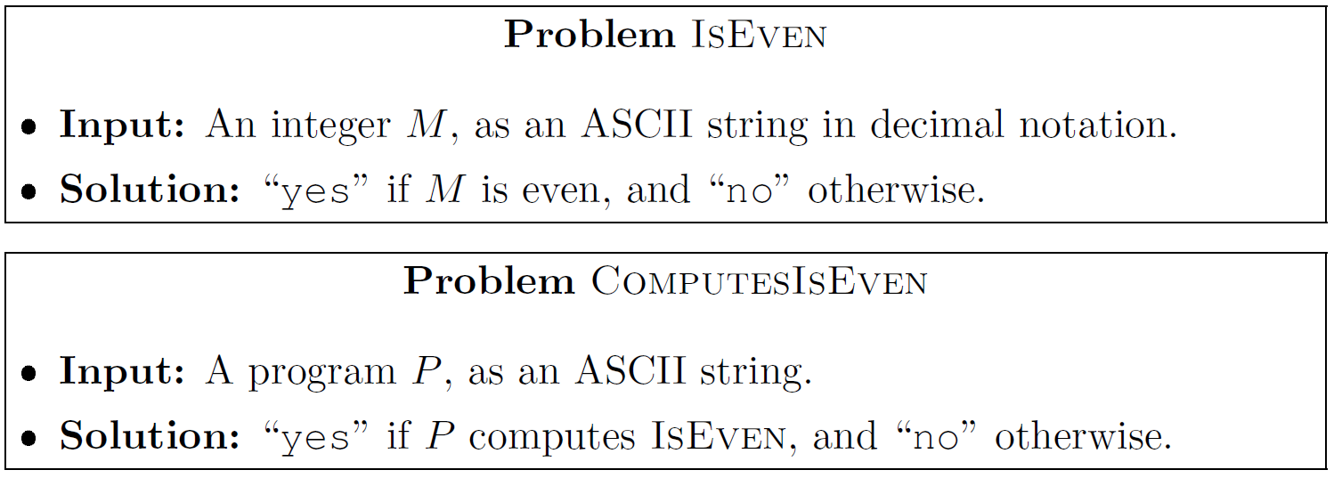
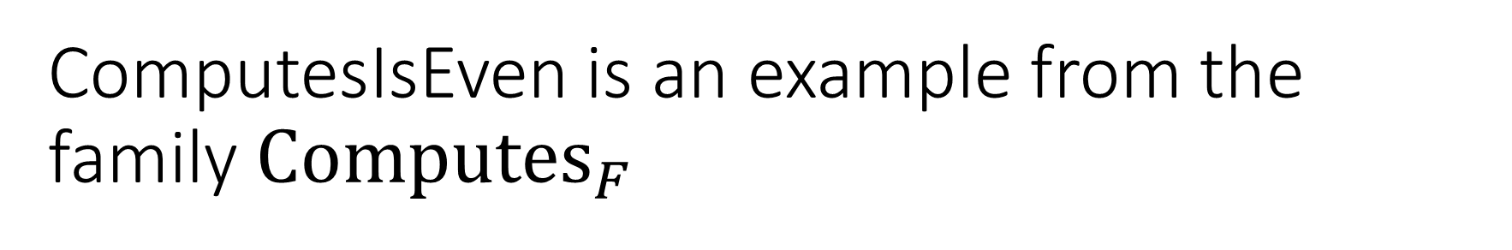
ComputesIsEven is an example from the family ${Computes}_{F}$

Slide 15
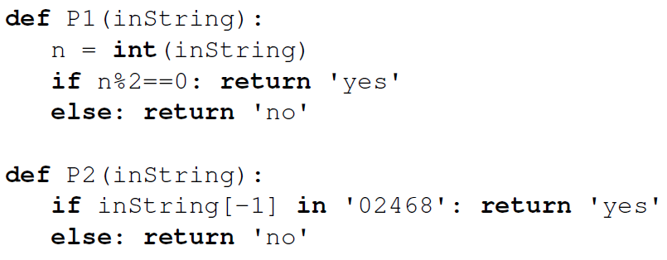
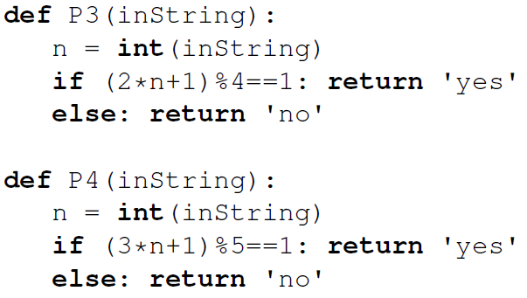
Test your understanding: which of the following are positive instances of ComputesIsEven?
Note the extreme difficulty of this challenge, even for a very simple underlying problem such as IsEven
In fact, ComputesIsEven is undecidable

Slide 16
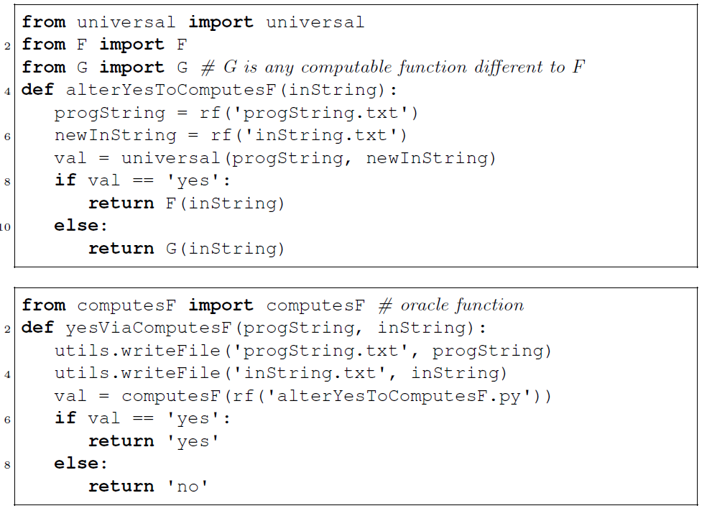
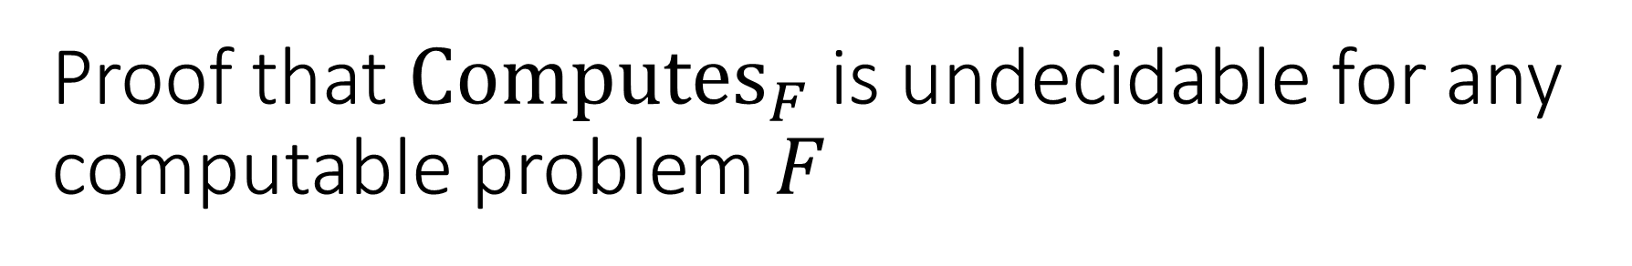
Proof that ${Computes}_{F}$ is undecidable for any computable problem $F$
reduction from YesOnString:

Slide 17
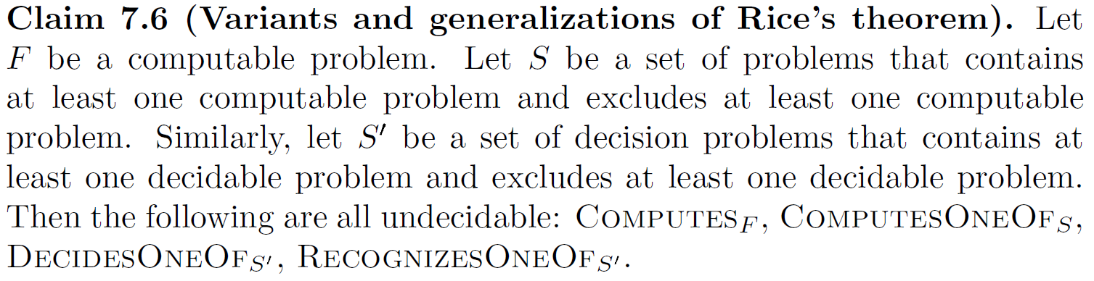
The previous result can be generalized in several ways (including Rice’s Theorem)

Slide 18
There are some famous uncomputable problems that aren’t about computer programs
Example 1: Diophantine equations
Example 2: Post correspondence problem
However, it turns out that when viewed in the right way, the above problems encode computer programs. So perhaps all uncomputable problems are “about” computer programs in some sense.

Slide 19
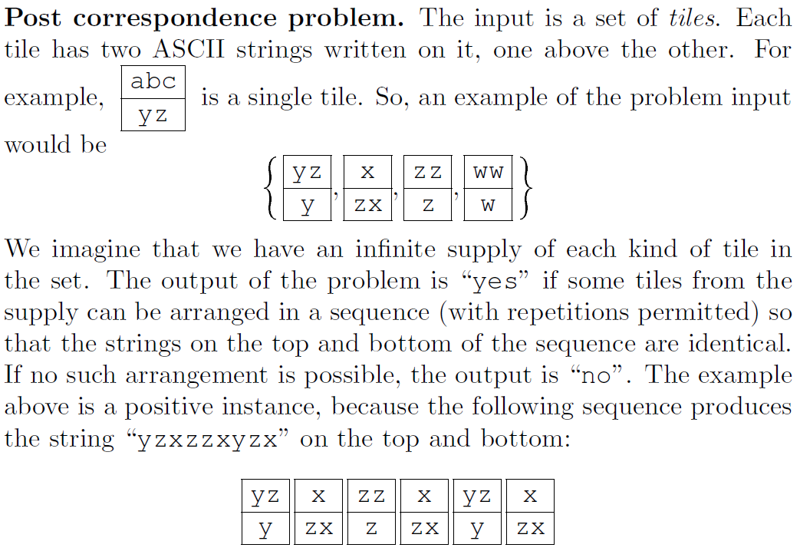
Definition of Post correspondence problem

Slide 20
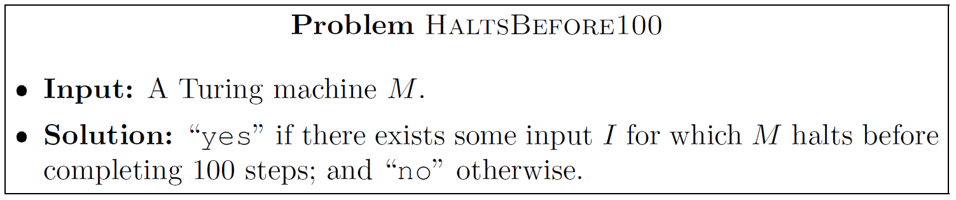
Not every question about programs is uncomputable
HaltsBefore100 is computable!
Can you see why?
Other examples of computable problems about programs:
How many lines in a given program?
How many states in a given Turing machine?
Are there any calls to the print() function in a given program?

Slide 21
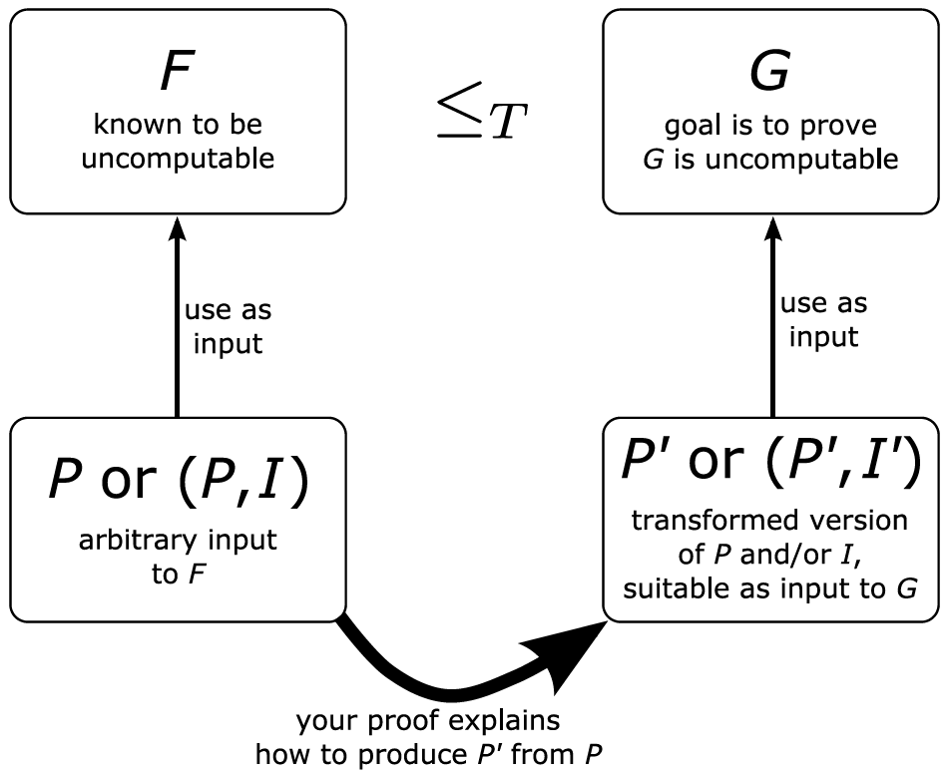
Proof technique 1 for uncomputability: the reduction recipe

Slide 22
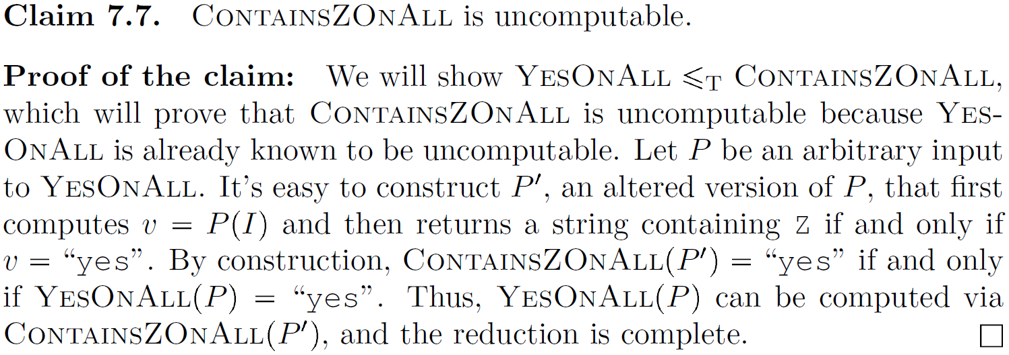
Example of the reduction recipe

Slide 23
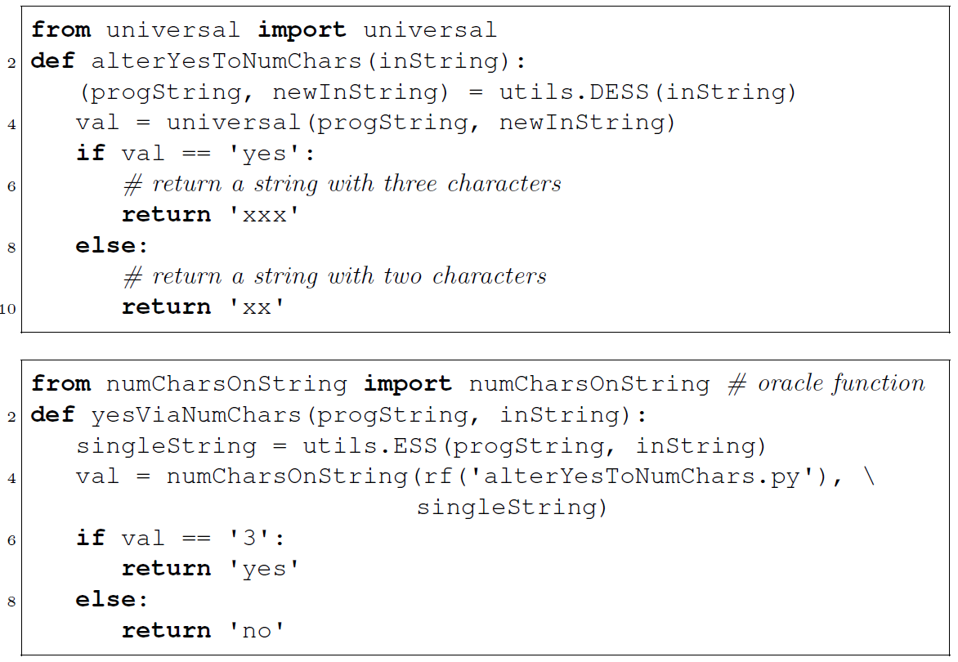
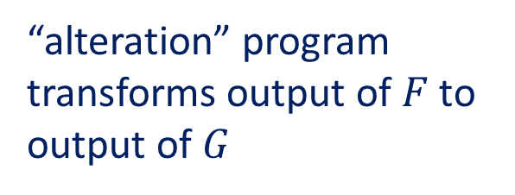
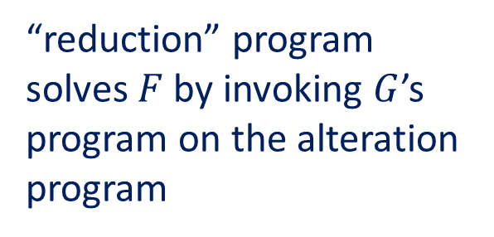
Technique 2: reduction with explicit Python programs
“alteration” program transforms output of $F$ to output of $G$
“reduction” program solves $F$ by invoking $G$’s program on the alteration program

Slide 24
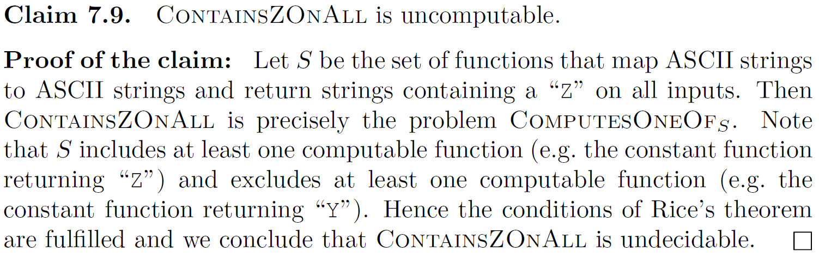
Technique 3: apply Rice's theorem

