Slide 1
8. Nondeterminism
Lecture slides for What Can Be Computed?

Slide 2
Example of nondeterminism: solving the problem FindNANA
In genetic strings, “N” stands for any one of “C”, “A”, “G”, “T”
So, findNANA.py searches its input for any one of the strings “CACA” “GAGA”, “TATA”, “AAAA”
We will search the 2KB file geneticString.txt, which actually contains all four of the above strings
For technical reasons (explained later), we will use the program ndFindNANADivConq.py, which searches its input using a nondeterministic divide-and-conquer strategy

Slide 3
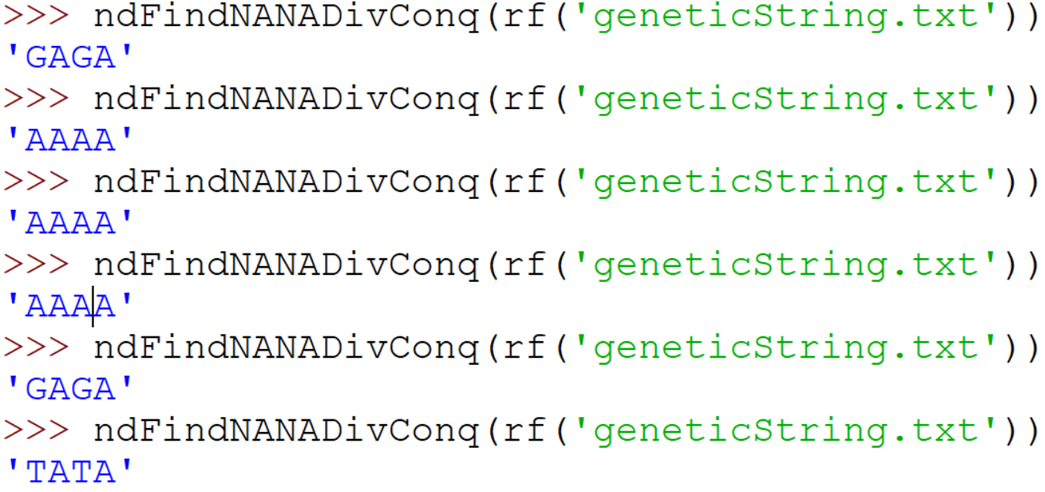
Example of nondeterminism: solving the problem FindNANA
Actual results (experiment with your own computer):

Slide 4
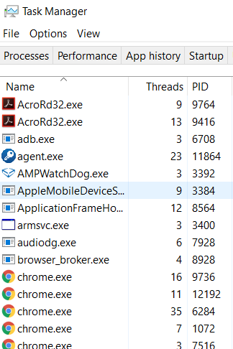
Nondeterminism is present in most modern computers
View a demo of task manager (Windows), activity monitor (Apple), ps (linux)
Note that hundreds of processes and threads are running “simultaneously”
In fact, only a few are genuinely simultaneous (exercise: exactly how many, on your own computer?)
The operating system rapidly switches between threads to give the appearance of simultaneously working on dozens of tasks
We can’t control exactly when the switches occur, which means the overall behavior is nondeterministic

Slide 5
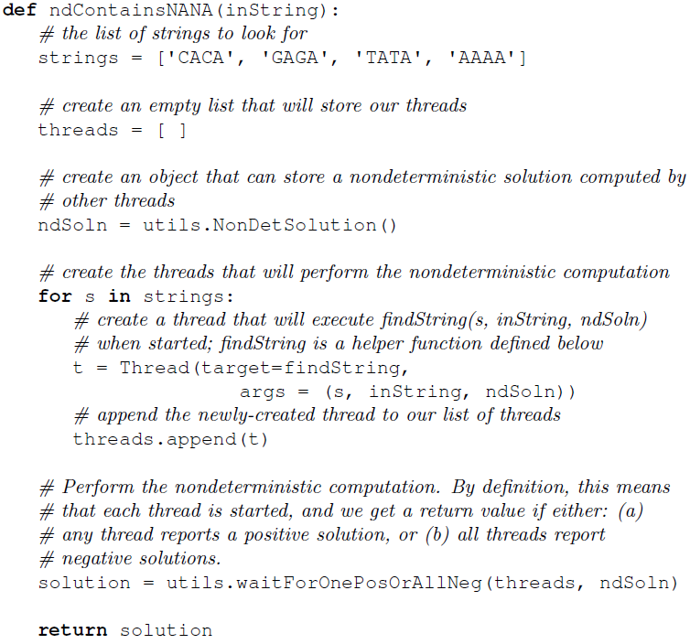
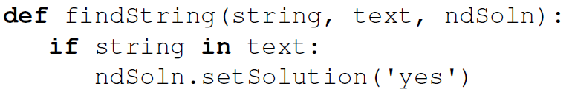
In Python, use the threading module for nondeterminism
findString will be invoked nondeterministically, in four separate threads
Wait for first positive solution if there is one, otherwise wait until all threads terminate with negative solution

Slide 6
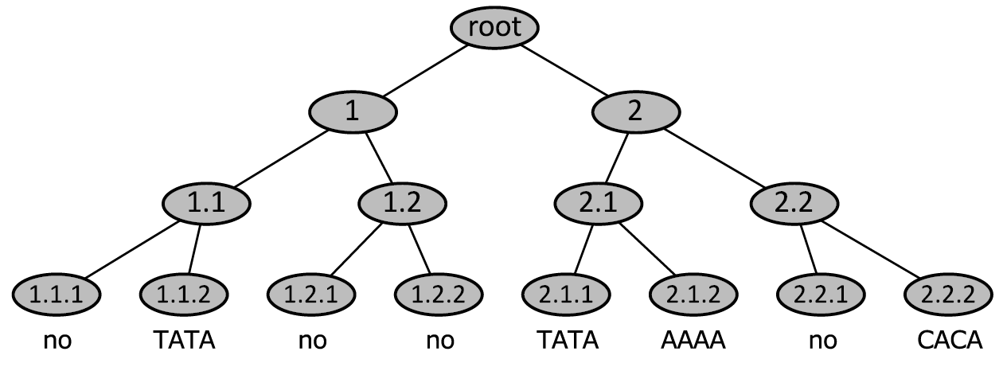
Computation trees are a useful way of modeling nondeterministic computations

Slide 7
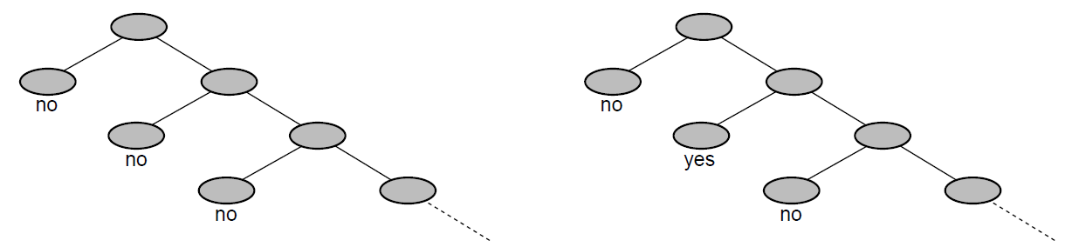
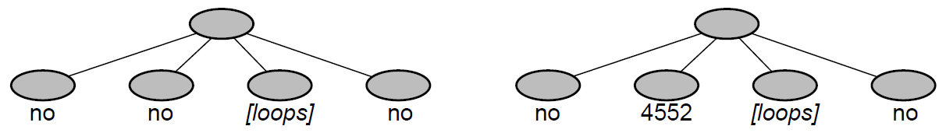
Any positive leaf is a valid output; infinite trees or looping nodes can lead to undefined output
Exercise: what is the output of each of these trees?

Slide 8
Nondeterminism does not allow us to solve more problems (compared to deterministic programs or Turing machines)
Claim: Any problem that can be computed by a nondeterministic Python program can also be computed by a deterministic Python program.
Sketch proof: Use a deterministic program to simulate the nondeterministic program. Keep a list of all the unexplored nodes in the computation tree and visit each in turn.

Slide 9
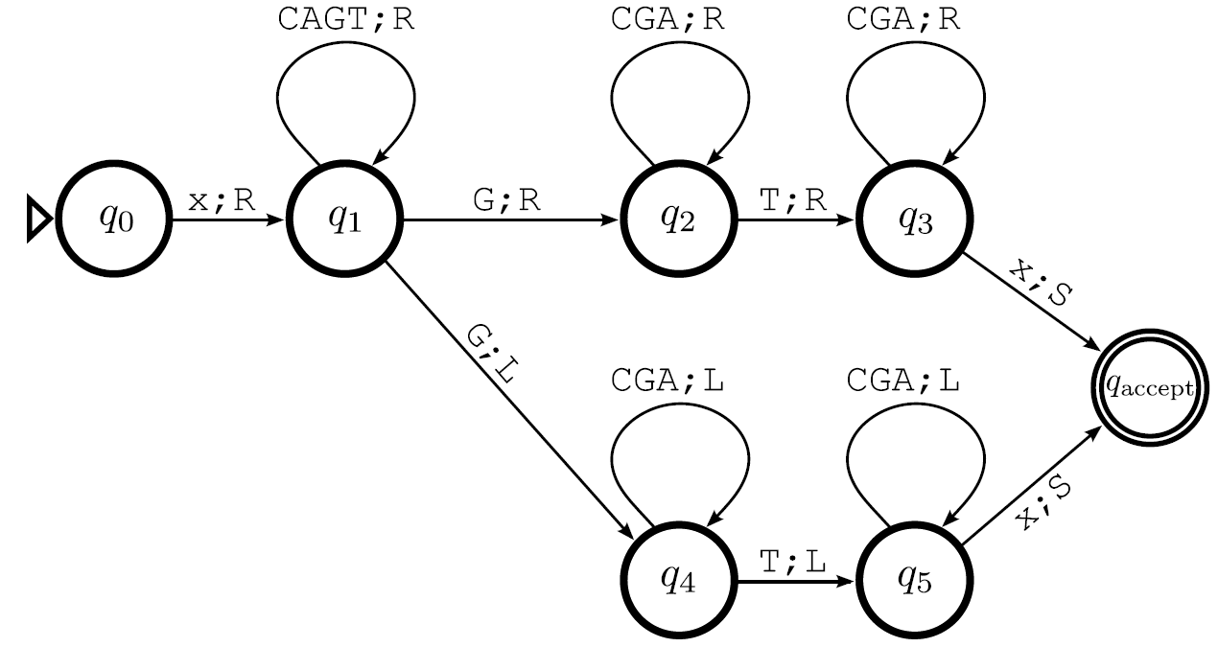
Nondeterministic Turing machines can clone themselves, following multiple transitions simultaneously
In this machine, which states exhibit nondeterminism?

Slide 10
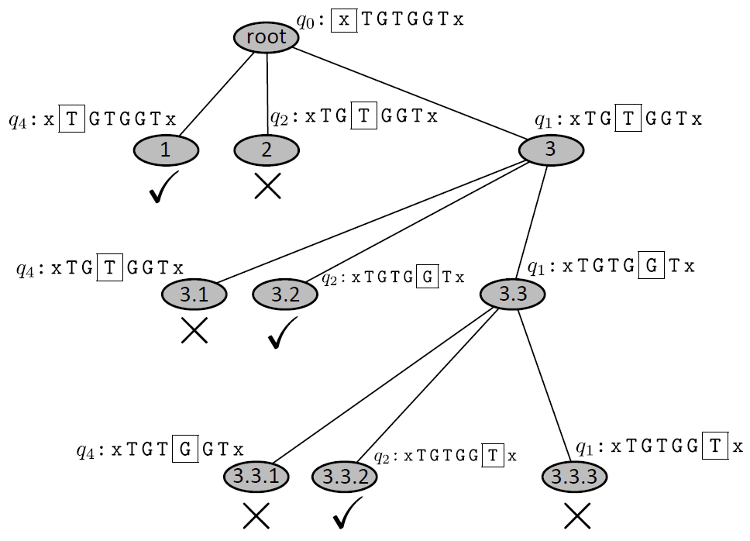
Example of a computation tree for nondeterministic Turing machine

Slide 11
Formally, nondeterministic Turing machines have transition functions that map to sets of configurations
Example:

Slide 12
Nondeterminism can be viewed in at least three equivalent ways
Simultaneous threads: programs execute all threads simultaneously
Random choice: program randomly chooses a single action to take when offered a choice
External choice: an external operator advises the program which action to take when offered a choice
In each case, we ask whether it is possible to reach a positive solution. All three models yield the same results.

Slide 13
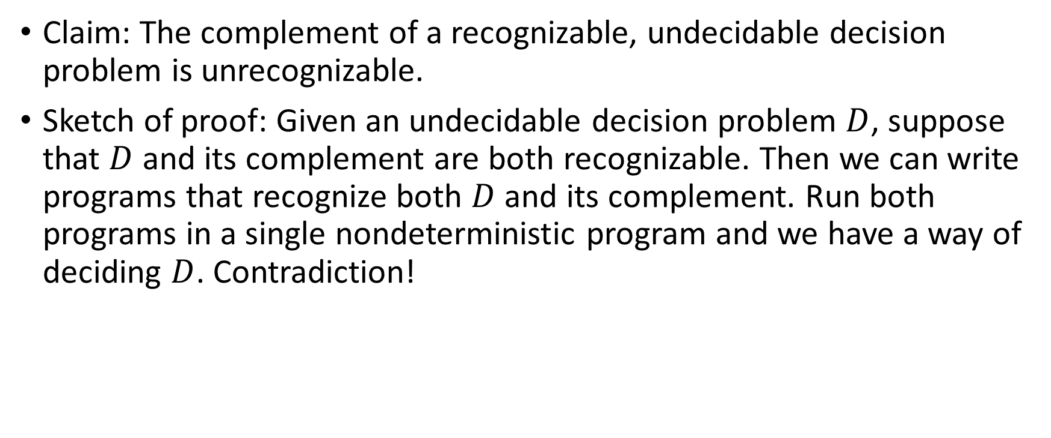
Nondeterminism provides a way to prove that unrecognizable problems exist
Claim: The complement of a recognizable, undecidable decision problem is unrecognizable.
Sketch of proof: Given an undecidable decision problem $D$, suppose that $D$ and its complement are both recognizable. Then we can write programs that recognize both $D$ and its complement. Run both programs in a single nondeterministic program and we have a way of deciding $D$. Contradiction!

Slide 14
Why study nondeterminism?
Sometimes it’s a natural way to think about a problem or to prove a result (e.g. previous slide)
To a certain limited extent, nondeterminism models real computations performed on large clusters of computers (e.g. the results computed by a search engine)
BUT our theoretical definition of nondeterminism permits an unbounded number of threads or clones, whereas any real system has a finite limit
Nondeterminism leads to important concepts in complexity theory, especially NP-completeness (which we study later)

