Slide 1
9. Finite automata
Lecture slides for What Can Be Computed?

Slide 2
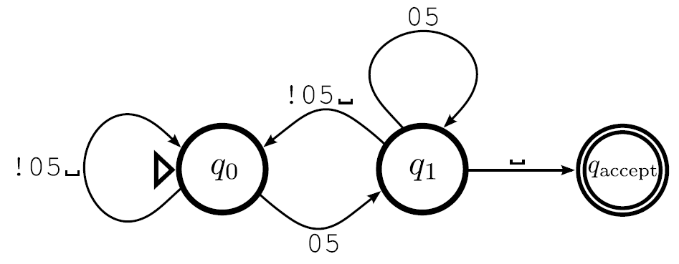
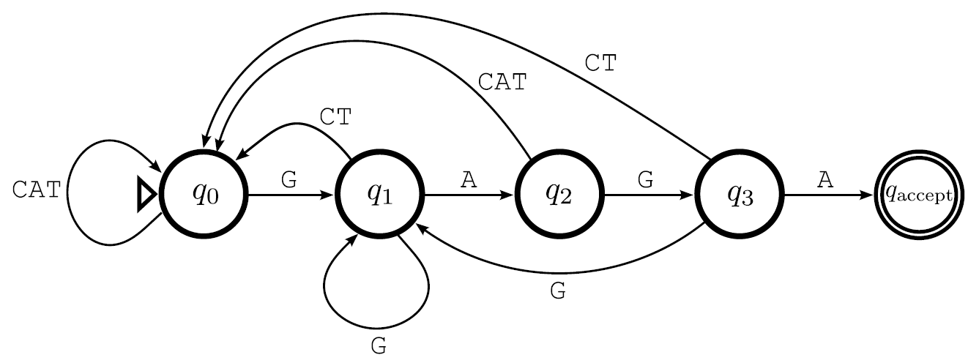
A dfa (deterministic finite automaton) is a special case of a Turing machine
Dfas never edit the tape, and the head always moves to the right
The only role of the blank symbol is to terminate the input
Examples:
containsGAGA
multipleOfFive
Note: no need to specify new symbol or direction

Slide 3
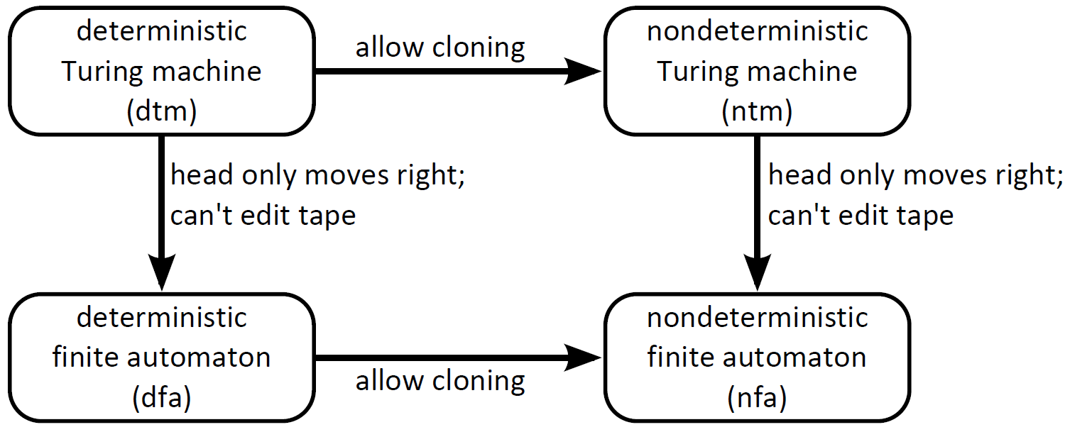
There are two ways of thinking about nfas (nondeterministic finite automata)

Slide 4
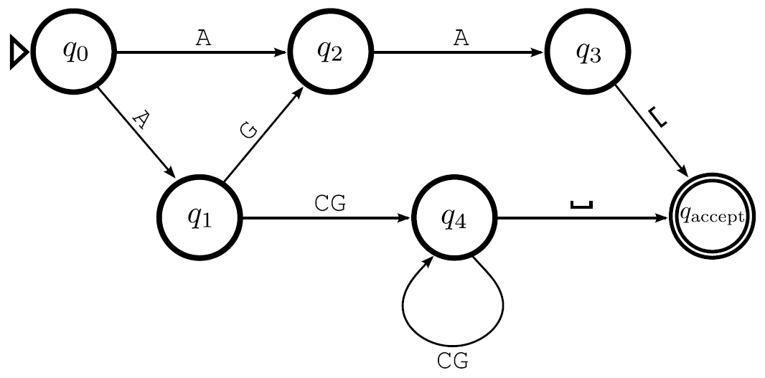
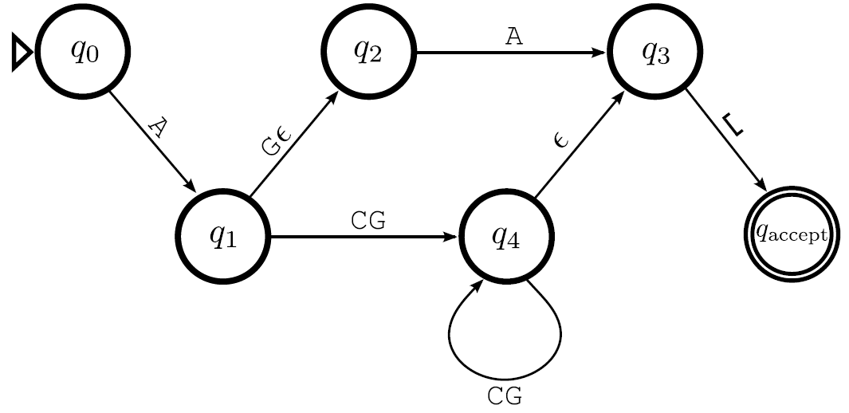
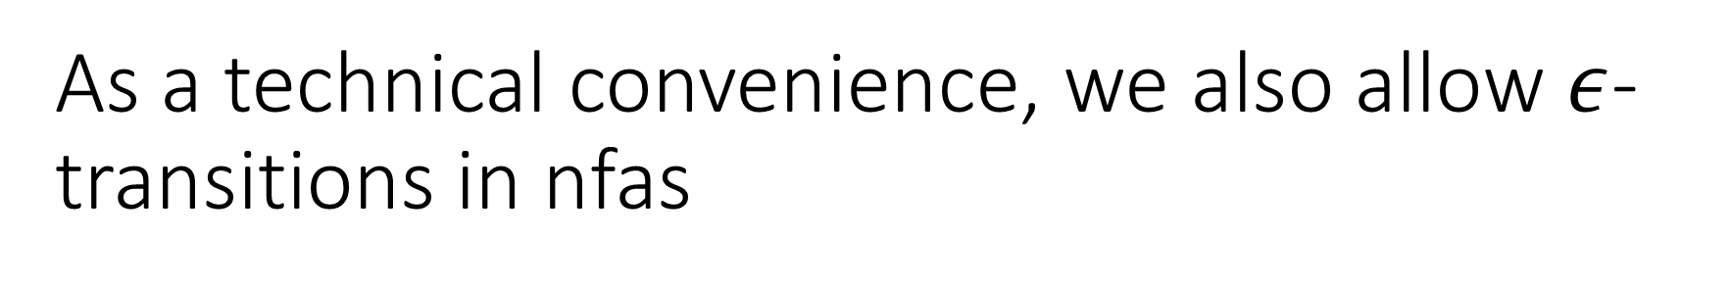
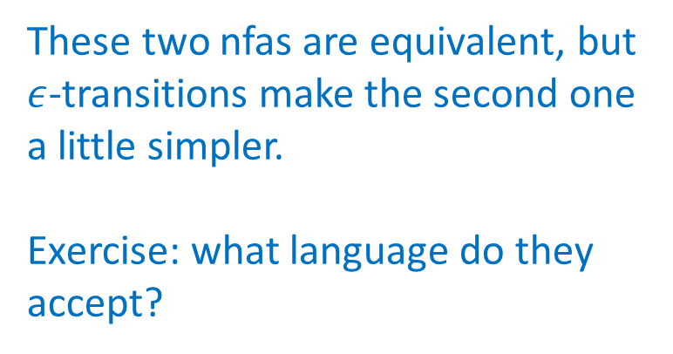
As a technical convenience, we also allow $ε$-transitions in nfas
These two nfas are equivalent, but $ε$-transitions make the second one a little simpler.
Exercise: what language do they accept?
Definition of acceptance: accept if any clone accepts, and reject if all clones reject (same as for nondeterministic Turing machines)

Slide 5
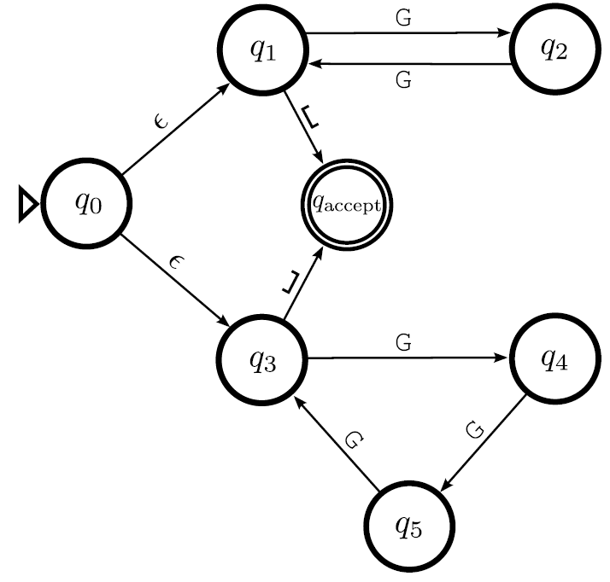
Example of an nfa that is simple to understand, compared to an equivalent dfa
Exercise: what language does this nfa accept?

Slide 6
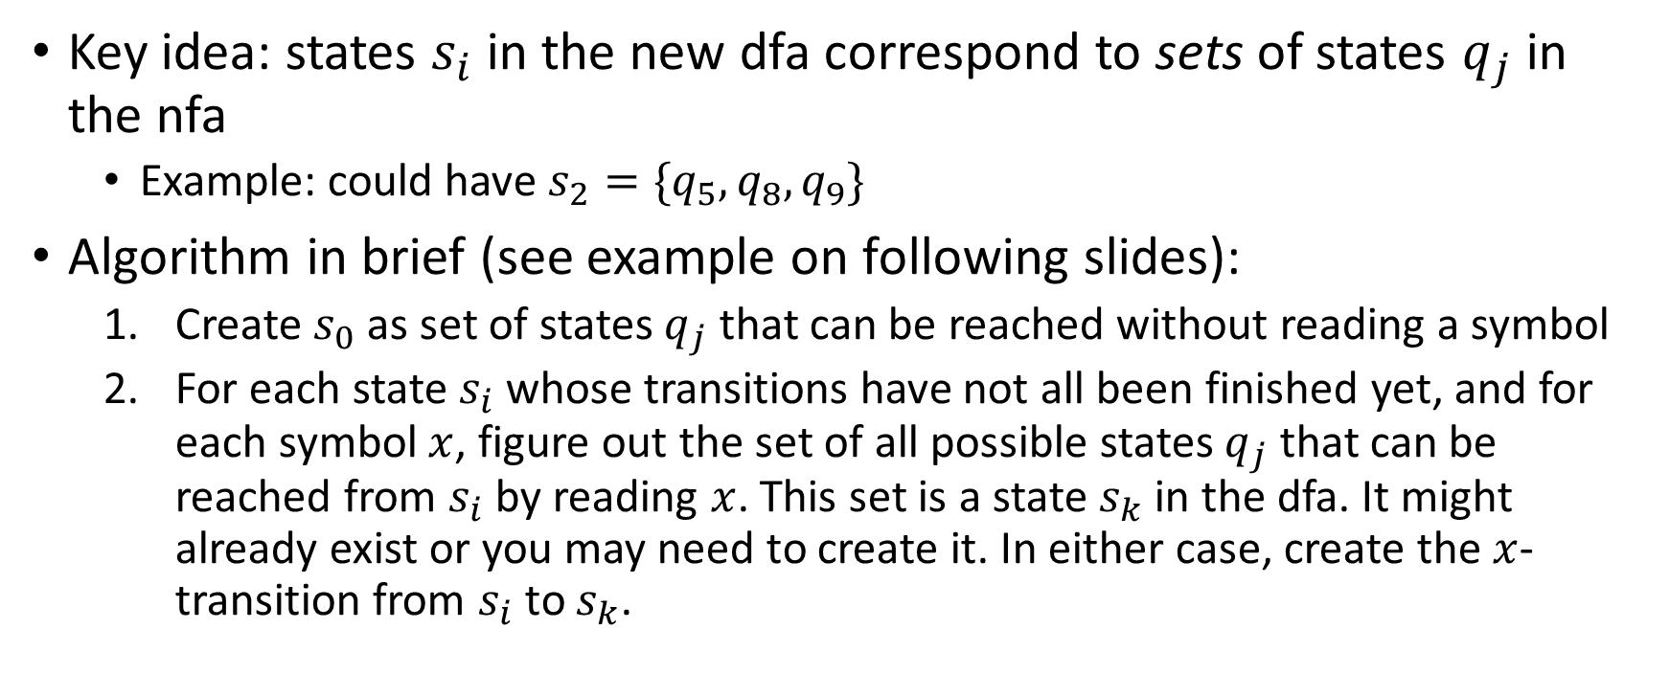
Algorithm for converting nfa to equivalent dfa
Key idea: states $s_{i}$ in the new dfa correspond to sets of states $q_{j}$ in the nfa
Example: could have $s_{2}=\{q_{5},q_{8},q_{9}\}$
Algorithm in brief (see example on following slides):
Create $s_{0}$ as set of states $q_{j}$ that can be reached without reading a symbol
For each state $s_{i}$ whose transitions have not all been finished yet, and for each symbol $x$, figure out the set of all possible states $q_{j}$ that can be reached from $s_{i}$ by reading $x$. This set is a state $s_{k}$ in the dfa. It might already exist or you may need to create it. In either case, create the $x$-transition from $s_{i}$ to $s_{k}$.

Slide 7
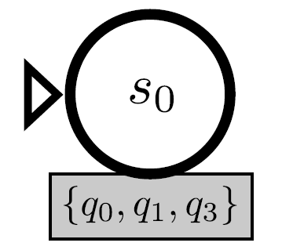
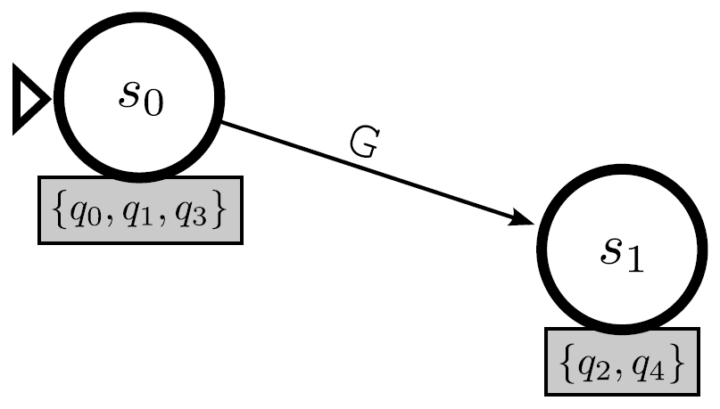
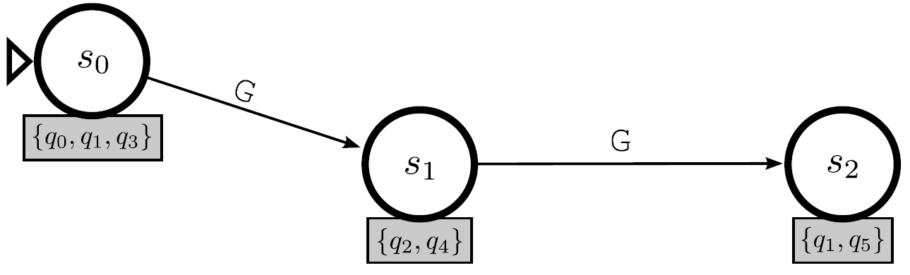
Example of converting nfa to dfa

Slide 8
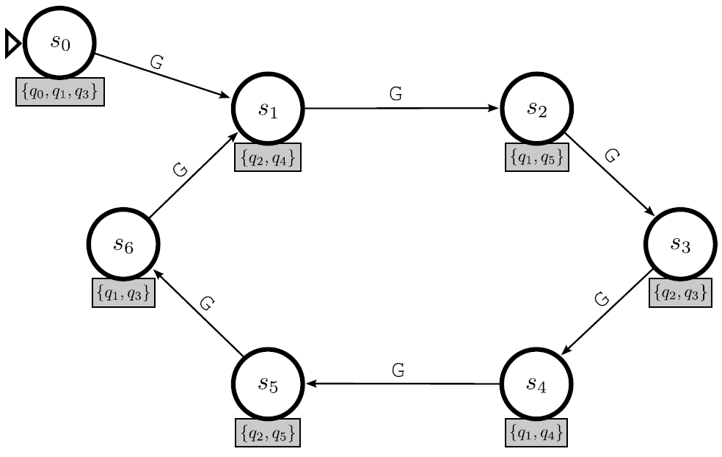
Example of converting nfa to dfa

Slide 9
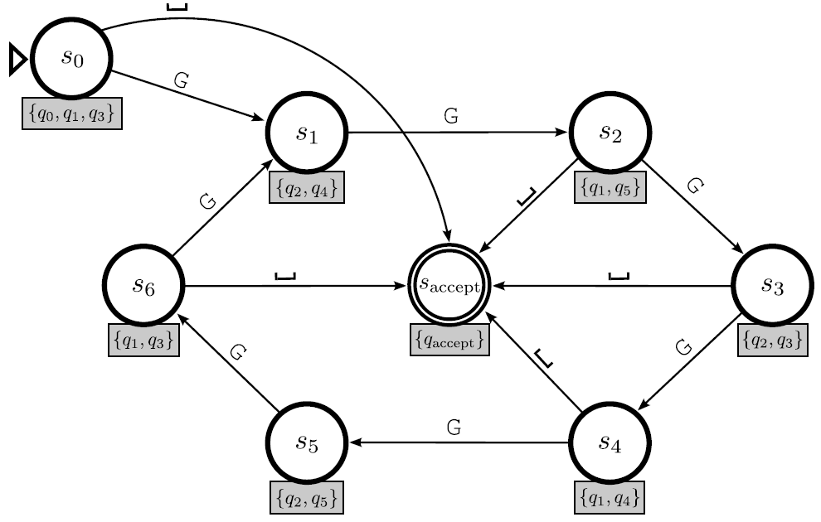
Example of converting nfa to dfa

Slide 10
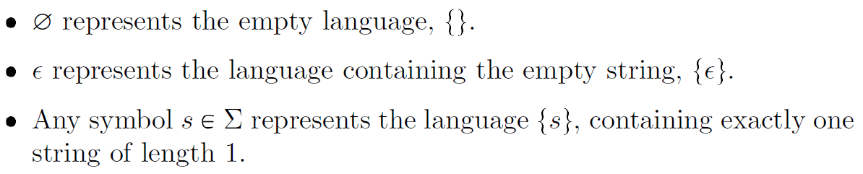
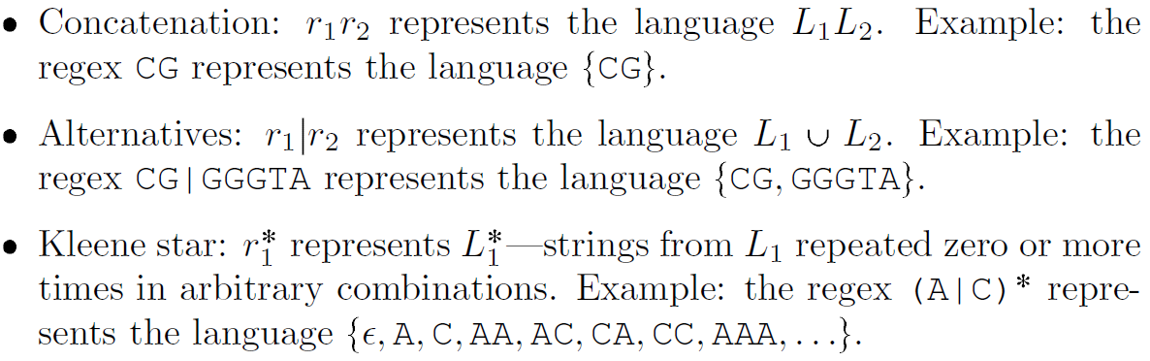
Regular expressions are a powerful tool for practical applications and theoretical analysis
Elementary definitions for pure regular expressions:

Slide 11
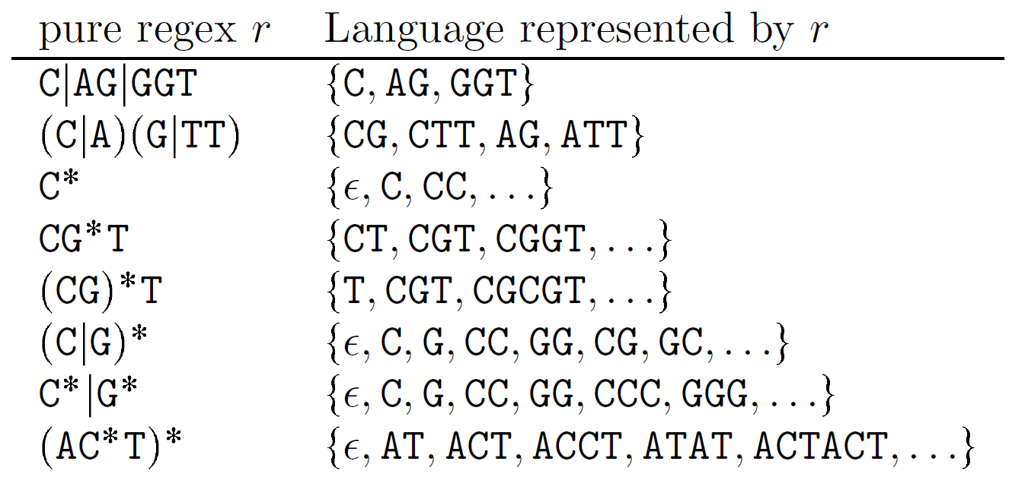
Examples of pure regular expressions

Slide 12
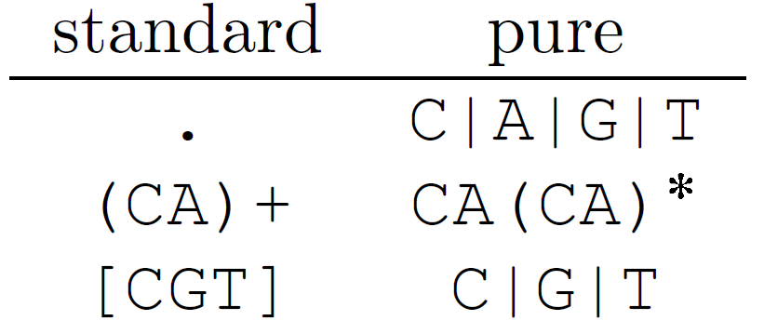
We can use additional notation to make regexes easier to use
A period “.” represents any single character
A plus “+” represents one or more repetitions
Square brackets “[ ]” represent a set of alternatives

Slide 13
Regexs and dfas are equivalent
Any dfa or nfa can be converted into an equivalent regular expression, and vice versa
The next few slides show examples of how to do this, without giving rigorous details

Slide 14
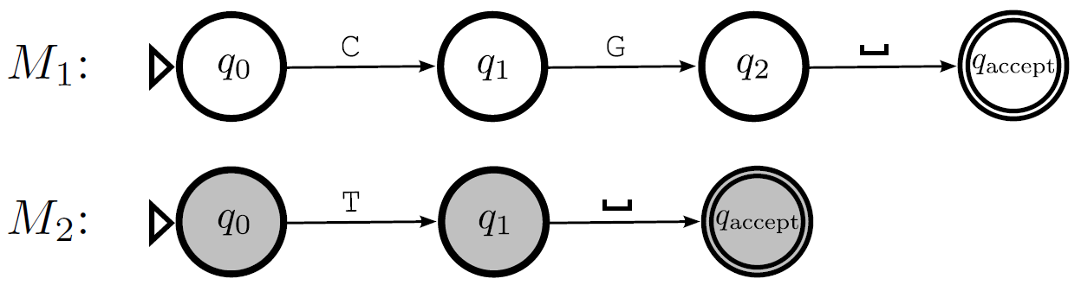
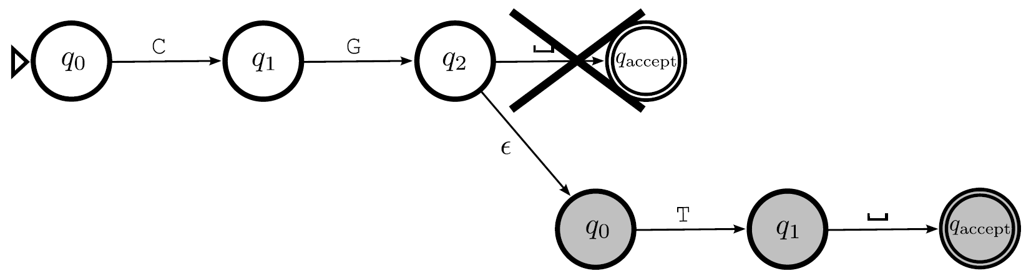



Implementing concatenation with an nfa
$$r_{1}=CG$$
$$r_{2}=T$$
$$r_{1}r_{2}=CGT$$

Slide 15
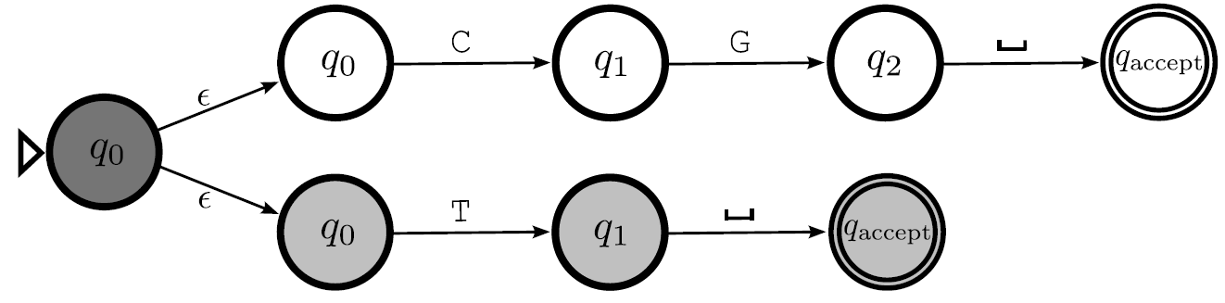

Implementing alternatives with an nfa
$$r_{1}=CG$$
$$r_{2}=T$$
$$r_{1} \left| r_{2}=CG \right| T$$

Slide 16
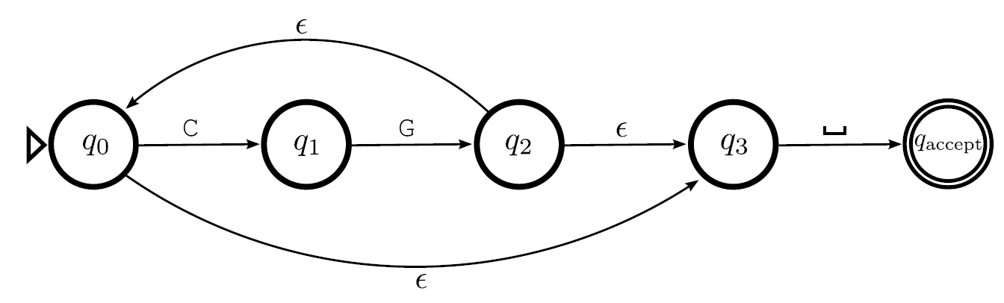

Implementing Kleene star with an nfa
$$r_{1}=CG$$
$$r_{2}=T$$
$${(r}_{1})^{∗}=(CG)^{∗}$$

Slide 17
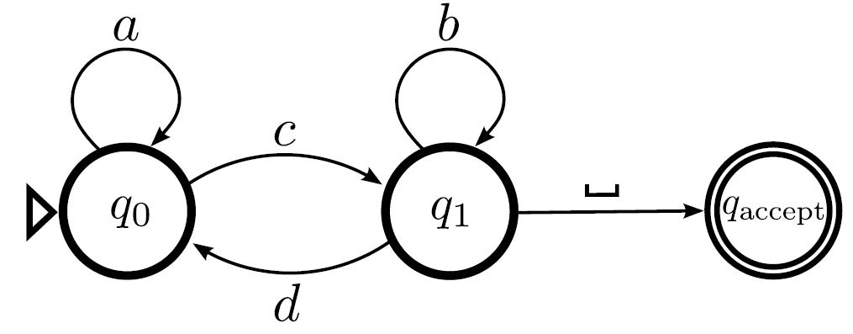
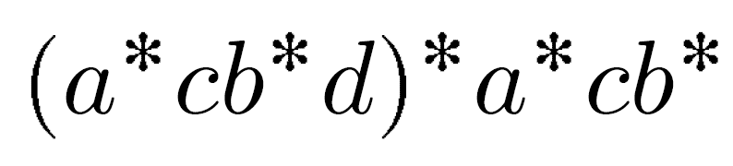
Converting a dfa to a regex always boils down to one particular example

Slide 18
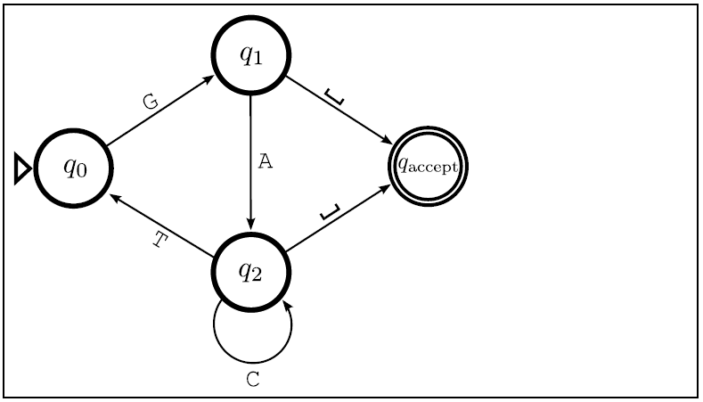
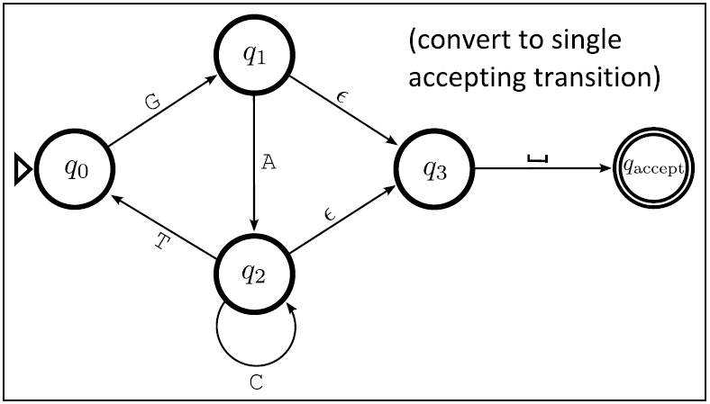
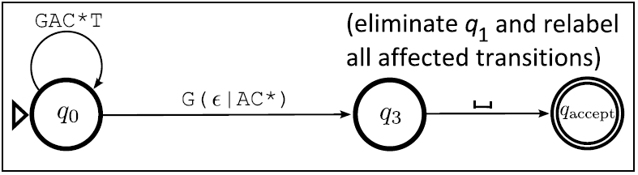
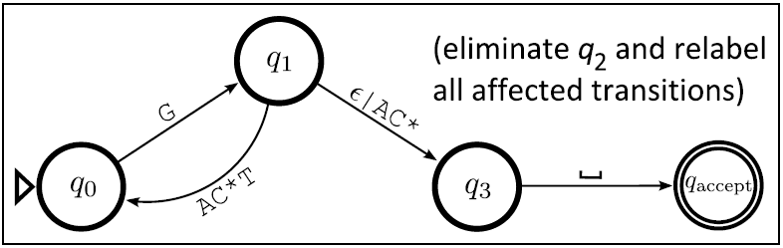
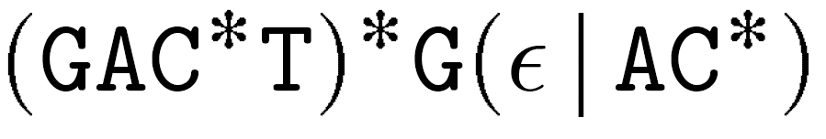
Given a dfa, gradually simplify it by relabeling transitions with regexes (then use previous slide)

Slide 19
Regular languages
Definition: A language is regular if and only if it is decided by some dfa. Equivalently, a language is regular if it’s decided by some nfa, or if it’s represented by some regular expression.
Note the analogy with the decidability:
A language is decidable if it’s decided by some Turing machine
A language is regular if it’s decided by some dfa (which is a restricted type of Turing machine
Big question: Are there any decidable languages that are not regular?
Answer: yes!
This is our first interesting example of computational models that do not have equivalent power

Slide 20
If a language is regular, then it’s decidable
Exercise: prove it! (Very easy.)

Slide 21
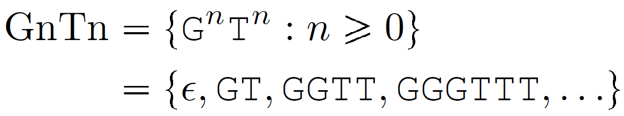
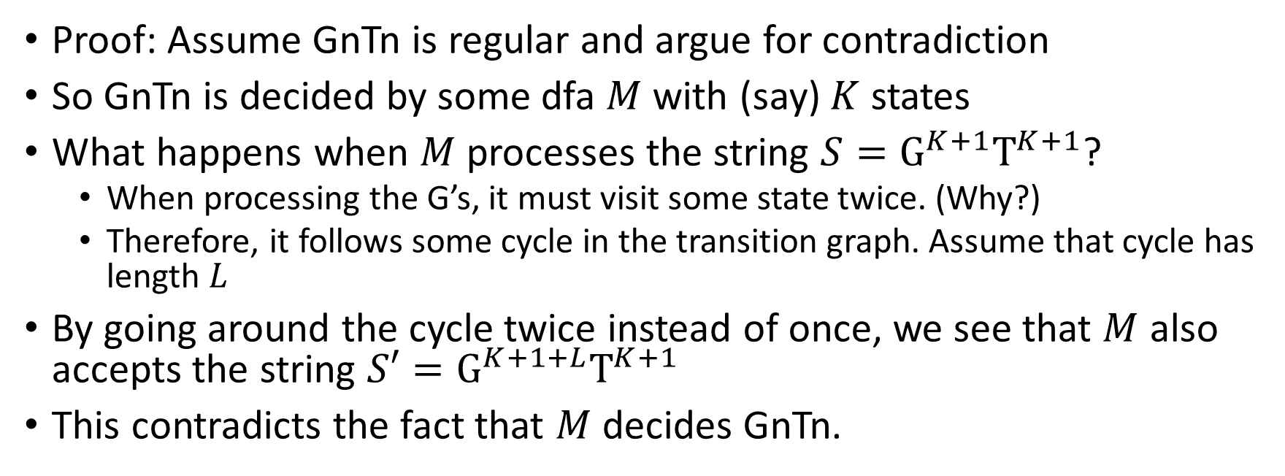
GnTn is decidable but not regular
Proof: Assume GnTn is regular and argue for contradiction
So GnTn is decided by some dfa $M$ with (say) $K$ states
What happens when $M$ processes the string $S=G^{K+1}T^{K+1}$?
When processing the G’s, it must visit some state twice. (Why?)
Therefore, it follows some cycle in the transition graph. Assume that cycle has length $L$
By going around the cycle twice instead of once, we see that $M$ also accepts the string $S′=G^{K+1+L}T^{K+1}$
This contradicts the fact that $M$ decides GnTn.

Slide 22
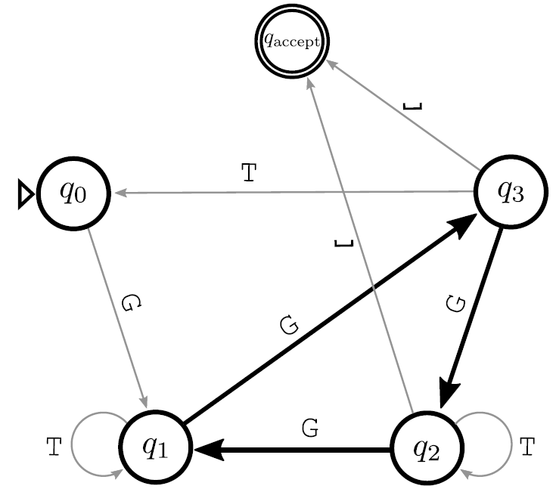
Visualization of the proof on previous slide
Cycle traversed while processing “GGGGGGTTTTTT”
If we instead traverse the cycle 0 times or 2 times, we see this dfa also accepts “GGGTTTTTT”, “GGGGGGGGGTTTTTT”.
Later, we will refer to this as pumping the substring “GGG” 0 times or 2 times.

Slide 23
New concept: pumping substrings
Next slide gives concrete examples, then following slide gives formal definition

Slide 24
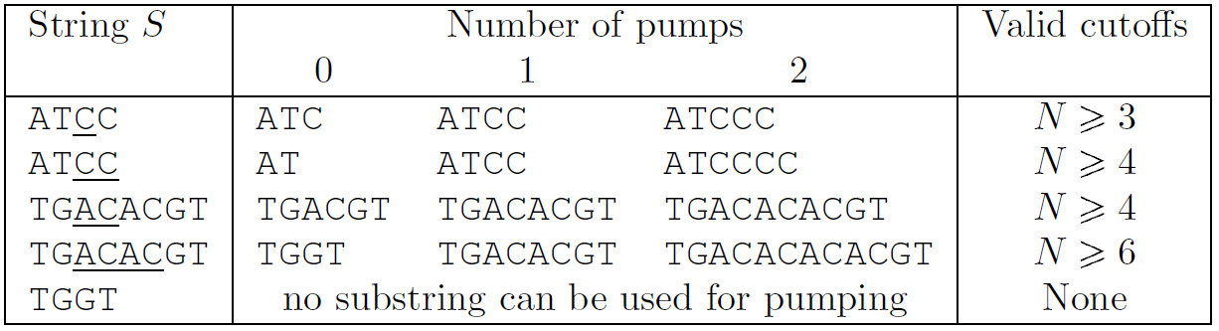
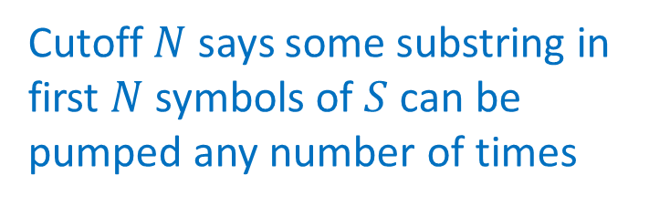
Example: pumping inside the language ATC*|TG(AC)*GT
Cutoff $N$ says some substring in first $N$ symbols of $S$ can be pumped any number of times
pumped substring is underlined

Slide 25
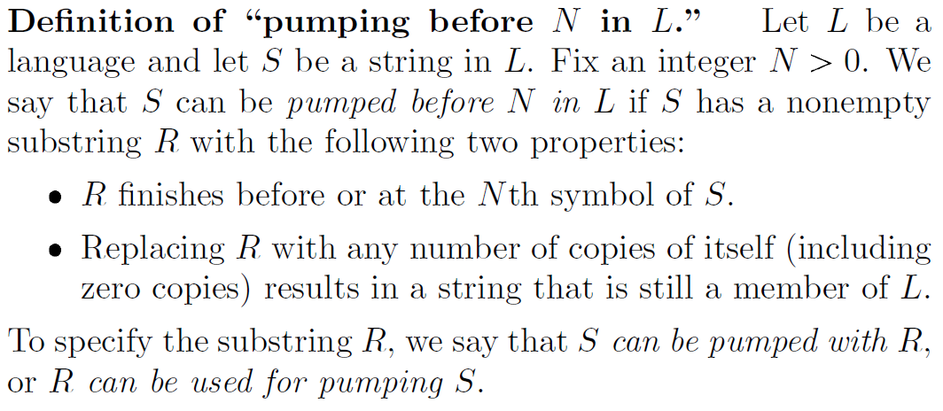
Formal definition of pumping

Slide 26
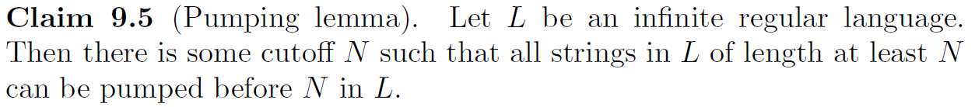
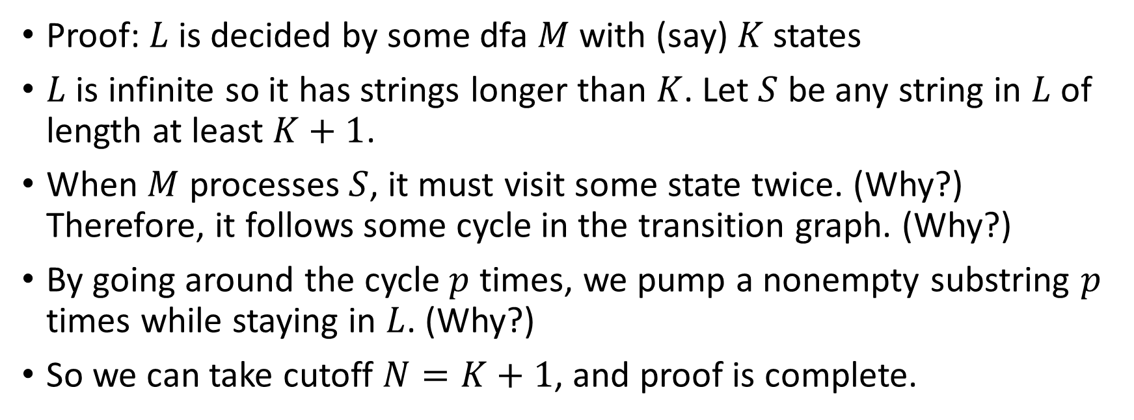
The pumping lemma tells us that infinite regular languages can always be pumped
Proof: $L$ is decided by some dfa $M$ with (say) $K$ states
$L$ is infinite so it has strings longer than $K$. Let $S$ be any string in $L$ of length at least $K+1$.
When $M$ processes $S$, it must visit some state twice. (Why?) Therefore, it follows some cycle in the transition graph. (Why?)
By going around the cycle $p$ times, we pump a nonempty substring $p$ times while staying in $L$. (Why?)
So we can take cutoff $N=K+1$, and proof is complete.

Slide 27
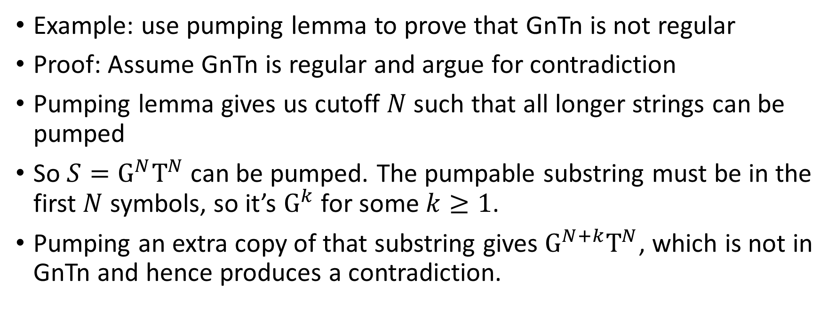
Main application of pumping lemma: prove that a language is not regular
Example: use pumping lemma to prove that GnTn is not regular
Proof: Assume GnTn is regular and argue for contradiction
Pumping lemma gives us cutoff $N$ such that all longer strings can be pumped
So $S=G^{N}T^{N}$ can be pumped. The pumpable substring must be in the first $N$ symbols, so it’s $G^{k}$ for some $k≥1$.
Pumping an extra copy of that substring gives $G^{N+k}T^{N}$, which is not in GnTn and hence produces a contradiction.

Slide 28
Combining regular languages
Exercise: prove the above claim
Important application: combine these properties with the pumping lemma to prove that more interesting languages are not regular. For example, we can prove that:
SameGT (language consisting of strings with the same number of G and T characters) is not regular.
The language of Java programs is not regular

