Slide 1
10. Complexity theory basics
Lecture slides for What Can Be Computed?

Slide 2
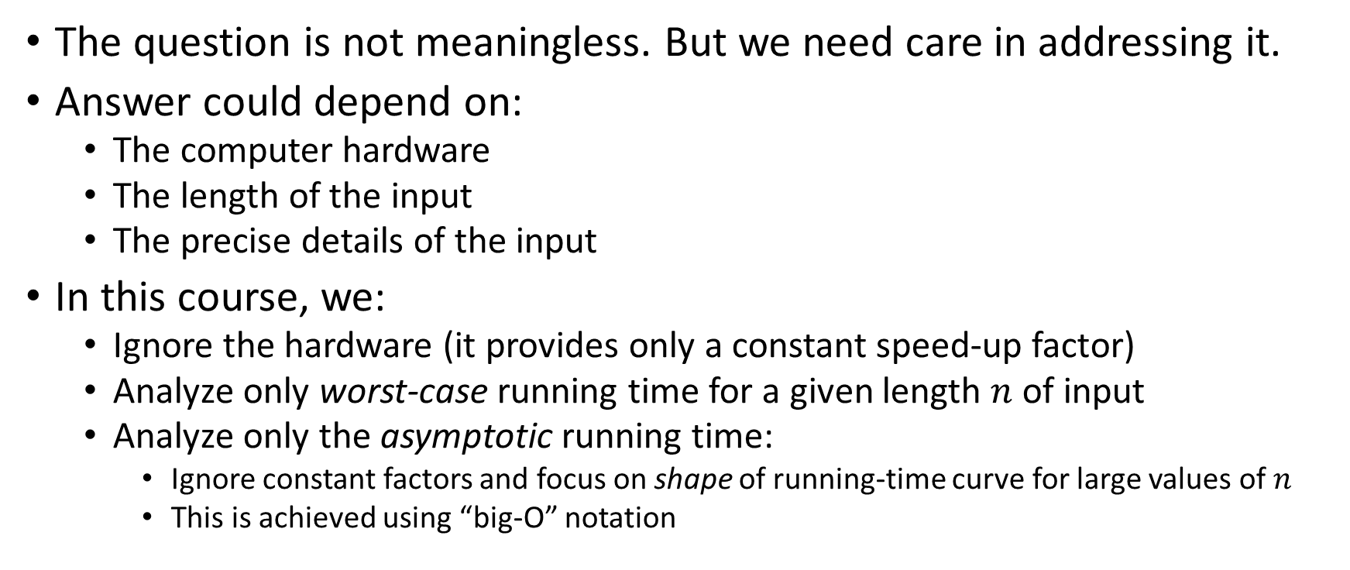
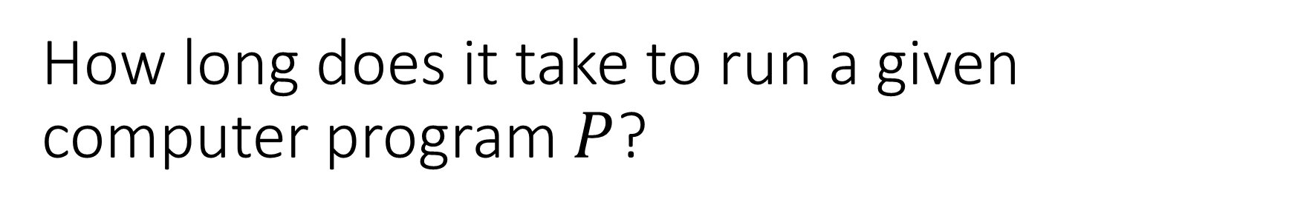
How long does it take to run a given computer program $P$?
The question is not meaningless. But we need care in addressing it.
Answer could depend on:
The computer hardware
The length of the input
The precise details of the input
In this course, we:
Ignore the hardware (it provides only a constant speed-up factor)
Analyze only worst-case running time for a given length $n$ of input
Analyze only the asymptotic running time:
Ignore constant factors and focus on shape of running-time curve for large values of $n$
This is achieved using “big-O” notation

Slide 3
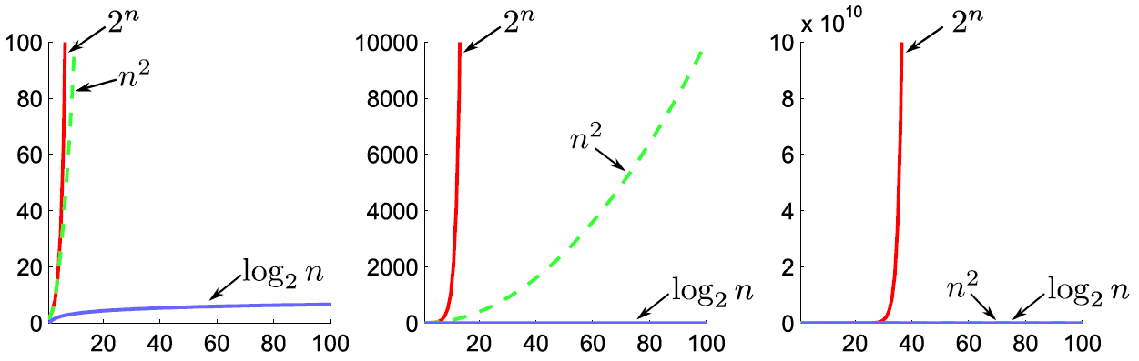
Key distinction: vast gulf between exponential, polynomial, and logarithmic functions
“Big-O notation” helps us formalize this distinction

Slide 4
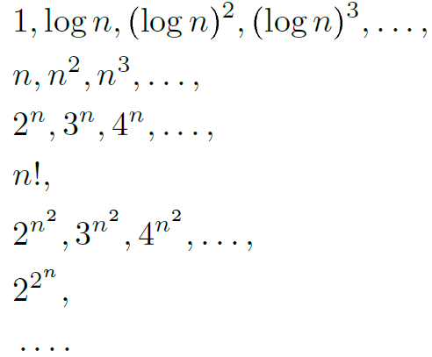
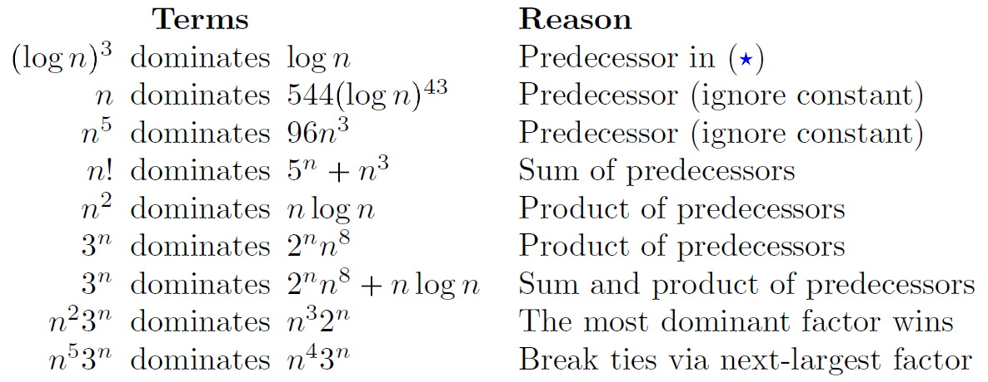

The book explains a simple approach to big-O, via dominant terms
Ordered list of dominant terms
Examples

Slide 5
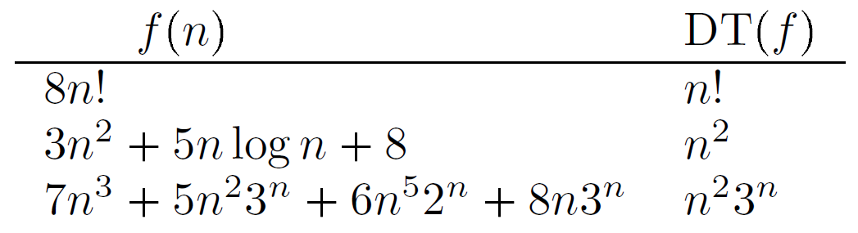
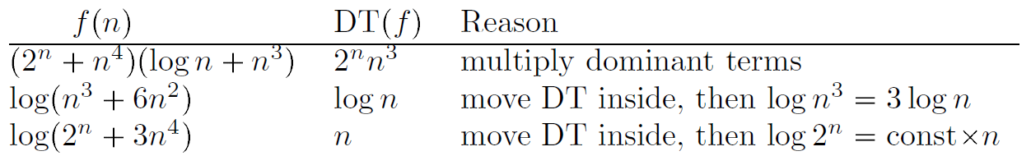
Examples of dominant terms

Slide 6
Examples of dominant terms

Slide 7
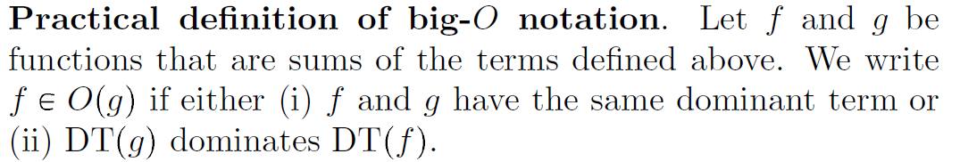
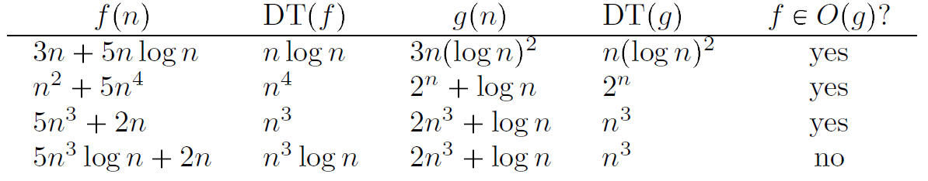
Practical definition of big-O notation

Slide 8
Practical definition of big-O notation

Slide 9
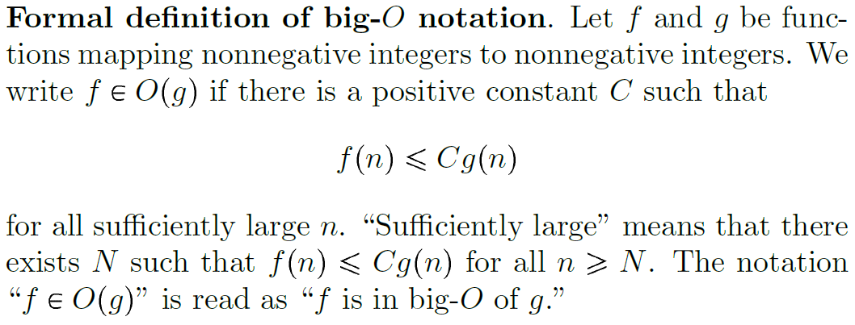
Formal definition of big-O notation

Slide 10
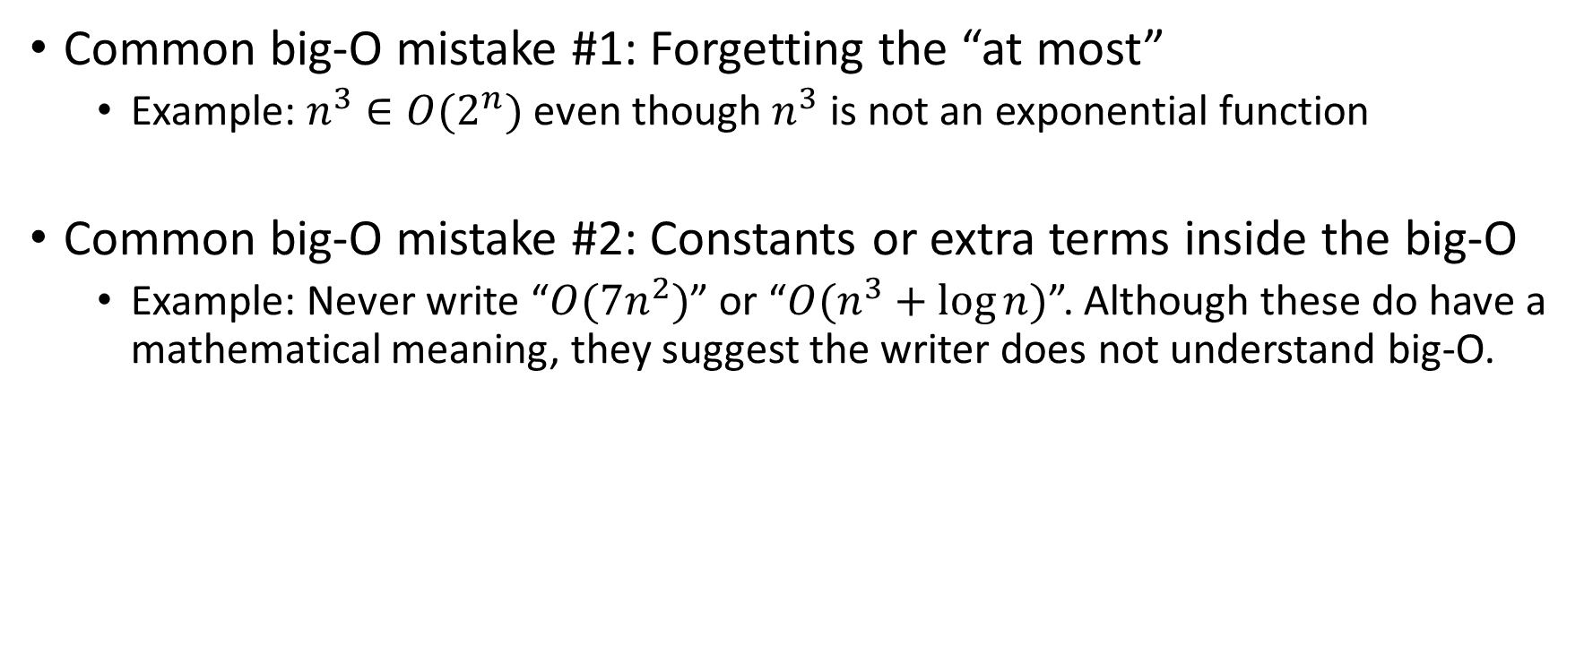
Two common big-O mistakes
Common big-O mistake #1: Forgetting the “at most”
Example: $n^{3}∈O(2^{n})$ even though $n^{3}$ is not an exponential function
Common big-O mistake #2: Constants or extra terms inside the big-O
Example: Never write “$O(7n^{2})$” or “$O(n^{3}+\log{n})$”. Although these do have a mathematical meaning, they suggest the writer does not understand big-O.

Slide 11
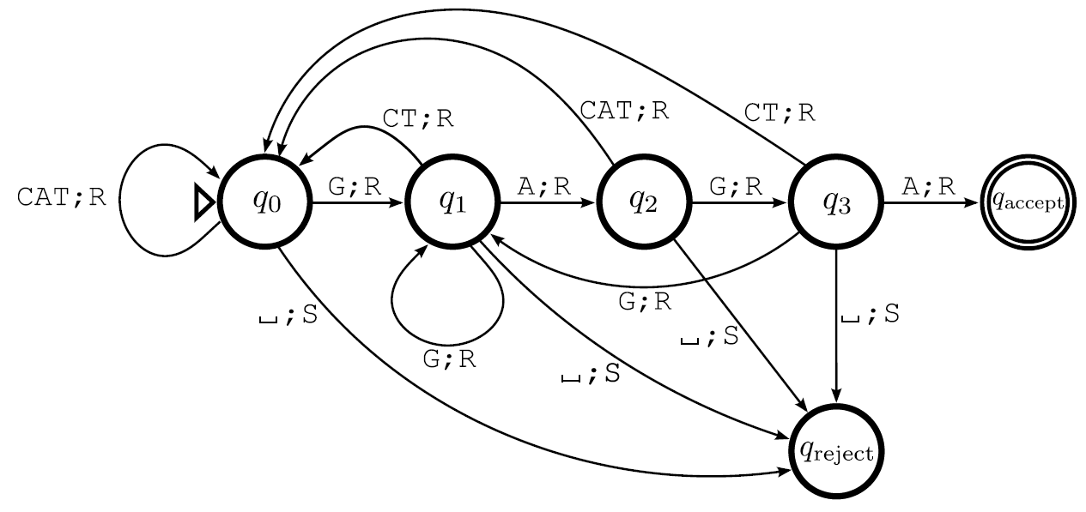
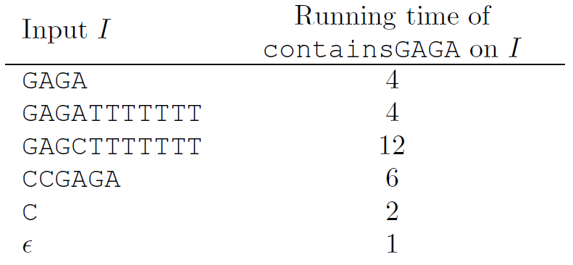
Exact running time of a Turing machine
containsGAGA machine

Slide 12
Exact running time of a Turing machine
containsGAGA machine

Slide 13
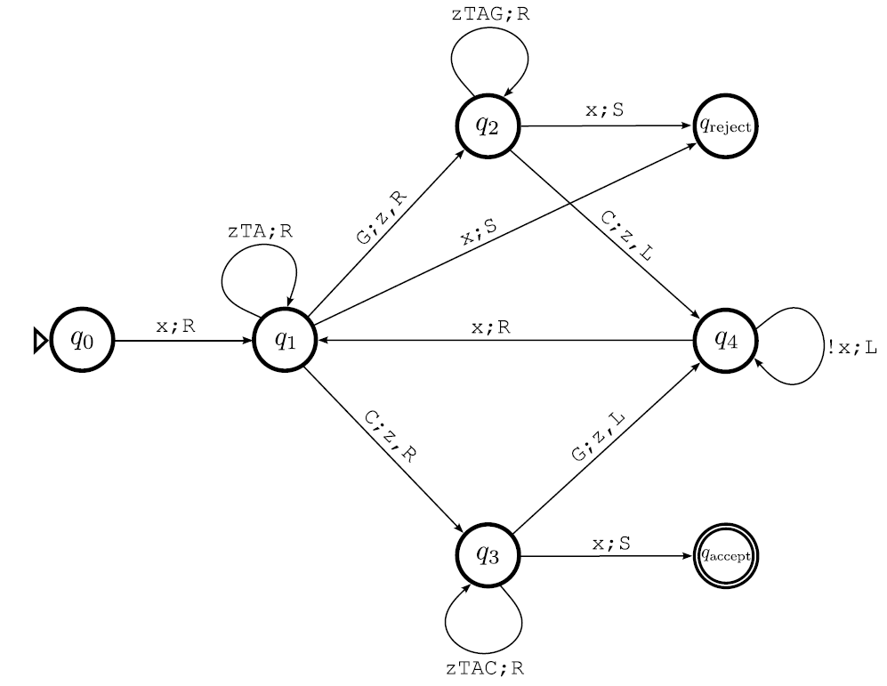
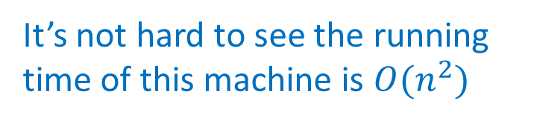
Calculating exact running times is usually tedious and unnecessary
Instead, use asymptotic estimates.
Example: moreCsThanGs
It’s not hard to see the running time of this machine is $O(n^{2})$

Slide 14
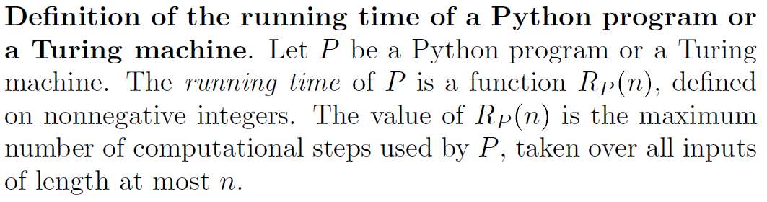
Formal definition of running time, also known as time complexity or complexity
maximum over given length, i.e. worst case
“computational step” is a single CPU instruction for Python programs, or a single transition for Turing machines

Slide 15
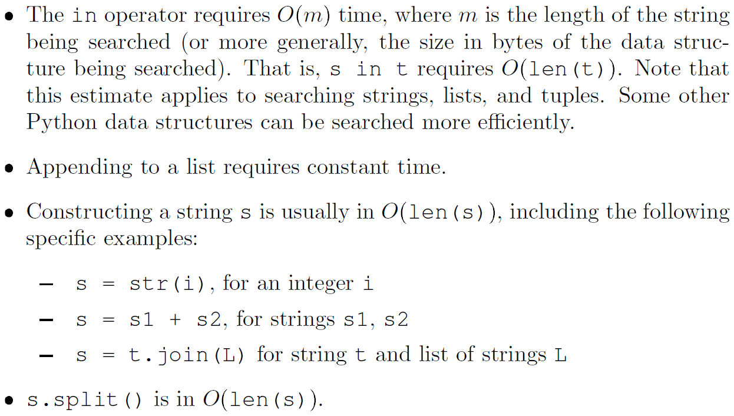
Calculating time complexity of Python programs uses known cost of built-in operations

Slide 16
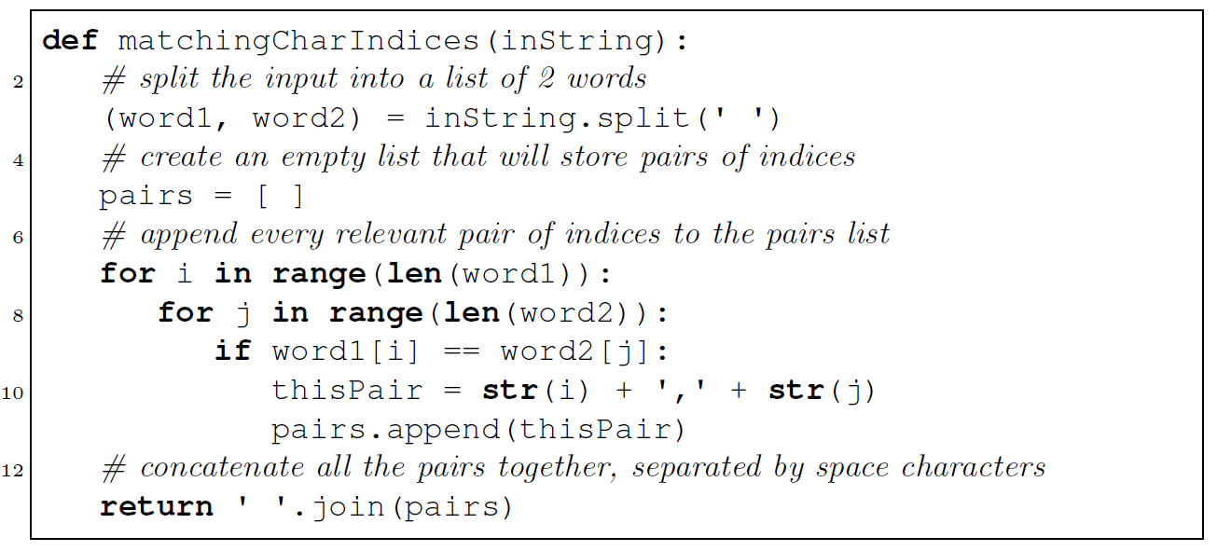
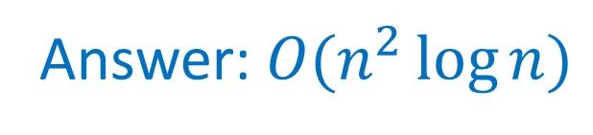
Exercise: calculate asymptotic running time of this Python program
Answer: $O(n^{2}\log{n})$

Slide 17
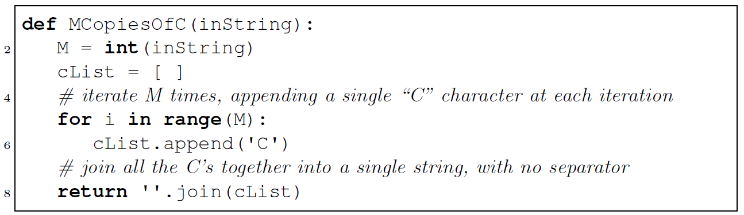
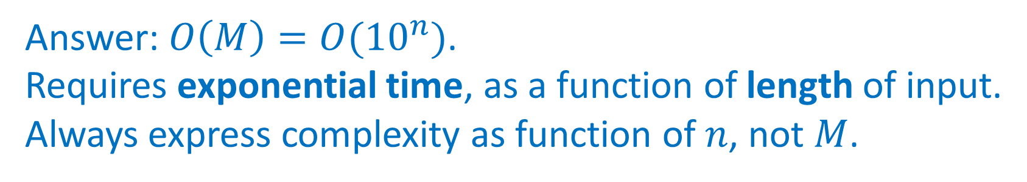
Trick question: time complexity of this apparently-simple program?
Answer: $O\left(M\right)=O({10}^{n})$.
Requires exponential time, as a function of length of input.
Always express complexity as function of $n$, not $M$.

Slide 18
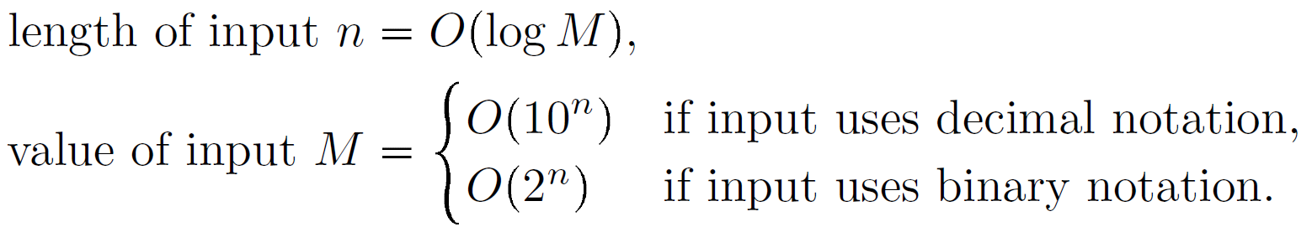
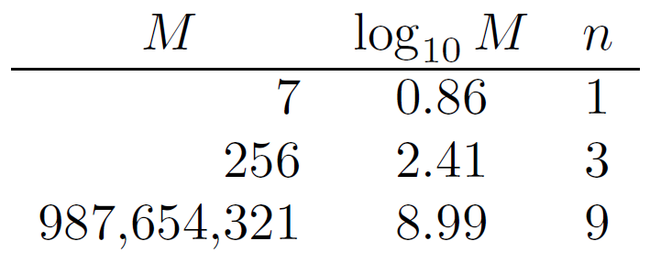
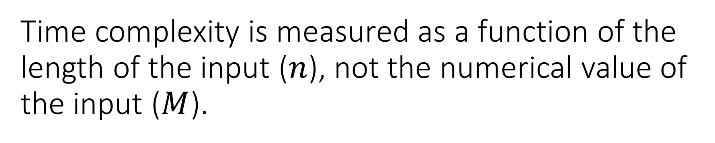
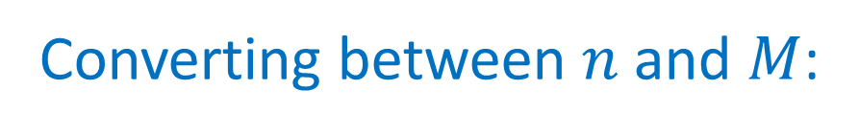
Time complexity is measured as a function of the length of the input ($n$), not the numerical value of the input ($M$).
Converting between $n$ and $M$:
Specific examples:

Slide 19
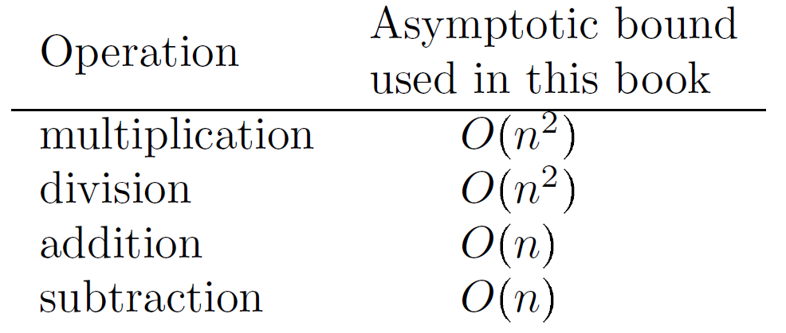
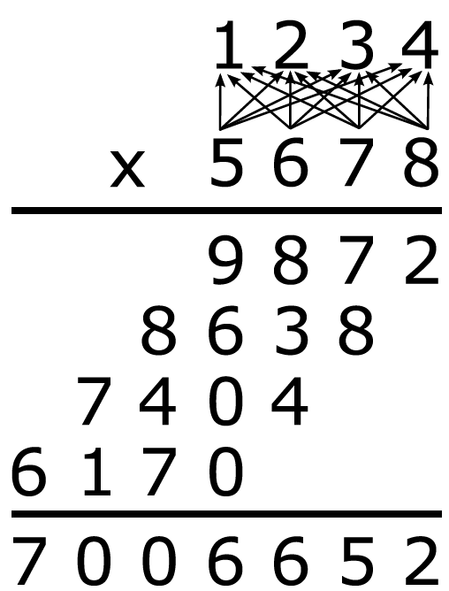
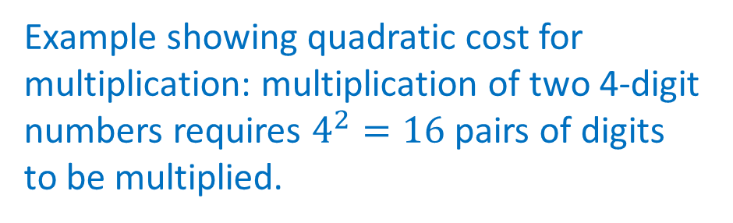
Arithmetic operations are not constant time
Example showing quadratic cost for multiplication: multiplication of two 4-digit numbers requires $4^{2}=16$ pairs of digits to be multiplied.

Slide 20
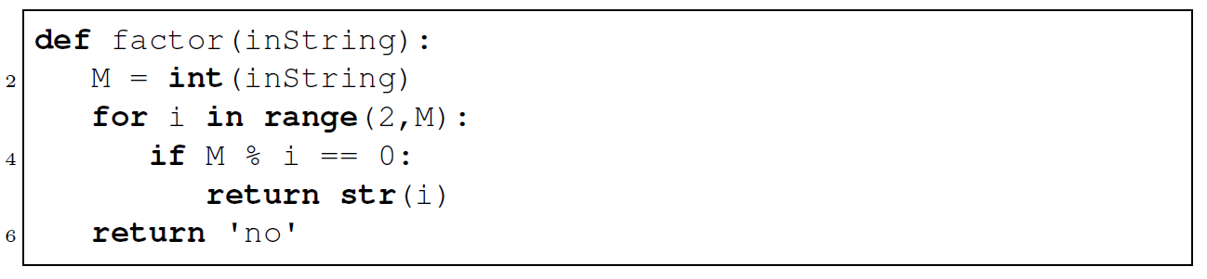
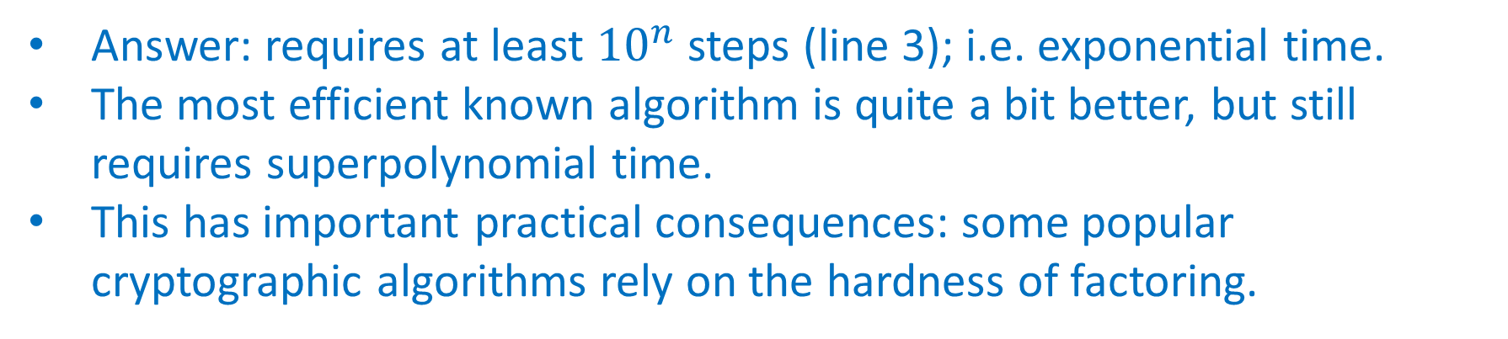
What is the time complexity of this naïve factoring algorithm?
Answer: requires at least ${10}^{n}$ steps (line 3); i.e. exponential time.
The most efficient known algorithm is quite a bit better, but still requires superpolynomial time.
This has important practical consequences: some popular cryptographic algorithms rely on the hardness of factoring.

Slide 21
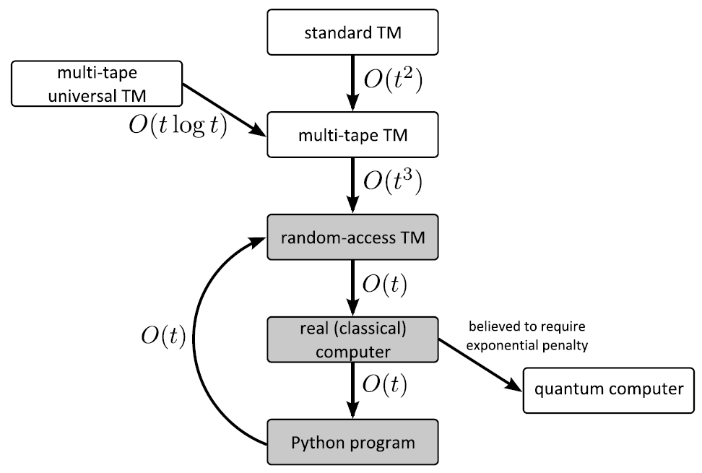
Classical computational models can simulate each other with only polynomial costs
Use Python programs as our standard model from now on. Equivalent to random-access TM and real computer, up to constant factor.

Slide 22
A complexity class is a collection of computational problems that share some property related to complexity.
Const, Lin, Quad consist of problems that can be solved in constant, linear, or quadratic time respectively
These complexity classes are rarely used in computational complexity theory, as they depend on the computational model. We are usually more concerned with broader properties such as whether or not a problem can be solved in polynomial time.
Poly consists of problems that can be solved in polynomial time
Expo consists of problems that can be solved in exponential time
PolyCheck consists of problems whose solutions can be verified in polynomial time
We study Poly, Expo, PolyCheck in much more detail later

