Slide 1
11. Poly and Expo
Lecture slides for What Can Be Computed?

Slide 2
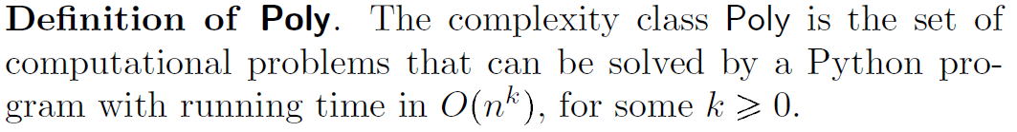
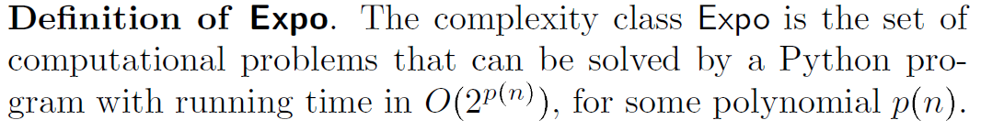
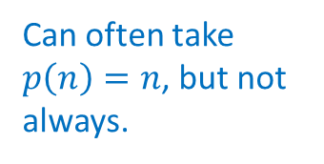
Formal definitions of Poly and Expo
Examples of problems in Poly: ContainsGAGA, Multiply, SortWords
Can often take $p\left(n\right)=n$, but not always.
Examples of problems in Expo: all the above, and also Factor, MCopiesOfC

Slide 3
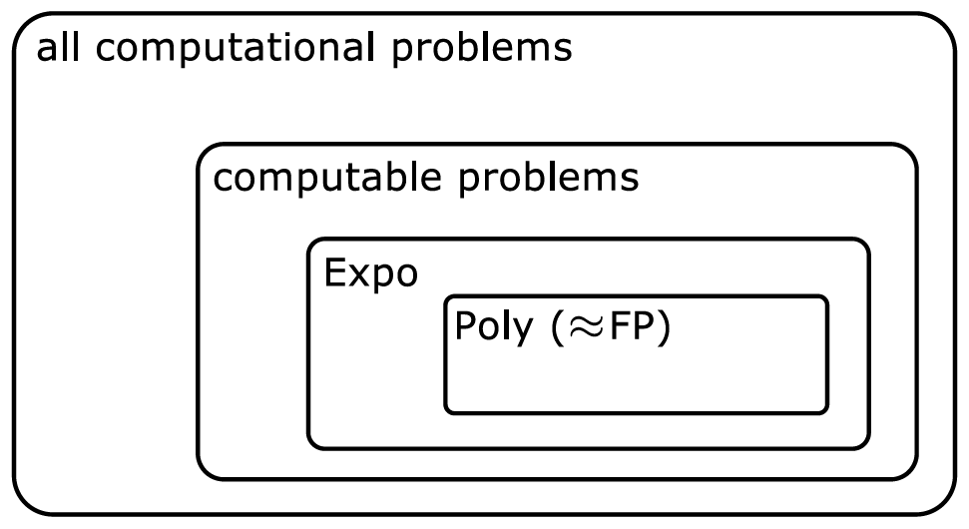
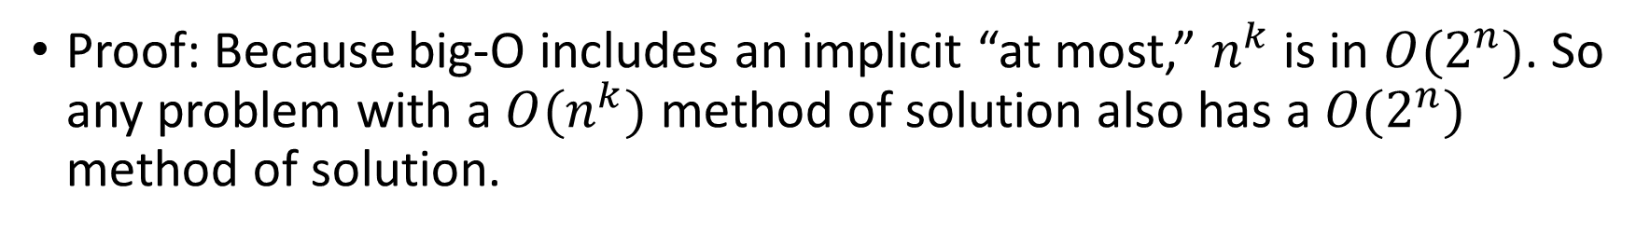
Poly is a subset of Expo
Proof: Because big-O includes an implicit “at most,” $n^{k}$ is in $O(2^{n})$. So any problem with a $O(n^{k})$ method of solution also has a $O(2^{n})$ method of solution.
Some books refer to Poly as FP, but the precise definition can vary

Slide 4
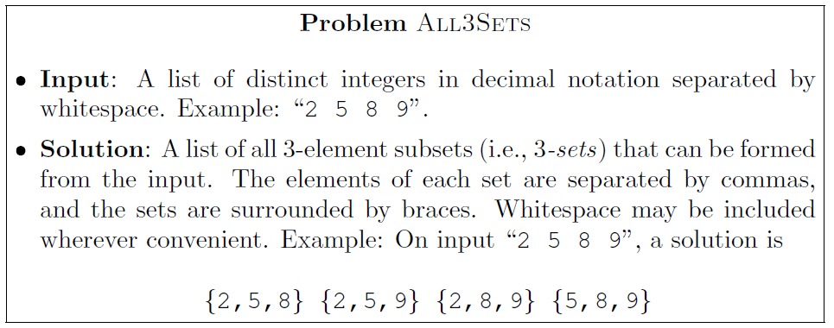
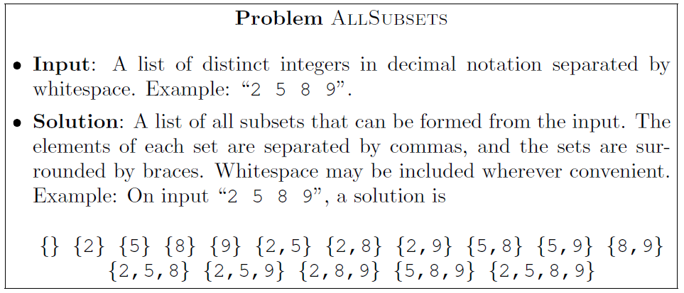
Useful examples: computational problems All3Sets and AllSubsets

Slide 5
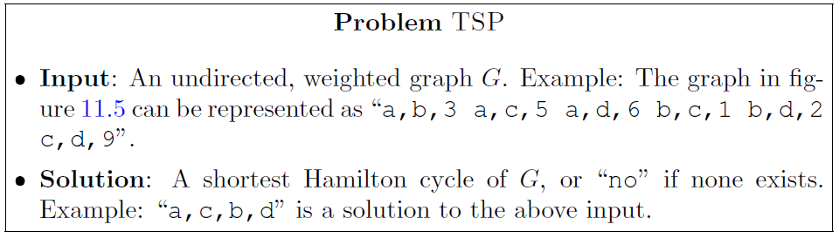
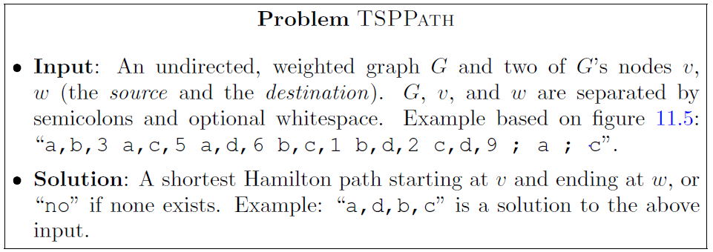
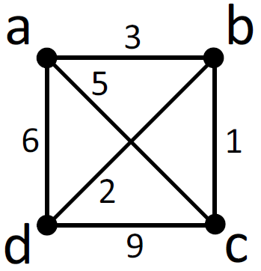
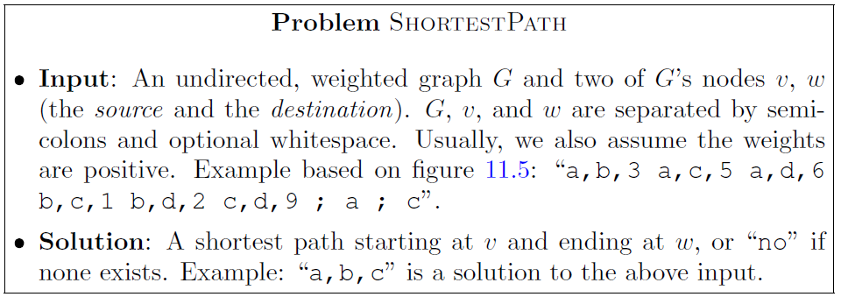
More useful examples: computational problems TSP, TSPPath and ShortestPath

Slide 6
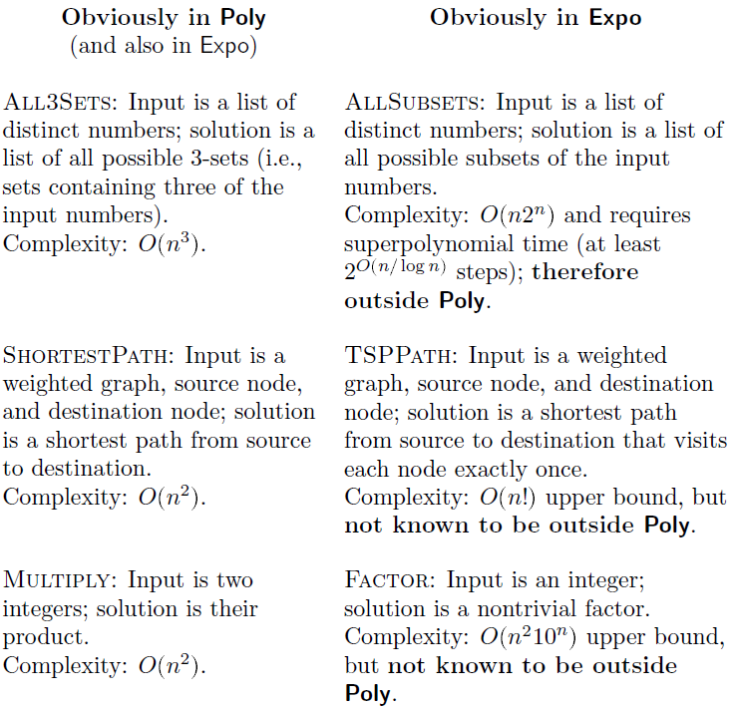
The boundary between Poly and Expo
Small changes to a problem can dramatically change its complexity, as demonstrated by each of these three pairs of problems.

Slide 7
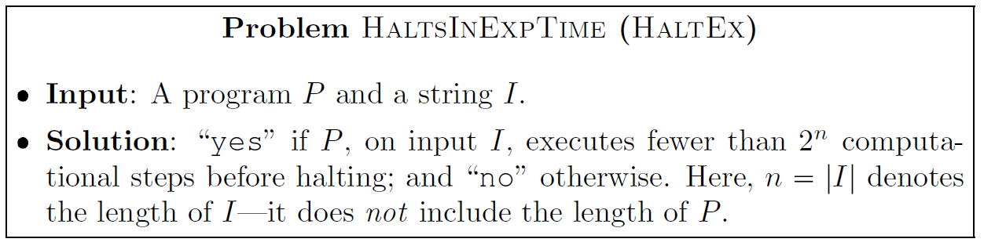
HaltEx: A decision problem in Expo but not Poly
HaltEx

Slide 8

HaltEx is in Expo
Proof: Given program $P$ and string $I$, simulate $P(I)$ for $2^{n}$ steps. This requires at most an exponential number of steps, showing that HaltEx is in Expo.
HaltEx

Slide 9
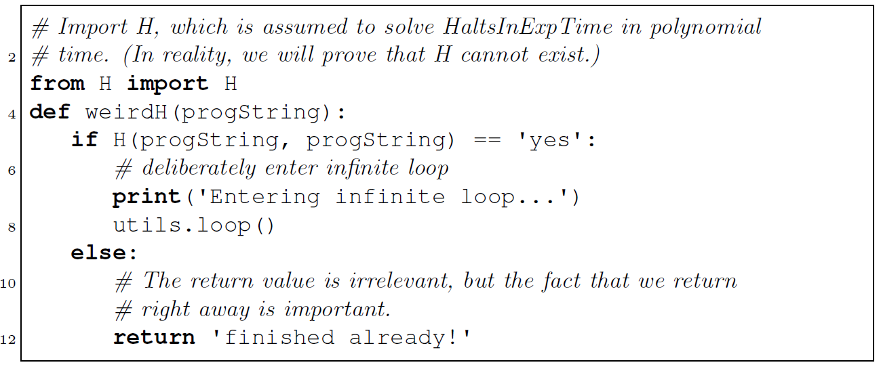
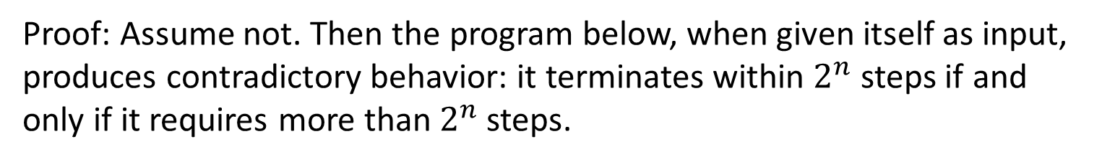
HaltEx is not in Poly
Proof: Assume not. Then the program below, when given itself as input, produces contradictory behavior: it terminates within $2^{n}$ steps if and only if it requires more than $2^{n}$ steps.

Slide 10
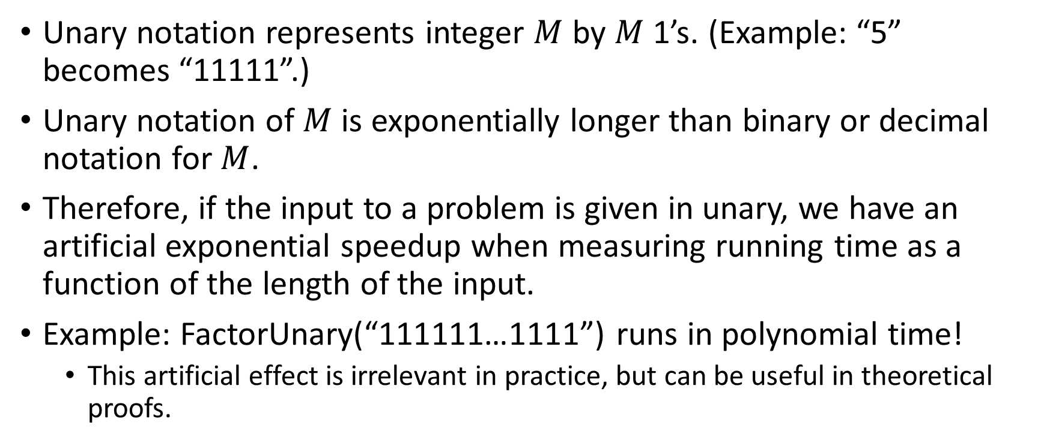
Unreasonable encodings of the input affect complexity
Unary notation represents integer $M$ by $M$ 1’s. (Example: “5” becomes “11111”.)
Unary notation of $M$ is exponentially longer than binary or decimal notation for $M$.
Therefore, if the input to a problem is given in unary, we have an artificial exponential speedup when measuring running time as a function of the length of the input.
Example: FactorUnary(“111111…1111”) runs in polynomial time!
This artificial effect is irrelevant in practice, but can be useful in theoretical proofs.

Slide 11
Why study Poly, really?
It is often claimed that problems in Poly are tractable, and that’s why they’re interesting
But some polynomial time algorithms are not useful in practice, and even quadratic algorithms are useless for very long inputs
Other reasons for studying Poly:
Poly is invariant to the computational model (except quantum)
Poly leads naturally to the important theory of NP-completeness, which we study later
Polynomial time algorithms tend to have a particular structure (iterate over sets whose size may increase additively but not geometrically), which gives mathematical insight

