Slide 1
12. PolyCheck and NPoly
Lecture slides for What Can Be Computed?

Slide 2
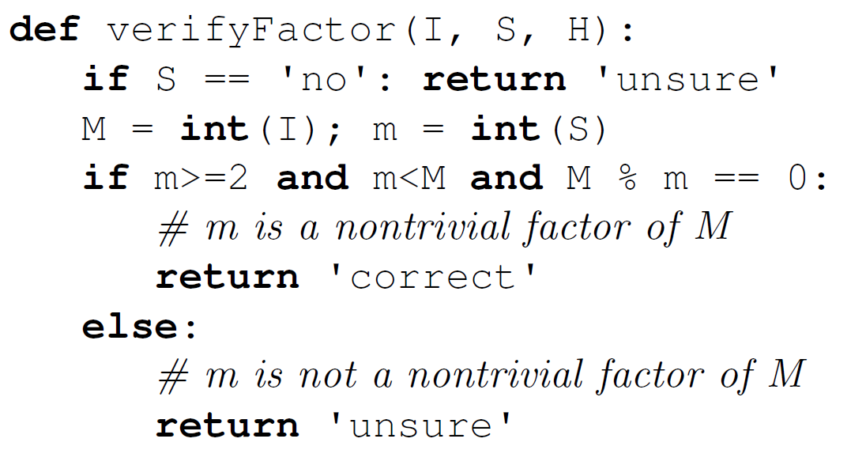
Informal definition of PolyCheck
Hint (not used by this program)
Proposed solution
A computational problem is in PolyCheck if, when given a proposed solution, a computer program can check (or verify) that the solution is correct in polynomial time.
Example: Factor is in PolyCheck, because the computer program shown verifies proposed solutions in polynomial time.
Input to the problem
Returns “unsure” instead of “incorrect,” for technical reasons discussed later

Slide 3
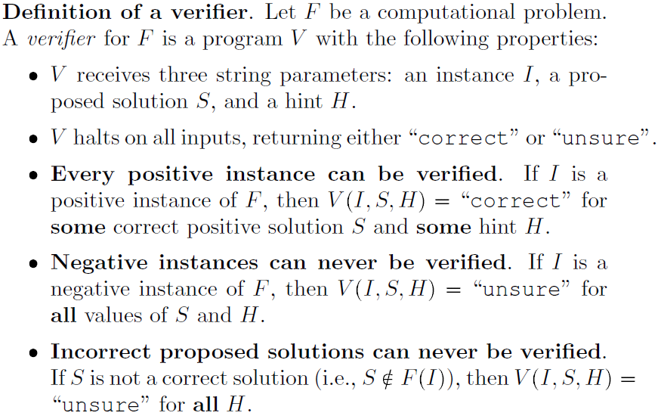
Definition of verifier
Hint (not used by this program)
Proposed solution
Input to the problem
Try examples I=“1400”, S=“200” and I=“1400”, S=“500”
Returns “unsure” instead of “incorrect,” for technical reasons discussed later

Slide 4
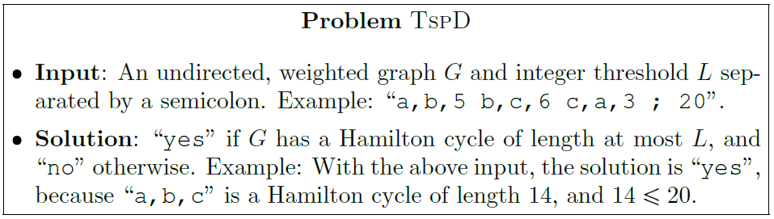
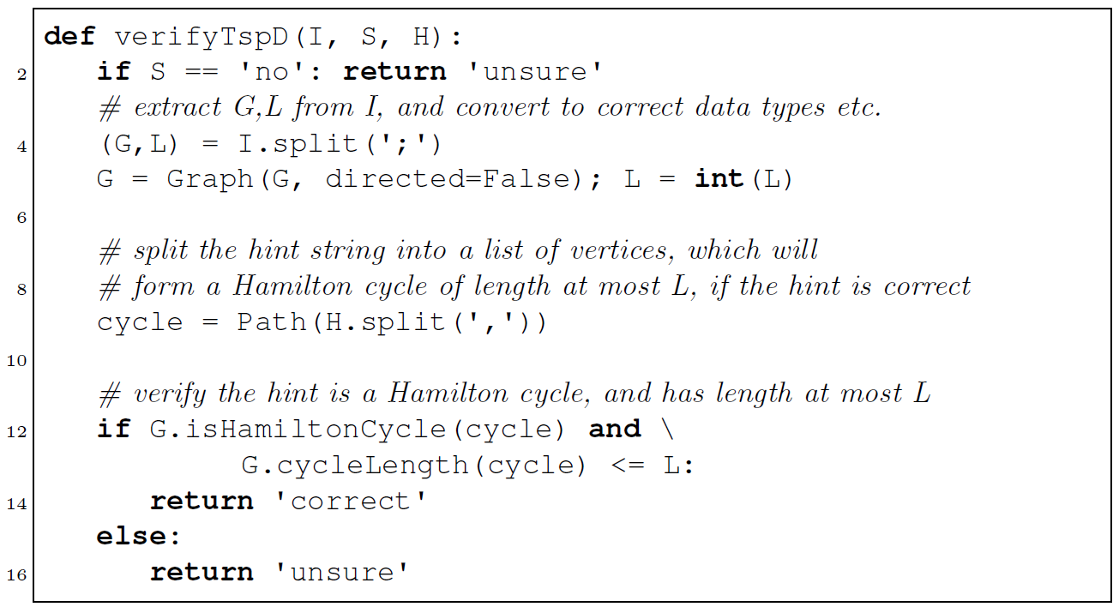
Example of a problem that needs a hint for verification: TSPD
I = “a,b,5 b,c,6 c,a,3;20”
S = “yes”
H = “a,b,c”

Slide 5
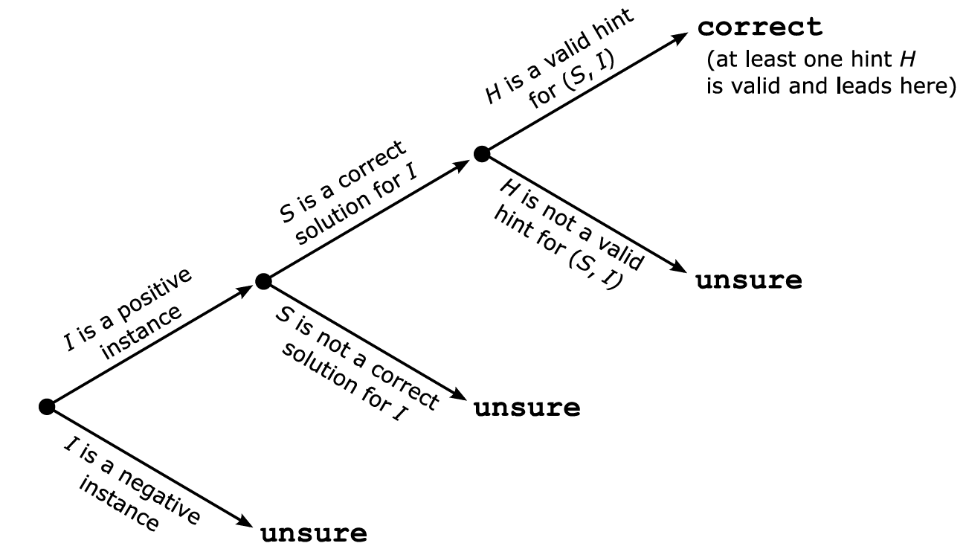
Diagrammatic view of verification
Exercise: construct values of $I,S,H$ for TSPD that lead to all four outcomes here.
Now can you see why we return “unsure” instead of “incorrect”?

Slide 6
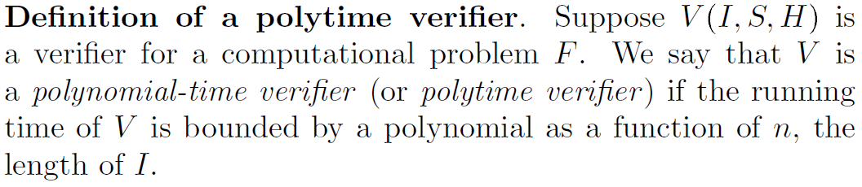
Definition of polytime verifier
Note that the lengths of $S$ and $H$ play no role here.

Slide 7
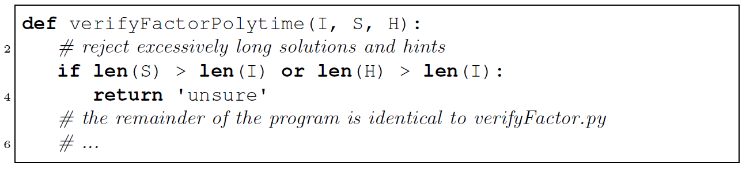
Technicality: polytime verifiers must check for excessively long solutions and hints

Slide 8
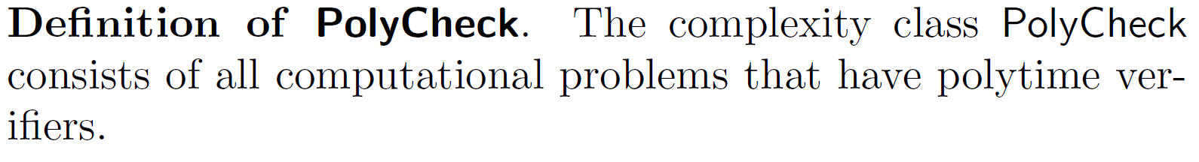
Formal definition of PolyCheck
Examples: Factor, TspD, and three new problems described on following slides (Packing, SubsetSum, and Partition)
Analogy for understanding PolyCheck: don’t need to find a needle in a haystack. We only need to look at something and determine whether it is a needle or a piece of hay.

Slide 9
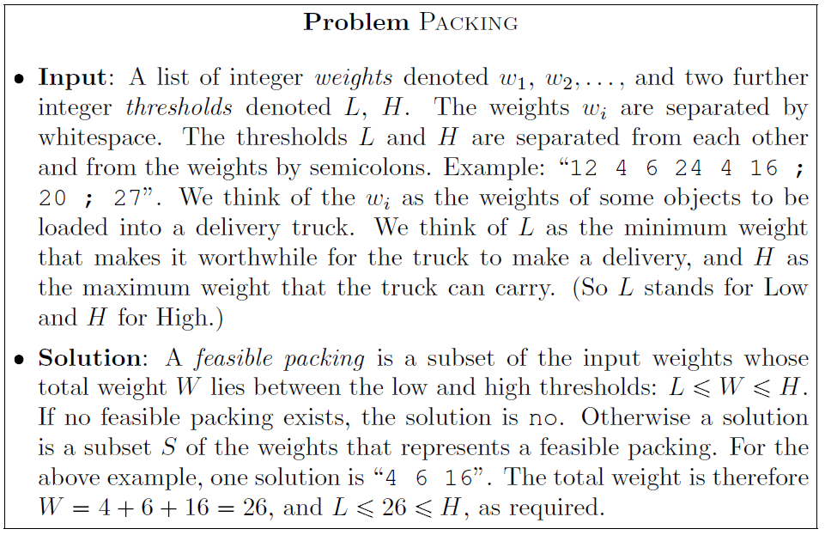
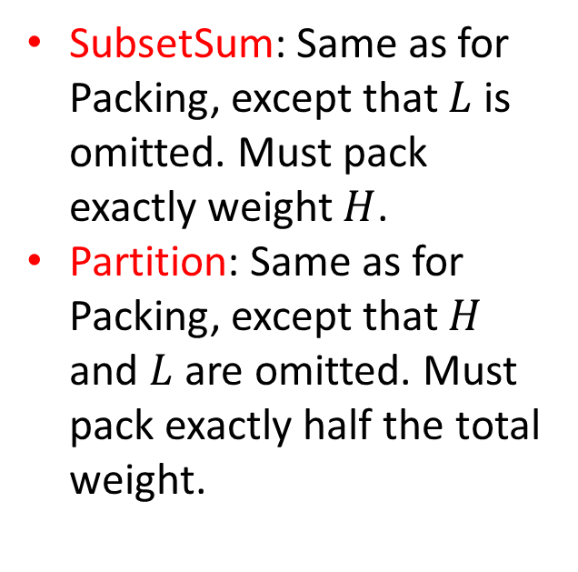
Computational problems Packing, SubsetSum, and Partition
SubsetSum: Same as for Packing, except that $L$ is omitted. Must pack exactly weight $H$.
Partition: Same as for Packing, except that $H$ and $L$ are omitted. Must pack exactly half the total weight.
Exercise: show that Packing, SubsetSum, and Partition are all in PolyCheck

Slide 10
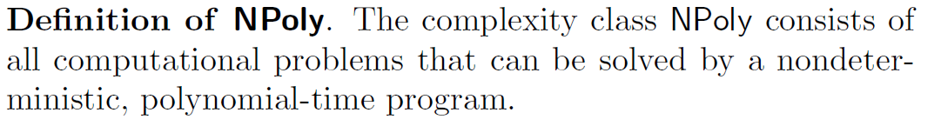
The complexity class NPoly
Definition of running time for nondeterministic programs: time until last thread completes, otherwise infinite
Examples: Factor, TspD, Packing, SubsetSum, and Partition
Exercise: why are these all in NPoly?

Slide 11
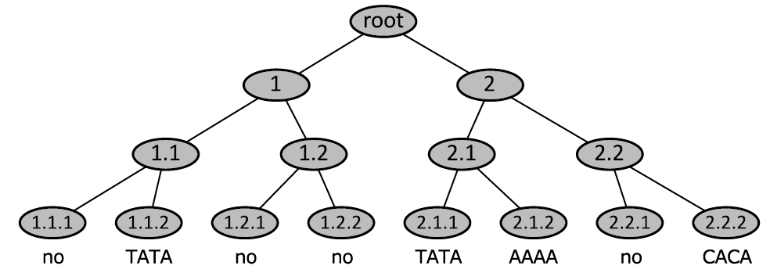
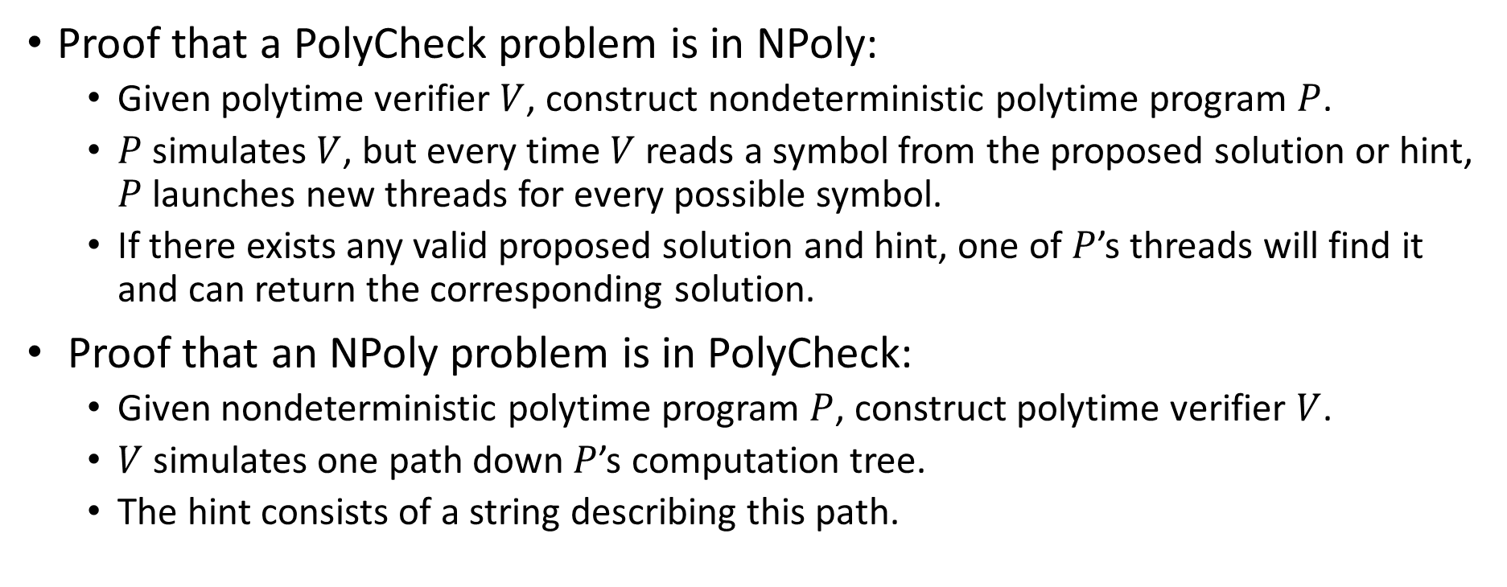
PolyCheck and NPoly are identical
Proof that a PolyCheck problem is in NPoly:
Given polytime verifier $V$, construct nondeterministic polytime program $P$.
$P$ simulates $V$, but every time $V$ reads a symbol from the proposed solution or hint, $P$ launches new threads for every possible symbol.
If there exists any valid proposed solution and hint, one of $P$’s threads will find it and can return the corresponding solution.
Proof that an NPoly problem is in PolyCheck:
Given nondeterministic polytime program $P$, construct polytime verifier $V$.
$V$ simulates one path down $P$’s computation tree.
The hint consists of a string describing this path.
Example of hint string: “2.1.2” for the path leading to “AAAA” in the tree shown)

Slide 12
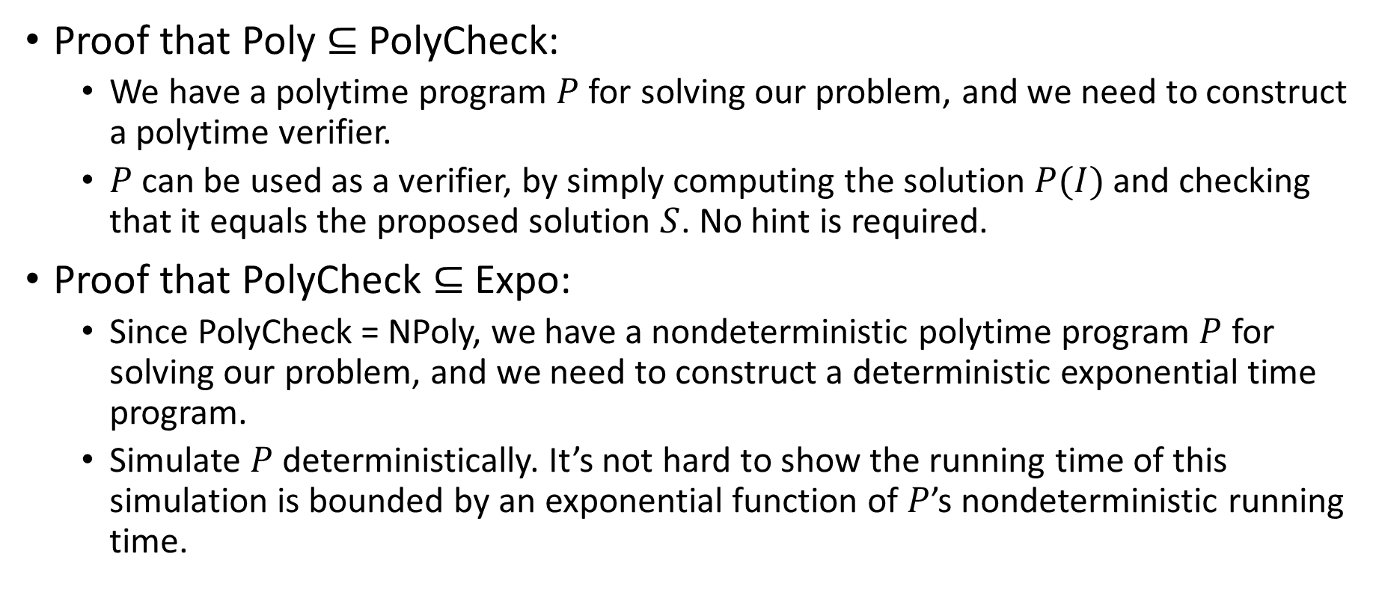
PolyCheck is sandwiched between Poly and Expo
Proof that Poly $⊆$ PolyCheck:
We have a polytime program $P$ for solving our problem, and we need to construct a polytime verifier.
$P$ can be used as a verifier, by simply computing the solution $P(I)$ and checking that it equals the proposed solution $S$. No hint is required.
Proof that PolyCheck $⊆$ Expo:
Since PolyCheck = NPoly, we have a nondeterministic polytime program $P$ for solving our problem, and we need to construct a deterministic exponential time program.
Simulate $P$ deterministically. It’s not hard to show the running time of this simulation is bounded by an exponential function of $P$’s nondeterministic running time.

Slide 13
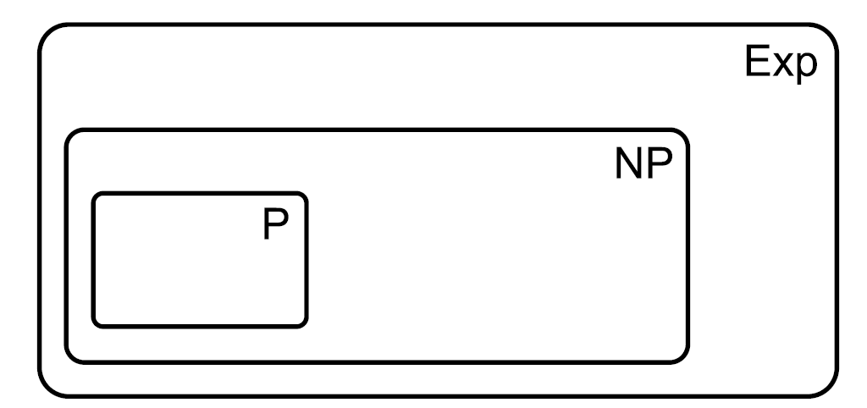
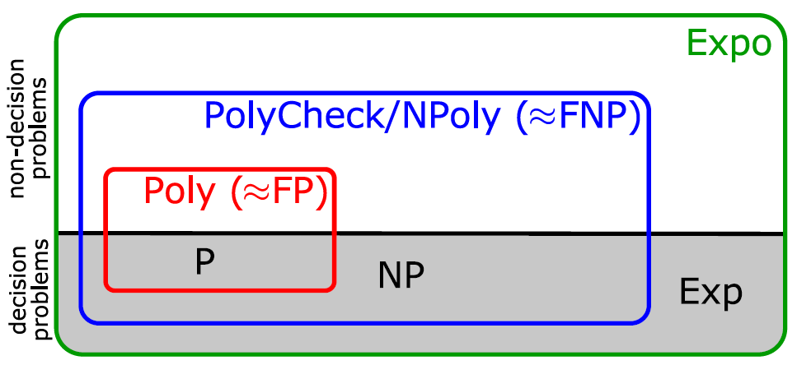
Complexity class summary
Decision problems only
P, NP, and Exp consist of the decision problems in Poly, NPoly, and Expo respectively
FNP is similar to NPoly
General problems

