Slide 1
13. Polynomial-time mapping reductions
Lecture slides for What Can Be Computed?

Slide 2
Important note: for the rest of the course, we focus on decision problems.
Problems that were previously defined as nondecision problems (e.g. Packing, Partition) are now considered as decision problems
Why? Because we are building up to NP-completeness, which is only defined for decision problems.

Slide 3
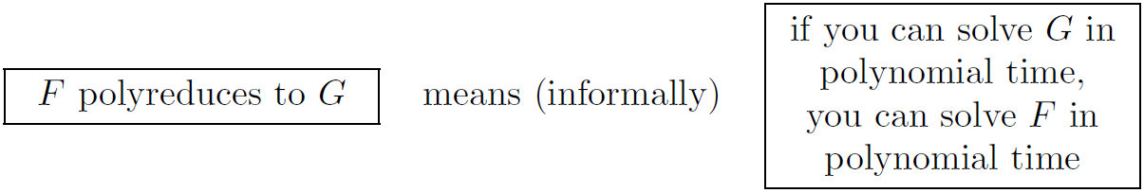
Informal definition of polyreduction (compare with Turing reductions)
Turing reductions:
Polyreductions:

Slide 4
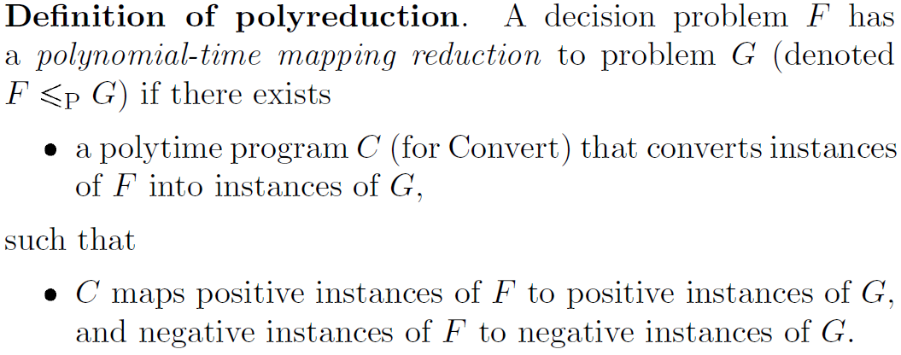
Formal definition of polyreduction

Slide 5
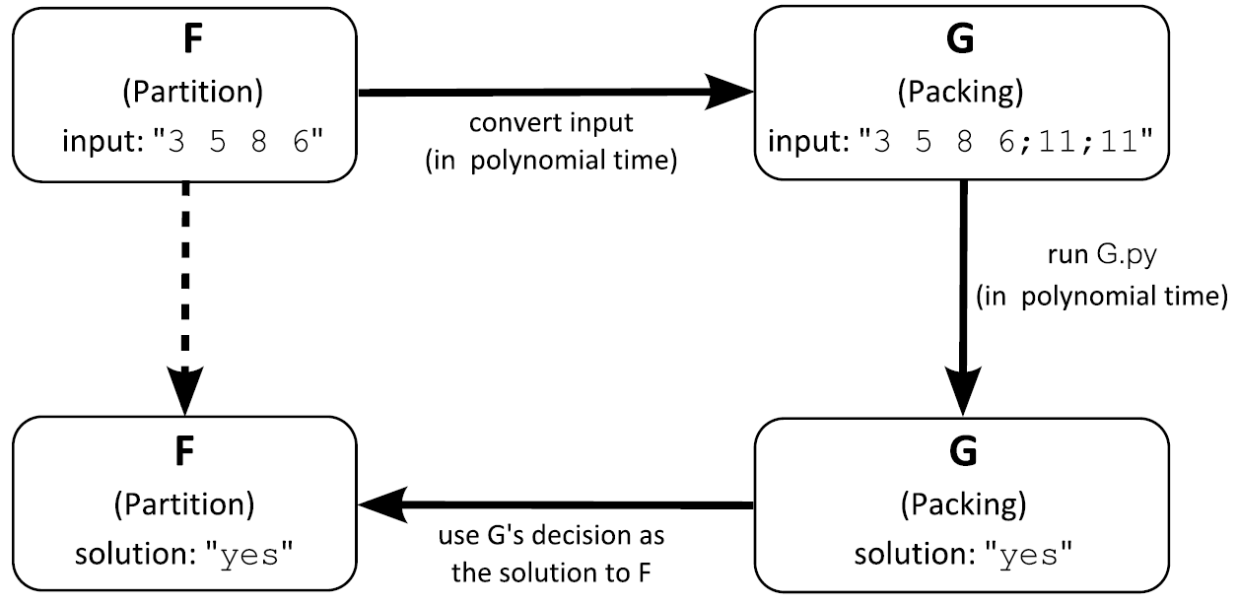
Example: polyreduce Partition to Packing

Slide 6
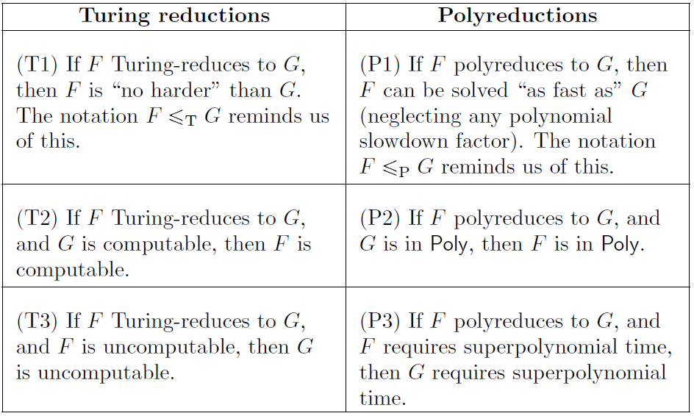
Compare again with Turing reductions

Slide 7
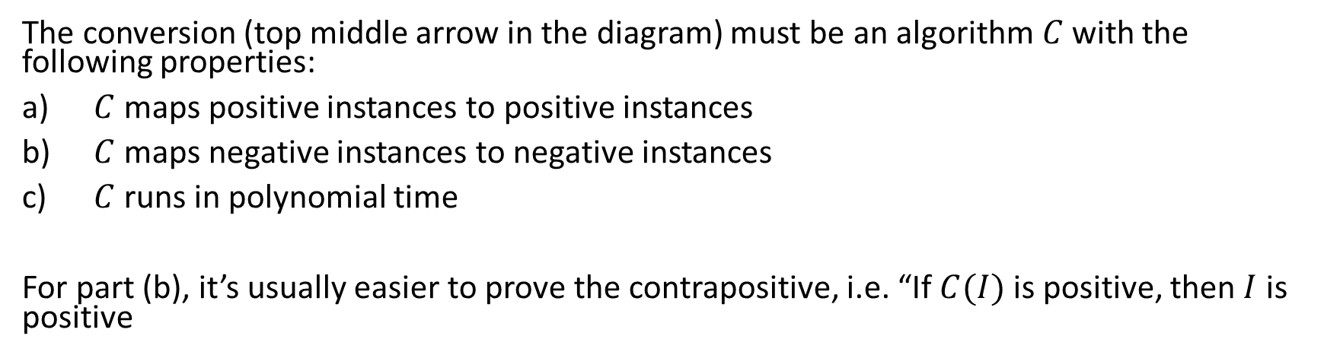
Proof technique for polyreductions
The conversion (top middle arrow in the diagram) must be an algorithm$C$ with the following properties:
$C$ maps positive instances to positive instances
$C$ maps negative instances to negative instances
$C$ runs in polynomial time
For part (b), it’s usually easier to prove the contrapositive, i.e. “If $C(I)$ is positive, then $I$ is positive

Slide 8
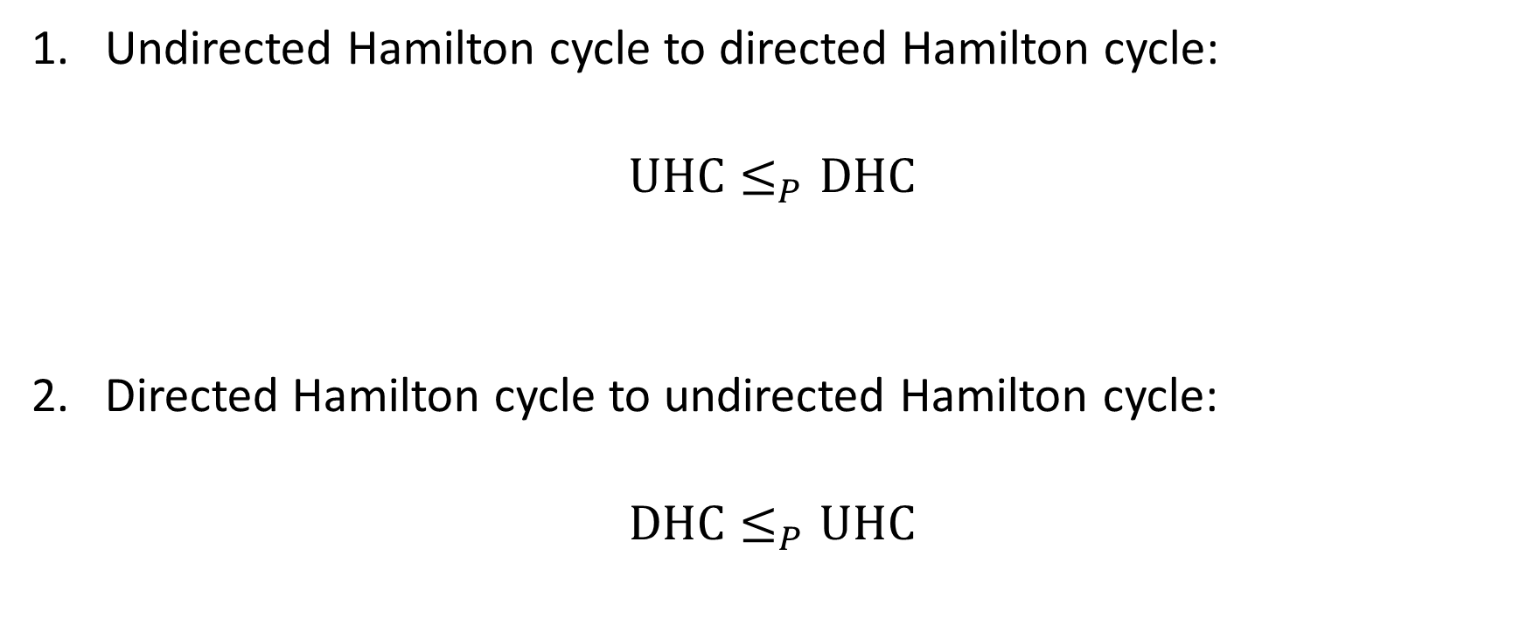
Next, two important polyreductions
Undirected Hamilton cycle to directed Hamilton cycle:
$$UHC≤_{P}DHC$$
Directed Hamilton cycle to undirected Hamilton cycle:
$$DHC≤_{P}UHC$$
Exercise: any idea how we can achieve these?

Slide 9
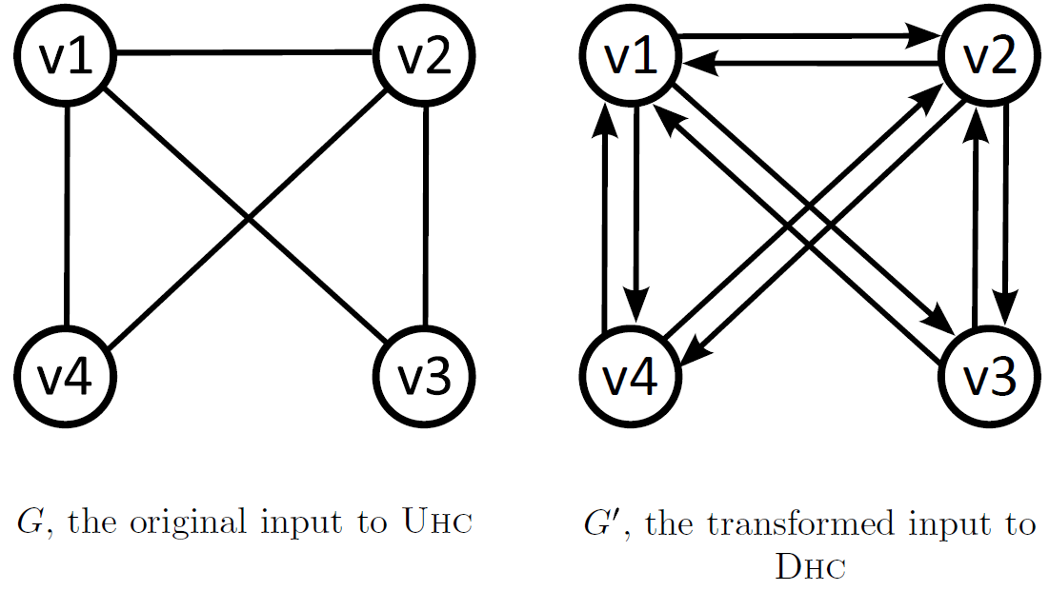
$$UHC≤_{P}DHC$$
Key trick: convert each undirected edge into two directed edges
Exercise: prove our three conditions (pos→pos, neg→neg, polytime)

Slide 10
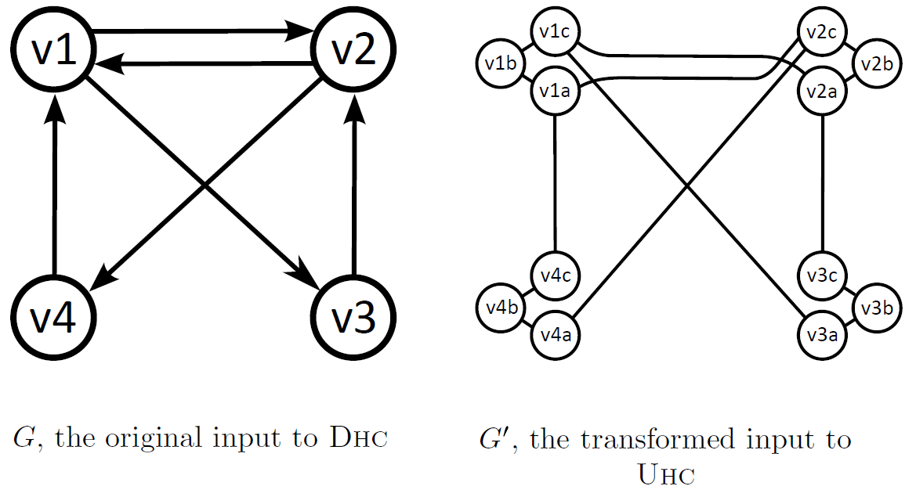
$$DHC≤_{P}UHC$$
Key trick: convert each node into connected “triplets”
Exercise: prove our three conditions (pos→pos, neg→neg, polytime)

Slide 11
Next: three important satisfiability problems
CircuitSAT: Given a circuit with many binary inputs and a single binary output, is there any setting of the inputs that causes a 1 to be output?
i.e. can we satisfy the circuit?
SAT: Given a Boolean formula, is there any setting of the variables that causes the formula as a whole to be True? (Technicality: the formula must be in conjunctive normal form, or CNF.)
i.e. can we satisfy the formula?
3-SAT: Same as SAT, but clauses in the formula have a maximum of three literals
Satisfiability problems have important practical applications, and they also play a central role in complexity theory

Slide 12
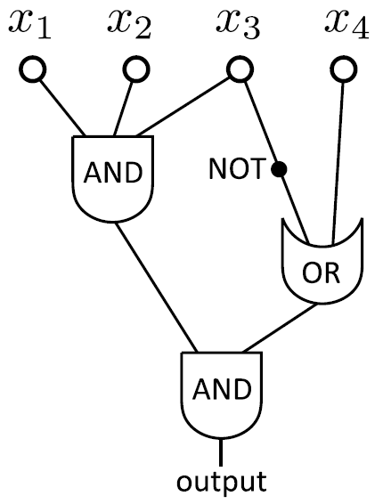
A CircuitSAT instance
Exercise: is this a positive instance of CircuitSAT? Equivalently, is the circuit satisfiable?

Slide 13
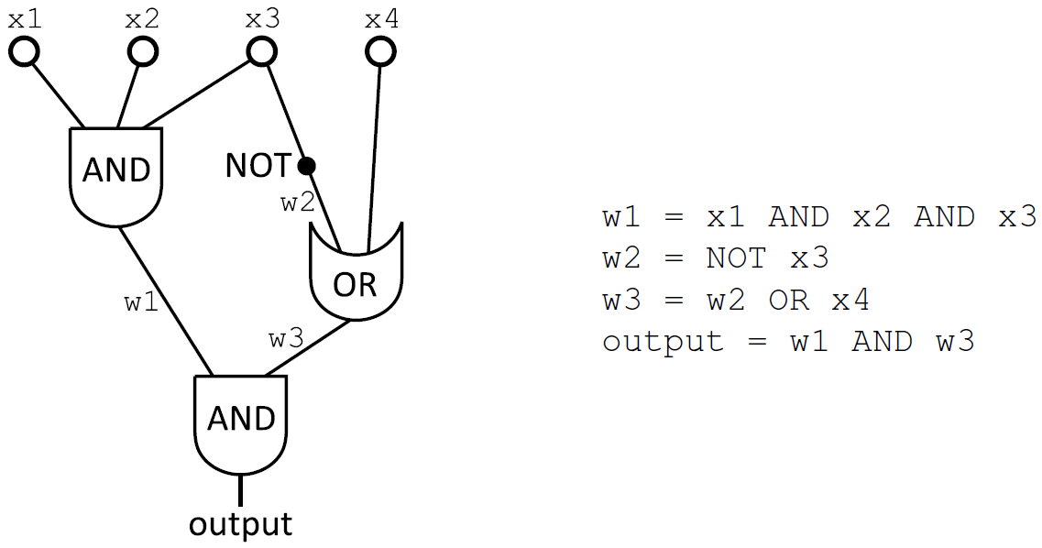
The same CircuitSAT instance represented as an ASCII string

Slide 14
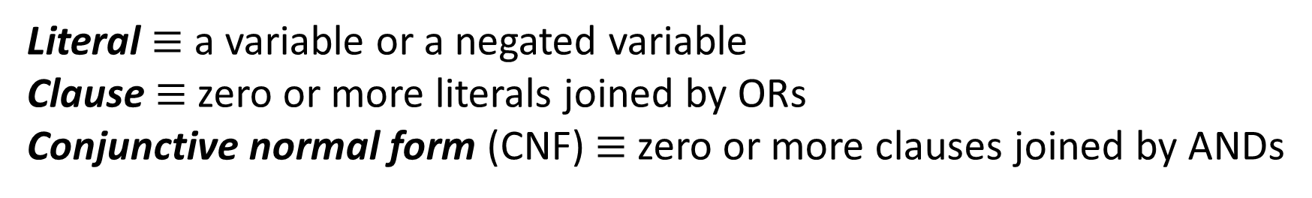
Terminology for Boolean formulas
literals
OR
NOT
AND
binary variable
clause
Literal $≡$ a variable or a negated variable
Clause $≡$ zero or more literals joined by ORs
Conjunctive normal form (CNF) $≡$ zero or more clauses joined by ANDs

Slide 15
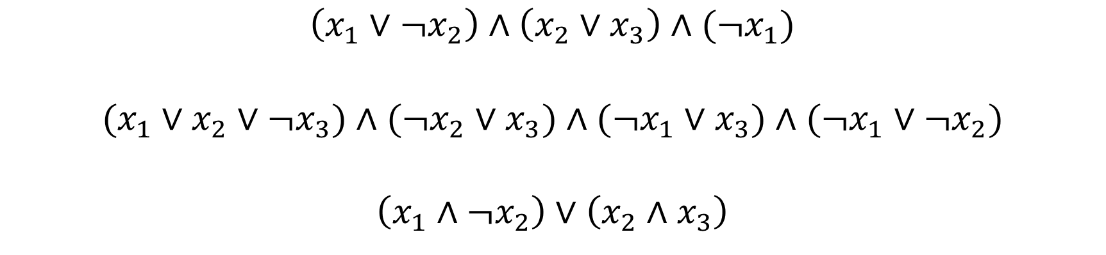
Exercise: which of these are positive instances of SAT?
$$\left(x_{1}∨¬x_{2}\right)∧\left(x_{2}{∨x}_{3}\right)∧(¬x_{1})$$
$$(x_{1}∨x_{2}∨¬x_{3})∧(¬x_{2}∨x_{3})∧(¬x_{1}∨x_{3})∧(¬x_{1}∨¬x_{2})$$
$$\left(x_{1}∧¬x_{2}\right)∨\left(x_{2}{∧x}_{3}\right)$$
Trick question: not in CNF, so negative instance by definition

Slide 16
SAT instances can easily be represented in ASCII
Example:
becomes

Slide 17
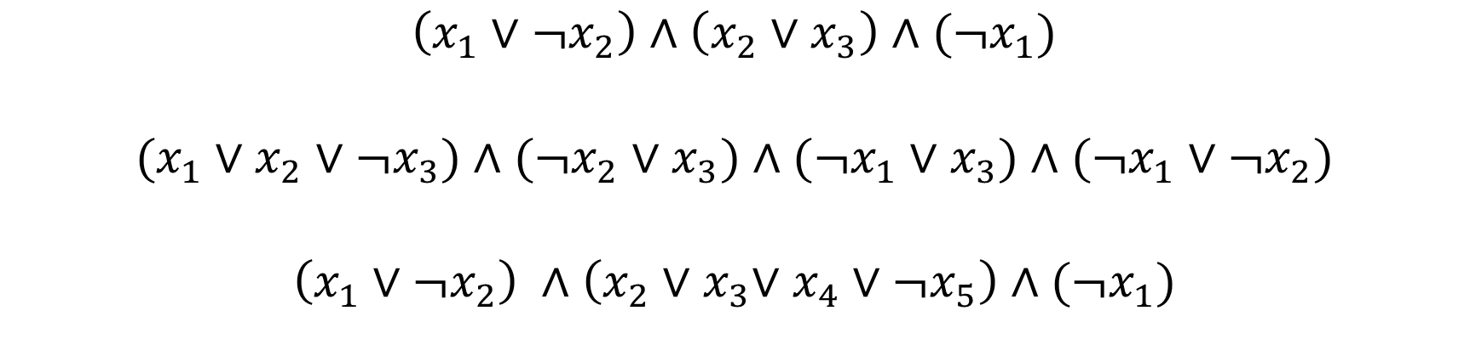
3-SAT is the same as SAT, except that clauses may have at most three literals
Exercise: which of the following are positive instances of 3-SAT?
$$\left(x_{1}∨¬x_{2}\right)∧\left(x_{2}{∨x}_{3}\right)∧(¬x_{1})$$
$$(x_{1}∨x_{2}∨¬x_{3})∧(¬x_{2}∨x_{3})∧(¬x_{1}∨x_{3})∧(¬x_{1}∨¬x_{2})$$
$$\left(x_{1}∨¬x_{2}\right) ∧\left(x_{2}{∨x}_{3}∨x_{4}∨¬x_{5}\right)∧(¬x_{1})$$
Trick question: not in 3-CNF, so negative instance by definition

Slide 18
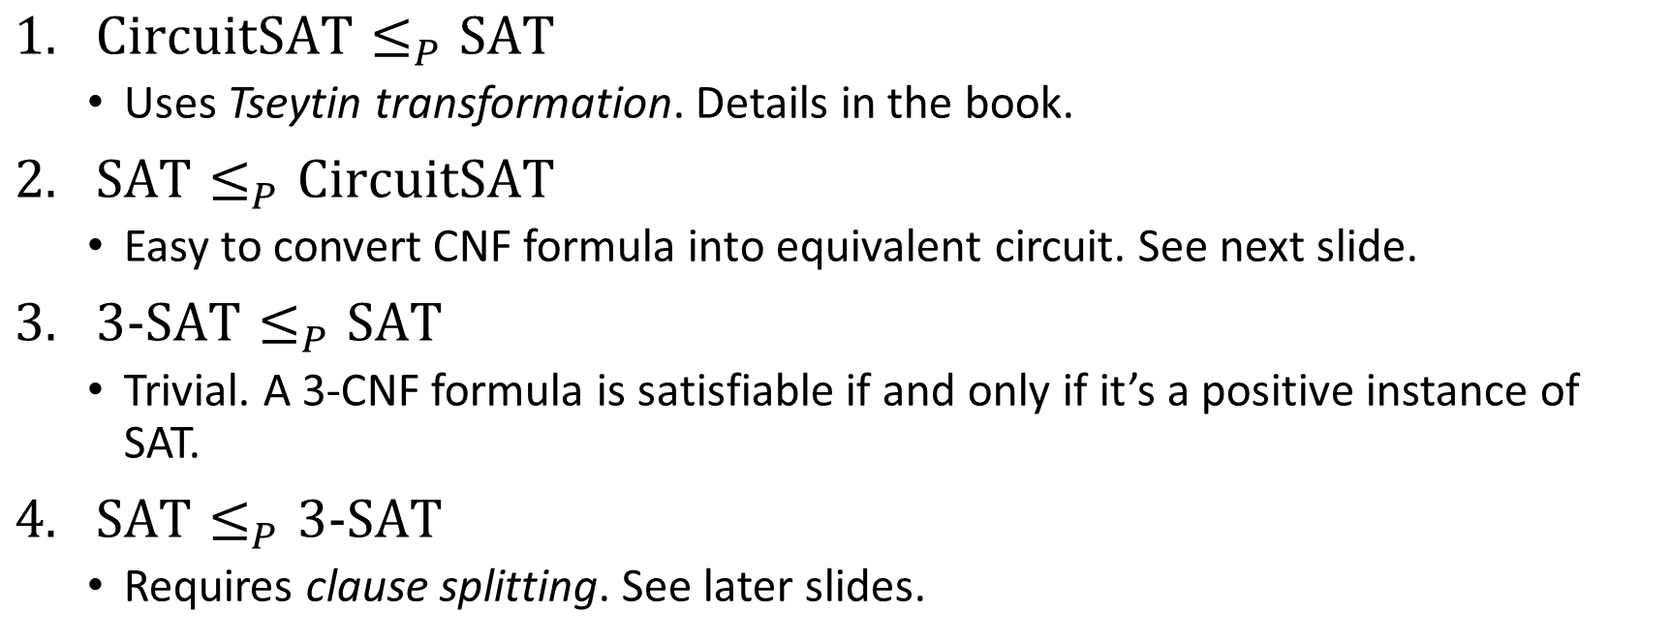
We study polyreductions between CircuitSAT, SAT, and 3-SAT
CircuitSAT
SAT
3-SAT
$\text{CircuitSAT}≤_{P}\text{SAT}$
Uses Tseytin transformation. Details in the book.
$\text{SAT}≤_{P}\text{Circuit}\text{SAT}$
Easy to convert CNF formula into equivalent circuit. See next slide.
$\text{3}\text{-}\text{SAT}≤_{P}\text{SAT}$
Trivial. A 3-CNF formula is satisfiable if and only if it’s a positive instance of SAT.
$\text{SAT}≤_{P}\text{3}\text{-}\text{SAT}$
Requires clause splitting. See later slides.

Slide 19
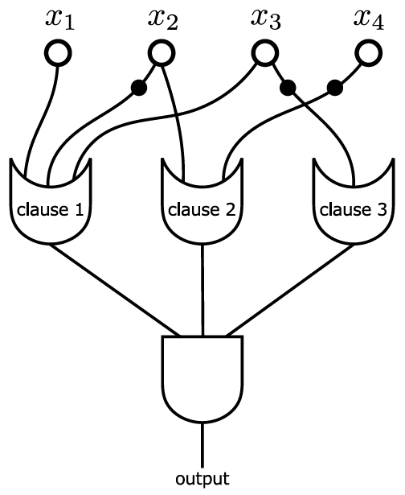
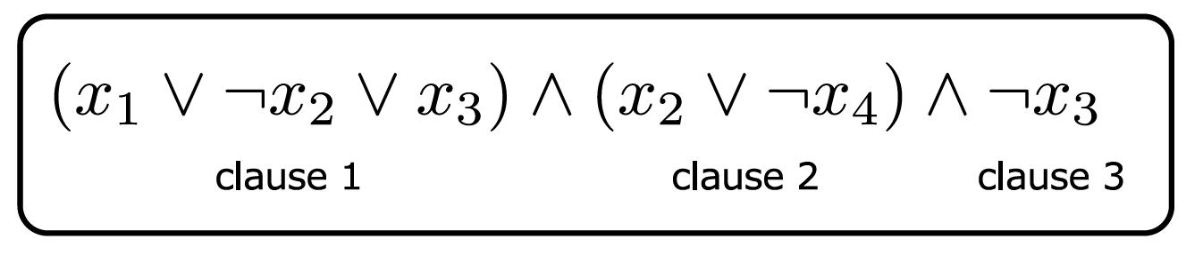

$$\text{SAT}≤_{P}\text{CircuitSAT}$$
Exercise: prove our three conditions (pos→pos, neg→neg, polytime)

Slide 20

Useful tool: splitting a clause
In general:
Specific example:
new dummy variable
Satisfying assignment of original clause maps to satisfying assignment of new clauses, and vice versa

Slide 21
$$\text{SAT}≤_{P}\text{3−}\text{SAT}$$
Achieve this by repeatedly splitting clauses in the SAT formula, until all clauses have at most three literals
Use a different, new dummy variable for each split
Example:
$$\left(x_{1}∨x_{2}∨x_{3}∨x_{4}∨x_{5}\right)∧\left(x_{6}∨x_{7}∨x_{8}∨x_{9}\right)$$
$$\left(x_{1}∨x_{2}∨x_{3}∨d_{1})∧({¬d}_{1}∨x_{4}∨x_{5}\right)∧\left(x_{6}∨x_{7}∨x_{8}∨x_{9}\right)$$
$$\left(x_{1}∨x_{2}∨d_{2})∧({¬d}_{2}∨x_{3}∨d_{1})∧({¬d}_{1}∨x_{4}∨x_{5}\right)∧\left(x_{6}∨x_{7}∨x_{8}∨x_{9}\right)$$
$$\left(x_{1}∨x_{2}∨d_{2})∧({¬d}_{2}∨x_{3}∨d_{1})∧({¬d}_{1}∨x_{4}∨x_{5}\right)∧\left(x_{6}∨x_{7}∨d_{3})∧(¬d_{3}∨x_{8}∨x_{9}\right)$$
Exercise: Does this run in polynomial time?

Slide 22
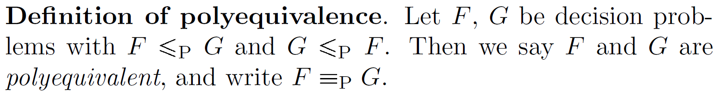
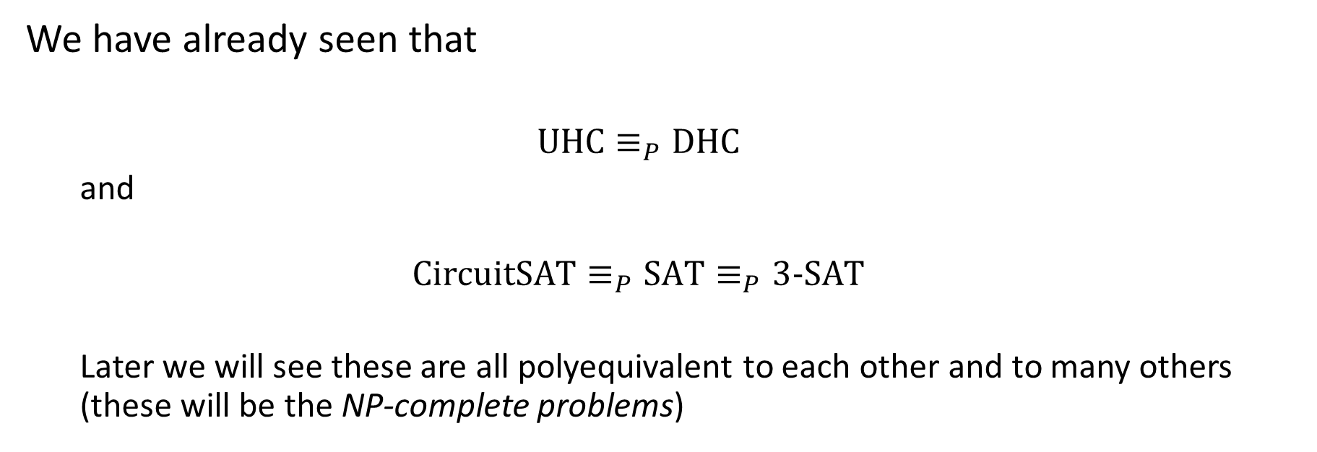
Polyequivalence
We have already seen that
$$\text{UHC}≡_{P}\text{DHC}$$
and
$$\text{CircuitSAT}≡_{P}\text{SAT}≡_{P}\text{3−}\text{SAT}$$
Later we will see these are all polyequivalent to each other and to many others (these will be the NP-complete problems)

