Slide 1
14. NP-completeness
Lecture slides for What Can Be Computed?

Slide 2
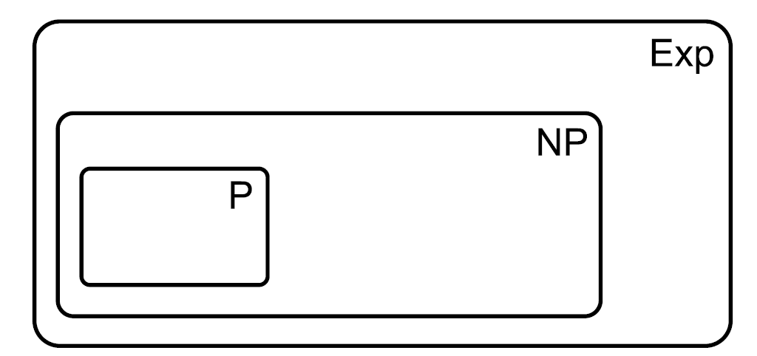
Recall definitions of P, NP, Exp
Remember, we restrict to decision problems in this chapter

Slide 3
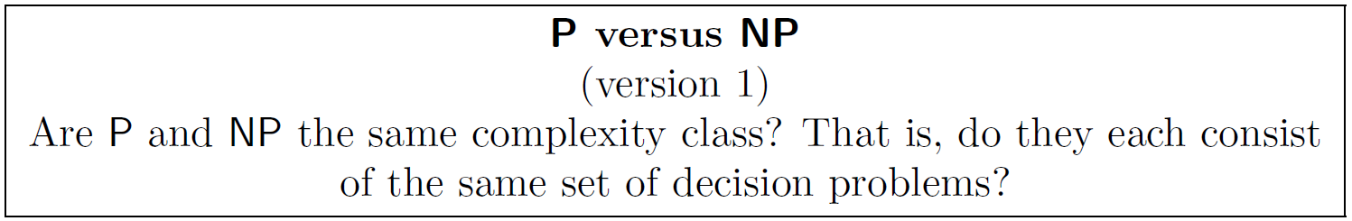
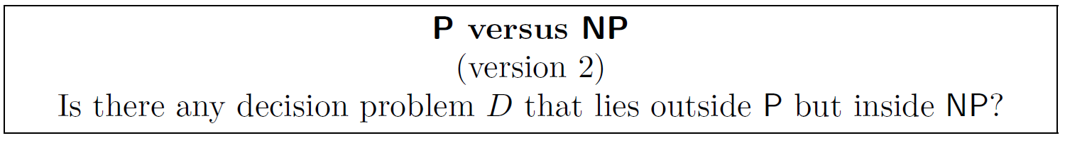
P versus NP: the most famous problem in computer science
Are there any computational problems in here?

Slide 4
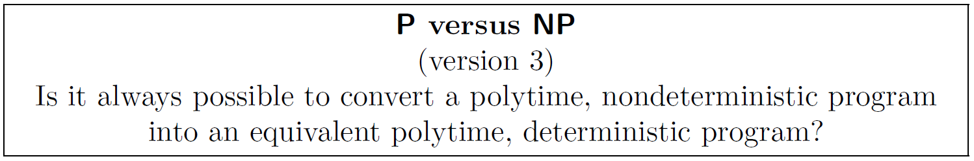
Can define in terms of determinism versus nondeterminism
“In P” means “can solve with polytime, deterministic program”
“In NP” means “can solve with polytime, nondeterministic program”

Slide 5
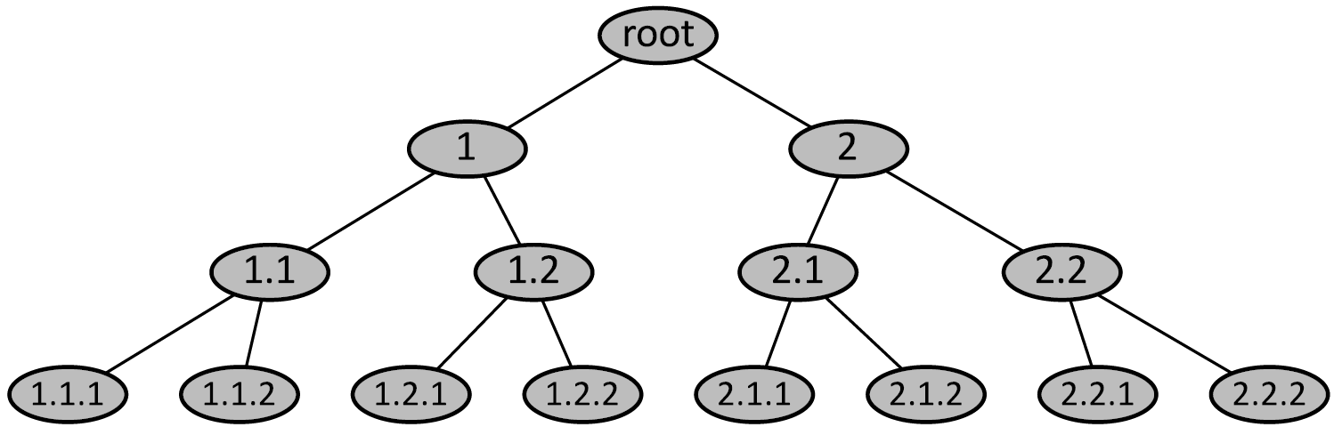
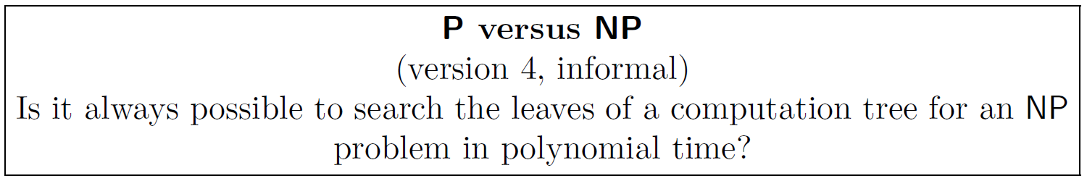
Interesting interpretation in terms of computation trees

Slide 6
Interesting: we already encountered many polyequivalent problems
we proved these
can be proved, but we didn’t do it
These problems are “equally hard” (if we ignore polynomial factors in running time)
Thousands of other problems are known to be at this same level of “hardness”
We call this class of problems NP-complete

Slide 7
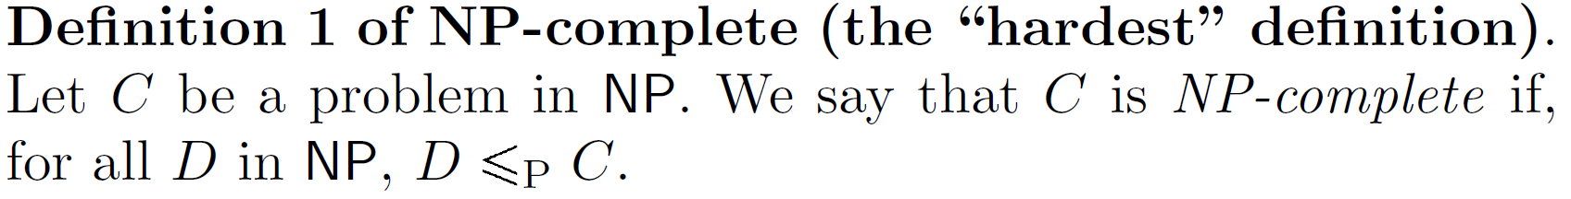
The classical definition of NP-complete problems defines them as the “hardest” problems in NP
Example:
DHC is NP-complete (although we haven’t proved that yet).
Given that DHC is NP-complete, the above definition tells us that all NP problems polyreduce to DHC! Strange, but true.

Slide 8
Famous example: it was proved in the 1970s that all NP problems polyreduce to SAT (Cook-Levin theorem)
Because of this, we obtain an easier but equivalent definition of NP-completeness:
Exercise: Why is this definition equivalent to the earlier one?

Slide 9
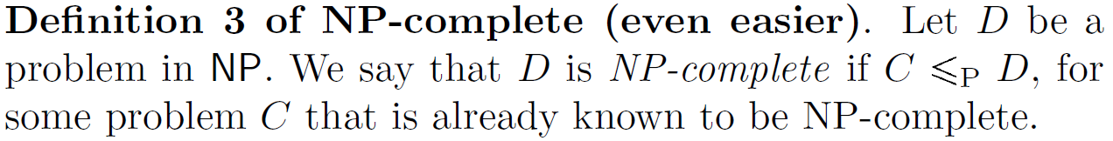
In fact, there’s nothing special about SAT in the definition of NP-completeness
Exercise: Why is this definition equivalent to the earlier ones?

Slide 10
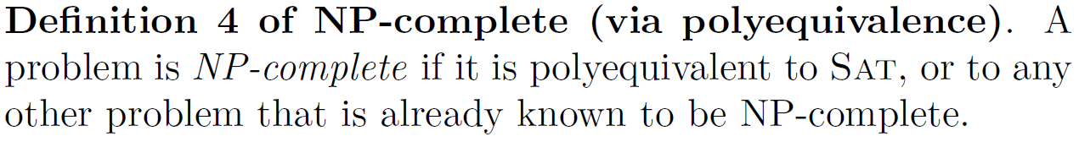
We can also define NP-completeness in terms of polyequivalence
Exercise: Why is this definition equivalent to the earlier ones?

Slide 11


NP-completeness gives us new ways of understanding P vs NP
Are there any computational problems in here?
Exercise: Why are these definitions equivalent to the earlier ones?

Slide 12
NP-hard means “as hard as NP-complete, and maybe harder”
An NP-hard problem could be outside NP
For problems in NP, the concepts of NP-hard and NP-complete are equivalent
Example: nondecision variants of NP-complete problems are NP-hard (e.g. nondecision variants of TSP, UHC, SAT)

Slide 13
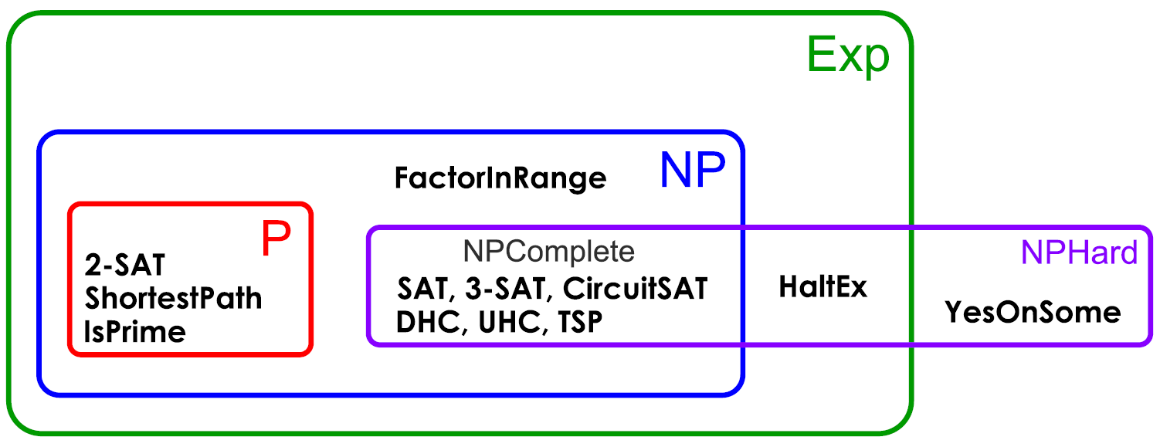
Summary of complexity classes, restricting attention to decision problems only
Important note: makes certain standard assumptions, such as P$≠$NP

Slide 14
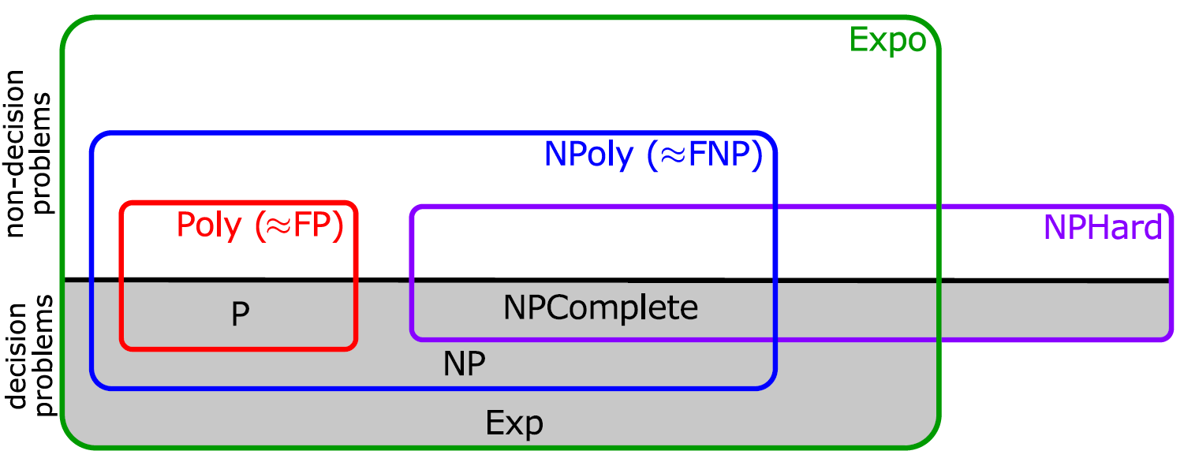
Summary of complexity classes, including nondecision problems
Important note: makes certain standard assumptions, such as P$≠$NP

Slide 15
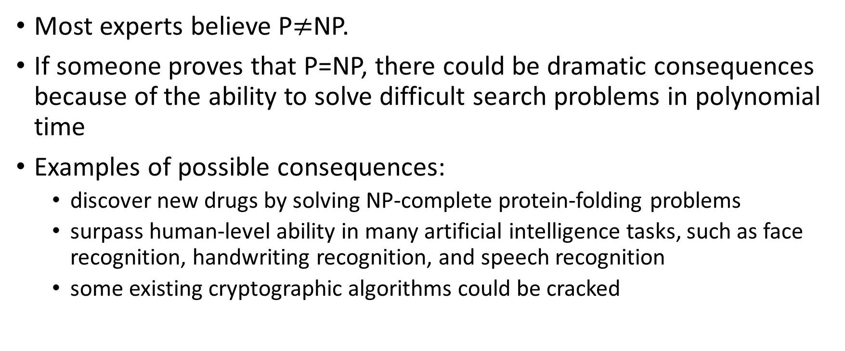
What if P=NP?
Most experts believe P$≠$NP.
If someone proves that P=NP, there could be dramatic consequences because of the ability to solve difficult search problems in polynomial time
Examples of possible consequences:
discover new drugs by solving NP-complete protein-folding problems
surpass human-level ability in many artificial intelligence tasks, such as face recognition, handwriting recognition, and speech recognition
some existing cryptographic algorithms could be cracked

Slide 16
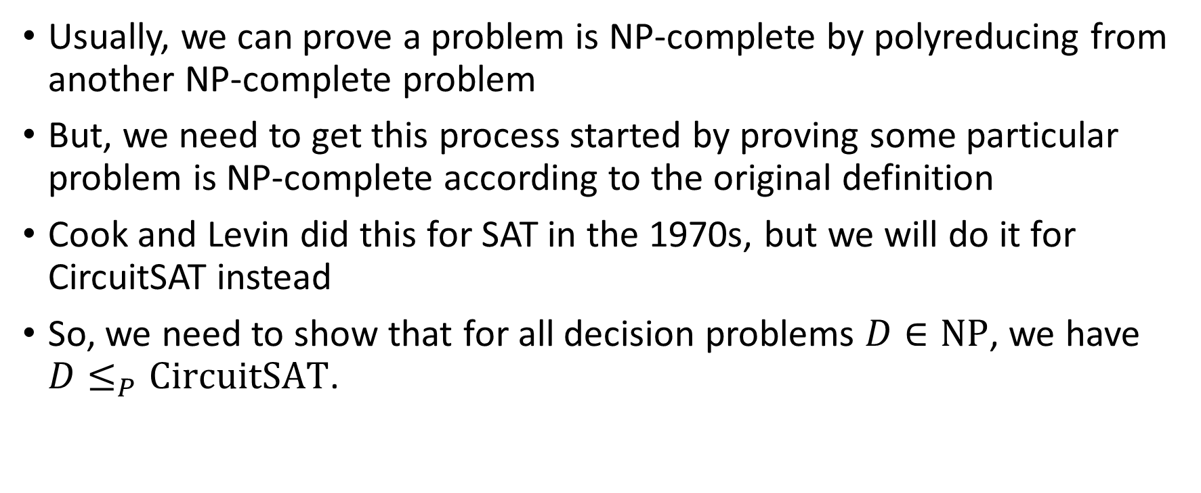
Our next goal: prove that CircuitSAT is NP-complete
Usually, we can prove a problem is NP-complete by polyreducing from another NP-complete problem
But, we need to get this process started by proving some particular problem is NP-complete according to the original definition
Cook and Levin did this for SAT in the 1970s, but we will do it for CircuitSAT instead
So, we need to show that for all decision problems $D∈\text{NP}$, we have $D≤_{P}\text{CircuitSAT}$.

Slide 17
Preliminary fact: polytime programs can be implemented by polysized circuits
Programs run on computers, which are made of circuits, so this is a reasonable claim
See book for detailed proof

Slide 18
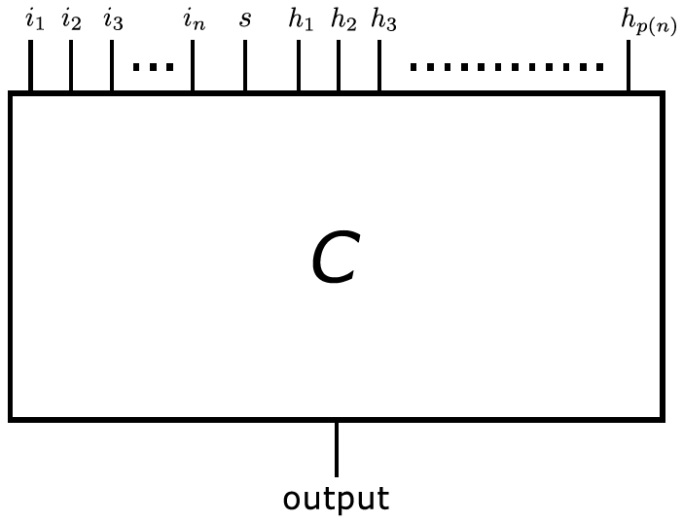
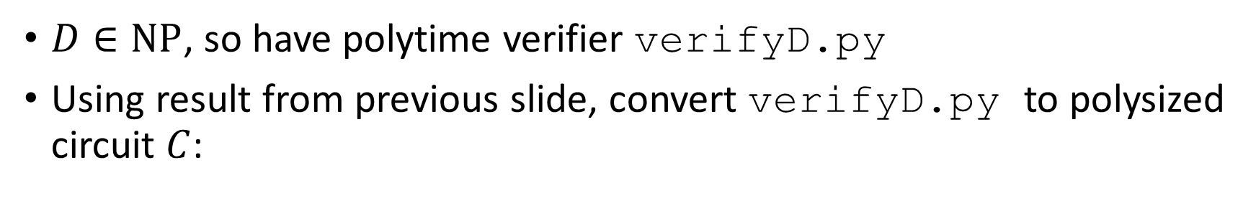

Sketch of proof that $D≤_{P}\text{CircuitSAT}$
$D∈\text{NP}$, so have polytime verifier verifyD.py
Using result from previous slide, convert verifyD.py to polysized circuit $C$:

Slide 19
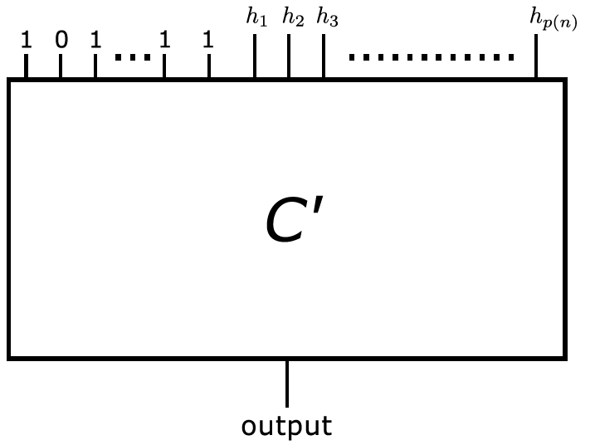


Sketch of proof that $D≤_{P}\text{CircuitSAT}$ (part II)
Given specific instance of $D$, convert $C$ to $C′$:

Slide 20
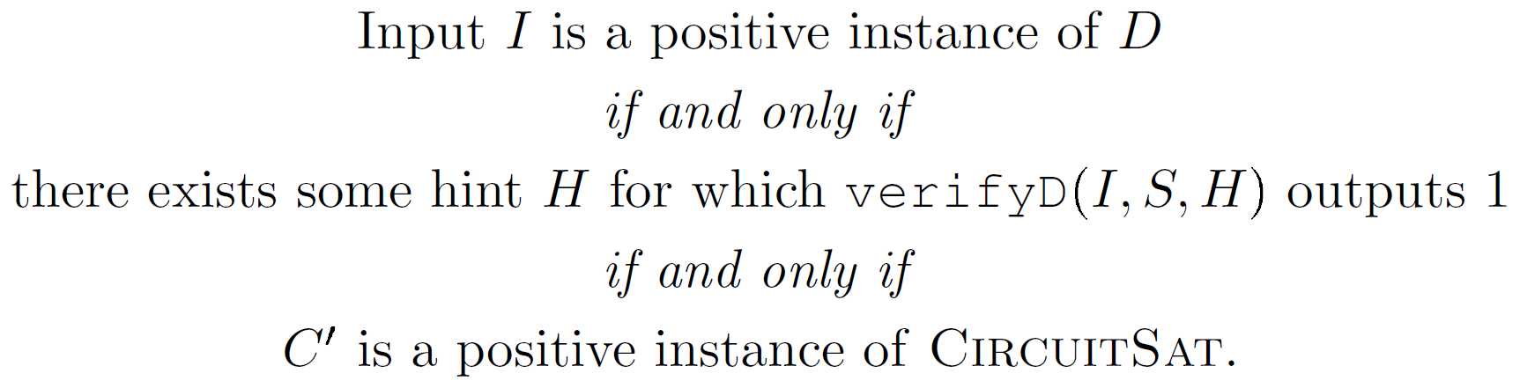
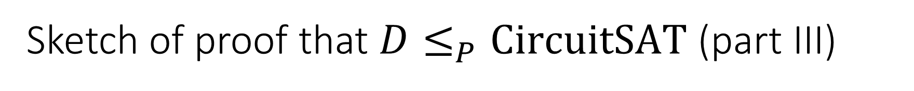

Sketch of proof that $D≤_{P}\text{CircuitSAT}$ (part III)
Observe equivalence between $D$ and $C′$:

Slide 21
NP-completeness is widespread
Thousands of NP complete problems are known, drawn from diverse areas of computer science, mathematics, engineering, biology, physics, etc. Examples include:
Computer science:
MaxClique, MaxCut, DeadlockAvoidance, CubicSubgraph
Applied math:
IntegerProgramming, TaskAssignment, MinimumBroadcastTime, SparseMatrixCompression
Pure math:
QuadraticDiophantineEquation, CosineIntegral
Biology:
MultipleSequenceAlignment

Slide 22
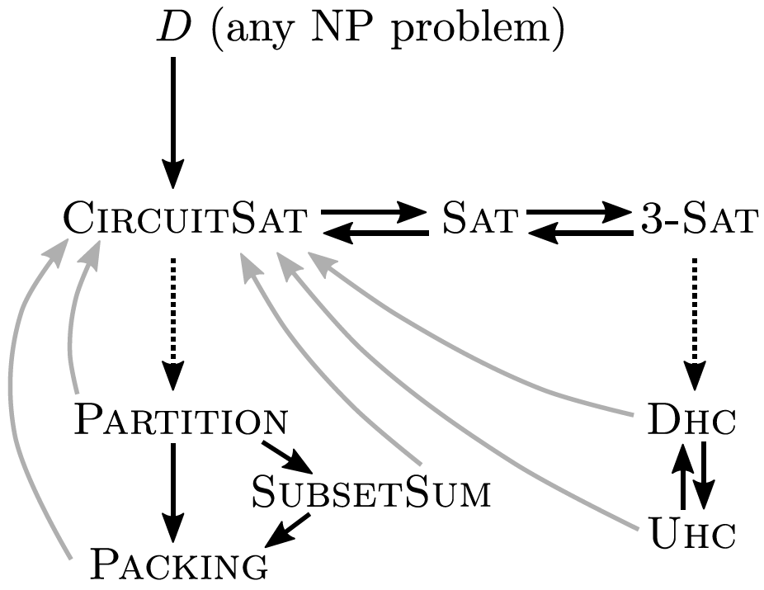
The web of NP-completeness
Arrows represent polyreductions
Solid black arrows: we proved
Dotted arrows: see other books
Grey arrows: follow from NP-completeness of CircuitSAT

Slide 23

Proof techniques for NP-completeness
To prove that problem $D$ is NP-complete, it’s usually easiest to use definition 3:
Choose a problem $C$ that is similar to $D$ or has a simple polyreduction to $D$.
Example (exercise): prove that HalfUHC is NP-complete

Slide 24
Good news and bad news about NP-completeness
There are many NP-complete problems, but there seem to be some problems between P and NP-complete.
Examples: Factor, DiscreteLog
Don’t forget that some seemingly challenging problems are actually in P
Examples: IsPrime, MinCut, ShortestPath, LinearProgramming
Some NP-hard problems can be approximated efficiently
Examples: TSP, TaskAssignment
Some NP-hard problems can be solved efficiently for real-world inputs
Example: SAT
Some NP-hard problems can be solved in pseudo-polynomial time
Examples: Packing, SubsetSum, Partition, TaskAssignment

