Slide 1
15. The original Turing machine
Lecture slides for What Can Be Computed?

Slide 2
Turing’s 1936 paper, On computable numbers, contains many striking ideas
Full title: On computable numbers, with an application to the Entscheidungsproblem
we study only these
definition of computing machines (which we now call Turing machines)
a convincing argument that any computation performed by a human can also be performed by a computer
a complete example of a universal computer
proofs that various problems are undecidable, including a variant of the halting problem
a resolution of a famous mathematical problem (the Entscheidungsproblem)
many other computational ideas, including nondeterminism, subroutines, recursion, binary numbers, Turing reductions, and proofs that an immense variety of mathematical calculations can be mechanized

Slide 3
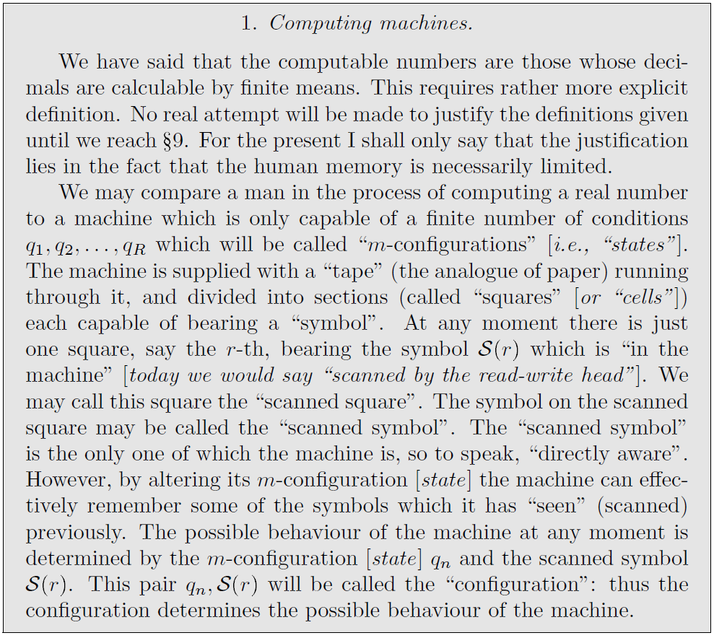
Description of Turing machine

Slide 4
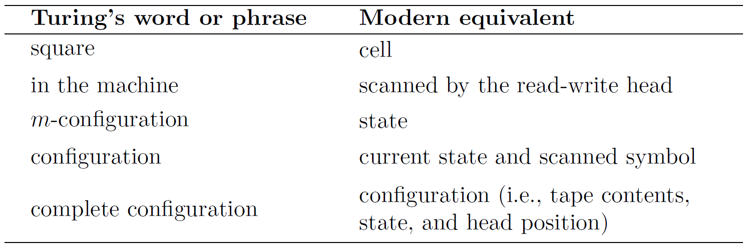
Differences in terminology

Slide 5
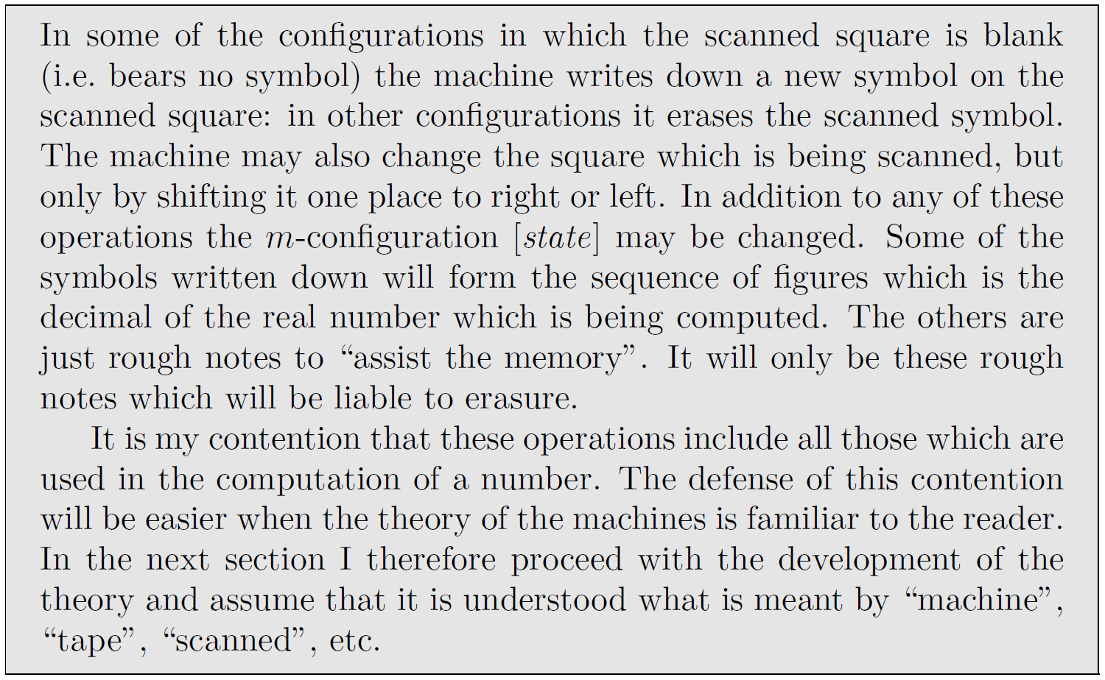
A Turing machine can do any (numerical) computation

Slide 6
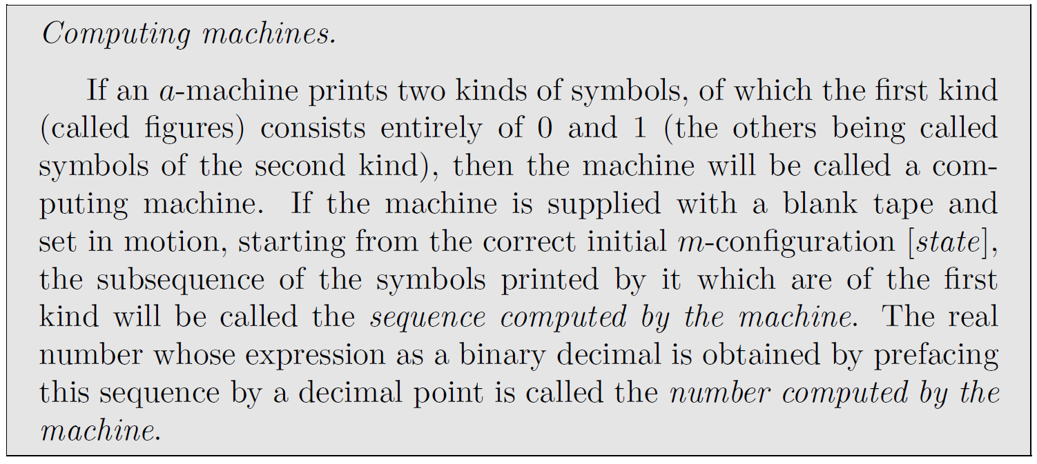
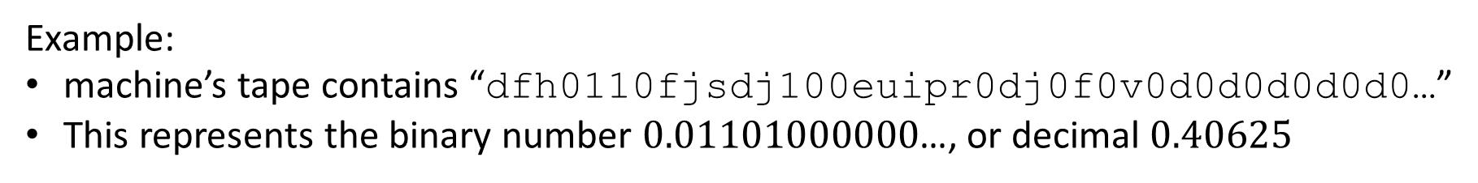
Example:
machine’s tape contains “dfh0110fjsdj100euipr0dj0f0v0d0d0d0d0d0…”
This represents the binary number $0.01101000000$…, or decimal $0.40625$

Slide 7
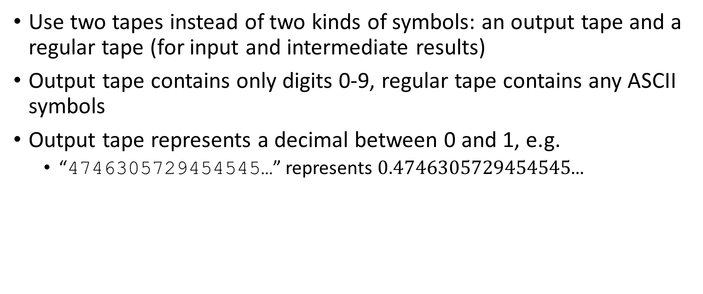
We use a slightly different model: two-tape decimal computing machine (2TDCM)
Use two tapes instead of two kinds of symbols: an output tape and a regular tape (for input and intermediate results)
Output tape contains only digits 0-9, regular tape contains any ASCII symbols
Output tape represents a decimal between 0 and 1, e.g.
“4746305729454545…” represents $0.4746305729454545$…

Slide 8
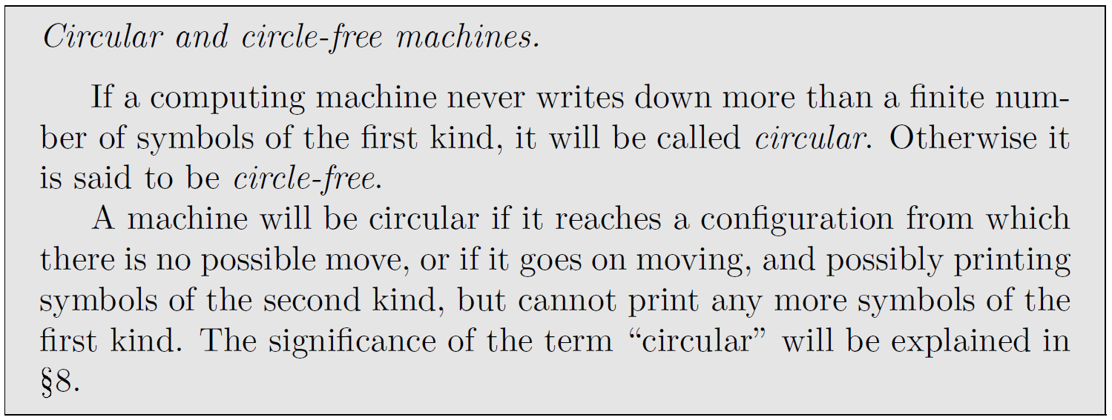
Turing doesn’t explicitly consider “halting” and instead considers circular versus circle-free
Turing considers this desirable: he wants the machine to output an infinite decimal expansion!
For 2TDCM:
circle-free means “writes infinitely many symbols on the output tape”
circular means “either halts or loops without writing on the output tape”

Slide 9
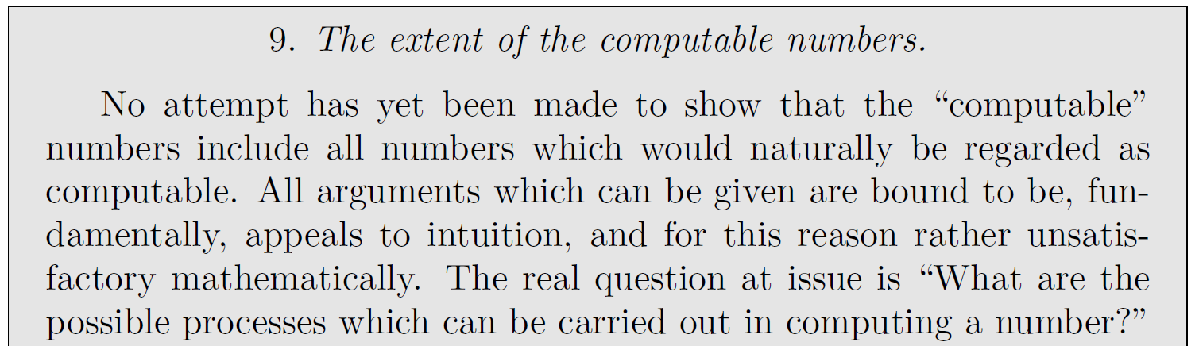
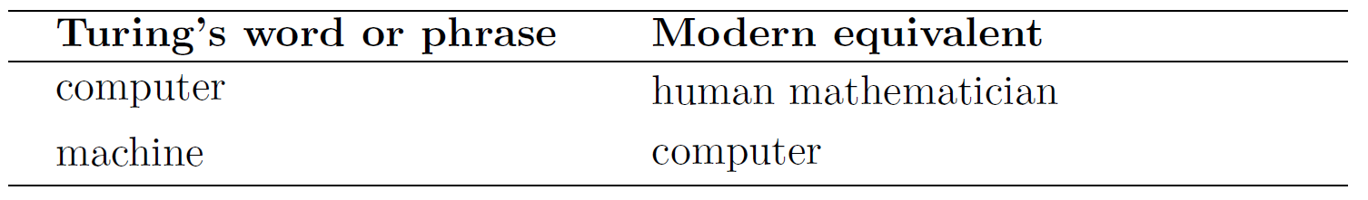
In section 9, Turing makes his first foray into artificial intelligence
Exercise 1: Do you believe the claim that a Turing machine can compute any number that a human mathematician can compute?
Exercise 2: Do you believe the claim that Turing machines and human brains are computationally equivalent? Carefully justify your answer.

Slide 10
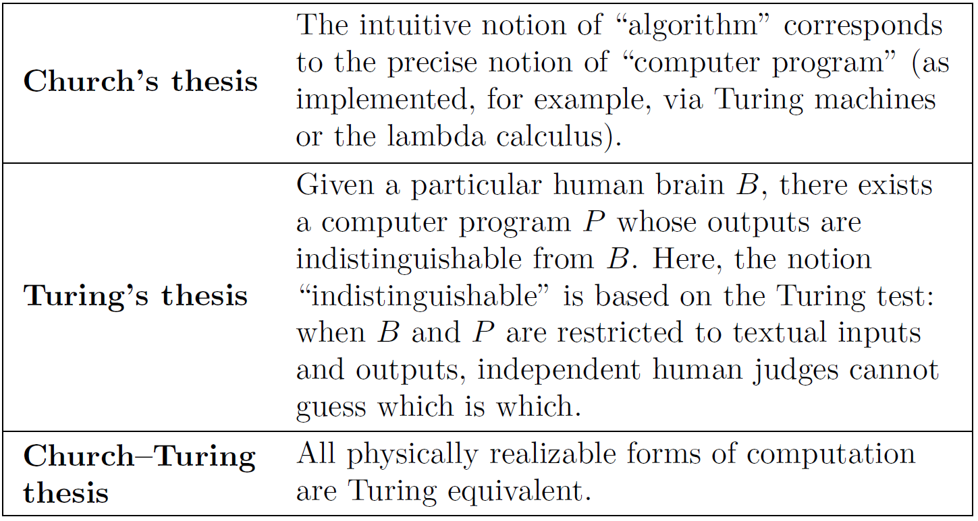
Turing’s work provides evidence for various hypotheses about AI

