Slide 1
16. You can't prove everything that's true (Gödel’s theorem via Turing’s ideas)
Lecture slides for What Can Be Computed?

Slide 2
Goal: investigate which mathematical statements can be proved
Main tools:
Proof systems
Logical systems
alphabet
axioms
inference rules
Same as proof system, but also has a truth assignment

Slide 3
Example of a proof system: BinAd

Slide 4

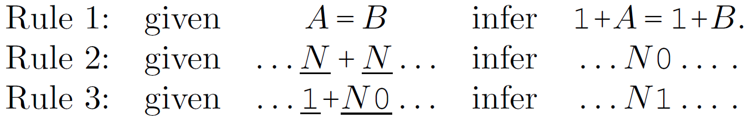

Example of a proof system: BinAd
Alphabet: $\left\{\text{0}, \text{1}, +, =\right\}$
Axiom:
Inference rules:

Slide 5
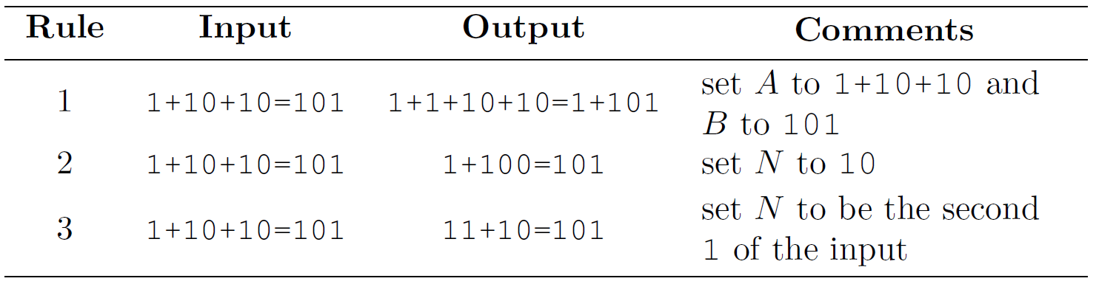
Examples of applying inference rules in BinAd
Experiments: after importing binAd.py, try
>>> applyRuleTwo('1+1+1=11')
>>> isProvable('1+1+1=11')
>>> isProvable('1=0')

Slide 6
Goal: investigate which mathematical statements can be proved
Main tools:
Proof systems
Logical systems
alphabet
axioms
inference rules
Same as proof system, but also has a truth assignment

Slide 7
Example of logical system: BinAdLogic
Use the obvious truth value: statement is true if it is mathematically correct (e.g. “1+1=10” is true; “1+1=1” is false)
Exercise: in BinAdLogic, is “10+100=110”
true?
provable?
Experiments:
>>> isTrue('1+1=10')
>>> isProvable('1+1=10')
>>> isTrue('10000=10000')
>>> isProvable('10000=10000')

Slide 8
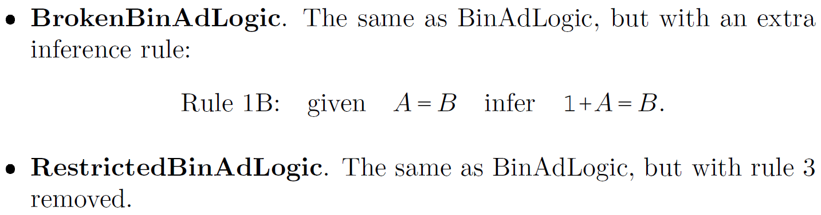
BUT in some logical systems, truth is not the same as provability
BinAdLogic
Examples:
Exercises:
Produce a BrokenBinAdLogic statement that is provable, but not true
Produce a RestrictedBinAdLogic statement that is true, but not provable
Think of a new truth assignment that “fixes” BrokenBinAdLogic
e.g. 1+1=1
e.g. 1+10=11

Slide 9
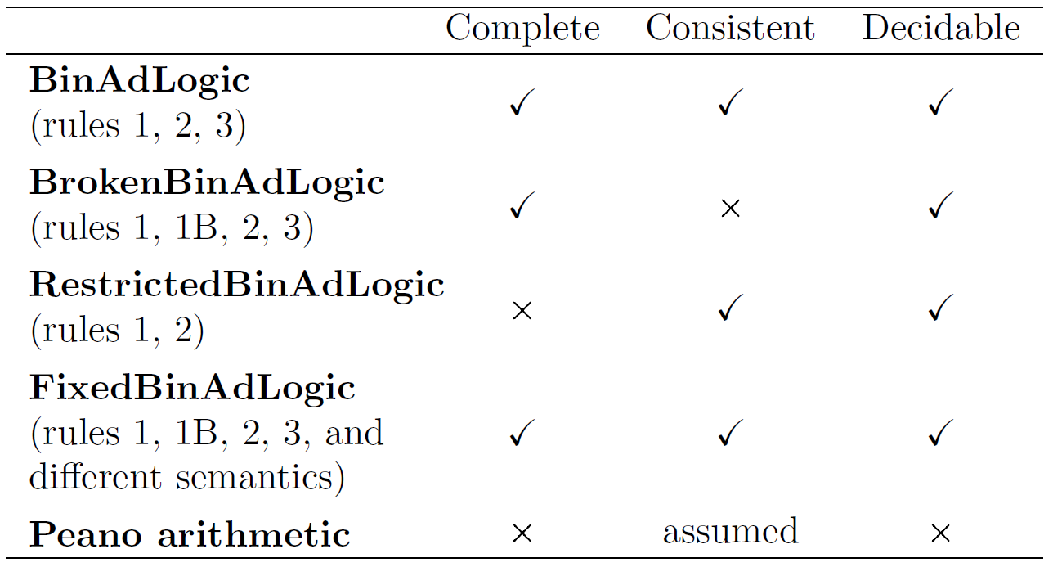
Consistency, completeness and decidability
A logical system is
consistent if all provable statements are true
complete if all true statements are provable
decidable if a computer program can decide the truth of statements
will be explained soon!

Slide 10
Peano arithmetic is a logical system that describes integers, addition, and multiplication
Example:
NOT EXISTS x,y, 0''*x=y AND y=0'''''
Meaning: there do not exist integers $x,y$ such that $2x=y$ and $y=5$

Slide 11
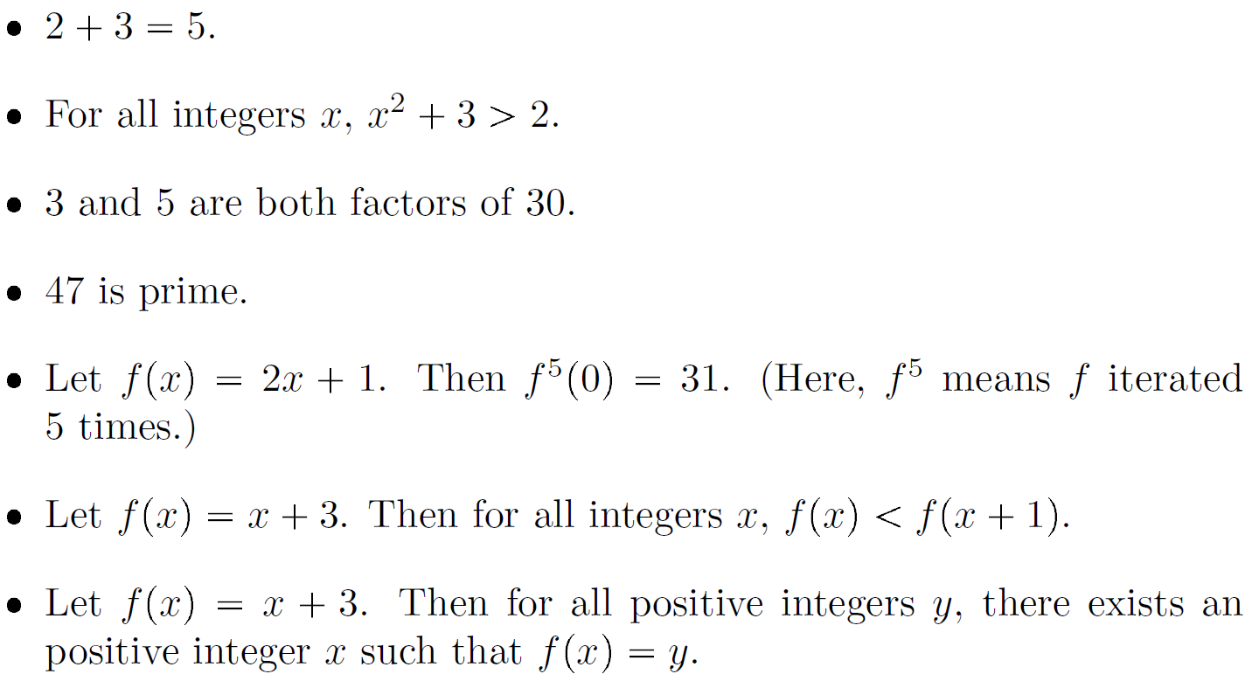
Peano arithmetic can express all the usual concepts of elementary number theory
We don’t study the details. Instead, take it on faith that Peano arithmetic can express the following statements:
Of course, statements can be true or false. This one is false.

Slide 12
Goal: prove that Peano arithmetic is incomplete (there exist true mathematical statements that can’t be proved)
Plan:
Show halting problem can be converted into Peano arithmetic (PA)
This immediately shows PA is undecidable, but doesn’t yet show it’s incomplete
Show provable PA statements can be recognized
They can’t be decided, but they can be recognized
Analyze a strange program called godel.py
Exhibit a true, unprovable PA statement embedded in godel.py

Slide 13
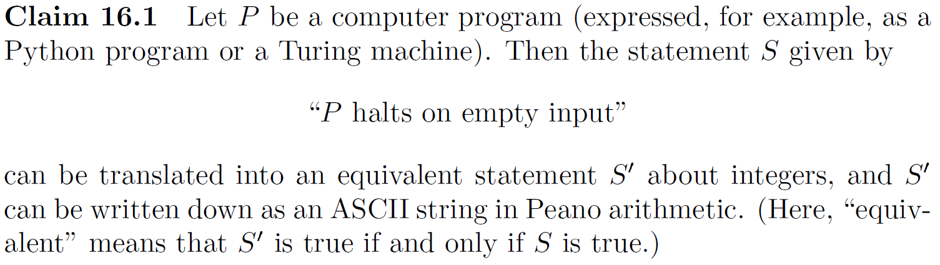

Show halting problem can be converted into Peano arithmetic (PA)
integer function that implements the transition function
Sketch of proof: Express as
there exists an integer $N$ such that $\text{Done}\left({\text{Step}}^{N}\left(m_{0}\right)\right)=1$
function that is 1 if machine has halted
initial machine state, expressed as binary integer

Slide 14
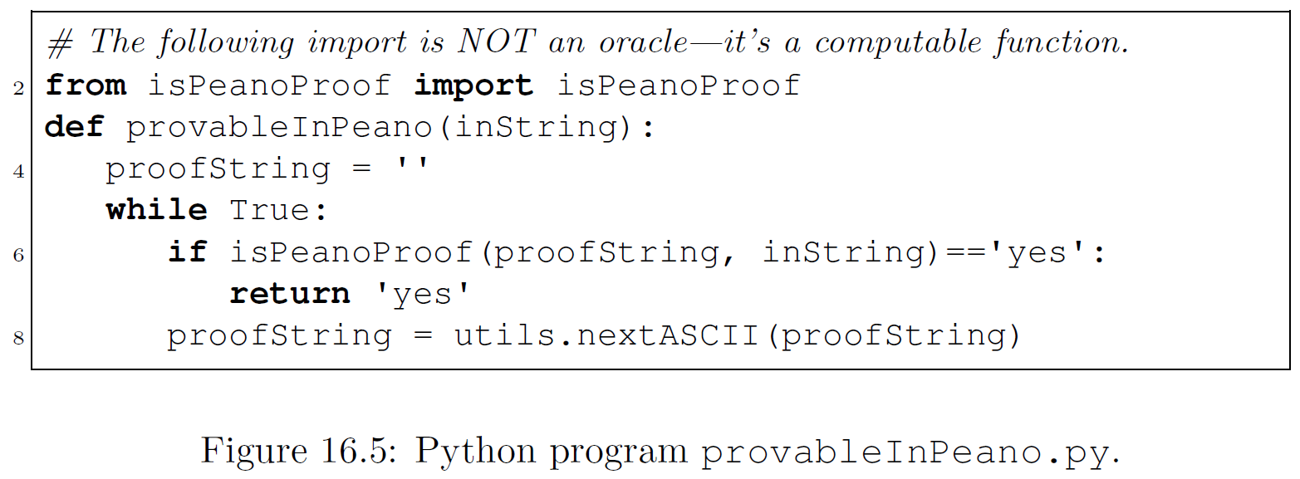
2. Show provable PA statements can be recognized
This program recognizes provable PA statements:

Slide 15
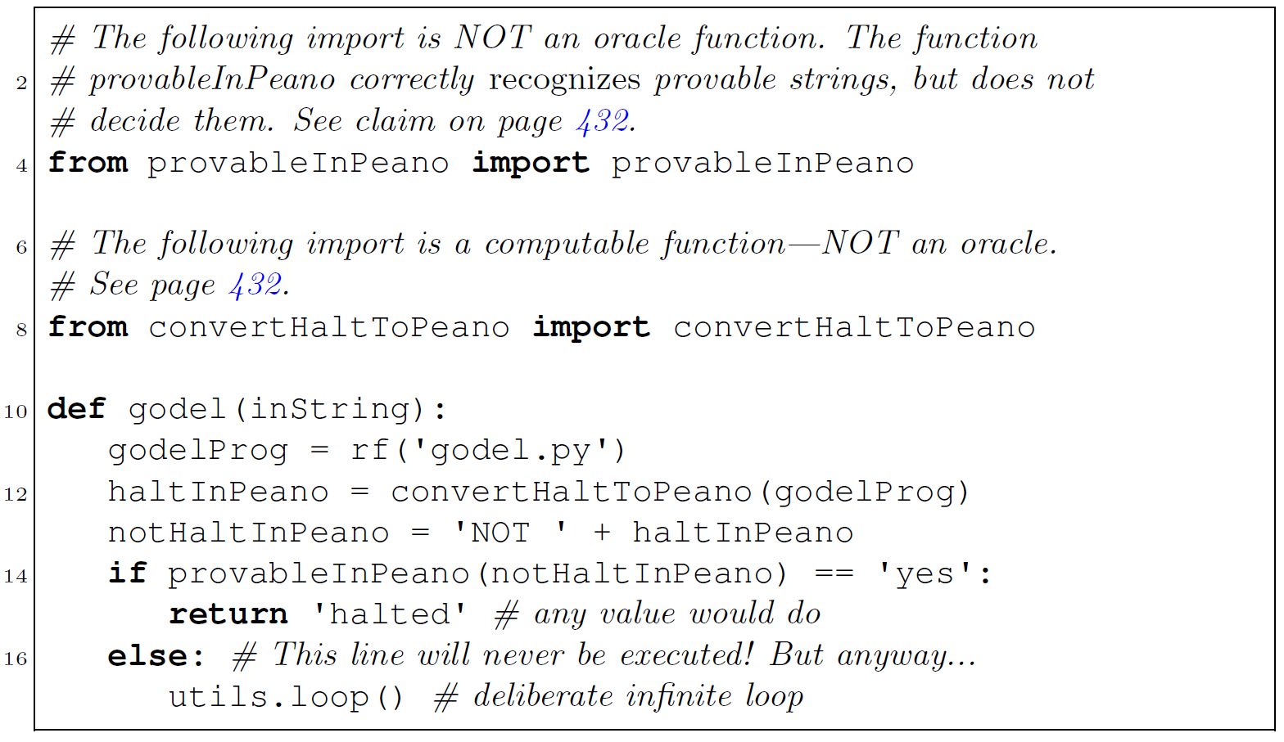
3. Analyze a strange program called godel.py
See step 2
See step 1
Note the meaning of notHaltInPeano:
“godel.py doesn't halt on empty input”
Exercise: what does this program do on empty input?

Slide 16
4. Exhibit a true, unprovable PA statement embedded in godel.py
See step 2
See step 1
Note the meaning of notHaltInPeano:
“godel.py doesn't halt on empty input”
Exercise: what does this program do on empty input?
Answer: It loops (specifically, hangs at line 14)…
…therefore, notHaltInPeano is true but not provable!! (Exercise: why?)

Slide 17
Overview of Turing, Gödel, and the incompleteness of mathematics
Gödel proved mathematics is incomplete in the early 1930s
But this proof requires some challenging mathematics
Turing tried to extend Gödel’s results later in the 1930s
While working on that, Turing invented Turing machines and demonstrated unsolvable problems for those machines
We have just seen that Turing’s ideas yield a surprisingly simple proof of Gödel’s earlier result that mathematics is incomplete

