Slide 1
17. Karp's 21 problems
Lecture slides for What Can Be Computed?

Slide 2
1972: dramatic moment in the history of theoretical computer science
SAT already known to be NP-complete
Proved by Cook (1971) and independently by Levin in Soviet Union
So, SAT is a “hardest” problem in NP
Presumably, therefore, SAT has some special property that makes it harder than most or all of the other NP problems
Karp’s 1972 paper dramatically refutes this, demonstrating 20 additional problems that are “equally hard” compared to SAT
Computer scientists conclude that NP-completeness is widespread, and therefore there are many important problems that will probably never be solvable in polynomial time

Slide 3
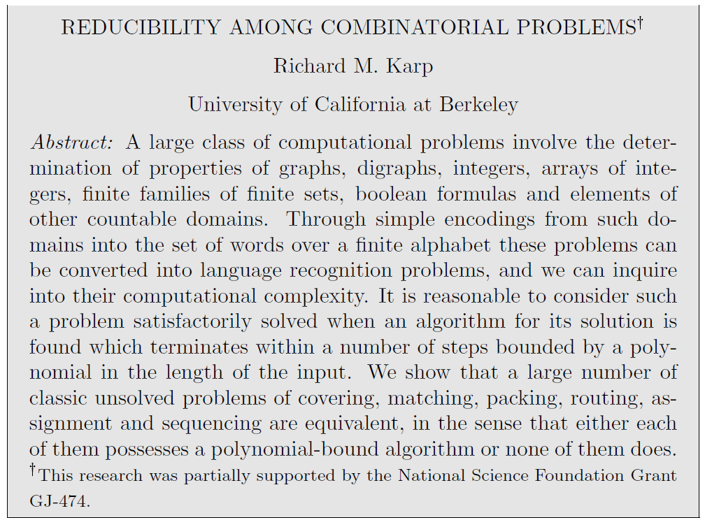

Slide 4
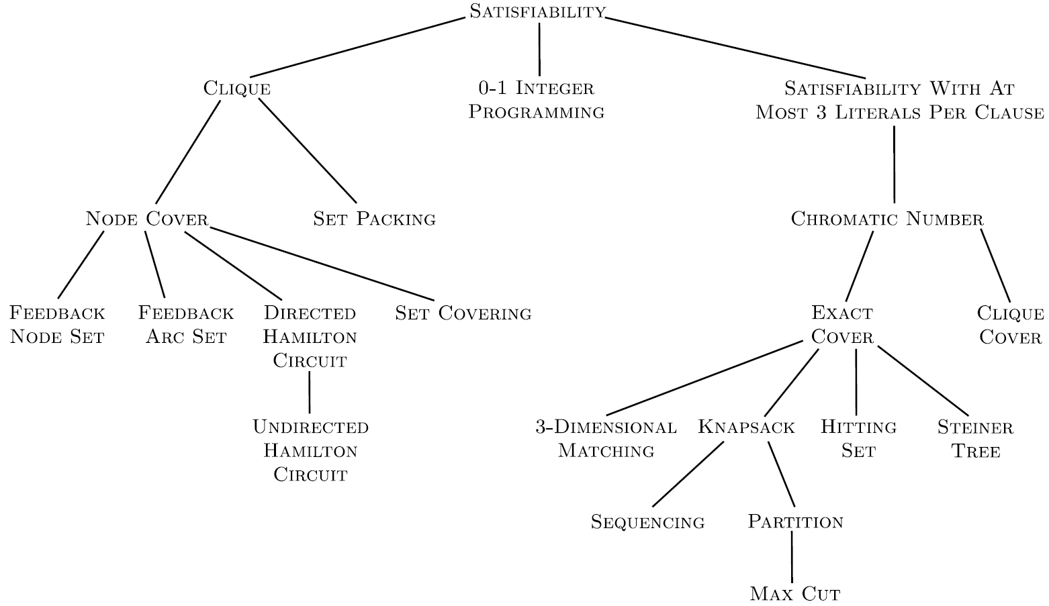
Karp’s reductions
We study only 5 of the 20 reductions

Slide 5
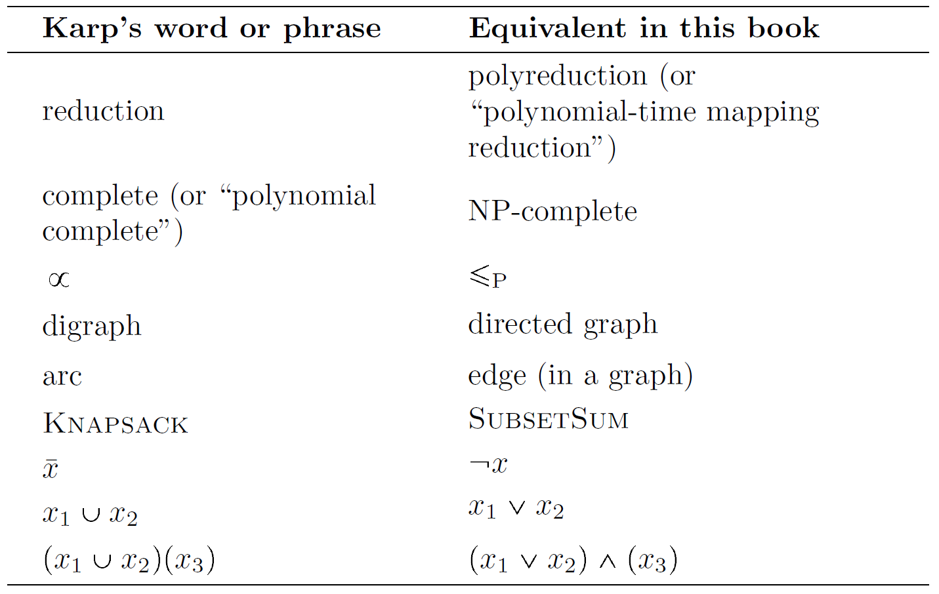

Slide 6
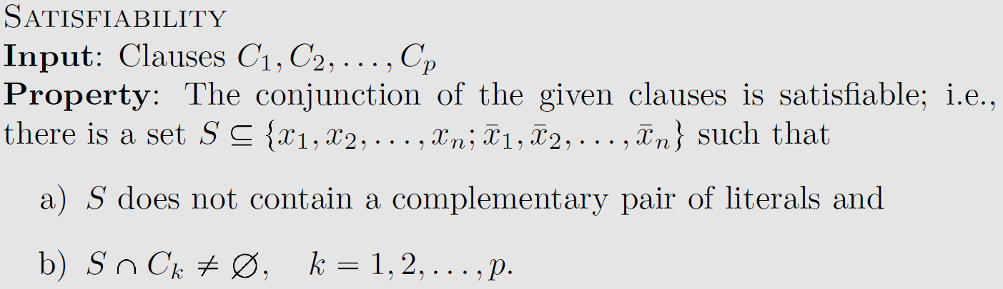
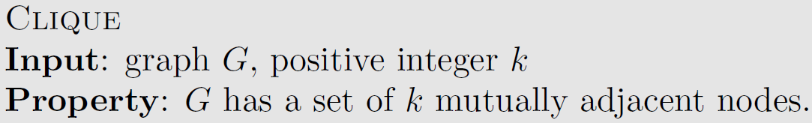
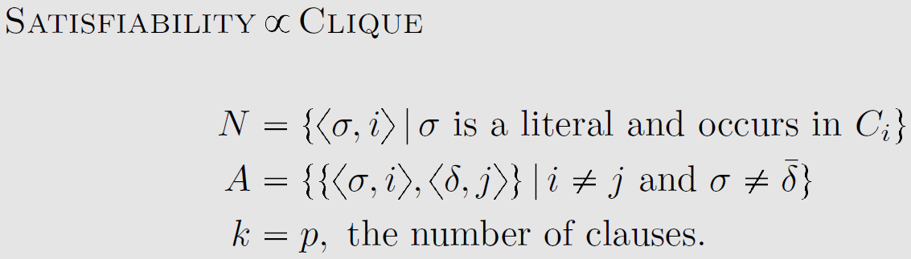
Karp’s definition of SAT
Karp’s definition of Clique
Karp’s reduction from SAT to Clique
Ouch. This is very terse.

Slide 7
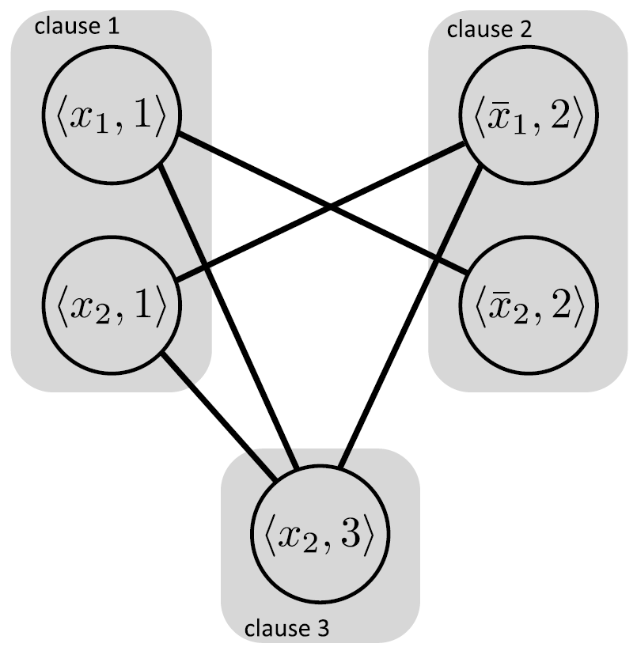

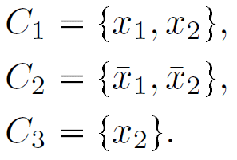

Example of $\text{SAT}≤_{P}\text{Clique}$
corresponding clique instance
SAT instance in our notation
Same SAT instance in Karp’s notation
Put edges between all pairs of nodes in distinct clauses, except complementary literals
Exercise: prove this maps positive to positive and negative to negative
Experiment:
>>> convertSatToClique((x1 OR x2) AND (NOT x1 OR NOT x2) AND (x2))

Slide 8
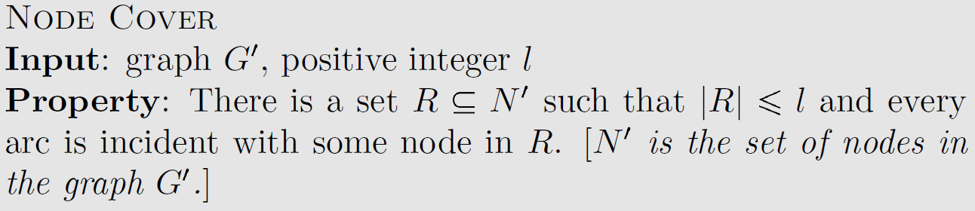
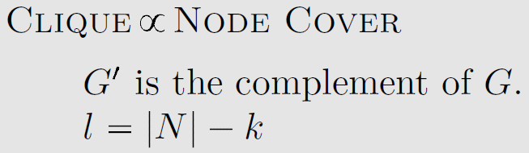
Karp’s definition of Clique
Karp’s definition of Node Cover
Karp’s reduction from Clique to Node Cover

Slide 9
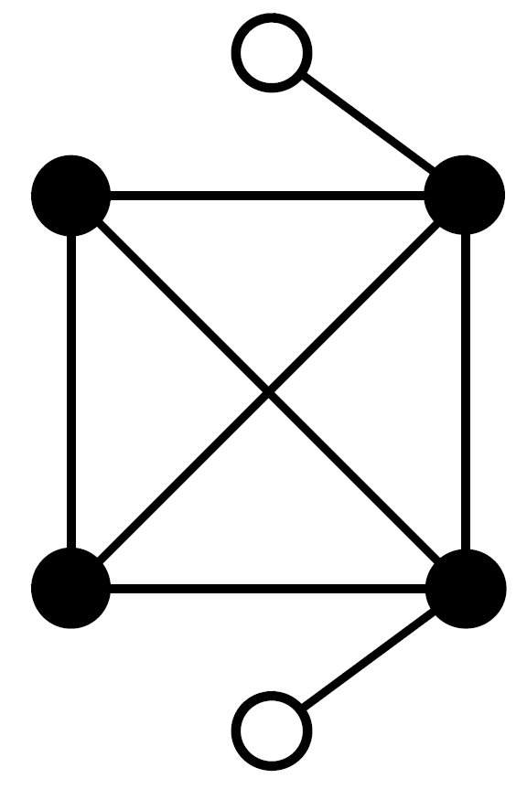
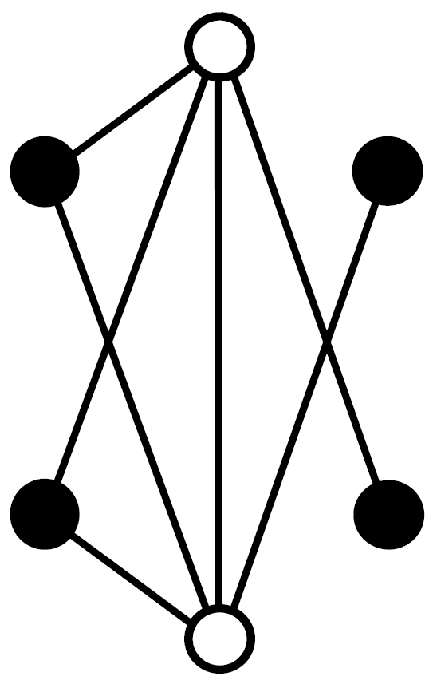
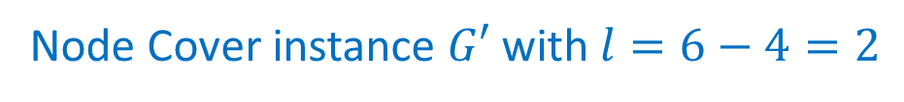
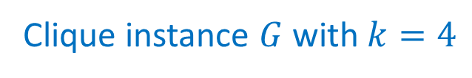

Example of $Clique≤_{P}\text{Node} \text{Cover}$
Exercise: prove this maps positive to positive and negative to negative
Clique instance $G$ with $k=4$
Node Cover instance $G′$ with $l=6−4=2$

Slide 10
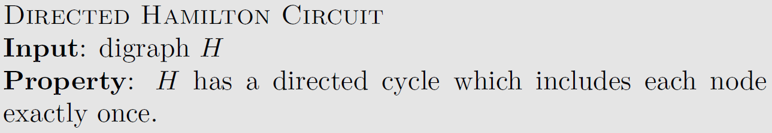
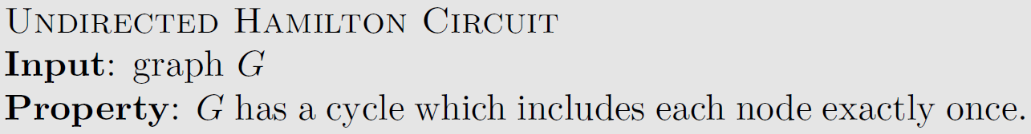
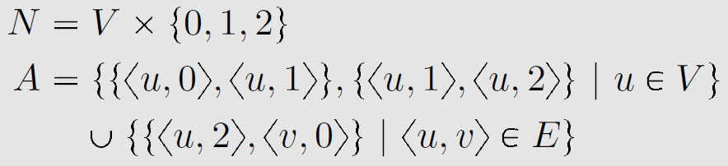
Karp’s definition of DHC
Karp’s definition of UHC
Karp’s reduction from DHC to UHC

Slide 11
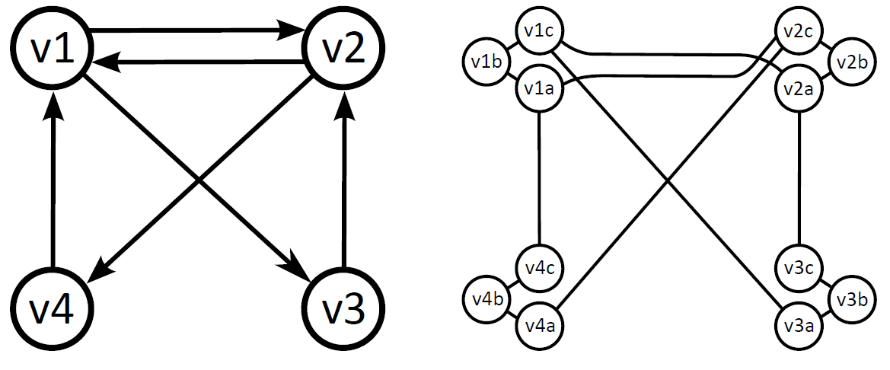

Karp’s $\text{DHC}≤_{P}\text{UHC}$ reduction is the same as the one in Chapter 13

Slide 12
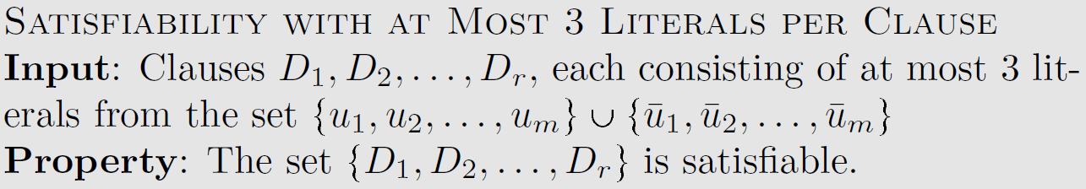
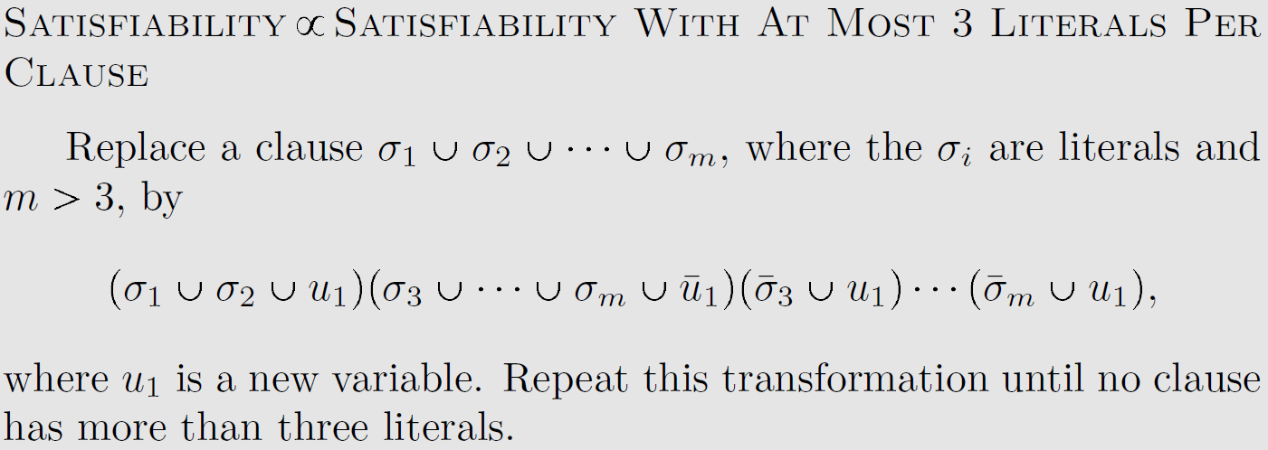
Karp’s definition of SAT
Karp’s definition of 3-SAT
Karp’s reduction from SAT to 3-SAT

Slide 13

Karp’s $\text{SAT}≤_{P}\text{3-}\text{SAT}$ reduction is almost the same as the one in Chapter 13
$$\left(x_{1}∨x_{2}∨x_{3}∨x_{4}∨x_{5}\right)∧\left(x_{6}∨x_{7}∨x_{8}∨x_{9}\right)$$
$$\left(x_{1}∨x_{2}∨x_{3}∨d_{1})∧({¬d}_{1}∨x_{4}∨x_{5}\right)∧\left(x_{6}∨x_{7}∨x_{8}∨x_{9}\right)$$
transform via clause-splitting
$$\left(x_{1}∨x_{2}∨d_{2})∧({¬d}_{2}∨x_{3}∨d_{1})∧({¬d}_{1}∨x_{4}∨x_{5}\right)∧\left(x_{6}∨x_{7}∨x_{8}∨x_{9}\right)$$
$$\left(x_{1}∨x_{2}∨d_{2})∧({¬d}_{2}∨x_{3}∨d_{1})∧({¬d}_{1}∨x_{4}∨x_{5}\right)∧\left(x_{6}∨x_{7}∨d_{3})∧(¬d_{3}∨x_{8}∨x_{9}\right)$$

Slide 14
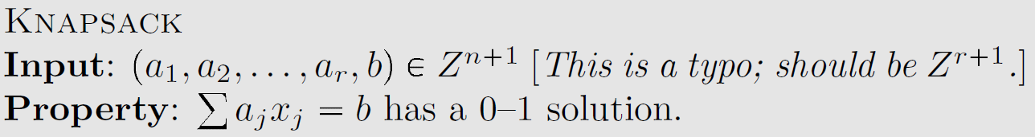
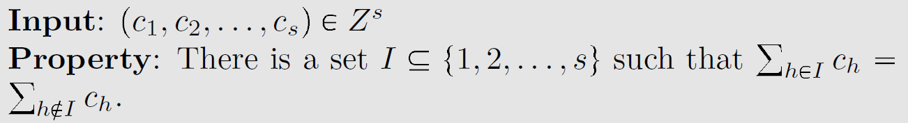
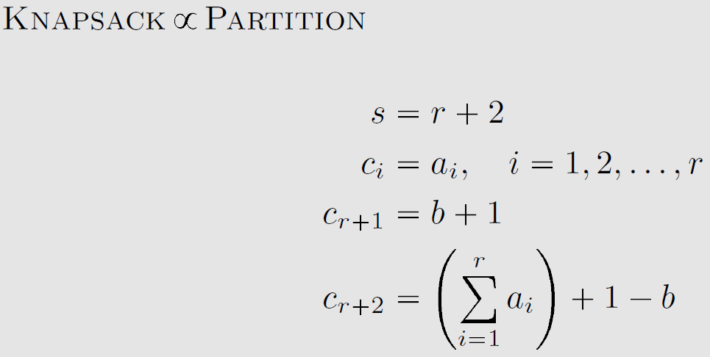
Karp’s definition of Knapsack
Karp’s definition of Partition
Karp’s reduction from Knapsack to Partition
Ouch. This is again very terse.
Why does it work?

Slide 15
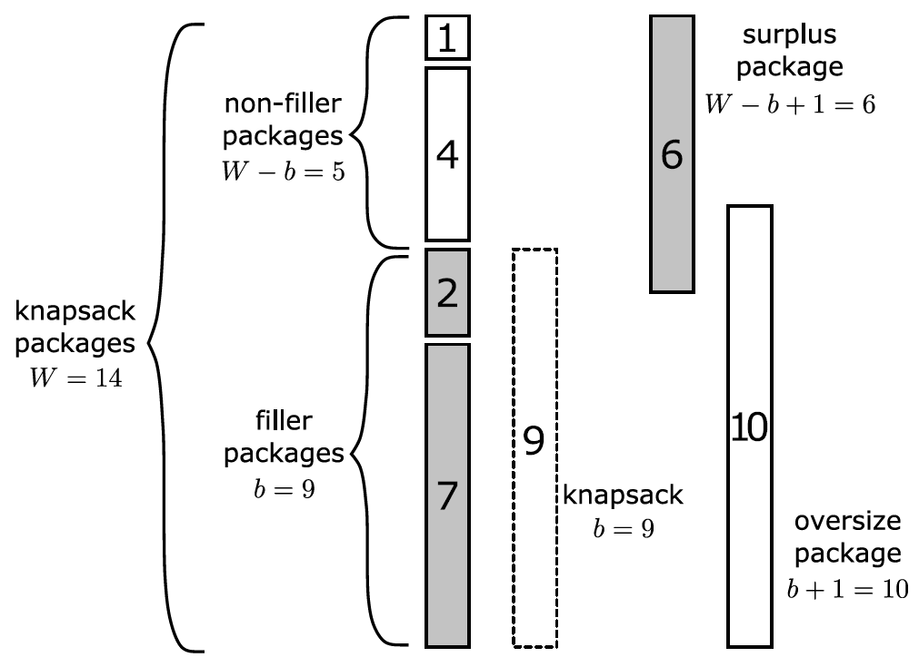
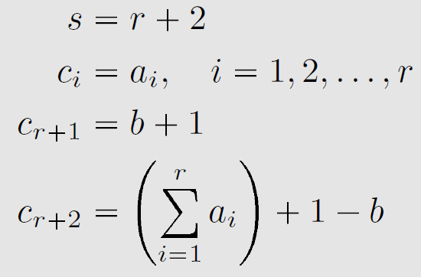
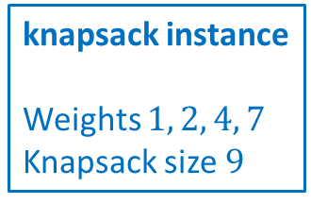

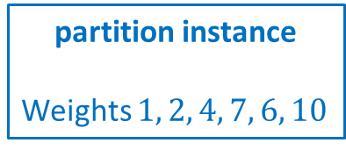
Example of $\text{Knapsack}≤_{P}\text{Partition}$
knapsack instance
Weights $1, 2, 4, 7$
Knapsack size $9$
partition instance
Weights $1, 2, 4, 7, 6, 10$
Exercise: prove this maps positive to positive and negative to negative
Karp’s notation

Slide 16
The rest of the paper: NP-hardness and more
Doesn’t explicitly define NP-hardness, but shows an awareness of it
Discusses possibility of problems lying strictly between P and NP:
Karp’s examples include graph isomorphism, primality, and linear programming
Since then, polynomial time algorithms have been found for primality and linear programming … and we seem to be close for graph isomorphism too
Modern examples would include integer factorization and discrete logarithm

