Slide 1
18. Conclusion: What will be computed?
Lecture slides for What Can Be Computed?

Slide 2
The big ideas about what can be computed
Uncomputable problems exist (i.e. some programs are impossible)
Universal computers and programs exist
All reasonable computational models can solve the same set of problems
The set of “reasonable” models includes Turing machines, Python programs, Java programs, quantum computers and algorithms, multicore computers, nondeterministic algorithms, and all physical systems described by current theories of physics.
This statement is one version of the Church-Turing thesis, which can also be regarded as a physical law. More expansive versions of the Church-Turing thesis place human brains and all other forms of consciousness into the same class of computational models as Turing machines.

Slide 3
The big ideas about what can be computed (part II)
Reductions let us prove that many uncomputable problems exist
And in fact, Rice's theorem yields infinite families of uncomputable problems
Finite automata cannot solve the same set of problems as Turing machines
To determine whether an algorithm is practical, we need to understand its absolute running time and its asymptotic running time
The single most important property of a computational problem is, can the problem be solved in polynomial time?

Slide 4
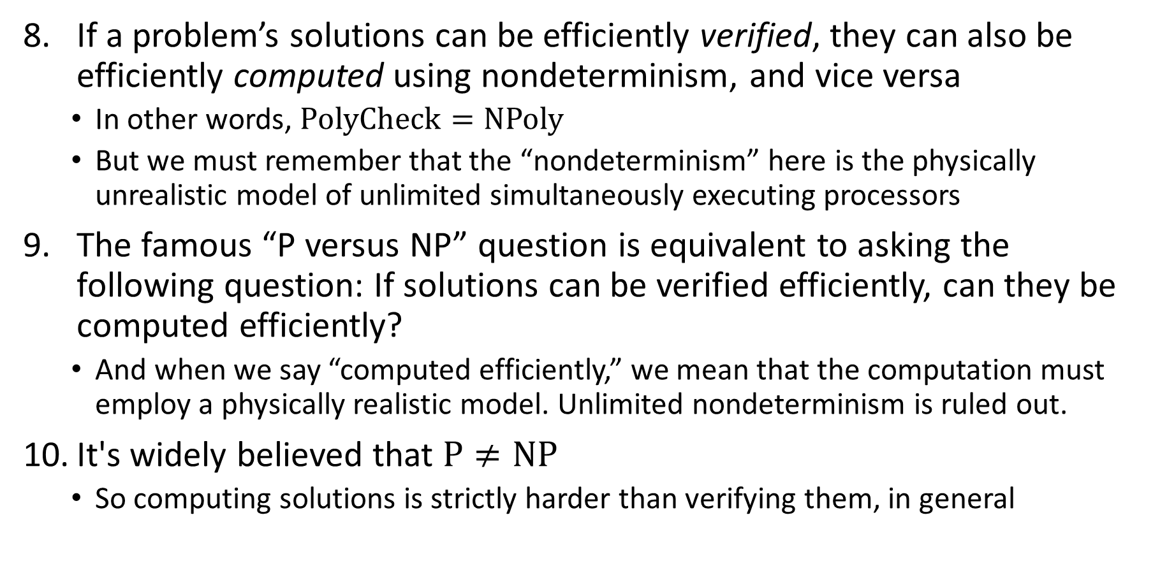
The big ideas about what can be computed (part III)
If a problem’s solutions can be efficiently verified, they can also be efficiently computed using nondeterminism, and vice versa
In other words, $\text{PolyCheck}=\text{NPoly}$
But we must remember that the “nondeterminism” here is the physically unrealistic model of unlimited simultaneously executing processors
The famous “P versus NP” question is equivalent to asking the following question: If solutions can be verified efficiently, can they be computed efficiently?
And when we say “computed efficiently,” we mean that the computation must employ a physically realistic model. Unlimited nondeterminism is ruled out.
It's widely believed that $\text{P}≠\text{NP}$
So computing solutions is strictly harder than verifying them, in general

Slide 5
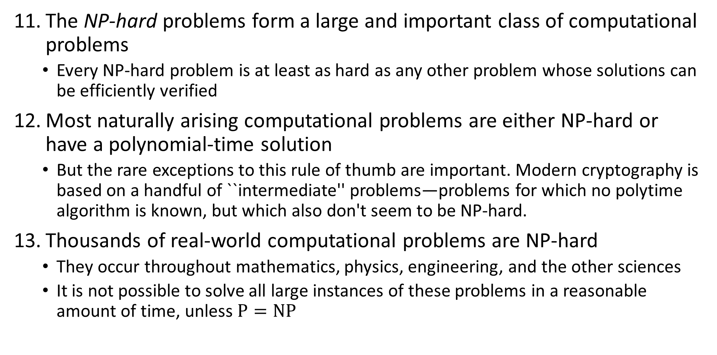
The big ideas about what can be computed (part IV)
The NP-hard problems form a large and important class of computational problems
Every NP-hard problem is at least as hard as any other problem whose solutions can be efficiently verified
Most naturally arising computational problems are either NP-hard or have a polynomial-time solution
But the rare exceptions to this rule of thumb are important. Modern cryptography is based on a handful of ``intermediate'' problems—problems for which no polytime algorithm is known, but which also don't seem to be NP-hard.
Thousands of real-world computational problems are NP-hard
They occur throughout mathematics, physics, engineering, and the other sciences
It is not possible to solve all large instances of these problems in a reasonable amount of time, unless $\text{P}=\text{NP}$

