Slide 1



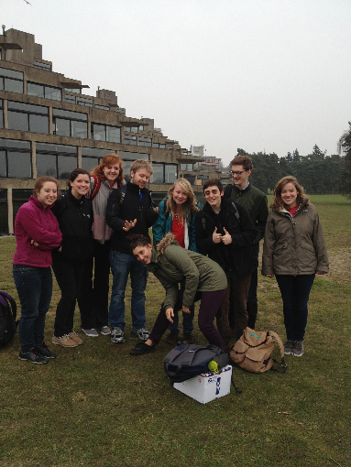
Norwich Science Program – Fall’17
Pre-Departure Info Session
John MacCormick (Local coordinator)

Slide 2
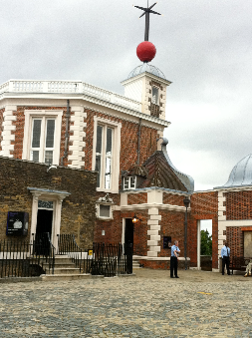

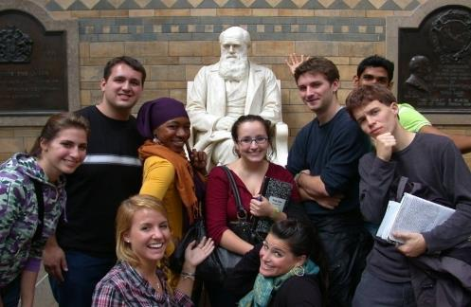


What Will You Do?
Fall Term:
SCI258 - History of science and technology through the lens of London
See course description
London and Surrounds
Aug 30 – Sept 15
Bath and Surrounds
Sept 16 – Sept 20
Continues in Norwich
3 Courses at UEA

Slide 3
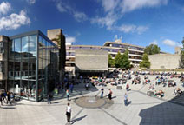
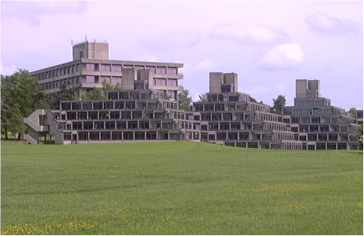
Academic Experience
British Universities in general and UEA specifically are different than Dickinson
Larger lectures
Independent reading lists
Few assignments / assessments
All finals follow spring semester
Finals are heavily weighted
Fall-only students must complete course via the “coursework-only” option (all exams are in the spring, even for fall courses)
Notes:
Day to day schedules of readings and homework are very uncommon.
You may have a topic schedule – it is then your responsibility to identify the relevant reading and complete it.
Few assignments during the semester
Really really important for you to keep up on your own.
Not uncommon for 70-100% of the grade for a course to be determined by the final.

Slide 4
Selecting Courses
UEA Course Catalogue:
https://www.uea.ac.uk/study/study-abroad/incoming/what-can-i-study
NSP Students take 60 UCU (= 3 Dickinson Credits)
Must take at least 40 UCU (typically 2 modules) in your school.
May take up to one module (up to 20 UCU) outside your school.
Module = Dickinson course
School = Dickinson Department
Notes:
Show course catalogue web page.
UCU = University Credit Units
Module = course
Faculty = Division
Will be Sciences or Social Sciences or Arts and Humanities depending upon your major.
It will be whichever you sign up for the most courses in.
Some courses are 10UCU
Often Mathematics
Take more of these to makeup 60 UCU

Slide 5
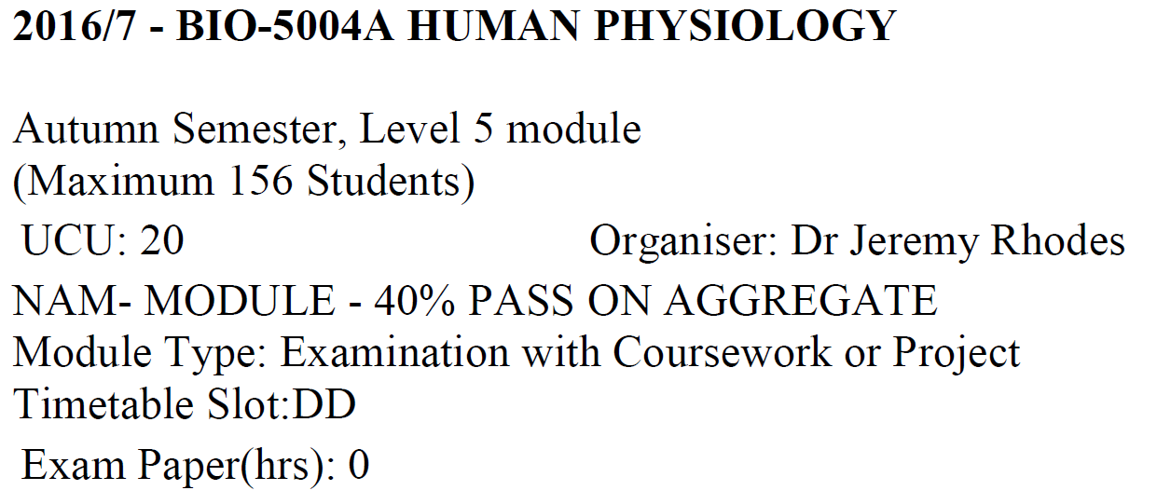
Course Catalogue Entries
Course Level:
4xxx = Dson 100-200 level
5xxx = Dson 200-300 level
6xxx = Dson 300-400 level
Grading:
Examination is in June!!
Probably has coursework-only option – you need to check in 1st week of semester
Semester:
A = Autumn (i.e. Fall)
Credits:
20 UCU = 1 Dickinson Credit
Meeting Times:
See Timetable /
Slotting Slides
Notes:
Course Level: British University is 3-years. Students do general education in additional years of HS before going to university.
So their level 4 is often our 200 level
2 is 200-300 level
Etc…
Most students take courses at 200 level. Some have done 300 level and occasionally 100 level for a 3rd non-major course.
Don’t ask why 4 is first level and 2, 3 are the next levels… best just to go with the flow on these things at the UEA!

Slide 6
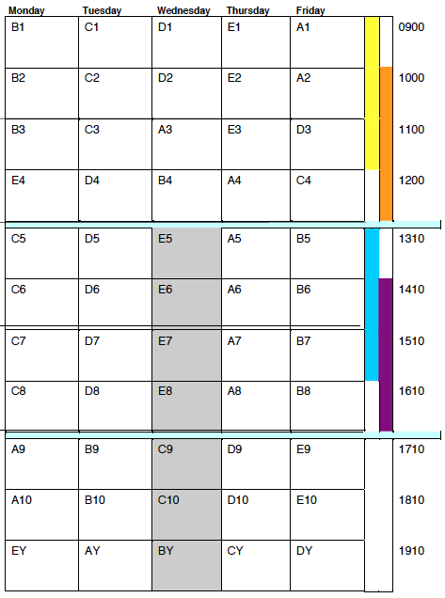
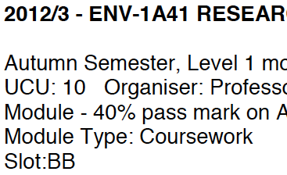
Timetable / Slotting
Major Slot Letter Example:
May meet in any/all slots labeled B.
Cannot schedule any other course that meets in a B slot
Will not conflict with any courses in slots starting with A, C, D, E.
Similar for AA, CC etc…
X
X
X
X
X
X
X
X
X
X

Slide 7
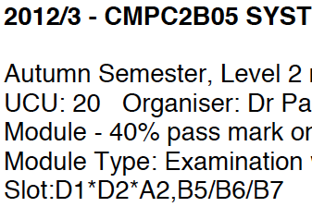
Timetable / Slotting
Lecture + Group Example:
(*) Meets as lecture in D1, D2 and A2.
(/) Meets as alternative group in B5 or B6 or B7
X
X
X
X
X
X
Notes:
Alternative group – lab or recitation problem solving session.

Slide 8
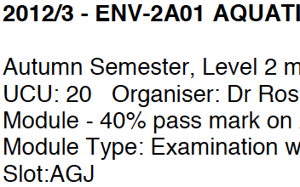
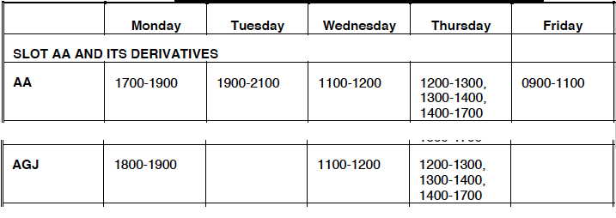
Timetable / Slotting
Derivative Sub-Slot Example:
X
X
X
X
X
X
X

Slide 9
To Do!!
Review Course Catalogue and Timetable Slotting System
https://www.uea.ac.uk/study/study-abroad/incoming/what-can-i-study
Pick 3 courses of interest + 2 alternates for each
Must have 40 UCU in one school
Mark courses on the timetable to avoid time clashes!
Talk with your advisor about transfer credits, major requirements and distribution requirements.
Be prepared to request courses during our meeting next Tue 4/18 noon in Althouse 204
Start the online UEA Study Abroad Application with Module Enrollment Form (use the very helpful instructions)

Slide 10
Preview of visa application
All students must obtain a visa in advance
Even though the UK government permits US citizens studying for only one semester to obtain a visa on arrival, UEA does not permit this approach
Online applications can’t be submitted until 90 days before arrival date
Prepare your online application in advance and submit it as soon as possible after the 90-day window opens (i.e. in the first week of June)
One-semester students get a “short-term study visa”; all-year students get a “Tier 4 (General) student visa”

