Slide 1
Thinking AI
John MacCormick
(Dickinson College, Pennsylvania + Visiting Academic in Computer Science,
University of Auckland)
How Artificial Intelligence Emulates Human Understanding
May 2025
Things fall apart; the centre cannot hold; Mere anarchy is loosed upon the world, The blood-dimmed tide is loosed, and everywhere The ceremony of innocence is drowned
w b yeats, 1919
Upon the upland road
Ride easy, stranger:
Surrender to the sky
Your heart of anger.
james k baxter, 1948
What you should probably do before you rush to build something is to figure out what the adverse consequences might be.
latanya sweeney, 2020

Slide 2
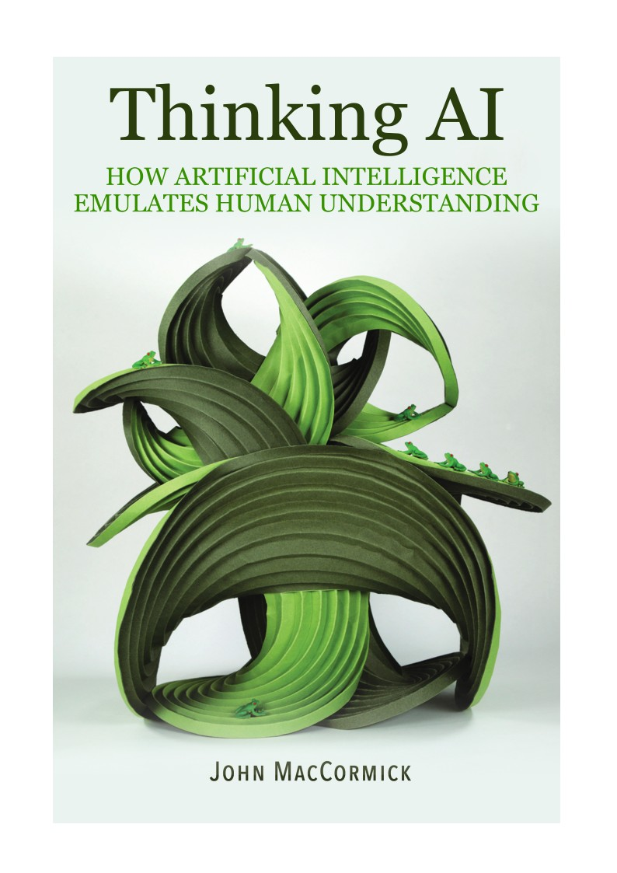
Targets non-expert audience
Uses examples from real AI systems to demonstrate some similarities between computer programs and human brain processes.
Connects with philosophy of AI: How should we feel about the fact that computers can think like humans?
DEEP FAKE

Slide 3
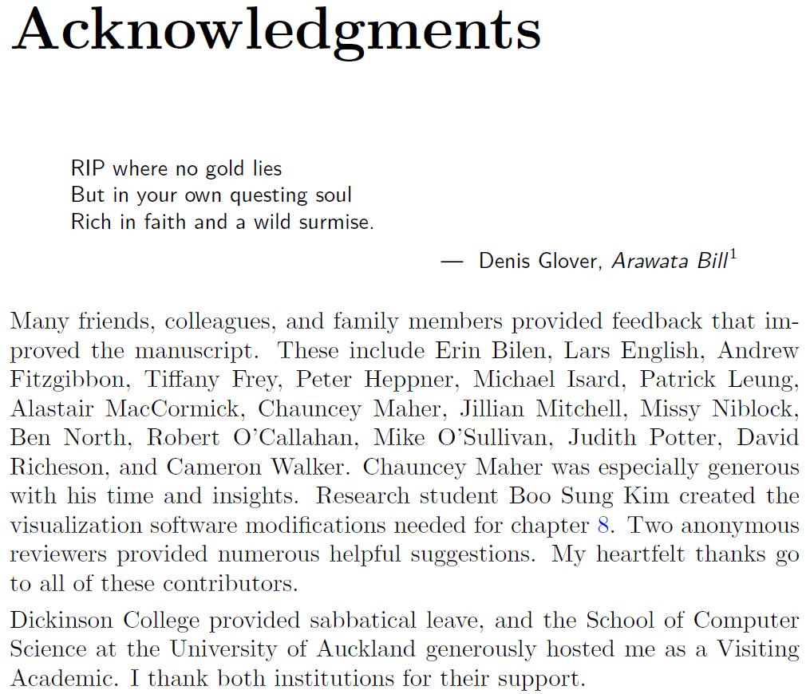







Slide 4

Conclusions
AI programs achieve the appearance of thinking or understanding via emergence
Example 0: full brain simulation
Example 1: deep convolutional neural networks for object recognition
Example 2: deep nets + reinforcement learning for discovering creative strategies in games
Example 3: transformer neural networks for understanding connections between concepts
We can still be happy and fulfilled in the presence of artificial human-like intelligence.

Slide 5
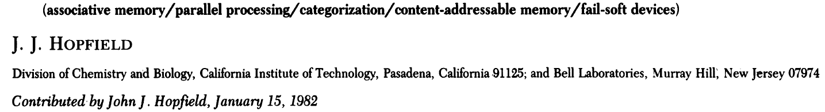

Emergent phenomena arise from the interactions of many simple components
one water molecule is not fluid
one gold atom is not metallic
one neuron is not conscious
one amino acid is not alive
– Jochen Fromm, The Emergence of Complexity (2004)

Slide 6

Conclusions
AI programs achieve the appearance of thinking or understanding via emergence
Example 0: full brain simulation
Example 1: deep convolutional neural networks for object recognition
Example 2: deep nets + reinforcement learning for discovering creative strategies in games
Example 3: transformer neural networks for understanding connections between concepts
We can still be happy and fulfilled in the presence of artificial human-like intelligence.

Slide 7
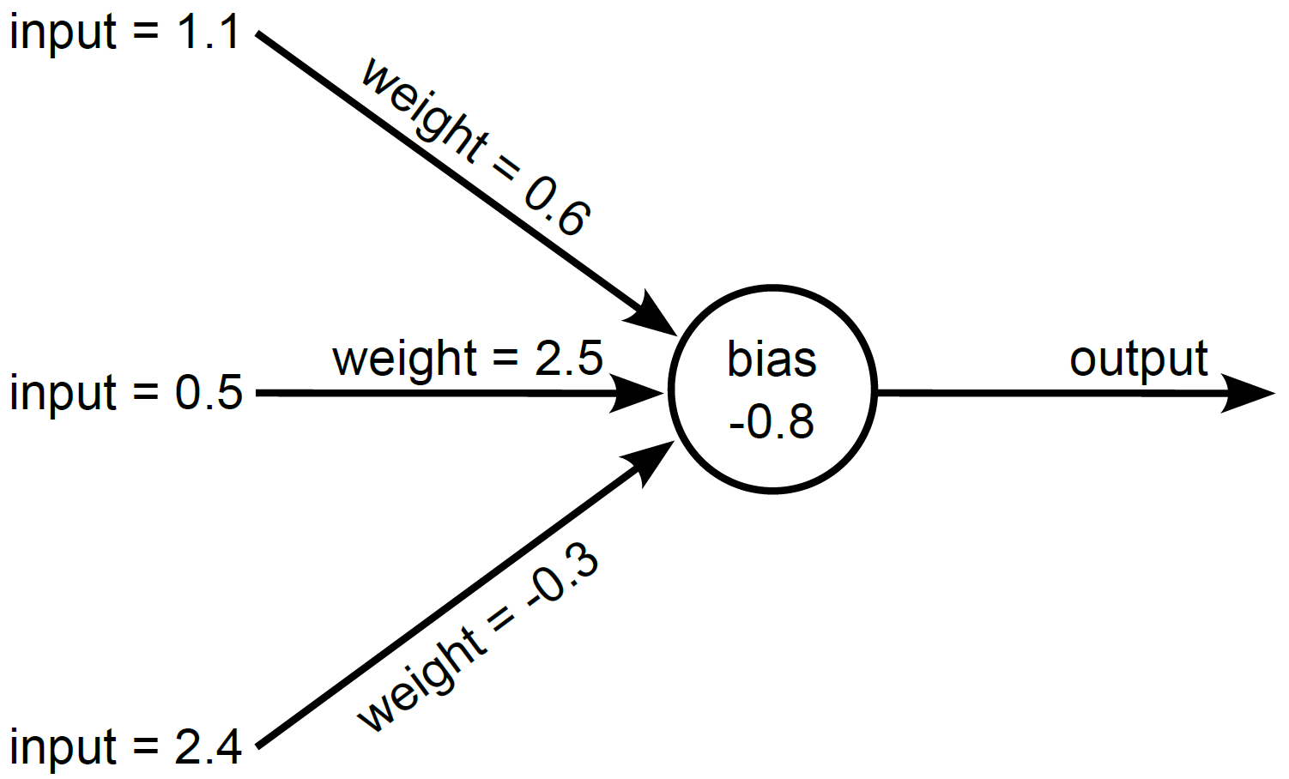
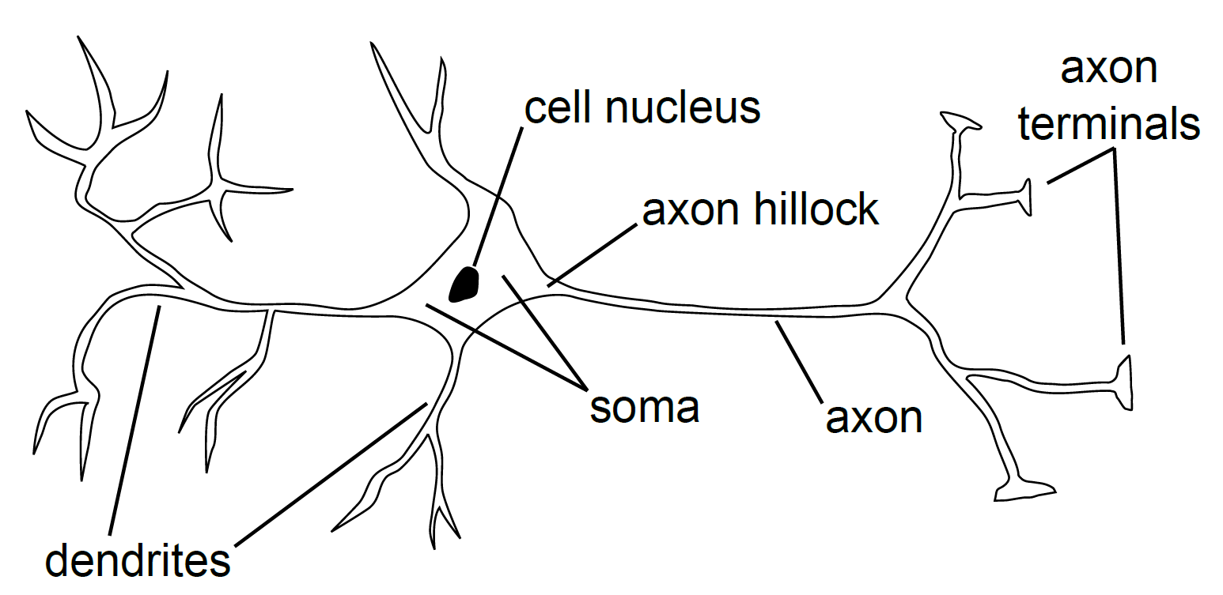
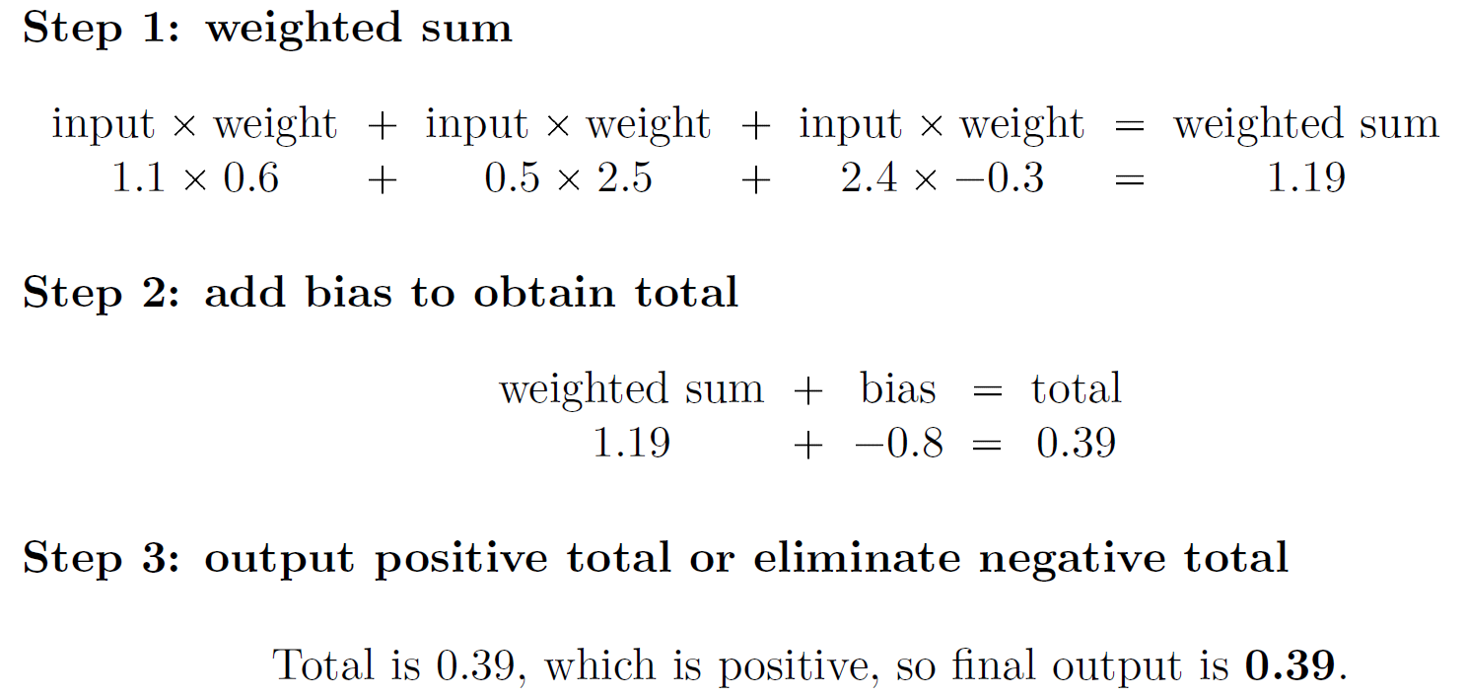
An artificial neuron is an extremely simple mathematical model inspired by biological neurons
Artificial neuron
Biological neuron

Slide 8
























Emergent AI example 1: Deep neural networks can discover visual features
output
input
wheelbarrow 0.14
About 10 layers, 15 million neurons, >100 million connections
rabbit 0.27
1000 output categories

Slide 9
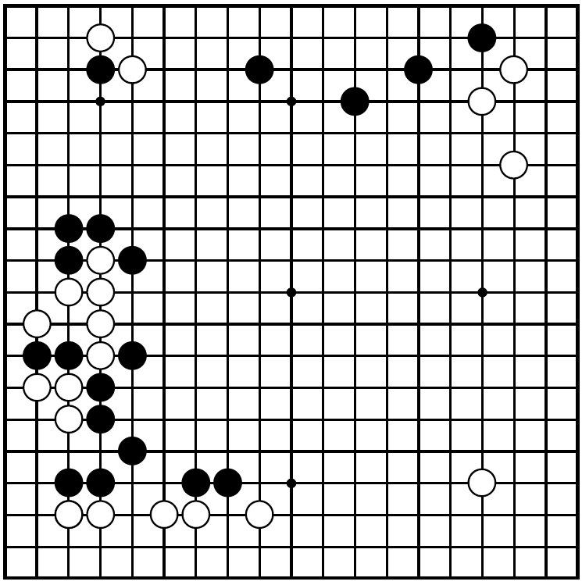
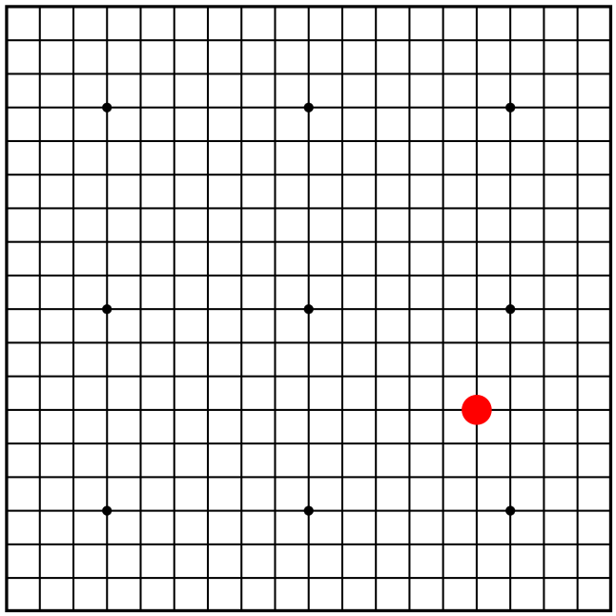





Emergent AI example 2: AlphaGo Zero (deep net + reinforcement learning) uses strategies that are creative and insightful
input
output
Dozens of layers, 20 million neurons, 50 million connections
Input to algorithm: only the game rules i.e., what are the legal moves and what is the score at the end of the game
Train by reinforcement learning: plays millions of games against itself, adjusting parameters to favor winning strategies

Slide 10
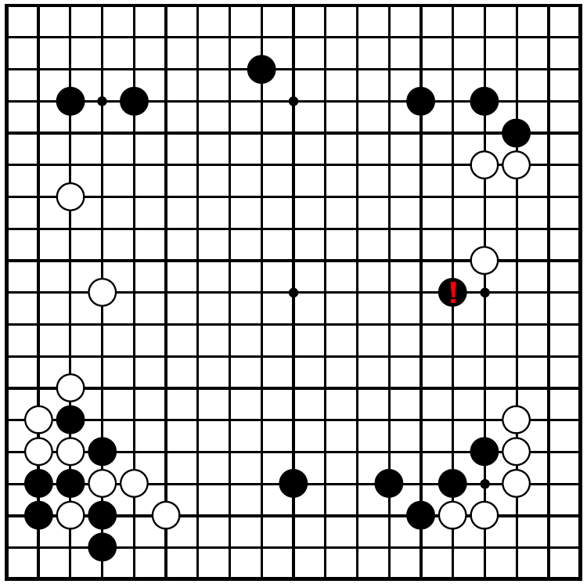


Emergent AI example 2: AlphaGo Zero (deep net + reinforcement learning) uses strategies that are creative and insightful
Main results:
Easily defeats all humans
Makes moves that experts consider creative
e.g. the famous “fifth line shoulder hit” by AlphaGo in game 2 against Lee Sedol
Spontaneously discovered jōseki (known strategic sequences)
e.g. “5-3 point press”, “small avalanche”
These are actions that, if performed by a human, would be described as creative or insightful

Slide 11
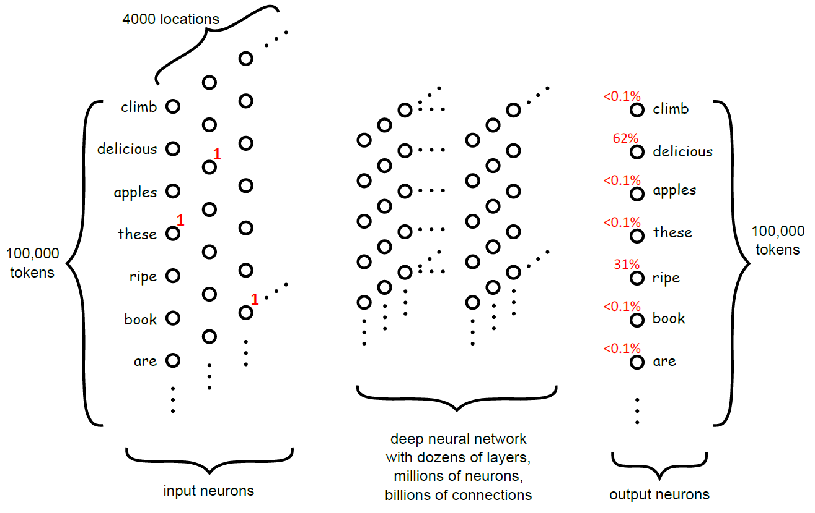





















Emergent AI example 3: Transformers can appear to understand connections between concepts
input
output
Completion: “delicious”
Prompt: “These apples are”

Slide 12
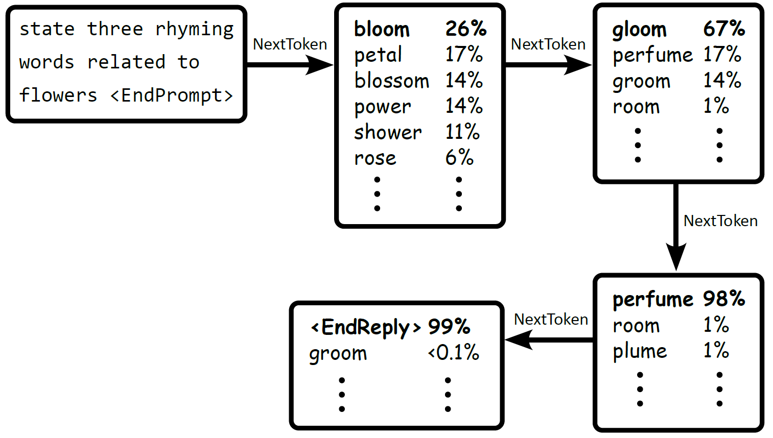

Emergent AI example 3: Transformers can appear to understand connections between concepts
input
State three rhyming words related to flowers <EndPrompt>
output
bloom
gloom
perfume

Slide 13
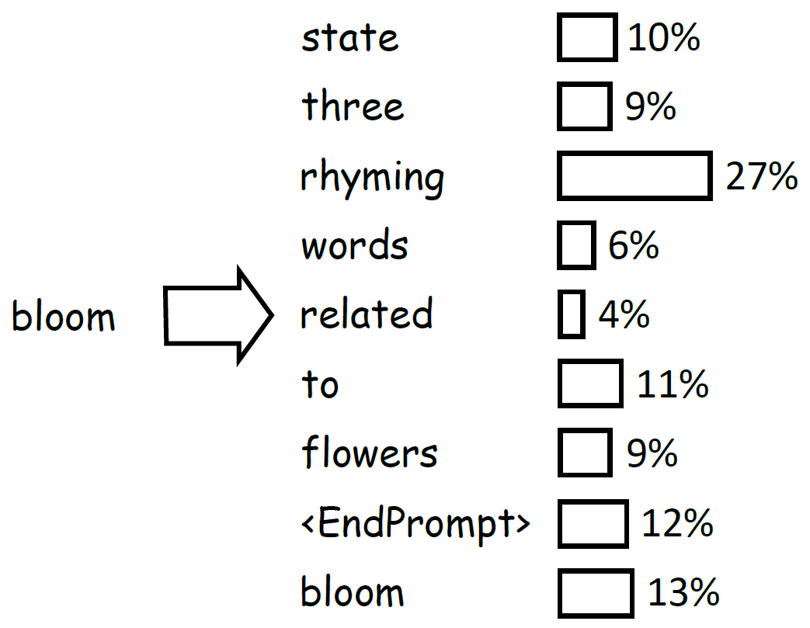
In a transformer, some circuits calculate attention scores, which are used to combine and connect concepts
attention calculation
This is the 1st of 12 attention layers.
Attentions in the 2nd layer combine combinations of concepts.
The 3rd layer combines combinations of combinations of concepts, and so on.
input
State three rhyming words related to flowers <EndPrompt> bloom

Slide 14
Emergent AI example 3: Transformers can appear to understand connections between concepts
input
State three rhyming words related to flowers <EndPrompt>
Emergent understanding?
“Related to flower”
+
“rhymes with bloom”
→
“perfume”
output
bloom
gloom
perfume

Slide 15
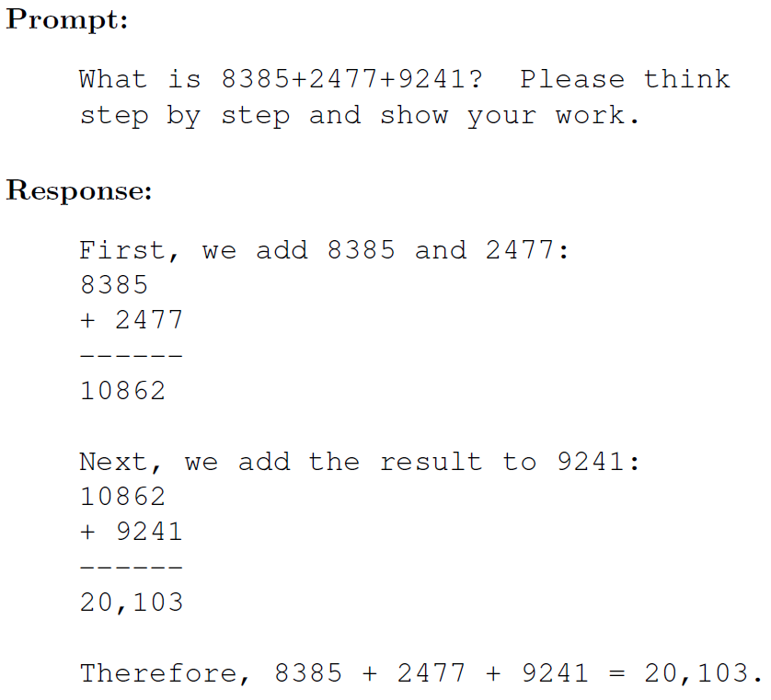
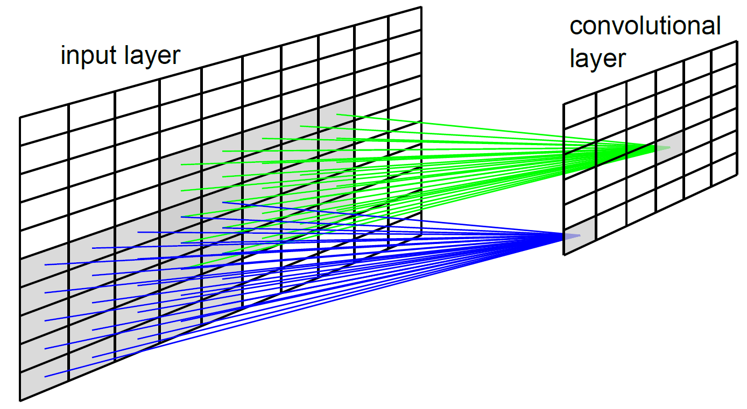
Here are some other ways AI programs resemble brain processes, without using emergence:
Convolutional processing
Neurons employ locality, sparsity, tied weights
Reinforcement learning
Dopamine and other neurotransmitters enable reinforcement learning in the brain
Chain-of-thought reasoning in large language models
Similar to the internal monologue employed by humans
Related to System 1 and System 2 in psychology

Slide 16
Conclusions
AI programs achieve the appearance of thinking or understanding via emergence
Example 0: full brain simulation
Example 1: deep convolutional neural networks for object recognition
Example 2: deep nets + reinforcement learning for discovering creative strategies in games
Example 3: transformer neural networks for understanding connections between concepts
We can still be happy and fulfilled in the presence of artificial human-like intelligence.

Slide 17




Analogy: compare the “death of vitalism” to the “death of dualism”
Vitalism: Living organisms possess a vital force or substance that animates them.
BUT
Modern biochemistry explains all properties of living organisms in terms of physical and chemical processes.
THEREFORE
For many non-experts, vitalism is not credible.
Dualism: Human brains possess a mental force or substance that enables them to reason.
BUT
Neuroscience and cognitive science will eventually explain all properties of brains in terms of physical and chemical processes.
THEREFORE
For many non-experts, dualism will eventually lose credibility.

Slide 18
But does AI really “think” / “understand”?
My answer: Yes, I believe emergent AI can resemble human thinking and understanding so closely that there is no meaningful difference.
Turing, “Computing Machinery and Intelligence” (Mind, 1950):
The reader will have anticipated that I have no very convincing arguments of a positive nature to support my views. If I had I should not have taken such pains to point out the fallacies in contrary views. Such evidence as I have I shall now give.
Emergent AI
Example 1: deep convolutional neural networks for object recognition
Example 2: reinforcement learning for discovering creative strategies in games
Example 3: transformer neural networks for understanding connections between concepts
Melanie Mitchell, Artificial Intelligence: A Guide for Thinking Humans (2019):
These systems don't understand photos in the sense that humans understand them.

Slide 19


Maybe computers can eclipse our greatest creative, artistic, and scientific achievements. So what? Let's just build and use AI systems that improve our lives and help us feel happy.
love
friendship
humor
religious faith
scientific insight
creation of literature, music, and art
These can probably be emulated perfectly by AIs.
But that doesn't take them away from humans.
We can continue to love, pray, laugh, ...
Maybe AIs can help us feel even more fulfilled while doing so.

Slide 20

Conclusions
AI programs achieve the appearance of thinking or understanding via emergence
Example 0: full brain simulation
Example 1: deep convolutional neural networks for object recognition
Example 2: deep nets + reinforcement learning for discovering creative strategies in games
Example 3: transformer neural networks for understanding connections between concepts
We can still be happy and fulfilled in the presence of artificial human-like intelligence.

Slide 21
Extra slides on brain simulation

Slide 22
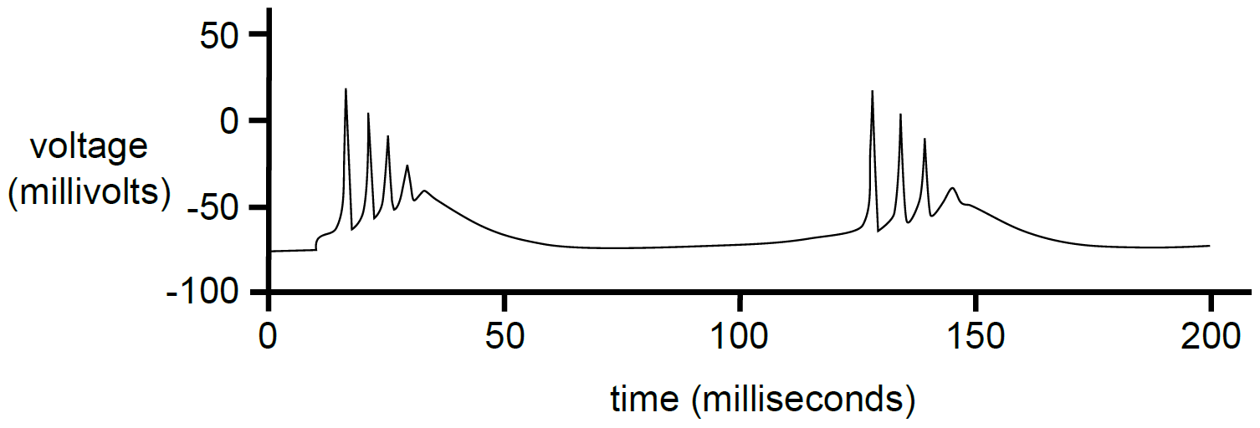
Biological neurons produce a burst of output called a spike train if they receive enough input

Slide 23
In principle, computers can simulate brains
The physiology and biochemistry of neurons is reasonably well understood
Computational neuroscientists build models that simulate, for example:
perception
memory
learning
Therefore, in principle, any human brain process can be simulated
The resulting emulation of “thinking” or “understanding” is an example of emergent AI

Slide 24
In principle, computers can simulate brains
BUT
It’s not practical: too low-level.
Serious challenges include scale, input/output
It's not very interesting.
Let's build useful AI systems that help/complement humans

Slide 25
Extra slides on philosophy of cognition

Slide 26
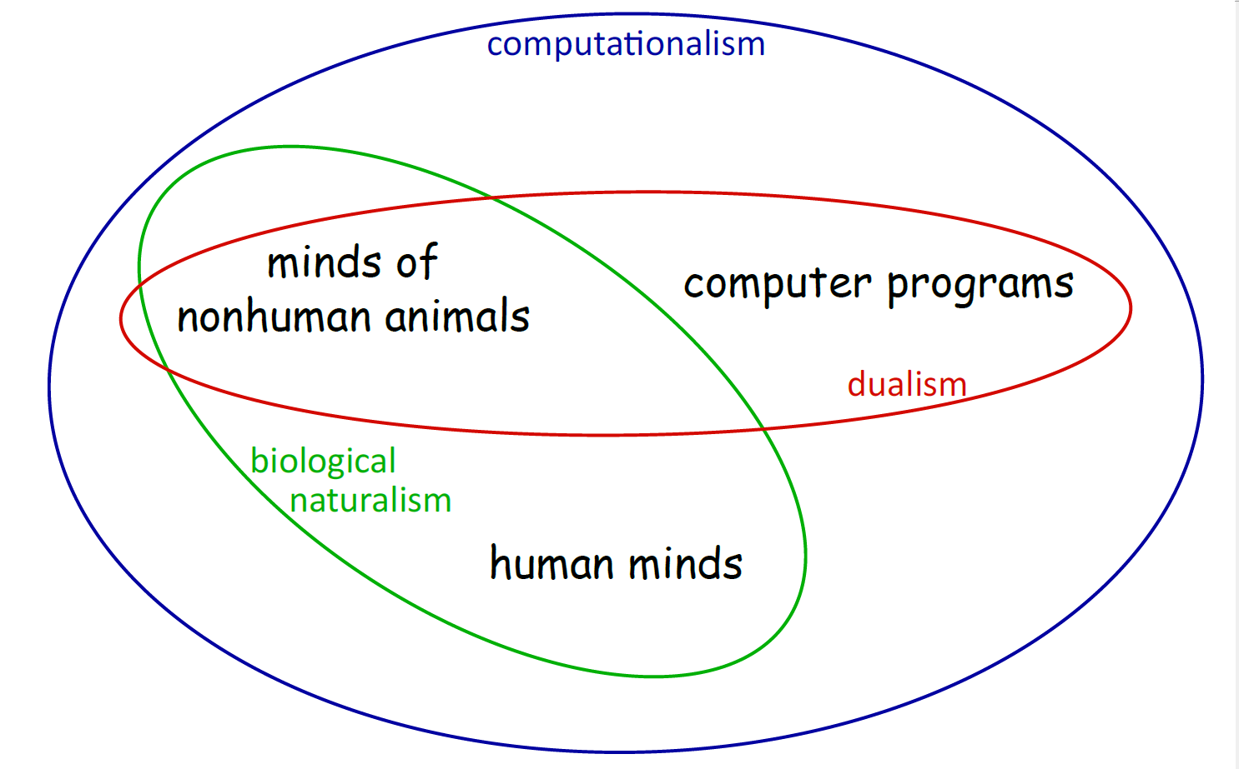
Computationalism seems to be the most plausible philosophy of cognition
Computationalism: brains and computer programs are equivalent
Dualism: human minds have a special mental force/substance that is not possessed by animals or computer programs
Biological naturalism: human and animal minds are qualitatively the same, varying only in complexity -- but computer programs cannot replicate them

