Slide 1
An accessible theory course, FOSS in the capstone, and other stories:
an overview of CS education research at Dickinson College
John MacCormick (Dickinson College; Visiting Academic in Computer Science at University of Auckland)
August 2024

Slide 2
Plan of talk
Background:
Who am I?
What is Dickinson College?
Four CS education projects at Dickinson:
Pair programming: the benefits of pairing by ability
Novel, accessible theory-of-computation course (emphasizes search problems and real programs)
Incorporating large-scale HFOSS (humanitarian open-source) projects in the computer science capstone course
Injecting functional programming into core courses
Total length of talk is about 35 minutes.
Questions and comments during the talk are welcome.

Slide 3
[discuss bio, Dickinson, biased alg]

Slide 4

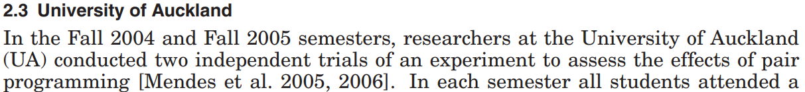
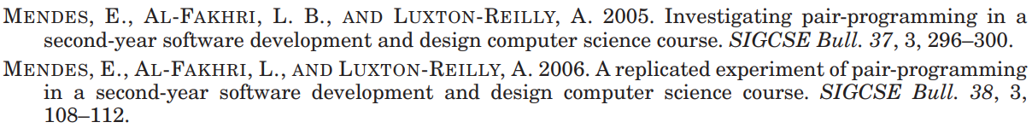


Pair programming
This study emphasized the effect of pair programming on individual programming skill
Lower-ability students score about 10% better on the individual programming exam, if they worked on programming assignments in pairs

Slide 5
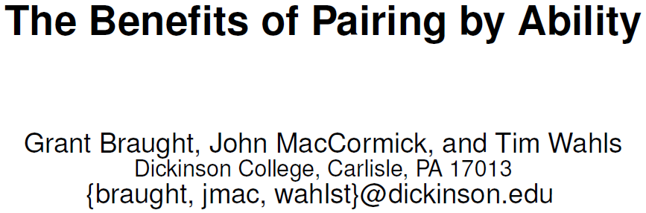
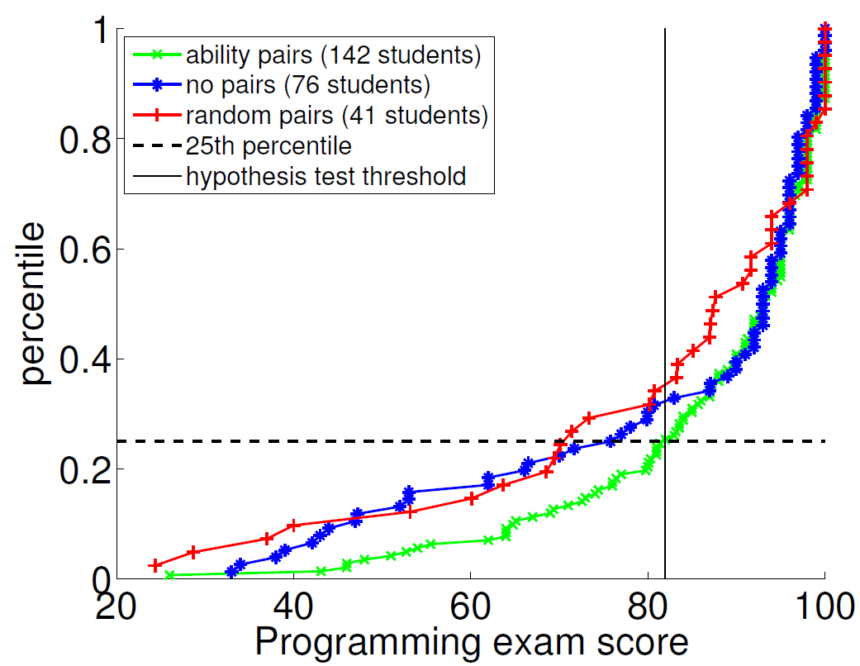
Pair programming, paired by ability
Null hypothesis: “the 25th percentile of programming exam scores for students trained with random pairs is the same as for students trained with ability pairs”
Conclusion: Lower-quartile students may perform about 10% better on the individual programming exam, if they have been paired with a partner of similar ability rather than a random partner (p=0.12)

Slide 6
Plan of talk
Background:
Who am I?
What is Dickinson College?
Four CS education projects at Dickinson:
Pair programming: the benefits of pairing by ability
Novel, accessible theory-of-computation course (emphasizes search problems and real programs)
Incorporating large-scale HFOSS (humanitarian open-source) projects in the computer science capstone course
Injecting functional programming into core courses
Total length of talk is about 35 minutes.
Questions and comments during the talk are welcome.

Slide 7
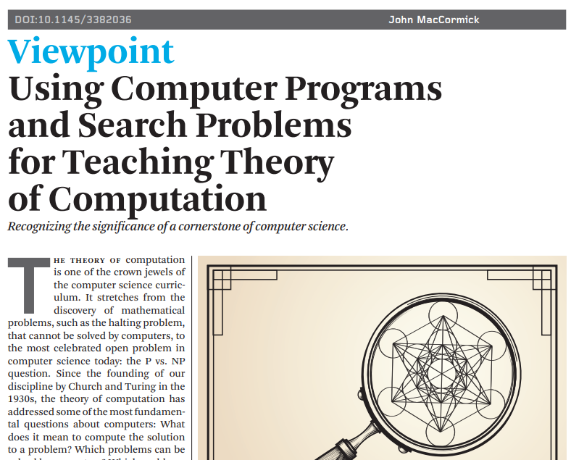

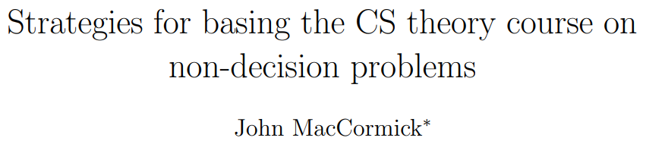
Accessible theory-of-computation course

Slide 8
How can we make the theory course more accessible, more practical, and less intimidating?
Use nondecision problems (a.k.a. search problems) as the primary paradigm
Contrasts with traditional decision problem paradigm
Use real computer programs as the primary computational model
Contrasts with traditional use of Turing machines

Slide 9
A long-term vision for the theory course
Make it more accessible and more practical
Teach it to a wider range of undergraduates in more institutions
Place it earlier in the curriculum with fewer prerequisites
How?
Use nondecision problems
Use real computer programs
Next: explain what this means

Slide 10
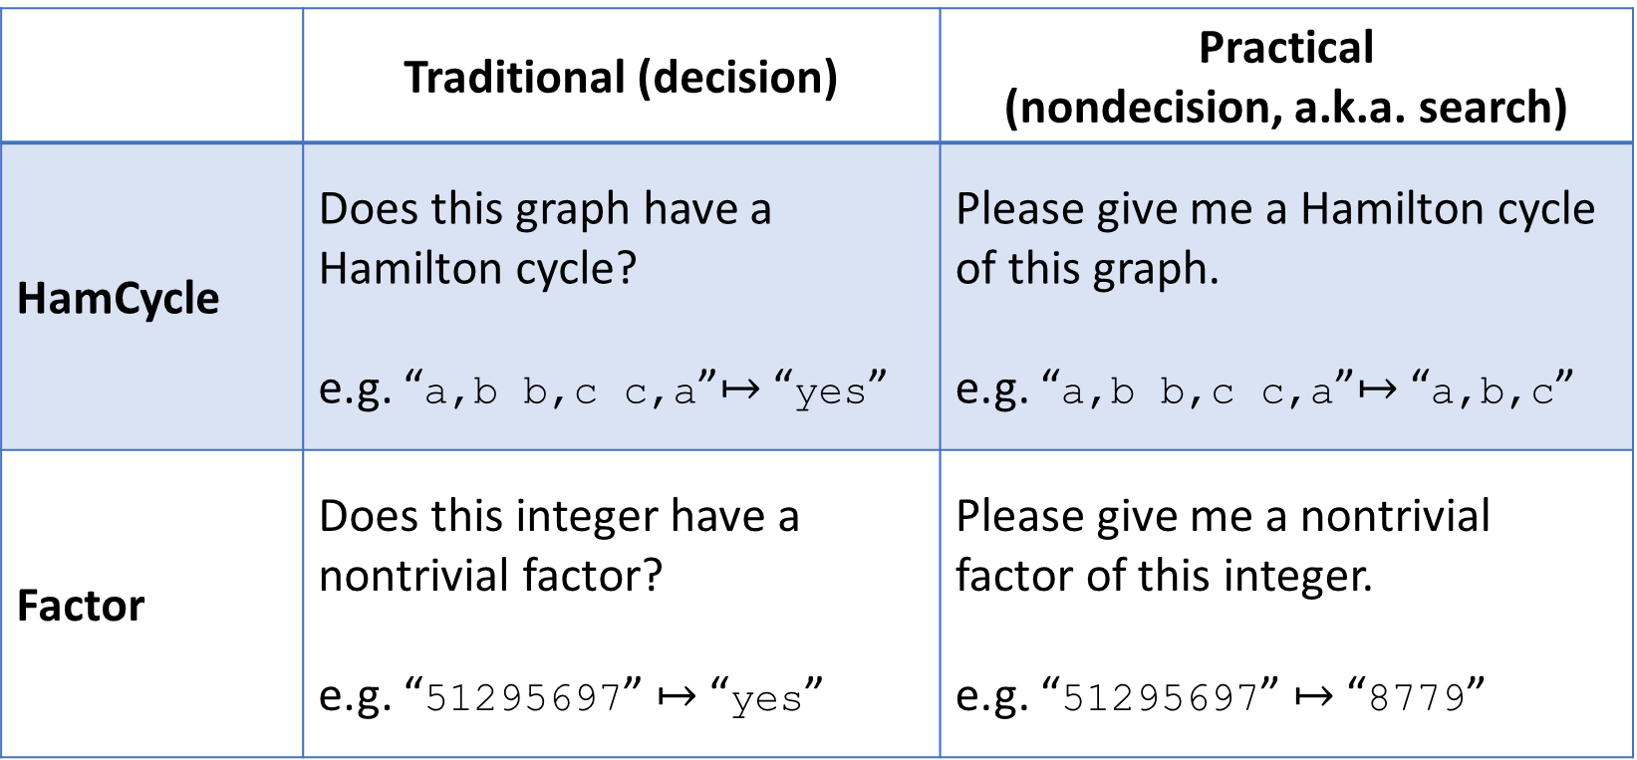

Examples of “solving a problem” instead of “deciding a language”
 | Traditional (decision) | Practical (nondecision, a.k.a. search)
HamCycle | Does this graph have a Hamilton cycle? e.g. “a,b b,c c,a”$↦$ “yes” | Please give me a Hamilton cycle of this graph. e.g. “a,b b,c c,a”$↦$ “a,b,c”
Factor | Does this integer have a nontrivial factor? e.g. “51295697” $↦$ “yes” | Please give me a nontrivial factor of this integer. e.g. “51295697” $↦$ “8779”

Slide 11
How can we make the theory course more accessible, more practical, and less intimidating?
Use nondecision problems (a.k.a. search problems) as the primary paradigm
Contrasts with traditional decision problem paradigm
Use real computer programs as the primary computational model
Contrasts with traditional use of Turing machines

Slide 12
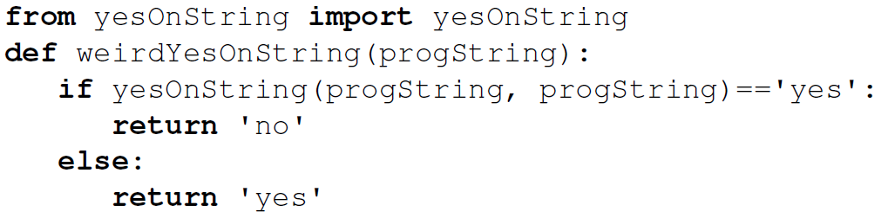
Using real computer programs permits interactive experimentation by students
Example 1: A classical diagonalization + proof by contradiction can be done explicitly in Python

Slide 13
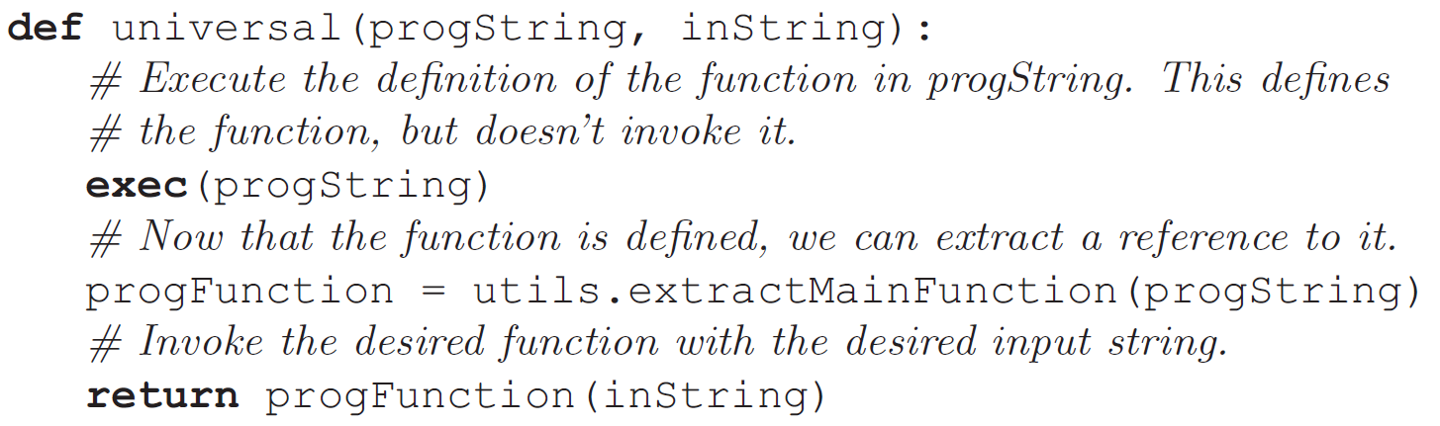
Using real computer programs permits interactive experimentation by students
Example 2: a “universal program” is much simpler than a universal Turing machine.

Slide 14
Plan of talk
Background:
Who am I?
What is Dickinson College?
Four CS education projects at Dickinson:
Pair programming: the benefits of pairing by ability
Novel, accessible theory-of-computation course (emphasizes search problems and real programs)
Incorporating large-scale HFOSS (humanitarian open-source) projects in the computer science capstone course
Injecting functional programming into core courses
Total length of talk is about 35 minutes.
Questions and comments during the talk are welcome.

Slide 15
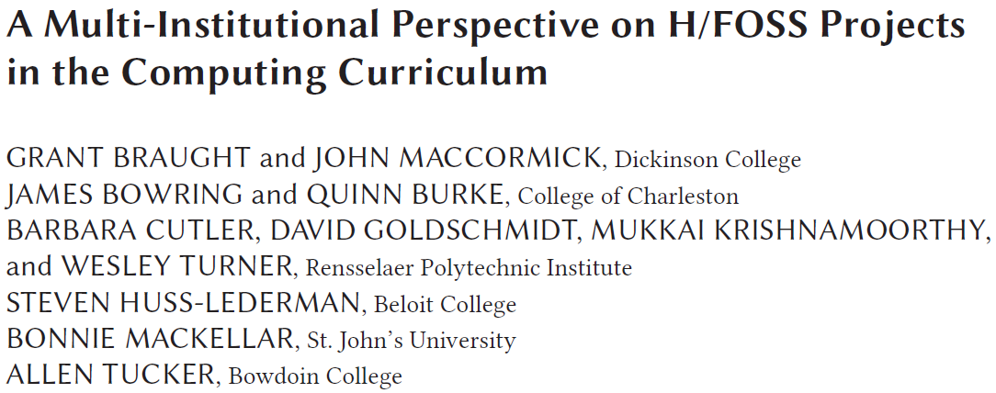
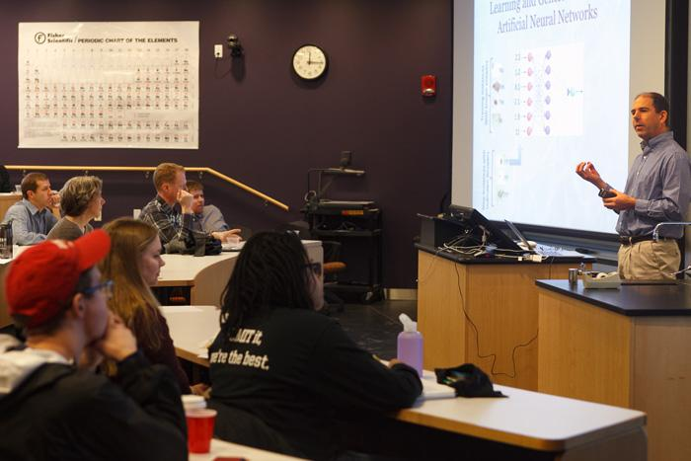
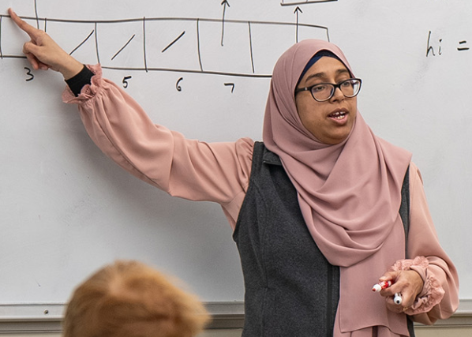
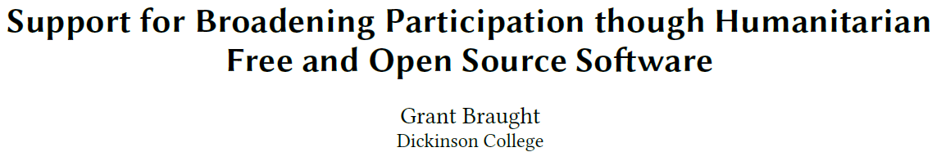
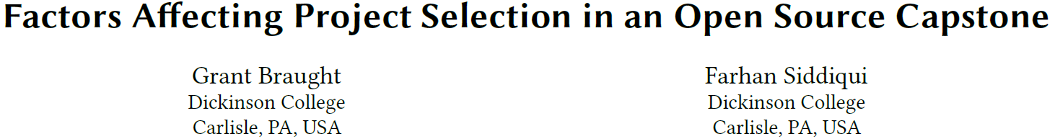

Incorporating large-scale H/FOSS (humanitarian open-source) projects in the computer science capstone course

Slide 16
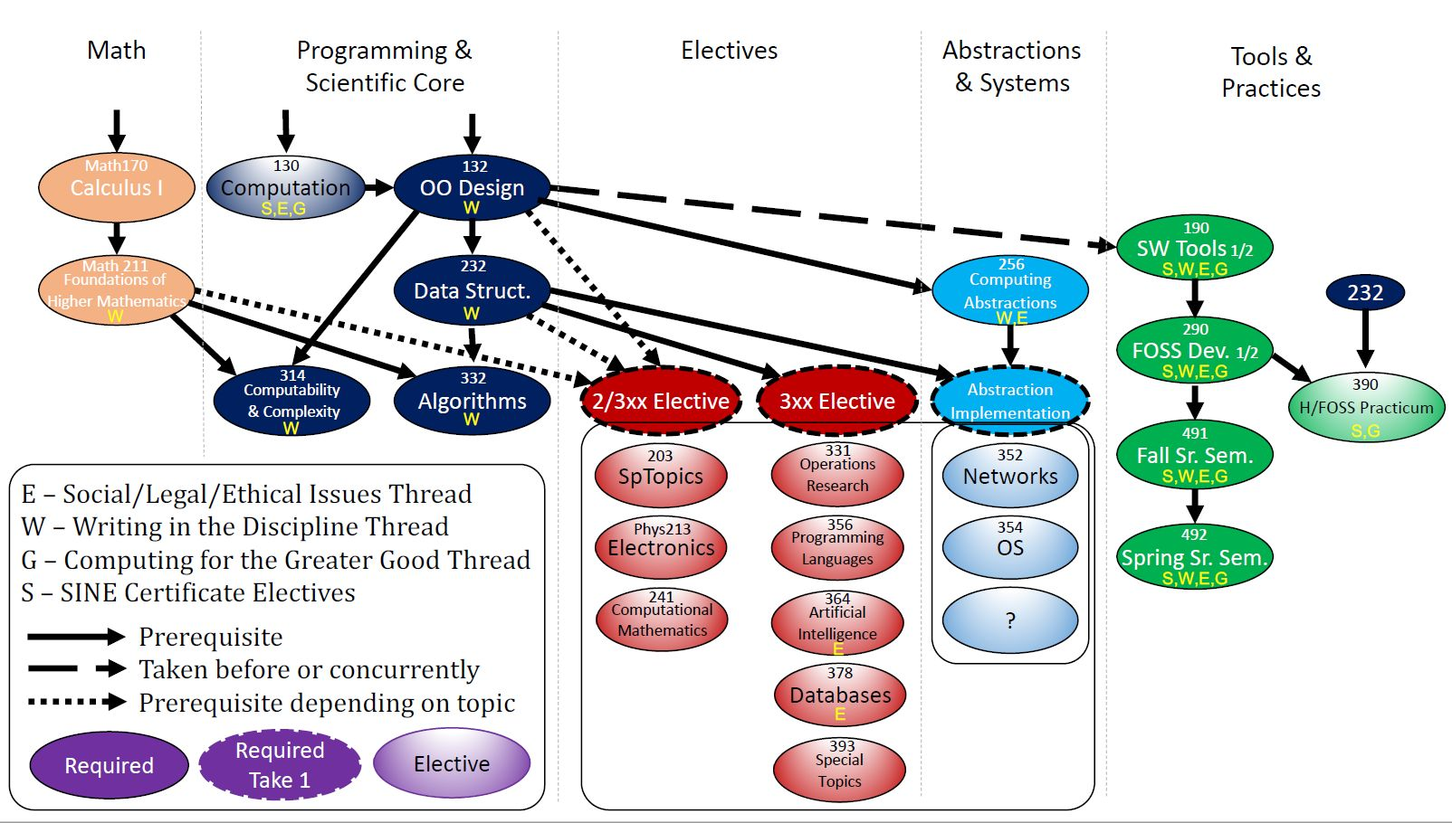
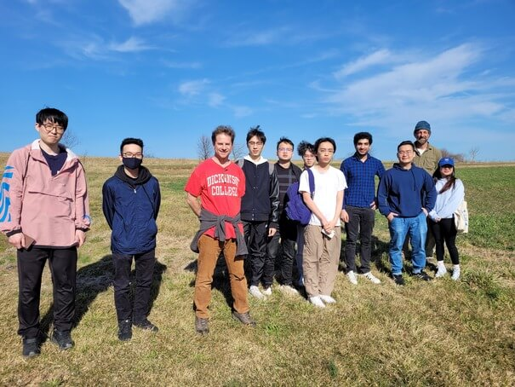

Slide 17
[demo main assignments from course schedule]

Slide 18
Potential advantages of H/FOSS in the capstone
Realism:
Large-scale code base
Professional tools (e.g. issue tracker, source control)
Communication (e.g. with external project maintainers)
Engagement:
Underrepresented groups may be more engaged by humanitarian projects
Potential disadvantage: some teams have little impact on their chosen project

Slide 19
Plan of talk
Background:
Who am I?
What is Dickinson College?
Four CS education projects at Dickinson:
Pair programming: the benefits of pairing by ability
Novel, accessible theory-of-computation course (emphasizes search problems and real programs)
Incorporating large-scale HFOSS (humanitarian open-source) projects in the computer science capstone course
Injecting functional programming into core courses
Total length of talk is about 35 minutes.
Questions and comments during the talk are welcome.

Slide 20
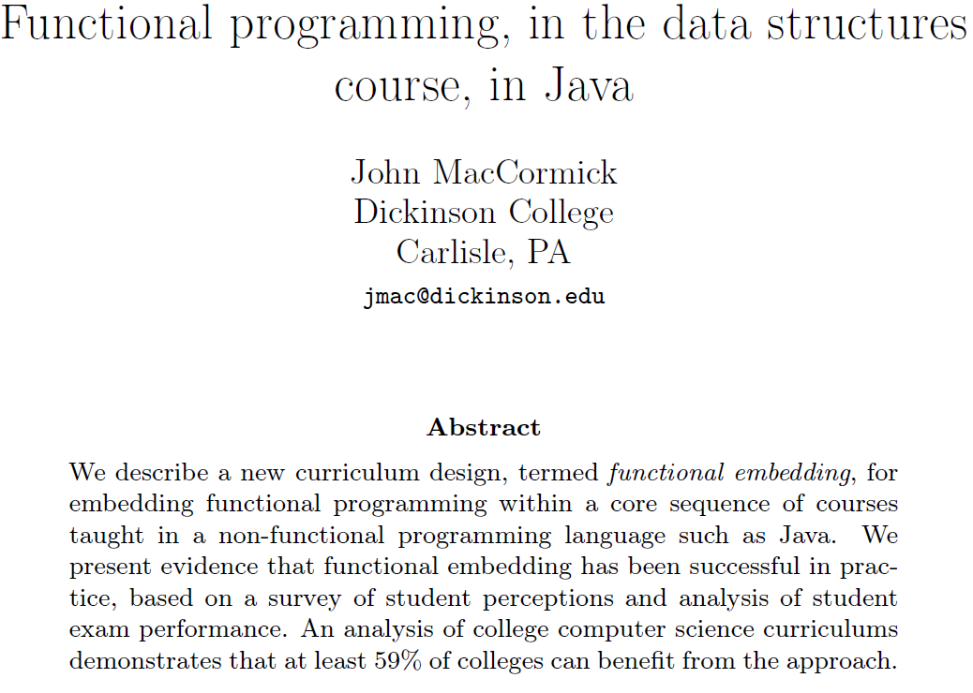
Recent work: incorporating functional programming into core courses while retaining the emphasis on imperative languages

Slide 21
Plan of talk
Thank you for listening 😊
Background:
Who am I?
What is Dickinson College?
Four CS education projects at Dickinson:
Pair programming: the benefits of pairing by ability
Novel, accessible theory-of-computation course (emphasizes search problems and real programs)
Incorporating large-scale HFOSS (humanitarian open-source) projects in the computer science capstone course
Injecting functional programming into core courses

