Slide 1
My Little Server Assignment
Done by: Ho Ting Sheng

Slide 2
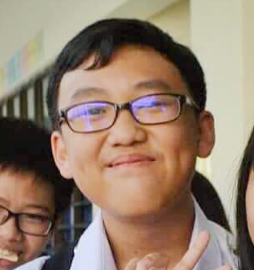
INTRODUCTION
Y1 Electrical & Electronic Engineering Student
First time doing Backend Server and Go Project~

Slide 3
ALERT!!
As a newbie,
The results will be
a bit awful🤣😞
INTRODUCTION
Y1 Electrical & Electronic Engineering Student
First time doing Backend Server and Go Project~

Slide 4
Overall View
01

Slide 5
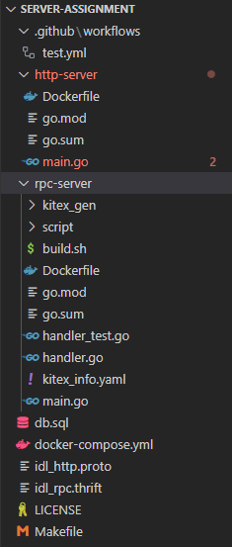
Directory
02
HTTP-Server
01
MySQL
Use MySQL as database
03
04
RPC-Server
Docker-compose

Slide 6
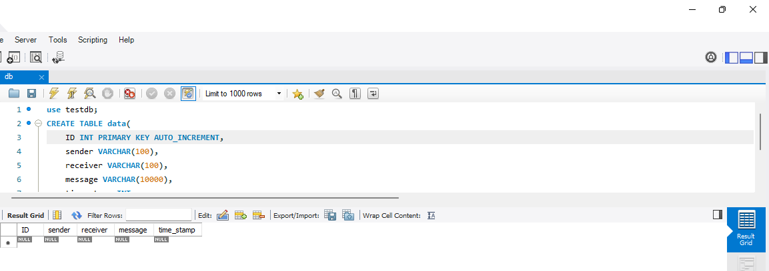
MySQL
This is what the
Database
Looks like

Slide 7
HTTP-Server
02

Slide 8
Apology
Instead of utilizing the Kitex / Hertz framework, I could only accomplish it using URL.Query(), therefore I did it in a traditional way rather than using request and response in HTTP IDL.

Slide 9
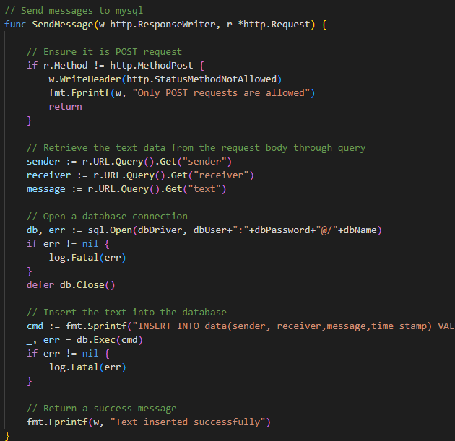
HTTP-Server (Send)
Steps:
Get data from query
Send chat information to MySQL database
Print success message

Slide 10
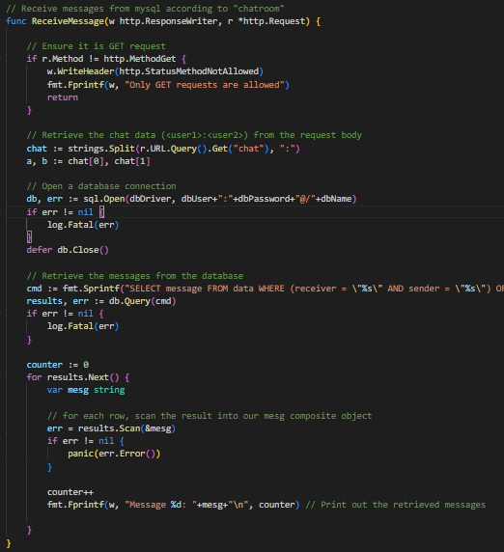
HTTP-Server (Pull)
Steps:
Get Chat-ID from query (<user1> : <user2>)
Figure out users
Select chat information in MySQL database that include the users
Printout message

Slide 11
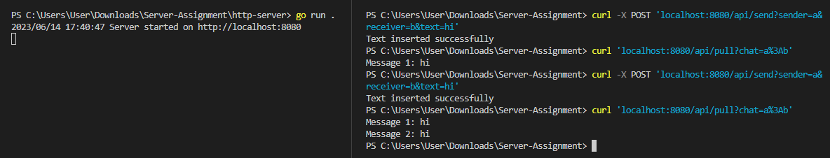

Results
Successfully send and pull message
MySQL does receive messages

Slide 12
RPC-Server
03

Slide 13
Apology ( Again...)
I'm not sure what to do with RPC-server, and I can't find any Kitex framework resources. So, I figured it out based on my understanding of what Peng WeiXing (https://o386706e92.larksuite.com/docx/QE9qdhCmsoiieAx6gWEuRxvWsRc)) was trying to express. Hence there are no test results, only being able to start the server...

Slide 14
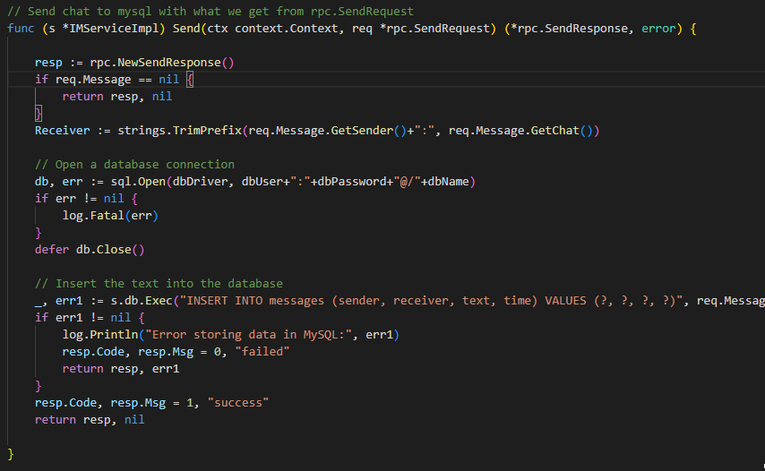

RPC-Server (Send)
Steps:
Get data from rpc.SendRequest
Send chat information to MySQL database
Return resp to tell user if the function is success

Slide 15
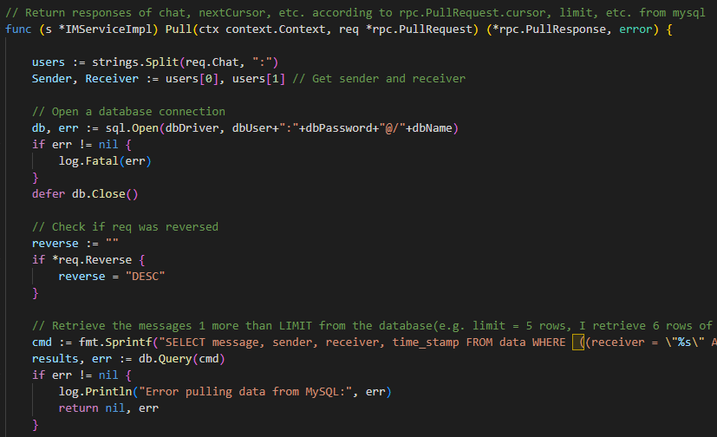
RPC-Server (Pull)
Steps:
Get data from rpc.PullRequest
Figure out users
Select chat information in MySQL database that include the users from cursor within page limit + 1 (if possible)

Slide 16
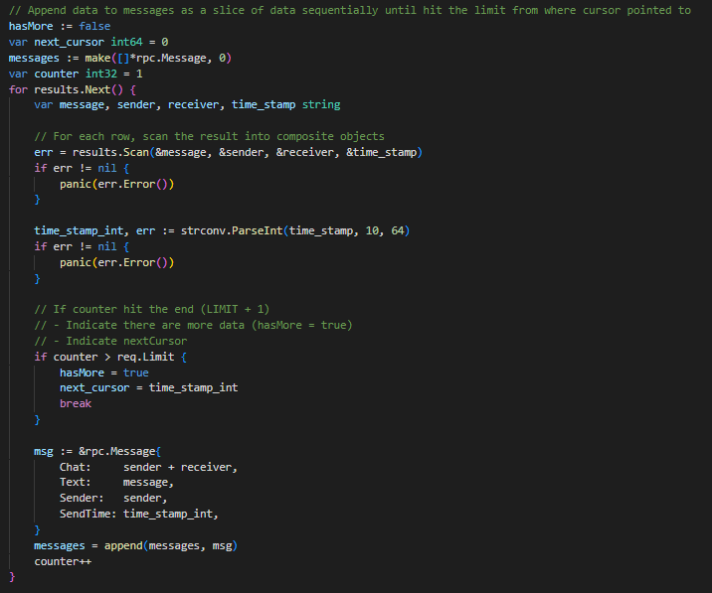
RPC-Server (Pull)
Steps:
Append data to response to users
Check if there is additional page after page limit
If (TRUE):
has-more = TRUE
Indicate the next cursor
Else:
has-more = FALSE
No next cursor
# It is simply cursor pagination 🤣

Slide 17
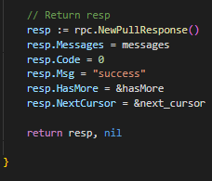
RPC-Server (Pull)
Steps:
Return a response with everything require

Slide 18


Results
Pass handler_test.go
Able to start server

Slide 19
Others
04

Slide 20
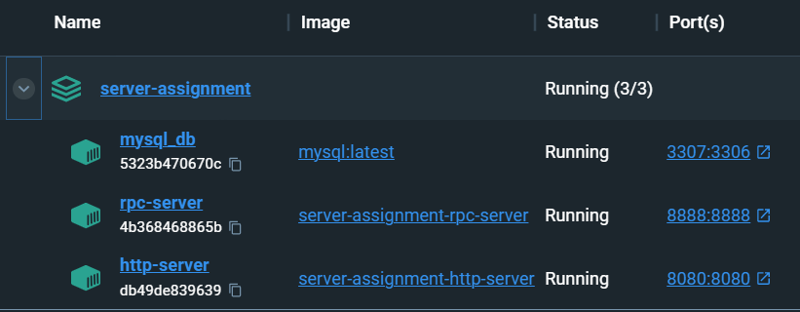

Docker-Compose
Able to initiate Container

Slide 21
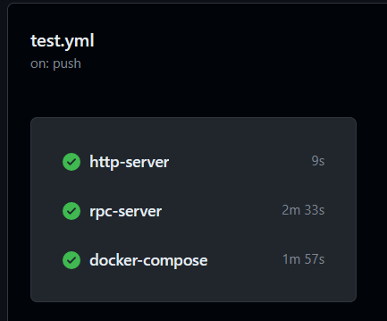
GitHub Actions
PASS
However…

Slide 22
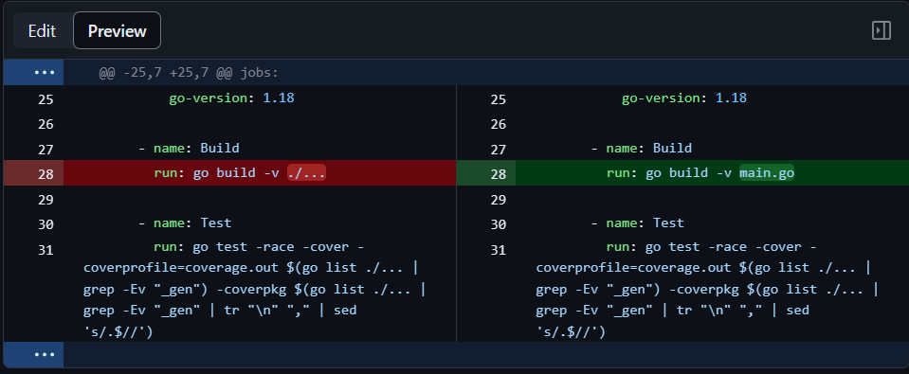
GitHub Actions
It succeeds only after some alterations in test.yml…

Slide 23
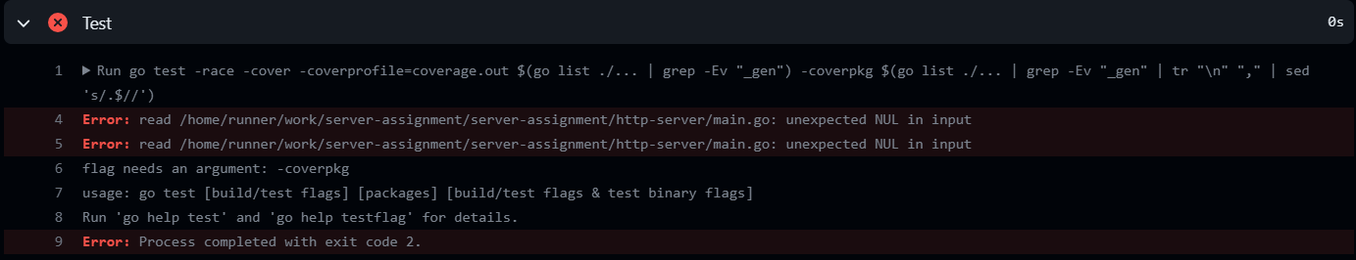
GitHub Actions
This is the error, but I'm not sure how to fix it… So, I change the test.yml in order to pass it. (I give up)

Slide 24
That’s It~
I apologize for not meeting the objective despite my best efforts😞. As an EEE student, this is a fantastic opportunity for me to try my hand at constructing a server, even if it is just a basic version🤣. Thank you TikTok for a memorable and rewarding journey. 👍🎉

Slide 25
fmt.Println(”Thank You”)
tuemail@freepik.com
+91 620 421 838
tupaginaweb.com
Por favor, conserva esta diapositiva para atribuirnos

