Slide 1

Red Wine Quality: A Statistical Analysis
John Manzo DSC530-301T August 14, 2021

Slide 2
Research Question
Question: Does higher alcohol volume improve the quality of red wine?
Null Hypothesis: There exists no relationship between alcohol volume and red wine quality.
Alternative Hypothesis: Alcohol volume does have an effect on red wine quality.
Exploritory Data Analysis Research Techniques:
Distrubution Analysis (histograms & box plots)
Summary & Test Statistics Analysis
PMF & CDF Analysis
Scatter Plot Analysis
Hypothisis Testing
Simple & Multiple Linear Regression Analysis

Slide 3
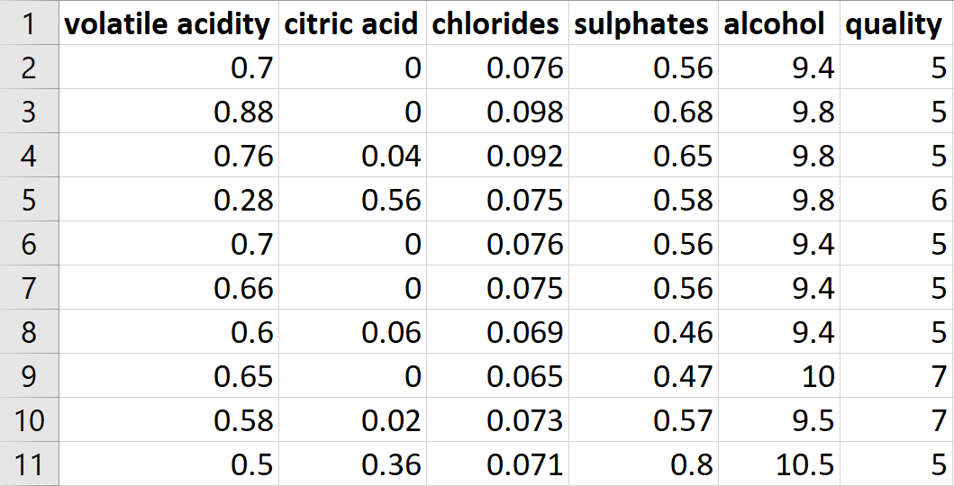
The Dataset
1,599 observations of red wine chemical composition and blind-taste test scores
Wines are varients of the Portuguese "Vinho Verde" red wine
Dataset Source: Paulo Cortez, University of Minho, Guimarães, Portugal, http://www3.dsi.uminho.pt/pcortez
Related Research:
P. Cortez, A. Cerdeira, F. Almeida, T. Matos and J. Reis. Modeling wine preferences by data mining from physicochemical properties. In Decision Support Systems, Elsevier, 47(4):547-553, 2009.

Slide 4
The Variables
Volatile Acidity (dm³) - the amount of acetic acid in wine, which at too high of levels can lead to an unpleasant, vinegar taste
Citric Acid (dm³) - found in small quantities, citric acid can add 'freshness' and flavor to wines
Chlorides (dm³) - the amount of salt in the wine
Sulphates (dm³) - a wine additive which acts as an antimicrobial and antioxidant agent
Alcohol (%vol) - the percentage of alcohol by volume in the wine
Quality (1-10 score) - the outcome variable, based on blind taste tests from three wine quality assessors

Slide 5
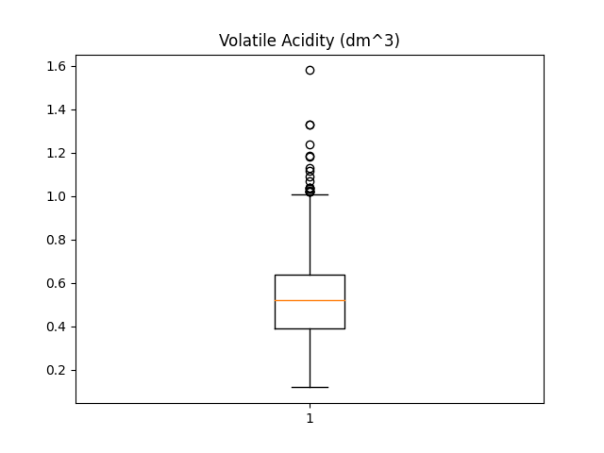
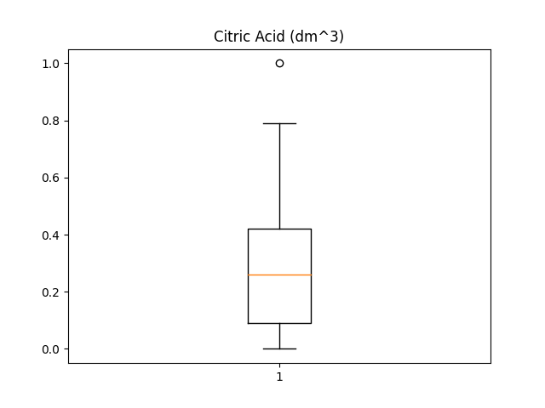
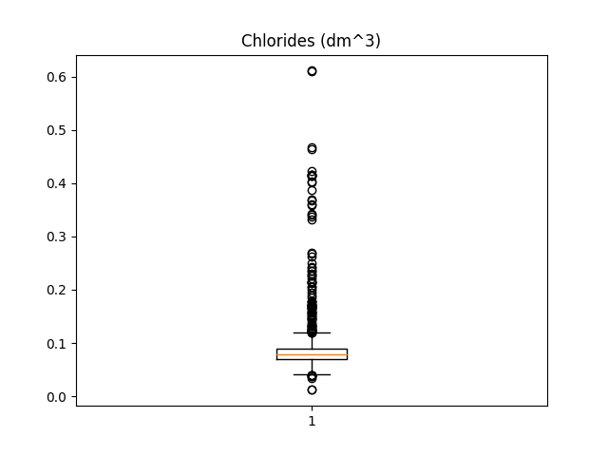
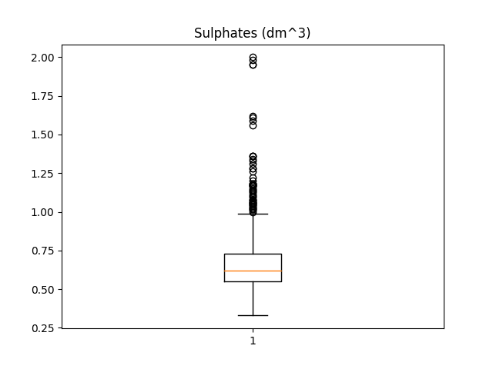
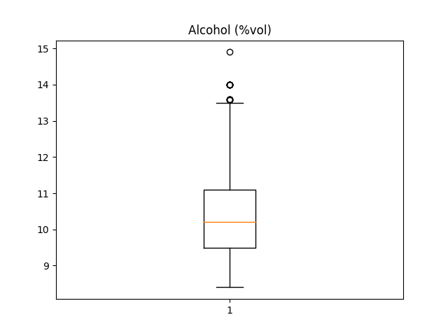
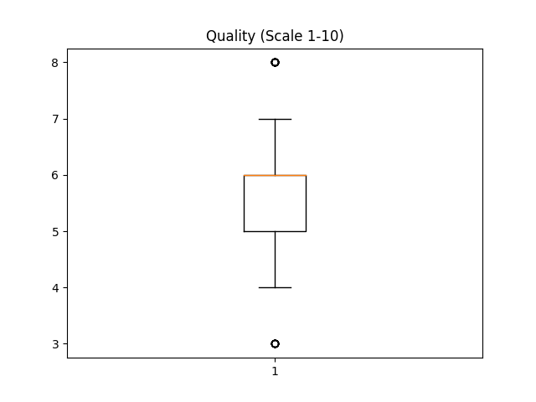
OUTLIER HANDLING
Domain knowledge of red wines: there are just a few outstanding and few terrible vintages, so the tiny proportion of outliers detected in the response variable were included in the analyses. Moreover, there is no indication of any missing or incorrectly recorded values. Highly problematic variables, like Chlorides, will be excluded from regression models, however.

Slide 6
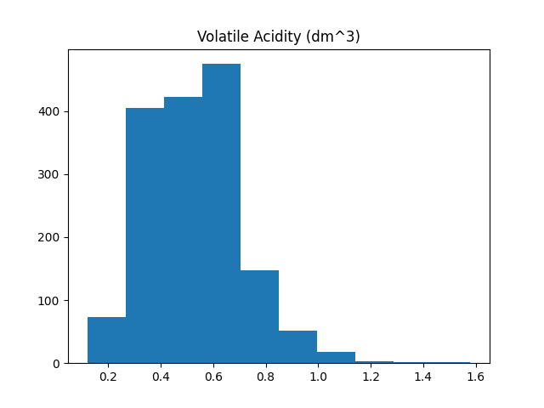
Distribution & Summary Stats
Variable: Volatile Acidity
Right-tailed, but exhibits a mostly normal distribution
The 19 outliers fall within the right tail
The distribution exhibits mild positive skewness
Count | Min | Mean | Median | Mode | Max | Variance | Std Dev | Skew | Outliers (#) | Outlier (%)
1599 | 0.12 | 0.528 | 0.52 | 0.6 | 1.58 | 0.032 | 0.179 | 0.672 | 19 | 1.19

Slide 7
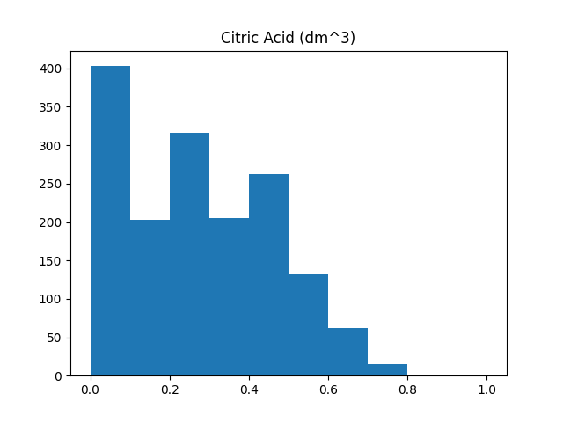
Distribution & Summary Stats
Variable: Citric Acid
Right-tailed, but with most values concentrated in the middle of the range
The 1 outlier is the last value of the right tail (1.0)
The distribution exhibits low positive skewness
Count | Min | Mean | Median | Mode | Max | Variance | Std Dev | Skew | Outliers (#) | Outlier (%)
1599 | 0.0 | 0.271 | 0.26 | 0.0 | 1.0 | 0.038 | 0.195 | 0.318 | 1 | 0.06

Slide 8
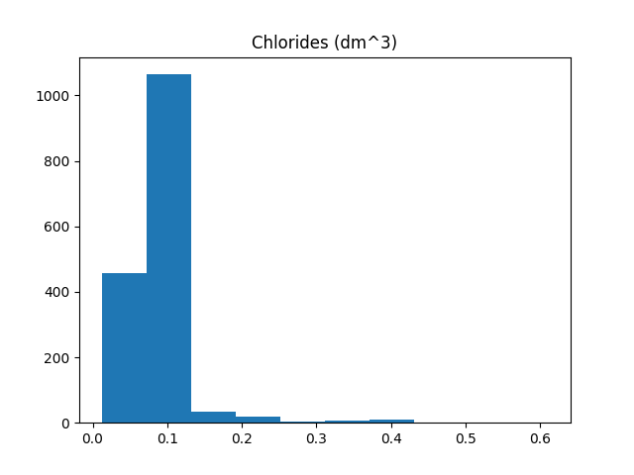
Distribution & Summary Stats
Variable: Chlorides
Right-tailed, with almost all values concentrated at the low end of the range
The 112 outliers all fall within the right tail The distribution exhibits high positive skewness
Tight range, low spread, and high outlier count will likely make this a poor explanatory variable
Count | Min | Mean | Median | Mode | Max | Variance | Std Dev | Skew | Outliers (#) | Outlier (%)
1599 | 0.012 | 0.087 | 0.079 | 0.08 | 0.611 | 0.002 | 0.047 | 5.68 | 112 | 7.0

Slide 9
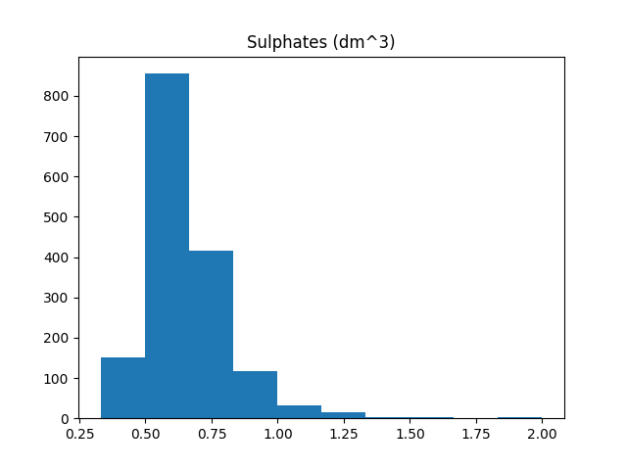
Distribution & Summary Stats
Variable: Sulphates
Long right-tail, but a mostly normal distribution about the mode
The 112 outliers all fall within the right tail
The distribution exhibits high positive skewness due to the long right tail
Controversy over sulphates makes this a tempting explanatory variable candidate
Count | Min | Mean | Median | Mode | Max | Variance | Std Dev | Skew | Outliers (#) | Outlier (%)
1599 | 0.33 | 0.658 | 0.62 | 0.6 | 2.0 | 0.029 | 0.17 | 2.43 | 59 | 3.69

Slide 10
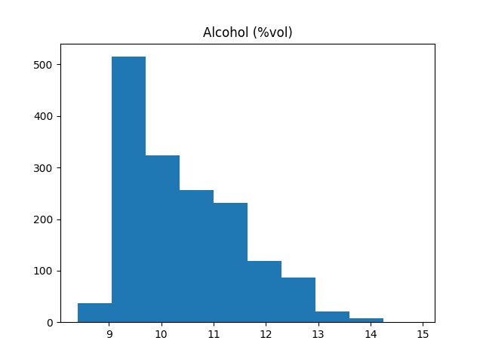
Distribution & Summary Stats
Variable: Alcohol
Right-tailed, with most values below the mean
The 13 outliers all fall within the right tail
The distribution exhibits low positive skewness due to the long right tail
This is the primary explanatory variable used to address the hypothesis
Count | Min | Mean | Median | Mode | Max | Variance | Std Dev | Skew | Outliers (#) | Outlier (%)
1599 | 8.4 | 10.42 | 10.2 | 9.5 | 14.9 | 1.14 | 1.07 | 0.86 | 13 | 0.81

Slide 11
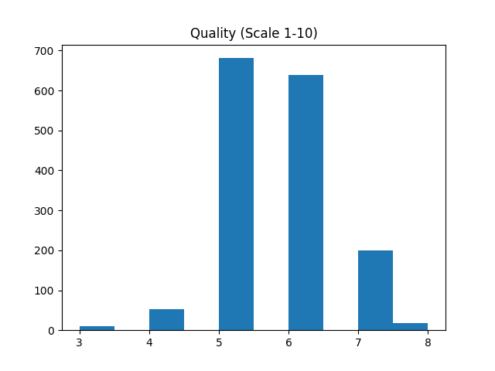
Distribution & Summary Stats
Variable: Quality
Mostly normal distribution is exhibited
The 28 outliers are all either min or max values (very bad/good wines)
The distribution exhibits low positive skewness, as more wines were judged better than average
This is the dependent variable used to address the hypothesis
Count | Min | Mean | Median | Mode | Max | Variance | Std Dev | Skew | Outliers (#) | Outlier (%)
1599 | 3 | 5.64 | 6.0 | 5 | 8 | 0.65 | 0.81 | 0.22 | 28 | 1.75

Slide 12
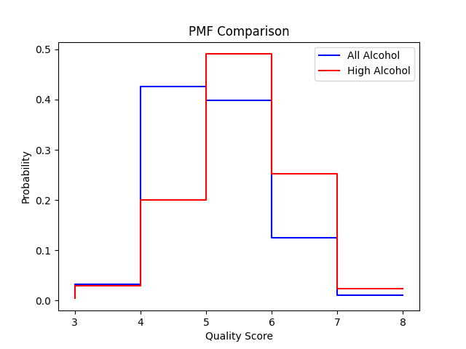
PMF Comparison
The “All Alcohol” PMF is calculated from all 1,599 observations
The “High Alcohol” PMF is from observations above the mean (n = 683)
The plot shows higher levels of alcohol are more probable to net higher quality scores, with the inverse also being true
This comparison supports the rejection of the null hypothesis, so additional testing is warranted

Slide 13
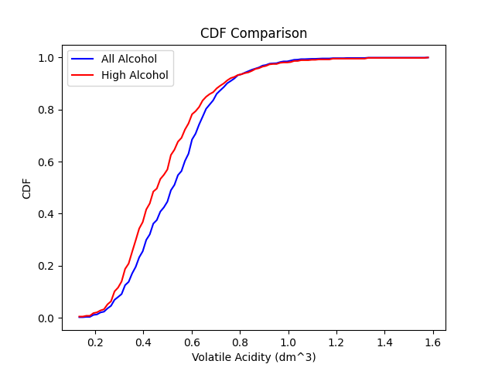
CDF Comparison
The “All Alcohol” CDF is calculated from all 1,599 observations
The “High Alcohol” CDF is from observations above the mean (n = 683)
The plot shows higher levels of alcohol tend to have lower levels of volatile acidity
Volatile acidity at higher levels spoils the flavor of wine
This relationship might mean volatile acidity will be a useful explanatory variable

Slide 14
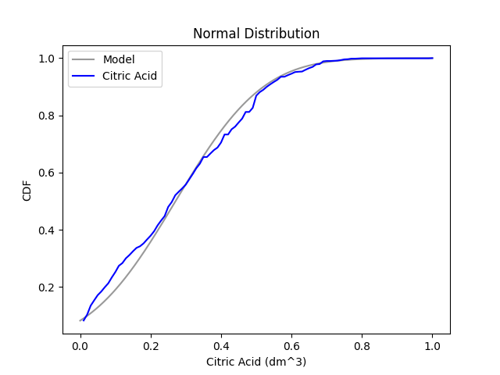
Analytical Distribution
This is a normal model with a linear scale
The plot shows the potential problems of attempting to model the citric acid variable
At the low end, the model under- estimates citric acid levels
At the high end, the model over- estimates citric acid levels
This model is a poor fit for the variable
A different type of distribution model is warranted were additional analysis of citric acid required

Slide 15
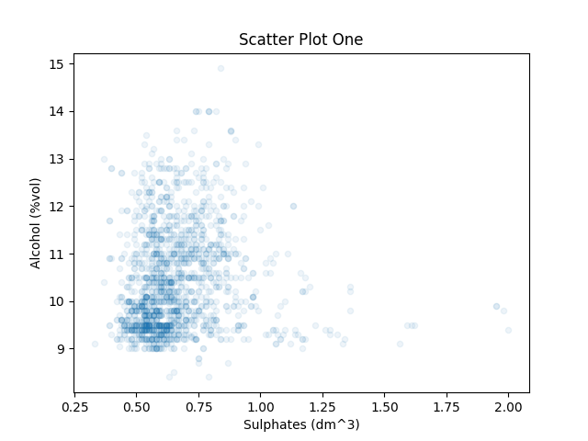
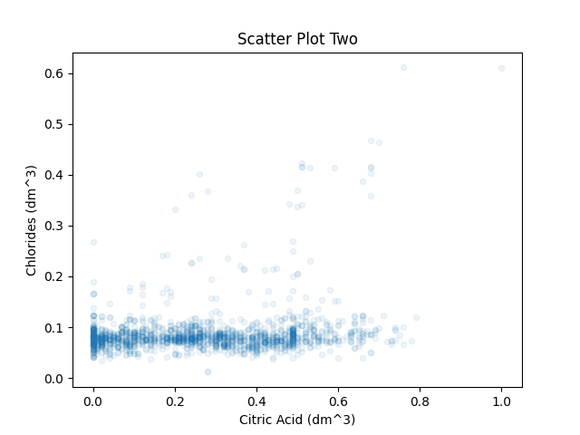
Scatter Plots
These plots look for relationships between potential explanatory variables
Plot One (Alcohol/Sulphates) indicates no meaningful linear or non-linear correlation
Plot Two (Chlorides/Citric Acid) does show evidence of a linear relationship in quadrant III, but the low Spearman’s stat relative to Pearson’s is likely an indication that Citric Acid’s long tail and ample outliers are the likely cause
The test stats (below) support the visual analysis
Pearson’s Correlation: 0.094 Spearman’s Correlation: 0.207
Covariance: [[0.02873262 0.01690678]
[0.01690678 1.1356474 ]]
Pearson’s Correlation: 0.204 Spearman’s Correlation: 0.113
Covariance: [[0.03794748 0.00186872]
[0.00186872 0.00221514]]

Slide 16
Hypothesis Test
Using Pearson’s correlation coefficient, this tests the correlation between the alcohol and quality variables at various sample sizes – these are the variables at the heart of the proposed hypothesis.
Findings: There exists a significant linear relationship at all sample sizes, and the correlation generally strengthens (and the p-values plummet) as the sample size grows.
There now exists enough evidence to reject the null hypothesis – alcohol levels do effect quality scores.
The answer to the research question, does higher alcohol volume improve the quality of red wine, is yes – the PMF comparison plot clearly shows it; this hypothesis test allows us to trust the plot.
Sample Size | Correlation | P-value
1599 | 0.476 | 2.83e-91
1369 | 0.489 | 3.85e-83
1141 | 0.505 | 6.04e-75
913 | 0.450 | 1.14e-46
685 | 0.427 | 1.03e-31
457 | 0.434 | 1.98e-22
229 | 0.247 | 0.0002

Slide 17
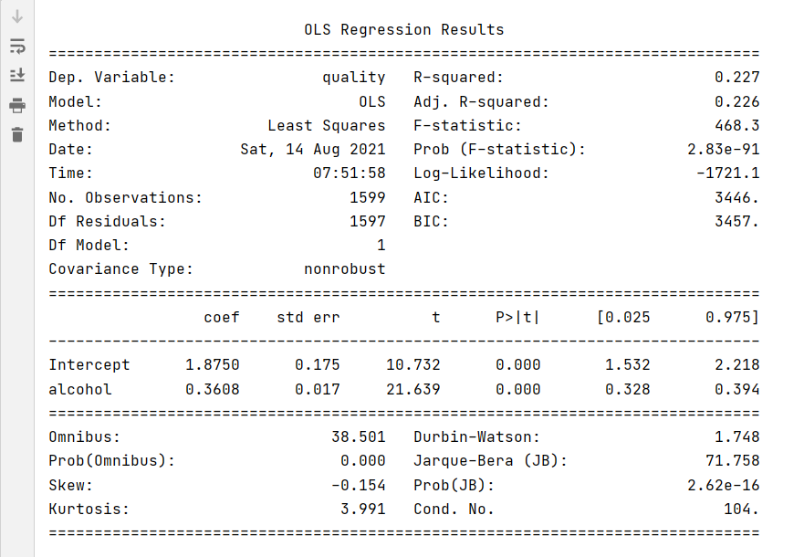
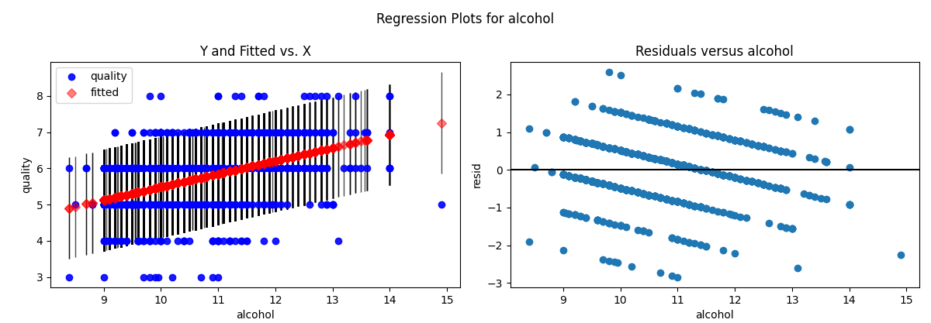
Simple Linear Regression
Explanatory Variable: Alcohol
Dependent Variable: Quality
With 95% confidence, it can be stated that changes in alcohol levels explain 22.7% of the variability in the quality scores.
The residual plots show a good (but not great) fit for the model.

Slide 18
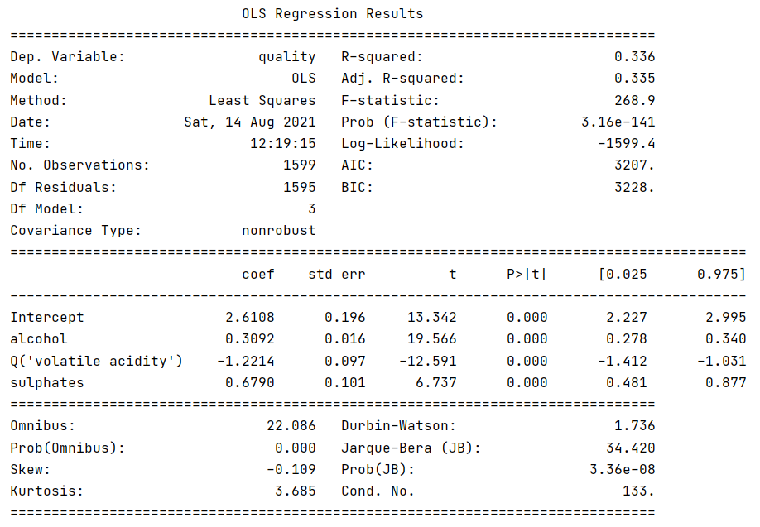
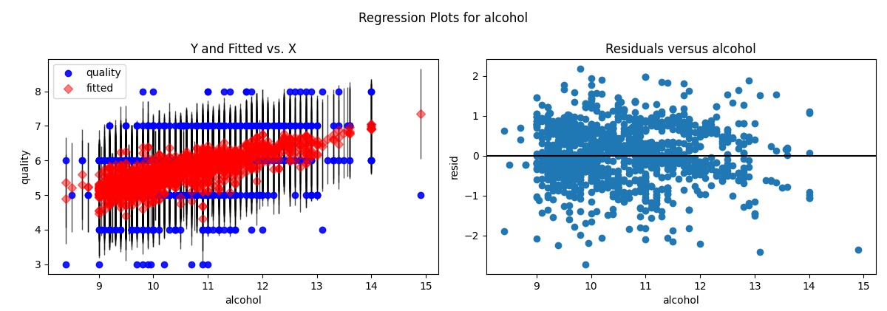
Multiple Linear Regression
Explanatory Variables: Alcohol, Volatile Acidity, and Sulphates
Dependent Variable: Quality
With 95% confidence, it can be stated that changes in the explanatory variables explain 33.5% of the variability in the quality scores – the model has improved.
These residual plots also show a slightly better fit than the single regression model.

