Slide 1

Management System for
Food E-Commerce with
PayPal Integration and
Database Algorithms
John Mark C. Abril
Farrah Mae Gregorio

Slide 2
CHAPTER I PROBLEM AND ITS BACKGROUND
Background of the Study
Statement of the Problem
Scope and Limitation of the Study

Slide 3
Background of the Study
Management system for food e-commerce
Content Management System (CMS)

Slide 4
Proposed System
Content delivery applications
Electronic payment system
Internet traffic issue
Database algorithms
Security features
3 users of the main website:
Administrator
Customers
Agent

Slide 5
Statement of the Problem
The main problem of other online food ordering website:
Don’t have PayPal payment
Geographical location of the customers
Less security provision
Internet traffic
Accurateness of the product management

Slide 6
How the researchers or proponents will have a file management system that can handle the uploaded files or documents of the user?
How the management system for food e-commerce with PayPal integration and database algorithms can maintain and secure the files, product and transaction of the client?
What are the helps of having different modules of a management system for food e-commerce with PayPal integration and database algorithms performing to improve the website?

Slide 7
How the clients and customer pay their purchased template or product?
How the clients sure if the management system for food e-commerce with PayPal integration and database algorithms is very secure and safe for the money transaction to those unethical hackers?
What is the performance of the system according to:
Accuracy,
Productivity,
Security?

Slide 8
Scope and Limitations of the Study
Scope:
3 main modules or users on the main website.
PayPal Integration.
E-mail for the verification.
Template uploaded to web server.
Client can manage and operate its template through CMS.
Database algorithm.
Security features.
2 main module on the template.

Slide 9
Admin of client site.
Handle many users.
Administrator can add co-admin or agent.
Google map API.
Limitation:
Only for Food E-Commerce
Can only run with the internet connection
Downloaded template excluded the web server

Slide 10
CHAPTER IV PRESENTATION, ANALYSIS AND INTERPRETATION
Developing the Proposed System
Context Diagram of the Proposed System
Project Development Process
Flowchart
Project Structure
HIPO Chart (Hierarchy plus Input-Process-Output)

Slide 11
Context Diagram of the Proposed System
Has 3 users:
Administrator
Client
Agent
Payment method
Geographical Location
Less security provision
Accurateness of the product management

Slide 12
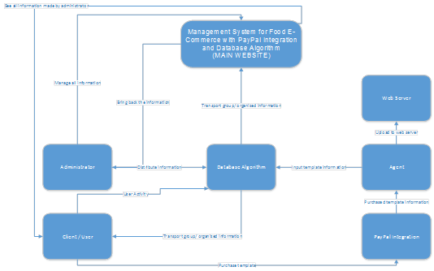
Context Diagram of the Proposed System

Slide 13
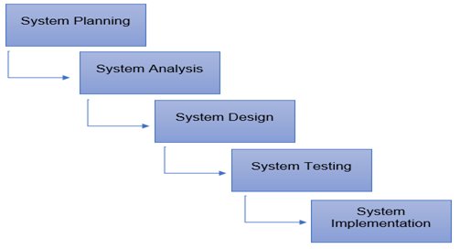
Project Development Process
Waterfall Model

Slide 14
Flowchart

Slide 15
HIPO (Hierarchy plus Input-Process-Output)

Slide 16
TABULATING RESULTS FROM THE PROPOSED SYSTEM
No. of Respondents | Businessman and businesswoman | Future Customers | Programmer or developer
40 | 20 | 10 | 10
Table I. Shows the number of respondents and their position

Slide 17
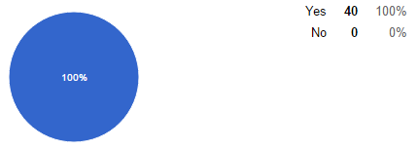
TABULATING RESULTS FROM THE PROPOSED SYSTEM
Table II. The result of the respondent’s feedback to a given questions.
The validity of every text field is accurate?

Slide 18
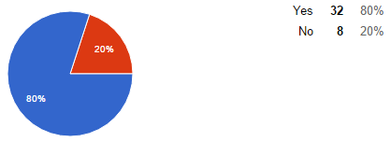
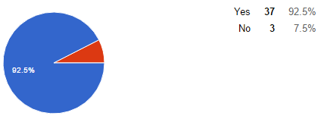
TABULATING RESULTS FROM THE PROPOSED SYSTEM
2. Did you prefer PayPal as a payment procedure?
3. Does the e-commerce website is good for small to medium scale business operation?

Slide 19
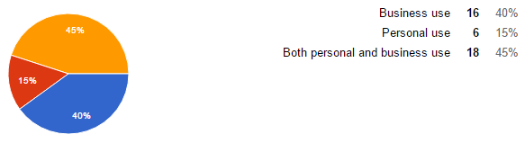
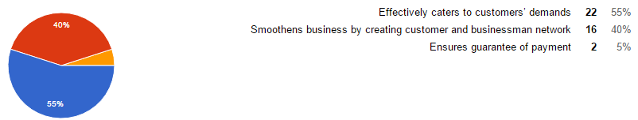
TABULATING RESULTS FROM THE PROPOSED SYSTEM
4. For what purpose do you use e-commerce website?
5. According to you how e-commerce is helpful for the business?

Slide 20
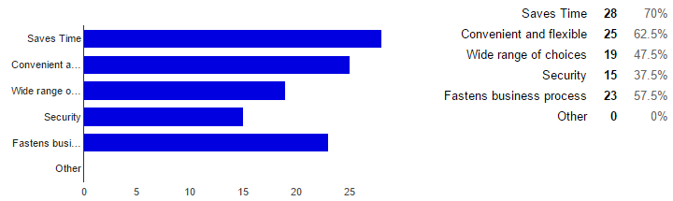
TABULATING RESULTS FROM THE PROPOSED SYSTEM
6. Why do you prefer online purchasing (choose as many as applicable)?

Slide 21
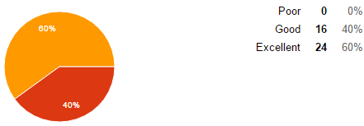
TABULATING RESULTS FROM THE PROPOSED SYSTEM
7. Rate e-commerce website from what you have seen and your experience with our sites in terms of Visual appearance/layout.

Slide 22
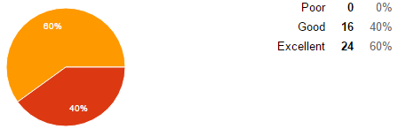
TABULATING RESULTS FROM THE PROPOSED SYSTEM
8. Rate e-commerce website from what you have seen and your experience with our sites in terms of Content.

Slide 23
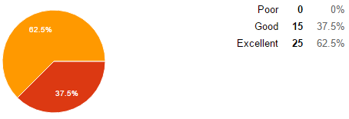
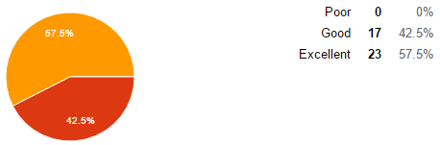
TABULATING RESULTS FROM THE PROPOSED SYSTEM
9. E-commerce website responds quickly to email queries?
10. E-commerce website has improved customer service?

Slide 24
CHAPTER V SUMMARY OF FINDINGS, CONCLUSIONS AND RECOMMENDATION
Summary of Findings
Conclusion
Recommendation

Slide 25
Summary of Findings
In terms of accuracy:
transporting different amount of data to a specific module.
operates all the information and transports the specific information to the specific account or user and to specific modules.
In terms of productivity:
administrator and co-administrator can monitor what’s going on their website.
Issue tracker.

Slide 26
Summary of Findings
In terms of security:
hashing for keeping the password and other information more secure.
signup process has a confirmation code thru email.
account cannot open if the account is open.
In administrator module, the permission is another algorithm.
The approximated consumption for the proposed system

Slide 27
Conclusion
The client who has and hasn’t any knowledge on how to create a system for their food business
The client can easily choose and purchased a template that available to our website
Also, it is an achievement for us to propose this complex type of study.

Slide 28
Recommendation
add a method for payment transaction
more security for cyber hacking
upgrade the web server
create a mobile application
create more algorithm
It is open to all researchers to criticize

