Slide 1
Azure SQL Database Managed Instances
John Q. Martin

Slide 2

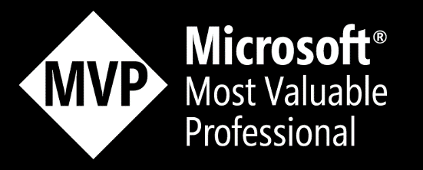




John Q. Martin
Product Manager for SentryOne
Microsoft Data Platform MVP
Over a decade of experience with SQL Server as a Dev, DBA and BI Dev. Most recently working as a Premier Field Engineer with Microsoft UK.
@SQLDiplomat
/JohnQMartin
jmartin@SentryOne.com
https://blogs.sentryone.com/author/JohnMartin

Slide 3
What is Managed Instance?
New Platform as a Service (PaaS) offering from Microsoft
Microsoft Azure Service
Comparable to on-premises SQL Server instance
Azure SQL Database

Slide 4
Is this Really PaaS?
Simply put, yes
No server OS to manage
No SQL Server Patching to deal with
High Availability and Disaster Recovery options built-in
It is Azure SQL Database

Slide 5
Amazon RDS
Managed Instance
Based on Retail SQL Server
Run older versions of SQL Server
Manually initiated updates
Authentication
Relies on SQL Authentication
Can be connected to on-premises AD
Limited access to instance
Built on Azure SQL DB
Running the latest builds
Full retail compatibility levels
Authentication
Native integration to Azure AD
Can use SQL Authentication
Full SA Permissions

Slide 6
Intended Workloads
On-Premises/IaaS SQL Server workloads
High degree of parity with retail SQL Server features
ISV, Third Party, and Custom Applications
If it runs on SQL Server it is a candidate
Cloud Migration or hybrid deployments

Slide 7
Key Features
SQL Server Agent
DB Mail
Change Tracking, CDC
Cross Database Queries
Linked Servers
Service Broker
vNet deployment
Native Backup
Database File Layout

Slide 8
Managed Instance Infrastructure
No public endpoint
On vNet from the outset
Express Route or VPN
Leverages Azure Storage for General Purpose instances
High capacity
Local Storage for Business Critical instances

Slide 9
Preparing for migration
Managed Instance is pre-configured cloud service
Some features not available
High-availability
SIMPLE/BULK LOGGED
Change service broker
Windows specific
Windows logins
Network shares
xp_cmdshell/local file system
FILESTREAM
Compatibility check
Data Migration Assistant
T-SQL scripts
Offline migration
Native RESTORE from Azure Blob Storage
RESTORE from network shares is currently not supported
.bacpac/.dacpac
Online migration
Data Migration Service
Log Reply API
Log shipping – still not supported’
Transactional Replication

Slide 10










Site 1
Availability Group 01
VPN
Site 2
Azure

Slide 11
Site 1
Availability Group 01
VPN
Site 2
Azure

Slide 12
Database Migration Service
Fully managed, reliable and seamless, migration service for both operational databases and data warehouses
Minimal down time migrations
Homogeneous and heterogeneous source-target pairs
Notes:
2 min (can skip if needed)

Slide 13
Migration to Managed Instance
Active Directory connectivity for Authentication
Need to configure Active Directory to sync to Azure Active Directory
Make use of Azure AD Connect
Migration of Instance level objects
Credentials, Logins, Jobs etc.

Slide 14
Migration to Managed Instance
Migration Leverages Backup to URL
Available in SQL Server 2012+
Roll your own for SQL Server 2005 SP4/2008/2008R2
Reduce costs with license transportability
Need on-premises SA licensing
Similar principal to existing IaaS option

Slide 15
Summary
PaaS alternative to SQL Server on-premises or IaaS VMs
High feature coverage against retail SQL Server product
Migration path uses established, trusted model

Slide 16
Thank You for your time and attention.

