Slide 1
AVL-Trees (Part 1)
COMP171

Slide 2
Data, a set of elements
Data structure, a structured set of elements, linear, tree, graph, …
Linear: a sequence of elements, array, linked lists
Tree: nested sets of elements, …
Binary tree
Binary search tree
Heap
…

Slide 3
Binary Search Tree
Review of ‘insertion’ and ‘deletion’ for BST
Sequentially insert 3, 2, 1, 4, 5, 6 to an BST Tree
If we continue to insert 7, 16, 15, 14, 13, 12, 11, 10, 8, 9

Slide 4
Balance Binary Search Tree
Worst case height of binary search tree: N-1
  Insertion, deletion can be O(N) in the worst case
We want a tree with small height
Height of a binary tree with N node is at least Θ(log N)
Goal: keep the height of a binary search tree O(log N)
Balanced binary search trees
  Examples: AVL tree, red-black tree

Slide 5

Balanced Tree?
Suggestion 1: the left and right subtrees of root have the same height
  Doesn’t force the tree to be shallow
Suggestion 2: every node must have left and right subtrees of the same height
  Only complete binary trees satisfy
  Too rigid to be useful
Our choice: for each node, the height of the left and right subtrees can differ at most 1

Slide 6
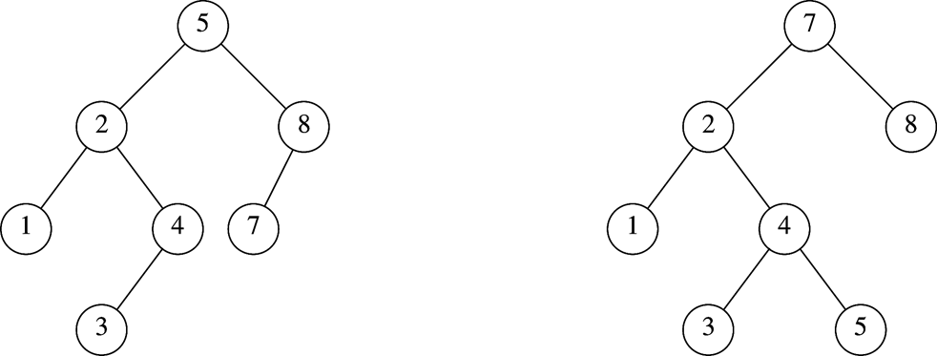
AVL Tree
An AVL (Adelson-Velskii and Landis 1962) tree is a binary search tree in which
  for every node in the tree, the height of the left and right subtrees differ by at most 1.
AVL tree
AVL property violated here

Slide 7
AVL Tree with
Minimum Number of Nodes
N₀ = 1
N₁ = 2
N₂ =4
N₃ = N₁+N₂+1=7

Slide 8
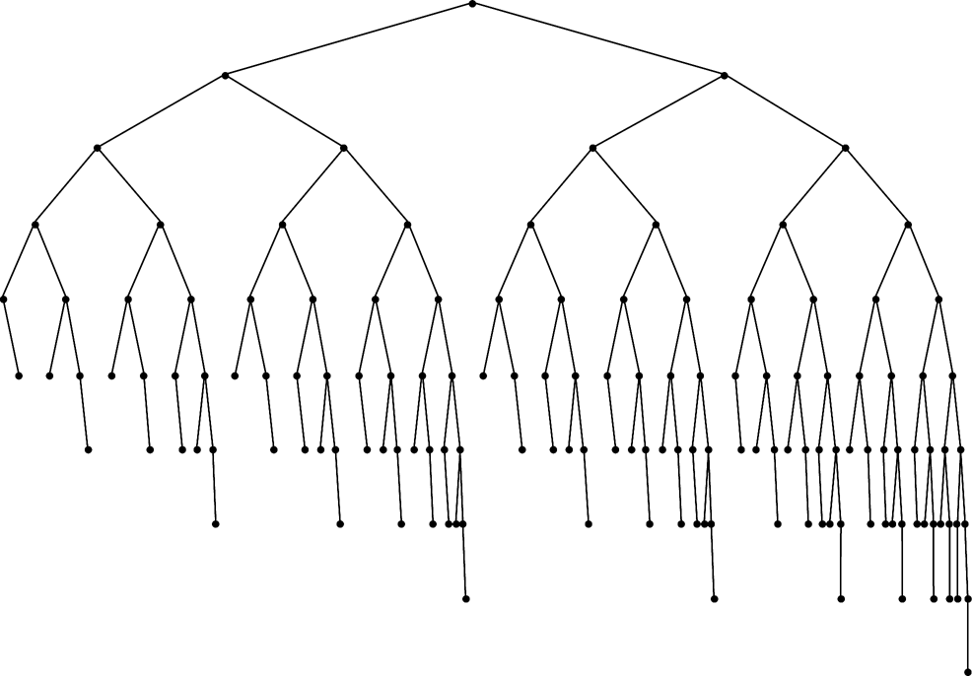
Smallest AVL tree
of height 7
Smallest AVL tree
of height 8
Smallest AVL tree of height 9

Slide 9
Height of AVL Tree
Denote N_{h} the minimum number of nodes in an AVL tree of height h
N₀=0, N₁ =2 (base)
N_{h}= N_{h-1} + N_{h-2} +1 (recursive relation)
N > N_{h}= N_{h-1} + N_{h-2} +1
>2 N_{h-2} >4 N_{h-4} >…>2^{i} N_{h-2i}
If h is even, let i=h/2–1. The equation becomes N>2^{h/2-1}N₂ ⇒ N>2^{h/2-1}x4 ⇒ h=O(logN)
If h is odd, let i=(h-1)/2. The equation becomes N>2^{(h-1)/2}N₁ ⇒ N>2^{(h-1)/2}x2 ⇒ h=O(logN)
Thus, many operations (i.e. searching) on an AVL tree will take O(log N) time

Slide 10
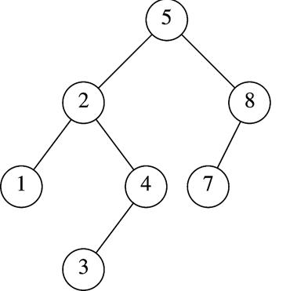
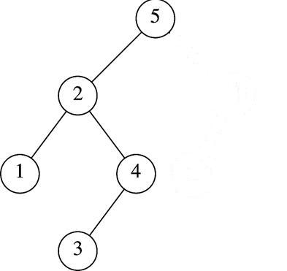
Insertion in AVL Tree
Basically follows insertion strategy of binary search tree
  But may cause violation of AVL tree property
Restore the destroyed balance condition if needed
7
6
8
6
Insert 6
Property violated
Original AVL tree
Restore AVL property

Slide 11
Some Observations
After an insertion, only nodes that are on the path from the insertion point to the root might have their balance altered
  Because only those nodes have their subtrees altered
Rebalance the tree at the deepest such node guarantees that the entire tree satisfies the AVL property
7
6
8
6
Node 5,8,7 might
have balance altered
Rebalance node 7
guarantees the whole tree be AVL

Slide 12

Different Cases for Rebalance
Denote the node that must be rebalanced α
  Case 1: an insertion into the left subtree of the left child of α
  Case 2: an insertion into the right subtree of the left child of α
  Case 3: an insertion into the left subtree of the right child of α
  Case 4: an insertion into the right subtree of the right child of α
Cases 1&4 are mirror image symmetries
with respect to α, as are cases 2&3

Slide 13
Rotations
Rebalance of AVL tree are done with simple modification to tree, known as rotation
Insertion occurs on the “outside” (i.e., left-left or right-right) is fixed by single rotation of the tree
Insertion occurs on the “inside” (i.e., left-right or right-left) is fixed by double rotation of the tree

Slide 14
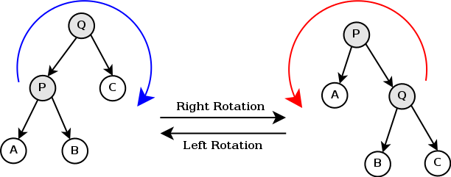
Tree Rotation

Slide 15
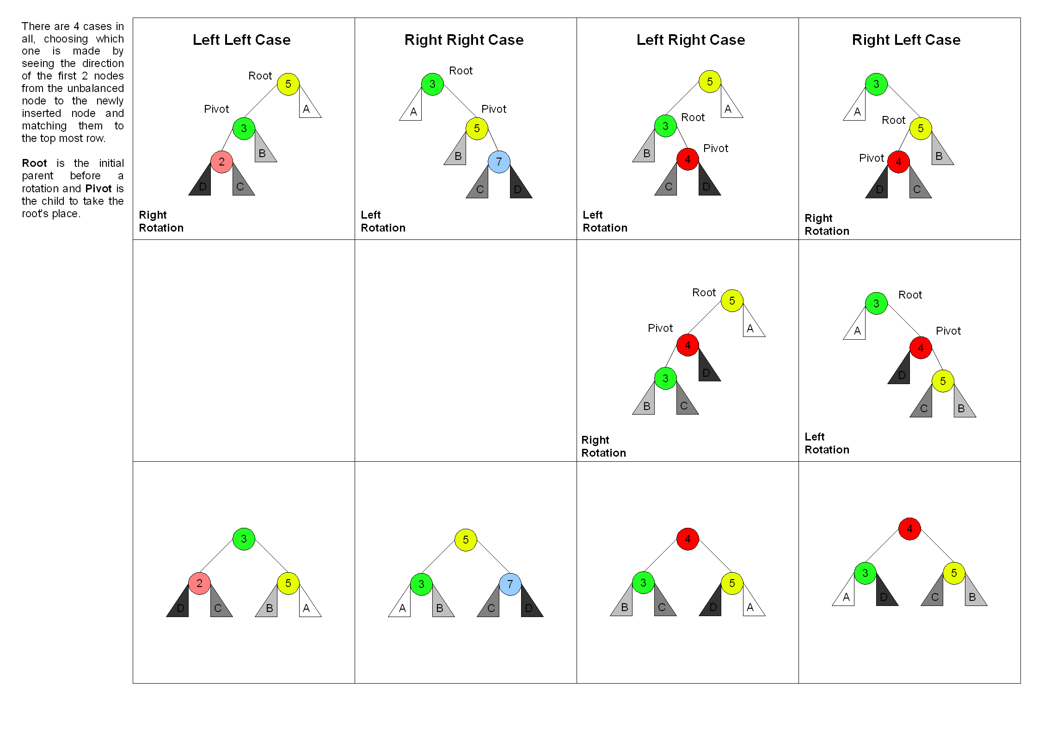

Slide 16
Insertion Algorithm
First, insert the new key as a new leaf just as in ordinary binary search tree
Then trace the path from the new leaf towards the root. For each node x encountered, check if heights of left(x) and right(x) differ by at most 1
  If yes, proceed to parent(x)
  If not, restructure by doing either a single rotation or a double rotation
Note: once we perform a rotation at a node x, we won’t need to perform any rotation at any ancestor of x.

Slide 17
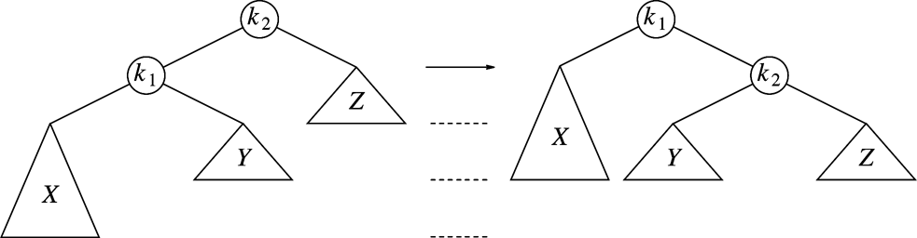
Single Rotation to Fix Case 1(left-left)
k2 violates
An insertion in subtree X,
AVL property violated at node k2
Solution: single rotation

Slide 18
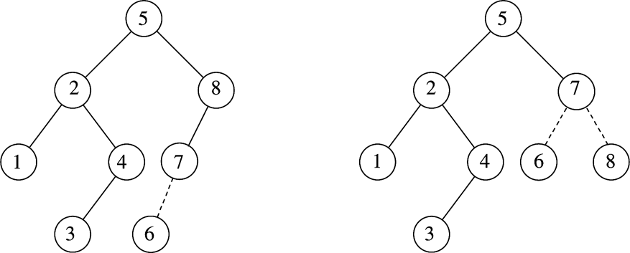
Single Rotation Case 1 Example
k2
k1
k1
X
k2
X

Slide 19
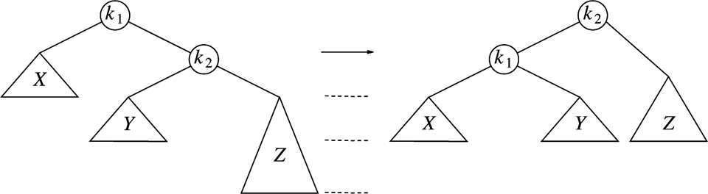
Single Rotation to Fix Case 4 (right-right)
k1 violates
An insertion in subtree Z
Case 4 is a symmetric case to case 1
Insertion takes O(Height of AVL Tree) time, Single rotation takes O(1) time

Slide 20
Single Rotation Example
Sequentially insert 3, 2, 1, 4, 5, 6 to an AVL Tree
3
3
2
2
2
2
2
1
3
1
3
1
3
Insert 3, 2
1
Single rotation
Insert 4
4
Insert 5,
violation at node 3
4
Insert 1
violation at node 3
2
2
5
4
1
4
1
4
2
5
3
5
3
5
1
3
6
Single rotation
Insert 6,
violation at node 2
6
Single rotation

Slide 21
If we continue to insert 7, 16, 15, 14, 13, 12, 11, 10, 8, 9
4
4
2
5
2
6
1
3
6
1
3
5
7
Insert 7,
violation at node 5
7
Single rotation
4
4
6
2
6
2
1
3
5
7
1
3
5
16
Single rotation
But….
Violation remains
15
Insert 16, fine
Insert 15
violation at node 7
16
15
7

Slide 22
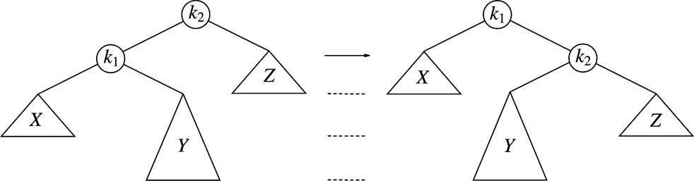
Single Rotation Fails to fix Case 2&3
Case 2: violation in k2 because of
insertion in subtree Y
Single rotation result
Single rotation fails to fix case 2&3
Take case 2 as an example (case 3 is a symmetry to it )
  The problem is subtree Y is too deep
  Single rotation doesn’t make it any less deep

Slide 23
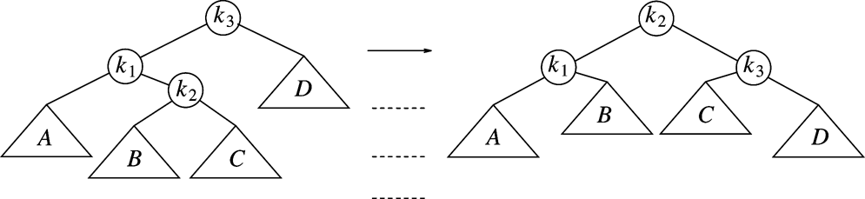
Double Rotation to Fix Case 2 (left-right)
Double rotation to fix case 2
Facts
  The new key is inserted in the subtree B or C
  The AVL-property is violated at k₃
  k₃-k₁-k₂ forms a zig-zag shape
Solution
  We cannot leave k₃ as the root
  The only alternative is to place k₂ as the new root

Slide 24
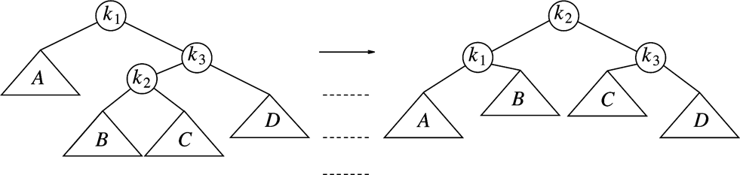
Double Rotation to fix Case 3(right-left)
Double rotation to fix case 3
Facts
  The new key is inserted in the subtree B or C
  The AVL-property is violated at k₁
  k₂-k₃-k₂ forms a zig-zag shape
Case 3 is a symmetric case to case 2

Slide 25
Restart our example
We’ve inserted 3, 2, 1, 4, 5, 6, 7, 16
We’ll insert 15, 14, 13, 12, 11, 10, 8, 9
4
4
2
6
2
6
1
3
5
7
k1
1
3
5
15
k2
Insert 16, fine
Insert 15
violation at node 7
16
k3
7
16
Double rotation
k1
k3
15
k2

Slide 26
4
4
2
6
k1
2
7
k2
A
1
3
5
15
k3
1
3
6
k1
15
k3
k2
7
16
D
5
14
16
Insert 14
14
C
Double rotation
4
k1
7
X
2
7
k2
4
15
1
3
6
15
2
6
14
16
Insert 13
5
14
16
1
3
5
13
Y
Z
Single rotation
13

Slide 27
7
7
4
15
4
15
2
6
14
16
2
6
13
16
1
3
5
13
1
3
5
12
14
Insert 12
12
Single rotation
7
7
4
13
4
15
2
6
12
15
2
6
13
16
1
3
5
11
14
16
1
3
5
12
14
Insert 11
Single rotation
11

Slide 28

7
7
4
13
4
13
2
6
12
15
2
6
11
15
1
3
5
11
14
16
1
3
5
10
12
14
16
Insert 10
10
Single rotation
7
7
4
13
4
13
2
6
11
15
2
6
11
15
1
3
5
8
12
14
16
1
3
5
10
12
14
16
9
10
8
Insert 8, fine
then insert 9
9
Single rotation

Slide 29
AVL-Trees (Part 2)
COMP171

Slide 30
A warm-up exercise …
Create a BST from a sequence,
  A, B, C, D, E, F, G, H
Create a AVL tree for the same sequence.

Slide 31

More about Rotations
When the AVL property is lost we can rebalance the tree via rotations
Single Right Rotation (SRR)
  Performed when A is unbalanced to the left (the left subtree is 2 higher than the right subtree) and B is left-heavy (the left subtree of B is 1 higher than the right subtree of B).
A
SRR at A
B
B
T3
T1
A
T1
T2
T2
T3

Slide 32

Rotations
Single Left Rotation (SLR)
  performed when A is unbalanced to the right (the right subtree is 2 higher than the left subtree) and B is right-heavy (the right subtree of B is 1 higher than the left subtree of B).
A
SLR at A
B
T1
B
A
T3
T2
T3
T1
T2

Slide 33
Rotations
Double Left Rotation (DLR)
  Performed when C is unbalanced to the left (the left subtree is 2 higher than the right subtree), A is right-heavy (the right subtree of A is 1 higher than the left subtree of A)
  Consists of a single left rotation at node A, followed by a single right at node C
C
SLR at A
C
SRR at C
B
A
T4
B
T4
A
C
T1
B
A
T3
T1
T2
T3
T4
A is balanced
T2
T3
T1
T2
DLR = SLR + SRR
Intermediate step, get B

Slide 34
Rotations
Double Right Rotation (DRR)
  Performed when A is unbalanced to the right (the right subtree is 2 higher than the left subtree), C is left-heavy (the left subtree of C is 1 higher than the right subtree of C)
  Consists of a single right rotation at node C, followed by a single left rotation at node A
A
SRR at C
A
SLR at A
B
T1
C
T1
B
A
C
B
T4
T2
C
T1
T2
T3
T4
T2
T3
T3
T4
DRR = SRR + SLR

Slide 35

Insertion Analysis
logN
Insert the new key as a new leaf just as in ordinary binary search tree: O(logN)
Then trace the path from the new leaf towards the root, for each node x encountered: O(logN)
  Check height difference: O(1)
  If satisfies AVL property, proceed to next node: O(1)
  If not, perform a rotation: O(1)
The insertion stops when
  A single rotation is performed
  Or, we’ve checked all nodes in the path
Time complexity for insertion O(logN)

Slide 36
class AVL {
public:
AVL();
AVL(const AVL& a);
~AVL();
bool empty() const;
bool search(const double x);
void insert(const double x);
void remove(const double x);
private:
Struct Node {
double element;
Node* left;
Node* right;
Node* parent;
Node(…) {…}; // constructuro for Node
}
Node* root;
int height(Node* t) const;
void insert(const double x, Node*& t) const; // recursive function
void singleLeftRotation(Node*& k2);
void singleRightRotation(Node*& k2);
void doubleLeftRotation(Node*& k3);
void doubleRightRotation(Node*& k3);
void delete(…)
}
Implementation:

Slide 37
Deletion from AVL Tree
Delete a node x as in ordinary binary search tree
  Note that the last (deepest) node in a tree deleted is a leaf or a node with one child
Then trace the path from the new leaf towards the root
For each node x encountered, check if heights of left(x) and right(x) differ by at most 1.
  If yes, proceed to parent(x)
  If no, perform an appropriate rotation at x Continue to trace the path until we reach the root

Slide 38
Deletion Example 1
20
20
10
35
15
35
5
15
25
40
10
18
25
40
18
30
38
45
30
38
45
50
50
Single Rotation
Delete 5, Node 10 is unbalanced

Slide 39
Cont’d
20
35
15
35
20
40
10
18
25
40
15
25
38
45
30
38
45
10
18
30
50
Continue to check parents
Oops!! Node 20 is unbalanced!!
50
Single Rotation
For deletion, after rotation, we need to continue tracing upward to see if AVL-tree property is violated at other node.
Different from insertion!

Slide 40
Summary of AVL Deletion
Similar to BST deletion
  Search for the node
  Remove it if found
    Zero children: replace it with null
    One child: replace it with the only child
    Two children: replace with in-order predecessor
      i.e., rightmost child in the left subtree

Slide 41
Summary of AVL Deletion
Remove a node can unbalance multiple ancesters
  Insert only required you to find the first unbalanced node
Remove will require going back to root rebalancing
  If the in-order predecessor was moved
    Need to trace back from its parent
  Otherwise, trace back from parent of the removed node

Slide 42
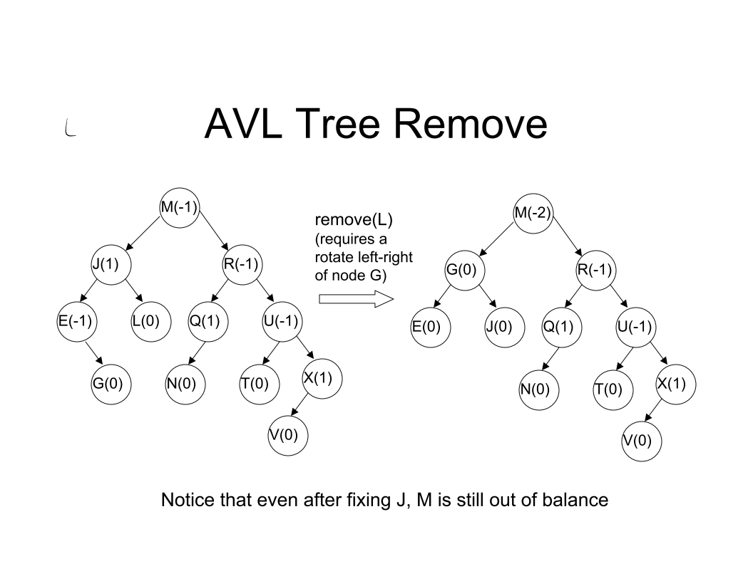

Slide 43
B⁺-Trees (Part 1)
COMP171

Slide 44
Main and secondary memories
Secondary storage device is much, much slower than the main RAM
Pages and blocks
Internal, external sorting
CPU operations
Disk access: Disk-read(), disk-write(), much more expensive than the operation unit

Slide 45

Contents
Why B⁺ Tree?
B⁺ Tree Introduction
Searching and Insertion in B⁺ Tree

Slide 46
Motivation
AVL tree with N nodes is an excellent data structure for searching, indexing, etc.
  The Big-Oh analysis shows most operations finishes within O(logN) time
The theoretical conclusion works as long as the entire structure can fit into the main memory
When the data size is too large and has to reside on disk, the performance of AVL tree may deteriorate rapidly

Slide 47
A Practical Example
A 500-MIPS machine, with 7200 RPM hard disk
  500 million instruction executions, and approximately 120 disk accesses each second (roughly, 500 000 faster!)
A database with 10,000,000 items, 256 bytes each (assume it doesn’t fit in memory)
The machine is shared by 20 users
Let’s calculate a typical searching time for 1 user
  A successful search need log 10000000 = 24 disk access, around 4 sec. This is way too slow!!
We want to reduce the number of disk access to a very small constant
Notes:
RPM revolutions per minute

Slide 48
From Binary to M-ary
Idea: allow a node in a tree to have many children
  Less disk access = less tree height = more branching
As branching increases, the depth decreases
An M-ary tree allows M-way branching
  Each internal node has at most M children
A complete M-ary tree has height that is roughly log_{M}N instead of log₂N
  if M = 20, then log₂₀ 2²⁰ < 5
  Thus, we can speedup the search significantly

Slide 49
M-ary Search Tree
Binary search tree has one key to decide which of the two branches to take
M-ary search tree needs M-1 keys to decide which branch to take
M-ary search tree should be balanced in some way too
  We don’t want an M-ary search tree to degenerate to a linked list, or even a binary search tree

Slide 50
B⁺ Tree
A B⁺-tree of order M (M>3) is an M-ary tree with the following properties:
  The data items are stored at leaves
  The root is either a leaf or has between two and M children
  Node:
    The (internal) node (non-leaf) stores up to M-1 keys (redundant) to guide the searching; key i represents the smallest key in subtree i+1
    All nodes (except the root) have between ⎡M/2⎤ and M children
  Leaf:
    A leaf has between ⎡L/2⎤ and L data items, for some L (usually L << M, but we will assume M=L in most examples)
    All leaves are at the same depth
Note there are various definitions of B-trees, but mostly in minor ways.
The above definition is one of the popular forms.
Notes:
|_x_| the floor of x, the greatest integer less than or equal to x
|-x-| the ceilling of x, the least integer greater than or equal to x

Slide 51
Keys in Internal Nodes
Which keys are stored at the internal nodes?
There are several ways to do it. Different books adopt different conventions.
We will adopt the following convention:
  key i in an internal node is the smallest key (redundant) in its i+1 subtree (i.e. right subtree of key i)
Even following this convention, there is no unique B⁺-tree for the same set of records.

Slide 52
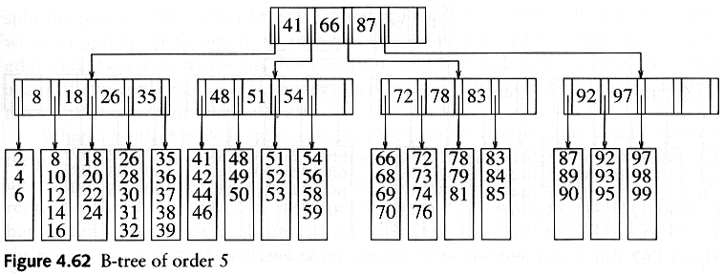
B⁺ Tree Example 1 (M=L=5)
Records are stored at the leaves (we only show the keys here)
Since L=5, each leaf has between 3 and 5 data items
Since M=5, each nonleaf nodes has between 3 to 5 children
Requiring nodes to be half full guarantees that the B+ tree does not degenerate into a simple binary tree

Slide 53
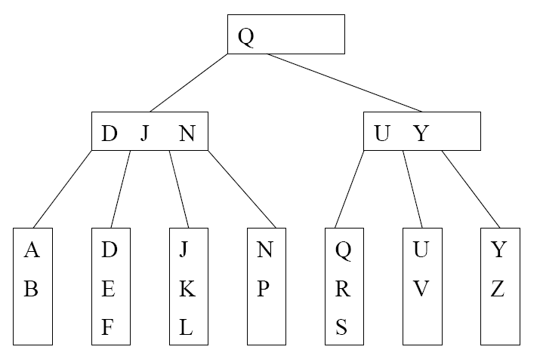
B⁺ Tree Example 2 (M=4, L=3)
We can still talk about left and right child pointers
E.g. the left child pointer of N is the same as the right child pointer of J
We can also talk about the left subtree and right subtree of a key in internal nodes

Slide 54
B+ Tree in Practical Usage
Each internal node/leaf is designed to fit into one I/O block of data. An I/O block usually can hold quite a lot of data. Hence, an internal node can keep a lot of keys, i.e., large M. This implies that the tree has only a few levels and only a few disk accesses can accomplish a search, insertion, or deletion.
B⁺-tree is a popular structure used in commercial databases. To further speed up the search, the first one or two levels of the B⁺-tree are usually kept in main memory.
The disadvantage of B⁺-tree is that most nodes will have less than M-1 keys most of the time. This could lead to severe space wastage. Thus, it is not a good dictionary structure for data in main memory.
The textbook calls the tree B-tree instead of B⁺-tree. In some other textbooks, B-tree refers to the variant where the actual records are kept at internal nodes as well as the leaves. Such a scheme is not practical. Keeping actual records at the internal nodes will limit the number of keys stored there, and thus increasing the number of tree levels.

Slide 55
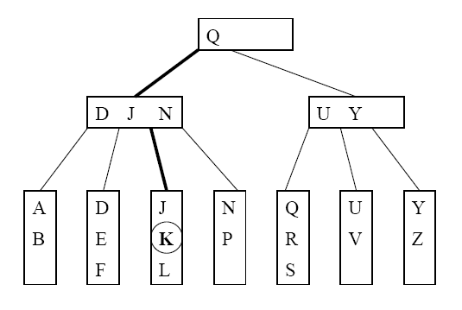
Searching Example
Suppose that we want to search for the key K. The path traversed is shown in bold.

Slide 56
Searching Algorithm
Let x be the input search key.
Start the searching at the root
If we encounter an internal node v, search (linear search or binary search) for x among the keys stored at v
  If x < K_{min} at v, follow the left child pointer of K_{min}
  If K_{i} ≤ x < K_{i+1} for two consecutive keys K_{i} and K_{i+1} at v, follow the left child pointer of K_{i+1}
  If x ≥ K_{max} at v, follow the right child pointer of K_{max}
If we encounter a leaf v, we search (linear search or binary search) for x among the keys stored at v. If found, we return the entire record; otherwise, report not found.

Slide 57
Insertion Procedure
we want to insert a key K
Search for the key K using the search procedure
This leads to a leaf x
Insert K into x
  If x is not full, trivial,
  If so, troubles, need splitting to maintain the properties of B+ tree (instead of rotations in AVL trees)

Slide 58
Insertion into a Leaf
A: If leaf x contains < L keys, then insert K into x (at the correct position in node x)
D: If x is already full (i.e. containing L keys). Split x
  Cut x off from its parent
  Insert K into x, pretending x has space for K. Now x has L+1 keys.
  After inserting K, split x into 2 new leaves x_{L} and x_{R}, with x_{L} containing the ⎣(L+1)/2⎦ smallest keys, and x_{R} containing the remaining ⎡(L+1)/2⎤ keys. Let J be the minimum key in x_{R}
  Make a copy of J to be the parent of x_{L} and x_{R}, and insert the copy together with its child pointers into the old parent of x.

Slide 59
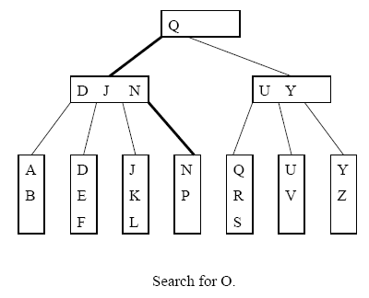
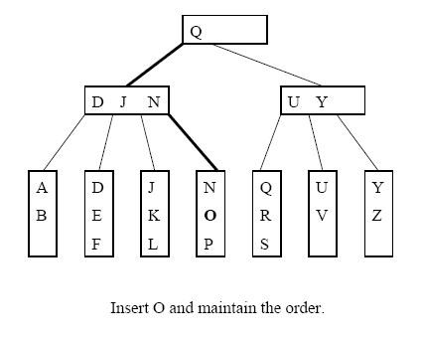
Inserting into a Non-full Leaf (L=3)

Slide 60
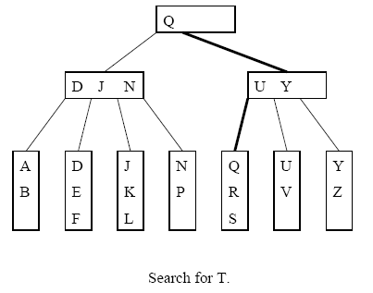
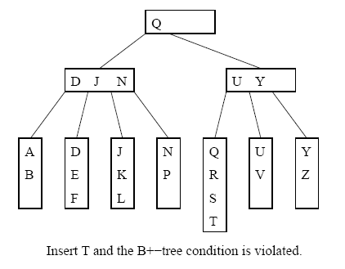
Splitting a Leaf: Inserting T

Slide 61
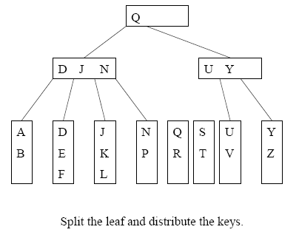
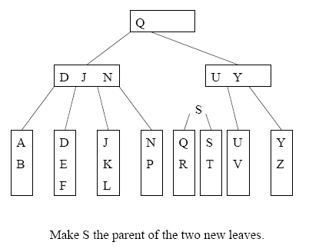
Splitting Example 1

Slide 62
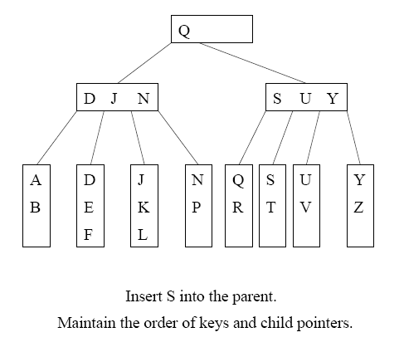
Two disk accesses to write the two leaves, one disk access to update the parent
For L=32, two leaves with 16 and 17 items are created. We can perform 15 more insertions without another split

Slide 63
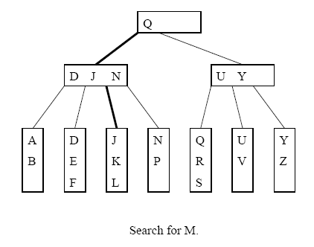
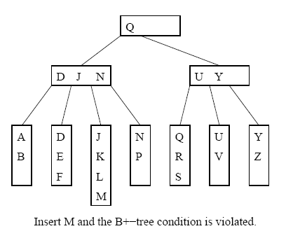
Splitting Example 2

Slide 64
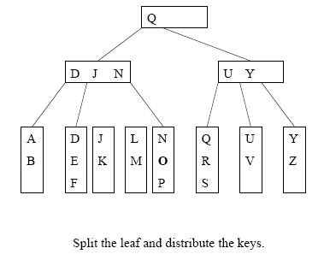
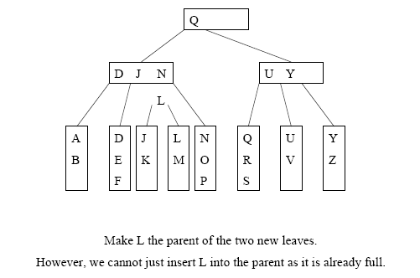
Cont’d
=> Need to split the internal node

Slide 65
E: Splitting an Internal Node
To insert a key K into a full internal node x:
Cut x off from its parent
Insert K as usual by pretending there is space
  Now x has M keys! Not M-1 keys.
Split x into 3 new internal nodes x_{L}and x_{R}, and x-parent!
  x_{L} containing the ( ⎡M/2⎤ - 1 ) smallest keys,
  and x_{R} containing the ⎣M/2⎦ largest keys.
  Note that the (⎡M/2⎤)th key J is a new node, not placed in x_{L} or x_{R}
Make J the parent node of x_{L} and x_{R}, and insert J together with its child pointers into the old parent of x.

Slide 66
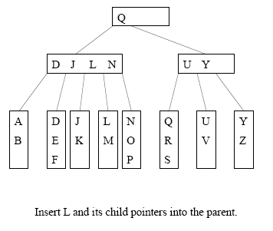
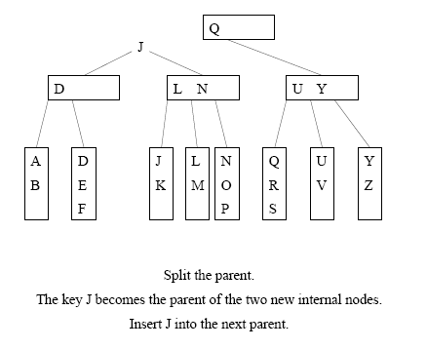
Example: Splitting Internal Node (M=4)
3+1 = 4, and 4 is split into 1, 1 and 2.
So D J L N is into D and J and L N

Slide 67
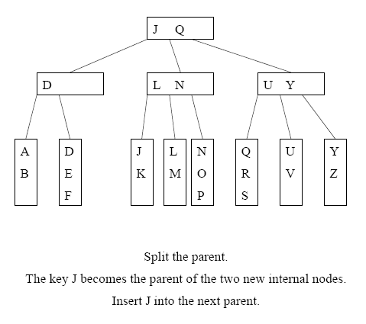
Cont’d

Slide 68
Termination
Splitting will continue as long as we encounter full internal nodes
If the split internal node x does not have a parent (i.e. x is a root), then create a new root containing the key J and its two children

Slide 69
Summary of B+ Tree of order M and of leaf size L
  The root is either a leaf or 2 to M children
  Each (internal) node (except the root) has between ⎡M/2⎤ and M children (at most M chidren, so at most M-1 keys)
  Each leaf has between ⎡L/2⎤ and L keys and corresponding data items
  We assume M=L in most examples.

Slide 70
Roadmap of insertion
Main conern: leaf and node might be full!
insert a key K
Search for the key K and get to a leaf x
Insert K into x
  If x is not full, trivial,
  If full, troubles ☹,
    need splitting to maintain the properties of B+ tree (instead of rotations in AVL trees)
A: Trivial (leaf is not full)
B: Leaf is full
  C: Split a leaf,
    D: trivial (node is not full)
    E: node is full → Split a node

Slide 71
B⁺-Trees (Part 2)
COMP171

Slide 72
Review: B+ Tree of order M and of leaf size L
  The root is either a leaf or 2 to M children
  Each (internal) node (except the root) has between ⎡M/2⎤ and M children (at most M chidren, so at most M-1 keys)
  Each leaf has between ⎡L/2⎤ and L keys and corresponding data items
  We assume M=L in most examples.

Slide 73
Deletion
To delete a key target, we find it at a leaf x, and remove it.
Two situations to worry about:
  (1) After deleting target from leaf x, x contains less than ⎡L/2⎤ keys (needs to merge nodes)
  (2) target is a key in some internal node (needs to be replaced, according to our convention)

Slide 74
Roadmap of deletion
Main concern: ‘too small’ to violate the ‘balance’ requirement.
Trivial (leaf is not small)
  A: Trivial (Node is not involved)
  B (situtation 1): Node is present, but only to be updated
C (situation 2): leaf is too small → borrow or merge
    J: borrow from right
    K: borrow from left
    L: merge with right
    M: merge with left
  Trivial (node is not small), only updates
  E: node is too small
      F: root
      G: borrow from right
      H: borrow from left
      I: merge of equals

Slide 75
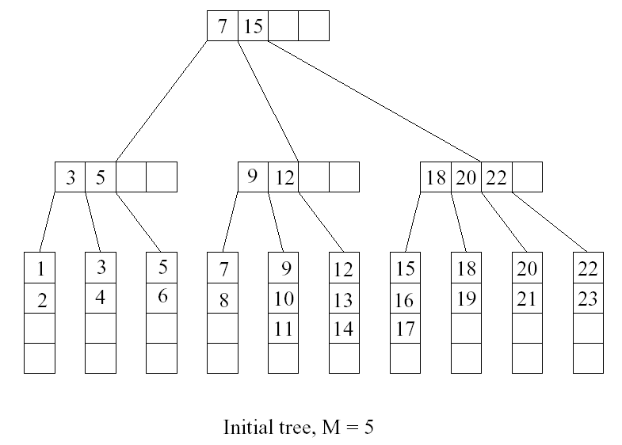
Deletion Example: A
Want to delete 15

Slide 76

B: Situation 1: ‘trivial’ appearance in a node
target can appear in at most one ancestor y of x as a key (why?)
Node y is seen when we searched down the tree.
After deleting from node x, we can access y directly and replace target by the new smallest key in x

Slide 77
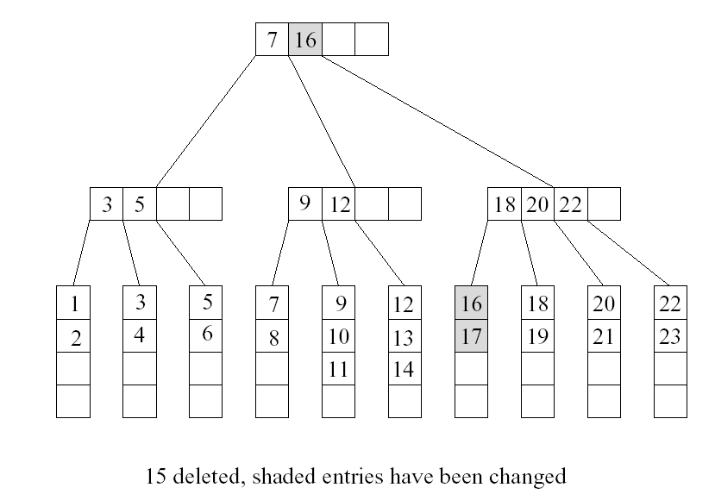
Want to delete 9

Slide 78
C: Situation 2:
Handling Leaves with Too Few Keys
Suppose we delete the record with key target from a leaf.
Let u be the leaf that has ⎡L/2⎤ - 1 keys (too few)
Let v be a sibling of u
Let k be the key in the parent of u and v that separates the pointers to u and v
There are two cases

Slide 79

Possible to ‘borrow’ …
J: Case 1: v contains ⎡L/2⎤+1 or more keys and v is the right sibling of u
  Move the leftmost record from v to u
K: Case 2: v contains ⎡L/2⎤+1 or more keys and v is the left sibling of u
  Move the rightmost record from v to u
Then set the key in parent of u that separates u and v to be the new smallest key in u

Slide 80
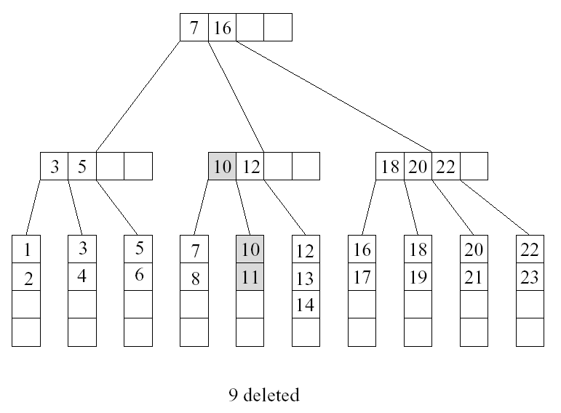
Want to delete 10, situation 1

Slide 81
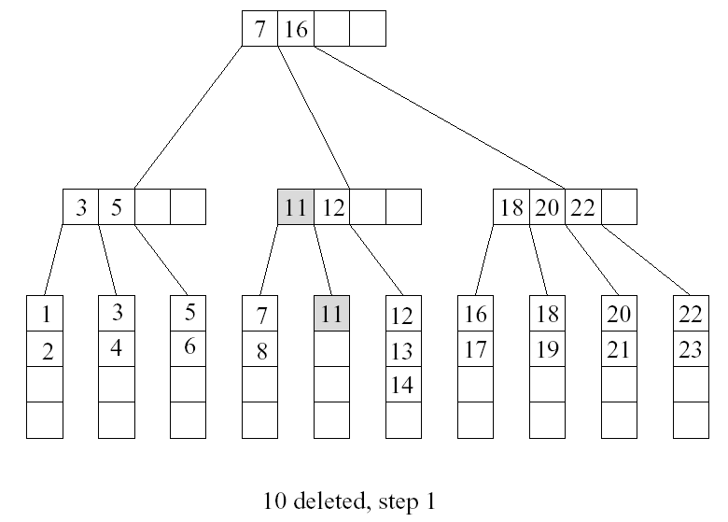
Deletion of 10 also incurs situation 2
u
v

Slide 82
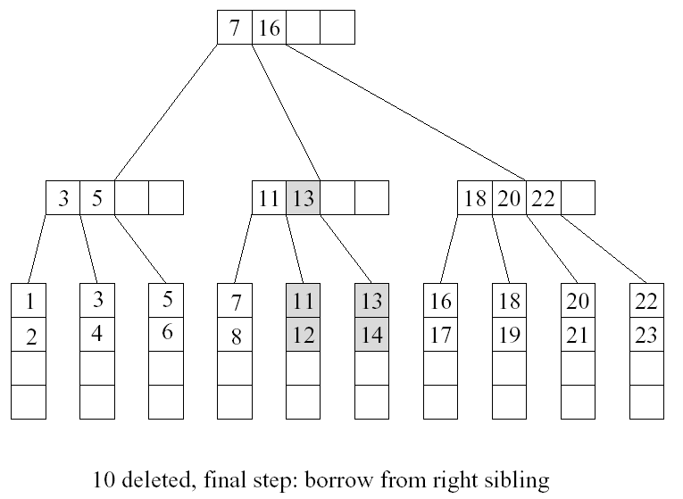

Slide 83

Impossible to ‘borrow’: Merging Two Leaves
If no sibling leaf with ⎡L/2⎤+1 or more keys exists, then merge two leaves.
L: Case 1: Suppose that the right sibling v of u contains exactly ⎡L/2⎤ keys. Merge u and v
  Move the keys in u to v
  Remove the pointer to u at parent
  Delete the separating key between u and v from the parent of u

Slide 84
Merging Two Leaves (Cont’d)
M: Case 2: Suppose that the left sibling v of u contains exactly ⎡L/2⎤ keys. Merge u and v
  Move the keys in u to v
  Remove the pointer to u at parent
  Delete the separating key between u and v from the parent of u

Slide 85
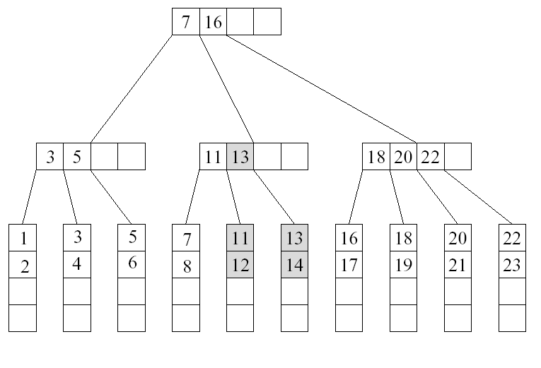
Example
Want to delete 12

Slide 86
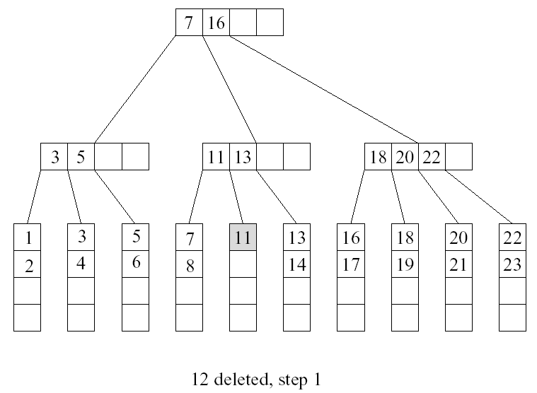
Cont’d
u
v

Slide 87
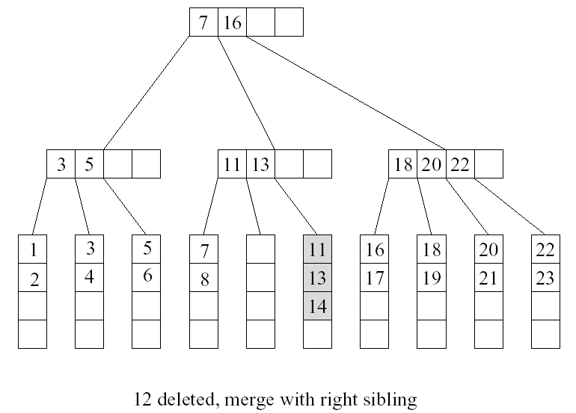
Cont’d

Slide 88
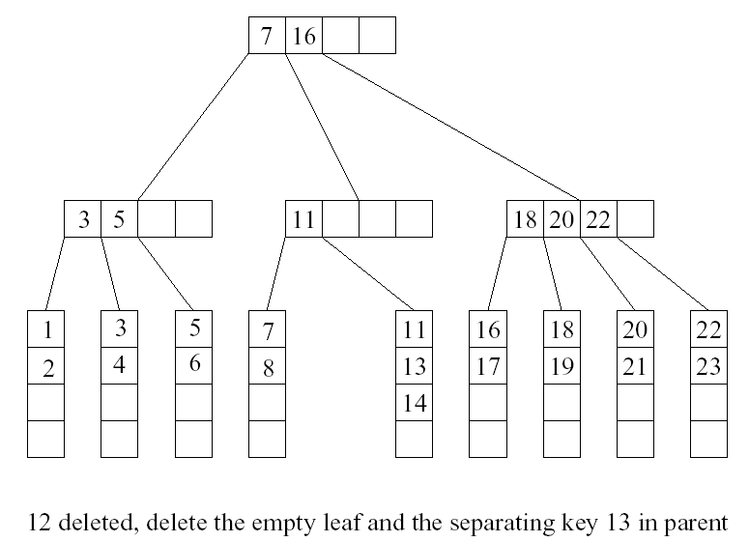
Cont’d
too few keys! …

Slide 89
E: Deleting a Key in an Internal Node
Suppose we remove a key from an internal node u, and u has less than ⎡M/2⎤ -1 keys after that
F: Case 0: u is a root
  If u is empty, then remove u and make its child the new root

Slide 90
G: Case 1: the right sibling v of u has ⎡M/2⎤ keys or more
  Move the separating key between u and v in the parent of u and v down to u
  Make the leftmost child of v the rightmost child of u
  Move the leftmost key in v to become the separating key between u and v in the parent of u and v.
H: Case 2: the left sibling v of u has ⎡M/2⎤ keys or more
  Move the separating key between u and v in the parent of u and v down to u.
  Make the rightmost child of v the leftmost child of u
  Move the rightmost key in v to become the separating key between u and v in the parent of u and v.

Slide 91
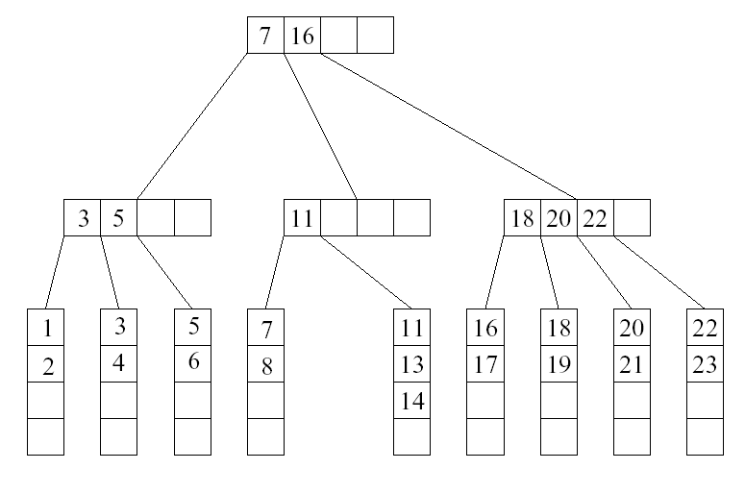
…Continue From Previous Example
case 2
u
v
M=5, a node has 3 to 5 children (that is, 2 to 4 keys).

Slide 92
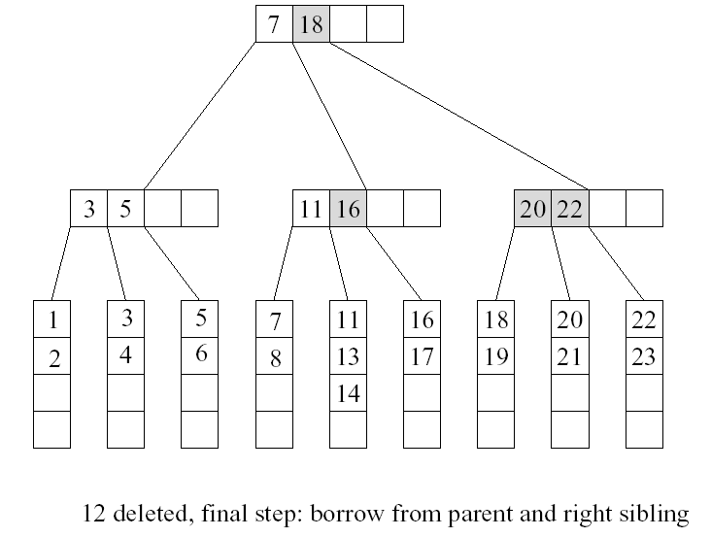
Cont’d

Slide 93
I: Case 3: all sibling v of u contains exactly ⎡M/2⎤ - 1 keys
  Move the separating key between u and v in the parent of u and v down to u
  Move the keys and child pointers in u to v
  Remove the pointer to u at parent.

Slide 94
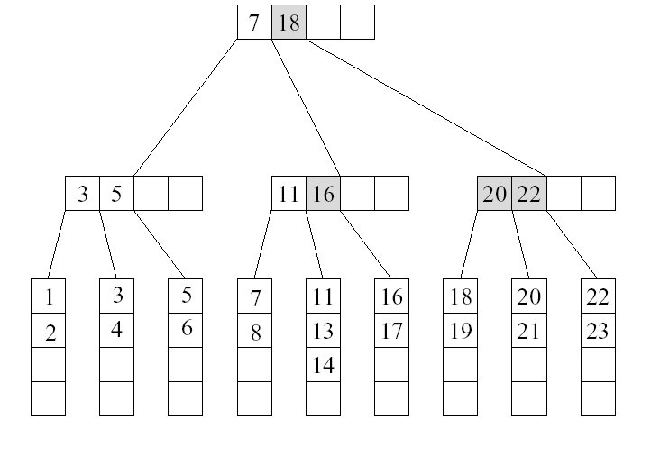
Example
Want to delete 5

Slide 95
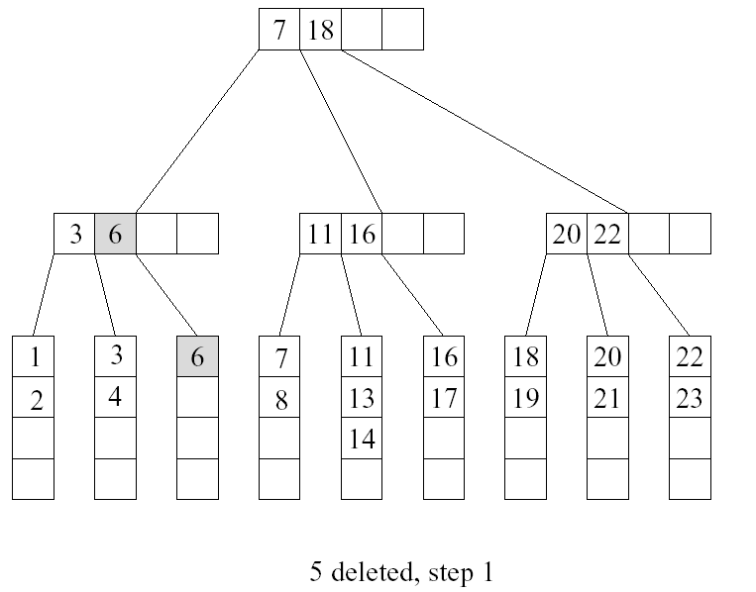
Cont’d
u
v

Slide 96
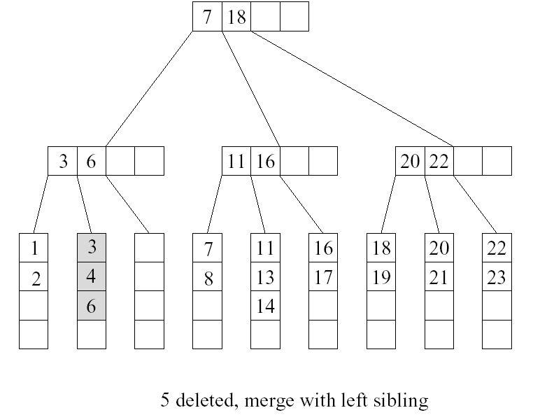
Cont’d

Slide 97
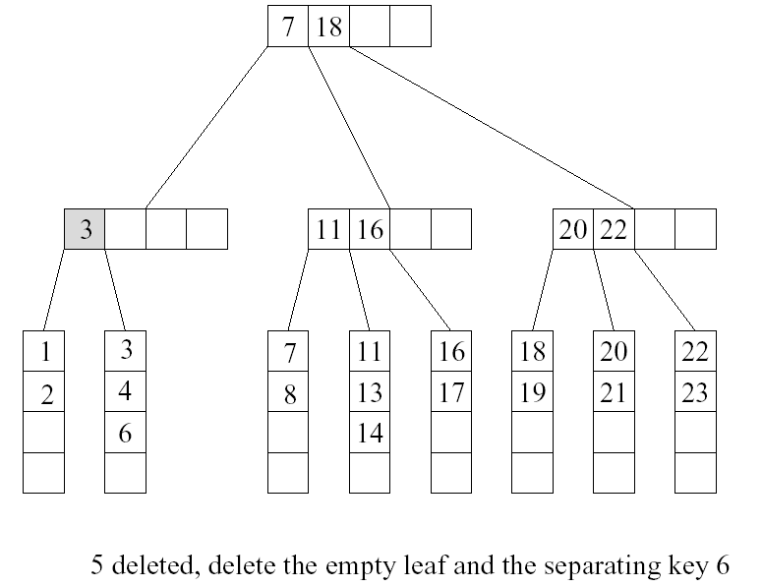
Cont’d
case 3
u
v

Slide 98
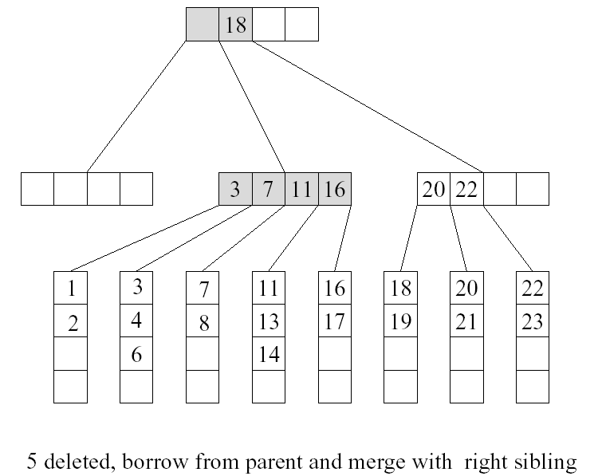
Cont’d

Slide 99
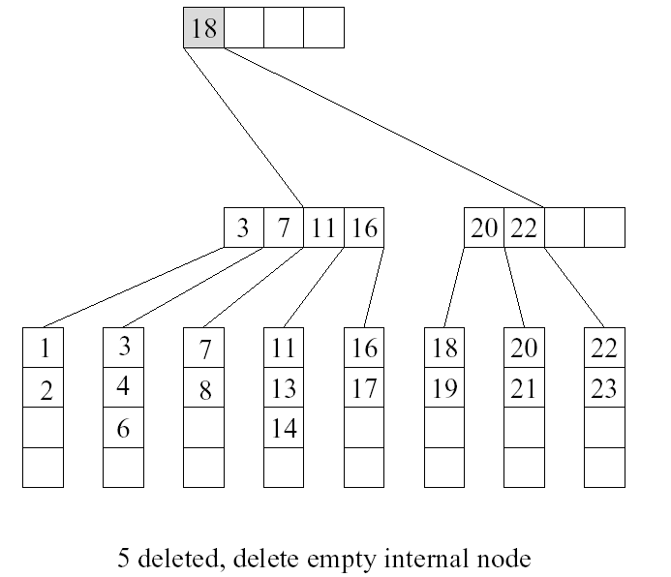
Cont’d

