Slide 1
Graph & BFS

Slide 2
Graphs
Extremely useful tool in modeling problems
Consist of:
  Vertices
  Edges
Vertices can be
considered “sites”
or locations.
Edges represent
connections.
D
E
C
A
F
B
Vertex
Edge

Slide 3
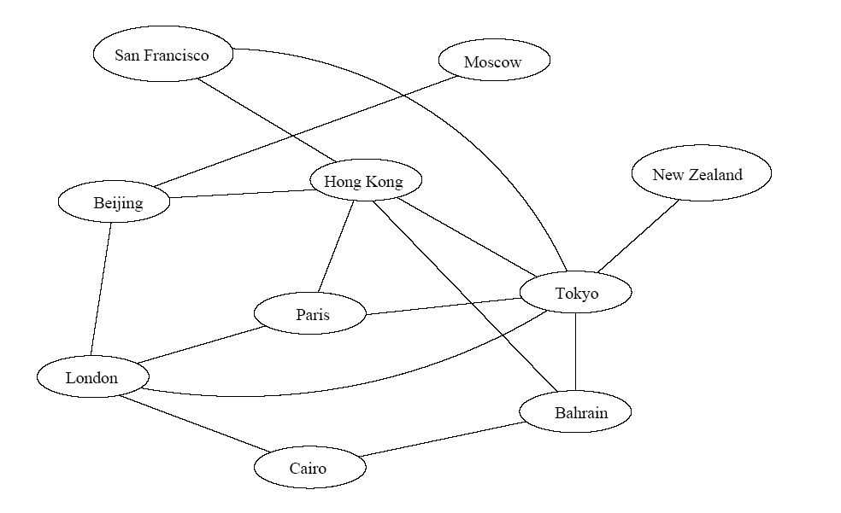

Application 1
Air flight system
Each vertex represents a city
Each edge represents a direct flight between two cities
A query on direct flights = a query on whether an edge exists
A query on how to get to a location = does a path exist from A to B
We can even associate costs to edges (weighted graphs), then ask “what is the cheapest path from A to B”

Slide 4
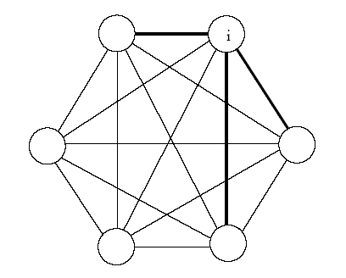

Application 2
Wireless communication
Represented by a weighted complete graph (every two vertices are connected by an edge)
Each edge represents the Euclidean distance dij between two stations
Each station uses a certain power i to transmit messages. Given this power i, only a few nodes can be reached (bold edges). A station reachable by i then uses its own power to relay the message to other stations not reachable by i.
A typical wireless communication problem is: how to broadcast between all stations such that they are all connected and the power consumption is minimized.

Slide 5
Graph, also called network (particularly when a weight is assgned to an edge)
A tree is a connected graph with no loops.
Graph algorithms might be very difficult!
  four color problem for planar graph!
171 only handles the simplest ones
  Traversal, BFS, DFS
  ((Minimum) spanning tree)
  Shortest paths from the source
  Connected components, topological sort

Slide 6
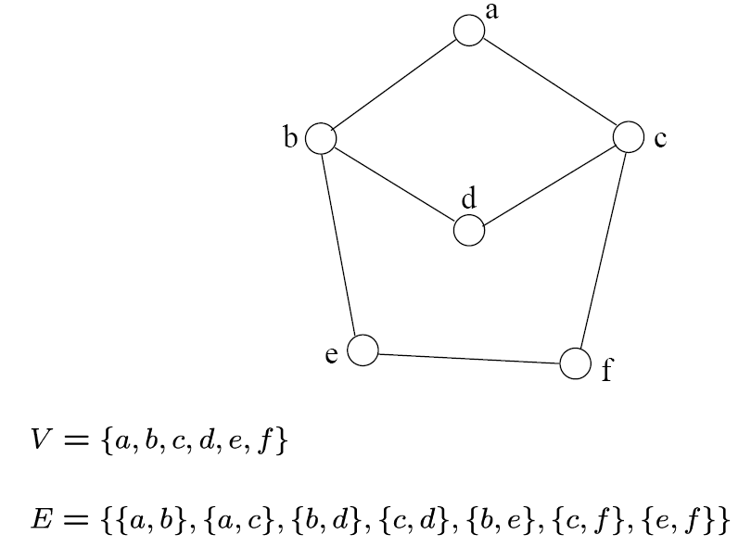
Definition
A graph G=(V, E) consists a set of vertices, V, and a set of edges, E.
Each edge is a pair of (v, w), where v, w belongs to V
If the pair is unordered, the graph is undirected; otherwise it is directed
{a,b}
{a,c}
{b,d}
{c,d}
{b,e}
{c,f}
{e,f}
An undirected graph

Slide 7
Terminology
If v₁ and v₂ are connected, they are said to be adjacent vertices
    v₁ and v₂ are endpoints of the edge {v₁, v₂}
If an edge e is connected to v, then v is said to be incident on e. Also, the edge e is said to be incident on v.
{v₁, v₂} = {v₂, v₁}
If we are talking about directed graphs, where edges have direction. This
means that {v₁,v₂} ≠ {v₂,v₁} . Directed graphs are drawn with arrows (called arcs) between edges.
A
B
This means {A,B} only, not {B,A}

Slide 8
Graph Representation
Two popular computer representations of a graph. Both represent the vertex set and the edge set, but in different ways.
  Adjacency Matrix
    Use a 2D matrix to represent the graph
  Adjacency List
    Use a 1D array of linked lists

Slide 9
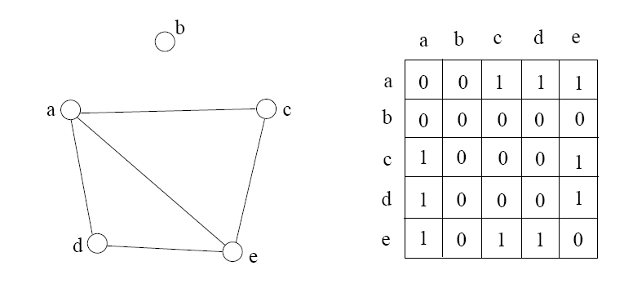
Adjacency Matrix
2D array A[0..n-1, 0..n-1], where n is the number of vertices in the graph
Each row and column is indexed by the vertex id
  e,g a=0, b=1, c=2, d=3, e=4
A[i][j]=1 if there is an edge connecting vertices i and j; otherwise, A[i][j]=0
The storage requirement is Θ(n²). It is not efficient if the graph has few edges. An adjacency matrix is an appropriate representation if the graph is dense: |E|=Θ(|V|²)
We can detect in O(1) time whether two vertices are connected.

Slide 10
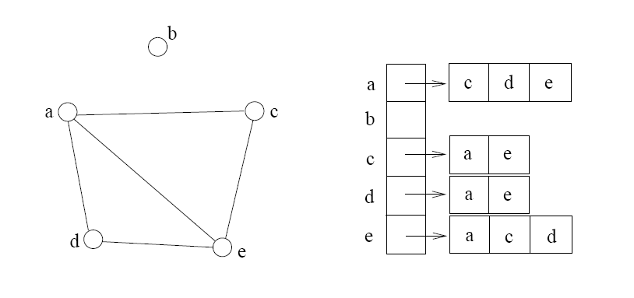
Adjacency List
If the graph is not dense, in other words, sparse, a better solution is an adjacency list
The adjacency list is an array A[0..n-1] of lists, where n is the number of vertices in the graph.
Each array entry is indexed by the vertex id
Each list A[i] stores the ids of the vertices adjacent to vertex i

Slide 11
Adjacency Matrix Example
0
 | 0 | 1 | 2 | 3 | 4 | 5 | 6 | 7 | 8 | 9
0 | 0 | 0 | 0 | 0 | 0 | 0 | 0 | 0 | 1 | 0
1 | 0 | 0 | 1 | 1 | 0 | 0 | 0 | 1 | 0 | 1
2 | 0 | 1 | 0 | 0 | 1 | 0 | 0 | 0 | 1 | 0
3 | 0 | 1 | 0 | 0 | 1 | 1 | 0 | 0 | 0 | 0
4 | 0 | 0 | 1 | 1 | 0 | 0 | 0 | 0 | 0 | 0
5 | 0 | 0 | 0 | 1 | 0 | 0 | 1 | 0 | 0 | 0
6 | 0 | 0 | 0 | 0 | 0 | 1 | 0 | 1 | 0 | 0
7 | 0 | 1 | 0 | 0 | 0 | 0 | 1 | 0 | 0 | 0
8 | 1 | 0 | 1 | 0 | 0 | 0 | 0 | 0 | 0 | 1
9 | 0 | 1 | 0 | 0 | 0 | 0 | 0 | 0 | 1 | 0
8
2
9
1
3
7
6
4
5

Slide 12
Adjacency List Example
0
0
1
2
3
4
5
6
7
8
9
8
2 | 3 | 7 | 9
8
1 | 4 | 8
2
9
1 | 4 | 5
1
2 | 3
7
3 | 6
3
6
5 | 7
4
5
1 | 6
0 | 2 | 9
1 | 8

Slide 13
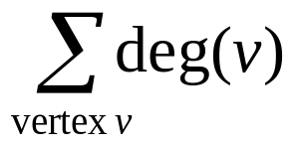
Storage of Adjacency List
The array takes up Θ(n) space
Define degree of v, deg(v), to be the number of edges incident to v. Then, the total space to store the graph is proportional to:
An edge e={u,v} of the graph contributes a count of 1 to deg(u) and contributes a count 1 to deg(v)
Therefore, Σ_{vertex v}deg(v) = 2m, where m is the total number of edges
In all, the adjacency list takes up Θ(n+m) space
  If m = O(n²) (i.e. dense graphs), both adjacent matrix and adjacent lists use Θ(n²) space.
  If m = O(n), adjacent list outperforms adjacent matrix
However, one cannot tell in O(1) time whether two vertices are connected

Slide 14
Adjacency List vs. Matrix
Adjacency List
  More compact than adjacency matrices if graph has few edges
  Requires more time to find if an edge exists
Adjacency Matrix
  Always require n² space
    This can waste a lot of space if the number of edges are sparse
  Can quickly find if an edge exists
  It’s a matrix, some algorithms can be solved by matrix computation!

Slide 15
Path between Vertices
A path is a sequence of vertices (v₀, v₁, v₂,… v_{k}) such that:
  For 0 ≤ i < k, {v_{i}, v_{i+1}} is an edge
  For 0 ≤ i < k-1, v_{i} ≠ v_{i+2}
    That is, the edge {v_{i}, v_{i+1}} ≠ {v_{i+1}, v_{i+2}}
  Note: a path is allowed to go through the same vertex or the same edge any number of times!
The length of a path is the number of edges on the path

Slide 16

Types of paths
A path is simple if and only if it does not contain a vertex more than once.
A path is a cycle if and only if v₀= v_{k}
    The beginning and end are the same vertex!
A path contains a cycle as its sub-path if some vertex appears twice or more

Slide 17
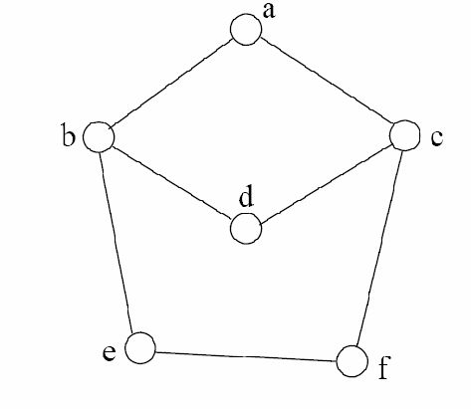
Path Examples
Are these paths?
Any cycles?
What is the path’s length?
{a,c,f,e}
{a,b,d,c,f,e}
{a, c, d, b, d, c, f, e}
{a,c,d,b,a}
{a,c,f,e,b,d,c,a}

Slide 18
Summary
A graph G=(V, E) consists a set of vertices, V, and a set of edges, E. Each edge is a pair of (v, w), where v, w belongs to V
graph, directed and undirected graph
vertex, node, edge, arc
incident, adjacent
degree, in-degree, out-degree, isolated
path, simple path,
path of length k, subpath
cycle, simple cycle, acyclic
connected, connected component
neighbor, complete graph, planar graph

Slide 19

Graph Traversal
Application example
  Given a graph representation and a vertex s in the graph
  Find all paths from s to other vertices
Two common graph traversal algorithms
    Breadth-First Search (BFS)
      Find the shortest paths in an unweighted graph
    Depth-First Search (DFS)
      Topological sort
      Find strongly connected components

Slide 20
BFS and Shortest Path Problem
Given any source vertex s, BFS visits the other vertices at increasing distances away from s. In doing so, BFS discovers paths from s to other vertices
What do we mean by “distance”? The number of edges on a path from s
From ‘local’ to ‘global’, step by step.
Example
0
Consider s=vertex 1
8
2
Nodes at distance 1?
2, 3, 7, 9
1
2
s
9
1
1
Nodes at distance 2?
8, 6, 5, 4
7
1
3
6
2
4
1
5
Nodes at distance 3?
0
2
2

Slide 21
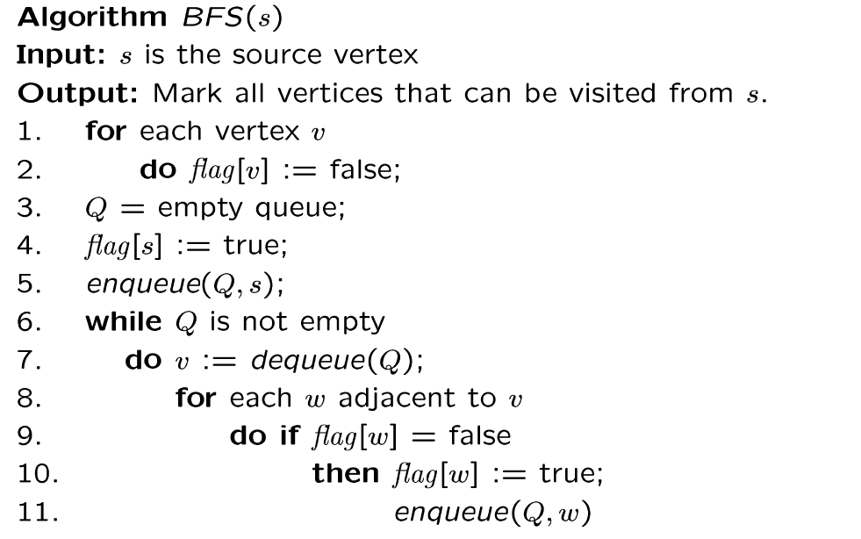
BFS Algorithm
// flag[ ]: visited table
Why use queue? Need FIFO

Slide 22
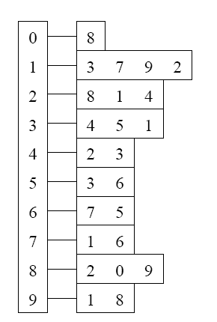
BFS Example
Adjacency List
Visited Table (T/F)
0
1
2
3
4
5
6
7
8
9
F
F
F
F
F
F
F
F
F
F
0
8
source
2
9
1
3
7
6
4
5
Initialize visited
table (all False)
Q =
{ }
Initialize Q to be empty

Slide 23
Adjacency List
Visited Table (T/F)
0
1
2
3
4
5
6
7
8
9
F
F
T
F
F
F
F
F
F
F
0
8
source
2
9
1
3
7
6
4
5
Flag that 2 has
been visited
Q =
{ 2 }
Place source 2 on the queue

Slide 24
Adjacency List
Visited Table (T/F)
0
1
2
3
4
5
6
7
8
9
F
T
T
F
T
F
F
F
T
F
0
8
Neighbors
source
2
9
1
3
7
6
4
5
Mark neighbors
as visited 1, 4, 8
Q =
{2} → { 8, 1, 4 }
Dequeue 2.
Place all unvisited neighbors of 2 on the queue

Slide 25
Adjacency List
Visited Table (T/F)
0
1
2
3
4
5
6
7
8
9
T
T
T
F
T
F
F
F
T
T
0
8
source
2
9
1
3
7
Neighbors
6
4
5
Mark new visited
Neighbors 0, 9
Q =
{ 8, 1, 4 } → { 1, 4, 0, 9 }
Dequeue 8.
-- Place all unvisited neighbors of 8 on the queue.
-- Notice that 2 is not placed on the queue again, it has been visited!

Slide 26
Adjacency List
Visited Table (T/F)
0
1
2
3
4
5
6
7
8
9
T
T
T
T
T
F
F
T
T
T
0
Neighbors
8
source
2
9
1
3
7
6
4
5
Mark new visited
Neighbors 3, 7
Q =
{ 1, 4, 0, 9 } → { 4, 0, 9, 3, 7 }
Dequeue 1.
-- Place all unvisited neighbors of 1 on the queue.
-- Only nodes 3 and 7 haven’t been visited yet.

Slide 27
Adjacency List
Visited Table (T/F)
0
1
2
3
4
5
6
7
8
9
T
T
T
T
T
F
F
T
T
T
0
8
source
2
9
Neighbors
1
3
7
6
4
5
Q =
{ 4, 0, 9, 3, 7 } → { 0, 9, 3, 7 }
Dequeue 4.
-- 4 has no unvisited neighbors!

Slide 28
Adjacency List
Visited Table (T/F)
Neighbors
0
1
2
3
4
5
6
7
8
9
T
T
T
T
T
F
F
T
T
T
0
8
source
2
9
1
3
7
6
4
5
Q =
{ 0, 9, 3, 7 } → { 9, 3, 7 }
Dequeue 0.
-- 0 has no unvisited neighbors!

Slide 29
Adjacency List
Visited Table (T/F)
0
1
2
3
4
5
6
7
8
9
T
T
T
T
T
F
F
T
T
T
0
8
source
2
9
1
3
7
6
4
5
Neighbors
Q =
{ 9, 3, 7 } → { 3, 7 }
Dequeue 9.
-- 9 has no unvisited neighbors!

Slide 30
Adjacency List
Visited Table (T/F)
0
1
2
3
4
5
6
7
8
9
T
T
T
T
T
T
F
T
T
T
0
8
Neighbors
source
2
9
1
3
7
6
4
5
Mark new visited
Vertex 5
Q =
{ 3, 7 } → { 7, 5 }
Dequeue 3.
-- place neighbor 5 on the queue.

Slide 31
Adjacency List
Visited Table (T/F)
0
1
2
3
4
5
6
7
8
9
T
T
T
T
T
T
T
T
T
T
0
8
source
2
9
1
7
Neighbors
3
6
4
5
Mark new visited
Vertex 6
Q =
{ 7, 5 } → { 5, 6 }
Dequeue 7.
-- place neighbor 6 on the queue

Slide 32
Adjacency List
Visited Table (T/F)
0
1
2
3
4
5
6
7
8
9
T
T
T
T
T
T
T
T
T
T
0
8
source
2
9
Neighbors
1
3
7
6
4
5
Q =
{ 5, 6} → { 6 }
Dequeue 5.
-- no unvisited neighbors of 5

Slide 33
Adjacency List
Visited Table (T/F)
0
1
2
3
4
5
6
7
8
9
T
T
T
T
T
T
T
T
T
T
0
8
source
2
9
1
Neighbors
3
7
6
4
5
Q =
{ 6 } → { }
Dequeue 6.
-- no unvisited neighbors of 6

Slide 34
Adjacency List
Visited Table (T/F)
0
1
2
3
4
5
6
7
8
9
T
T
T
T
T
T
T
T
T
T
0
8
source
2
9
1
3
7
6
4
5
What did we discover?
Look at “visited” tables.
There exists a path from source
vertex 2 to all vertices in the graph
Q =
{ }
STOP!!! Q is empty!!!

Slide 35
Time Complexity of BFS
(Using Adjacency List)
Assume adjacency list
  n = number of vertices m = number of edges
O(n + m)
Each vertex will enter Q
at most once.
Each iteration takes time proportional to deg(v) + 1 (the number 1 is to account for the case where deg(v) = 0 --- the work required is 1, not 0).

Slide 36
Running Time
Recall: Given a graph with m edges, what is the total degree?
The total running time of the while loop is:
this is summing over all the iterations in the while loop!
Σ_{vertex v} deg(v) = 2m
O( Σ_{vertex v} (deg(v) + 1) ) = O(n+m)

Slide 37
Time Complexity of BFS
(Using Adjacency Matrix)
Assume adjacency list
  n = number of vertices m = number of edges
O(n²)
Finding the adjacent vertices of v requires checking all elements in the row. This takes linear time O(n).
Summing over all the n iterations, the total running time is O(n²).
So, with adjacency matrix, BFS is O(n²) independent of the number of edges m.
With adjacent lists, BFS is O(n+m); if m=O(n²) like in a dense graph, O(n+m)=O(n²).

Slide 38
Breadth First Search (BFS)
Part 2
COMP171

Slide 39
Shortest Path Recording
BFS we saw only tells us whether a path exists from source s, to other vertices v.
  It doesn’t tell us the path!
  We need to modify the algorithm to record the path
How can we do that?
  Note: we do not know which vertices lie on this path until we reach v!
  Efficient solution:
    Use an additional array pred[0..n-1]
    Pred[w] = v means that vertex w was visited from v

Slide 40
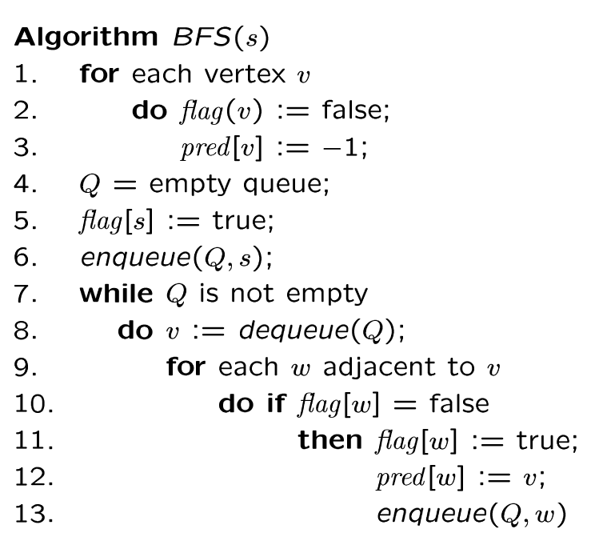
BFS + Path Finding
initialize
all pred[v] to -1
Record where you came from

Slide 41
Example
Visited Table
(T/F)
Adjacency List
0
1
2
3
4
5
6
7
8
9
F
F
F
F
F
F
F
F
F
F
-
-
-
-
-
-
-
-
-
-
0
8
source
2
9
1
3
7
6
4
5
Pred
Initialize visited
table (all False)
Initialize Pred to -1
Q =
{ }
Initialize Q to be empty

Slide 42
Adjacency List
Visited Table (T/F)
0
1
2
3
4
5
6
7
8
9
F
F
T
F
F
F
F
F
F
F
-
-
-
-
-
-
-
-
-
-
0
8
source
2
9
1
3
7
6
4
5
Pred
Flag that 2 has
been visited.
Q =
{ 2 }
Place source 2 on the queue.

Slide 43
Adjacency List
Visited Table (T/F)
0
1
2
3
4
5
6
7
8
9
F
T
T
F
T
F
F
F
T
F
-
2
-
-
2
-
-
-
2
-
0
8
Neighbors
source
2
9
1
3
7
6
4
5
Pred
Mark neighbors
as visited.
Record in Pred
that we came from 2.
Q =
{2} → { 8, 1, 4 }
Dequeue 2.
Place all unvisited neighbors of 2 on the queue

Slide 44
Adjacency List
Visited Table (T/F)
0
1
2
3
4
5
6
7
8
9
T
T
T
F
T
F
F
F
T
T
8
2
-
-
2
-
-
-
2
8
0
8
source
2
9
1
3
7
Neighbors
6
4
5
Pred
Mark new visited
Neighbors.
Record in Pred
that we came
from 8.
Q =
{ 8, 1, 4 } → { 1, 4, 0, 9 }
Dequeue 8.
-- Place all unvisited neighbors of 8 on the queue.
-- Notice that 2 is not placed on the queue again, it has been visited!

Slide 45
Adjacency List
Visited Table (T/F)
0
1
2
3
4
5
6
7
8
9
T
T
T
T
T
F
F
T
T
T
8
2
-
1
2
-
-
1
2
8
0
Neighbors
8
source
2
9
1
3
7
6
4
5
Pred
Mark new visited
Neighbors.
Record in Pred
that we came
from 1.
Q =
{ 1, 4, 0, 9 } → { 4, 0, 9, 3, 7 }
Dequeue 1.
-- Place all unvisited neighbors of 1 on the queue.
-- Only nodes 3 and 7 haven’t been visited yet.

Slide 46
Adjacency List
Visited Table (T/F)
0
1
2
3
4
5
6
7
8
9
T
T
T
T
T
F
F
T
T
T
8
2
-
1
2
-
-
1
2
8
0
8
2
Neighbors
source
9
1
3
7
6
4
5
Pred
Q =
{ 4, 0, 9, 3, 7 } → { 0, 9, 3, 7 }
Dequeue 4.
-- 4 has no unvisited neighbors!

Slide 47
Adjacency List
Visited Table (T/F)
Neighbors
0
1
2
3
4
5
6
7
8
9
T
T
T
T
T
F
F
T
T
T
8
2
-
1
2
-
-
1
2
8
0
8
source
2
9
1
3
7
6
4
5
Pred
Q =
{ 0, 9, 3, 7 } → { 9, 3, 7 }
Dequeue 0.
-- 0 has no unvisited neighbors!

Slide 48
Adjacency List
Visited Table (T/F)
0
1
2
3
4
5
6
7
8
9
T
T
T
T
T
F
F
T
T
T
8
2
-
1
2
-
-
1
2
8
0
8
source
2
9
1
3
7
6
4
5
Neighbors
Pred
Q =
{ 9, 3, 7 } → { 3, 7 }
Dequeue 9.
-- 9 has no unvisited neighbors!

Slide 49
Adjacency List
Visited Table (T/F)
0
1
2
3
4
5
6
7
8
9
T
T
T
T
T
T
F
T
T
T
8
2
-
1
2
3
-
1
2
8
0
8
Neighbors
source
2
9
1
3
7
6
4
5
Pred
Mark new visited
Vertex 5.
Record in Pred
that we came
from 3.
Q =
{ 3, 7 } → { 7, 5 }
Dequeue 3.
-- place neighbor 5 on the queue.

Slide 50
Adjacency List
Visited Table (T/F)
0
1
2
3
4
5
6
7
8
9
T
T
T
T
T
T
T
T
T
T
8
2
-
1
2
3
7
1
2
8
0
8
source
2
9
1
7
Neighbors
3
6
4
5
Pred
Mark new visited
Vertex 6.
Record in Pred
that we came
from 7.
Q =
{ 7, 5 } → { 5, 6 }
Dequeue 7.
-- place neighbor 6 on the queue.

Slide 51
Adjacency List
Visited Table (T/F)
0
1
2
3
4
5
6
7
8
9
T
T
T
T
T
T
T
T
T
T
8
2
-
1
2
3
7
1
2
8
0
8
source
2
9
Neighbors
1
3
7
6
4
5
Pred
Q =
{ 5, 6} → { 6 }
Dequeue 5.
-- no unvisited neighbors of 5.

Slide 52
Adjacency List
Visited Table (T/F)
0
1
2
3
4
5
6
7
8
9
T
T
T
T
T
T
T
T
T
T
8
2
-
1
2
3
7
1
2
8
0
8
source
2
9
1
Neighbors
3
7
6
4
5
Pred
Q =
{ 6 } → { }
Dequeue 6.
-- no unvisited neighbors of 6.

Slide 53
BFS Finished
Adjacency List
Visited Table (T/F)
0
1
2
3
4
5
6
7
8
9
T
T
T
T
T
T
T
T
T
T
8
2
-
1
2
3
7
1
2
8
0
8
source
2
9
1
3
7
6
4
5
Pred
Pred now can be traced backward
to report the path!
Q =
{ }
STOP!!! Q is empty!!!

Slide 54
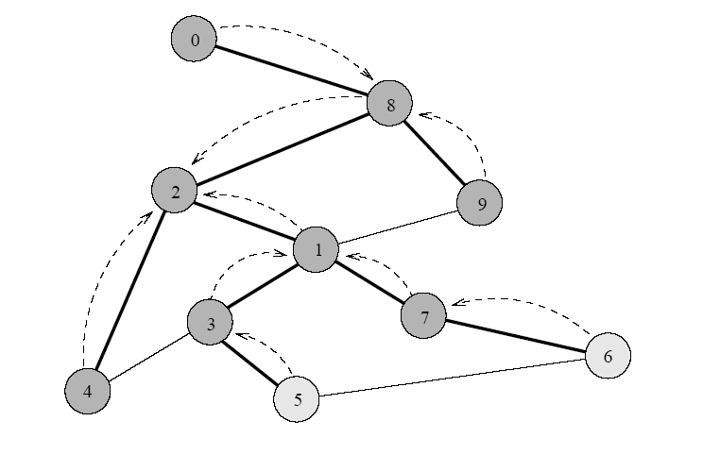
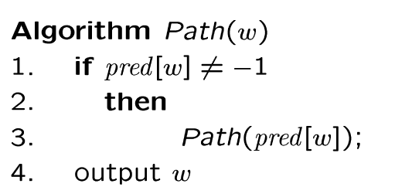
Path Reporting
nodes
visited from
0
1
2
3
4
5
6
7
8
9
8
2
-
1
2
3
7
1
2
8
Recursive algorithm
Try some examples, report path from s to v:
Path(0) ->
Path(6) ->
Path(1) ->
The path returned is the shortest from s to v (minimum number of edges).

Slide 55
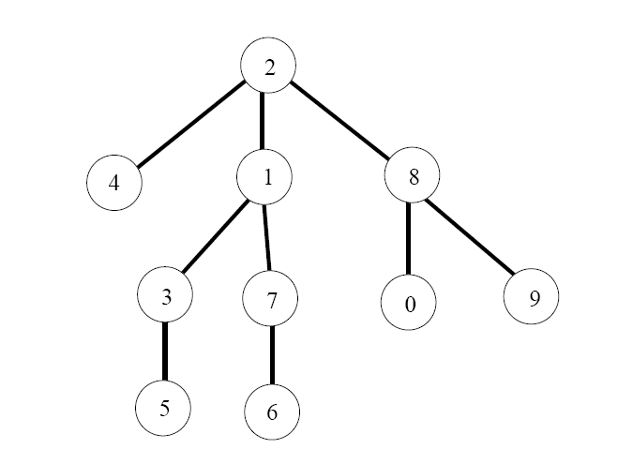
BFS Tree
The paths found by BFS is often drawn as a rooted tree (called BFS tree), with the starting vertex as the root of the tree.
BFS tree for vertex s=2.
Question: What would a “level” order traversal tell you?

Slide 56

Record the Shortest Distance
d(v) = ∞;
d(s) = 0;
d(w)=d(v)+1;

Slide 57
Application of BFS
One application concerns how to find
connected components in a graph
If a graph has more than one connected components, BFS builds a BFS-forest (not just BFS-tree)!
  Each tree in the forest is a connected component.

Slide 58
Depth-First Search
COMP171

Slide 59
Depth-First Search (DFS)
DFS is another popular graph search strategy
  Idea is similar to pre-order traversal (visit node, then visit children recursively)
DFS can provide certain information about the graph that BFS cannot
  It can tell whether we have encountered a cycle or not

Slide 60
DFS Algorithm
DFS will continue to visit neighbors in a recursive pattern
  Whenever we visit v from u, we recursively visit all unvisited neighbors of v. Then we backtrack (return) to u.
  Note: it is possible that w2 was unvisited when we recursively visit w1, but became visited by the time we return from the recursive call.
u
v
w3
w1
w2

Slide 61
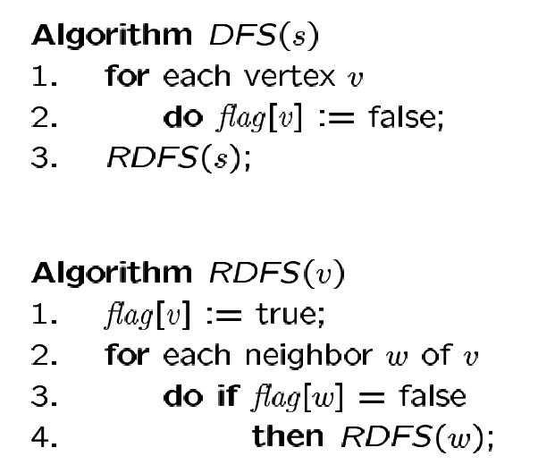
DFS Algorithm
Flag all vertices as not
visited
Flag yourself as visited
For unvisited neighbors,
call RDFS(w) recursively
We can also record the paths using pred[ ].

Slide 62
observe the similarity with the pre-ordering traversal of trees …

Slide 63
Example
Adjacency List
Visited Table (T/F)
0
0
1
2
3
4
5
6
7
8
9
F
F
F
F
F
F
F
F
F
F
-
-
-
-
-
-
-
-
-
-
8
source
2
9
1
3
7
6
4
5
Pred
Initialize visited
table (all False)
Initialize Pred to -1

Slide 64
Adjacency List
Visited Table (T/F)
0
0
1
2
3
4
5
6
7
8
9
F
F
T
F
F
F
F
F
F
F
-
-
-
-
-
-
-
-
-
-
8
source
2
9
1
3
7
6
4
5
Pred
Mark 2 as visited
RDFS( 2 )
Now visit RDFS(8)

Slide 65
Adjacency List
Visited Table (T/F)
0
8
0
1
2
3
4
5
6
7
8
9
F
F
T
F
F
F
F
F
T
F
-
-
-
-
-
-
-
-
2
-
source
2
9
1
3
7
6
4
5
Pred
Mark 8 as visited
mark Pred[8]
Recursive
calls
RDFS( 2 )
RDFS(8)
2 is already visited, so visit RDFS(0)

Slide 66
Adjacency List
Visited Table (T/F)
0
8
0
1
2
3
4
5
6
7
8
9
T
F
T
F
F
F
F
F
T
F
8
-
-
-
-
-
-
-
2
-
source
2
9
1
3
7
6
4
5
Pred
Mark 0 as visited
Mark Pred[0]
Recursive
calls
RDFS( 2 )
RDFS(8)
RDFS(0) -> no unvisited neighbors, return
to call RDFS(8)

Slide 67
Back to 8
Adjacency List
Visited Table (T/F)
0
8
0
1
2
3
4
5
6
7
8
9
T
F
T
F
F
F
F
F
T
F
8
-
-
-
-
-
-
-
2
-
source
2
9
1
3
7
6
4
5
Pred
Recursive
calls
RDFS( 2 )
RDFS(8)
Now visit 9 -> RDFS(9)

Slide 68
Adjacency List
Visited Table (T/F)
0
8
0
1
2
3
4
5
6
7
8
9
T
F
T
F
F
F
F
F
T
T
8
-
-
-
-
-
-
-
2
8
source
2
9
1
3
7
6
4
5
Pred
Mark 9 as visited
Mark Pred[9]
Recursive
calls
RDFS( 2 )
RDFS(8)
RDFS(9)
-> visit 1, RDFS(1)

Slide 69
Adjacency List
Visited Table (T/F)
0
8
0
1
2
3
4
5
6
7
8
9
T
T
T
F
F
F
F
F
T
T
8
9
-
-
-
-
-
-
2
8
source
2
9
1
3
7
6
4
5
Pred
Mark 1 as visited
Mark Pred[1]
Recursive
calls
RDFS( 2 )
RDFS(8)
RDFS(9)
RDFS(1)
visit RDFS(3)

Slide 70
Adjacency List
Visited Table (T/F)
0
8
0
1
2
3
4
5
6
7
8
9
T
T
T
T
F
F
F
F
T
T
8
9
-
1
-
-
-
-
2
8
source
2
9
1
3
7
6
4
5
Pred
Mark 3 as visited
Mark Pred[3]
Recursive
calls
RDFS( 2 )
RDFS(8)
RDFS(9)
RDFS(1)
RDFS(3)
visit RDFS(4)

Slide 71
Adjacency List
Visited Table (T/F)
0
8
0
1
2
3
4
5
6
7
8
9
T
T
T
T
T
F
F
F
T
T
8
9
-
1
3
-
-
-
2
8
source
2
9
1
3
7
6
4
5
Pred
RDFS( 2 )
RDFS(8)
RDFS(9)
RDFS(1)
RDFS(3)
RDFS(4) → STOP all of 4’s neighbors have been visited
return back to call RDFS(3)
Mark 4 as visited
Mark Pred[4]
Recursive
calls

Slide 72
Adjacency List
Visited Table (T/F)
0
8
0
1
2
3
4
5
6
7
8
9
T
T
T
T
T
F
F
F
T
T
8
9
-
1
3
-
-
-
2
8
source
2
9
1
3
7
6
4
5
Back to 3
Pred
RDFS( 2 )
RDFS(8)
RDFS(9)
RDFS(1)
RDFS(3)
visit 5 -> RDFS(5)
Recursive
calls

Slide 73
Adjacency List
Visited Table (T/F)
0
8
0
1
2
3
4
5
6
7
8
9
T
T
T
T
T
T
F
F
T
T
8
9
-
1
3
3
-
-
2
8
source
2
9
1
3
7
6
4
5
Pred
RDFS( 2 )
RDFS(8)
RDFS(9)
RDFS(1)
RDFS(3)
RDFS(5)
3 is already visited, so visit 6 -> RDFS(6)
Recursive
calls
Mark 5 as visited
Mark Pred[5]

Slide 74
Adjacency List
Visited Table (T/F)
0
8
0
1
2
3
4
5
6
7
8
9
T
T
T
T
T
T
T
F
T
T
8
9
-
1
3
3
5
-
2
8
source
2
9
1
3
7
6
4
5
RDFS( 2 )
RDFS(8)
RDFS(9)
RDFS(1)
RDFS(3)
RDFS(5)
RDFS(6)
visit 7 -> RDFS(7)
Pred
Recursive
calls
Mark 6 as visited
Mark Pred[6]

Slide 75
Adjacency List
Visited Table (T/F)
0
8
0
1
2
3
4
5
6
7
8
9
T
T
T
T
T
T
T
T
T
T
8
9
-
1
3
3
5
6
2
8
source
2
9
1
3
7
6
4
5
Pred
RDFS( 2 )
RDFS(8)
RDFS(9)
RDFS(1)
RDFS(3)
RDFS(5)
RDFS(6)
RDFS(7) -> Stop no more unvisited neighbors
Recursive
calls
Mark 7 as visited
Mark Pred[7]

Slide 76
Adjacency List
Visited Table (T/F)
0
0
1
2
3
4
5
6
7
8
9
T
T
T
T
T
T
T
T
T
T
8
9
-
1
3
3
5
6
2
8
8
source
2
9
1
3
7
6
4
5
RDFS( 2 )
RDFS(8)
RDFS(9)
RDFS(1)
RDFS(3)
RDFS(5)
RDFS(6) -> Stop
Pred
Recursive
calls

Slide 77
Adjacency List
Visited Table (T/F)
0
0
1
2
3
4
5
6
7
8
9
T
T
T
T
T
T
T
T
T
T
8
9
-
1
3
3
5
6
2
8
8
source
2
9
1
3
7
6
4
5
RDFS( 2 )
RDFS(8)
RDFS(9)
RDFS(1)
RDFS(3)
RDFS(5) -> Stop
Pred
Recursive
calls

Slide 78
Adjacency List
Visited Table (T/F)
0
0
1
2
3
4
5
6
7
8
9
T
T
T
T
T
T
T
T
T
T
8
9
-
1
3
3
5
6
2
8
8
source
2
9
1
3
7
6
4
5
RDFS( 2 )
RDFS(8)
RDFS(9)
RDFS(1)
RDFS(3) -> Stop
Pred
Recursive
calls

Slide 79
Adjacency List
Visited Table (T/F)
0
0
1
2
3
4
5
6
7
8
9
T
T
T
T
T
T
T
T
T
T
8
9
-
1
3
3
5
6
2
8
8
source
2
9
1
3
7
6
4
5
RDFS( 2 )
RDFS(8)
RDFS(9)
RDFS(1) -> Stop
Pred
Recursive
calls

Slide 80
Adjacency List
Visited Table (T/F)
0
0
1
2
3
4
5
6
7
8
9
T
T
T
T
T
T
T
T
T
T
8
9
-
1
3
3
5
6
2
8
8
source
2
9
1
3
7
6
4
5
RDFS( 2 )
RDFS(8)
RDFS(9) -> Stop
Pred
Recursive
calls

Slide 81
Adjacency List
Visited Table (T/F)
0
0
1
2
3
4
5
6
7
8
9
T
T
T
T
T
T
T
T
T
T
8
9
-
1
3
3
5
6
2
8
8
source
2
9
1
3
7
6
4
5
RDFS( 2 )
RDFS(8) -> Stop
Pred
Recursive
calls

Slide 82
Example Finished
Adjacency List
Visited Table (T/F)
0
0
1
2
3
4
5
6
7
8
9
T
T
T
T
T
T
T
T
T
T
8
9
-
1
3
3
5
6
2
8
8
source
2
9
1
3
7
6
4
5
RDFS( 2 ) -> Stop
Pred
Recursive calls finished

Slide 83
DFS Path Tracking
0
Adjacency List
Visited Table (T/F)
8
0
1
2
3
4
5
6
7
8
9
T
T
T
T
T
T
T
T
T
T
8
9
-
1
3
3
5
6
2
8
source
2
9
1
3
7
6
4
5
DFS find out path too
Pred
Try some examples.
Path(0) ->
Path(6) ->
Path(7) ->

Slide 84

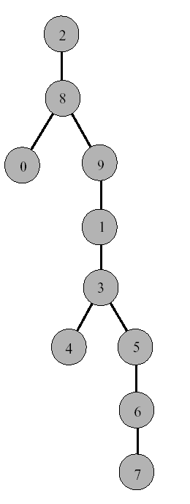
DFS Tree
Resulting DFS-tree.
Notice it is much “deeper”
than the BFS tree.
Captures the structure of the recursive calls
when we visit a neighbor w of v, we add w as child of v
whenever DFS returns from a vertex v, we climb up in the tree from v to its parent

Slide 85
Time Complexity of DFS
(Using adjacency list)
We never visited a vertex more than once
We had to examine all edges of the vertices
  We know Σ_{vertex v} degree(v) = 2m where m is the number of edges
So, the running time of DFS is proportional to the number of edges and number of vertices (same as BFS)
  O(n + m)
You will also see this written as:
  O(|v|+|e|) |v| = number of vertices (n) |e| = number of edges (m)

Slide 86
Connected Components,
Directed Graphs,
Topological Sort
COMP171

Slide 87
Graph Application: Connectivity
G =
P
Q
N
L
R
O
M
D
s
E
C
How do we tell if two vertices
are connected?
A
F
A connected to F?
A connected to L?
B
K
G
H

Slide 88
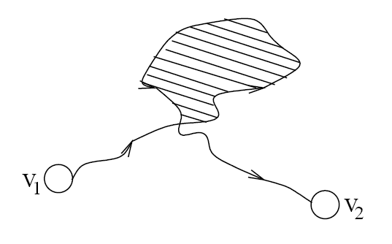
Connectivity
A graph is connected if and only if there exists a path between every pair of distinct vertices.
A graph is connected if and only if there exists a simple path between every pair of distinct vertices
  since every non-simple path contains a cycle, which can be bypassed
How to check for connectivity?
  Run BFS or DFS (using an arbitrary vertex as the source)
  If all vertices have been visited, the graph is connected.
  Running time? O(n + m)

Slide 89
Connected Components

Slide 90

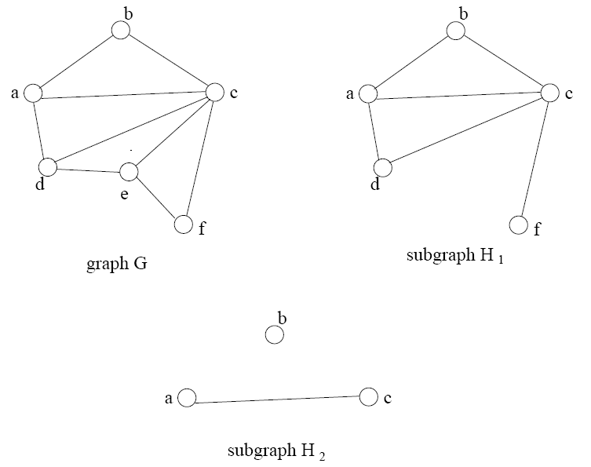
Subgraphs

Slide 91
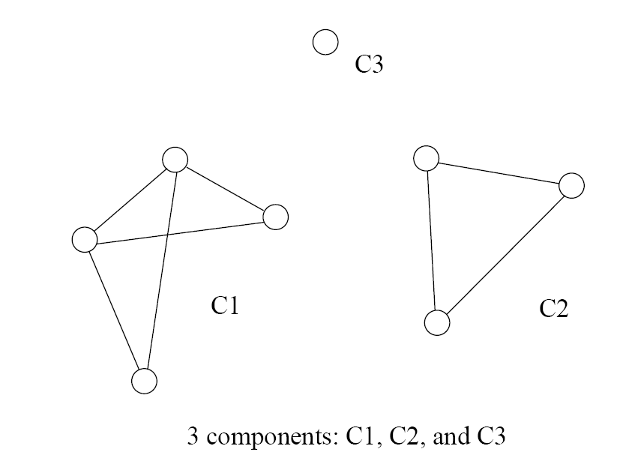
Connected Components
Formal definition
  A connected component is a maximal connected subgraph of a graph
The set of connected components is unique for a given graph

Slide 92
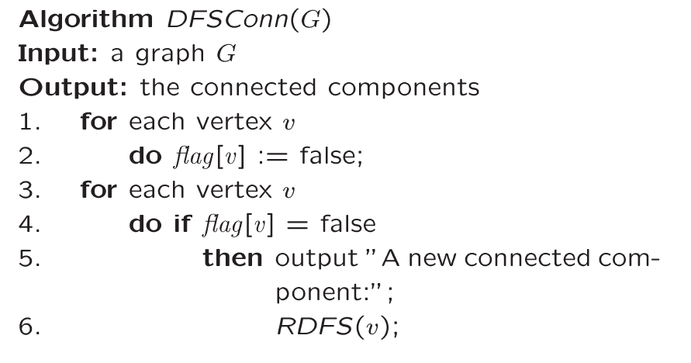
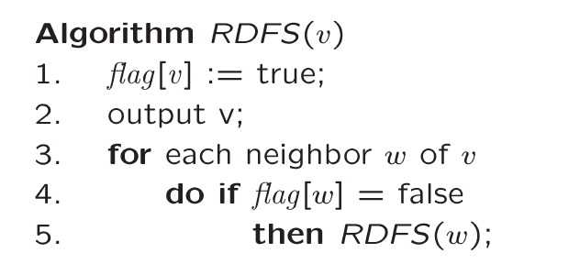
Finding Connected Components
For each vertex
If not visited
This will find all vertices connected to “v” => one
connected component
Call DFS
Basic DFS algorithm

Slide 93
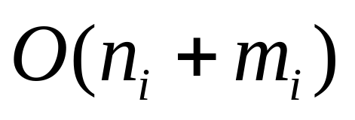
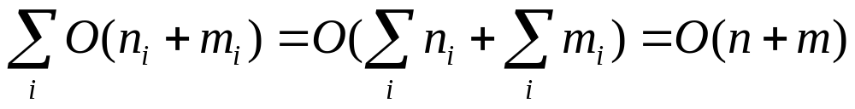
Time Complexity
Running time for each i connected component
Running time for the graph G
Reason: Can two connected components share
  the same edge?
  the same vertex?

Slide 94

Trees
Tree arises in many computer science applications
A graph G is a tree if and only if it is connected and acyclic
  (Acyclic means it does not contain any simple cycles)
The following statements are equivalent
  G is a tree
  G is acyclic and has exactly n-1 edges
  G is connected and has exactly n-1 edges

Slide 95
Tree Example
6
3
8
0
7
2
9
1
5
4
Is it a graph?
Does it contain cycles? In other words, is it acyclic?
How many vertices?
How many edges?

Slide 96

Directed Graph
A graph is directed if direction is assigned to each edge.
Directed edges are denoted as arcs.
  Arc is an ordered pair (u, v)
Recall: for an undirected graph
  An edge is denoted {u,v}, which actually corresponds to two arcs (u,v) and (v,u)

Slide 97
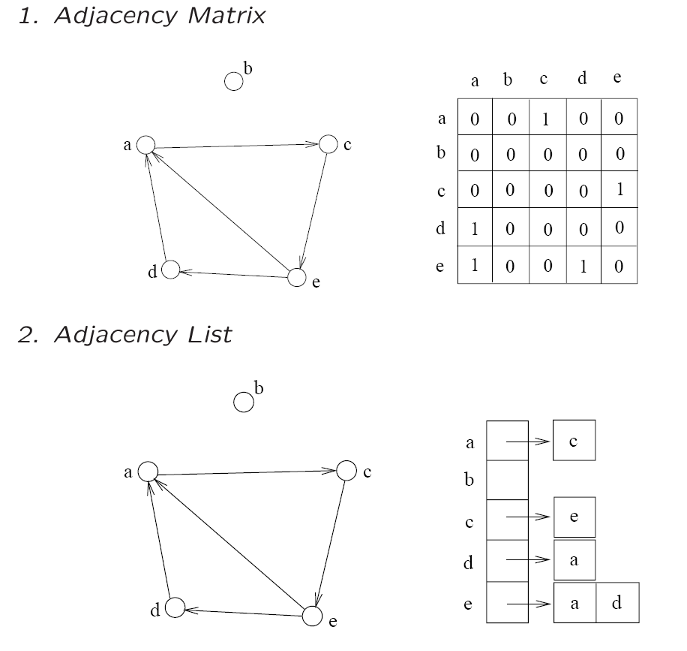
Representations
The adjacency matrix and adjacency list can be used

Slide 98

Directed Acyclic Graph
A directed path is a sequence of vertices
(v₀, v₁, . . . , v_{k})
  Such that (v_{i}, v_{i+1}) is an arc
A directed cycle is a directed path such that the first and last vertices are the same.
A directed graph is acyclic if it does not contain any directed cycles

Slide 99
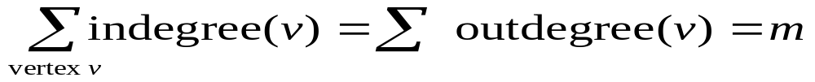
Indegree and Outdegree
Since the edges are directed
  We can’t simply talk about Deg(v)
Instead, we need to consider the arcs coming “in” and going “out”
  Thus, we define terms Indegree(v), and Outdegree(v)
Each arc(u,v) contributes count 1 to the outdegree of u and the indegree of v

Slide 100
Calculate Indegree and Outdegree
Outdegree is simple to compute
  Scan through list Adj[v] and count the arcs
Indegree calculation
  First, initialize indegree[v]=0 for each vertex v
  Scan through adj[v] list for each v
    For each vertex w seen, indegree[w]++;
    Running time: O(n+m)

Slide 101
Example
3
Indeg(2)?
Indeg(8)?
Outdeg(0)?
Num of Edges?
Total OutDeg?
Total Indeg?
6
8
0
7
2
9
1
5
4

Slide 102
Directed Graphs Usage
Directed graphs are often used to represent order-dependent tasks
  That is we cannot start a task before another task finishes
We can model this task dependent constraint using arcs
An arc (i,j) means task j cannot start until task i is finished
Clearly, for the system not to hang, the graph must be acyclic
i
j
Task j cannot start
until task i is finished

Slide 103
University Example
CS departments course structure
₁₀₄
₁₅₁
₁₇₁
₁₈₀
₃₄₂
₂₂₁
₂₀₁
₂₁₁
₂₅₁
₂₇₁
_{M111}
_{M132}
₂₅₂
₂₃₁
₃₀₃
₃₄₃
₂₇₂
₃₆₁
₃₈₁
₃₂₇
₃₄₁
₃₃₆
₃₃₄
₃₆₂
Any directed cycles?
₃₃₂
How many indeg(171)?
How many outdeg(171)?

Slide 104
Topological Sort
Topological sort is an algorithm for a directed acyclic graph
Linearly order the vertices so that the linear order respects the ordering relations implied by the arcs
3
For example:
0, 1, 2, 5, 9
0, 4, 5, 9
0, 6, 3, 7 ?
6
8
0
2
7
9
1
5
4
It may not be unique as they are many ‘equal’ elements!

Slide 105
Topological Sort Algorithm
Observations
  Starting point must have zero indegree
  If it doesn’t exist, the graph would not be acyclic
Algorithm
A vertex with zero indegree is a task that can start right away. So we can output it first in the linear order
If a vertex i is output, then its outgoing arcs (i, j) are no longer useful, since tasks j does not need to wait for i anymore- so remove all i’s outgoing arcs
With vertex i removed, the new graph is still a directed acyclic graph. So, repeat step 1-2 until no vertex is left.

Slide 106
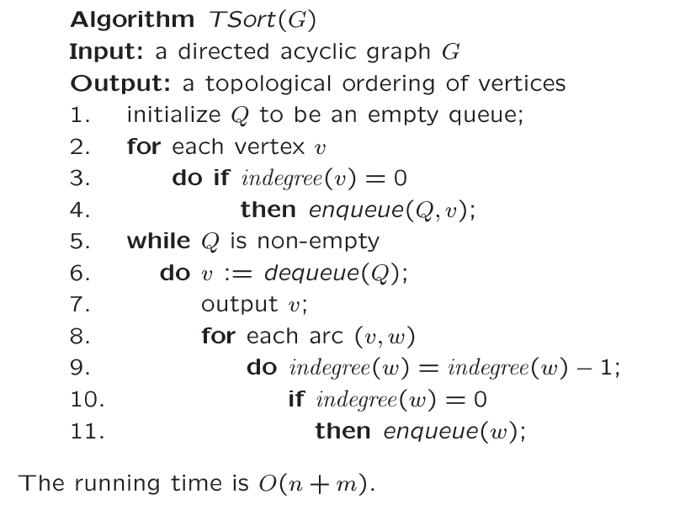
Topological Sort
Find all starting points
Take all outgoing arcs, all ‘w’s
Reduce indegree(w)
Place new start
vertices on the Q

Slide 107
Example
Indegree
0
1
2
3
4
5
6
7
8
9
6 | 1 | 4
0
1
2
3
4
5
6
7
8
9
0
1
2
1
1
2
1
1
2
2
2
start
6
3
7 | 5
8
8
5
0
2
7
9
1
9
3 | 2
5
8
4
9
Q = { 0 }
OUTPUT: 0

Slide 108
Indegree
0
1
2
3
4
5
6
7
8
9
6 | 1 | 4
0
1
2
3
4
5
6
7
8
9
0
1
2
1
1
2
1
1
2
2
2
-1
6
3
7 | 5
8
8
5
-1
0
2
7
9
1
9
3 | 2
-1
5
8
4
9
Dequeue 0 Q = { }
-> remove 0’s arcs – adjust
indegrees of neighbors
Decrement 0’s
neighbors
OUTPUT: 0

Slide 109
Indegree
0
1
2
3
4
5
6
7
8
9
6 | 1 | 4
0
1
2
3
4
5
6
7
8
9
0
0
2
1
0
2
0
1
2
2
2
6
3
7 | 5
8
8
5
0
2
7
9
1
9
3 | 2
5
8
4
9
Q = { 6, 1, 4 }
Enqueue all starting points
Enqueue all
new start points
OUTPUT: 0

Slide 110
Indegree
0
1
2
3
4
5
6
7
8
9
6 | 1 | 4
0
1
2
3
4
5
6
7
8
9
0
0
2
1
0
2
0
1
2
2
2
6
3
7 | 5
-1
8
8
-1
5
2
7
9
1
9
3 | 2
5
8
4
9
Dequeue 6 Q = { 1, 4 }
Remove arcs .. Adjust indegrees
of neighbors
Adjust neighbors
indegree
OUTPUT: 0 6

Slide 111
Indegree
0
1
2
3
4
5
6
7
8
9
6 | 1 | 4
0
1
2
3
4
5
6
7
8
9
0
0
1
0
0
2
0
1
2
2
2
3
7 | 5
8
8
5
2
7
9
1
9
3 | 2
5
8
4
9
Q = { 1, 4, 3 }
Enqueue 3
Enqueue new
start
OUTPUT: 0 6

Slide 112
Indegree
0
1
2
3
4
5
6
7
8
9
6 | 1 | 4
0
1
2
3
4
5
6
7
8
9
0
0
1
0
0
2
0
1
2
2
2
3
7 | 5
-1
8
8
5
2
7
9
1
9
3 | 2
5
8
4
9
Dequeue 1 Q = { 4, 3 }
Adjust indegrees of neighbors
Adjust neighbors
of 1
OUTPUT: 0 6 1

Slide 113
Indegree
0
1
2
3
4
5
6
7
8
9
6 | 1 | 4
0
1
2
3
4
5
6
7
8
9
0
0
0
0
0
2
0
1
2
2
2
3
7 | 5
8
8
5
2
7
9
9
3 | 2
5
8
4
9
Dequeue 1 Q = { 4, 3, 2 }
Enqueue 2
Enqueue new
starting points
OUTPUT: 0 6 1

Slide 114
Indegree
0
1
2
3
4
5
6
7
8
9
6 | 1 | 4
0
1
2
3
4
5
6
7
8
9
0
0
0
0
0
2
0
1
2
2
2
3
7 | 5
8
8
5
2
7
9
9
-1
3 | 2
5
8
4
9
Dequeue 4 Q = { 3, 2 }
Adjust indegrees of neighbors
Adjust 4’s
neighbors
OUTPUT: 0 6 1 4

Slide 115
Indegree
0
1
2
3
4
5
6
7
8
9
6 | 1 | 4
0
1
2
3
4
5
6
7
8
9
0
0
0
0
0
1
0
1
2
2
2
3
7 | 5
8
8
5
2
7
9
9
3 | 2
5
8
9
Dequeue 4 Q = { 3, 2 }
No new start points found
NO new start
points
OUTPUT: 0 6 1 4

Slide 116
Indegree
0
1
2
3
4
5
6
7
8
9
6 | 1 | 4
0
1
2
3
4
5
6
7
8
9
0
0
0
0
0
1
0
1
2
2
2
3
7 | 5
8
8
5
2
7
9
9
3 | 2
5
8
9
-1
Dequeue 3 Q = { 2 }
Adjust 3’s neighbors
OUTPUT: 0 6 1 4 3

Slide 117
Indegree
0
1
2
3
4
5
6
7
8
9
6 | 1 | 4
0
1
2
3
4
5
6
7
8
9
0
0
0
0
0
1
0
1
1
2
2
7 | 5
8
8
5
2
7
9
9
3 | 2
5
8
9
Dequeue 3 Q = { 2 }
No new start points found
OUTPUT: 0 6 1 4 3

Slide 118
Indegree
0
1
2
3
4
5
6
7
8
9
6 | 1 | 4
0
1
2
3
4
5
6
7
8
9
0
0
0
0
0
1
0
1
1
2
2
7 | 5
8
8
5
2
7
9
9
-1
3 | 2
5
8
-1
9
Dequeue 2 Q = { }
Adjust 2’s neighbors
OUTPUT: 0 6 1 4 3 2

Slide 119
Indegree
0
1
2
3
4
5
6
7
8
9
6 | 1 | 4
0
1
2
3
4
5
6
7
8
9
0
0
0
0
0
0
0
0
1
2
2
7 | 5
8
8
5
7
9
9
3 | 2
5
8
9
Dequeue 2 Q = { 5, 7 }
Enqueue 5, 7
OUTPUT: 0 6 1 4 3 2

Slide 120
Indegree
0
1
2
3
4
5
6
7
8
9
6 | 1 | 4
0
1
2
3
4
5
6
7
8
9
0
0
0
0
0
0
0
0
1
2
2
7 | 5
8
8
5
7
9
9
3 | 2
5
8
9
-1
Dequeue 5 Q = { 7 }
Adjust neighbors
OUTPUT: 0 6 1 4 3 2 5

Slide 121
Indegree
0
1
2
3
4
5
6
7
8
9
6 | 1 | 4
0
1
2
3
4
5
6
7
8
9
0
0
0
0
0
0
0
0
1
1
2
7 | 5
8
8
5
7
9
9
3 | 2
8
9
Dequeue 5 Q = { 7 }
No new starts
OUTPUT: 0 6 1 4 3 2 5

Slide 122
Indegree
0
1
2
3
4
5
6
7
8
9
6 | 1 | 4
0
1
2
3
4
5
6
7
8
9
0
0
0
0
0
0
0
0
1
1
2
7 | 5
8
8
5
7
9
9
3 | 2
8
9
-1
Dequeue 7 Q = { }
Adjust neighbors
OUTPUT: 0 6 1 4 3 2 5 7

Slide 123
Indegree
0
1
2
3
4
5
6
7
8
9
6 | 1 | 4
0
1
2
3
4
5
6
7
8
9
0
0
0
0
0
0
0
0
0
1
2
7 | 5
8
8
5
9
9
3 | 2
8
9
Dequeue 7 Q = { 8 }
Enqueue 8
OUTPUT: 0 6 1 4 3 2 5 7

Slide 124
Indegree
0
1
2
3
4
5
6
7
8
9
6 | 1 | 4
0
1
2
3
4
5
6
7
8
9
0
0
0
0
0
0
0
0
0
1
2
7 | 5
8
8
5
9
9
3 | 2
8
9
-1
Dequeue 8 Q = { }
Adjust indegrees of neighbors
OUTPUT: 0 6 1 4 3 2 5 7 8

Slide 125
Indegree
0
1
2
3
4
5
6
7
8
9
6 | 1 | 4
0
1
2
3
4
5
6
7
8
9
0
0
0
0
0
0
0
0
0
0
2
7 | 5
8
5
9
9
3 | 2
8
9
Dequeue 8 Q = { 9 }
Enqueue 9
Dequeue 9 Q = { }
STOP – no neighbors
OUTPUT: 0 6 1 4 3 2 5 7 8 9

Slide 126
6
3
8
0
2
7
9
1
5
4
OUTPUT: 0 6 1 4 3 2 5 7 8 9
Is output topologically correct?

Slide 127
Topological Sort: Complexity
We never visited a vertex more than one time
For each vertex, we had to examine all outgoing edges
  Σ outdegree(v) = m
  This is summed over all vertices, not per vertex
So, our running time is exactly
  O(n + m)

Slide 128
Summary:
Two representations:
Some definitions: …
Two sizes: n = |V| and m=|E|,
  m = O(n^2)
Adjacency List
  More compact than adjacency matrices if graph has few edges
  Requires a scan of adjacency list to check if an edge exists
  Requires a scan to obtain all edges!
Adjacency Matrix
  Always require n² space
    This can waste a lot of space if the number of edges are sparse
  find if an edge exists in O(1)
  Obtain all edges in O(n)
O(n+m) for indegree for a DAG

Slide 129
(one), Two, (three) algorithms:
RDFS(v)
v is visited
W = {unvisited neighbors of v}
for each w in W
RDFS(w)
BFS (queue)
s is visited
enqueue(Q,s)
while not-empty(Q)
v <- dequeue(Q)
W = {unvisited neighbors of v}
for each w in W
w is visited
enqueue(Q,w)
DFS (stack)
s is visited
push(S,s)
while not-empty(S)
v <- pop(S)
W = {unvisited neighbors of v}
for each w in W
w is visited
push(S,w)

Slide 130
Two applications
For each non-visited vertex, run ‘connected component’ (either BFS or DFS)
  For a connected component, list all vertices, find a spanning tree (BFS tree or DFS tree)
‘Shortest paths’ and ‘topological sort’ (for DAG only) are close to BFS

