Slide 1
Hashing
COMP171

Slide 2
Hashing …
Again, a (dynamic) set of elements in which we do ‘search’, ‘insert’, and ‘delete’
  Linear ones: lists, stacks, queues, …
  Nonlinear ones: trees, graphs (relations between elements are explicit)
  Now for the case ‘relation is not important’, but want to be ‘efficient’ for searching (like in a dictionary)!
Generalizing an ordinary array,
  direct addressing!
  An array is a direct-address table
A set of N keys, compute the index, then use an array of size N
  Key k at k -> direct address, now key k at h(k) -> hashing
Basic operation is in O(1)!
To ‘hash’ (is to ‘chop into pieces’ or to ‘mince’), is to make a ‘map’ or a ‘transform’ …

Slide 3
Hash Table
Hash table is a data structure that supports
  Finds, insertions, deletions (deletions may be unnecessary in some applications)
The implementation of hash tables is called hashing
  A technique which allows the executions of above operations in constant average time
Tree operations that requires any ordering information among elements are not supported
  findMin and findMax
  Successor and predecessor
  Report data within a given range
  List out the data in order

Slide 4
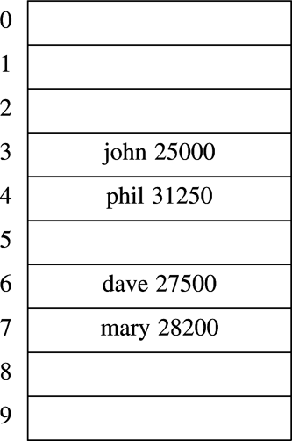
General Idea
The ideal hash table data structure is an array of some fixed size, containing the items
A search is performed based on key
Each key is mapped into some position in the range 0 to TableSize-1
The mapping is called hash function
Data item
A hash table

Slide 5
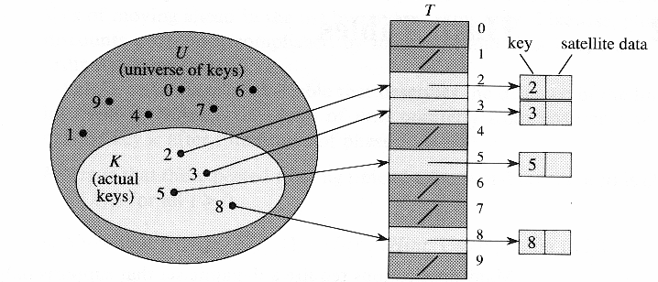
Unrealistic Solution
Each position (slot) corresponds to a key in the universe of keys
  T[k] corresponds to an element with key k
  If the set contains no element with key k, then T[k]=NULL

Slide 6

Unrealistic Solution
Insertion, deletion and finds all take O(1) (worst-case) time
Problem: waste too much space if the universe is too large compared with the actual number of elements to be stored
  E.g. student IDs are 8-digit integers, so the universe size is 10⁸, but we only have about 7000 students

Slide 7
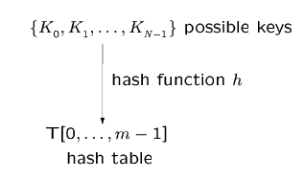
Hashing
Usually, m << N
h(K_{i}) = an integer in [0, …, m-1] called the hash value of K_{i}
The keys are assumed to be natural numbers, if they are not, they can always be converted or interpreted in natural numbers.

Slide 8
Example Applications
Compilers use hash tables (symbol table) to keep track of declared variables.
On-line spell checkers. After prehashing the entire dictionary, one can check each word in constant time and print out the misspelled word in order of their appearance in the document.
Useful in applications when the input keys come in sorted order. This is a bad case for binary search tree. AVL tree and B+-tree are harder to implement and they are not necessarily more efficient.

Slide 9
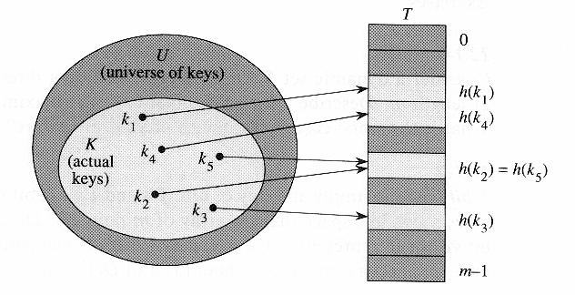
Hash Function
With hashing, an element of key k is stored in T[h(k)]
h: hash function
  maps the universe U of keys into the slots of a hash table T[0,1,...,m-1]
  an element of key k hashes to slot h(k)
  h(k) is the hash value of key k

Slide 10

Collision
Problem: collision
  two keys may hash to the same slot
  can we ensure that any two distinct keys get different cells?
    No, if N>m, where m is the size of the hash table
Task 1: Design a good hash function
  that is fast to compute and
  can minimize the number of collisions
Task 2: Design a method to resolve the collisions when they occur

Slide 11
Design Hash Function
A simple and reasonable strategy: h(k) = k mod m
  e.g. m=12, k=100, h(k)=4
  Requires only a single division operation (quite fast)
Certain values of m should be avoided
  e.g. if m=2^{p}, then h(k) is just the p lowest-order bits of k; the hash function does not depend on all the bits
  Similarly, if the keys are decimal numbers, should not set m to be a power of 10
It’s a good practice to set the table size m to be a prime number
Good values for m: primes not too close to exact powers of 2
  e.g. the hash table is to hold 2000 numbers, and we don’t mind an average of 3 numbers being hashed to the same entry
    choose m=701

Slide 12
Deal with String-type Keys
Can the keys be strings?
Most hash functions assume that the keys are natural numbers
  if keys are not natural numbers, a way must be found to interpret them as natural numbers
Method 1: Add up the ASCII values of the characters in the string
  Problems:
    Different permutations of the same set of characters would have the same hash value
    If the table size is large, the keys are not distribute well. e.g. Suppose m=10007 and all the keys are eight or fewer characters long. Since ASCII value <= 127, the hash function can only assume values between 0 and 127*8=1016

Slide 13
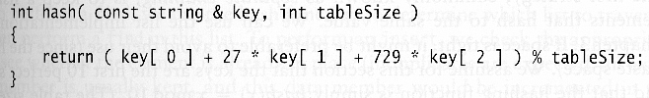
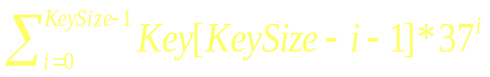
a,…,z and space
Method 2
  If the first 3 characters are random and the table size is 10,0007 => a reasonably equitable distribution
  Problem
    English is not random
    Only 28 percent of the table can actually be hashed to (assuming a table size of 10,007)
Method 3
  computes
  involves all characters in the key and be expected to distribute well
27²

Slide 14
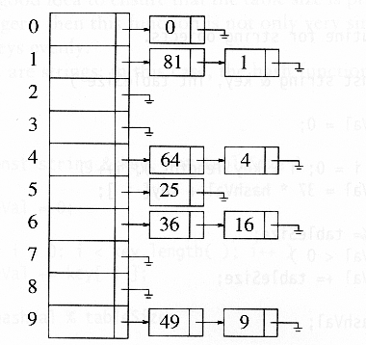
Collision Handling:
(1) Separate Chaining
Like ‘equivalent classes’ or clock numbers in math
Instead of a hash table, we use a table of linked list
keep a linked list of keys that hash to the same value
Keys:
Set of squares
Hash function:
h(K) = K mod 10

Slide 15
Separate Chaining Operations
To insert a key K
  Compute h(K) to determine which list to traverse
  If T[h(K)] contains a null pointer, initiatize this entry to point to a linked list that contains K alone.
  If T[h(K)] is a non-empty list, we add K at the beginning of this list.
To delete a key K
  compute h(K), then search for K within the list at T[h(K)]. Delete K if it is found.

Slide 16
Separate Chaining Features
If the hash function works well, the number of keys in each linked list will be a small constant.
Therefore, we expect that each search, insertion, and deletion can be done in constant time.
Disadvantage: Memory allocation in linked list manipulation will slow down the program.
Advantage: deletion is easy.

Slide 17
Collision Handling:
(2) Open Addressing
Instead of following pointers, compute the sequence of slots to be examined
Open addressing: relocate the key K to be inserted if it collides with an existing key.
  We store K at an entry different from T[h(K)].
Two issues arise
  what is the relocation scheme?
  how to search for K later?
Three common methods for resolving a collision in open addressing
  Linear probing
  Quadratic probing
  Double hashing

Slide 18

Open Addressing Strategy
To insert a key K, compute h₀(K). If T[h₀(K)] is empty, insert it there. If collision occurs, probe alternative cell h₁(K), h₂(K), .... until an empty cell is found.
h_{i}(K) = (hash(K) + f(i)) mod m, with f(0) = 0
  f: collision resolution strategy

Slide 19
Linear Probing
f(i) =i
  cells are probed sequentially (with wrap-around)
  h_{i}(K) = (hash(K) + i) mod m
Insertion:
  Let K be the new key to be inserted, compute hash(K)
  For i = 0 to m-1
    compute L = ( hash(K) + I ) mod m
    T[L] is empty, then we put K there and stop.
  If we cannot find an empty entry to put K, it means that the table is full and we should report an error.

Slide 20
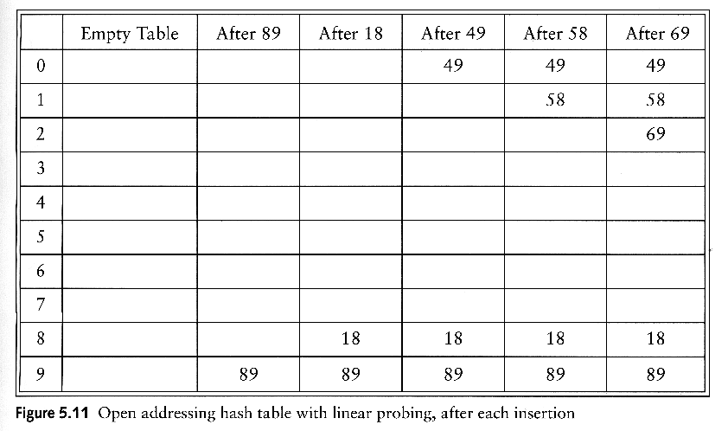
Linear Probing Example
h_{i}(K) = (hash(K) + i) mod m
E.g, inserting keys 89, 18, 49, 58, 69 with hash(K)=K mod 10
To insert 58, probe T[8], T[9], T[0], T[1]
To insert 69, probe T[9], T[0], T[1], T[2]

Slide 21
Primary Clustering
We call a block of contiguously occupied table entries a cluster
On the average, when we insert a new key K, we may hit the middle of a cluster. Therefore, the time to insert K would be proportional to half the size of a cluster. That is, the larger the cluster, the slower the performance.
Linear probing has the following disadvantages:
  Once h(K) falls into a cluster, this cluster will definitely grow in size by one. Thus, this may worsen the performance of insertion in the future.
  If two clusters are only separated by one entry, then inserting one key into a cluster can merge the two clusters together. Thus, the cluster size can increase drastically by a single insertion. This means that the performance of insertion can deteriorate drastically after a single insertion.
  Large clusters are easy targets for collisions.

Slide 22
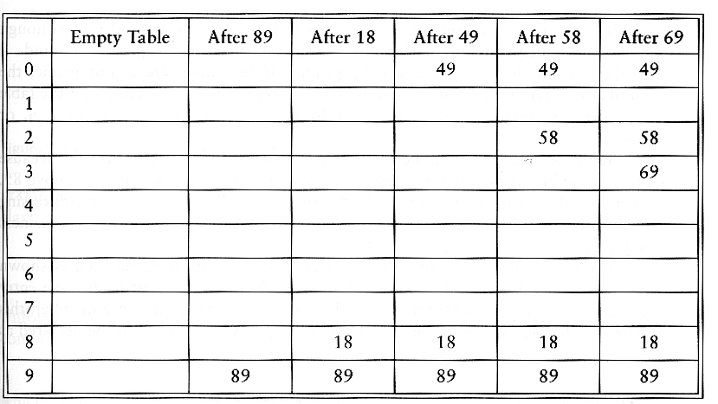
Quadratic Probing Example
f(i) = i²
h_{i}(K) = ( hash(K) + i² ) mod m
E.g., inserting keys 89, 18, 49, 58, 69 with hash(K) = K mod 10
To insert 58, probe T[8], T[9], T[(8+4) mod 10]
To insert 69, probe T[9], T[(9+1) mod 10], T[(9+4) mod 10]

Slide 23
Quadratic Probing
Two keys with different home positions will have different probe sequences
  e.g. m=101, h(k1)=30, h(k2)=29
  probe sequence for k1: 30,30+1, 30+4, 30+9
  probe sequence for k2: 29, 29+1, 29+4, 29+9
If the table size is prime, then a new key can always be inserted if the table is at least half empty (see proof in text book)
Secondary clustering
  Keys that hash to the same home position will probe the same alternative cells
  Simulation results suggest that it generally causes less than an extra half probe per search
  To avoid secondary clustering, the probe sequence need to be a function of the original key value, not the home position

Slide 24
Double Hashing
To alleviate the problem of clustering, the sequence of probes for a key should be independent of its primary position => use two hash functions: hash() and hash2()
f(i) = i * hash2(K)
  E.g. hash2(K) = R - (K mod R), with R is a prime smaller than m

Slide 25
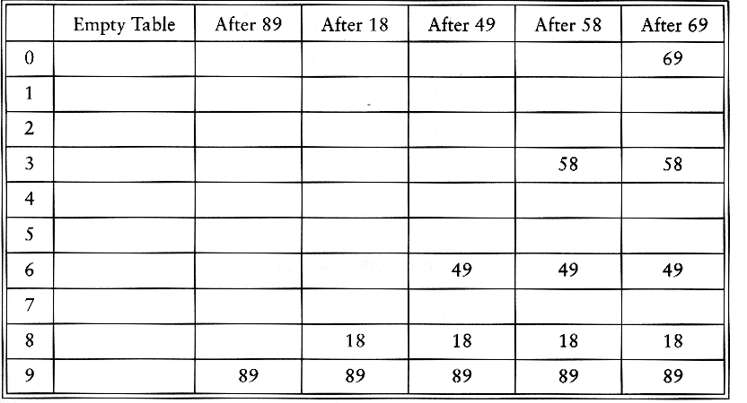
Double Hashing Example
h_{i}(K) = ( hash(K) + f(i) ) mod m; hash(K) = K mod m
f(i) = i * hash2(K); hash2(K) = R - (K mod R),
Example: m=10, R = 7 and insert keys 89, 18, 49, 58, 69
To insert 49, hash2(49)=7, 2nd probe is T[(9+7) mod 10]
To insert 58, hash2(58)=5, 2nd probe is T[(8+5) mod 10]
To insert 69, hash2(69)=1, 2nd probe is T[(9+1) mod 10]

Slide 26
Choice of hash2()
Hash2() must never evaluate to zero
For any key K, hash2(K) must be relatively prime to the table size m. Otherwise, we will only be able to examine a fraction of the table entries.
  E.g.,if hash(K) = 0 and hash2(K) = m/2, then we can only examine the entries T[0], T[m/2], and nothing else!
One solution is to make m prime, and choose R to be a prime smaller than m, and set
hash2(K) = R – (K mod R)
Quadratic probing, however, does not require the use of a second hash function
  likely to be simpler and faster in practice

Slide 27
Deletion in Open Addressing
Actual deletion cannot be performed in open addressing hash tables
  otherwise this will isolate records further down the probe sequence
Solution: Add an extra bit to each table entry, and mark a deleted slot by storing a special value DELETED (tombstone) or it’s called ‘lazy deletion’.

Slide 28
Re-hashing
If the table is full
Double the size and re-hash everything with a new hashing function

Slide 29
Pattern Matching
COMP171
Spring 2009

Slide 30
Pattern Matching
Given a text string T[0..n-1] and a pattern P[0..m-1], find all occurrences of the pattern within the text.
Example: T = 000010001010001 and P = 0001:
  first occurrence starts at T[1].
  second occurrence starts at T[5].
  third occurrence starts at T[11].

Slide 31
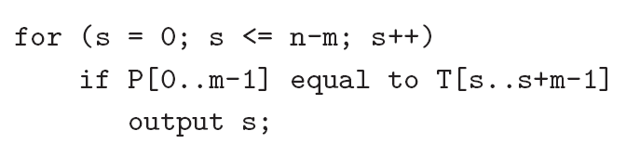
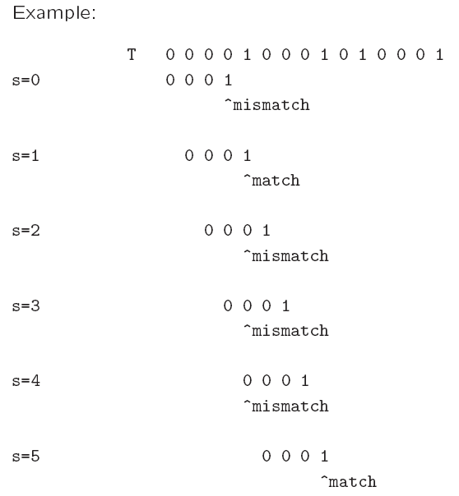
Naïve algorithm
Worst-case running time = O(nm).

Slide 32
Can we do it better?
The naïve algo is O(mn) in the worst case
But we do have linear algorithm (optional):
  Boyer-Moore
  Knuth-Morris-Pratt
  Finite automata
Using idea of ‘hashing’! Robin-Karp algorithm

Slide 33
Boyer-Moore Algorithm
Basic idea is simple.
We match the pattern P against substrings in the text string T from right to left.
We align the pattern with the beginning of the text string. Compare the characters starting from the rightmost character of the pattern. If fail, shift the pattern to the right, by how far?
http://www.prism.gatech.edu/~jgirata3/boyermoore/

Slide 34
-------X-------
ANPANMAN-------
-ANPANMAN------
--ANPANMAN-----
---ANPANMAN----
----ANPANMAN---
-----ANPANMAN--
------ANPANMAN-
-------ANPANMAN
The X in position 8 excludes all 8 of the possible

Slide 35
Rabin-Karp Algorithm
Key idea:
  Think of the pattern P[0..m-1] as a key, transform it into an equivalent integer p.
  Similarly, we transform substrings in the text string T[] into integers.
    For s=0,1,…,n-m, transform T[s..s+m-1] to an equivalent integer t_{s}.
  The pattern occurs at position s if and only if p=t_{s}.
If we compute p and t_{s} quickly, then the pattern matching problem is reduced to comparing p with n-m+1 integers.
http://www-igm.univ-mlv.fr/~lecroq/string/node5.html

Slide 36
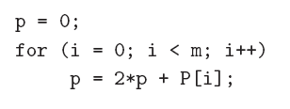
Rabin-Karp Algorithm
How to compute p?
  p = 2^{m-1} P[0] + 2^{m-2} P[1] + … + 2 P[m-2] + P[m-1]
Using Horner’s rule
This takes O(m) time, assuming each arithmetic operation can be done in O(1) time.

Slide 37
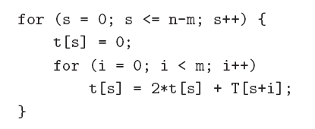
Rabin-Karp Algorithm
Similarly, to compute the (n-m+1) integers t_{s} from the text string.
This takes O((n – m + 1) m) time, assuming that each arithmetic operation can be done in O(1) time.
This is a bit time-consuming.

Slide 38
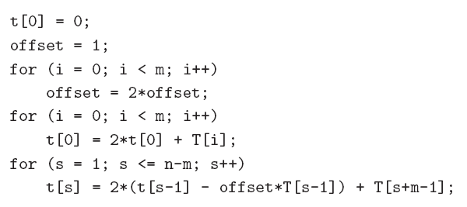
Rabin-Karp Algorithm
A better method to compute the integers incrementally using previous result:
compute offset = 2^{m}
Horner’s rule to compute t₀
t_{S-1}
t_{S}
This takes O(n+m) time, assuming that each arithmetic operation can be done in O(1) time.

Slide 39
Problem
The problem with the previous strategy is that when m is large, it is unreasonable to assume that each arithmetic operation can be done in O(1) time.
  In fact, given a very long integer, we may not even be able to use the default integer type to represent it.
Therefore, we will use modulo arithmetic. Let q be a prime number so that 2q can be stored in one computer word.
  This makes sure that all computations can be done using single-precision arithmetic.

Slide 40
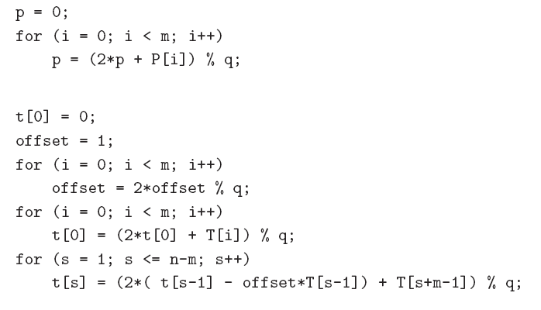
Compute equivalent integer for pattern
O(m)
O(n+m)

Slide 41
Once we use the modulo arithmetic, when p=t_{s} for some s, we can no longer be sure that P[0 .. m-1] is equal to T[s .. s+ m -1 ].
Therefore, after the equality test p = t_{s}, we should compare P[0..m-1] with T[s..s+m-1] character by character to ensure that we really have a match.
So the worst-case running time becomes O(nm), but it avoids a lot of unnecessary string matchings in practice.

Slide 42
A spell checker with hashing
Start by reading in words from a dictionary file named dictionary. The words in this dictionary
file will be listed one per line, sorted alphabetically. Store each word in a hash table, using
chaining to resolve collisions. Start with a table size of roughly 4K entries (the table size should
be prime). If necessary, rehash to a larger table size to keep the load factor less than 1.0.
After hashing each word in the dictionary file, read in the user-specified text file and check it for
spelling errors by looking up each word in the hash table. A word is defined as a string of letters
(possibly containing single quotes), separated by white space and/or punctuation marks. If a word
cannot be found in the hash table, it represents a possible misspelling.

