Slide 1

C++ Quick Review

Slide 2
Outline
Functions
  Function calls
  Pass-by-value
  Pass-by-reference
  Passing arrays to functions
  Passing functions to functions?
Recursion
Pointers and dynamic objects
COMP152

Slide 3
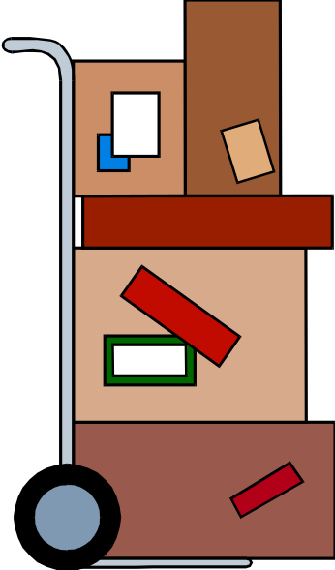
Functions in a C Program
Every time a function is called, a “stack” is created. The return of the function removes the stack back to the caller
main is the “mother” function
C++ programs usually have the following form:
  // include statements
  // function prototypes
  // main() function
  // user-defined functions
COMP152

Slide 4
Functions & Memory
Every function needs a place to store its local variables. Collectively, this storage is called the stack
This storage (memory aka “RAM”) is a series of storage spaces and their numerical addresses
Instead of using raw addresses, we use variables to associate a name to an address (kept track by the compiler)
All of the data/variables for a particular function call are located in a stack frame
i
Memory
location
d2
d1
y
x
void aFunc(int x, int y) {
double d1, d2;
int i;
}
COMP152

Slide 5
Functions & Memory (cont)
When a function is called, a new stack frame is set aside
Parameters and return values are passed by copy (ie, they’re copied into and out of the stack frame)
When a function finishes, all its stack frame is reclaimed
void aFunc(int x, int y) {
double d1 = x + y;
}
int main(int argc,
const char * argv[]) {
int x = 7;
aFunc(1, 2);
aFunc(2, 3);
return 0;
}
d1
y
aFunc
x
x
7
main
COMP152
Notes:
Have the same small groups walk through this example and show how memory for stack frames get reused. Get the students active as much as possible, since these next few slides will be dense. We need to the students engaged in the material, otherwise we’ll lose them!!

Slide 6
Function Prototype
The function prototype declares the interface, or input and output parameters of the function, leaving the implementation for the function definition.
The function prototype or declaration has the following syntax:
  <type> <function name>(<type list>);
Example: A function that prints the card (J) given the card number (11) as input:
  void printcard(int);
  (This is a void function - a function that does not return a value)
COMP152

Slide 7
return and exit
A function may return values to its environment
  return
  exit
return returns a value to the caller function
  return( -1 ), return( i+j), etc.
  Control is given to the caller to execute the exit statement
  Memory as occupied by the function is reclaimed
  In main(), calling return basically exits the program (returns to the caller which is the operating system)
exit returns control and value directly to the operating system
  exit( -1 ), exit( i+j ), etc.
  Usually in case of error or you want to exit the program early without going back to main()
  The whole program exits and the whole memory space is reclaimed by the OS
  The return code may be used to signal to the OS on the state/error encountered before exiting
COMP152

Slide 8
Function Definition
The function definition can be placed anywhere in the program after the function prototypes. This is important for separating the interface from implementation in OOP.
You can place a function definition in front of main(). In this case there is no need to provide a function prototype for the function, since the function is already defined before its use.
A function definition has following syntax:
<type> <function name>(<parameter list>){
<local declarations>
<sequence of statements>
}
COMP152

Slide 9

Function Call
A function call has the following syntax:
<function name>(<parameter list>)
  There is a one-to-one correspondence between the parameters in a function call and the parameters in the function definition.
COMP152

Slide 10
Pass by Value
An important fact to remember about parameter passing by value is that changes to the parameters inside the function body have no effect outside of the function
This is due to parameter copying in the call
COMP152

Slide 11
Pass by Value: Example
An example to show how the function does not affect a variable which is used as a parameter:
// Test the effect of a function
// on its parameter
#include <iostream>
using namespace std;
void Increment(int Number) {
Number = Number + 1;
cout << "The parameter Number is: "
<< Number << endl;
}
COMP152

Slide 12
Pass by Value: Example
void main() {
int I = 10;
//parameter is a variable
Increment(I);
cout << "The variable I is: "
<< I << endl;
//parameter is a constant
Increment(35);
cout << "The variable I is: "
<< I << endl;
//parameter is an expression
Increment(I+26);
cout << "The variable I is: "
<< I << endl;
}
COMP152

Slide 13
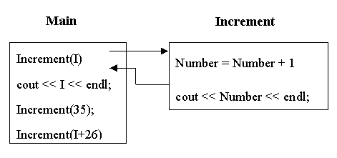
Pass by Value: Example
COMP152

Slide 14

Multiple Outputs: Passing Parameters by Reference
To have a function with multiple outputs, we have to use pass by reference.
Remember: reference is an alias. Both variables, though of different names, refer to the same memory space
Reference (address) of parameter is passed to the function, instead of its value.
If the function changes the parameter value, the changes will be reflected in the program calling it.
How to pass parameters by reference:
  <type>& <variable>, ... , <type>& <variable>
COMP152

Slide 15
Pass by Reference: Example
An example to show how the function does not affect a variable which is used as a parameter:
// Test the effect of a function
// on its parameter
#include <iostream>
using namespace std;
void Increment(int & Number) {
Number = Number + 1;
cout << "The parameter Number is: "
<< Number << endl;
}
COMP152

Slide 16
Reference Variables
  Reference and constant reference variables are commonly used for parameter passing to a function
  They can also be used as local variables or as class data members
  A reference (or constant reference) variable serves as an alternative name for an object.
    int m = 10;
    int & j = m;
    cout <<“value of m = “ << m << endl; //value of m printed is 10
    j = 18;
    cout << “value of m = “ << m << endl; //value of m printed is 18
  A reference variable is different from a pointer
    A pointer needs NOT be initialized while defining, but a reference variable should always refer to some other object.
      int * p;
      int m = 10;
      int & j = m; //valid
      int & k; //compilation error
      int & k = 1; //cannot assign a reference to a
      // constant: compilation error
COMP152

Slide 17
Reference
References are an additional name, or “aliaes”
to an existing memory location
If we wanted something called “ref” to refer to a variable x, use reference:
Pointer:
Reference:
x
9
x
ref
9
ref
COMP152
Notes:
References fix some of those pointer problems.
If we wanted something called “ref” to point to a variable x, we’d declare a pointer variable and assign the address of x into it. With references, we’d attach an additional name – ref – to the same memory location as x.
Note how the pointer necessitates an extra variable, whereas the reference didn’t

Slide 18
Pointer vs. Reference
  A pointer can be assigned a new value to point at a different object, but a reference variable always refers to the same object. Assigning a reference variable with a new value actually changes the value of the referred object.
    int * p;
    int m = 10;
    int & j = m; //valid
    p = &m; //p now points at m
    int n = 12;
    j = n; // the value of m is set to 12. But j still refers to m, not to n.
    cout << “value of m = “ << m <<endl; //value of m printed is 12
    n = 36;
    Cout << “value of j = “ << j << endl; //value of j printed is 12
    p = &n;
  A constant reference variable v refers to an object whose value cannot be changed through v.
    int m = 8;
    const int & j = m; //ok
    m = 16; //valid and now j is changed to 16
    j = 20; //compilation error as j is a constant reference
    int & m = m; // compilation error as a reference cannot refers to itself
    const int n = 10;
    int & k = n; // cannot assign a reference to a constant variable:
    //compilation error as n is a constant
    const int & r = n; // ok as both r and n are constants
COMP152

Slide 19
Pass by Reference: An Example
To show how the function affects a variable which is used as a parameter:
#include <iostream>
using namespace std;
void Increment(int& Number){
Number = Number + 1;
cout << "The parameter Number: " << Number << endl;
}
void main(){
int I = 10;
Increment(I); // parameter is a variable
cout << "The variable I is: " << I << endl;
}
COMP152

Slide 20
Function Call by Value
  void f(int x) { cout << “value of x = “ << x << endl;
  x = 4; return; }
  main() { int v = 5;
  f(v);
  cout << “value of v = “ << v << endl;}
  Output: Value of x =
  Value of v =
  When a variable v is passed by value to a function f, its value is copied to the corresponding variable x in f
  Any changes to the value of x does NOT affect the value of v
  Call by value is the default mechanism for parameter passing in C++
5
5
COMP152

Slide 21
Function Call by Reference
  void f(int &x) { cout << “value of x = “ << x << endl;
  x = 4; return; }
  main() { int v = 5;
  f(v);
  cout << “value of v = “ << v << endl;}
  Output: Value of x =
  Value of v =
  When a variable v is passed by reference to a parameter x of function f, v and the corresponding parameter x refer to the same variable
  Any changes to the value of x DOES affect the value of v
5
4
COMP152

Slide 22
Function Call by Constant Reference
  void f( const int &x ) { cout << “value of x = “ << x << endl;
  x = 4; // invalid as x is a rvalue
  }
  main() { int v = 5;
  f(v);
  cout << “value of v = “ << v << endl;
  }
  Passing variable v by constant reference to parameter x of f will NOT allow any change to the value of x.
  It is appropriate for passing large objects that should not be changed by the called function.
COMP152

Slide 23
Usage of Parameter Passing
Call by value is appropriate for small objects that should not be changed by the function
  Because small objects may be copied without too much overhead
Call by constant reference is appropriate for large objects that should not be changed by the function
  Large objects should not be copied for efficiency concern
Call by reference is appropriate for all objects that may be changed by the function
  An alternative approach is to use pointer, and pass the address of the object into the function
COMP152

Slide 24
Final remarks
Advantage of passing by reference: Large data objects do not have to be copied
  Saving much CPU time and storage
Be careful with the parameters though
  You may modify them unintentionally
  To safeguard modification, use const in the parameter instead
  For code clarity and to minimize bug, you should always put const in front of the variable if you are not going to change the variable in the function
foo( const int & bar, const int & foobar);
COMP152

Slide 25
Array Element Pass by Reference
Pass-by-reference example:
void swap(int& x, int& y) { // x and y may be changed
int temp;
if (x > y){
temp = x;
x = y;
y = temp;
}
}
void main() {
int A[10] = {9,8,7,6,5,4,3,2,1,0};
swap(A[3], A[5]);
}
COMP152

Slide 26


Array Element Pass by Reference
Before:
After:
COMP152

Slide 27
Passing Entire Arrays to Functions
Arrays can be passed to functions in their entirety.
All that is required is the address of the first element and dimensions of the array.
The remainder of the array will be passed by reference automatically.
COMP152

Slide 28
Arrays to Functions: An Example
//Find the largest value in an array
//input: n - number of elements to check
// a[ ] - array of elements
// output:index to the largest element
#include <iostream>
using namespace std;
int max_element(int n, const int a[]) {
int max_index = 0;
for (int i=1; i<n; i++)
if (a[i] > a[max_index])
max_index = i;
return max_index;
}
void main() {
int A[10] = {9,8,7,6,5,4,10,2,1,0};
cout << A[max_element(10,A)] << endl;
}
This is the same as
int * a
COMP152

Slide 29
Passing Multidimensional Arrays
How to pass a multidimensional array to a function:
void displayBoard(int b[][4]);
// function prototype requires variable name for arrays
void main(){
int board [4][4];
...
displayBoard(board);
...
}
void displayBoard(int b[][4]){
// could also be: void displayBoard(int b[4][4]){
// but NOT: void displayBoard(int b[][]){
...
}
COMP152

Slide 30
Passing Multi-Dimensional Array
When passing a multidimensional array to a function, only the size of the 1st dimension is optional, the 2nd, 3rd, etc. dimensions must be specified.
This is because, for example, for an array index int A[i][j][k] in a statement, the physical address representation is computed at compilation time as
A + i * 4 * (MAX_1 * MAX_2) +
j * 4 * MAX_2 + k * 4
where MAX_1 and MAX_2 are the maximum range of j and k, respectively
As shown above, the dimension size is needed for address computation at compilation time.
C++ compiler relies on the programmer to make sure that the array would NOT be accessed out of range and hence will not check whether i, j, k exceed their dimension sizes during compilation time.
COMP152

Slide 31
Modify a Variable with Return by Reference
int & bar (int n, int * iptr){
return iptr[n/2];
}
const int & foobar (int n, int * iptr){
return iptr[n/2];
}
int main(){
int j;
int A[] = {10, 9, 8, 7, 6, 5, 4, 3, 2, 1};
j = bar( 10, A );
cout << j << endl;
bar( 10, A ) = 10;
cout << A[ 10/2 ] << endl;
j = foobar( 10, A );
cout << j << endl;
foobar( 10, A ) = 10; // not valid: compiler complains
return 0;
}
5
10
10
COMP152

Slide 32
Recursion
A function is defined recursively if it has the following two parts
An anchor or base case
  The function is defined for one or more specific values of the parameter(s)
An inductive or recursive case
  The function's value for current parameter(s) is defined in terms of previously defined function values and/or parameter(s)
Recursive call (also called the recursion step)
  The function launches (calls) a fresh copy of itself to work on the smaller problem
  Can result in many more recursive calls, as the function keeps dividing each new problem into two conceptual pieces
  This sequence of smaller and smaller problems must eventually converge on the base case; otherwise the recursion will continue forever
COMP152

Slide 33
Recursion
Recursion is one way to decompose a task into smaller subtasks. At least one of the subtasks is a smaller example of the same task.
The smallest example of the same task has a non-recursive solution.
  Example: The factorial function
  n! = n * (n-1)! and 1! = 1
COMP152

Slide 34


Factorial
The factorial of a nonnegative integer n, written n! (and pronounced “n factorial”), is the product
  n · (n – 1) · (n – 2) · … · 1
Recursive definition of the factorial function
  n! = n · (n – 1)!
    5! = 5 · 4 · 3 · 2 · 1
    5! = 5 · ( 4 · 3 · 2 · 1)
    5! = 5 · ( 4! )
COMP152

Slide 35
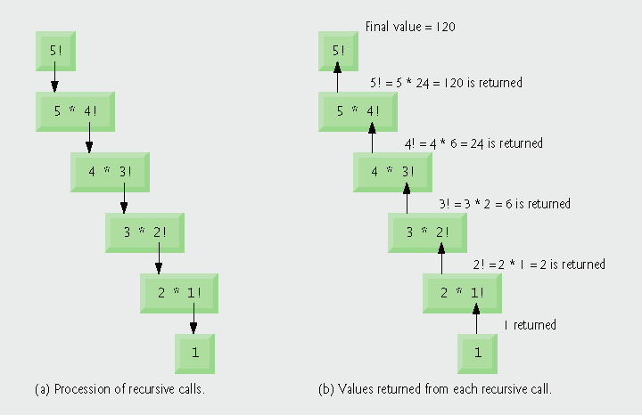
factorial function
The C++ equivalent of this definition:
int fac(int numb){
if(numb<=1)
return 1;
else
return numb * fac(numb-1);
}
recursion means that a function calls itself
COMP152

Slide 36
Full program for factorial.cpp
unsigned long factorial( unsigned long ); // function prototype
int main()
{
// calculate the factorials of 0 through 10
for ( int counter = 0; counter <= 10; counter++ )
cout << setw( 2 ) << counter << "! = "
<< factorial( counter ) << endl;
return 0;
}
// recursive definition of function factorial
unsigned long factorial( unsigned long number )
{
if ( number <= 1 ) // test for base case
return 1; // base cases: 0! = 1 and 1! = 1
else // recursion step
return number * factorial( number - 1 );
}
COMP152

Slide 37
factorial.cpp Sample Output
0! = 1
1! = 1
2! = 2
3! = 6
4! = 24
5! = 120
6! = 720
7! = 5040
8! = 40320
9! = 362880
10! = 3628800
setw() to format the output
COMP152

Slide 38
iterfactorial.cpp
// iterative method factorial
unsigned long factorial( unsigned long number )
{
unsigned long result = 1;
// iterative factorial calculation
for ( unsigned long i = number; i >= 1; i-- )
result *= i;
return result;
}
COMP152

Slide 39
Binary Search for a Sorted Array
  Search for an element in an ordered array
    Sequential search
    Binary search
  Binary search
    Compare the search element with the middle element of the array
    If not equal, then apply binary search to half of the array (if not empty) where the search element would be.
COMP152

Slide 40
Binary Search with Recursion
// Searches an ordered array of integers using recursion
int bsearchr(const int data[], // input: array
int first, // input: lower bound
int last, // input: upper bound
int value // input: value to find
)// output: index if found, otherwise return –1
{ int middle = (first + last) / 2;
if (data[middle] == value)
return middle;
else if (first >= last)
return -1;
else if (value < data[middle])
return bsearchr(data, first, middle-1, value);
else
return bsearchr(data, middle+1, last, value);
}
COMP152

Slide 41
Binary Search (driver)
int main() {
const int array_size = 8;
int list[array_size]={1, 2, 3, 5, 7, 10, 14, 17};
int search_value;
cout << "Enter search value: ";
cin >> search_value;
cout << bsearchr(list,0,array_size-1,search_value)
<< endl;
return 0;
}
COMP152

Slide 42
Binary Search w/o Recursion
// Searches an ordered array of integers
int bsearch(const int data[], // input: array
int size, // input: array size
int value // input: value to find
){ // output: if found, return the index
// index; otherwise, return -1
int first, last, middle;
first = 0;
last = size - 1;
while (true) {
middle = (first + last) / 2;
if (data[middle] == value)
return middle; // found
else if (first >= last)
return -1; // not found
else if (value < data[middle])
last = middle - 1; //lower half
else
first = middle + 1; //upper half
}
}
COMP152

Slide 43
Recursion vs. Iteration
Negatives of recursion
  Overhead of repeated function calls
    Creating stacks can be expensive in both processor time and memory space
  Each recursive call causes another copy of the function (actually only the function’s variables) to be created
    Can consume considerable memory
Iteration
  Normally occurs within a function
  Overhead of repeated function calls and extra memory assignment is removed
COMP152

Slide 44
Recursion vs. Iteration
Most of the problems that can be solved recursively can also be solved iteratively (nonrecursively)
A recursive approach is usually chosen in preference to an iterative approach when
  the recursive approach more naturally mirrors the problem and results in a program that is easier to understand and debug
  an iterative solution is not apparent
COMP152

Slide 45
Recursion Example: Permutation
Generate all the permutation sequences of n numbers
  n! number of sequences
  For n=3: abc, acb, bac, bca, cba, cab
Let the numbers be labeled as a1 a2 a3 … an
The permuted sequences are
a1 perm(a2 a3 a4…an),
a2 perm(a1 a3 a4…an),
a3 perm(a2 a1 a4…an),
….
an perm(a2 a3 a4 … a1)
COMP152

Slide 46
Permutation Codes
/* template <class T>
inline void swap( T& a, T& b){
// swap a and b
T temp = a;
a = b;
b = temp;
} */
// Permutation codes to permute list[ k: m ]
// simply prints the permuted sequences out from 0 to m
template<class T>
void Perm( T list[], int k, int m ){
// generate all permutations of list[ k:m ]
int i;
if( k == m ){
for( i = 0; i <= m; i++ )
cout << list[ i ];
cout << endl;
}
else
for( i = k; i <= m; i++ ){
swap( list[ k ], list[ i ] );
Perm( list, k+1, m );
swap( list[ k ], list[ i ] ); // restore back to the original sequence for the next iteration
}
}
COMP152

Slide 47
Usage
int main(){
char str[] = "abcde";
Perm( str, 2, 4 );
cout << endl;
Perm( str, 0, 2 );
}
Output:
abcde
abced
abdce
abdec
abedc
abecd
abc
acb
bac
bca
cba
cab
COMP152

Slide 48
Pointers
A pointer is a variable which contains addresses of other variables
Accessing the data at the contained address is called “dereferencing a pointer” or “following a pointer”
x
(4104)
y
(4100)
4096
pointer
n
(4096)
int main(){
int n=7;
int * y = &n;
}
7
COMP152

Slide 49
Traditional Pointer Usage
void IndirectSwap(char *Ptr1, char *Ptr2){
  char temp = *Ptr1;
  *Ptr1 = *Ptr2;
  *Ptr2 = temp;
}
int main() {
  char a = 'y';
  char b = 'n';
  IndirectSwap(&a, &b);
  cout << a << b << endl;
  return 0;
}
COMP152

Slide 50
Pass by Reference: Another Way of Implementation
void IndirectSwap(char& y, char& z) {
  char temp = y;
  y = z;
  z = temp;
}
int main() {
  char a = 'y';
  char b = 'n';
  IndirectSwap(a, b);
  cout << a << b << endl;
  return 0;
}
COMP152

Slide 51
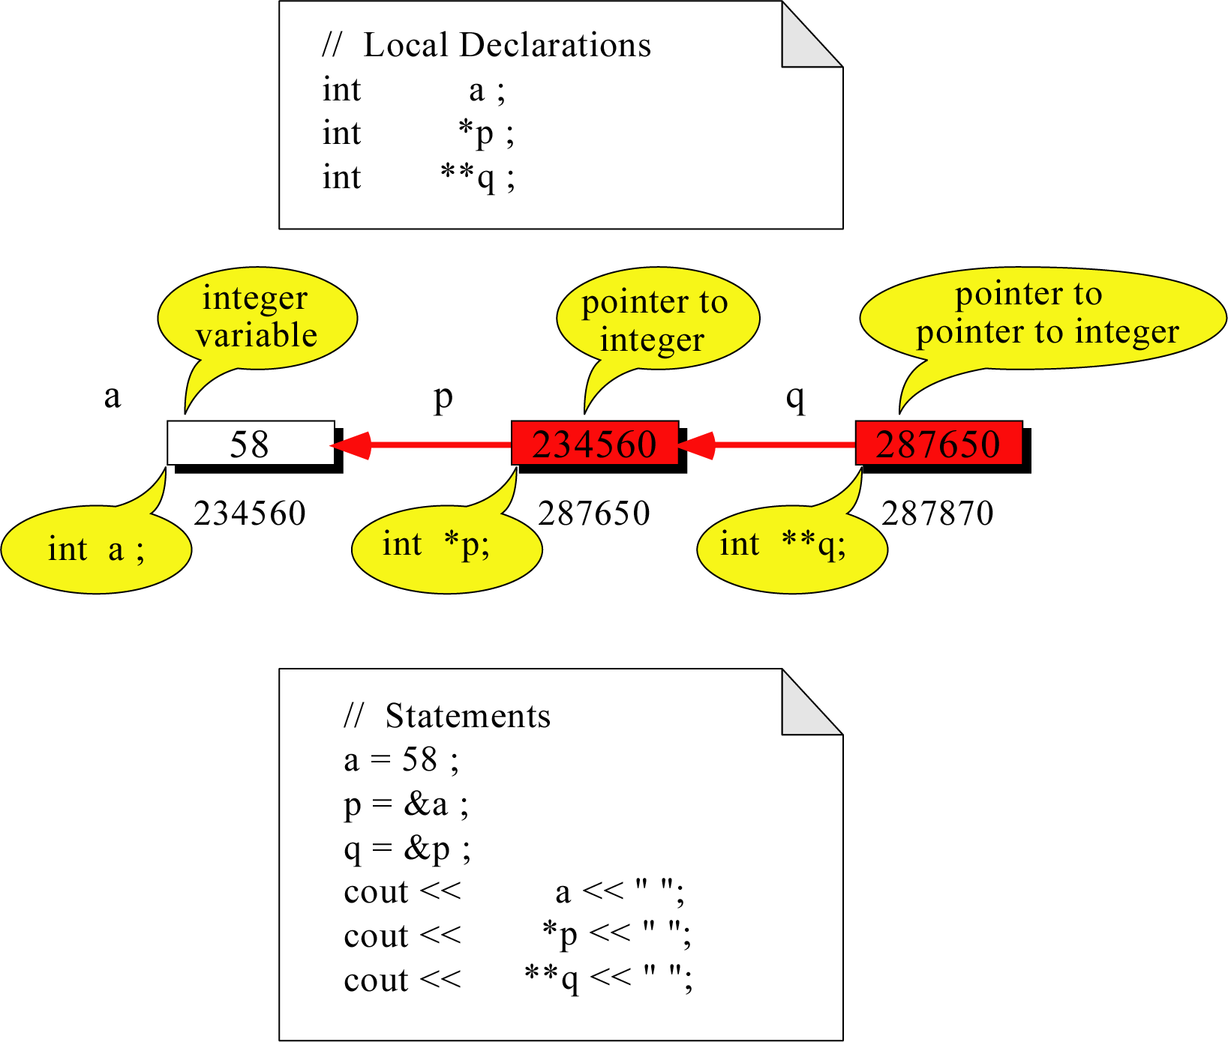
Pointer to Pointer
What is the output?
58 58 58
COMP152

Slide 52
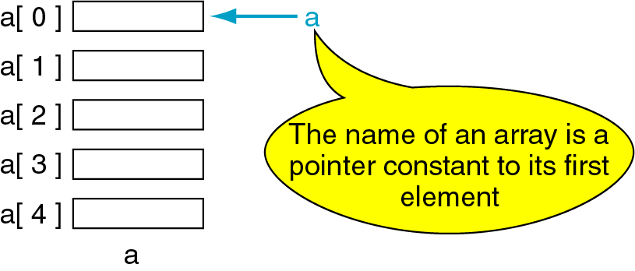
Pointers and Arrays
The name of an array refers only to the address of the first element not the whole array.
1000
1004
1008
1012
1016
COMP152

Slide 53
Array Name is a Pointer Constant
#include <iostream>
using namespace std;
void main (){
// Demonstrate array name is a pointer constant
int a[5];
cout << "Address of a[0]: " << &a[0] << endl
<< "Name as pointer: " << a << endl;
}
/* result:
Address of a[0]: 0x0065FDE4
Name as pointer: 0x0065FDE4
*/
COMP152

Slide 54

Multiple Array Pointers
Both a and p are pointers to the same array.
#include <iostream>
using namespace std;
void main(){
int a[5] = {2,4,6,8,22};
int *p = &a[1];
cout << a[0] << " "
<< p[-1];
cout << a[1] << " "
<< p[0];
}
A[0]
a[0]
2 2
4 4
2
p
a[1]
4
a[2]
6
a[3]
P[0]
8
a[4]
22
COMP152

Slide 55
Pointer Arithmetic
Given a pointer p, p+n refers to the nth element, i.e., offset from p by n positions.
a
2
p - 1
4
p
a + 1
a + 2
6
p + 1
a + 3
8
p + 2
a + 4
22
p + 3
COMP152

Slide 56
Dereferencing Array Pointers
a[0] or *(a + 0)
2
a
a[1] or *(a + 1)
4
a + 1
a[2] or *(a + 2)
6
a + 2
a[3] or *(a + 3)
8
a + 3
a[4] or *(a + 4)
22
a + 4
*(a+n) is identical to a[n]
COMP152

Slide 57
Array of Pointers & Pointers to Array
a
p
1
b
2
9
c
8
1
2
3
7
6
5
An array of Pointers
A pointer to an array
int a = 1, b = 2, c[] = {1,2,3};
int *p[5];
p[0] = &a;
p[1] = &b;
p[2] = c;
int list[5] = {9, 8, 7, 6, 5};
int *P;
P = list;//points to 1st entry
P = &list[0];//points to 1st entry
P = &list[1];//points to 2nd entry
P = list + 1; //points to 2nd entry
COMP152

Slide 58
Pointer to 2-Dimensional Arrays
table[i] = &table[i][0] refers to the address of the ith row
table
1
2
3
4
table + 1
table[ 0] or *( table + 0 )
5
6
7
8
table + 2
table[ 1] or *( table + 1 )
9
10
11
12
table[ 2] or *( table + 2 )
int table[3][4] = {{1,2,3,4},
{5,6,7,8},{9,10,11,12}};
What is
**table ?
*(table[i]+j)
= table[i][j]
for(int i=0; i<3; i++){
for(int j=0; j<4; j++)
cout << *(*(table+i)+j);
cout << endl;
}
COMP152
Get the address of the 1st element of
the ith row of table, i.e., &table[i][0]

Slide 59
table and table[0] are of the same address
int table[2][2] = {{0,1}, {1,2}};
cout << table << endl;
cout << table[0] << endl;
cout << table[0][0] << endl;
Output:
0xffbff938
0xffbff938
0
COMP152

Slide 60
main()
Note that main() is a function, the parent/mother function of all functions called by the program
  The operating system first calls/executes this “function”
Since it is a function, it can have arguments
  Command line arguments
  Access it through argc and argv
  The first argument is always the executable name
COMP152

Slide 61
#include <iostream>
using namespace std;
int main(int argc, char ** argv){
int i;
for( i = 0; i < argc; i++ )
cout << argv[i] << endl;
return(0);
}
Get the number of arguments here
Get the strings here
cssu5:> a.out 1 2 3
a.out
1
2
3
cssu5:> a.out hello world guys !
a.out
hello
world
guys
!
COMP152

Slide 62
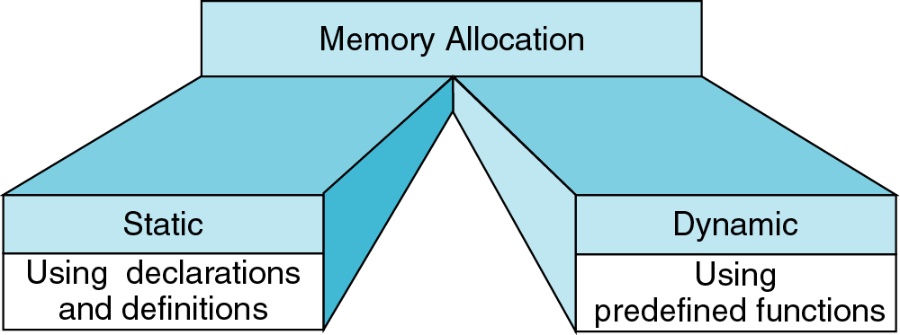
Memory Allocation
new
delete
{
int a[200];
…
}
int* ptr;
ptr = new int[200];
…
delete [] ptr;
COMP152

Slide 63
Example
Dynamic Memory Allocation
  Request for “unnamed” memory from the
  Operating System
  int *p, n=10;
  p = new int;
  p = new int[100];
new
p
new
p
new
  p = new int[n];
p
COMP152

Slide 64
How Does C++ Keep Track of the Size of the Array?
For each object allocated on the heap, there is a leader indicating the size of the array
  The size of the leader is system dependent (usually 4 bytes)
  The pointer points to the first useful element of the array
At de-allocation (delete [] p), the system peeps into the leader and releases the array, including the leader
size
p
COMP152

Slide 65
p must be at the beginning of the array
Note that at de-allocation, the compiler will load the size immediately before the pointer p
  Therefore, remember to position the pointer to the beginning of the array before deletion
  Otherwise, the size will be loaded wrongly
The following is hence bad programming style which does not lead to portable codes:
  delete [] (p+1);
  delete p[3]; //delete an element
  p++; delete [] p;
  etc.
Always de-allocate the whole array, not the partial one
Always de-allocate array on heap; no need to de-allocate variables on stack
COMP152

Slide 66
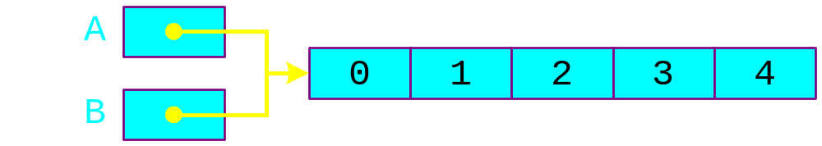
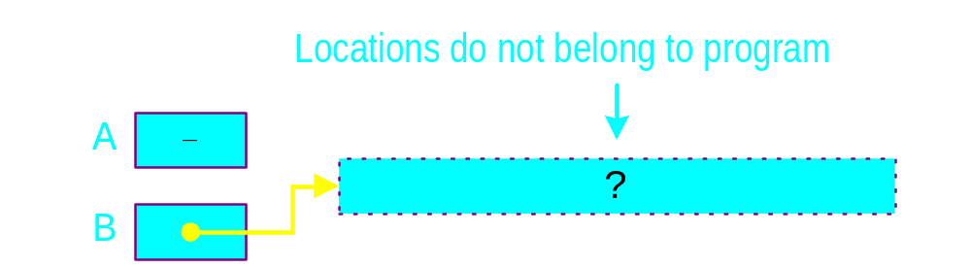
Dangling Pointer Problem
  int *A = new int[5];
  for(int i=0; i<5; i++)
  A[i] = i;
  int *B = A;
  delete [] A;
  B[0] = 1; // illegal! Segmentation fault
COMP152

Slide 67
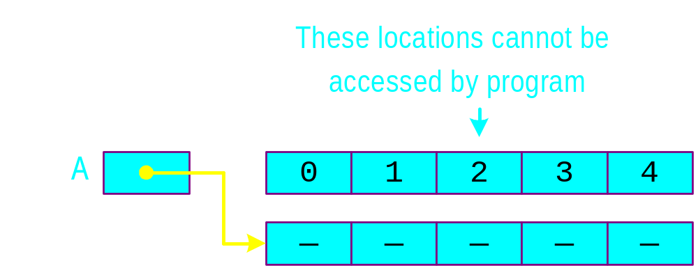
Memory Leak Problem
  int *A = new int [5];
  for(int i=0; i<5; i++)
  A[i] = i;
  A = new int [5];
1
2
3
A
0
2
4
COMP152

Slide 68
A Dynamic 2D Array
A dynamic array is an array of pointers to save space when not all rows of the array are full.
int **table;
table
32
18
12
24
table[0]
table[1]
table[2]
table[3]
table[4]
table[5]
13
11
16
12
42
19
14
22
13
13
14
11
18
table = new int*[6];
…
table[0] = new int[4];
table[1] = new int[7];
table[2] = new int[1];
table[3] = new int[3];
table[4] = new int[2];
table[5] = NULL;

Slide 69
Memory Deallocation
Memory leak is a serious bug!
Each row must be deleted individually
Be careful to delete each row before deleting the table pointer.
  int **table;
  table = new int* [6];
  for (int i=0; i< 6; i++)
  table[i] = new int [5];
  ……
  for(int i=0; i<6; i++)
  delete [ ] table[i];
  delete [ ] table;
COMP152

Slide 70
Creating a matrix of any dimensions, m by n:
int m, n;
cin >> m >> n >> endl;
int** mat;
mat = imatrix(m,n);
mat[1][3] = 8;
…
int** imatrix(int nr, int nc) {
int** m;
m = new int*[nr];
for (int i=0;i<nr;i++)
m[i] = new int[nc];
return m;
}
COMP152

Slide 71
Constant pointer and constant object
const int * iptr means that the object being pointed to by iptr is constant and cannot be changed
  This is the same as int const * iptr
  You can NEVER do *iptr = 10;
  However, you may do reassignment iptr = bptr;
int * const iptr means that the pointer is a constant, not the object that it points to
  You have to initialize the pointer by int * const iptr = &a;
  Can NEVER have iptr = &b;
  Can have *iptr = 4;
COMP152

Slide 72
const
void foo3( int ** const bar ){
bar[1][1] = 5; // change int
bar[1] = new int[3];
// change int *
bar = new int * [3];
// change int ** -- invalid: Compiler // complains
return;
}
int main(){
int ** iptr;
int i, j;
iptr = new int * [10];
for( i = 0; i < 10; i++ )
iptr[ i ] = new int [10];
for( i = 0; i < 10; i++ )
for( j = 0; i < 10; i++ )
iptr[i][j] = i*j;
foo1( iptr );
foo2( iptr );
foo3( iptr );
return 0;
}
#include <iostream>
using namespace std;
// illustration of static variable
// same as void foo1( int const ** bar )
void foo1( const int ** bar ){
bar[1][1] = 5;
// change int invalid: Compiler complains
bar[1] = new int[3]; // change int *
bar = new int * [3]; // change int **
return;
}
void foo2( int * const * bar ){
bar[1][1] = 5; // change int
bar[1] = new int[3];
//change int * invalid:Compiler complains
bar = new int * [3]; // change int **
return;
}
COMP152

