Slide 1
Merge sort, Insertion sort

Slide 2
Sorting
Selection sort or bubble sort
  Find the minimum value in the list
  Swap it with the value in the first position
  Repeat the steps above for remainder of the list (starting at the second position)
Insertion sort
Merge sort
Quicksort
Shellsort
Heapsort
Topological sort
…

Slide 3
Bubble sort and analysis
for (i=0; i<n-1; i++) {
for (j=0; j<n-1-i; j++) {
if (a[j+1] < a[j]) { // compare the two neighbors
tmp = a[j]; // swap a[j] and a[j+1]
a[j] = a[j+1];
a[j+1] = tmp;
}
}
}
Worst-case analysis: N+N-1+ …+1= N(N+1)/2, so O(N^2)

Slide 4
Insertion:
  Incremental algorithm principle
Mergesort:
  Divide and conquer principle

Slide 5

Insertion sort
1) Initially p = 1
2) Let the first p elements be sorted.
3) Insert the (p+1)th element properly in the list (go inversely from right to left) so that now p+1 elements are sorted.
4) increment p and go to step (3)

Slide 6
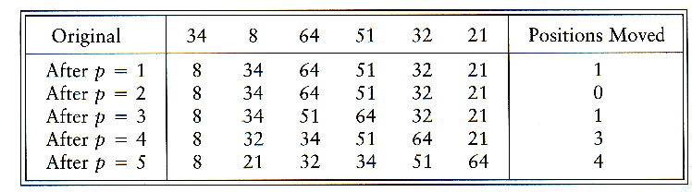
Insertion Sort

Slide 7
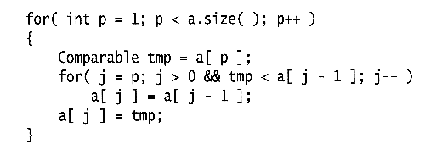
Insertion Sort
see applet
http://www.cis.upenn.edu/~matuszek/cse121-2003/Applets/Chap03/Insertion/InsertSort.html
Consists of N - 1 passes
For pass p = 1 through N - 1, ensures that the elements in positions 0 through p are in sorted order
  elements in positions 0 through p - 1 are already sorted
  move the element in position p left until its correct place is found among the first p + 1 elements

Slide 8
Extended Example
To sort the following numbers in increasing order:
34 8 64 51 32 21
p = 1; tmp = 8;
34 > tmp, so second element a[1] is set to 34: {8, 34}…
We have reached the front of the list. Thus, 1st position a[0] = tmp=8
After 1st pass: 8 34 64 51 32 21
(first 2 elements are sorted)

Slide 9
P = 2; tmp = 64;
34 < 64, so stop at 3rd position and set 3rd position = 64
After 2nd pass: 8 34 64 51 32 21
(first 3 elements are sorted)
P = 3; tmp = 51;
51 < 64, so we have 8 34 64 64 32 21,
34 < 51, so stop at 2nd position, set 3rd position = tmp,
After 3rd pass: 8 34 51 64 32 21
(first 4 elements are sorted)
P = 4; tmp = 32,
32 < 64, so 8 34 51 64 64 21,
32 < 51, so 8 34 51 51 64 21,
next 32 < 34, so 8 34 34, 51 64 21,
next 32 > 8, so stop at 1st position and set 2nd position = 32,
After 4th pass: 8 32 34 51 64 21
P = 5; tmp = 21, . . .
After 5th pass: 8 21 32 34 51 64

Slide 10
Analysis: worst-case running time
Inner loop is executed p times, for each p=1..N
⇒ Overall: 1 + 2 + 3 + . . . + N = O(N²)
Space requirement is O(N)

Slide 11
The bound is tight
The bound is tight Θ(N²)
That is, there exists some input which actually uses Ω(N²) time
Consider input as a reversed sorted list
  When a[p] is inserted into the sorted a[0..p-1], we need to compare a[p] with all elements in a[0..p-1] and move each element one position to the right
  ⇒ Ω(i) steps
  the total number of steps is Ω(Σ₁^{N-1} i) = Ω(N(N-1)/2) = Ω(N²)

Slide 12
Analysis: best case
The input is already sorted in increasing order
  When inserting A[p] into the sorted A[0..p-1], only need to compare A[p] with A[p-1] and there is no data movement
  For each iteration of the outer for-loop, the inner for-loop terminates after checking the loop condition once => O(N) time
If input is nearly sorted, insertion sort runs fast

Slide 13
Summary on insertion sort
Simple to implement
Efficient on (quite) small data sets
Efficient on data sets which are already substantially sorted
More efficient in practice than most other simple O(n2) algorithms such as selection sort or bubble sort: it is linear in the best case
Stable (does not change the relative order of elements with equal keys)
In-place (only requires a constant amount O(1) of extra memory space)
It is an online algorithm, in that it can sort a list as it receives it.

Slide 14
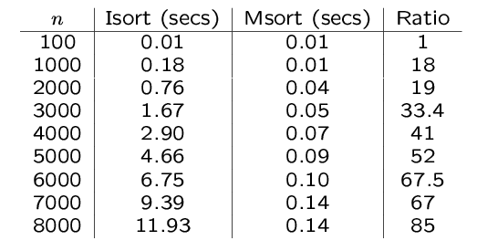
An experiment
Code from textbook (using template)
Unix time utility

Slide 15
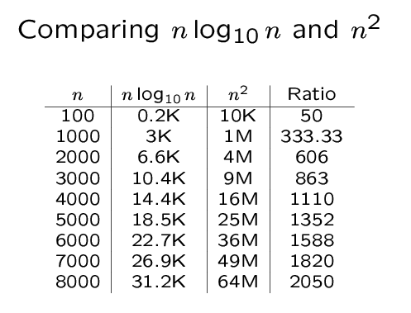

Slide 16
Mergesort
Based on divide-and-conquer strategy
Divide the list into two smaller lists of about equal sizes
Sort each smaller list recursively
Merge the two sorted lists to get one sorted list

Slide 17
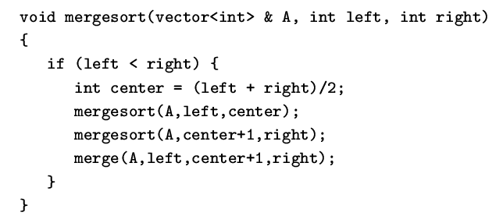
Mergesort
Divide-and-conquer strategy
  recursively mergesort the first half and the second half
  merge the two sorted halves together

Slide 18
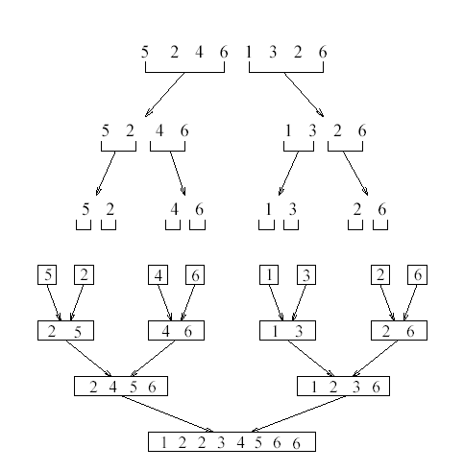
see applet
http://www.cosc.canterbury.ac.nz/people/mukundan/dsal/MSort.html

Slide 19
How do we divide the list? How much time needed?
How do we merge the two sorted lists? How much time needed?

Slide 20
How to divide?
If an array A[0..N-1]: dividing takes O(1) time
  we can represent a sublist by two integers left and right: to divide A[left..Right], we compute center=(left+right)/2 and obtain A[left..Center] and A[center+1..Right]

Slide 21
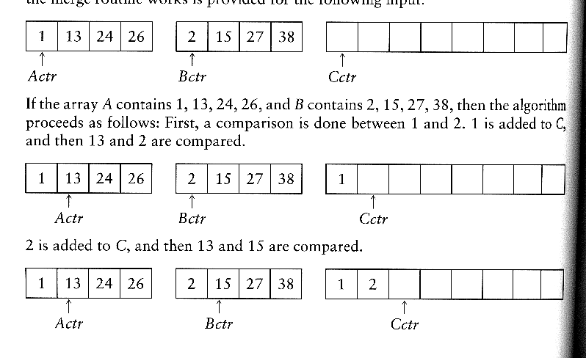
How to merge?
Input: two sorted array A and B
Output: an output sorted array C
Three counters: Actr, Bctr, and Cctr
  initially set to the beginning of their respective arrays
(1) The smaller of A[Actr] and B[Bctr] is copied to the next entry in C, and the appropriate counters are advanced
(2) When either input list is exhausted, the remainder of the other list is copied to C

Slide 22

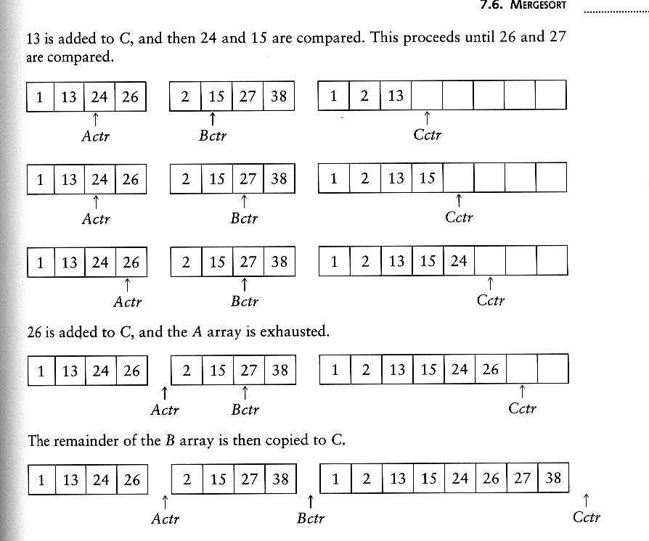
Example: Merge

Slide 23
Example: Merge...
Running time analysis:
  Clearly, merge takes O(m1 + m2) where m1 and m2 are
the sizes of the two sublists.
Space requirement:
  merging two sorted lists requires linear extra memory
  additional work to copy to the temporary array and back

Slide 24
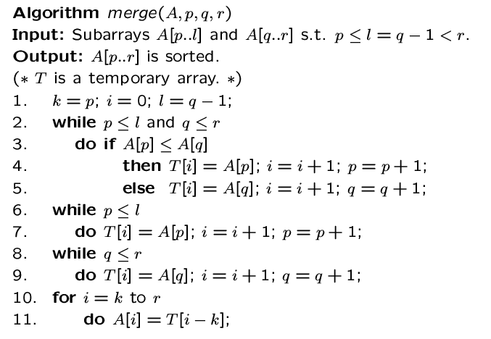

Slide 25
Analysis of mergesort
Let T(N) denote the worst-case running time of mergesort to sort N numbers.
Assume that N is a power of 2.
Divide step: O(1) time
Conquer step: 2 T(N/2) time
Combine step: O(N) time
Recurrence equation:
  T(1) = 1
  T(N) = 2T(N/2) + N

Slide 26
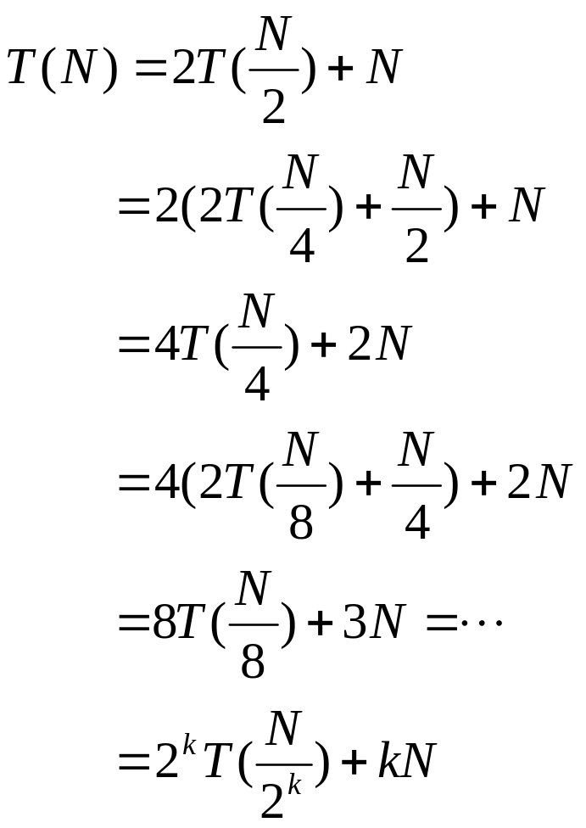
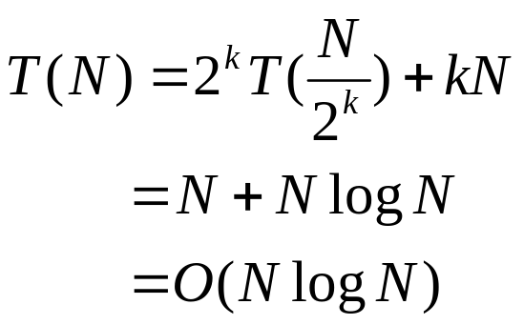
Analysis: solving recurrence
Since N=2^{k}, we have k=log₂ n

Slide 27
Don’t forget:
We need an additional array for ‘merge’! So it’s not ‘in-place’!

Slide 28
Quicksort

Slide 29
Introduction
Fastest known sorting algorithm in practice
Average case: O(N log N) (we don’t prove it)
Worst case: O(N²)
  But, the worst case seldom happens.
Another divide-and-conquer recursive algorithm, like mergesort

Slide 30
Quicksort
S
Divide step:
  Pick any element (pivot) v in S
  Partition S – {v} into two disjoint groups
  S1 = {x ∈ S – {v} | x <= v}
  S2 = {x ∈ S – {v} | x ≥ v}
Conquer step: recursively sort S1 and S2
Combine step: the sorted S1 (by the time returned from recursion), followed by v, followed by the sorted S2 (i.e., nothing extra needs to be done)
v
v
S1
S2
To simplify, we may assume that we don’t have repetitive elements,
So to ignore the ‘equality’ case!

Slide 31
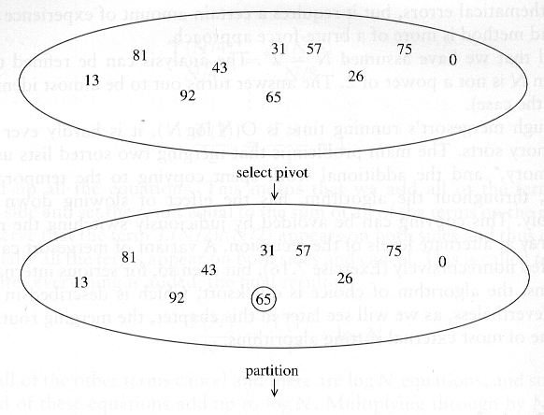
Example

Slide 32
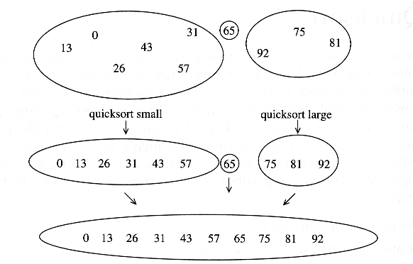

Slide 33
Pseudo-code
Input: an array a[left, right]
QuickSort (a, left, right) {
if (left < right) {
pivot = Partition (a, left, right)
Quicksort (a, left, pivot-1)
Quicksort (a, pivot+1, right)
}
}
Compare with MergeSort:
MergeSort (a, left, right) {
if (left < right) {
mid = divide (a, left, right)
MergeSort (a, left, mid-1)
MergeSort (a, mid+1, right)
merge(a, left, mid+1, right)
}
}

Slide 34
Two key steps
How to pick a pivot?
How to partition?

Slide 35
Pick a pivot
Use the first element as pivot
  if the input is random, ok
  if the input is presorted (or in reverse order)
    all the elements go into S2 (or S1)
    this happens consistently throughout the recursive calls
    Results in O(n²) behavior (Analyze this case later)
Choose the pivot randomly
  generally safe
  random number generation can be expensive

Slide 36
In-place Partition
  If use additional array (not in-place) like MergeSort
    Straightforward to code like MergeSort (write it down!)
    Inefficient!
  Many ways to implement
  Even the slightest deviations may cause surprisingly bad results.
    Not stable as it does not preserve the ordering of the identical keys.
    Hard to write correctly ☹

Slide 37
An easy version of in-place partition to understand,
but not the original form
int partition(a, left, right, pivotIndex) {
pivotValue = a[pivotIndex];
swap(a[pivotIndex], a[right]); // Move pivot to end
// move all smaller (than pivotValue) to the begining
storeIndex = left;
for (i from left to right) {
if a[i] < pivotValue
swap(a[storeIndex], a[i]);
storeIndex = storeIndex + 1 ;
}
swap(a[right], a[storeIndex]); // Move pivot to its final place
return storeIndex;
}
Look at Wikipedia

Slide 38
quicksort(a,left,right) {
if (right>left) {
pivotIndex = left;
select a pivot value a[pivotIndex];
pivotNewIndex=partition(a,left,right,pivotIndex);
quicksort(a,left,pivotNewIndex-1);
quicksort(a,pivotNewIndex+1,right);
}
}

Slide 39
A better partition
Want to partition an array A[left .. right]
First, get the pivot element out of the way by swapping it with the last element. (Swap pivot and A[right])
Let i start at the first element and j start at the next-to-last element (i = left, j = right – 1)
swap
5
6
4
6
3
12
19
5
6
4
19
3
12
6
pivot
i
j

Slide 40
Want to have
  A[x] <= pivot, for x < i
  A[x] >= pivot, for x > j
When i < j
  Move i right, skipping over elements smaller than the pivot
  Move j left, skipping over elements greater than the pivot
  When both i and j have stopped
    A[i] >= pivot
    A[j] <= pivot
<= pivot
>= pivot
i
j
5
6
4
19
3
12
6
5
6
4
19
3
12
6
i
j
i
j

Slide 41
When i and j have stopped and i is to the left of j
  Swap A[i] and A[j]
    The large element is pushed to the right and the small element is pushed to the left
  After swapping
    A[i] <= pivot
    A[j] >= pivot
  Repeat the process until i and j cross
swap
5
6
4
19
3
12
6
5
3
4
19
6
12
6
i
j
i
j

Slide 42
When i and j have crossed
  Swap A[i] and pivot
Result:
  A[x] <= pivot, for x < i
  A[x] >= pivot, for x > i
5
3
4
19
6
12
6
i
j
5
3
4
19
6
12
6
j
i
5
3
4
6
6
12
19
j
i

Slide 43
Implementation (put the pivot on the leftmost instead of rightmost)
void quickSort(int array[], int start, int end)
{
int i = start; // index of left-to-right scan
int k = end; // index of right-to-left scan
if (end - start >= 1) // check that there are at least two elements to sort
{
int pivot = array[start]; // set the pivot as the first element in the partition
while (k > i) // while the scan indices from left and right have not met,
{
while (array[i] <= pivot && i <= end && k > i) // from the left, look for the first
i++; // element greater than the pivot
while (array[k] > pivot && k >= start && k >= i) // from the right, look for the first
k--; // element not greater than the pivot
if (k > i) // if the left seekindex is still smaller than
swap(array, i, k); // the right index,
// swap the corresponding elements
}
swap(array, start, k); // after the indices have crossed,
// swap the last element in
// the left partition with the pivot
quickSort(array, start, k - 1); // quicksort the left partition
quickSort(array, k + 1, end); // quicksort the right partition
}
else // if there is only one element in the partition, do not do any sorting
{
return; // the array is sorted, so exit
}
}
Adapted from http://www.mycsresource.net/articles/programming/sorting_algos/quicksort/

Slide 44
void quickSort(int array[])
// pre: array is full, all elements are non-null integers
// post: the array is sorted in ascending order
{
quickSort(array, 0, array.length - 1); // quicksort all the elements in the array
}
void quickSort(int array[], int start, int end)
{
…
}
void swap(int array[], int index1, int index2) {…}
// pre: array is full and index1, index2 < array.length
// post: the values at indices 1 and 2 have been swapped

Slide 45
With duplicate elements …
  Partitioning so far defined is ambiguous for duplicate elements (the equality is included for both sets)
  Its ‘randomness’ makes a ‘balanced’ distribution of duplicate elements
  When all elements are identical:
    both i and j stop → many swaps
    but cross in the middle, partition is balanced (so it’s n log n)
Notes:
If neither i nor j stops, no swaps will be performed (needs code). But the pivot is at the end, unbalanced partition
Leads to n^2.

Slide 46
A better Pivot
Use the median of the array
  Partitioning always cuts the array into roughly half
  An optimal quicksort (O(N log N))
  However, hard to find the exact median (chicken-egg?)
    e.g., sort an array to pick the value in the middle
  Approximation to the exact median: …

Slide 47
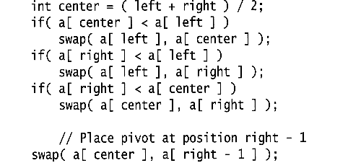
Median of three
We will use median of three
  Compare just three elements: the leftmost, rightmost and center
  Swap these elements if necessary so that
    A[left] = Smallest
    A[right] = Largest
    A[center] = Median of three
  Pick A[center] as the pivot
  Swap A[center] and A[right – 1] so that pivot is at second last position (why?)
median3

Slide 48
2
5
6
4
13
3
12
19
6
A[left] = 2, A[center] = 13, A[right] = 6
2
5
6
4
6
3
12
19
13
Swap A[center] and A[right]
2
5
6
4
6
3
12
19
13
Choose A[center] as pivot
pivot
2
5
6
4
19
3
12
6
13
Swap pivot and A[right – 1]
pivot
Note we only need to partition A[left + 1, …, right – 2]. Why?

Slide 49
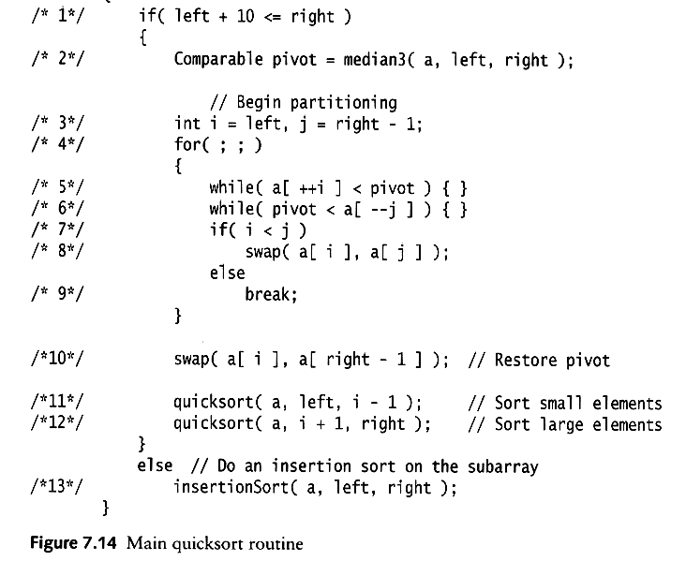
Works only if pivot is picked as median-of-three.
  A[left] <= pivot and A[right] >= pivot
  Thus, only need to partition A[left + 1, …, right – 2]
j will not run past the beginning
  because a[left] <= pivot
i will not run past the end
  because a[right-1] = pivot
The coding style is efficient, but hard to read ☹

Slide 50
i=left;
j=right-1;
while (1) {
do i=i+1;
while (a[i] < pivot);
do j=j-1;
while (pivot < a[j]);
if (i<j) swap(a[i],a[j]);
else break;
}

Slide 51
Small arrays
For very small arrays, quicksort does not perform as well as insertion sort
  how small depends on many factors, such as the time spent making a recursive call, the compiler, etc
Do not use quicksort recursively for small arrays
  Instead, use a sorting algorithm that is efficient for small arrays, such as insertion sort

Slide 52
A practical implementation
Choose pivot
Partitioning
Recursion
For small arrays

Slide 53
Quicksort Analysis
Assumptions:
  A random pivot (no median-of-three partitioning)
  No cutoff for small arrays
Running time
  pivot selection: constant time, i.e. O(1)
  partitioning: linear time, i.e. O(N)
  running time of the two recursive calls
T(N)=T(i)+T(N-i-1)+cN where c is a constant
  i: number of elements in S1

Slide 54
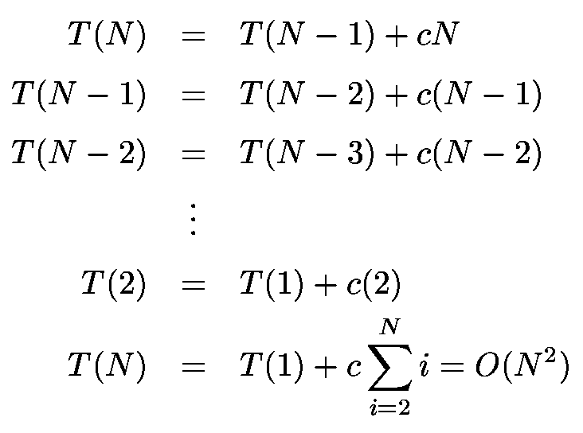
Worst-Case Analysis
What will be the worst case?
  The pivot is the smallest element, all the time
  Partition is always unbalanced

Slide 55
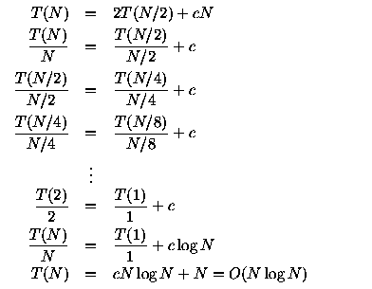
Best-case Analysis
What will be the best case?
  Partition is perfectly balanced.
  Pivot is always in the middle (median of the array)

Slide 56
Average-Case Analysis
Assume
  Each of the sizes for S1 is equally likely
This assumption is valid for our pivoting (median-of-three) strategy
On average, the running time is O(N log N) (covered in comp271)

Slide 57
Quicksort is ‘faster’ than Mergesort
Both quicksort and mergesort take O(N log N) in the average case.
Why is quicksort faster than mergesort?
  The inner loop consists of an increment/decrement (by 1, which is fast), a test and a jump.
  There is no extra juggling as in mergesort.
inner loop

Slide 58
Lower bound for sorting, radix sort
COMP171

Slide 59
Lower Bound for Sorting
Mergesort and heapsort
  worst-case running time is O(N log N)
Are there better algorithms?
Goal: Prove that any sorting algorithm based on only comparisons takes Ω(N log N) comparisons in the worst case (worse-case input) to sort N elements.

Slide 60
Lower Bound for Sorting
Suppose we want to sort N distinct elements
How many possible orderings do we have for N elements?
We can have N! possible orderings (e.g., the sorted output for a,b,c can be a b c, b a c, a c b, c a b, c b a, b c a.)

Slide 61
Lower Bound for Sorting
Any comparison-based sorting process can be represented as a binary decision tree.
  Each node represents a set of possible orderings, consistent with all the comparisons that have been made
  The tree edges are results of the comparisons

Slide 62
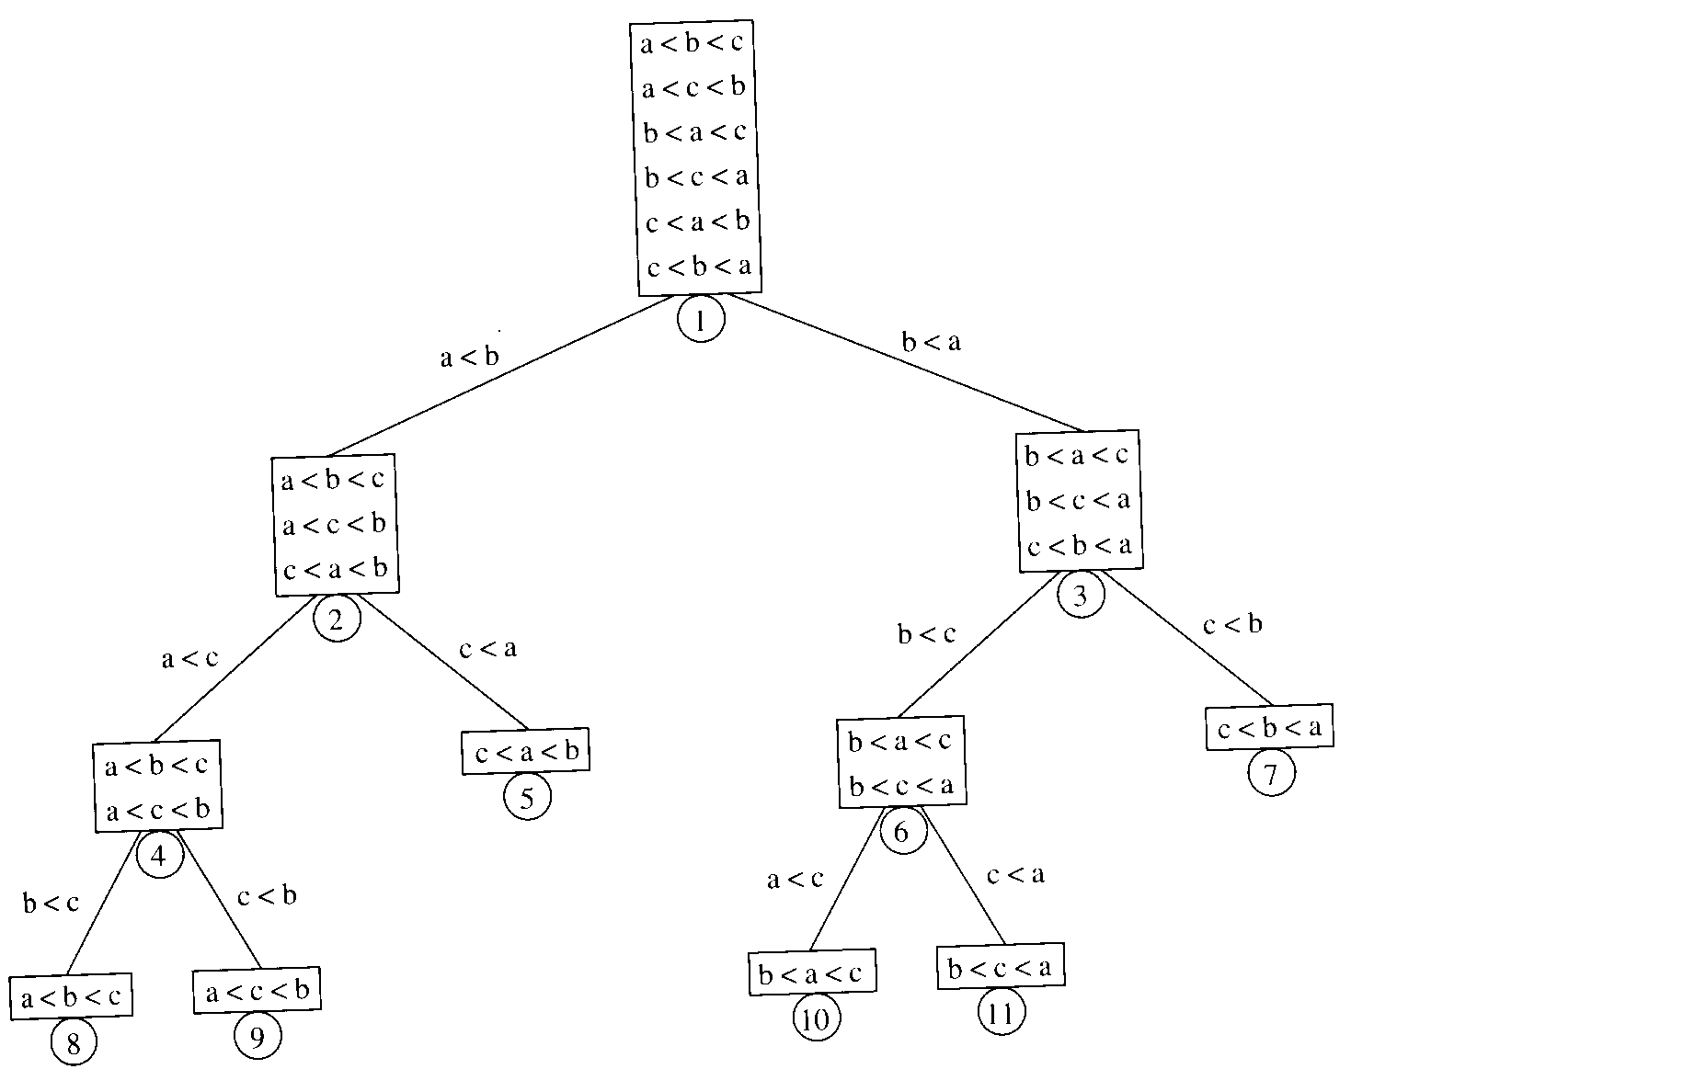
Decision tree for
Algorithm X for sorting
three elements a, b, c

Slide 63
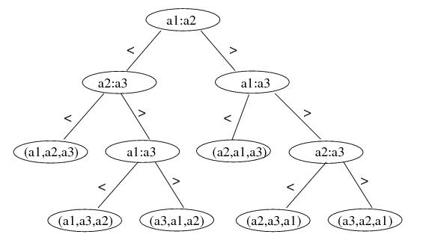
Lower Bound for Sorting
A different algorithm would have a different decision tree
Decision tree for Insertion Sort on 3 elements:
There exists an input ordering that corresponds to each root-to-leaf path to arrive at a sorted order. For decision tree of insertion sort, the longest path is O(N²).

Slide 64
Lower Bound for Sorting
The worst-case number of comparisons used by the sorting algorithm is equal to the depth of the deepest leaf
  The average number of comparisons used is equal to the average depth of the leaves
A decision tree to sort N elements must have N! leaves
  a binary tree of depth d has at most 2^{d} leaves
  ⇒ a binary tree with 2^{d} leaves must have depth at least d
  ⇒ the decision tree with N! leaves must have depth at least ⎡log₂ (N!)⎤
Therefore, any sorting algorithm based on only comparisons between elements requires at least
⎡ log₂(N!) ⎤ comparisons in the worst case.

Slide 65
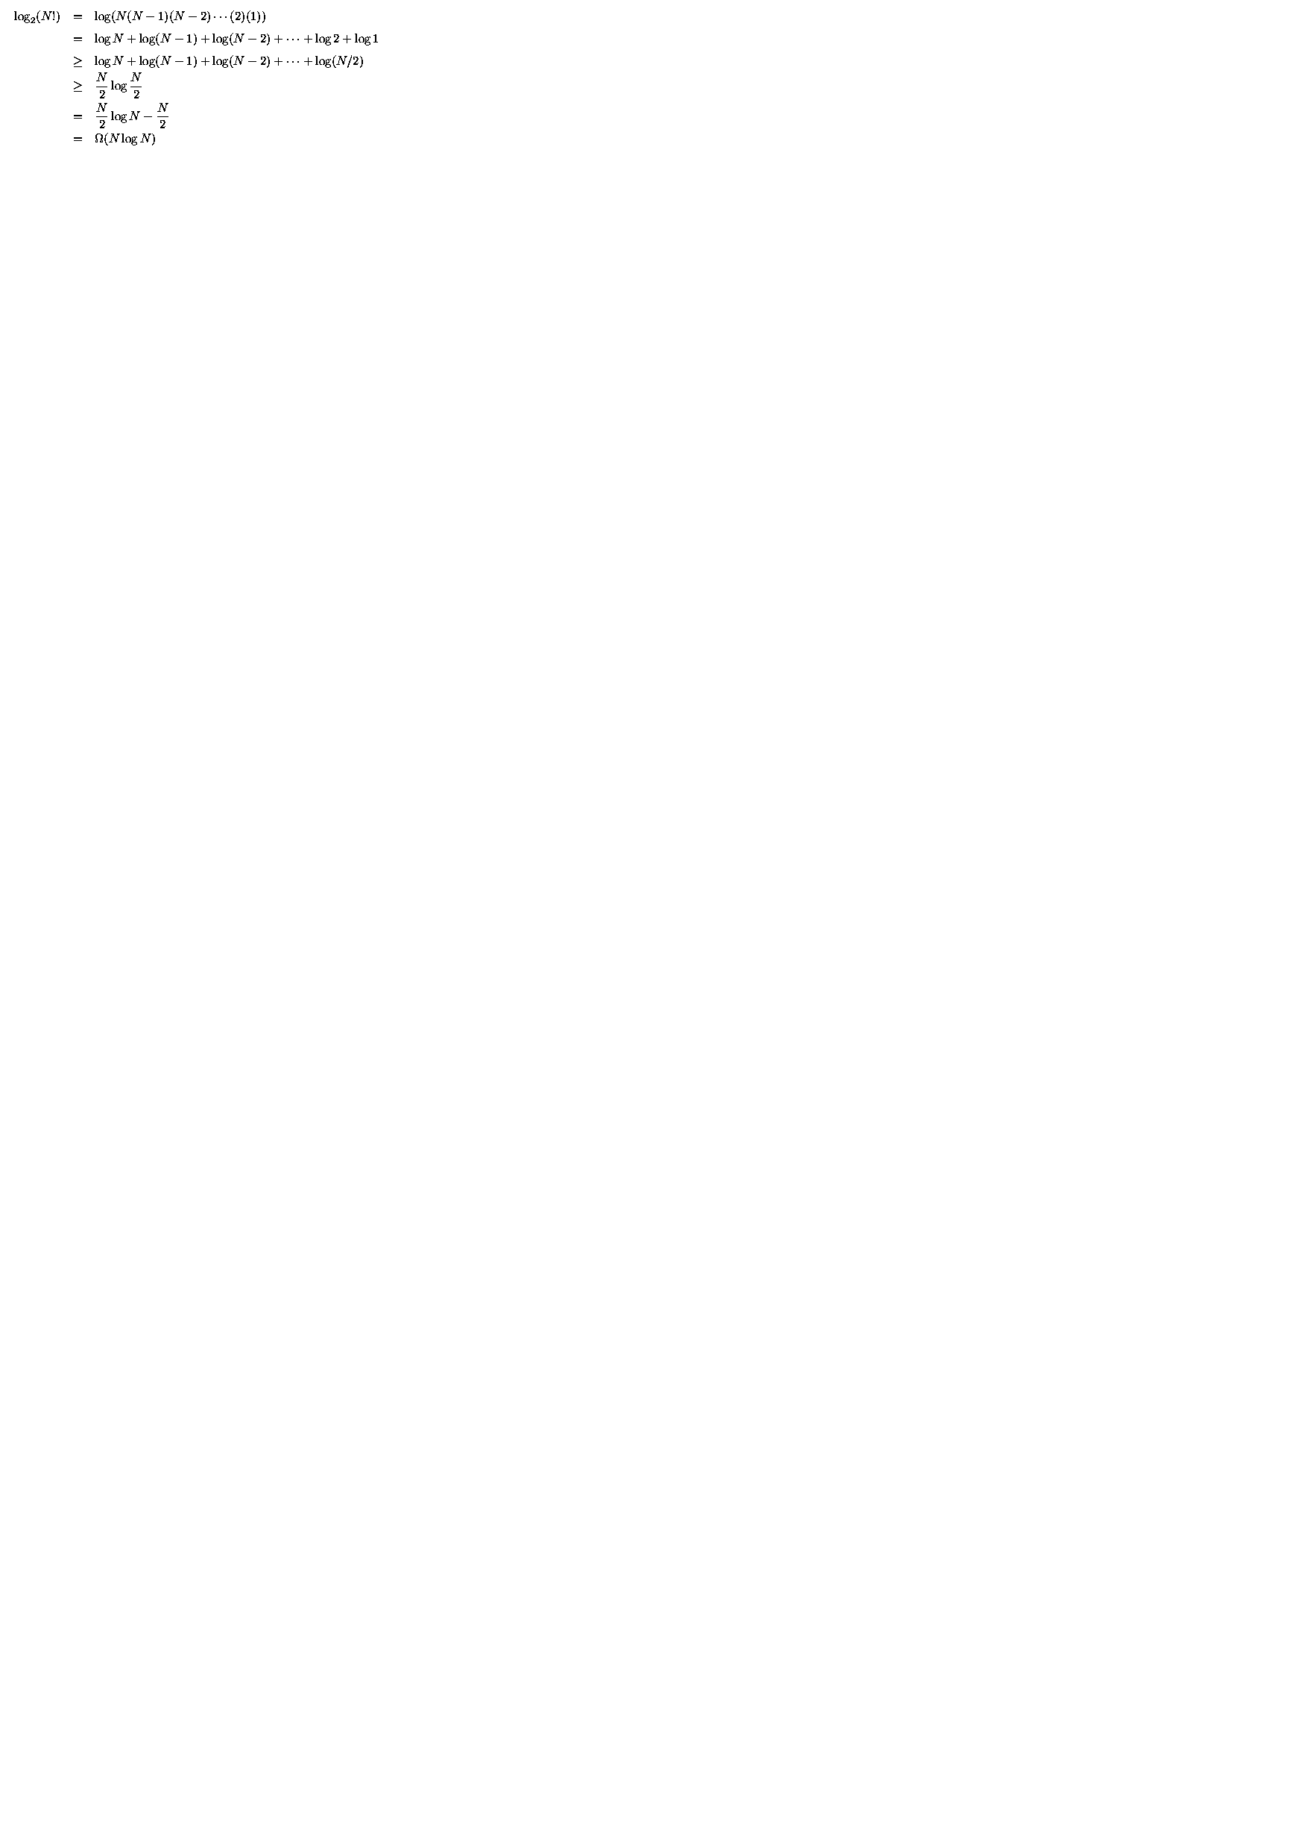
Lower Bound for Sorting
Any sorting algorithm based on comparisons between elements requires Ω(N log N) comparisons.

Slide 66
Linear time sorting
Can we do better (linear time algorithm) if the input has special structure (e.g., uniformly distributed, every number can be represented by d digits)? Yes.
Counting sort, radix sort

Slide 67
Counting Sort
Assume N integers are to be sorted, each is in the range 1 to M.
Define an array B[1..M], initialize all to 0 ⇒ O(M)
Scan through the input list A[i], insert A[i] into B[A[i]] ⇒ O(N)
Scan B once, read out the nonzero integers ⇒ O(M)
Total time: O(M + N)
  if M is O(N), then total time is O(N)
  Can be bad if range is very big, e.g. M=O(N²)
N=7, M = 9,
Want to sort 8 1 9 5 2 6 3
1
2
3
5
6
8
9
Output: 1 2 3 5 6 8 9

Slide 68
Counting sort
What if we have duplicates?
B is an array of pointers.
Each position in the array has 2 pointers: head and tail. Tail points to the end of a linked list, and head points to the beginning.
A[j] is inserted at the end of the list B[A[j]]
Again, Array B is sequentially traversed and each nonempty list is printed out.
Time: O(M + N)

Slide 69
Counting sort
M = 9,
Wish to sort 8 5 1 5 9 5 6 2 7
1
2
5
6
7
8
9
5
5
Output: 1 2 5 5 5 6 7 8 9

Slide 70
Radix Sort
Extra information: every integer can be represented by at most k digits
  d₁d₂…d_{k} where d_{i} are digits in base r
  d₁: most significant digit
  d_{k}: least significant digit

Slide 71
Radix Sort
Algorithm
  sort by the least significant digit first (counting sort)
  => Numbers with the same digit go to same bin
  reorder all the numbers: the numbers in bin 0 precede the numbers in bin 1, which precede the numbers in bin 2, and so on
  sort by the next least significant digit
  continue this process until the numbers have been sorted on all k digits

Slide 72
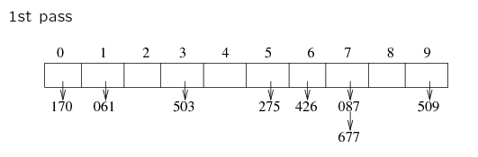
Radix Sort
Least-significant-digit-first
Example: 275, 087, 426, 061, 509, 170, 677, 503
170 061 503 275 426 087 677 509

Slide 73
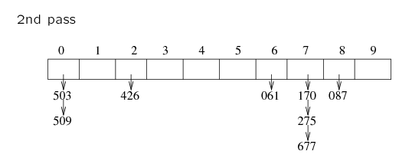
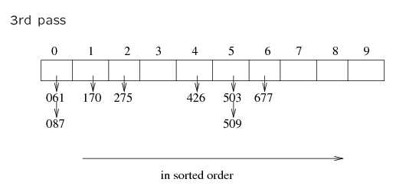
170 061 503 275 426 087 677 509
503 509 426 061 170 275 677 087
061 087 170 275 426 503 509 677

Slide 74
Radix Sort
Does it work?
Clearly, if the most significant digit of a and b are different and a < b, then finally a comes before b
If the most significant digit of a and b are the same, and the second most significant digit of b is less than that of a, then b comes before a.

Slide 75
Radix Sort
Example 2: sorting cards
  2 digits for each card: d₁d₂
  d₁ = ♠♥♣♦: base 4
    ♦ ≤ ♣ ≤ ♥ ≤ ♠
  d₂ = A, 2, 3, ...J, Q, K: base 13
    A ≤ 2 ≤ 3 ≤ ... ≤ J ≤ Q ≤ K
  ♦2 ≤ ♣2 ≤ ♥5 ≤ ♠K

Slide 76
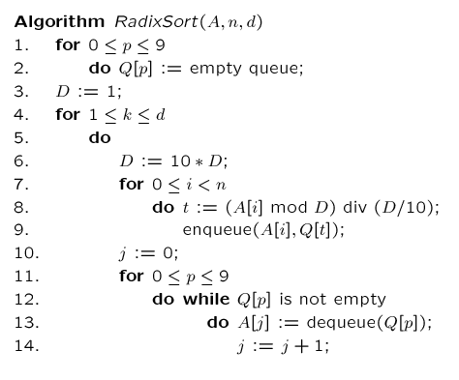
A=input array, n=|numbers to be sorted|,
d=# of digits, k=the digit being sorted, j=array index
// base 10
// FIFO
// d times of counting sort
// scan A[i], put into correct slot
// re-order back to original array

Slide 77
Radix Sort
Increasing the base r decreases the number of passes
Running time
  k passes over the numbers (i.e. k counting sorts, with range being 0..r)
  each pass takes 2N
  total: O(2Nk)=O(Nk)
  r and k are constants: O(N)
Note:
  radix sort is not based on comparisons; the values are used as array indices
  If all N input values are distinct, then k = Ω(log N) (e.g., in binary digits, to represent 8 different numbers, we need at least 3 digits). Thus the running time of Radix Sort also become Ω(N log N).

Slide 78
Heaps, Heap Sort, and Priority Queues

Slide 79
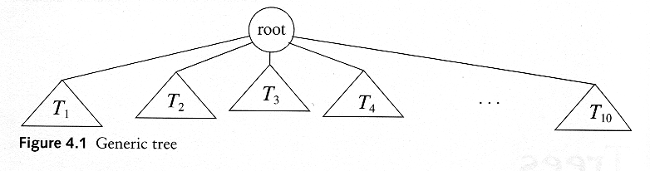
Trees
A tree T is a collection of nodes
  T can be empty
  (recursive definition) If not empty, a tree T consists of
    a (distinguished) node r (the root),
    and zero or more nonempty subtrees T₁, T₂, ...., T_{k}

Slide 80
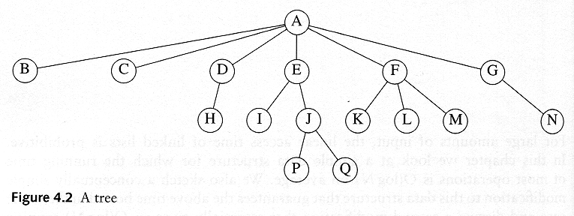

Some Terminologies
Child and Parent
  Every node except the root has one parent
  A node can have an zero or more children
Leaves
  Leaves are nodes with no children
Sibling
  nodes with same parent

Slide 81
More Terminologies
Path
  A sequence of edges
Length of a path
  number of edges on the path
Depth of a node
  length of the unique path from the root to that node
Height of a node
  length of the longest path from that node to a leaf
  all leaves are at height 0
The height of a tree = the height of the root
= the depth of the deepest leaf
Ancestor and descendant
  If there is a path from n1 to n2
  n1 is an ancestor of n2, n2 is a descendant of n1
  Proper ancestor and proper descendant

Slide 82
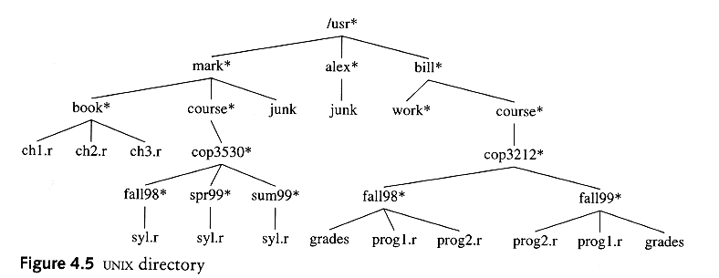
Example: UNIX Directory

Slide 83
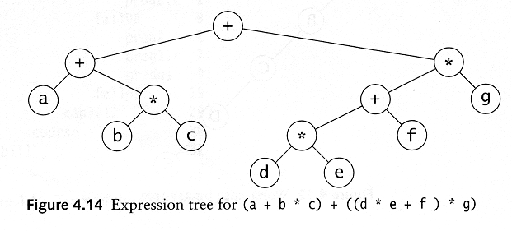
Example: Expression Trees
Leaves are operands (constants or variables)
The internal nodes contain operators
Will not be a binary tree if some operators are not binary

Slide 84
Background: Binary Trees
root
Has a root at the topmost level
Each node has zero, one or two children
A node that has no child is called a leaf
For a node x, we denote the left child, right child and the parent of x as left(x), right(x) and parent(x), respectively.
Parent(x)
x
leaf
leaf
left(x)
right(x)
leaf

Slide 85
Struct Node {
double element; // the data
Node* left; // left child
Node* right; // right child
// Node* parent; // parent
}
class Tree {
public:
Tree(); // constructor
Tree(const Tree& t);
~Tree(); // destructor
bool empty() const;
double root(); // decomposition (access functions)
Tree& left();
Tree& right();
// Tree& parent(double x);
// … update …
void insert(const double x); // compose x into a tree
void remove(const double x); // decompose x from a tree
private:
Node* root;
}
A binary tree can be naturally implemented by pointers.

Slide 86
Height (Depth) of a Binary Tree
The number of edges on the longest path from the root to a leaf.
Height = 4

Slide 87
Background: Complete Binary Trees
A complete binary tree is the tree
  Where a node can have 0 (for the leaves) or 2 children and
  All leaves are at the same depth
No. of nodes and height
  A complete binary tree with N nodes has height O(logN)
  A complete binary tree with height d has, in total, 2^{d+1}-1 nodes
height
no. of nodes
0
1
1
2
2
4
3
8
d
2^{d}

Slide 88

Proof: O(logN) Height
Proof: a complete binary tree with N nodes has height of O(logN)
  Prove by induction that number of nodes at depth d is 2^{d}
  Total number of nodes of a complete binary tree of depth d is 1 + 2 + 4 +…… 2^{d} = 2^{d+1} - 1
  Thus 2^{d+1} - 1 = N
  d = log(N+1)-1 = O(logN)
Side notes: the largest depth of a binary
tree of N nodes is O(N)

Slide 89
(Binary) Heap
Heaps are “almost complete binary trees”
  All levels are full except possibly the lowest level
  If the lowest level is not full, then nodes must be packed to the left
Pack to the left

Slide 90
1
4
2
5
2
5
4
3
6
1
3
6
A heap
Not a heap
Heap-order property: the value at each node is less than or equal to the values at both its descendants --- Min Heap
It is easy (both conceptually and practically) to perform insert and deleteMin in heap if the heap-order property is maintained

Slide 91
Structure properties
  Has 2^{h} to 2^{h+1}-1 nodes with height h
  The structure is so regular, it can be represented in an array and no links are necessary !!!
Use of binary heap is so common for priority queue implemen-tations, thus the word heap is usually assumed to be the implementation of the data structure

Slide 92
Heap Properties
Heap supports the following operations efficiently
  Insert in O(logN) time
  Locate the current minimum in O(1) time
  Delete the current minimum in O(log N) time

Slide 93
Array Implementation of Binary Heap
A
B
C
A
B
C
D
E
F
G
H
I
J
0
1
2
3
4
5
6
7
8
…
D
E
F
G
H
I
J
For any element in array position i
  The left child is in position 2i
  The right child is in position 2i+1
  The parent is in position floor(i/2)
A possible problem: an estimate of the maximum heap size is required in advance (but normally we can resize if needed)
Note: we will draw the heaps as trees, with the implication that an actual implementation will use simple arrays
Side notes: it’s not wise to store normal binary trees in arrays, because it may generate many holes

Slide 94
class Heap {
public:
Heap(); // constructor
Heap(const Heap& t);
~Heap(); // destructor
bool empty() const;
double root(); // access functions
Heap& left();
Heap& right();
Heap& parent(double x);
// … update …
void insert(const double x); // compose x into a heap
void deleteMin(); // decompose x from a heap
private:
double* array;
int array-size;
int heap-size;
}

Slide 95
Insertion
Algorithm
  Add the new element to the next available position at the lowest level
  Restore the min-heap property if violated
    General strategy is percolate up (or bubble up): if the parent of the element is larger than the element, then interchange the parent and child.
1
1
1
2
5
2
5
2
2.5
swap
4
3
6
4
3
6
2.5
4
3
6
5
Insert 2.5
Percolate up to maintain
the heap property

Slide 96
Insertion Complexity
7
9
8
A heap!
17
16
14
10
20
18
Time Complexity = O(height) = O(logN)

Slide 97
deleteMin: First Attempt
Algorithm
  Delete the root.
  Compare the two children of the root
  Make the lesser of the two the root.
  An empty spot is created.
  Bring the lesser of the two children of the empty spot to the empty spot.
  A new empty spot is created.
  Continue

Slide 98
Example for First Attempt
1
2
5
2
5
4
3
6
4
3
6
2
1
5
3
5
4
3
6
4
6
Heap property is preserved, but completeness is not preserved!

Slide 99
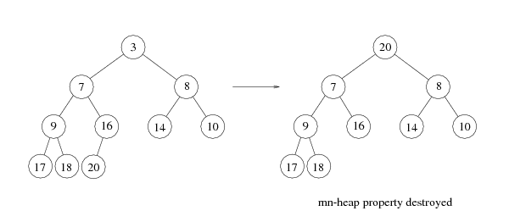
deleteMin
Copy the last number to the root (i.e. overwrite the minimum element stored there)
Restore the min-heap property by percolate down (or bubble down)

Slide 100
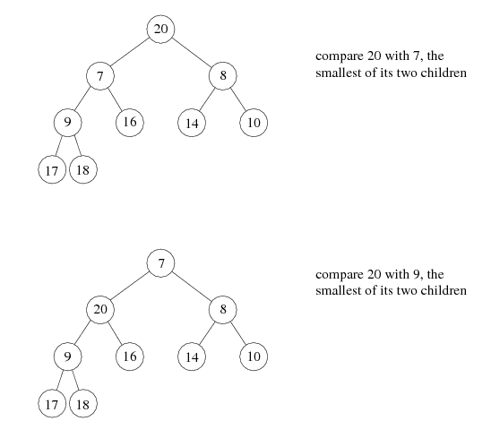
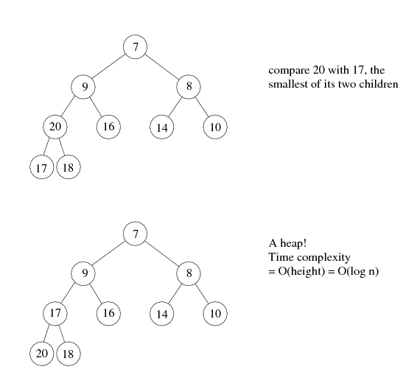

Slide 101
An Implementation Trick
(see Weiss book)
Implementation of percolation in the insert routine
  by performing repeated swaps: 3 assignment statements for a swap. 3d assignments if an element is percolated up d levels
  An enhancement: Hole digging with d+1 assignments (avoiding swapping!)
7
7
7
4
9
8
9
4
8
8
17
16
4
14
10
17
14
10
17
9
14
10
20
18
20
18
16
20
18
16
Dig a hole
Compare 4 with 16
Compare 4 with 9
Compare 4 with 7

Slide 102
Insertion PseudoCode
void insert(const Comparable &x)
{
//resize the array if needed
if (currentSize == array.size()-1
array.resize(array.size()*2)
//percolate up
int hole = ++currentSize;
for (; hole>1 && x<array[hole/2]; hole/=2)
array[hole] = array[hole/2];
array[hole]= x;
}

Slide 103
deleteMin with ‘Hole Trick’
The same ‘hole’ trick used in insertion can be used here too
2
2
5
5
4
3
6
4
3
6
1. create hole
tmp = 6 (last element)
2. Compare children and tmp
bubble down if necessary
2
2
3
5
3
5
4
6
4
6
3. Continue step 2 until
reaches lowest level
4. Fill the hole

Slide 104
deleteMin PseudoCode
void deleteMin()
{
if (isEmpty()) throw UnderflowException();
//copy the last number to the root, decrease array size by 1
array[1] = array[currentSize--]
percolateDown(1); //percolateDown from root
}
void percolateDown(int hole) //int hole is the root position
{
int child;
Comparable tmp = array[hole]; //create a hole at root
for( ; hold*2 <= currentSize; hole=child){ //identify child position
child = hole*2;
//compare left and right child, select the smaller one
if (child != currentSize && array[child+1] <array[child]
child++;
if(array[child]<tmp) //compare the smaller child with tmp
array[hole] = array[child]; //bubble down if child is smaller
else
break; //bubble stops movement
}
array[hole] = tmp; //fill the hole
}

Slide 105
Heap is an efficient structure
Array implementation
‘hole’ trick
Access is done ‘bit-wise’, shift, bit+1, …

Slide 106
Heapsort
(1) Build a binary heap of N elements
  the minimum element is at the top of the heap
(2) Perform N DeleteMin operations
  the elements are extracted in sorted order
(3) Record these elements in a second array and then copy the array back

Slide 107
Build Heap
Input: N elements
Output: A heap with heap-order property
Method 1: obviously, N successive insertions
Complexity: O(NlogN) worst case

Slide 108
Heapsort – Running Time Analysis
(1) Build a binary heap of N elements
  repeatedly insert N elements ⇒ O(N log N) time
  (there is a more efficient way, check textbook p223 if interested)
(2) Perform N DeleteMin operations
  Each DeleteMin operation takes O(log N) ⇒ O(N log N)
(3) Record these elements in a second array and then copy the array back
  O(N)
Total time complexity: O(N log N)
Memory requirement: uses an extra array, O(N)

Slide 109
Heapsort: in-place, no extra storage
Observation: after each deleteMin, the size of heap shrinks by 1
  We can use the last cell just freed up to store the element that was just deleted
  ⇒ after the last deleteMin, the array will contain the elements in decreasing sorted order
To sort the elements in the decreasing order, use a min heap
To sort the elements in the increasing order, use a max heap
  the parent has a larger element than the child

Slide 110
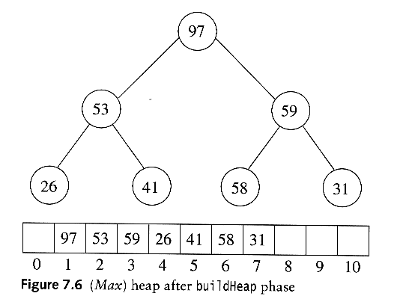
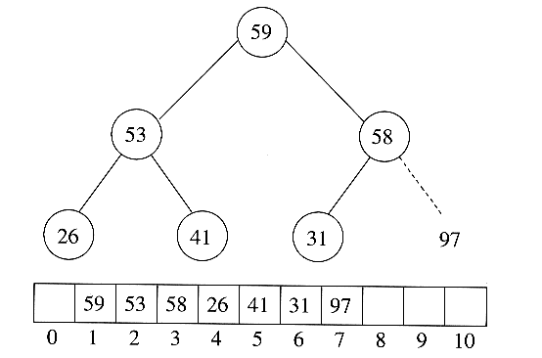
Sort in increasing order: use max heap
Delete 97

Slide 111
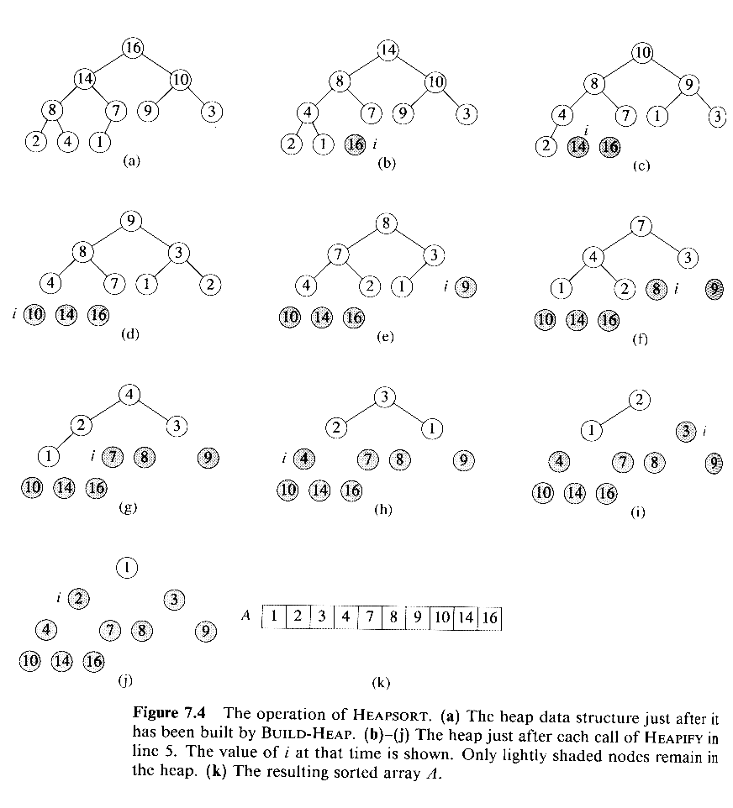
Delete 16
Delete 14
Delete 10
Delete 9
Delete 8

Slide 112
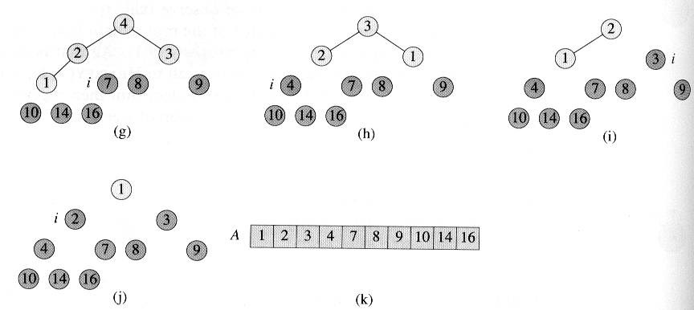

Slide 113
One possible Heap ADT
Template <typename Comparable>
class BinaryHeap
{
public:
BinaryHeap(int capacity=100);
explicit BinaryHeap(const vector<comparable> &items);
bool isEmpty() const;
void insert(const Comparable &x);
void deleteMin();
void deleteMin(Comparable &minItem);
void makeEmpty();
private:
int currentSize; //number of elements in heap
vector<Comparable> array; //the heap array
void buildHeap();
void percolateDown(int hole);
}
See for the explanation of “explicit” declaration for conversion constructors in http://www.glenmccl.com/tip_023.htm

Slide 114

Priority Queue: Motivating Example
3 jobs have been submitted to a printer in the order A, B, C.
Sizes: Job A – 100 pages
Job B – 10 pages
Job C -- 1 page
Average waiting time with FIFO service:
(100+110+111) / 3 = 107 time units
Average waiting time for shortest-job-first service:
(1+11+111) / 3 = 41 time units
A queue be capable to insert and deletemin?
Priority Queue

Slide 115
Priority Queue
Priority queue is a data structure which allows at least two operations
  insert
  deleteMin: finds, returns and removes the minimum elements in the priority queue
Applications: external sorting, greedy algorithms
deleteMin
Priority Queue
insert

Slide 116
Possible Implementations
Linked list
  Insert in O(1)
  Find the minimum element in O(n), thus deleteMin is O(n)
Binary search tree (AVL tree, to be covered later)
  Insert in O(log n)
  Delete in O(log n)
  Search tree is an overkill as it does many other operations
Eerr, neither fit quite well…

Slide 117
It’s a heap!!!

