Slide 1
Performance Drivers – Nodule Characteristics

Slide 2
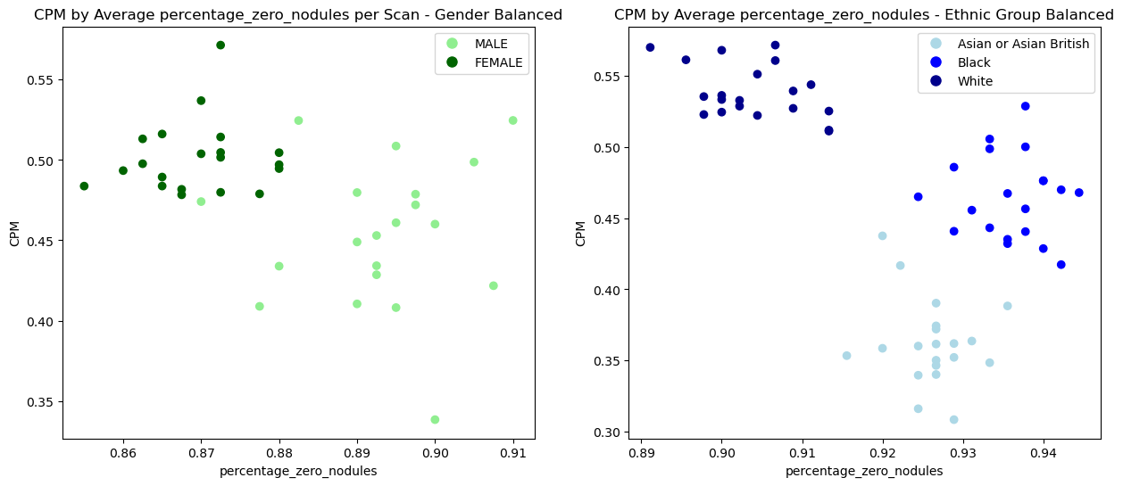
CPM By No Nodules – 20 Samples

Slide 3
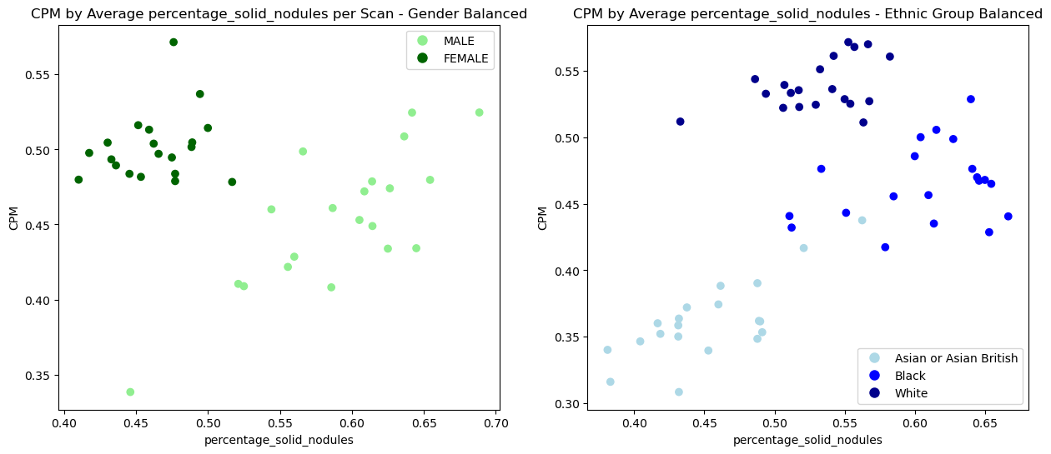
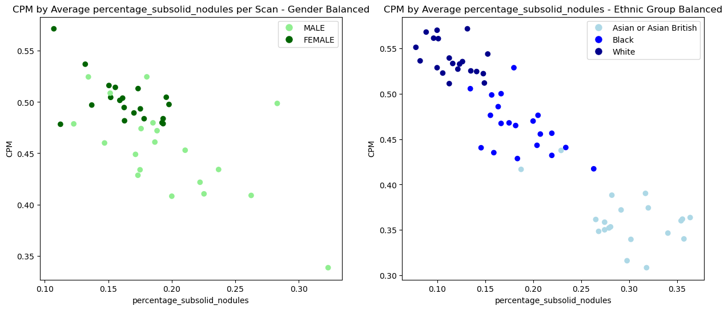
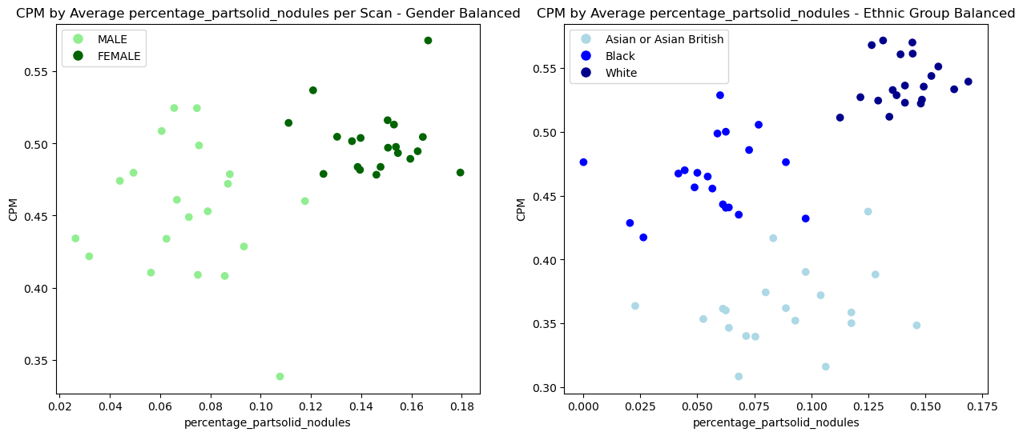
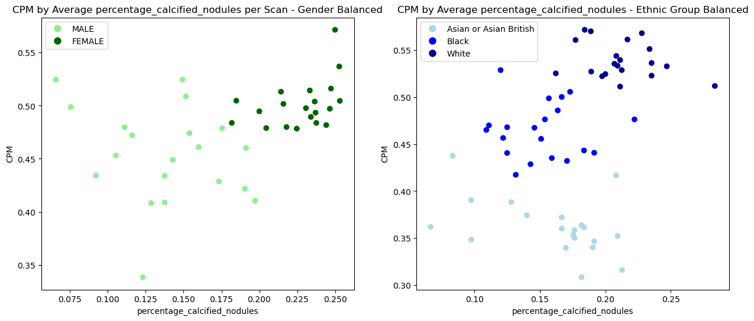
CPM By Nodule Type – Gender/ Ethnic Groups – 20 Samples

Slide 4
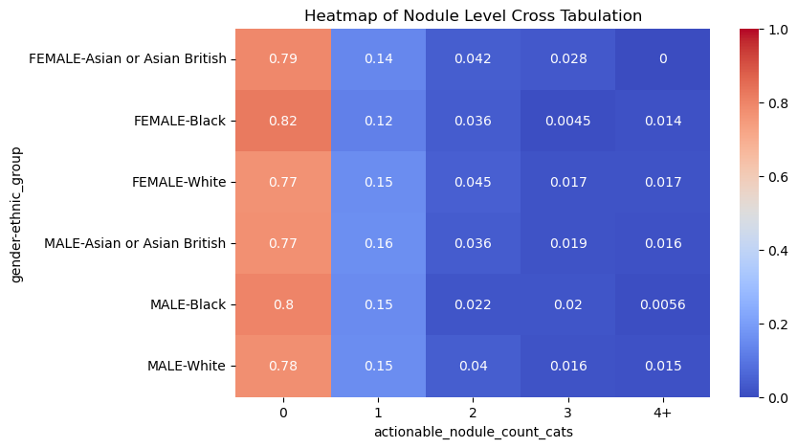
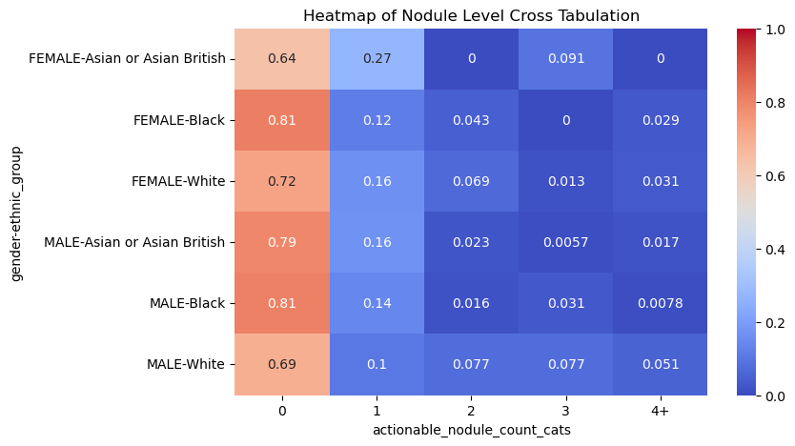
SUMMIT Vs Test Sample - Nodule Characteristic- Nodule Counts
SUMMIT Sample
Test Sample

Slide 5
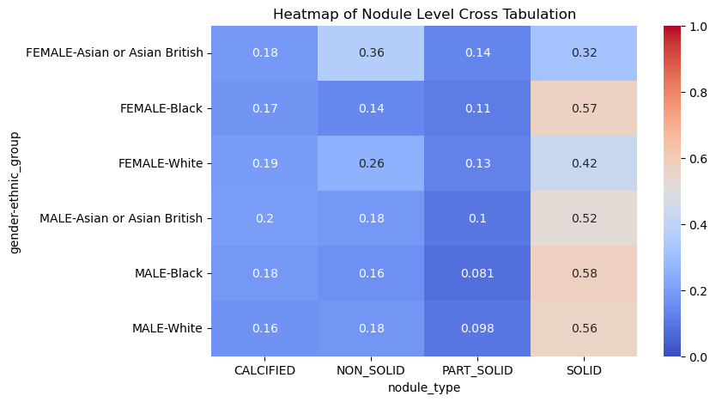
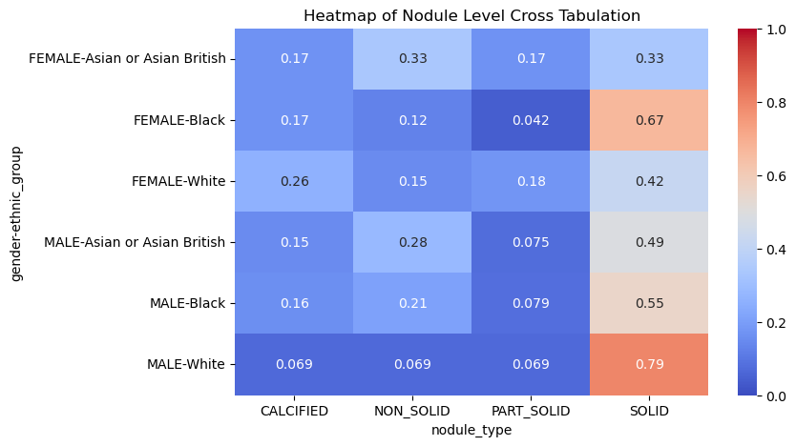
SUMMIT Vs Test Sample - Nodule Characteristic- Nodule Type
SUMMIT Sample
Test Sample

Slide 6
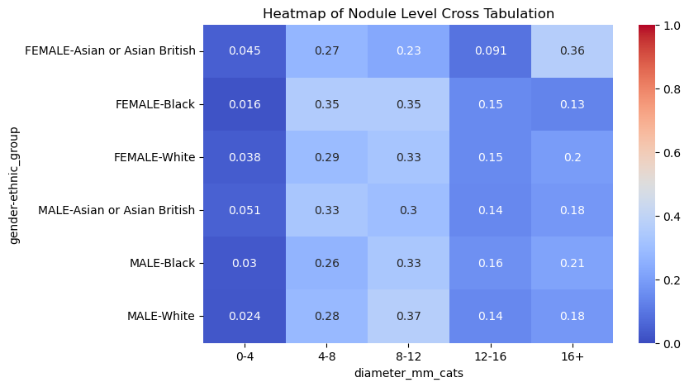
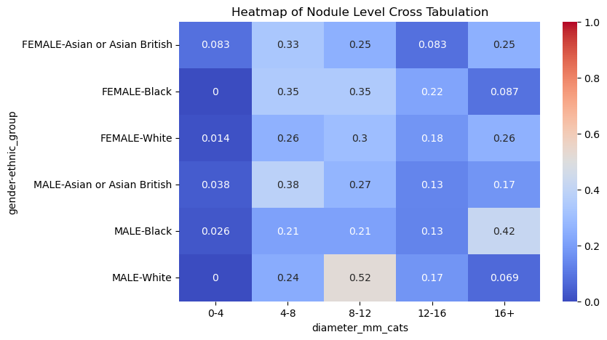
SUMMIT Vs Test Sample - Nodule Characteristic- Nodule Diameter
SUMMIT Sample
Test Sample

Slide 7
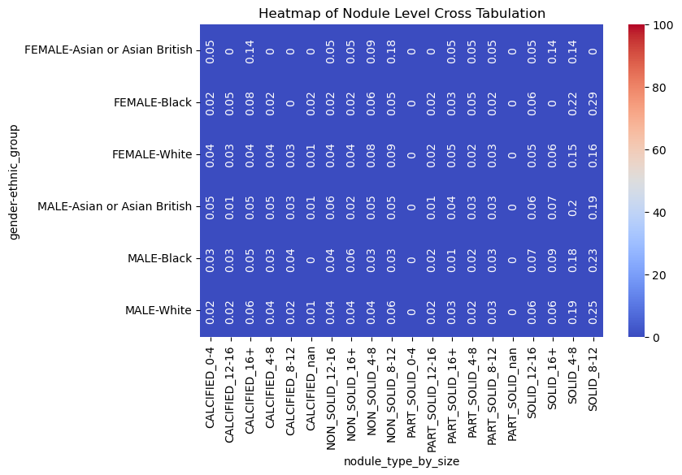

SUMMIT Vs Test Sample - Nodule Characteristic- Type & Diameter
SUMMIT Sample
Test Sample

