Slide 1
Fairness In Nodule Detection Algorithms – Group Comparison and Statistical Significance

Slide 2
Summary
When checking whether the FROC produced from two groups is statistically different:
When calculating the p-value using auc and for each of the seven operating points points to a low p–value
But the confidence interval crosses zero
Most likely reason for this contradiction is a high-variability of underlying data
Excluding scans with > 6 nodules (keeping 97% percentile of scans), changes performance dramatically across protected groups.

Slide 3
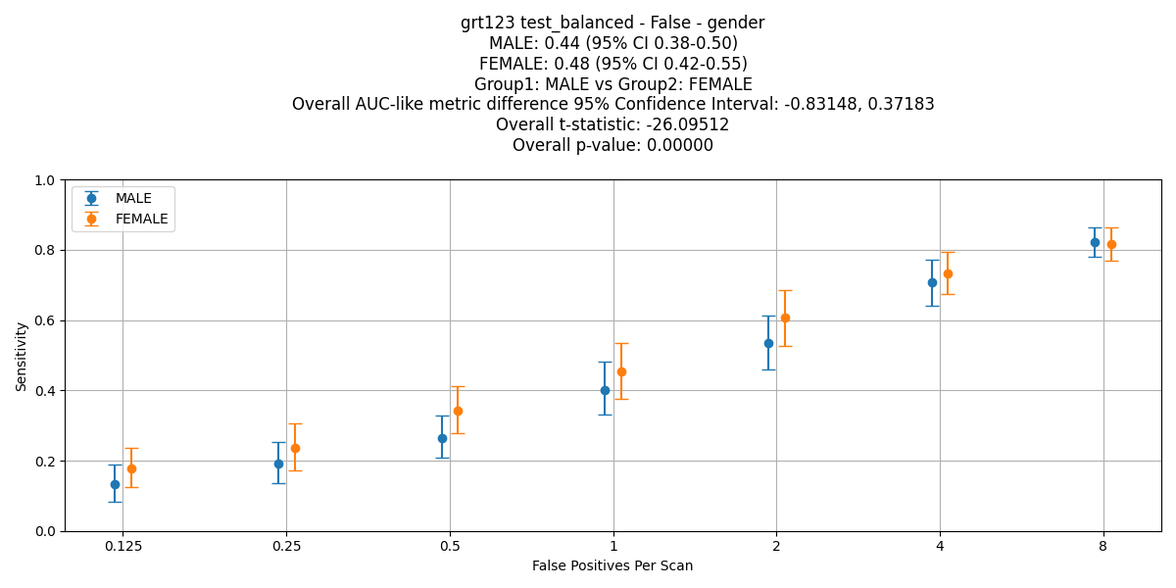
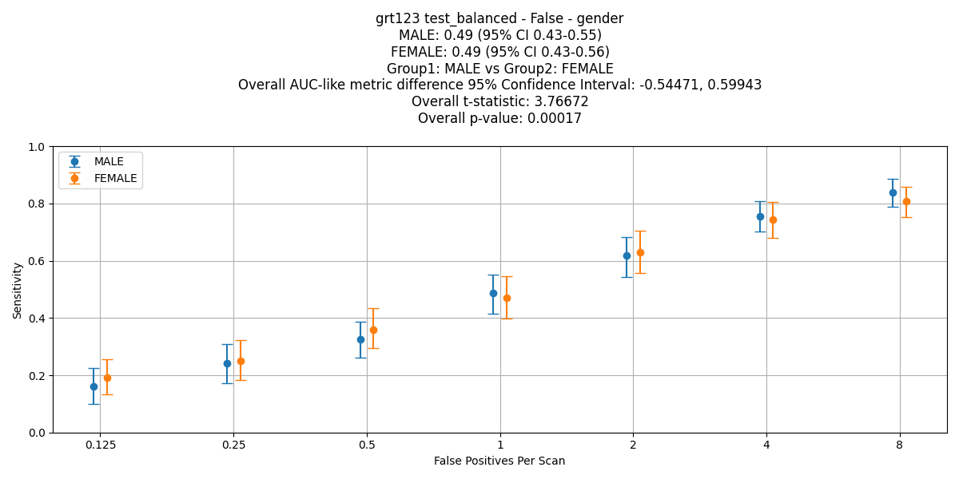
Experiments – Gender Comparisons – Outlier Exclusions (>6 nodules)
All cases, no nodules excluded, Men: 344 (400 nodules), Women: 250 (299 nodules)
GRT123

Slide 4
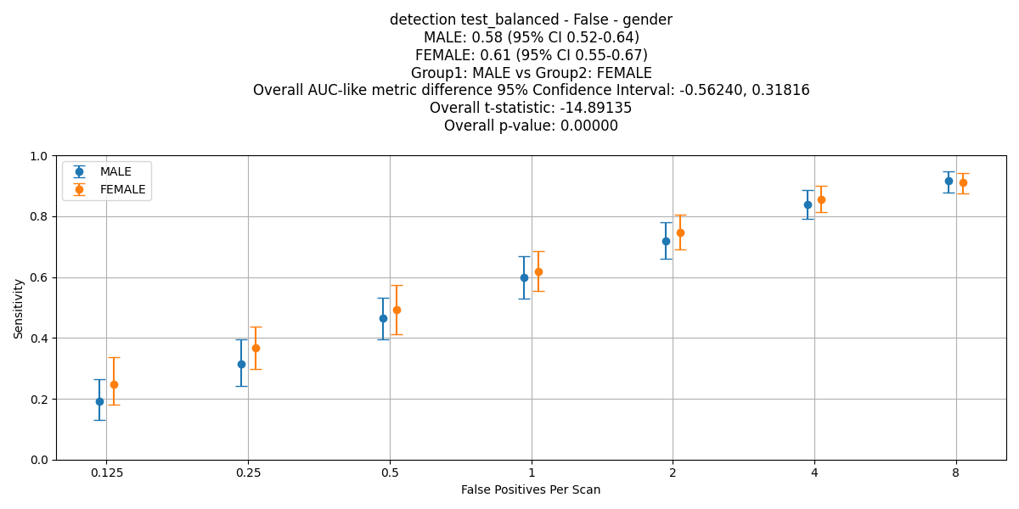
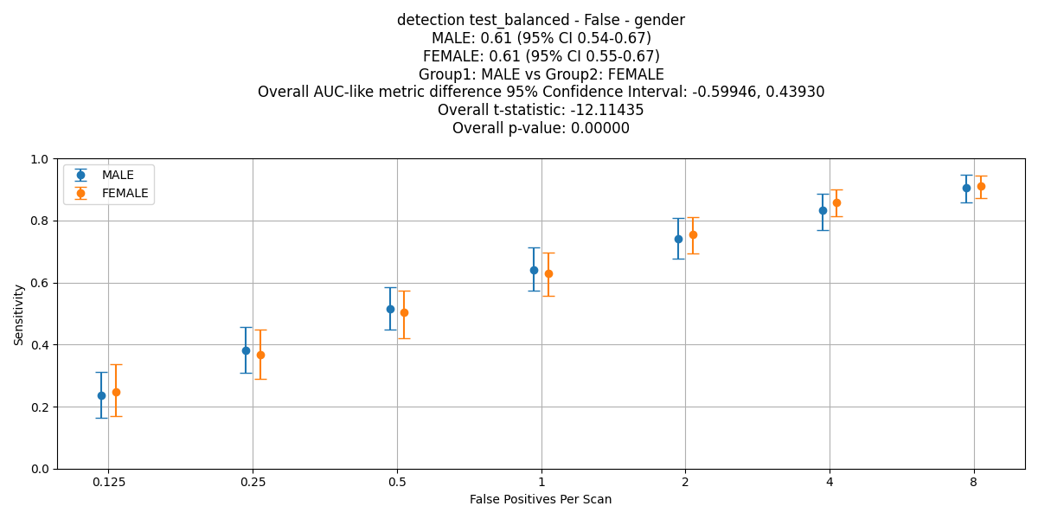
Experiments – Gender Comparisons – Outlier Exclusions (>6 nodules)
All cases, no nodules excluded, Men: 344 (400 nodules), Women: 250 (299 nodules)
Detection

Slide 5
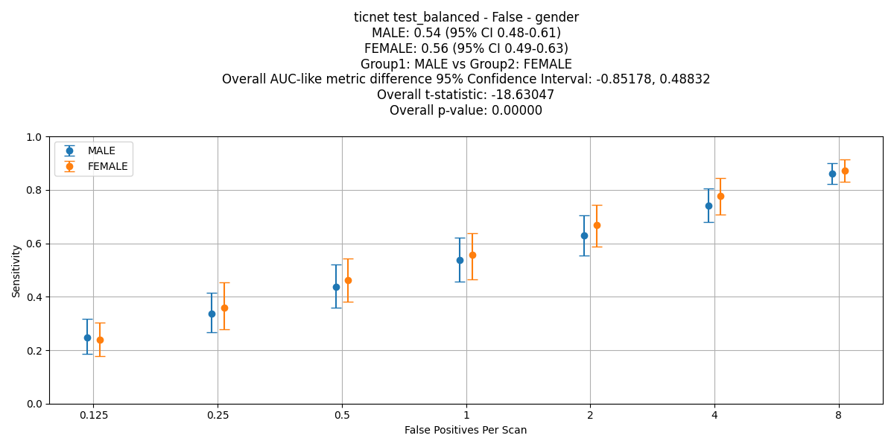
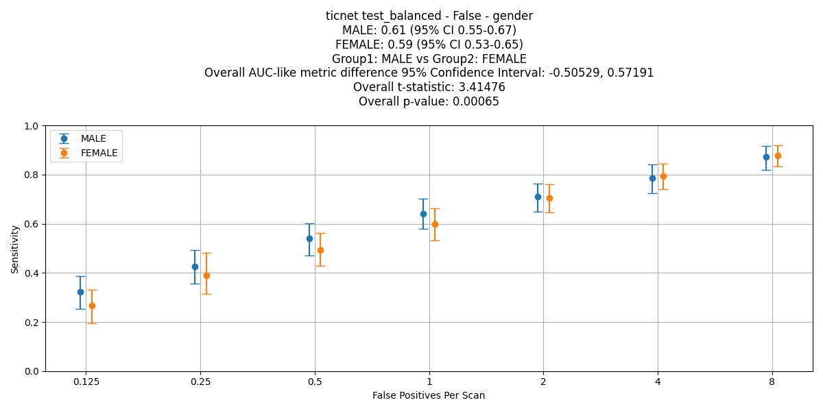
Experiments – Gender Comparisons – Outlier Exclusions (>6 nodules)
All cases, no nodules excluded, Men: 344 (400 nodules), Women: 250 (299 nodules)
TiCNet

Slide 6
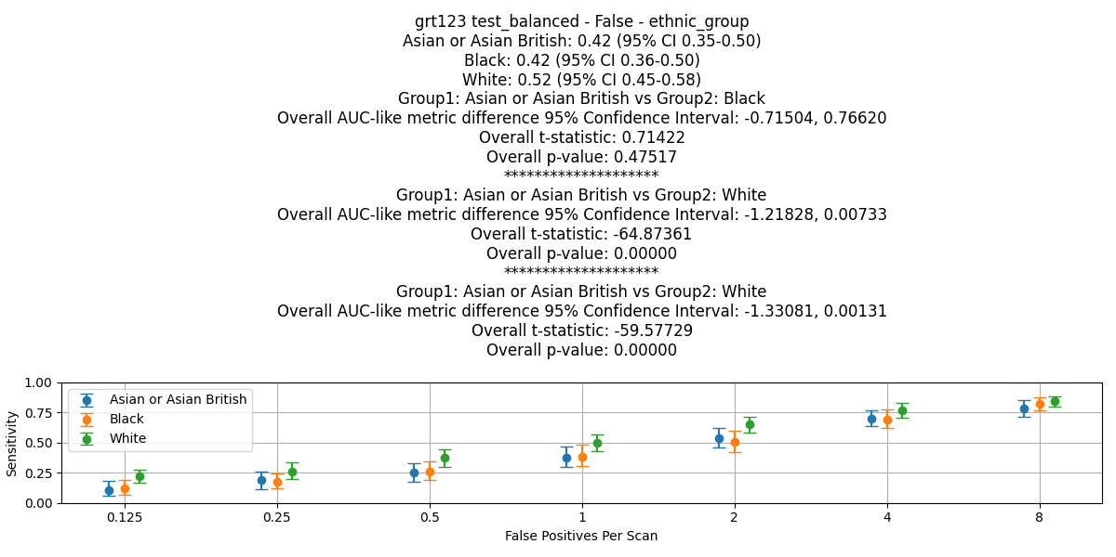
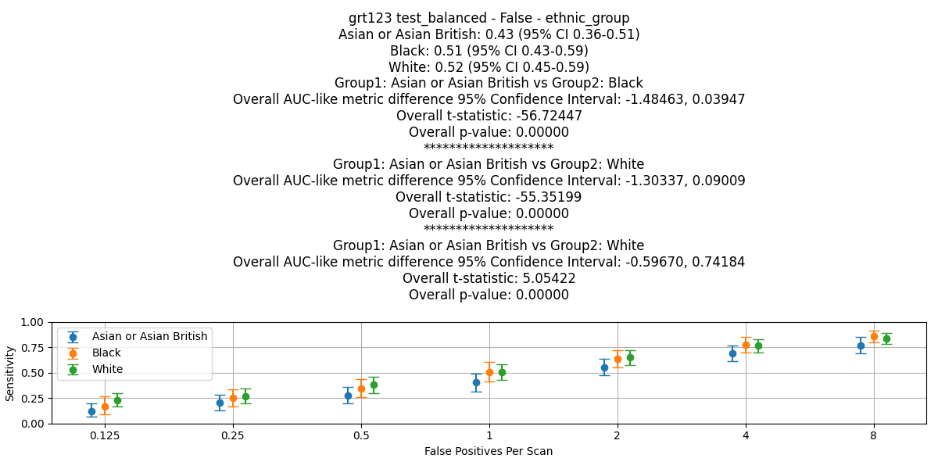
Experiments – Ethnic Group Comparisons – Outlier Exclusions (>6 nodules)
GRT123

Slide 7
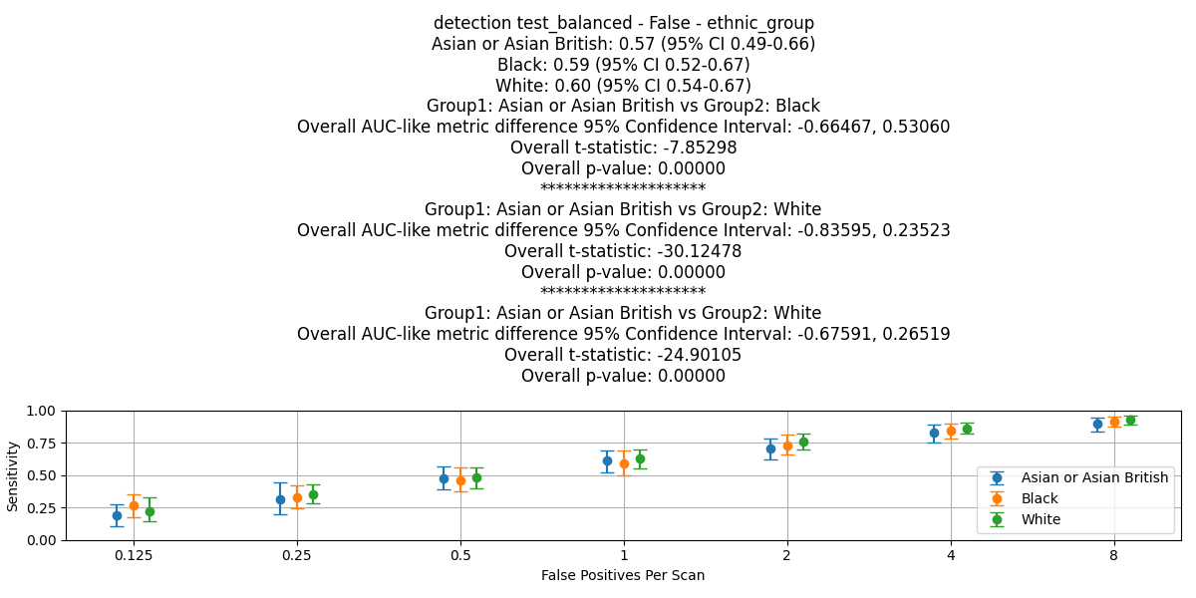
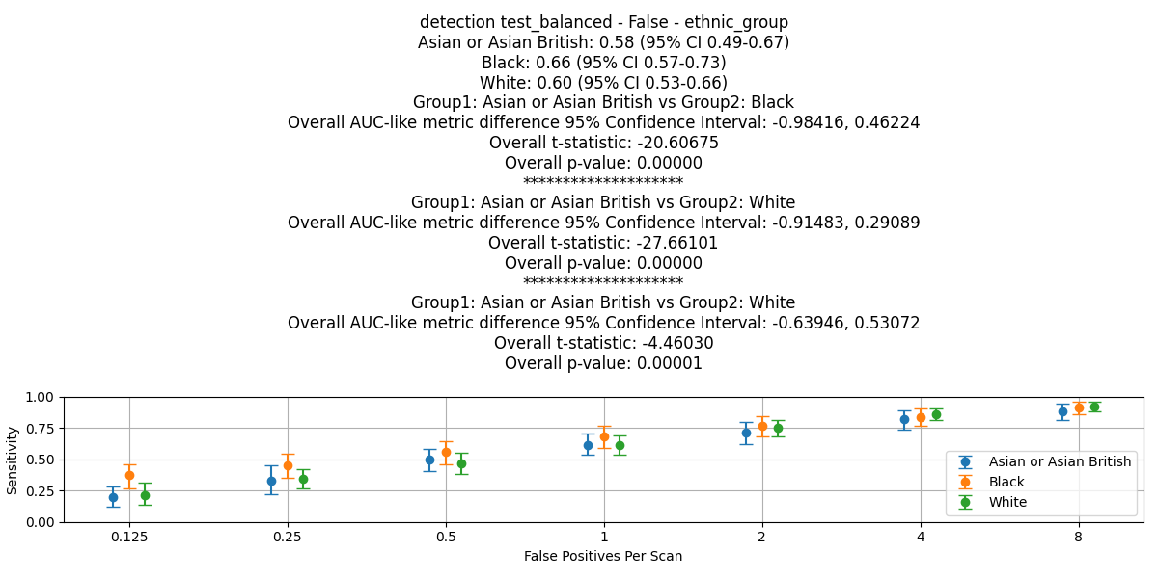
Experiments – Ethnic Group Comparisons – Outlier Exclusions (>6 nodules)
MONAI Detection

Slide 8
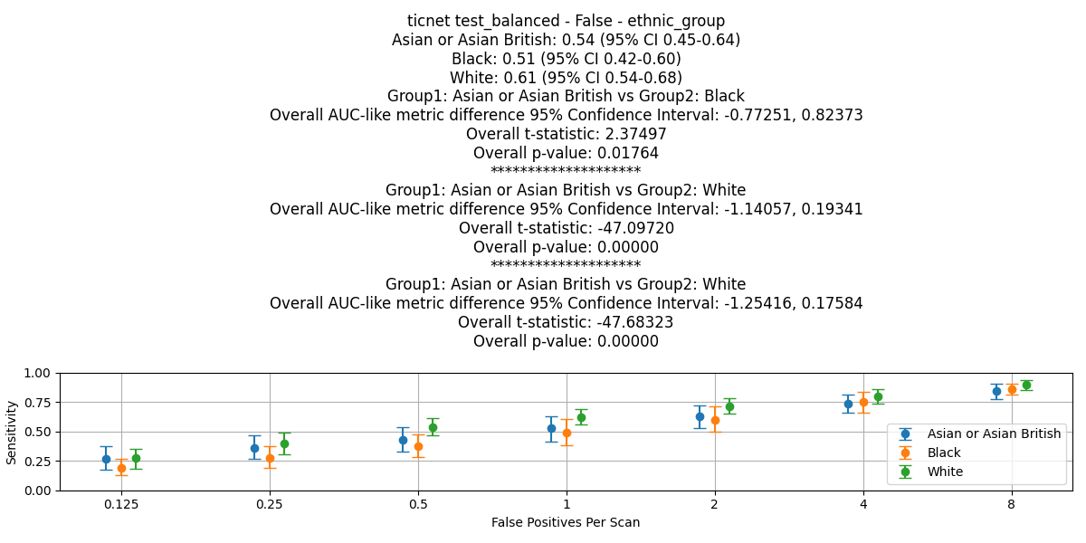
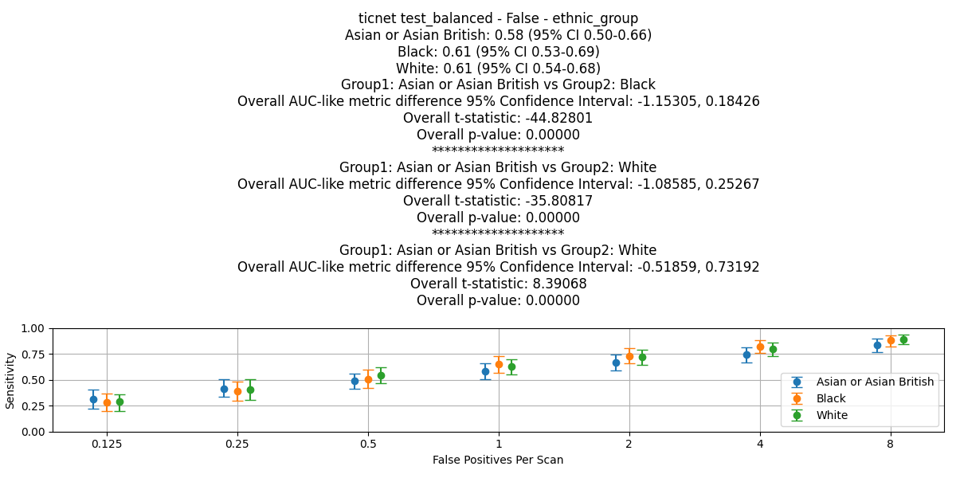
Experiments – Ethnic Group Comparisons – Outlier Exclusions (>6 nodules)
TiCNet

Slide 9
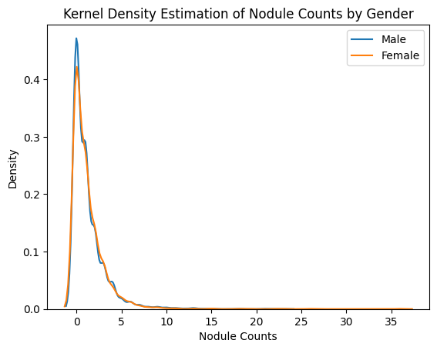
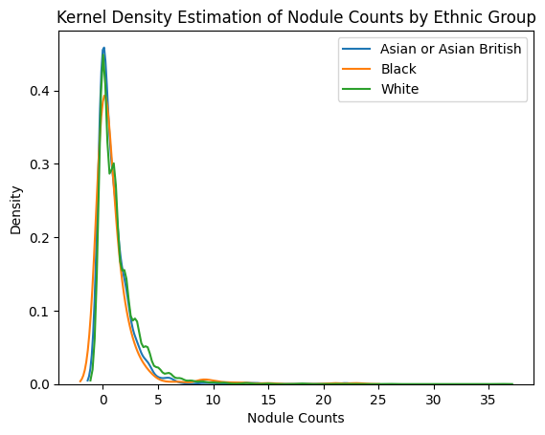
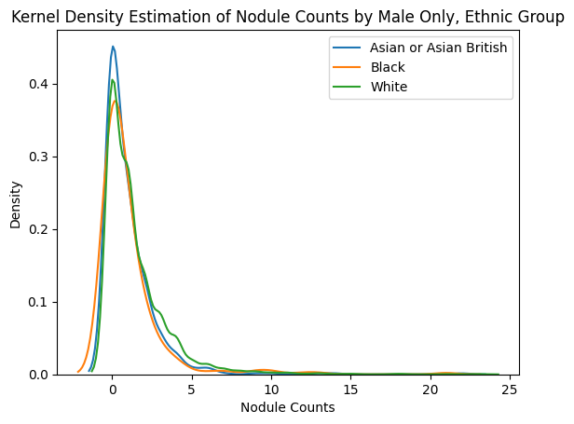
Nodule Count Distributions By Protected Group – All Test Balanced Sample
Asian or Asian British vs Black: p-value: 0.937
Asian or Asian British vs White: p-value: 1.338e-05
Black vs White: p-value: 0.001
Male, Asian or Asian British vs Black: p-value: 0.853
Male, Asian or Asian British vs White: p-value: 1.387e-05
Male, Black vs White: p-value: 0.005
Male vs Female: p-value: 0.931

Slide 10


