Slide 1
Evaluation of Nodule Detection Algorithms
John McCabe, Nov 2023

Slide 2
Background
Most Lung Cancer Screening (LCS) programmes use some form of CADe to support Radiologists.
Modern CADe systems now use some form of deep learning (DL).
Performance of neural nets rely on large amounts of training data and in most cases struggle to generalize well.
Due to commercial competitiveness, model architecture and training data of CADe systems is kept secret.
Following work investigates generalisability of two publicly available state of the art (SOTA) nodule detection algorithms as proxies for commercial CADe systems.
Several papers have highlighted that the under-perform on protected groups due to the training data imbalance.
The SUMMIT dataset is imbalanced with regards to gender and ethnicity.
This work additionally investigates whether there is any variation in performance across these protected groups.

Slide 3
Objectives overview
Evaluate SUMMIT with data trained on LUNA16 to identify if there is a performance drop due to data drift between LUNA16 and SUMMIT.
Identify model sensitivity to being tuned for specific dataset by re-training models on SUMMIT data without changing any hyperparameters to.
Review performance for protected groups e.g. gender and ethnicity.

Slide 4
Methods
Public nodule detection algorithms are typically trained and evaluated against the LUNA16 dataset, which comprises:
Released 2016 (updates up until 2018)
888 Lung CT, with 1187 nodules
Slice thickness :
174 cases < 1mm
395 cases >= 1mm and < 2mm
319 cases >= 2mm
Select two publicly available SOTA nodule detection algorithms to act as proxies for commercial products.
Selection based on following criteria:
Code available
Uses single timepoint
Published LUNA16 FROC score
Models selected:
GRT123, winner Kaggle Data Science Bowl 2017
nnDetection implemented in MONAI
GRT123

Slide 6
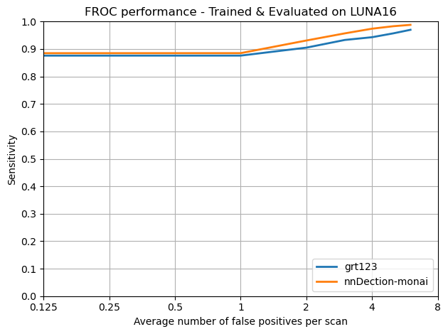
Results

