Slide 1
Fairness In Nodule Detection Algorithms – Group Comparison and Statistical Significance

Slide 2
Summary
When checking whether the FROC produced from two groups is statistically different:
When calculating the p-value using auc and for each of the seven operating points points to a low p–value
But the confidence interval crosses zero
Most likely reason for this contradiction is a high-variability of underlying data
Following slides demonstrate this!

Slide 3
Results

Slide 4
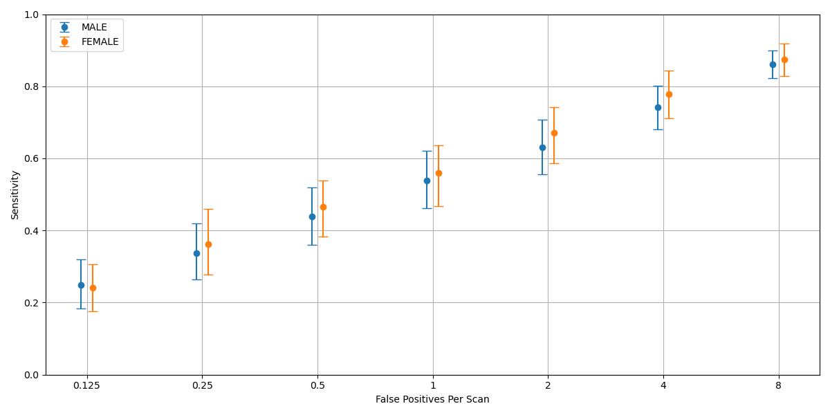
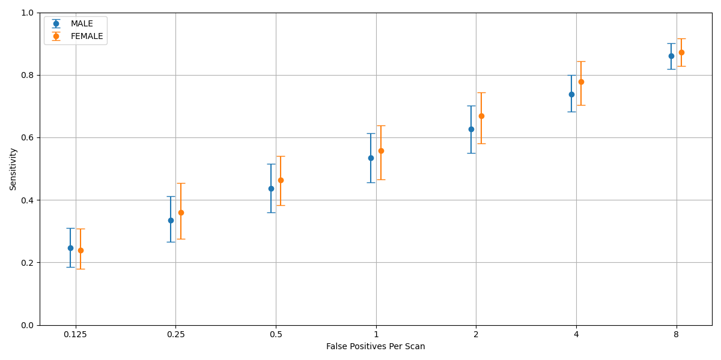
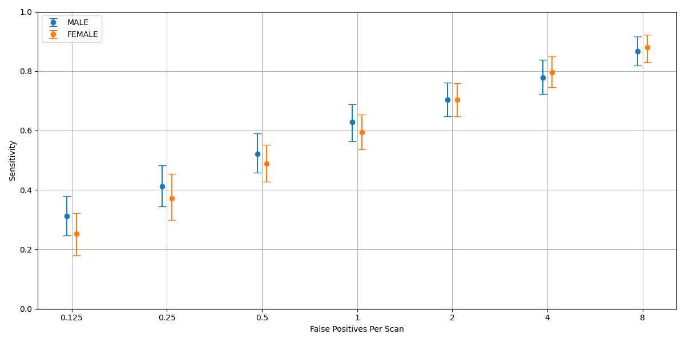
Experiments
All cases
Male: 344
Female: 250
Cases that are annotations only
Male: 163
Female: 135
Cases with > 7 nodules removed
Male: 336 (8 cases removed)
Female: 248 (2 cases removed)

