Slide 1



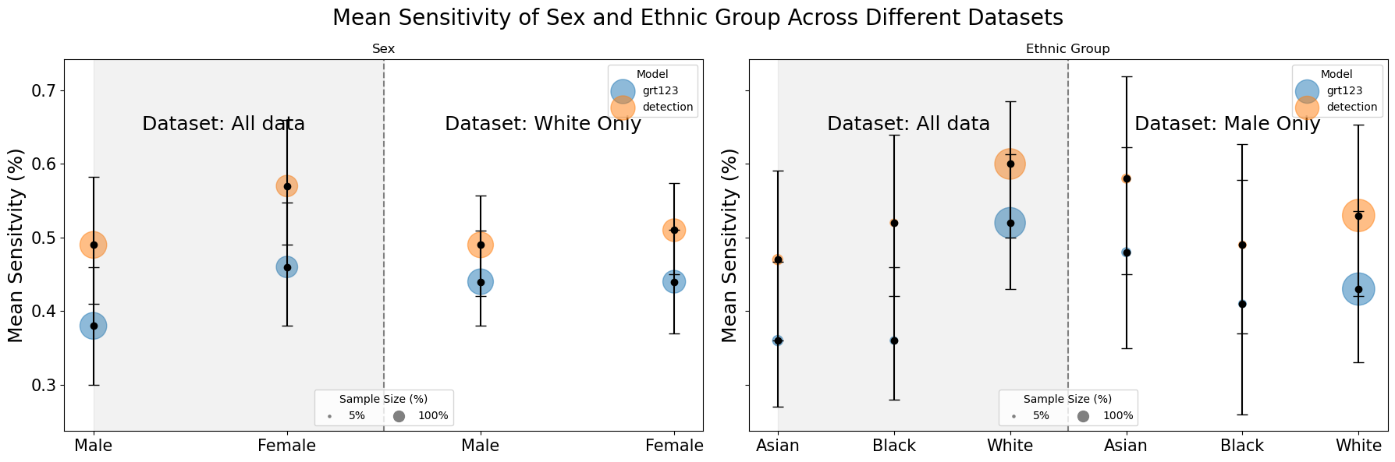




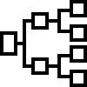
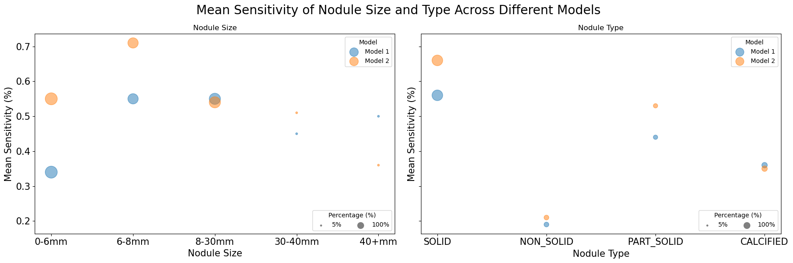



Exploring Fairness in State-of-the-Art Pulmonary
Nodule Detection Algorithms
Introduction
Results
Aim of lung cancer screening (LCS) is nodule detection
CADe increasingly used for efficiency
Training datasets are unbalanced for protected groups
Methods
Comparative analysis (groups & types of nodule)
Representative, LCS dataset i.e., unbalanced
Two SOTA nodule detection algorithms chosen
Avg. sensitivity @ 7 false positives per scan
Conclusion
Group performance is independent of training data size
Nodule detection is driven by the prevalence of subtypes in the data
Algorithm design influences the nodule detection profile

