Slide 1
Evaluation of Nodule Detection Algorithms
John McCabe, Nov 2023

Slide 2
Background
Most Lung Cancer Screening (LCS) programmes use some form of CADe to support Radiologists.
Modern CADe systems now use some form of deep learning (DL).
Performance of neural nets rely on large amounts of training data and in most cases struggle to generalize well.
Due to commercial competitiveness, model architecture and training data of CADe systems is kept secret.
Following work investigates generalisability of two publicly available state of the art (SOTA) nodule detection algorithms as proxies for commercial CADe systems.
Several papers have highlighted that DL models under-perform on protected groups due to the training data imbalance.
The SUMMIT dataset is imbalanced with regards to gender and ethnicity.
This work additionally investigates whether there is any variation in performance across these protected groups.

Slide 3
Objectives overview
Evaluate SUMMIT with data trained on LUNA16 to identify if there is a performance drop due to data drift between LUNA16 and SUMMIT.
Identify model sensitivity to being tuned for specific dataset by re-training models on SUMMIT data without changing any hyperparameters to.
Review performance for protected groups e.g. gender and ethnicity.

Slide 4
Methods
Public nodule detection algorithms are typically trained and evaluated against the LUNA16 dataset. The standard metric used to measure performance is FROC.
Select two publicly available SOTA nodule detection algorithms to act as proxies for commercial products.
Selection based on following criteria:
Published LUNA16 FROC score
One-time SOTA FROC score
Uses single timepoint
Code available
Models selected:
GRT123, winner Kaggle Data Science Bowl 2017
nnDetection implemented in MONAI
Infer results on SUMMIT validation datasets on models trained on LUNA16 data (use weights where available, otherwise retrain on LUNA16 data)
Train models on SUMMIT training dataset and re-run inference on validation dataset.
Filter results by protective groups to check relative performance based on naturally imbalanced SUMMIT dataset.
Re-train models on different subsets of SUMMIT training set to see effect of balancing protected groups.
Optimise model hyperparameters for SUMMIT dataset and evaluate performance.

Slide 5
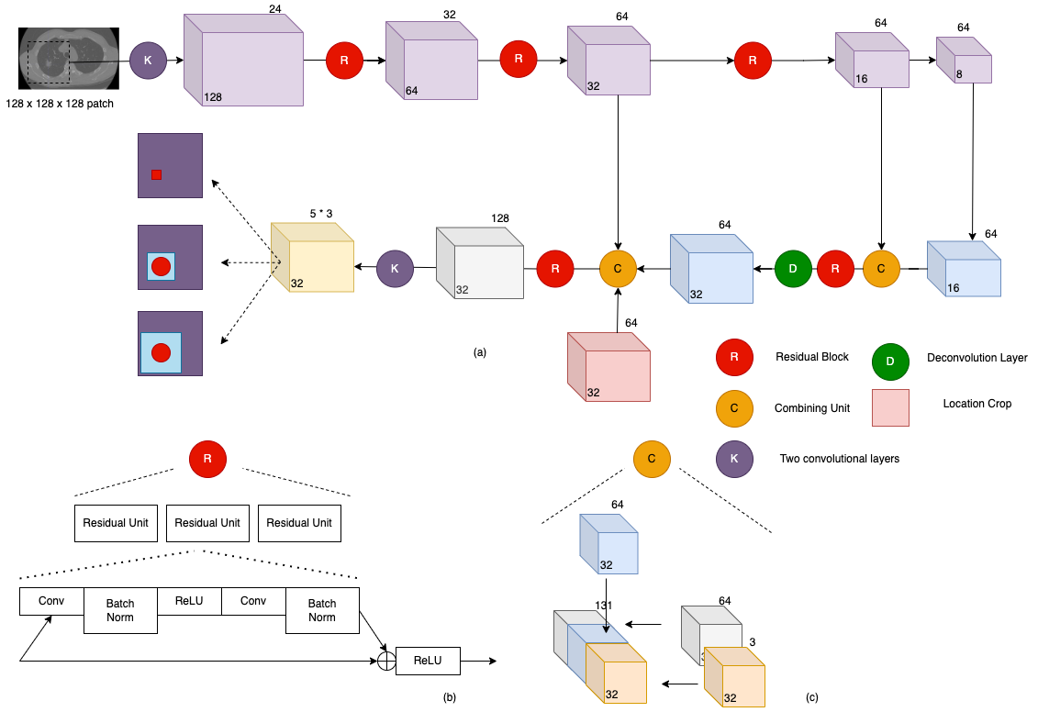
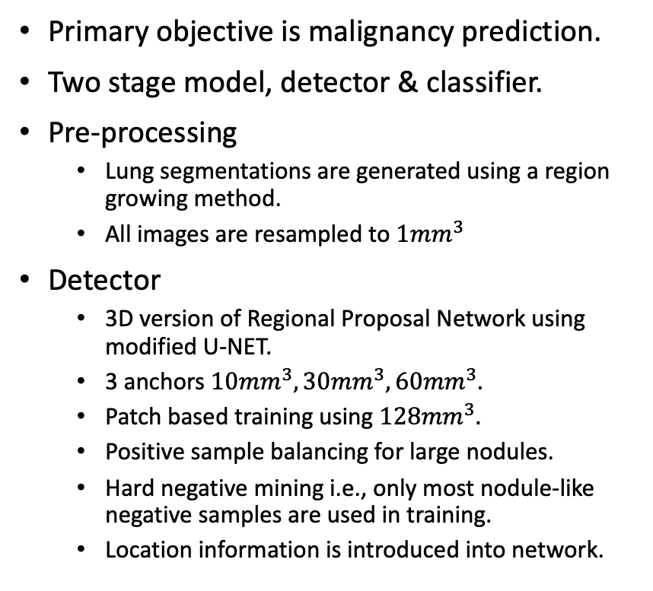
Models
GRT123
Primary objective is malignancy prediction.
Two stage model, detector & classifier.
Pre-processing
Lung segmentations are generated using a region growing method.
All images are resampled to ${1mm}^{3}$
Detector
3D version of Regional Proposal Network using modified U-NET.
3 anchors ${10mm}^{3}, {30mm}^{3}, {60mm}^{3}.$
Patch based training using ${128mm}^{3}.$
Positive sample balancing for large nodules.
Hard negative mining i.e., only most nodule-like negative samples are used in training.
Location information is introduced into network.
Nodule detection network. The figure inside the cube references spatial size and the figure top-right of the cube refers to the channels. (a) shows an overview of the network, comprising of a forward pass and a backward pass. (b) shows the composition of the residual blocks and (c) shows how the localisation block is concatenated into the network.

Slide 6
Models
nnDetection by Monai

Slide 7
Datasets
LUNA16
SUMMIT

Slide 8
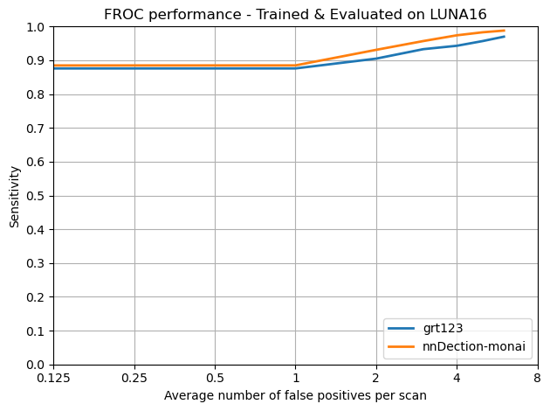
Results

