Slide 1
Fairness In Nodule Detection Algorithms – Outlier Influence on Statistical Comparison Tests
John McCabe, Sep 2024

Slide 2
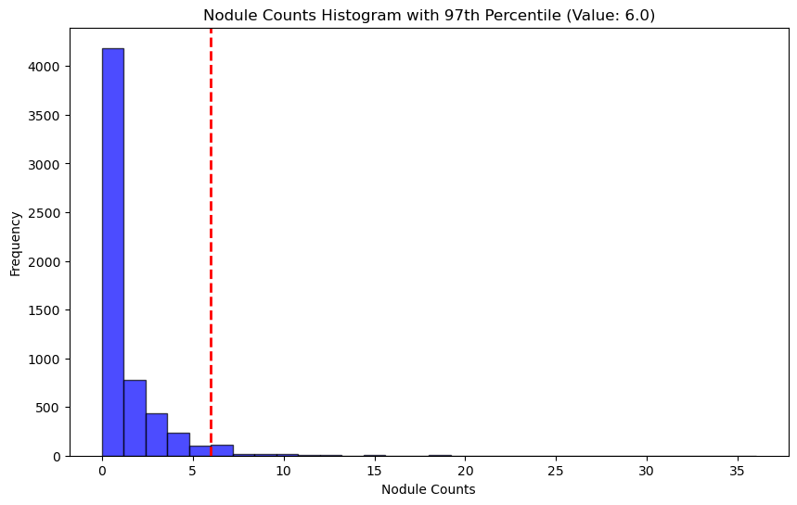
Nodule Count Per Scan Distribution – Outlier Definition
Scans with large numbers of nodules disproportionately influence FROC analysis
Compounded by bootstrapping
Following analysis explores impact on FROC with scans beyond 97th percentile removed

Slide 3
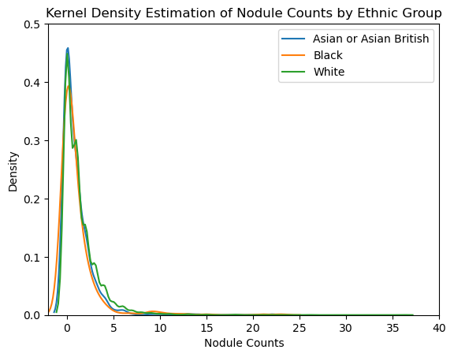
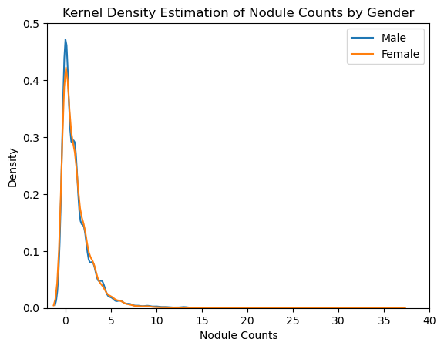
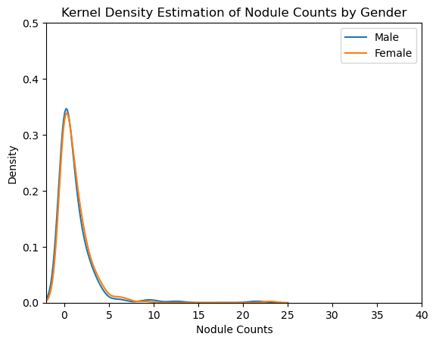
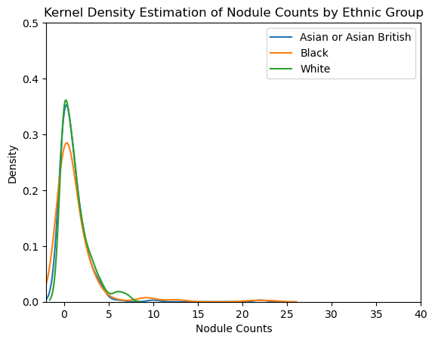
Nodule Count Distribution per Scan: A Comparison Across Protected Groups
Gender
Ethnic Group
All Sample
Asian … vs Black: p-value:0.9377
Asian … vs White: p-value: 1.3380e-05
Black vs White: p-value: 0.0005
p-value: 0.9315
Test Dataset
p-value: 0.8577
Asian … vs Black: p-value:0.3873
Asian … vs White: p-value: 0.3268
Black vs White: p-value: 0.8632

Slide 4
FROC Score Comparison – With and without Outliers
Model | Dataset | Protected Group | Category | Scans (Nodules) | CPM With outliers | Scans (Nodules) | CPM Without outliers
GRT123 | Test Balanced | All | All | 594 (699) | 0.45 (95% CI 0.41-0.49) | 581 (540) | 0.49 (95% CI 0.45-0.53)
 |  | Gender | MALE | 344 (400) | 0.44 (95% CI 0.38-0.5) | 335 (287) | 0.49 (95% CI 0.43-0.55)
 |  |  | FEMALE | 250 (299) | 0.48 (95% CI 0.42-0.55) | 246 (253) | 0.49 (95% CI 0.43-0.56)
 |  | Ethnic Group | Asian or Asian British | 198 (207) | 0.42 (95% CI 0.35-0.5) | 196 (175) | 0.43 (95% CI 0.36-0.51)
 |  |  | Black | 198 (250) | 0.42 (95% CI 0.35-0.51) | 190 (144) | 0.51 (95% CI 0.43-0.59)
 |  |  | White | 198 (242) | 0.52 (95% CI 0.45-0.58) | 195 (221) | 0.52 (95% CI 0.45-0.59)
Detection | Test Balanced | All | All | 594 (699) | 0.59 (95% CI 0.55-0.63) | 581 (540) | 0.61 (95% CI 0.56-0.65)
 |  | Gender | MALE | 344 (400) | 0.58 (95% CI 0.52-0.64) | 335 (287) | 0.61 (95% CI 0.54-0.67)
 |  |  | FEMALE | 250 (299) | 0.6 (95% CI 0.55-0.67) | 246 (253) | 0.61 (95% CI 0.55-0.68)
 |  | Ethnic Group | Asian or Asian British | 198 (207) | 0.58 (95% CI 0.49-0.66) | 196 (175) | 0.58 (95% CI 0.49-0.66)
 |  |  | Black | 198 (250) | 0.59 (95% CI 0.52-0.67) | 190 (144) | 0.65 (95% CI 0.57-0.73)
 |  |  | White | 198 (242) | 0.6 (95% CI 0.54-0.67) | 195 (221) | 0.6 (95% CI 0.53-0.67)
TiCNet | Test Balanced | All | All | 594 (699) | 0.55 (95% CI 0.5-0.6) | 581 (540) | 0.6 (95% CI 0.56-0.64)
 |  | Gender | MALE | 344 (400) | 0.54 (95% CI 0.48-0.61) | 335 (287) | 0.61 (95% CI 0.55-0.67)
 |  |  | FEMALE | 250 (299) | 0.56 (95% CI 0.49-0.64) | 246 (253) | 0.59 (95% CI 0.53-0.65)
 |  | Ethnic Group | Asian or Asian British | 198 (207) | 0.54 (95% CI 0.45-0.64) | 196 (175) | 0.58 (95% CI 0.5-0.65)
 |  |  | Black | 198 (250) | 0.51 (95% CI 0.43-0.59) | 190 (144) | 0.61 (95% CI 0.53-0.68)
 |  |  | White | 198 (242) | 0.61 (95% CI 0.54-0.68) | 195 (221) | 0.62 (95% CI 0.54-0.68)

Slide 5
FROC Score Comparison – With and without Outliers – Actionable Nodules
Model | Dataset | Protected Group | Category | Scans (Nodules) | CPM With outliers | Scans (Nodules) | CPM Without outliers
GRT123 | Test Balanced | All | All | 594 (230) | 0.47 (95% CI 0.4-0.55) | 581 (173) | 0.47 (95% CI 0.4-0.55)
 |  | Gender | MALE | 344 (120) | 0.45 (95% CI 0.35-0.55) | 335 (93) | 0.46 (95% CI 0.34-0.57)
 |  |  | FEMALE | 250 (110) | 0.5 (95% CI 0.4-0.6) | 246 (80) | 0.5 (95% CI 0.39-0.61)
 |  | Ethnic Group | Asian or Asian British | 198 (65) | 0.37 (95% CI 0.24-0.52) | 196 (52) | 0.36 (95% CI 0.23-0.52)
 |  |  | Black | 198 (62) | 0.47 (95% CI 0.34-0.61) | 190 (48) | 0.5 (95% CI 0.34-0.66)
 |  |  | White | 198 (103) | 0.53 (95% CI 0.43-0.64) | 195 (73) | 0.53 (95% CI 0.42-0.65)
Detection | Test Balanced | All | All | 594 (230) | 0.5 (95% CI 0.43-0.56) | 581 (173) | 0.5 (95% CI 0.42-0.58)
 |  | Gender | MALE | 344 (120) | 0.48 (95% CI 0.38-0.58) | 335 (93) | 0.47 (95% CI 0.36-0.58)
 |  |  | FEMALE | 250 (110) | 0.52 (95% CI 0.42-0.63) | 246 (80) | 0.53 (95% CI 0.42-0.64)
 |  | Ethnic Group | Asian or Asian British | 198 (65) | 0.42 (95% CI 0.29-0.56) | 196 (52) | 0.4 (95% CI 0.27-0.55)
 |  |  | Black | 198 (62) | 0.53 (95% CI 0.4-0.66) | 190 (48) | 0.57 (95% CI 0.41-0.73)
 |  |  | White | 198 (103) | 0.52 (95% CI 0.43-0.64) | 195 (73) | 0.53 (95% CI 0.43-0.63)
TiCNet | Test Balanced | All | All | 594 (230) | 0.51 (95% CI 0.44-0.58) | 581 (173) | 0.52 (95% CI 0.45-0.6)
 |  | Gender | MALE | 344 (120) | 0.52 (95% CI 0.42-0.62) | 335 (93) | 0.53 (95% CI 0.42-0.64)
 |  |  | FEMALE | 250 (110) | 0.52 (95% CI 0.42-0.61) | 246 (80) | 0.53 (95% CI 0.42-0.63)
 |  | Ethnic Group | Asian or Asian British | 198 (65) | 0.41 (95% CI 0.28-0.55) | 196 (52) | 0.41 (95% CI 0.28-0.57)
 |  |  | Black | 198 (62) | 0.51 (95% CI 0.39-0.64) | 190 (48) | 0.55 (95% CI 0.41-0.69)
 |  |  | White | 198 (103) | 0.58 (95% CI 0.47-0.69) | 195 (73) | 0.58 (95% CI 0.47-0.69)
Notes:
594 (230)
344 (120)
250 (110)
198 (65)
198 (62)
198 (103)

Slide 6
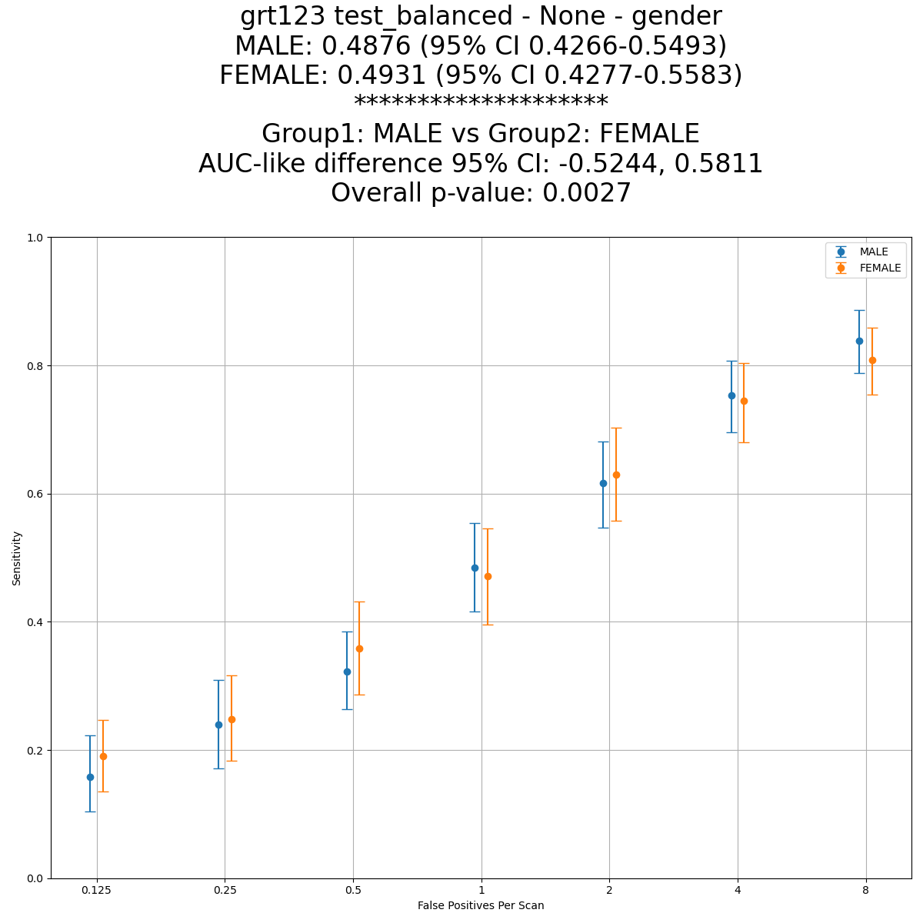
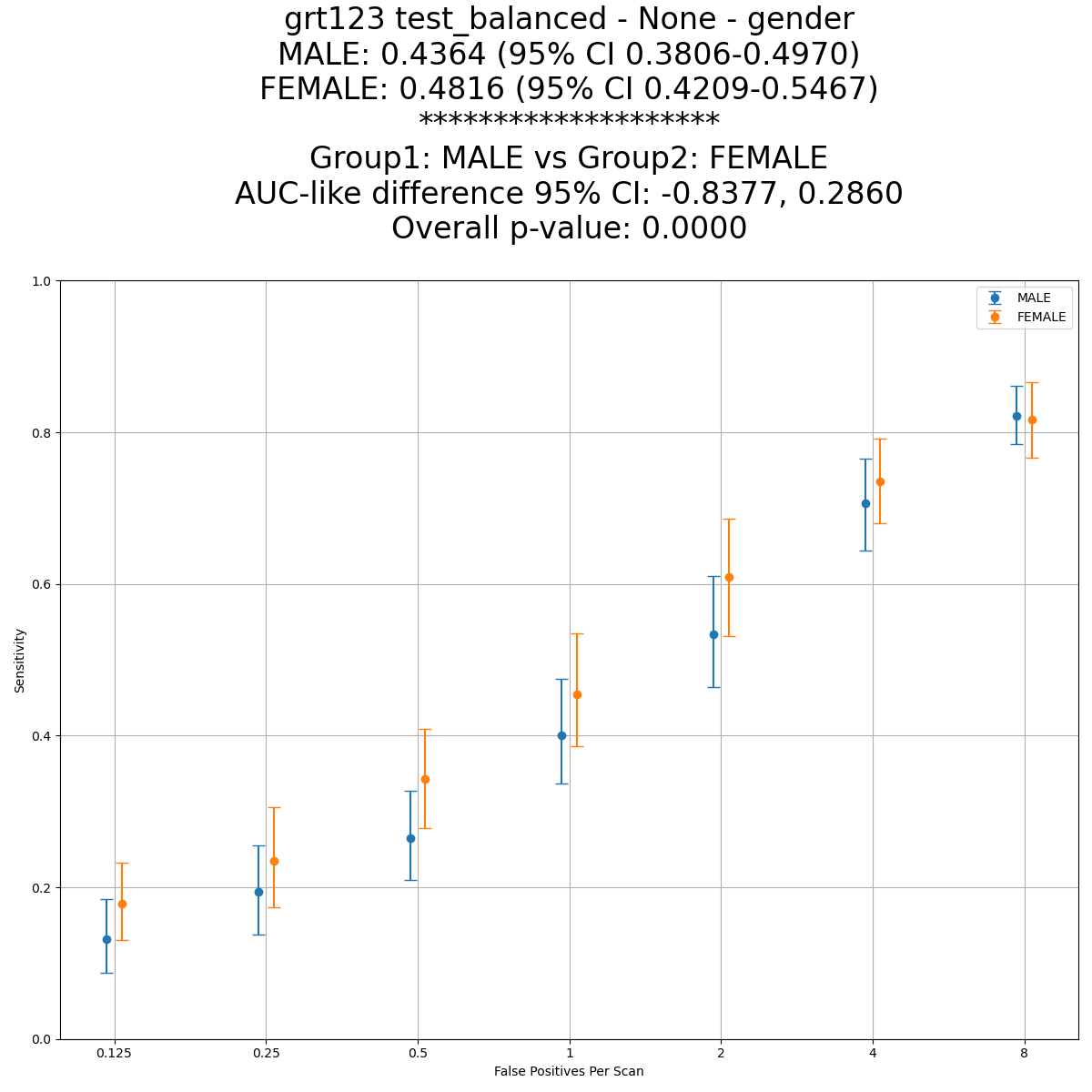
FROC Score Comparison – With and without Outliers: Model GRT123, Dataset: Test Balanced, Protected Group: Gender
With Outliers
Without Outliers

Slide 7
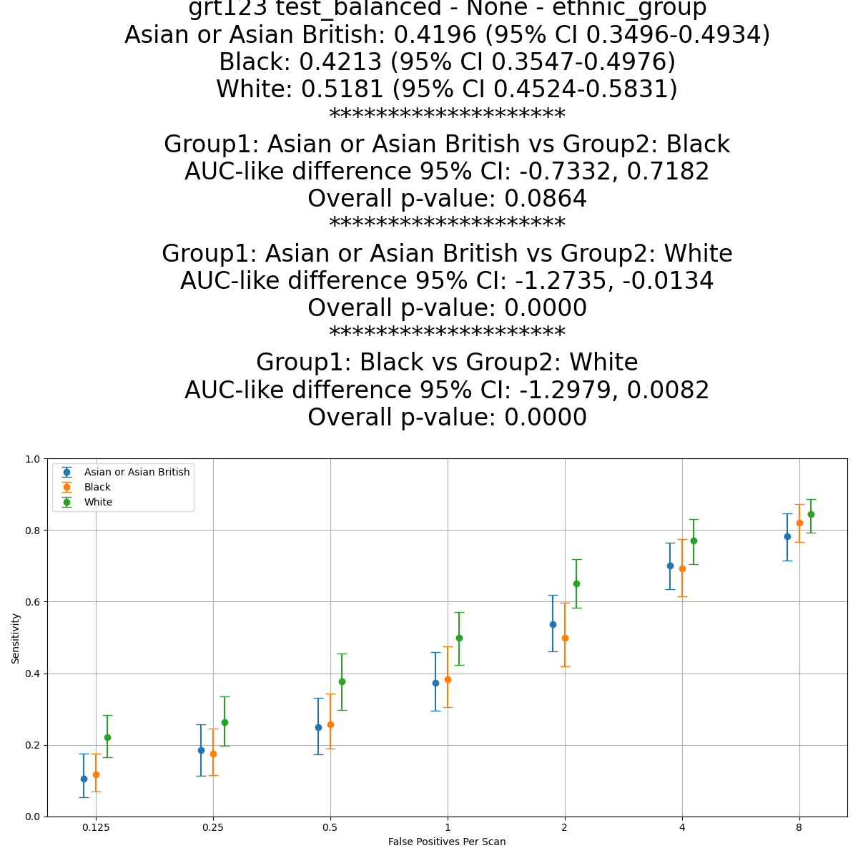
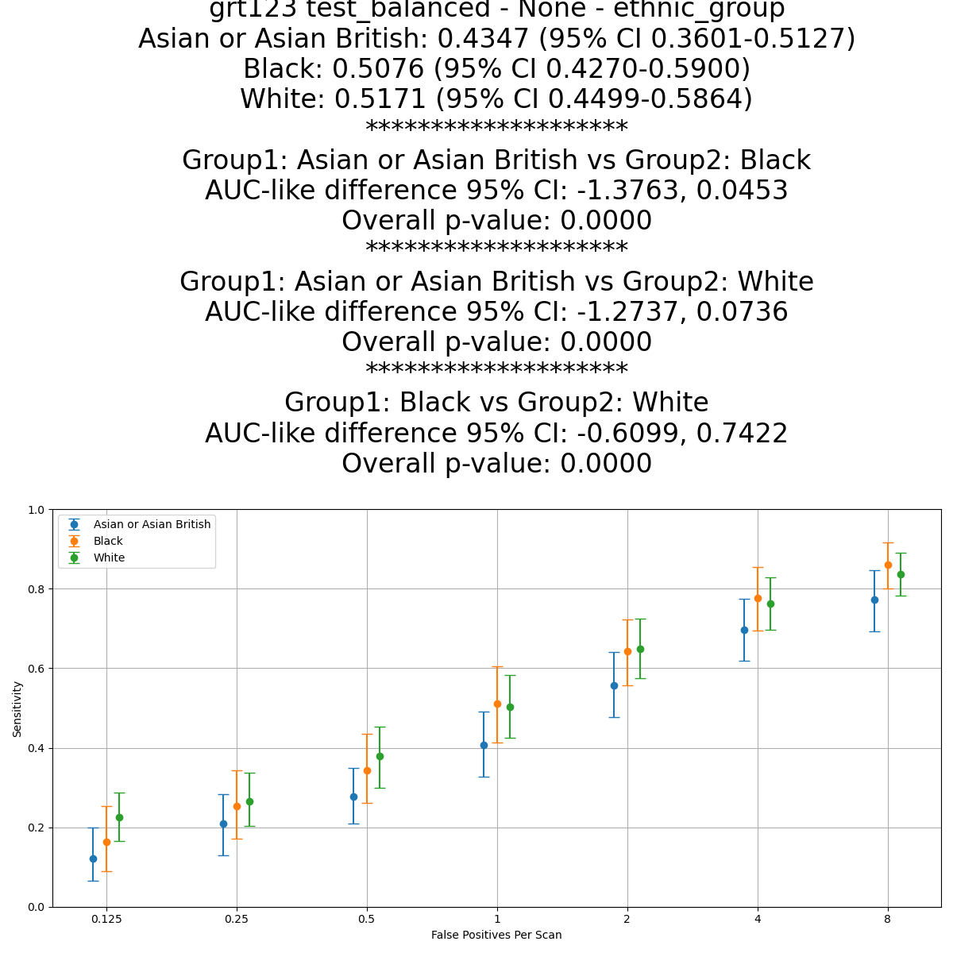
FROC Score Comparison – With and without Outliers: Model GRT123, Dataset: Test Balanced, Protected Group: Ethnic Group
With Outliers
Without Outliers

Slide 8
Conclusion
FROC Score Sensitivity
The FROC score, especially when using bootstrapping is highly sensitive to individual cases within the dataset
Scans with large numbers of nodules can have a significant impact on the overall CPM score
Influence on Statistical Significance Testing
Datasets with high-variance can result in contradictory results in statistical significance testing
Though p-value is low, the 95% CI difference often crosses zero implying observed differences are less likely to be significant
Future work
Careful consideration must be given to composition of Training, Validation and Test datasets
Influence of outliers must be considered

