Slide 1
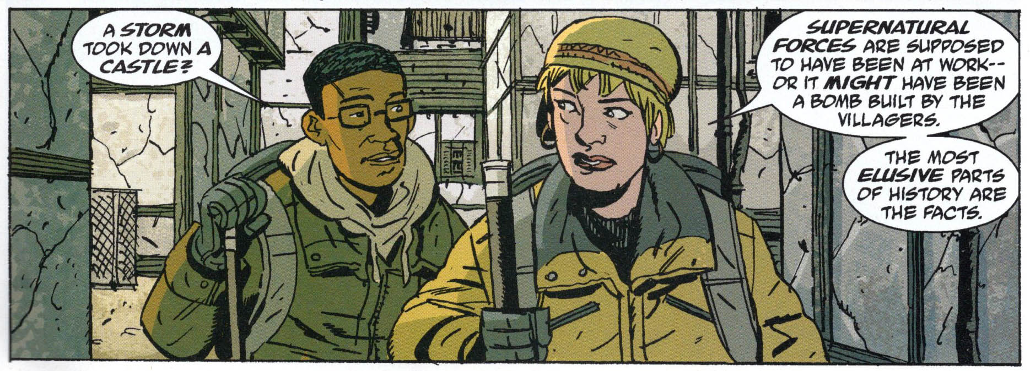
History and (in?) Comics
Some book recommendations for adults who like comics and history.
Who says comics cannot be serious?
Can history be told in comics?

Slide 2
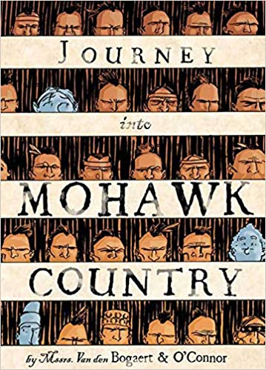
A graphic novel adaptation of the journal of Harmen Meyndertsz van den Bogaert, a 22 year old Dutch trader who, during the winter 1634-1635, travelled from the Dutch colony of New Netherland deep into New York State
Bogaert, H. M. v. d., & O'Connor, G. (2006). Journey into Mohawk County (1st ed. ed.).
New York: Syracuse University Press.

Slide 3
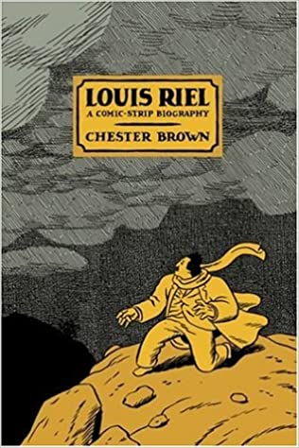
This award-winning Canadian bestseller tells the story of the charismatic, and perhaps mad, nineteenth century Métis leader, whose struggle to win rights for his people led to violent rebellion on the nation's western frontier.
Brown, C. (2003). Louis Riel : a comic-strip biography (1st hardcover ed.). Montréal,
Canada: Drawn and Quarterly.

Slide 4
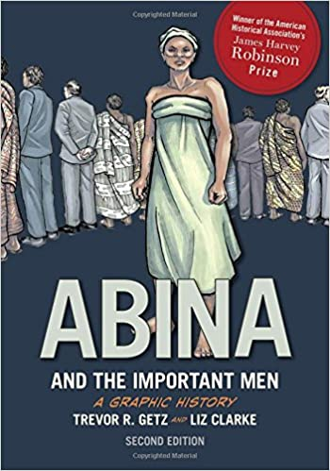
Winner of the James Harvey Robinson Prize from the American Historical Association, and widely acclaimed by educators and students, Abina and the Important Men, is a compelling and powerfully illustrated "graphic history" based on an 1876 court transcript of a West African woman named Abina, who was wrongfully enslaved and took her case to court.
Getz, T. R., & Clarke, L. (2012). Abina and the important men : a graphic history (1st ed.).
New York: Oxford University Press.

Slide 5
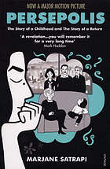
This text tells the story of Marjane Satrapi's life in Tehran from six to 14, years that saw the overthrow of the Shah's regime, the triumph of the Islamic Revolution & the devastating effects of war with Iraq. Satrapi paints a portrait of daily life in Iran & of the bewildering contradictions between home life & public life.
Satrapi, M. (2008). Persepolis: The story of a childhood and the story of a return.
London: Vintage.

Slide 6
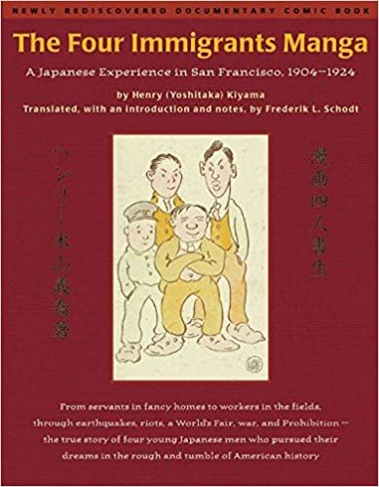
From servants in fancy homes to workers in the fields, through earthquakes, riots, a World's Fair, war, and Prohibition--the true story of four young Japanese men who pursued their dreams in the rough and tumble of American history.
Kiyama, H. Y. (1999). The four immigrants manga : a Japanese experience in San Francisco,
1904-1924. Berkeley, Calif.: Stone Bridge Press.

Slide 7
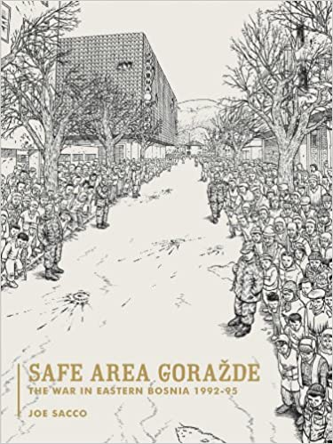
Comic strips reveal the lives of those living in the Muslim enclave of Gorazde during the Bosian war, describing how they survived Serbian attacks that left them without access to the outside world, electricity, or running water.
Sacco, J. (2011). Safe area Goražde (Special ed.). Seattle, WA.: Fantagraphics.

Slide 8
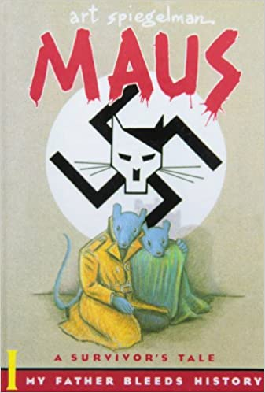
The author describes the Holocaust experiences of his father, Vladek Spiegelman, from youth and marriage in pre-war Poland imprisonment in Auschwitz.
Spiegelman, A. (2011). Maus : a survivor's tale (25th anniversary edition ed.). New
York: Pantheon Books.

Slide 9
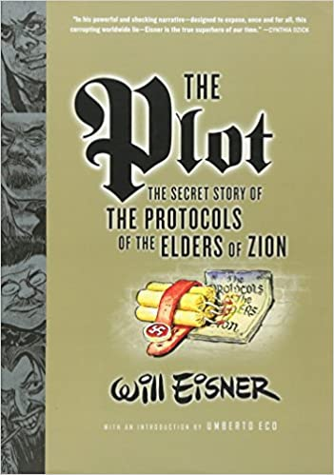
Examines the fabrication of The Protocols of the Elders of Zion, which purports to be the actual blueprint by Jewish leaders to take over the world. This work exposes the twisted history of the Protocols from nineteenth-century Russia to modern-day Ku Klux Klan members to Islamic fundamentalists.
Eisner, W. (2006). The plot: The secret story of 'The Protocols of the Elders of Zion’.
London: W W Norton & co. ltd.

Slide 10
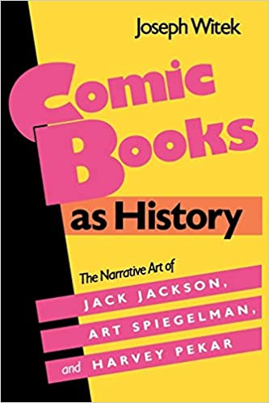
Offers a focused and perceptive analysis of a phenomenon in our popular culture - the new respectability of the comic book form - and argues that the comics medium has a productive tradition of telling true stories with grace and economy.
Witek, J. (1990). Comic books as history: The narrative art of Jack Jackson, Art Spiegelman, and Harvey Pekar. Jackson, Miss: Univ. Press of Mississippi.

