Slide 1
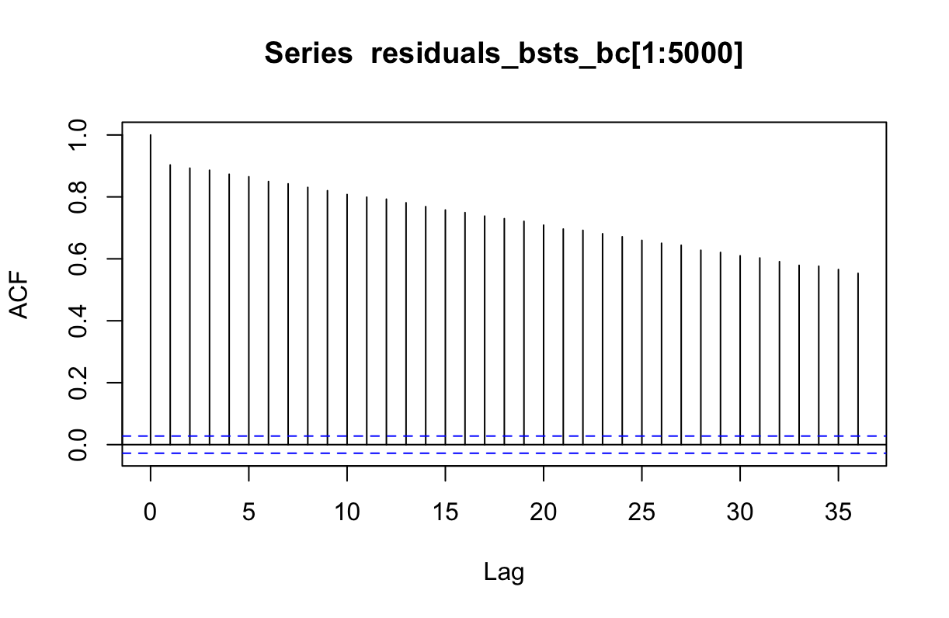
ACF Plot of BSTS Box-Cox Differenced Model Residuals

Slide 2
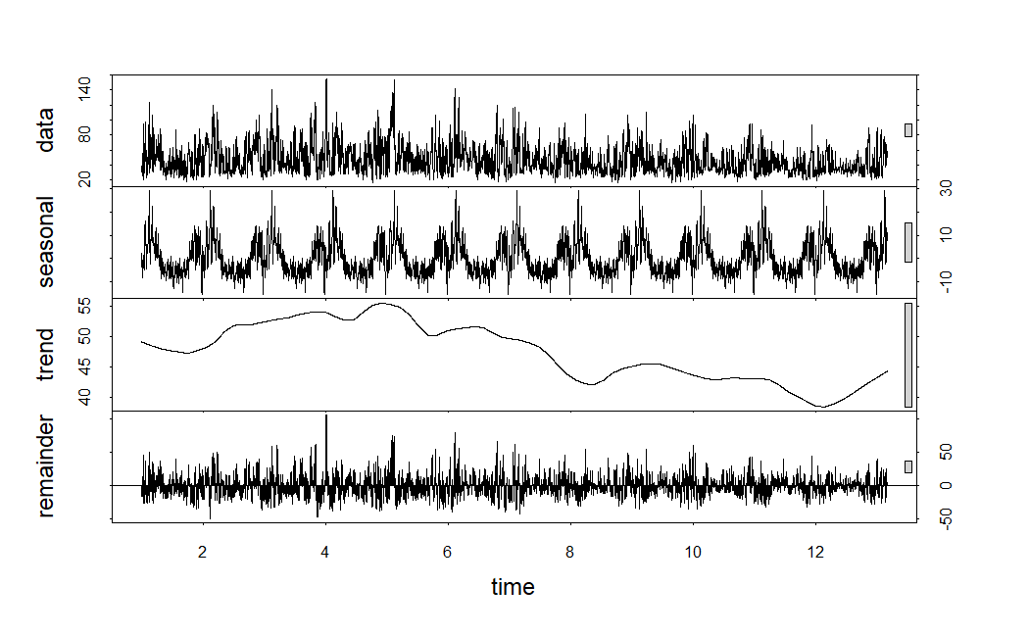
STL Decomposition

Slide 3
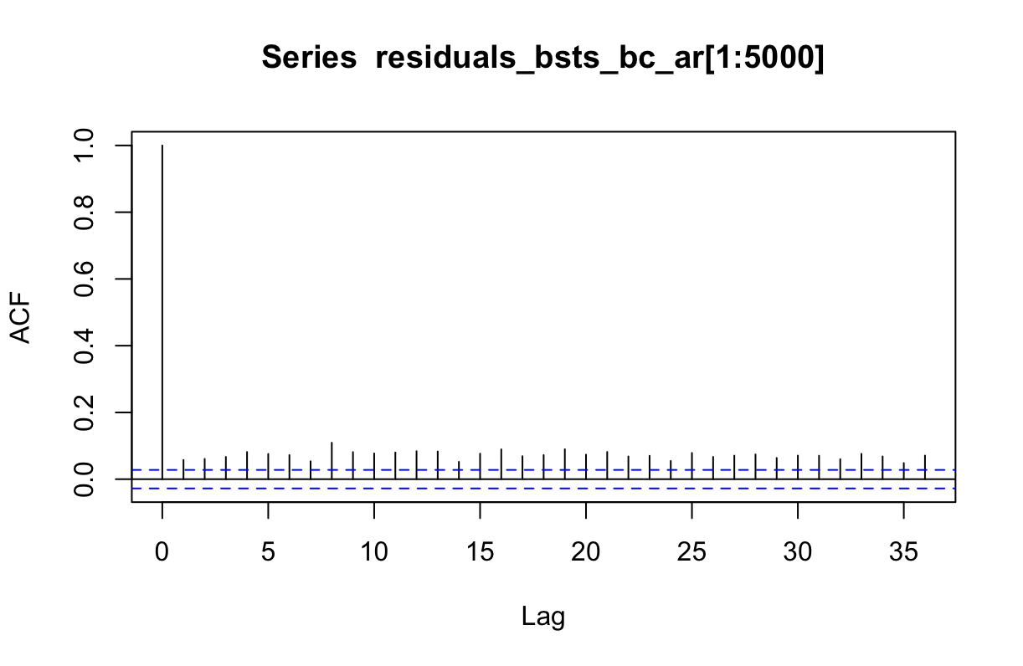
ACF Plot of BSTS Box-Cox Differenced AR(2) Model Residuals

Slide 4
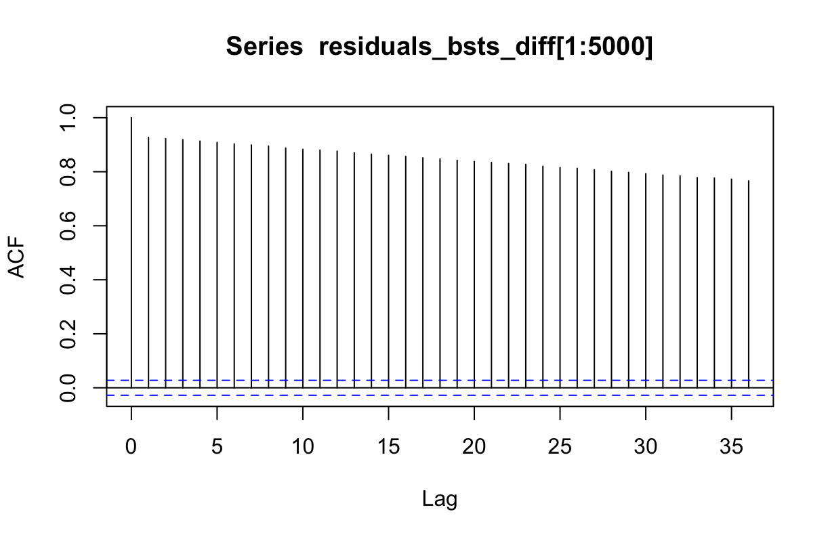
ACF Plot of BSTS First-Order Differenced Model Residuals

Slide 5
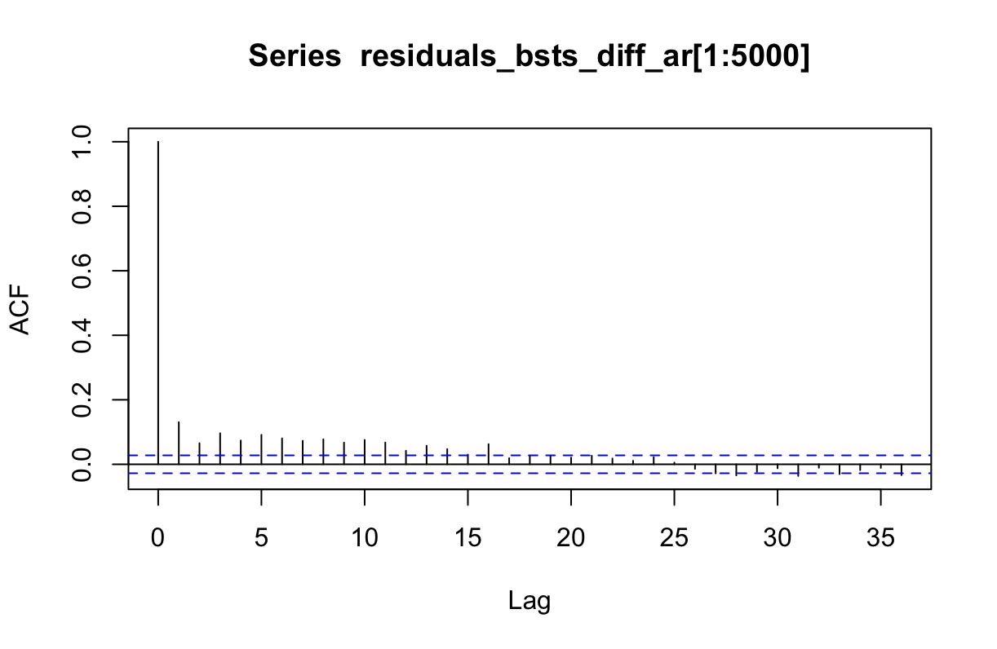
ACF Plot of BSTS First-Order Differenced AR(5) Model Residuals

Slide 6
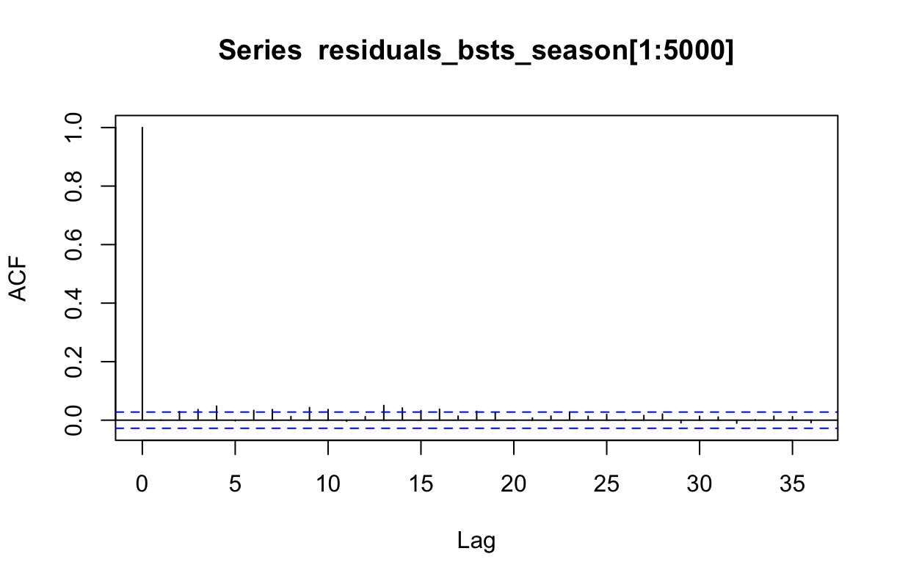
ACF Plot of BSTS Seasonal Differenced Model Residuals

Slide 7
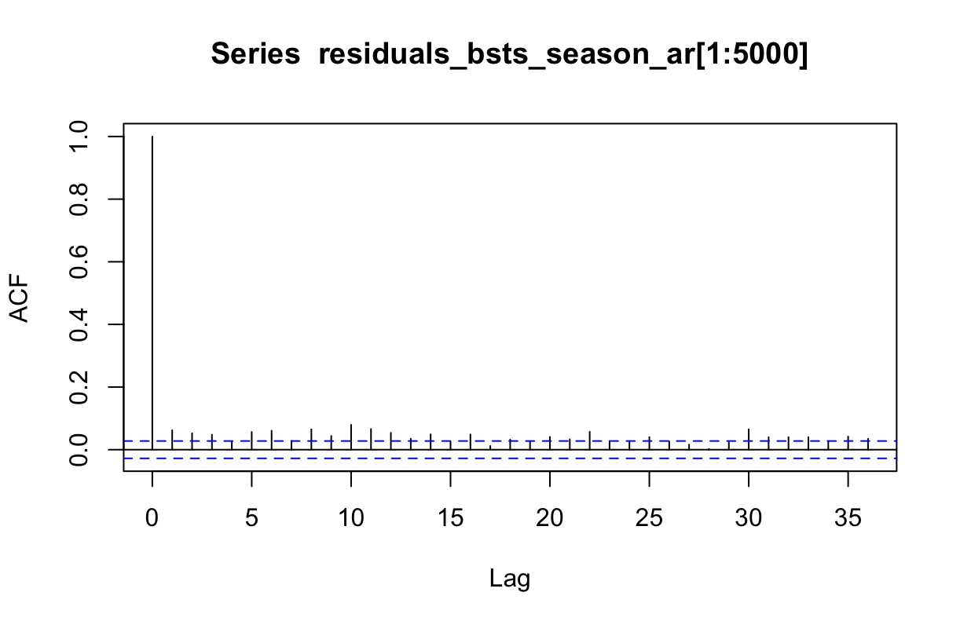
ACF Plot of BSTS Seasonal Differenced AR(5) Model Residuals

Slide 8
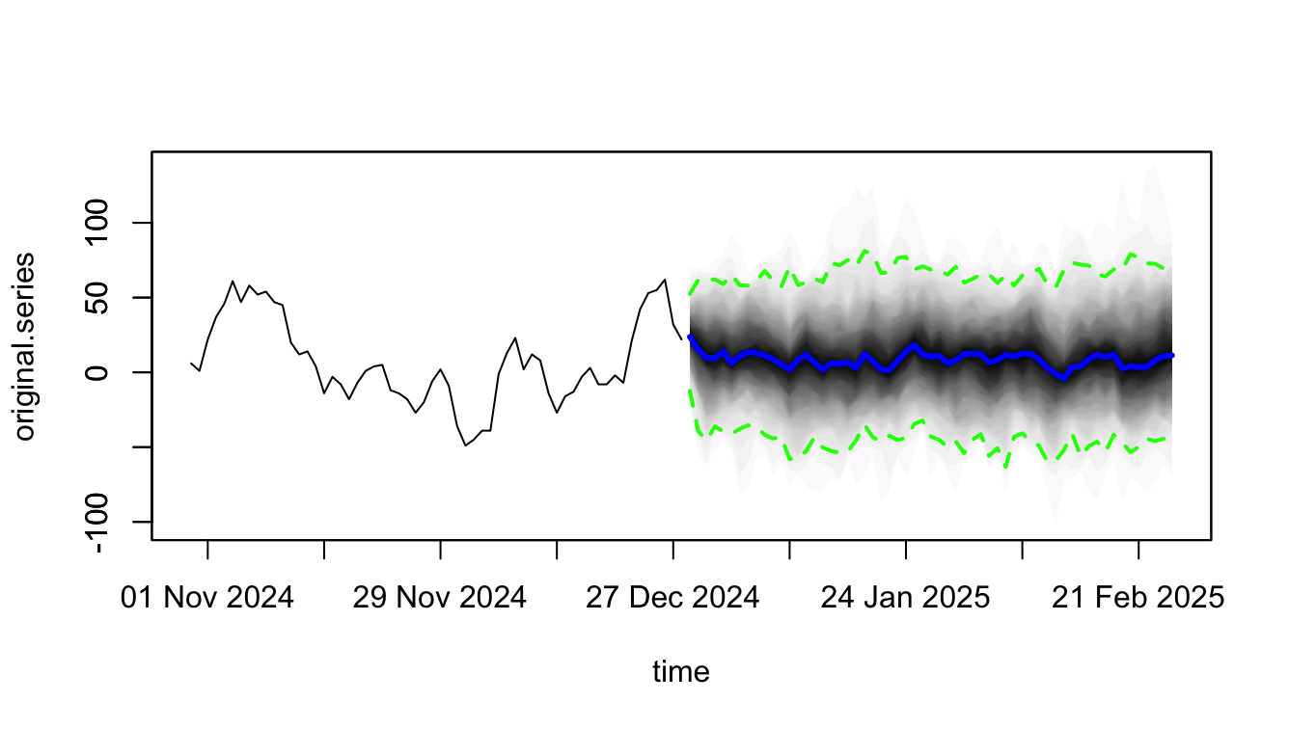
BSTS Seasonal Differenced AR(5) Model Forecast
AQI

