Slide 1
Improving communications with community pharmacies
Cheryl Way,
Pharmacy and Medicines
Management Lead
17/7/14

Slide 2
Recommendations from the evaluation of the DMR service
“Electronic access to improved quality discharge information was highlighted by community pharmacists, hospital pharmacists and General Practitioners as the key to the smooth and safe transition of the patient from the hospital into the community. The efficient processes and therefore the uptake of the DMR scheme would be greatly enhanced by this, providing that patient consent issues have been addressed”

Slide 3
Medicines transcribing and e-discharge project (Mted)
A medicines transcribing and e-discharge system developed by NWIS and C&V in consultation with users
It is part of the Welsh Clinical Portal (WCP)
It produces electronic information about medicines on transfer or discharge to primary care
It is sent to GP practices via the Welsh Clinical Communications Gateway (WCCG)
It could be shared more widely e.g. with community pharmacists

Slide 4
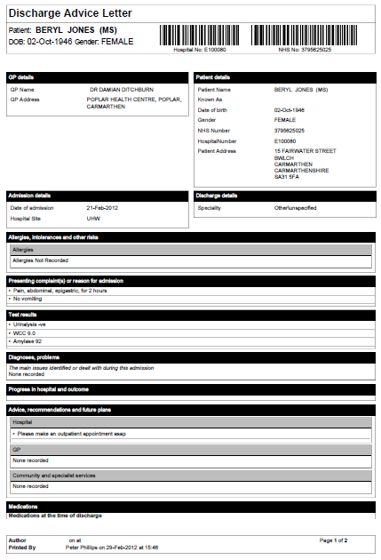
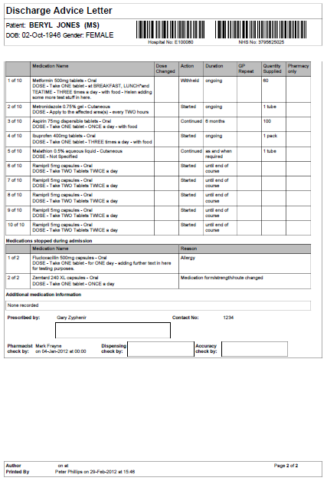
Medicines transcribing and e-discharge (Mted) DAL

Slide 5
W G Health Technology and Telehealth Funded (HTTF) Project
Will build on Medicines transcribing and e-discharge (Mted) project in Welsh hospitals
Electronic Discharge Advice Letter (DAL) is created and stored on NWIS servers
Plan is to allow community pharmacists secure access to view their patients’ DALs on the server
Methods being investigated for
ascertaining which pharmacy the patient wishes to use
possible registration with pharmacy/pharmacist e.g. CAS
obtaining patient consent to share information
notifying pharmacists of discharge

Slide 6
W G Health Technology and Telehealth Funded (HTTF) Project
Plan to pilot in Choose Pharmacy sites in Cwm Taf and
Betsi Cadwalladr Health Boards
Use similar technology to the Common Ailments Service
(CAS)
Will improve secure connectivity to NHS Wales network
Dependent on Mted implementation in these areas for
pilot
Cardiff and Vale also been invited to be included in the
pilot as they already have Mted in place on some wards

Slide 7
Wales Information Governance Board (WIGB)
“The Board agreed to continue to support the development of the electronic Discharge Advice Letter for community pharmacies. The Board asked to be kept updated with progress in relation to:
Content of the discharge advice letter
Patient consent
Access controls and auditing of access”.
WIGB minutes 10th April 2013
Update planned for October 2014 meeting

Slide 8
Research 2013-14 in Wales - NWIS/Cardiff University
Questionnaire to all community pharmacies in Wales on required contents of DAL
over 50% response rate
will be used to draft requirements
MSc project with patient and public focus groups
across Wales
ascertained what information patients and public were happy to share with community pharmacists
asked about awareness of DMR service

Slide 9
HTTF Project progress
Project Sponsor – Roger Walker, WG
Project Manager – Laurence James, NWIS
Project Board Chair – Karen Eveleigh, WG
Clinical Reference Group Chair – Andrew Evans
Project team met once, meeting again next week
Project brief drafted
Pilot end of 2014-15

Slide 10

Questions?

