Slide 1
Weather Analysis Walkthrough & Conclusion
This presentation will include an analysis of Texas weather across five years: 1940, 1950, 1951, 1960, 1970
The last slide will have conclusions that I have drawn from the data

Slide 2
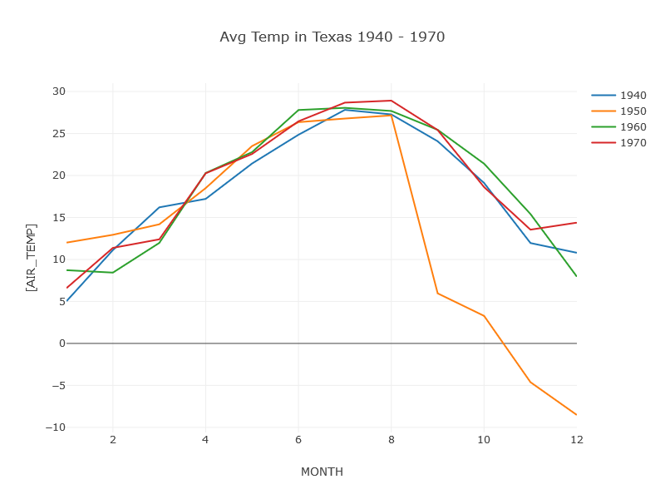
Texas Average Temperature (1940,1950,1960,1970)
The average air temperature in Texas per month has not varied significantly in 1940, 1960, and 1970.
However there is a major drop in average air temperature from month 8 to month 9 of 1950 that continues through the end of the year. Lets take a look at 1951 to see if the low temperatures continue.

Slide 3
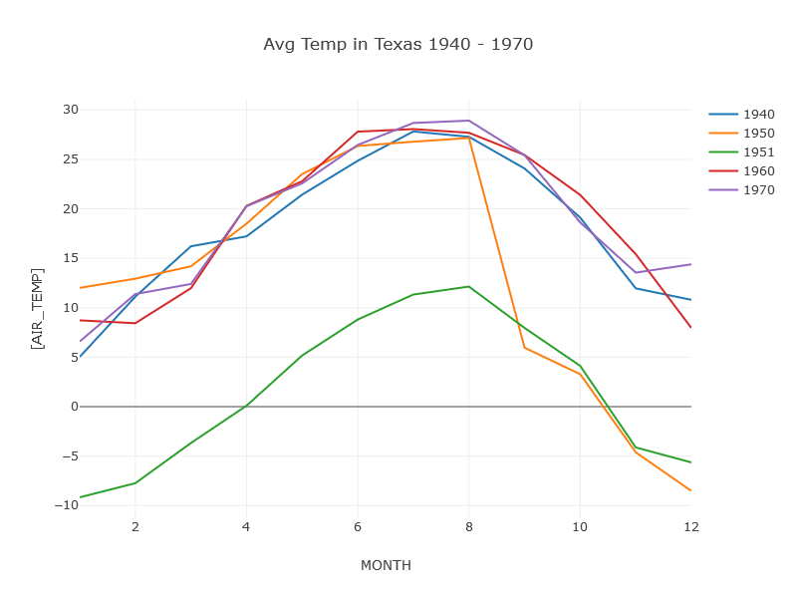
Texas Average Temperature (1940,1950, 1951, 1960,1970)
Now we have added the year 1951 to our line chart we can see that the average air temperatures for 1951 are approximately 17 degrees Celsius lower than the average air temperatures for 1940, 1960, and 1970.
It seems that the state of Texas had experienced a cold front from mid 1950 to at least the end of 1951. Next lets take a look at some aspects of that weather.

Slide 4
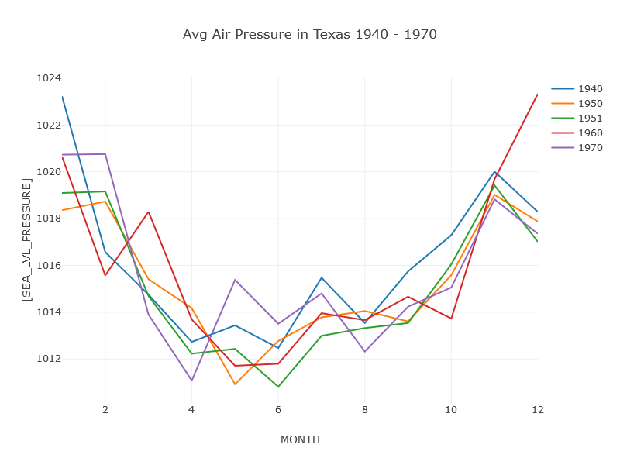
Average Air Pressure
Air pressure is generally a factor in what type of weather an area is experiencing, with low pressure systems contributing to rain and high pressure systems contributing to fair weather.
The average air pressure for all five years is close to one atmosphere, or 1000 Hectopascals. This means that there were infrequent high and low pressure systems in Texas so the weather was between fair and rainy.

Slide 5
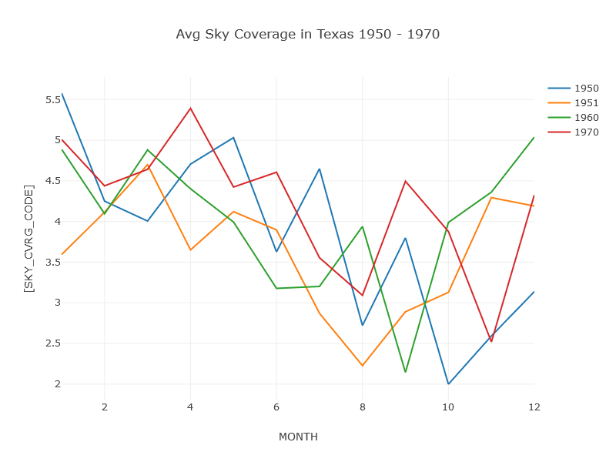
Sky Coverage (1950,1951,1960,1970)
The sky codes state what level of cloud cover existed at a certain point in time.
On average, the four years had 3/10 to 4.5/10 obscuration of the sky, with cloud cover generally decreasing in the mid months.
The year 1950 had the highest amount of cloud cover in months 3, 5, 11, and 12.
The year 1951 had the highest cloud cover in months 1, 3, 11, and 12.

Slide 6
Air Temperature and Cloud Coverage
An interesting but weak trend I noticed is that generally the average temperature for a month increased as the same month’s cloud coverage decreased.

Slide 7
Conclusion
After analyzing the weather dataset for Texas in the later half of 1950 and all of 1951 I can conclude that:
Texas experienced a significant drop in air temperatures
The average air pressure was close to one atmosphere, so there were infrequent high and low pressure systems in that time period
On average there was about 3/10 to 4.5/10 of cloud coverage each month.

