Slide 1
Lunar Landers Project Description
Group 12 - Dan Hrubec, Julian Gonzales, Jake DiStefano, John Mistica

Slide 2
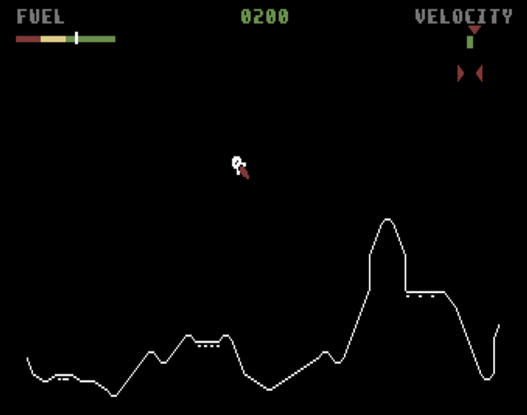
Project Overview
Lunar Landers is a multiplayer extension of the classic arcade game Lunar Lander
Players compete with one another to land their spacecraft in the landing zone first, and try to prevent others from doing so
New features such as lunar wind and creatures will make the experience more challenging than its singleplayer origin

Slide 3
Purpose of the Project
This product is not catered to businesses, but rather individual gamers. These gamers only seek to gain entertainment from the product, not profit
The developers and storefronts which sell the game will seek to make a profit off of sales
The goal of this project is to entertain the players, and to offer players a challenge to share with their friends or others they find online
We can measure this by observing the amount of matches a user plays over time, and see how long it captures their interest

Slide 4
Scope of Work
The work addressed with this product would be the entertainment of people by challenging one another in video games
Currently there are many games that allow players to challenge each other
Many current games are either expensive or difficult to learn
The space multiplayer combat genre specifically usually has a large barrier to entry
Games that force players to compete with one another in short challenges are not uncommon
Many recent Battle Royale games also cater to the same players we aim to capture

Slide 5
Scope of the Product
The work handled by the product would be to create an environment where players can pick up and play the game
Our product would need to have a strong server established to allow client connections and create matches for players to play
There are several scenarios in which people would use the product
People playing for fun: Most players will be attracted to the game for its easy controls and will be playing the game for fun and to relax
People playing competitively: More experienced players will want to compete with other experienced players to be the best
People playing alone: Some people will not want to play with others, and can play the game alone and give more of an arcade game feel

Slide 6

Stakeholders
The developing organization will act as the client since the project will have the same features for every customer
The customers are any sort of person interested in engaging, simple competitive games
The consumer will be responsible for installing and updating the product
All server updates, bugs or glitches, and patches will be the organization's responsibility

Slide 7
Relevant Facts and Assumptions
Feedback and data gathered from customer play will be utilized by the developing organization
It will be used to determine player engagement and success in entertainment
It will be used for game balance, to determine which aspects of the game are not fun or otherwise not engaging to interact with
An assumption will be made that players can play with each other regardless of the platform they play on
To encourage the multiplayer aspect of the game, while not burdening the consumer to have to restrict themselves to one platform to play with others
This will restrict the capabilities of the game to the weakest platform available

