Slide 1
Lunar Landers
Group 12: Jacob DiStefano, Dan Hrubec, Julian Gonzales, John Mistica

Slide 2
Lunar Landers Project Description
Lunar Landers is a multiplayer extension of the classic arcade game, Lunar Lander
Multiple players compete to land in the same area, contending to see who can land first while preventing others from doing so
The game also includes multiple hazards not present in the source materials, such as wind and wildlife
Users will be able to queue into quick matches, lasting no longer than two minutes
Matches can also be played locally with friends, or a party can be formed to queue into an online match
Statistics from each game will be accumulated on the server side, and stored, and can be accessed by the user
This data will also be available to the user, and will be used to place users on a global leaderboard

Slide 3
Design Goals
Simplicity and Ease of Use are the core design goals to be optimized around for the game
The minimal controls and two dimensional gameplay must be simple so users can catch on quickly and have fun without investing too much time on learning mechanics
The user interface must be simple and easily interpretable so users can easily navigate menus and queue for games
Variety during gameplay is another core design aspect to be optimized
During map generation each map should be unique, so the player never plays the same map twice
Stage Hazards such as wind should make gameplay varied while not frustrating players
The Queueing/Matchmaking system should match players with a varied set of players, to encourage new players to play together

Slide 4
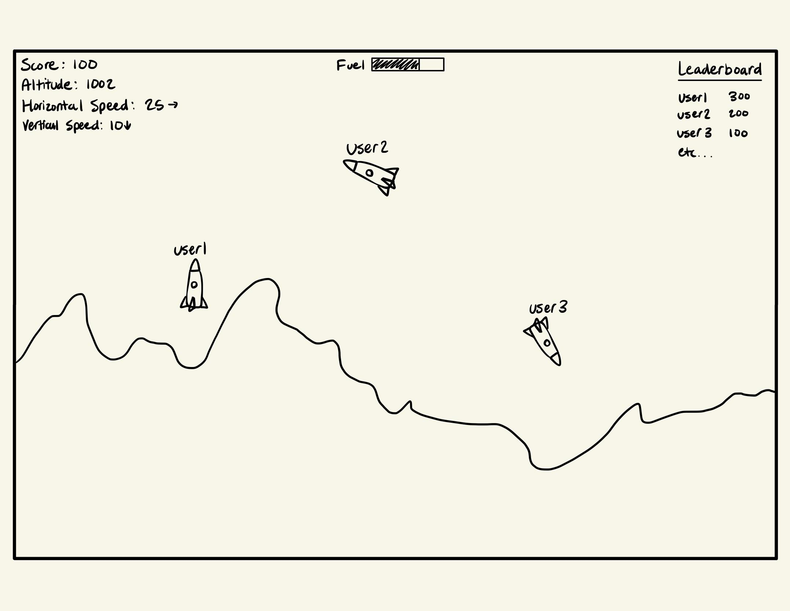
User Interface

Slide 5

System Architecture
The game will use common system Architecture of a client-server relation.
When the players load into the game queue, it will try to on a port than the server has open.
Once enough players join in, a match will be created and the players can begin.

Slide 6
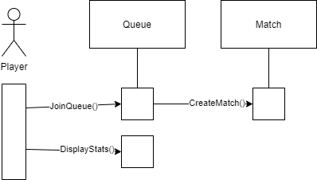
Dynamic Model of Use-Case
Diagram depicts the standard use case of a casual matchmaking.
Main difference in competitive matchmaking is the queue will have to wait for players around the same skill rating rather than simply waiting for enough players.

Slide 7
Initial Subsystem Decomposition
Client: This component is responsible for the user interface as well as utilizing resources to send players into the queue.
Server: This component connects the players from the queue into an actual match. The server has an open port in which the players connect to when finding a match.
Game/Match: This component is the actual game, which has a seed and generates a new map accordingly. Players all connect and interact with each other on this match and map.
Queue: This component pertains to the server, and listens in on a port. Depending on the type of match being played, will either wait for enough players and send them into a game, or waits for enough players within the same skill rating to send them into a match.
Statistics: This component displays all of the players statistics both in game and out of game. Statistics in game pertain to data about the map, for example the players position on the map, and out of game displays total games played, win percentage, and rating.

Slide 8
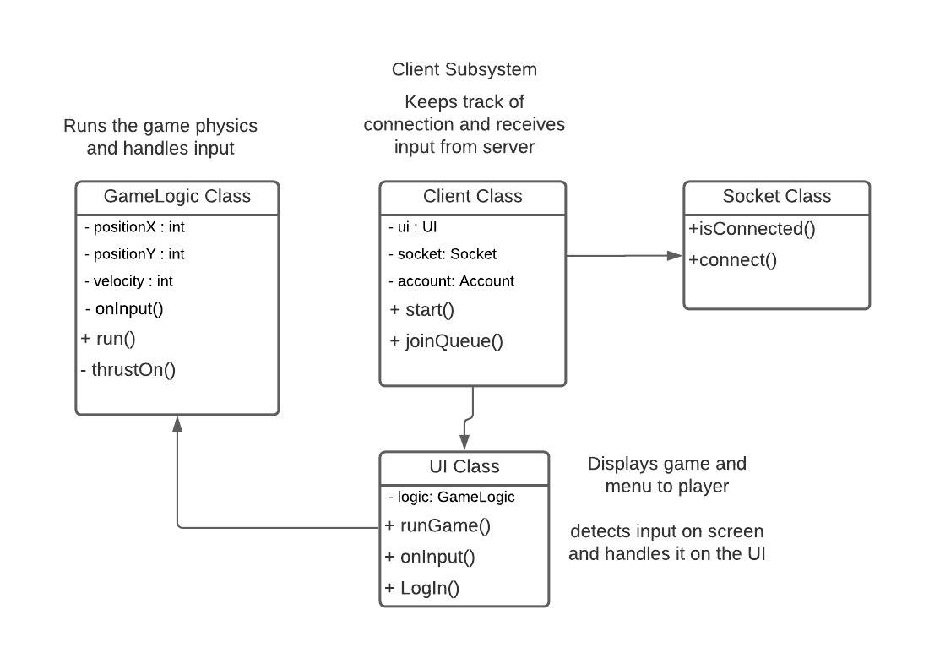
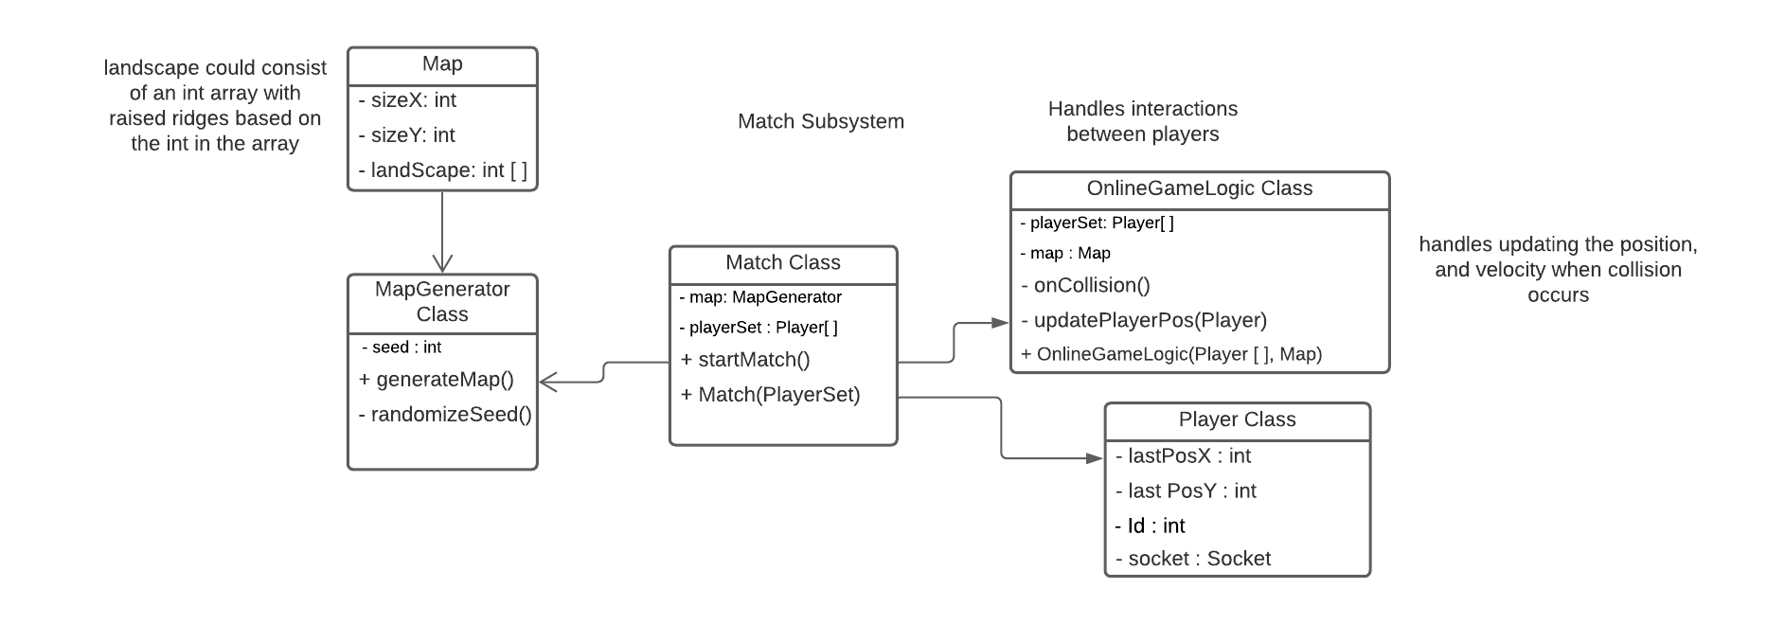
Subsystem Design

Slide 9
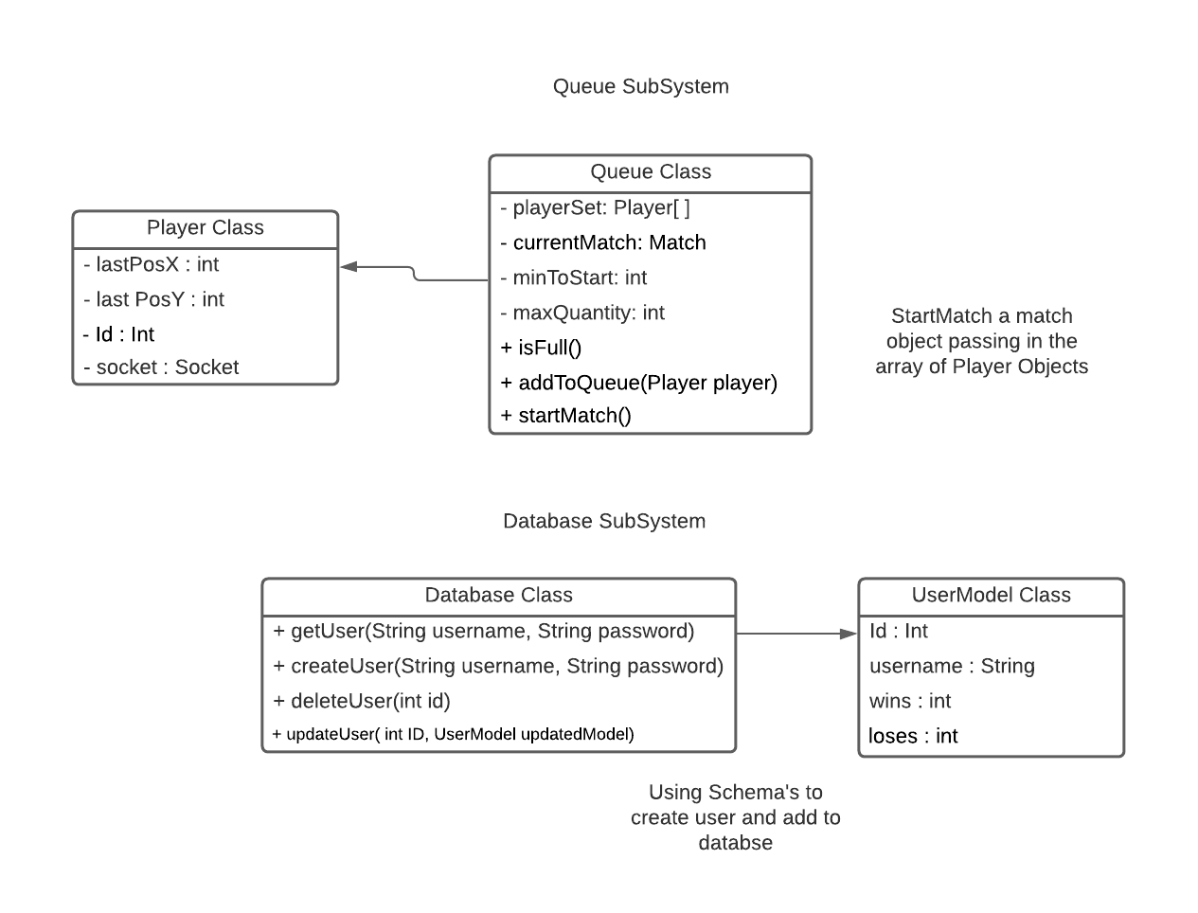
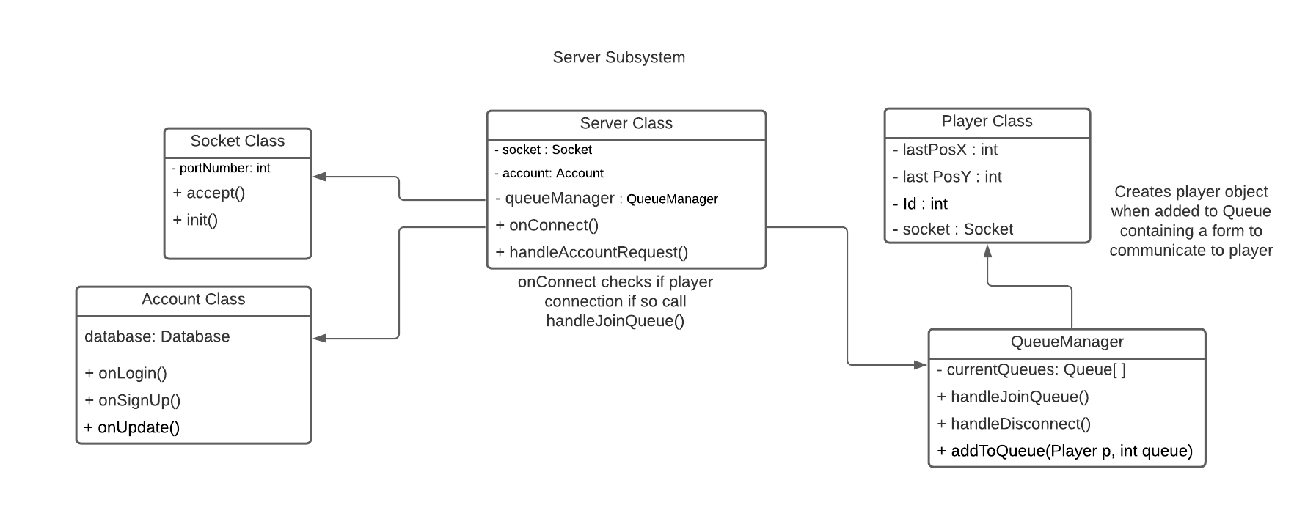
Subsystem Design

Slide 10
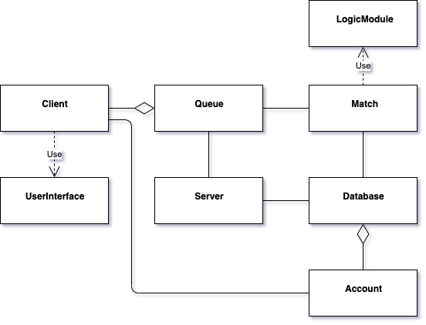
Final System Design

