Slide 1
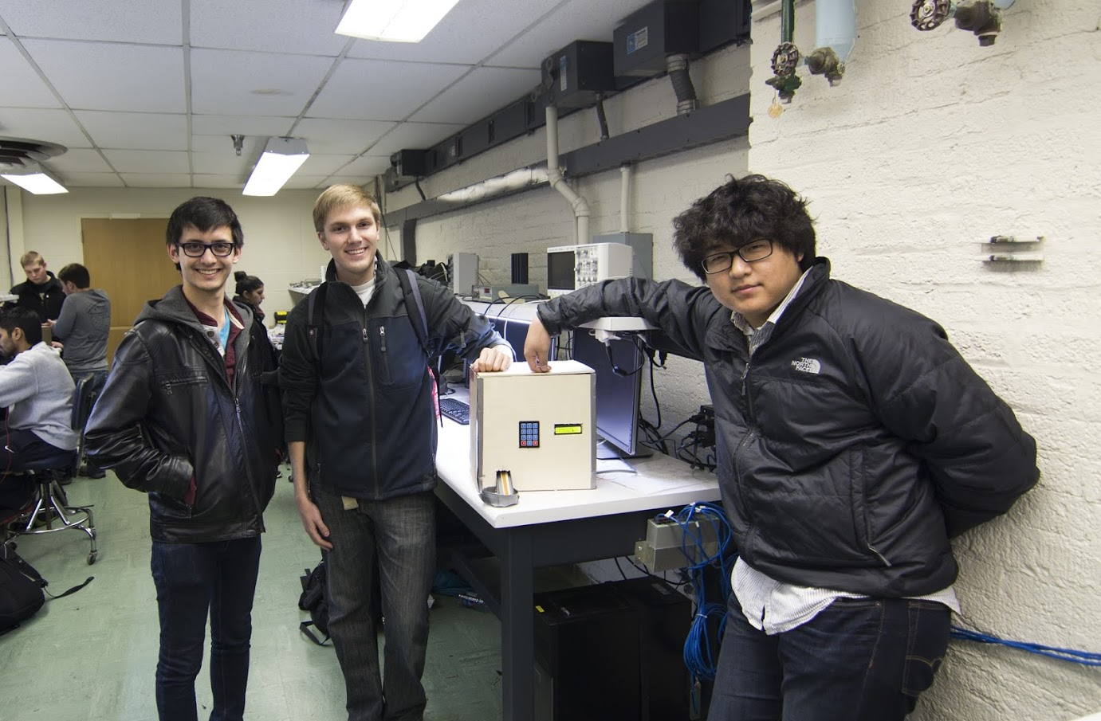
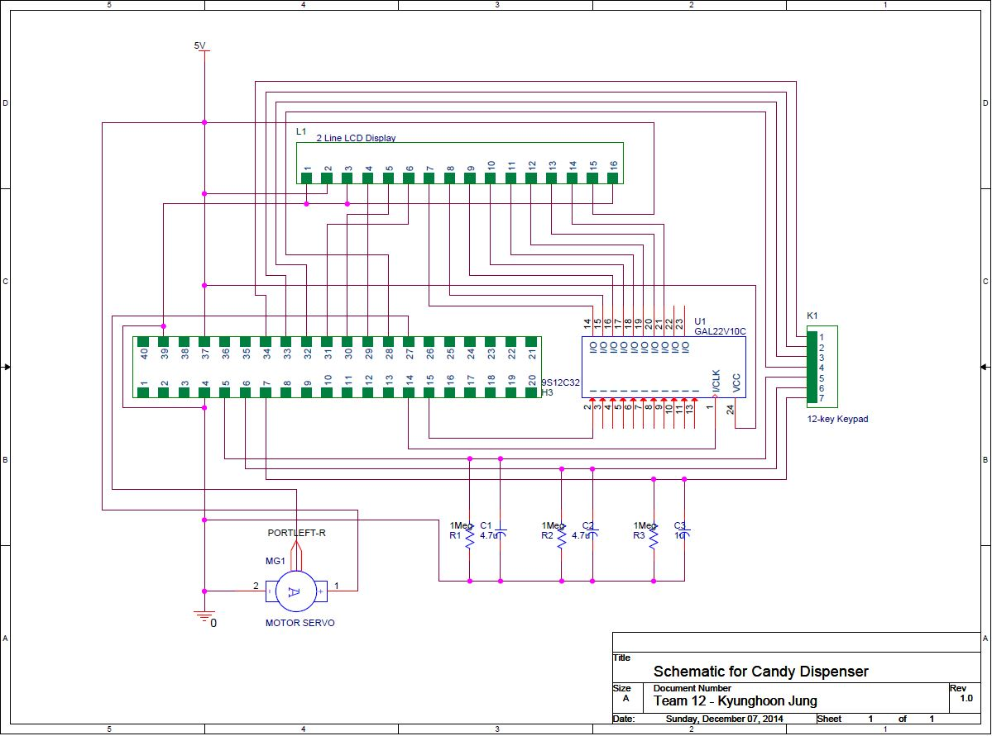
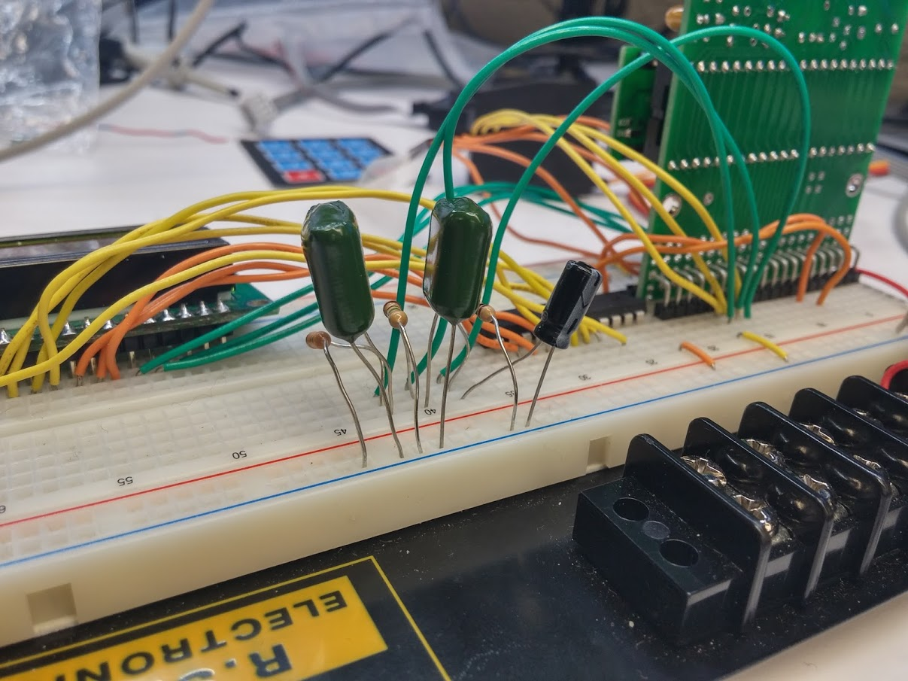

ECE 362 Embedded Microcontroller Mini-Project − Fall 2014
Team 12 / Candy Dispenser
https://www.youtube.com/watch?v=JPPdzIhSHxg&feature=youtu.be
Electrical Schematic for the Candy Dispenser
Text used should be a minimum of 36-point (bold)
Leave background WHITE (no color)
Digijock(ette)-Strength Digital System DesignTM

