Slide 1
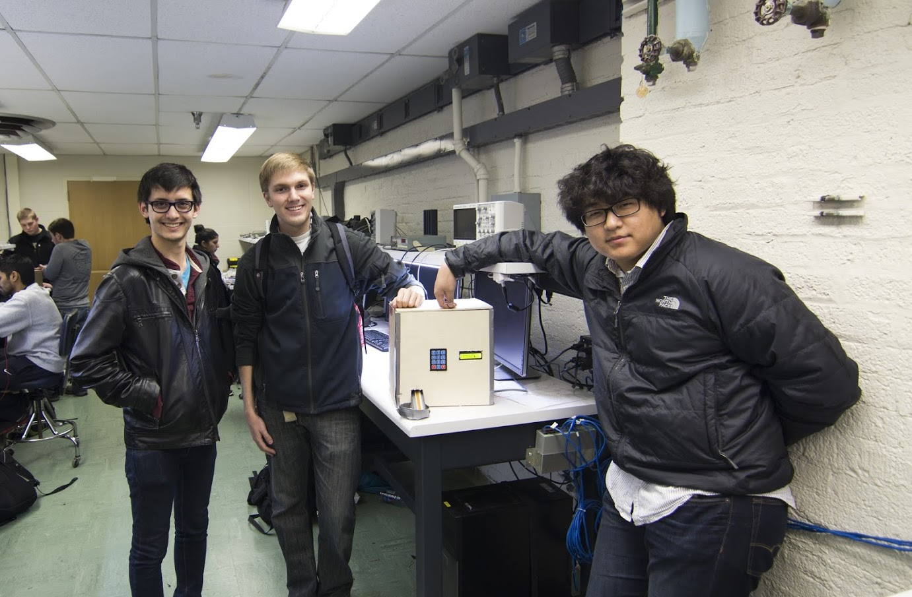
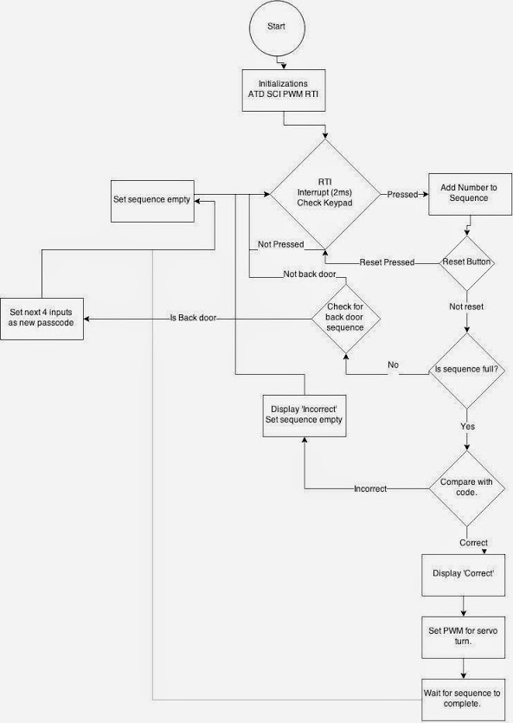
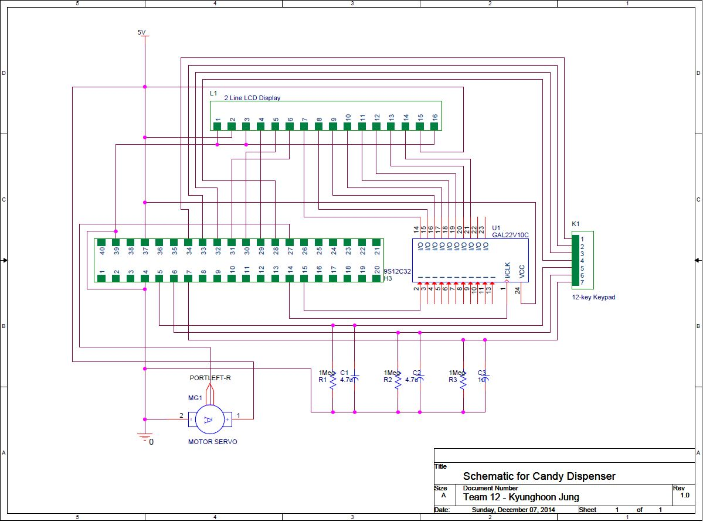
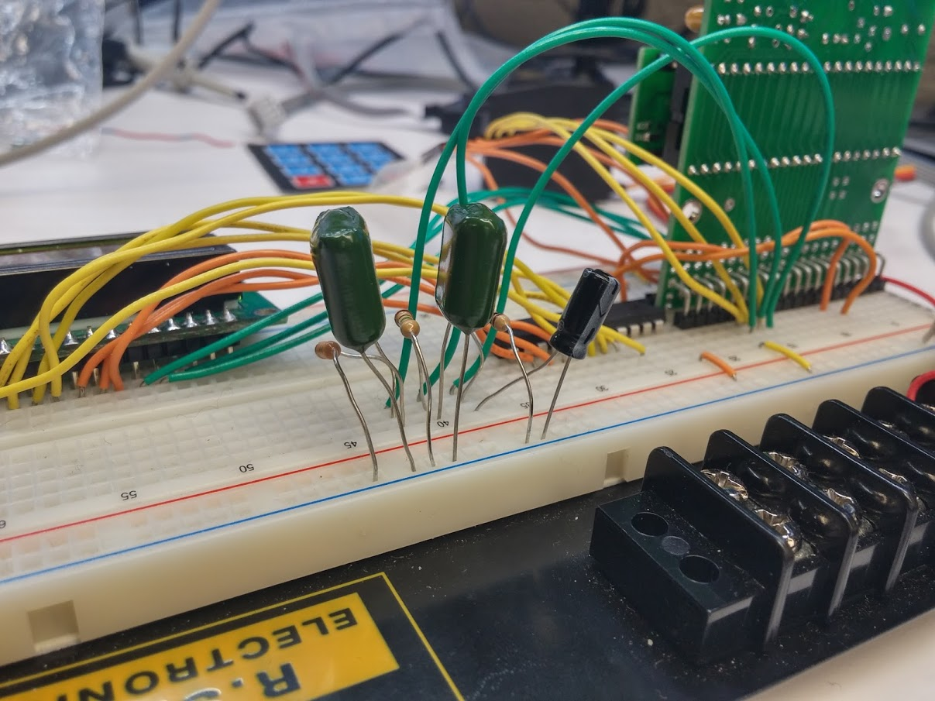

ECE 362 Embedded Microcontroller Mini-Project − Fall 2014
Team 12 / Candy Dispenser
https://www.youtube.com/watch?v=JPPdzIhSHxg&feature=youtu.be
Electrical Schematic for the Candy Dispenser
Peripherals: RTI: Inputs of the keypad ATD: Controlled the columns of the keypad PWM: Rotated the motor SPI: Displayed messages on the LCD screen
The purpose of this project was to create a safe environment to store candy without the fear of other people taking any. This was done using a keypad lock code, and LCD for instructions, and a motor to control the dispensing of the candy. Upon initialization the user is told by the LCD to input the PIN code. If the code is entered in correctly the motor will activate, and the candy will flow from its secure position inside to the user outside.
Software Flowchart
Electrical Circuit in Action
Digijock(ette)-Strength Digital System DesignTM

