Slide 1
Alarm Bot
John Lee

Slide 2

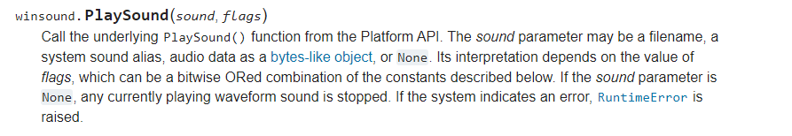
Tagline
Make a straightforward yet useful alarm app with Python in Visual Studio Code.
Finding source code that meets my demands is difficult
Change in focus: Perhaps the software doesn't need to be so specialized
Roadblocks
ambiguous error codes difficulties integrating the "datetime" library average lack of experience

Slide 3
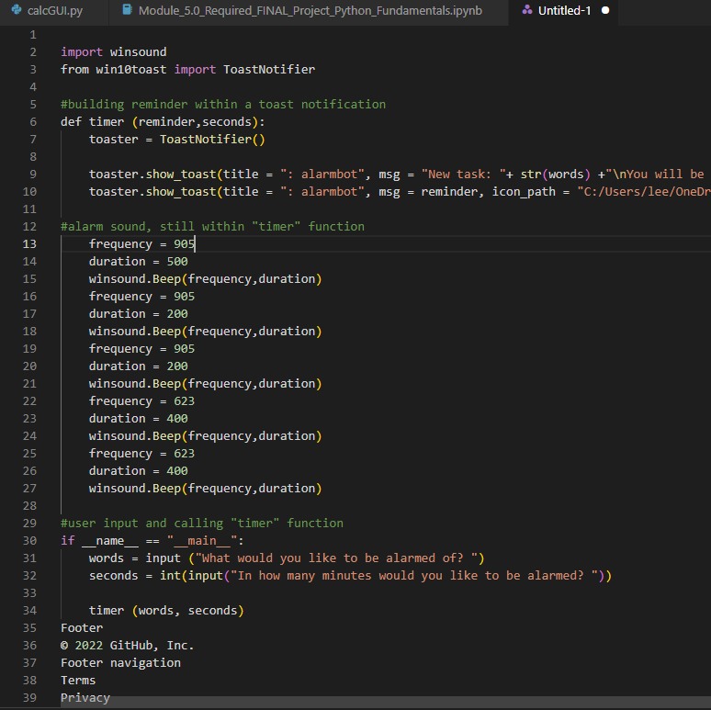
Screenshot

