Slide 1
Kable’s Mill Annual Meeting
November 12, 2025

Slide 2
Annual Meeting 2024
Welcome & Introductions
President: John Banford
Treasurer: Scott Umina
Member at Large: John Montavon
Towne Properties Manager: Leslie Backus
Towne Properties Assistant: Susan Hedgecoth

Slide 3
Agenda – November 12, 2025
I. Call to Order 7:00 PM
II. Establishment of a Quorum
III. Proof of Notice
IV. Treasurer’s Report
a. Collection policy
b. 2024-year end financial report
b. 2025 projected year end report
V, President’s Report
VII. Open Discussion
VIII. Adjournment

Slide 4
Annual Meeting – Treasurer’s Report
Collection Policy
2) 2025 Projected Year End Report

Slide 5
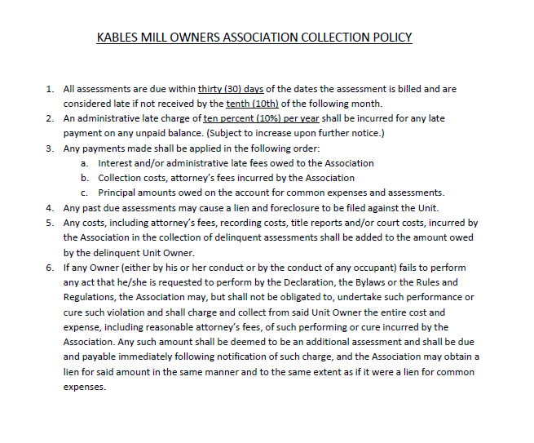

Slide 6
Treasurer’s Report – 2025 Spending

