Slide 1
Project 2: Hotel Price Predictor
John Millar
Kalen Asberry
Mark Foxworth

Slide 2
Summary and Goal of Project
Using Kaggle’s Hotel Booking Demand dataset, this project seeks to examine:
Key features in determining hotel prices
Best times to travel abroad to save money hotels
The project will utilize various data cleaning and machine learning techniques to determine which model most accurately predicts hotel prices.

Slide 3
Questions of the Data:
What data features have the most impact on hotel price?
Lead Time (if it’s a City Hotel)
Arrival Date (Week & Month)
Is there true cost savings in booking a hotel well in advance?
Yes for City Hotels; No for Resort Hotels
When is the best time to travel to save money on hotels?
Off Season, especially for Resort Hotels
Can this data be used to build a machine learning model to accurately predict hotel prices?
Yes with a margin of error between $10 to $20 per night

Slide 4
Data Source:
Hotel Booking Demand Data
Source – Kaggle
https://www.kaggle.com/jessemostipak/hotel-booking-demand/data#nd
Description:
~119,000 rows of data with 32 columns.
Data includes Average Daily Rates, meal plan, country, lead time, booking date and hotel types.

Slide 5
Data Cleaning Process
Steps (Combine columns and drop unnecessary data):
Arrival month was converted to numerical values
Arrival day, month, and year were combined in a new row labeled date.
All daily rates less than $40 to $50 were eliminated to remove discounted prices.
Market segments such as aviation, corporate, undefined and complementary rates were dropped to reduce noise and focus on standard consumer rates
Other features were dropped
Null values were dropped

Slide 6
Data Cleaning continued….
Transformed non-numeric data using one-hot-encoder and dummy values
Rounded average daily rate to the nearest $10 dollars to simplify model predictions
Additional filter options to sort data by country
Use standard scaler to normalize the final data frame
Data frame cleaned to 116,000 rows with 13 columns

Slide 7
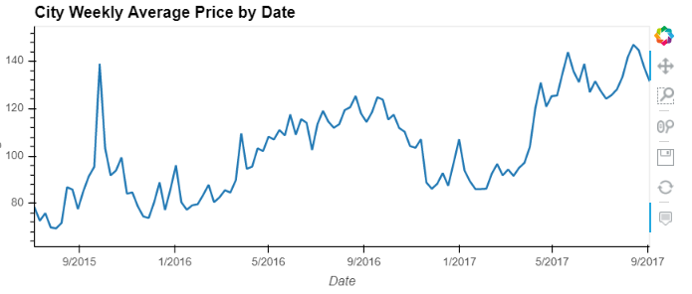
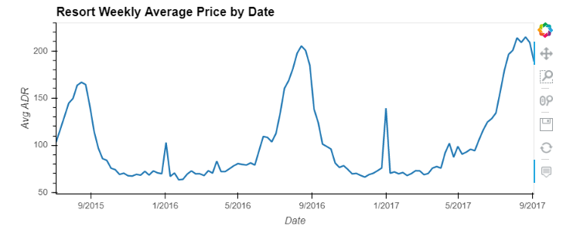
Best Time to Travel: Average Weekly Rates
Data split by City and Resort Hotel
Resampled based on a weekly average
High seasonality in the resort hotel data with high peaks and valleys with peak time in the summer / lat fall months.
General upward trend in the City hotel prices over time.
Data indicates the best time to travel to save money is during the non peak times outside of vacation season or holidays

Slide 8
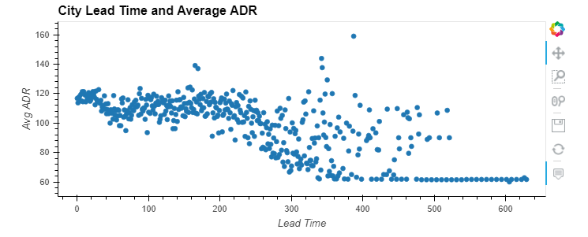
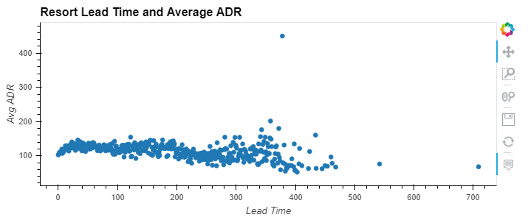
Lead Time & ADR
Average ADR based on Lead Time (in days) was plotted to examine the relationship.
There is a linear relationship between city ADR and lead time.
There is not a strong linear relationship between resort ADR and lead time.

Slide 9
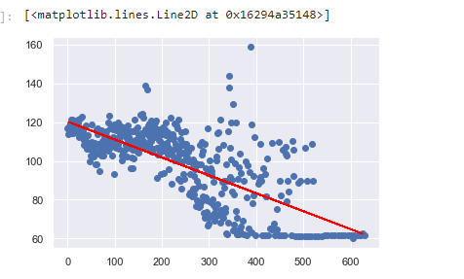
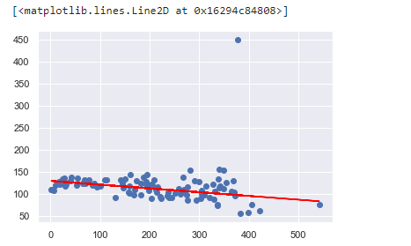
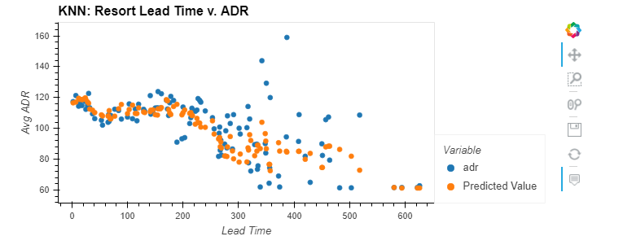
Linear Regression & K Nearest Neighbors
Linear Regression
Analysis was performed based on the average ADR and lead time for both City and Resort data.
Model result for City had MSE of 15.38.
Model result for Resort had MSE of 39.22.
KNN
City data had MSE of 15.06

Slide 10
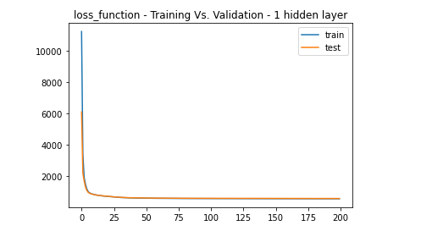
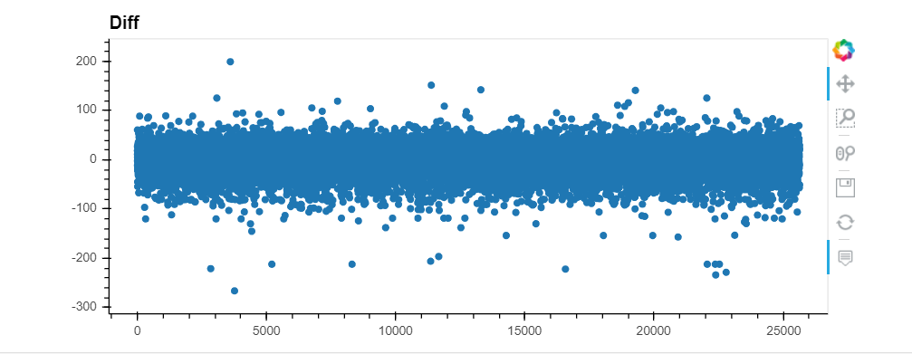
Deep Learning Techniques
Ran two models with following:
Epochs = 200
Features = 15
Nodes = 8
Activation = Linear
MSE Model w/ 1 Hidden Layers = 572
Results indicate the model is within $100 dollars of the actual value which is not accurate.

Slide 11
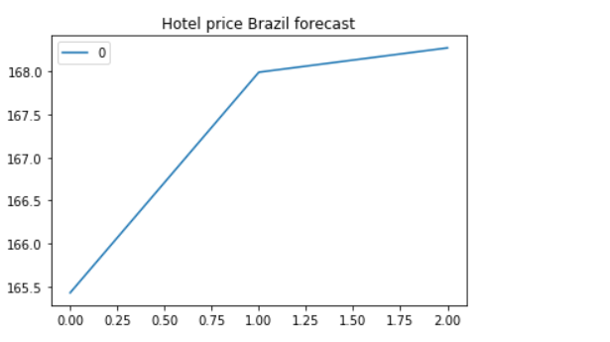
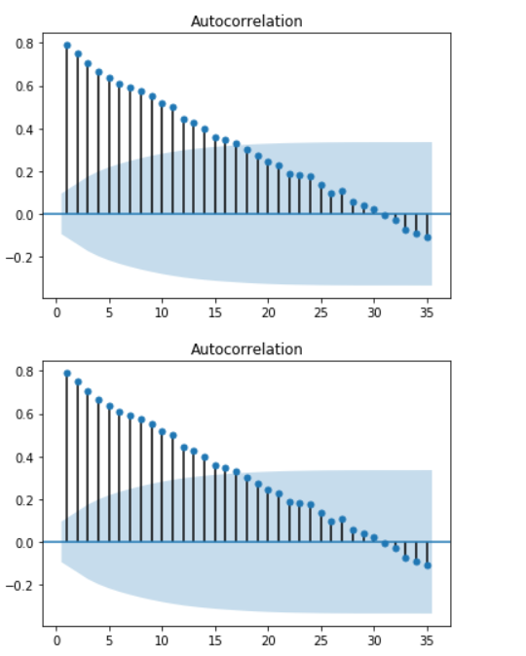
ARIMA Model
Filtered by country (Brazil)
To be finalized
With seasonal events this autocorrelations has spikes due to some events such as Carnival and Olympics.
Due to the high volume of people and major events during certain time of the year the means of the Autocorrelation are higher but as time goes on there is not as much traffic the mean will eventually go negative.

Slide 12
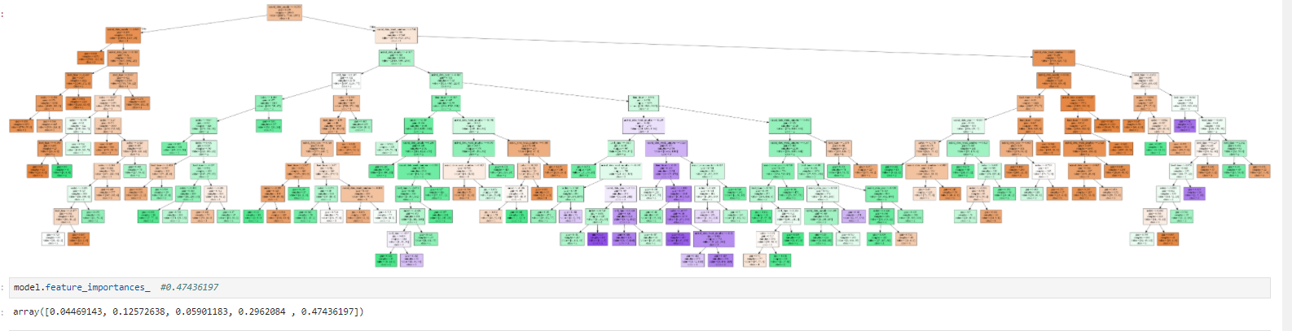
Decision Tree
0.47436197
This Decision Tree showed us some surprising data, the must important feature with 47% out of 1 being arrival data week number. That make more sense when Brazil has the most traction of hotel and resort visitors during certain time of the year Such as Olympics and Carnival. Making the tree look at the weeks with the most volume of the outcomes.

Slide 13
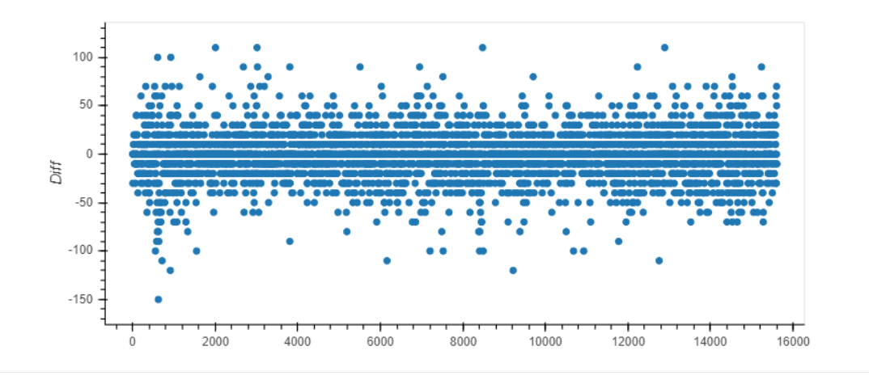
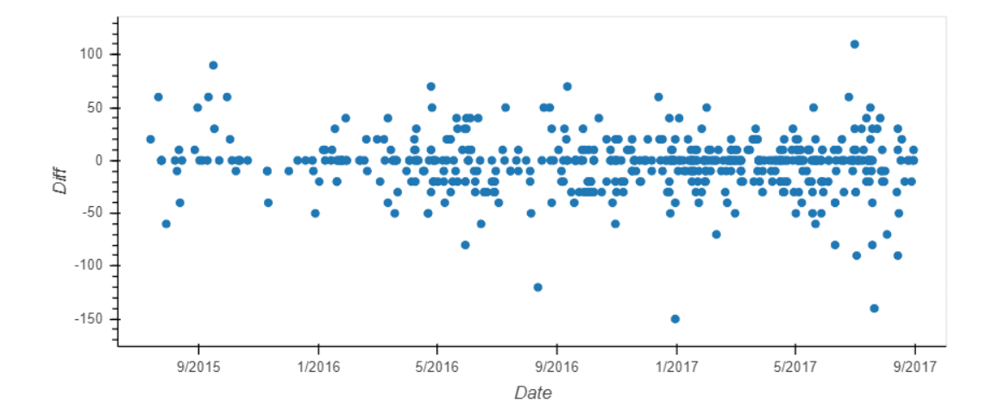
Random Forest Model / Gradient Boosting
Using Random Forest and Gradient Boosting we can predict the price within a $50 range.
Filtered by country, we can predict the exact price 1/3 of the time.
Features with most weight:
Lead Time
Arrival Date (Week)
Arrival Date (Month)
Country
Confirmed cost savings in booking in advanced (lead time).

Slide 14
Final Results & Lessons Learned
Final Results
With current data, can accurately predict 25% to 31% of prices.
Accurate within $10 to $20 (Regression)
Deep learning model was not accurate with a mse of 572. Significant variances between predicted and actual adr values.
There is a correlation between cost and lead time (Based on Weights).
Lessons Learned
More Data
Actual Hotel Identifier
Star Ratings
More memory
Dataset size caused significant slowdowns on machines
More Models
SRIMA model to account for seasonality

