Slide 1
Introduction to uncertainty quantification
John Nardini,
The College of New Jersey
MT2: Data-Driven Mathematical Modeling
Code and slides available at: https://github.com/johnnardini/SIAM_LS_MT_2022

Slide 2
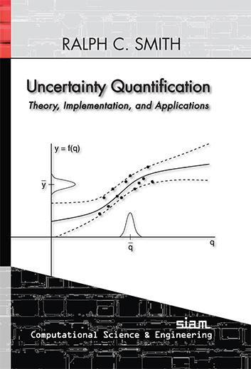
Main reference
Chapter 7: Frequentist Techniques for Parameter Estimation

Slide 3
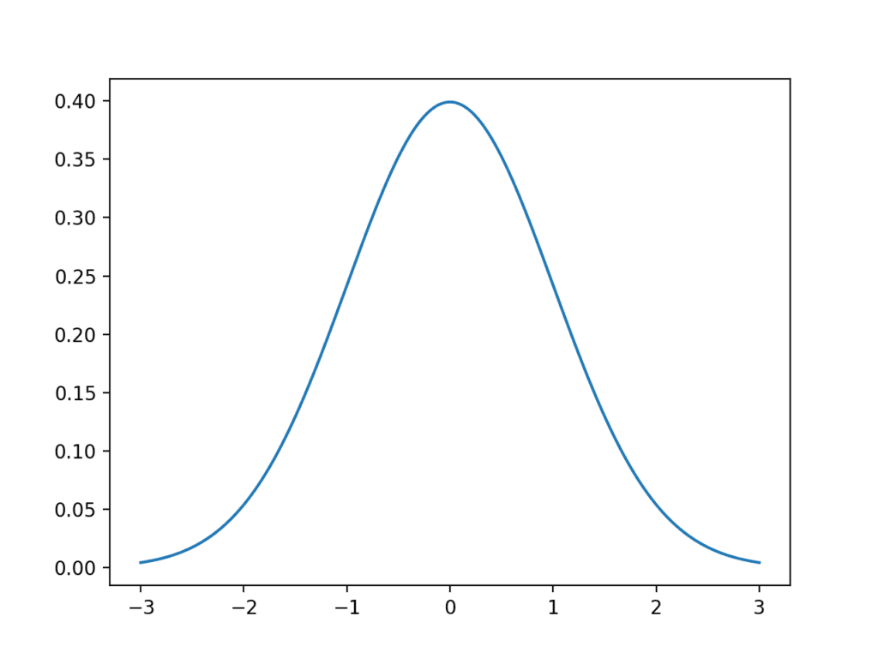




Differing perspectives
Frequentist approach
Model parameters $q_{0}$ are fixed and unknown scalars
Goal: Estimate $q_{0}$ from data $Y$with the estimator $\hat{q}$, and quantify the uncertainty of $\hat{q}.$
Bayesian approach
Model parameters $q$are random variables with true distribution $p(q)$
Goal: Estimate $p(q)$ with posterior distribution $p(q|Y)$, where $Y$ is some sampled data
$$q_{0}$$
$$\hat{q}$$

Slide 4
Differing perspectives
Frequentist approach
Model parameters $q_{0}$ are fixed and unknown scalars
Goal: Estimate $q_{0}$ from data $Y$with the estimator $\hat{q}$, and quantify the uncertainty of $\hat{q}.$
Bayesian approach
Model parameters $q$are random variables with true distribution $p(q)$
Goal: Estimate $p(q)$ with posterior distribution $p(q|Y)$, where $Y$ is some sampled data
$$q_{0}$$
$$\hat{q}$$

Slide 5
Differing perspectives
Frequentist approach
Model parameters $q_{0}$ are fixed and unknown scalars
Goal: Estimate $q_{0}$ from data $Y$with the estimator $\hat{q}$, and quantify the uncertainty of $\hat{q}.$
Bayesian approach
Model parameters $q$are random variables with true distribution $p(q)$
Goal: Estimate $p(q)$ with posterior distribution $p(q|Y)$, where $Y$ is some sampled data
$$q_{0}$$
$$\hat{q}$$

Slide 6
Differing perspectives
Frequentist approach
Model parameters $q_{0}$ are fixed and unknown scalars
Goal: Estimate $q_{0}$ from data $Y$with the estimator $\hat{q}$, and quantify the uncertainty of $\hat{q}.$
Bayesian approach
Model parameters $q$are random variables with true distribution $p(q)$
Goal: Estimate $p(q)$ with posterior distribution $p(q|Y)$, where $Y$ is some sampled data
$$q_{0}$$
$$\hat{q}$$

Slide 7
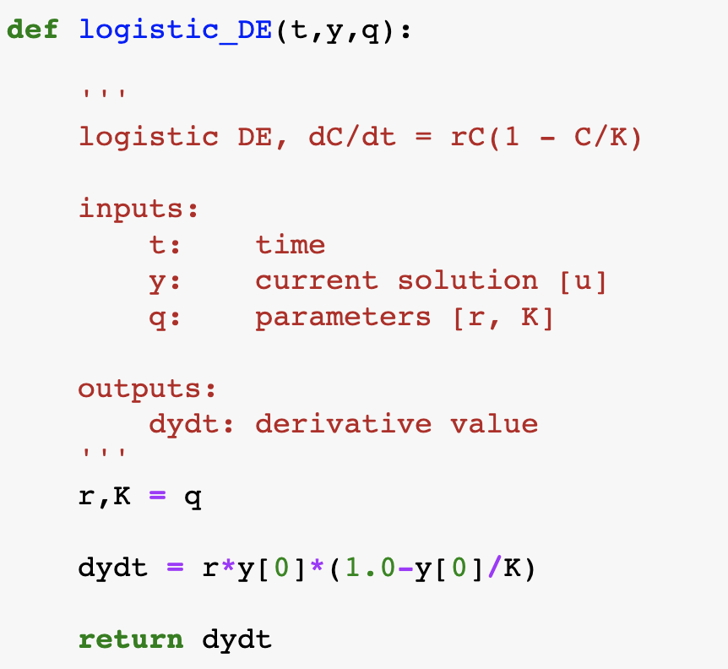
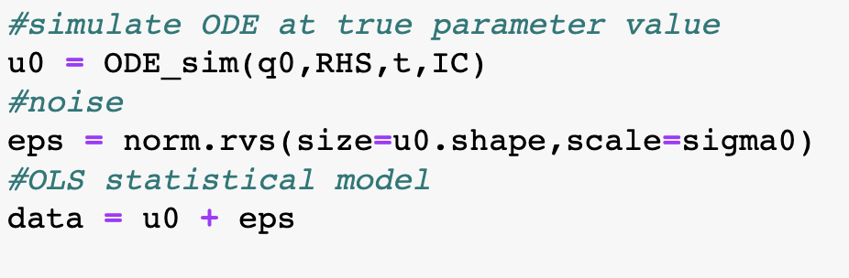


Data generation
$$\frac{du(t,u\left(t\right);q)}{dt}=f(t,u\left(t\right);q)$$
$$Y_{i}=u\left(t_{i}; q_{0}\right)+ε_{i},$$
$$ε_{i}\sim 𝒩(0, σ_{0})$$

Slide 8
Artificial data from the logistic dataset

Slide 9
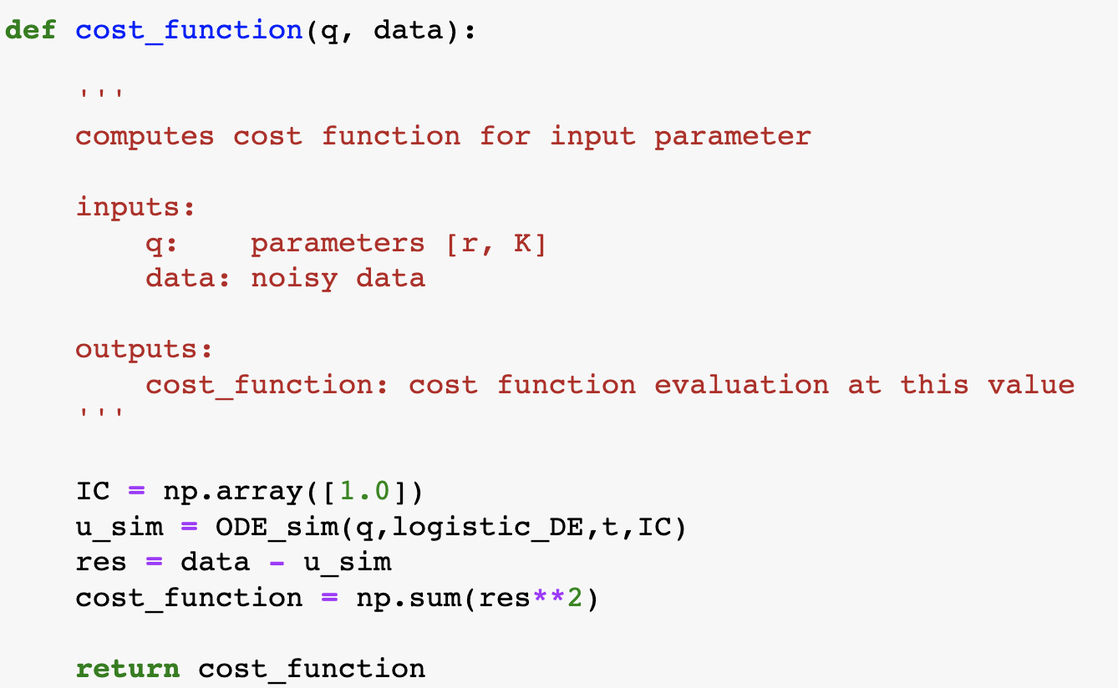
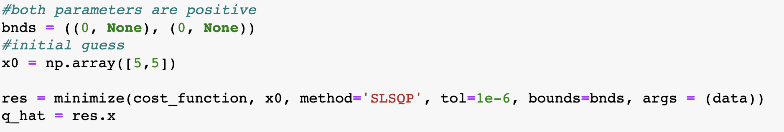
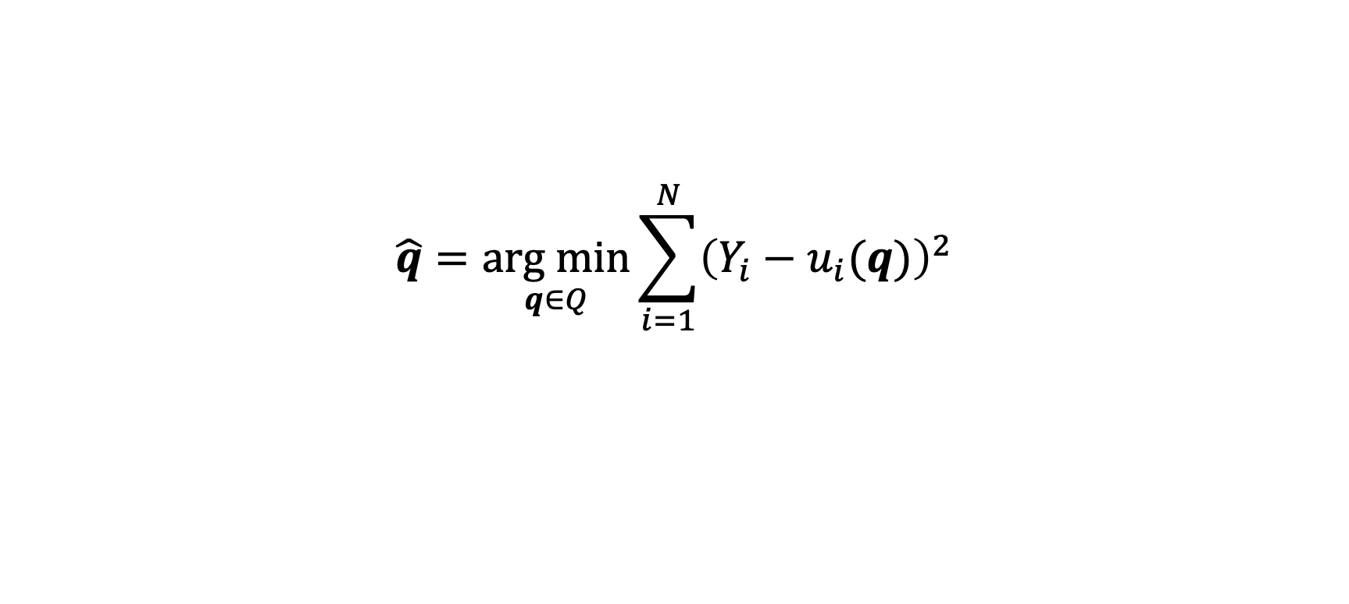
OLS Estimator
$$\hat{q}=\underset{q∈Q}{arg min}{\sum_{i=1}^{N}{{\left(Y_{i}−u_{i}(q)\right)}^{2}}}$$

Slide 10
Results
Parameter | True | Estimated
r | 0.5 | 0.50070
K | 10.0 | 10.0222

Slide 11

Estimator variance components
The variance of the estimator $\hat{q}$ consists of two components:
Noise in the data
Model sensitivity to its parameters

Slide 12
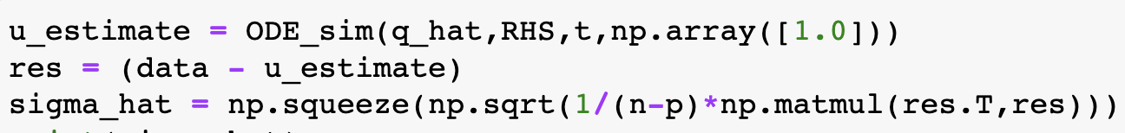
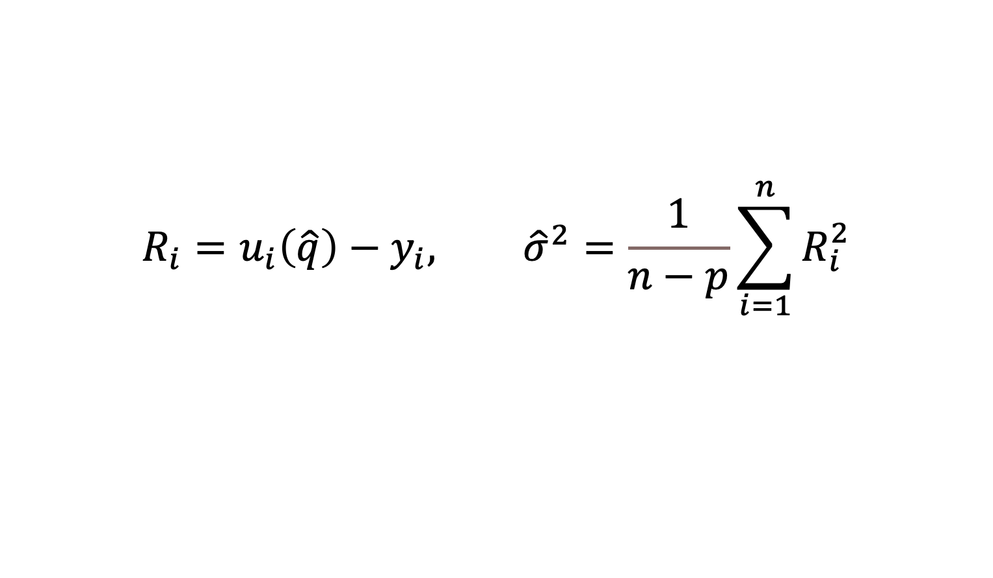
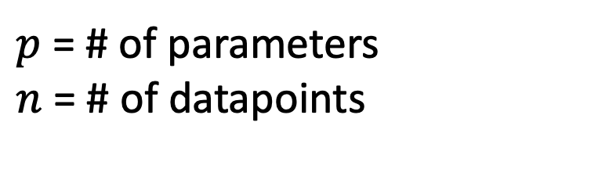
Estimating the noise in the data
$$R_{i}=u_{i}\left(\hat{q}\right)−y_{i}, {\hat{σ}}^{2}=\frac{1}{n−p}\sum_{i=1}^{n}{R_{i}^{2}}$$
$p$ = # of parameters
$n$ = # of datapoints

Slide 13
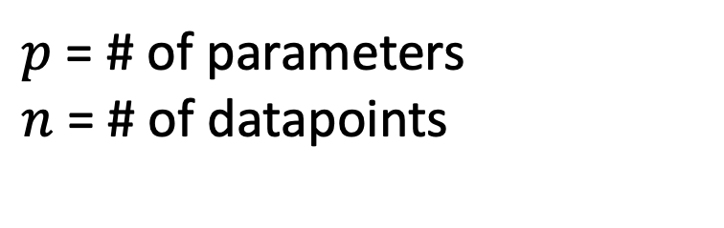
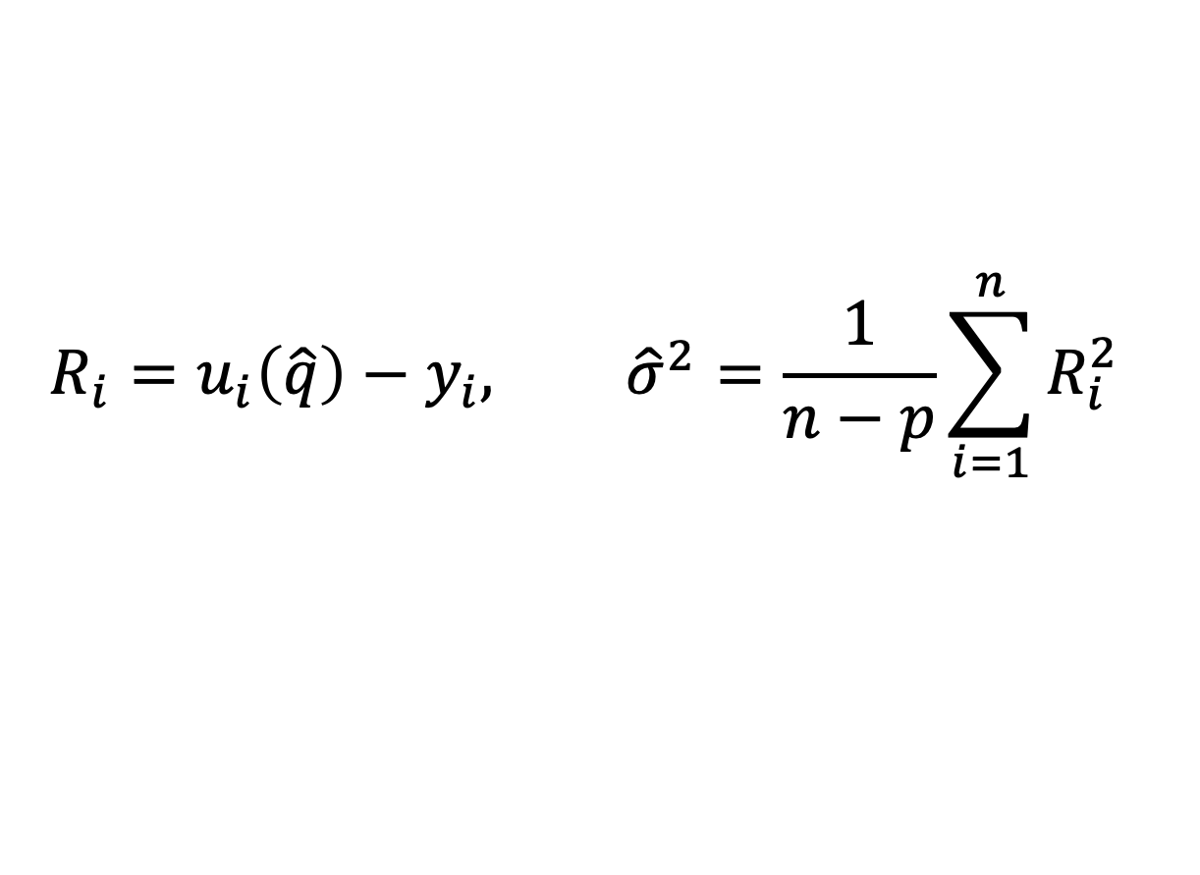
Estimating the noise in the data
$p$ = # of parameters
$n$ = # of datapoints
$$R_{i}=u_{i}\left(\hat{q}\right)−y_{i}, {\hat{σ}}^{2}=\frac{1}{n−p}\sum_{i=1}^{n}{R_{i}^{2}}$$

Slide 14

Model sensitivity equations
How does our mathematical model, $u(t;q)$, change with perturbations to model parameters $q={\left[r, K\right]}^{T}$?
Partial derivatives!
$$χ_{k}(t;q)=\frac{∂u(t;q)}{∂q_{k}}$$
e.g. $χ_{r}(t;q)=\frac{∂u(t;q)}{∂r}$, $χ_{K}(t;q)=\frac{∂u(t;q)}{∂K}$

Slide 15
Model sensitivity equations
How does our mathematical model, $u(t;q)$, change with perturbations to model parameters $q={\left[r, K\right]}^{T}$?
Partial derivatives!
$$χ_{k}(t;q)=\frac{∂u(t;q)}{∂q_{k}}$$
e.g. $χ_{r}(t;q)=\frac{∂u(t;q)}{∂r}$, $χ_{K}(t;q)=\frac{∂u(t;q)}{∂K}$

Slide 16
Model sensitivity equations
How does our mathematical model, $u(t;q)$, change with perturbations to model parameters $q={\left[r, K\right]}^{T}$?
Partial derivatives!
$$χ_{k}(t;q)=\frac{∂u(t;q)}{∂q_{k}}$$
e.g. $χ_{r}(t;q)=\frac{∂u(t;q)}{∂r}$, $χ_{K}(t;q)=\frac{∂u(t;q)}{∂K}$

Slide 17
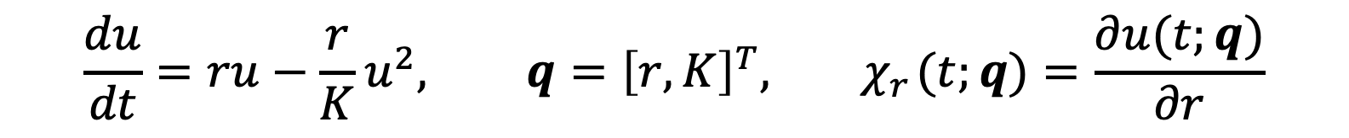
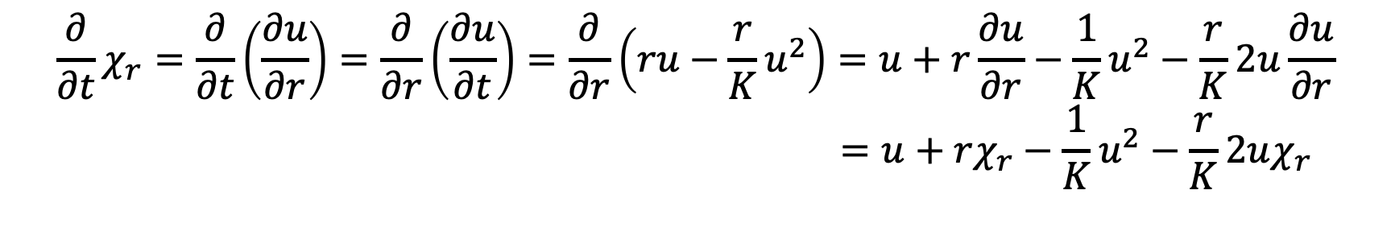
Deriving DE models for sensitivities
$$\frac{du}{dt}=ru−\frac{r}{K}u^{2}, q={\left[r, K\right]}^{T},{ χ}_{r}(t;q)=\frac{∂u(t;q)}{∂r}$$
$$\frac{∂}{∂t}χ_{r}=\frac{∂}{∂t}\left(\frac{∂u}{∂r}\right)=\frac{∂}{∂r}\left(\frac{∂u}{∂t}\right)=\frac{∂}{∂r}\left(ru−\frac{r}{K}u^{2}\right)=u+r\frac{∂u}{∂r}−\frac{1}{K}u^{2}−\frac{r}{K}2u\frac{∂u}{∂r} \\ =u+rχ_{r}−\frac{1}{K}u^{2}−\frac{r}{K}2uχ_{r}$$

Slide 18
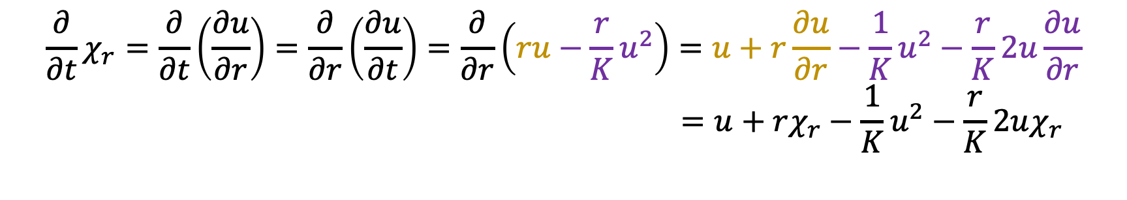
Deriving DE models for sensitivities
$$\frac{du}{dt}=ru−\frac{r}{K}u^{2}, q={\left[r, K\right]}^{T},{ χ}_{r}(t;q)=\frac{∂u(t;q)}{∂r}$$
$$\frac{∂}{∂t}χ_{r}=\frac{∂}{∂t}\left(\frac{∂u}{∂r}\right)=\frac{∂}{∂r}\left(\frac{∂u}{∂t}\right)=\frac{∂}{∂r}\left(ru−\frac{r}{K}u^{2}\right)=u+r\frac{∂u}{∂r}−\frac{1}{K}u^{2}−\frac{r}{K}2u\frac{∂u}{∂r} \\ =u+rχ_{r}−\frac{1}{K}u^{2}−\frac{r}{K}2uχ_{r}$$

Slide 19
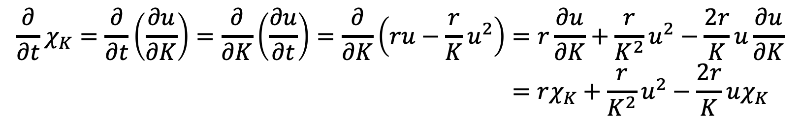
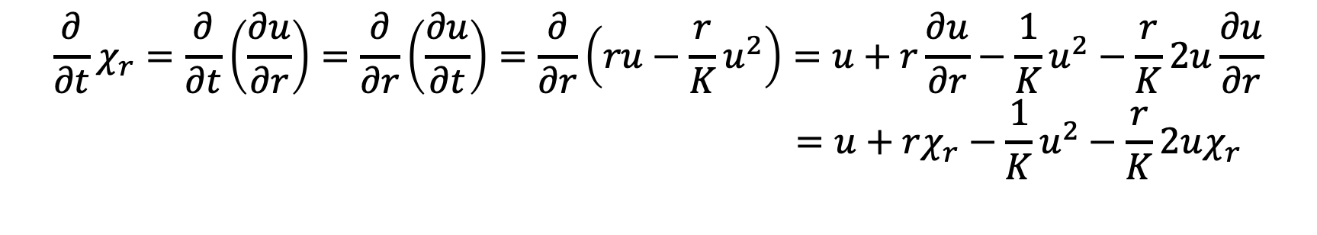
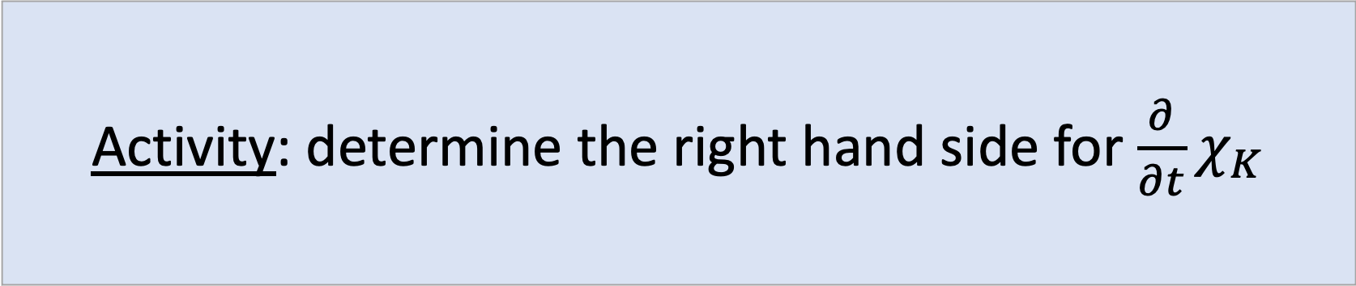
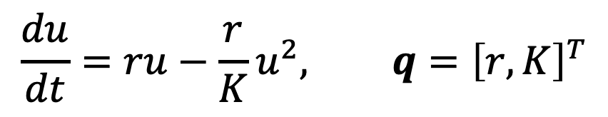
Deriving DE models for sensitivities: the logistic equation
$$\frac{du}{dt}=ru−\frac{r}{K}u^{2}, q={\left[r, K\right]}^{T}$$
$$\frac{∂}{∂t}χ_{r}=\frac{∂}{∂t}\left(\frac{∂u}{∂r}\right)=\frac{∂}{∂r}\left(\frac{∂u}{∂t}\right)=\frac{∂}{∂r}\left(ru−\frac{r}{K}u^{2}\right)=u+r\frac{∂u}{∂r}−\frac{1}{K}u^{2}−\frac{r}{K}2u\frac{∂u}{∂r} \\ =u+rχ_{r}−\frac{1}{K}u^{2}−\frac{r}{K}2uχ_{r}$$
Activity: determine the right hand side for $\frac{∂}{∂t}χ_{K}$
$$\frac{∂}{∂t}χ_{K}=\frac{∂}{∂t}\left(\frac{∂u}{∂K}\right)=\frac{∂}{∂K}\left(\frac{∂u}{∂t}\right)=\frac{∂}{∂K}\left(ru−\frac{r}{K}u^{2}\right)=r\frac{∂u}{∂K}+\frac{r}{K^{2}}u^{2}−\frac{2r}{K}u\frac{∂u}{∂K} \\ =rχ_{K}+\frac{r}{K^{2}}u^{2}−\frac{2r}{K}uχ_{K}$$

Slide 20
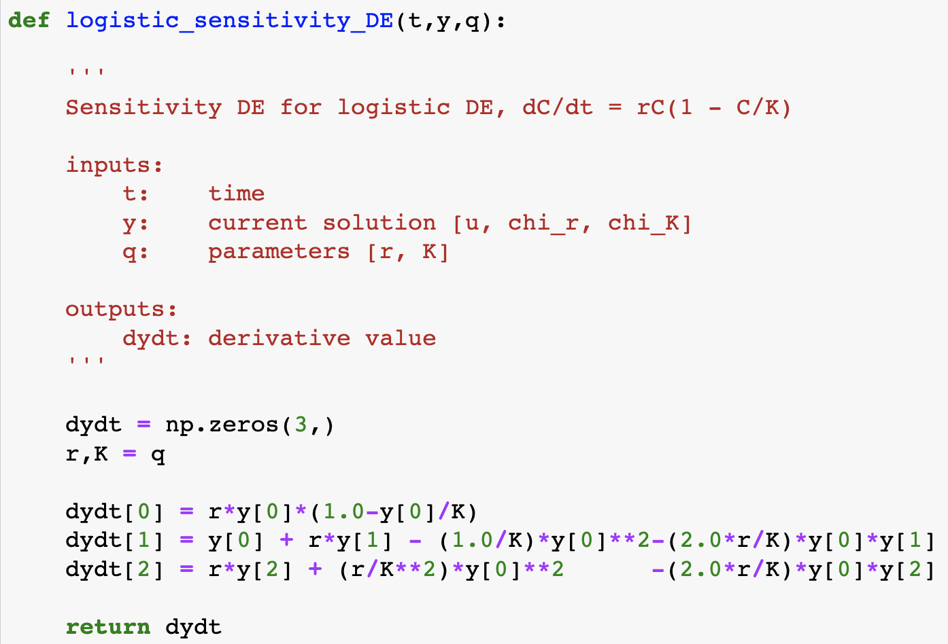


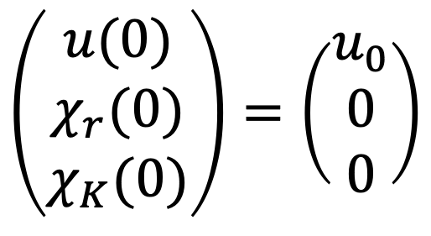

The full sensitivity equations
$$\frac{du}{dt}=ru\left(1−\frac{u}{K}\right)$$
$$\frac{dχ_{r}}{dt}=u+rχ_{r}−\frac{1}{K}u^{2}−\frac{2r}{K}uχ_{r}$$
$$\frac{dχ_{K}}{dt}=rχ_{K}+\frac{r}{K^{2}}u^{2}−\frac{2r}{K}uχ_{K}$$
$$\left(\begin{aligned}u(0) \\ χ_{r}(0) \\ χ_{K}(0)\end{aligned}\right)=\left(\begin{aligned}u_{0} \\ 0 \\ 0\end{aligned}\right)$$

Slide 21
Sensitivity model simulations

Slide 22
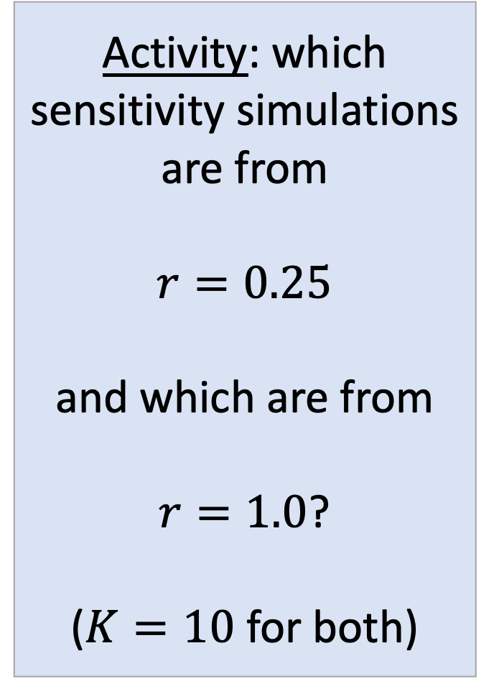
Simulation 1
Activity: which sensitivity simulations are from
$$r=0.25$$
and which are from
$r=1.0$?
($K=10$ for both)
$$r=0.25$$
Simulation 2
$$r=1.0$$

Slide 23

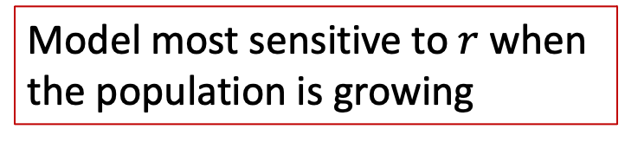
Model most sensitive to $r$ when the population is growing
Model most sensitive to $K$ when the population is at confluence

Slide 24


General sensitivity equations
For the DE model $\frac{du(t,u\left(t\right);q)}{dt}=f\left(t,u\left(t\right);q\right),$
& ${ χ}_{k}(t;q)=\frac{∂u(t;q)}{∂q_{k}}$
$$\frac{∂χ_{k}}{∂t} =\frac{∂f}{∂q_{k}}+\frac{∂f}{∂u}χ_{k}$$
Key: $f(t,u\left(t;q\right);q$) depends on $q$ both directly and indirectly (via $u$ )

Slide 25
Estimator sampling distribution
$$\hat{q} \sim 𝒩\left(q_{0},V\right), V=σ_{0}^{2}{\left[χ^{T}\left(q_{0}\right)χ\left(q_{0}\right)\right]}^{−1}$$

Slide 26
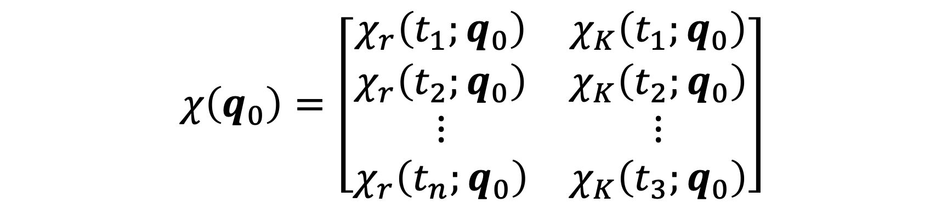
Estimator sampling distribution
$$\hat{q} \sim 𝒩\left(q_{0},V\right), V=σ_{0}^{2}{\left[χ^{T}\left(q_{0}\right)χ\left(q_{0}\right)\right]}^{−1}$$
$$χ\left(q_{0}\right)=\left[\begin{matrix}\begin{aligned}χ_{r}\left(t_{1};q_{0}\right) \\ χ_{r}\left(t_{2};q_{0}\right) \\ ⋮ \\ χ_{r}\left(t_{n};q_{0}\right)\end{aligned} & \begin{aligned}χ_{K}\left(t_{1};q_{0}\right) \\ χ_{K}\left(t_{2};q_{0}\right) \\ ⋮ \\ χ_{K}\left(t_{3};q_{0}\right)\end{aligned}\end{matrix}\right]$$

Slide 27
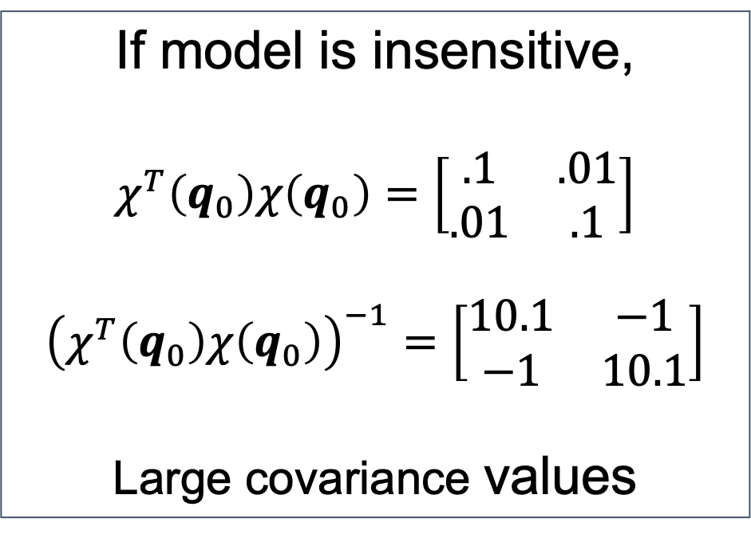
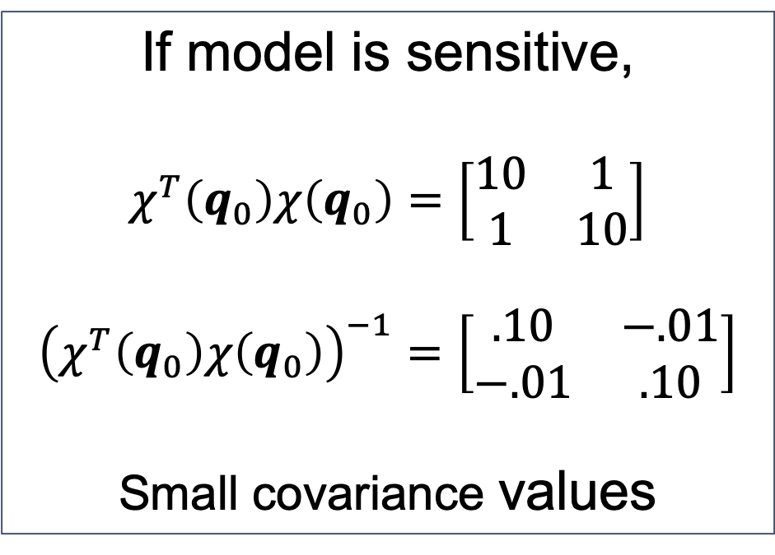
Estimator sampling distribution
$$\hat{q} \sim 𝒩\left(q_{0},V\right), V=σ_{0}^{2}{\left[χ^{T}\left(q_{0}\right)χ\left(q_{0}\right)\right]}^{−1}$$
If model is insensitive,
$$χ^{T}\left(q_{0}\right)χ\left(q_{0}\right)=\left[\begin{matrix}.1 & .01 \\ .01 & .1\end{matrix}\right]$$
$${\left(χ^{T}\left(q_{0}\right)χ\left(q_{0}\right)\right)}^{−1}=\left[\begin{matrix}10.1 & −1 \\ −1 & 10.1\end{matrix}\right]$$
Large covariance values
If model is sensitive,
$$χ^{T}\left(q_{0}\right)χ\left(q_{0}\right)=\left[\begin{matrix}10 & 1 \\ 1 & 10\end{matrix}\right]$$
$${\left(χ^{T}\left(q_{0}\right)χ\left(q_{0}\right)\right)}^{−1}=\left[\begin{matrix}.10 & −.01 \\ −.01 & .10\end{matrix}\right]$$
Small covariance values

Slide 28
Confidence interval construction
$$\hat{q} \sim 𝒩\left({ q}_{0} ,{ σ}_{0}^{2}{\left[χ^{T}\left(q_{0}\right)χ\left(q_{0}\right)\right]}^{−1}\right)$$

Slide 29
Confidence interval construction
$$\hat{q} \sim 𝒩\left({ q}_{0} ,{ σ}_{0}^{2}{\left[χ^{T}\left(q_{0}\right)χ\left(q_{0}\right)\right]}^{−1}\right)$$
$$\hat{q}−q_{0} \sim 𝒩\left( 0 ,{ σ}_{0}^{2}{\left[χ^{T}\left(q_{0}\right)χ\left(q_{0}\right)\right]}^{−1}\right)$$

Slide 30
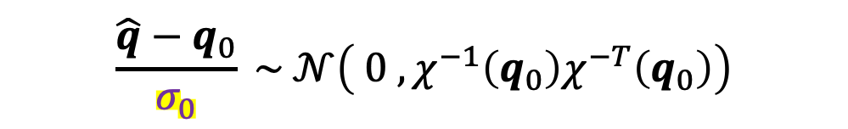
Confidence interval construction
$$\hat{q} \sim 𝒩\left({ q}_{0} ,{ σ}_{0}^{2}{\left[χ^{T}\left(q_{0}\right)χ\left(q_{0}\right)\right]}^{−1}\right)$$
$$\hat{q}−q_{0} \sim 𝒩\left( 0 ,{ σ}_{0}^{2}{\left[χ^{T}\left(q_{0}\right)χ\left(q_{0}\right)\right]}^{−1}\right)$$
$$\frac{\hat{q}−q_{0}}{σ_{0}} \sim 𝒩\left( 0 ,χ^{−1}\left(q_{0}\right)χ^{−T}\left(q_{0}\right)\right)$$

Slide 31
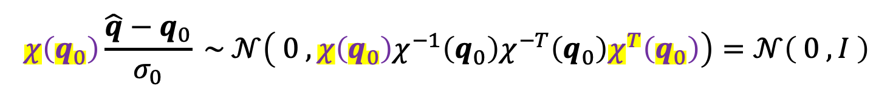
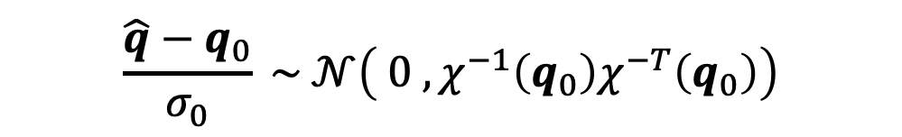
Confidence interval construction
$$\hat{q} \sim 𝒩\left({ q}_{0} ,{ σ}_{0}^{2}{\left[χ^{T}\left(q_{0}\right)χ\left(q_{0}\right)\right]}^{−1}\right)$$
$$\hat{q}−q_{0} \sim 𝒩\left( 0 ,{ σ}_{0}^{2}{\left[χ^{T}\left(q_{0}\right)χ\left(q_{0}\right)\right]}^{−1}\right)$$
$$\frac{\hat{q}−q_{0}}{σ_{0}} \sim 𝒩\left( 0 ,χ^{−1}\left(q_{0}\right)χ^{−T}\left(q_{0}\right)\right)$$
$$χ\left(q_{0}\right)\frac{\hat{q}−q_{0}}{σ_{0}} \sim 𝒩\left( 0 ,χ\left(q_{0}\right)χ^{−1}\left(q_{0}\right)χ^{−T}\left(q_{0}\right)χ^{T}\left(q_{0}\right)\right)=𝒩\left( 0 , I \right)$$

Slide 32


Confidence interval construction
$$χ\left(q_{0}\right)\frac{\hat{q}−q_{0}}{σ_{0}} \sim 𝒩\left( 0 , I \right)$$
Question: What distribution should be used to create a confidence interval for $\hat{q}$?
(A)
Normal
(B)
Q-distribution
(C)
T-distribution
(D)
Z-distribution

Slide 33
Confidence interval construction
$$χ\left(q_{0}\right)\frac{\hat{q}−q_{0}}{σ_{0}} \sim 𝒩\left( 0 , I \right)$$
Question: What distribution should be used to create a confidence interval for $\hat{q}$?
(A)
Normal
(B)
Q-distribution
(C)
T-distribution
(D)
Z-distribution

Slide 34

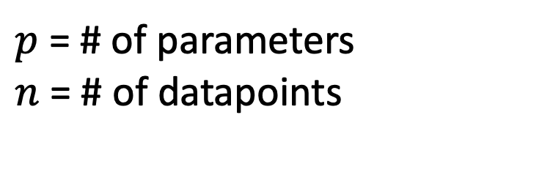
Confidence interval construction
When $σ_{0}$ is known:
$$χ\left(\hat{q}\right)\frac{\hat{q}−q_{0}}{σ_{0}} \sim 𝒩\left( 0 , I \right)$$
When $σ_{0}$ is unknown and estimated with $\hat{σ}$:
$$χ\left(\hat{q}\right)\frac{\hat{q}−q_{0}}{\hat{σ}} \sim t_{n−p}$$
$p$ = # of parameters
$n$ = # of datapoints

Slide 35

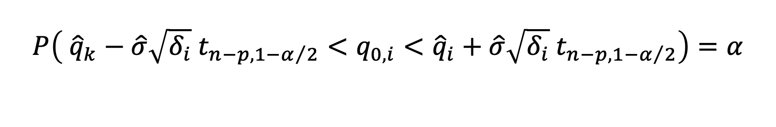
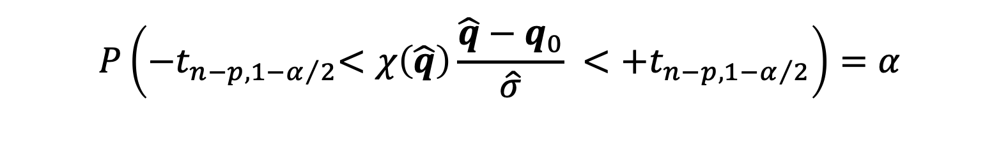
Confidence interval construction
When $σ_{0}$ is unknown and estimated with $\hat{σ}$:
$$χ\left(q_{0}\right)\frac{\hat{q}−q_{0}}{σ_{0}} \sim t_{n−p},$$
$$P\left({−t}_{n−p,1−α/2}<χ\left(\hat{q}\right)\frac{\hat{q}−q_{0}}{\hat{σ}} <{+t}_{n−p,1−α/2}\right)=α$$
$$P\left( {\hat{q}}_{k}−{\hat{σ}\sqrt{δ_{i}} t}_{n−p,1−α/2}<q_{0,i}<{\hat{q}}_{i}+{\hat{σ}\sqrt{δ_{i}} t}_{n−p,1−α/2}\right)=α$$
$δ_{i}$ is the $i^{th}$ diagonal entry of ${\left[χ^{T}\left(\hat{q}\right)χ\left(\hat{q}\right)\right]}^{−1}$

Slide 36
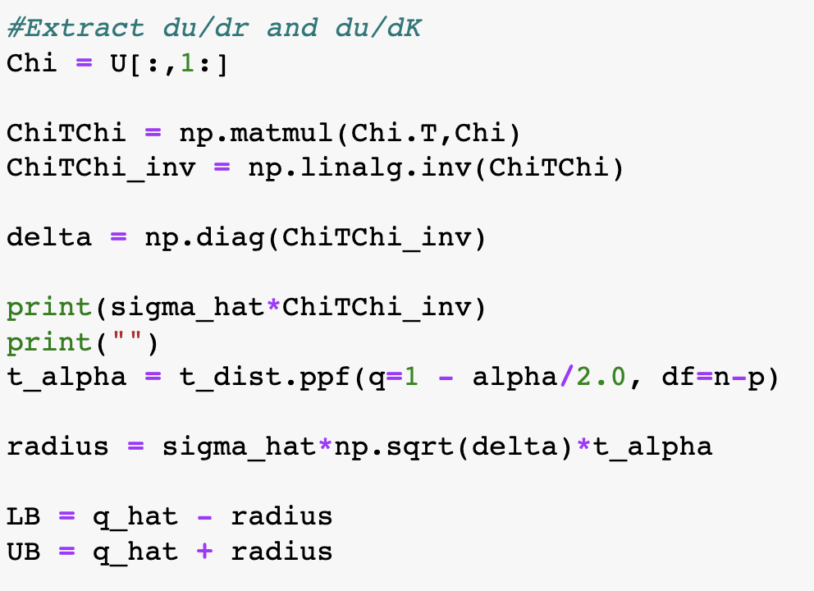
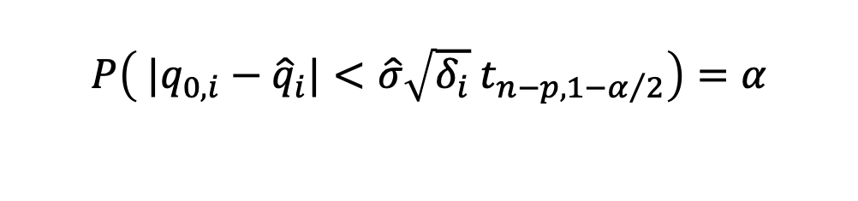

$$P\left( |q_{0,i}−{\hat{q}}_{i}|<{\hat{σ}\sqrt{δ_{i}} t}_{n−p,1−α/2}\right)=α$$
$δ_{i}$ is the $i^{th}$ diagonal entry
of ${\left[χ^{T}\left(\hat{q}\right)χ\left(\hat{q}\right)\right]}^{−1}$

Slide 37
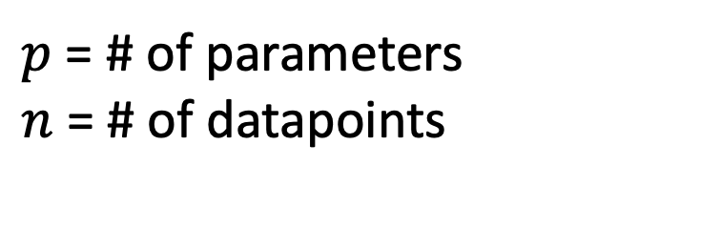
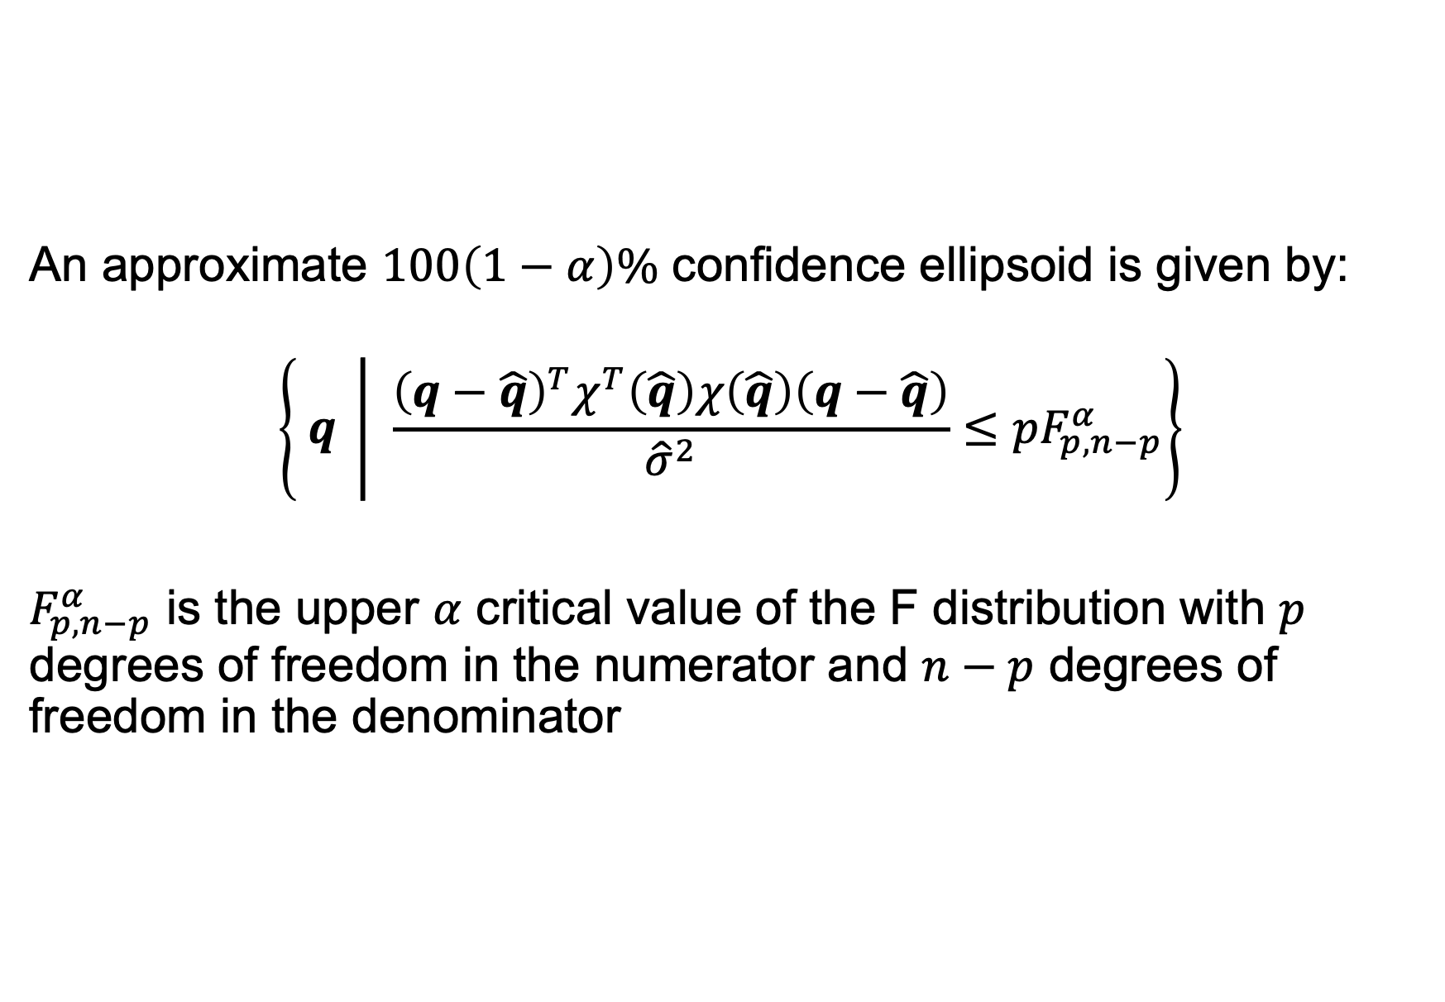
Confidence ellipsoids
An approximate $100\left(1−α\right)\%$ confidence ellipsoid is given by:
$$\left\{ q \left| \frac{{\left(q−\hat{q}\right)}^{T}χ^{T}\left(\hat{q}\right)χ\left(\hat{q}\right)\left(q−\hat{q}\right)}{{\hat{σ}}^{2}}≤pF_{p,n−p}^{α}\right.\right\}$$
$F_{p,n−p}^{α}$ is the upper $α$ critical value of the F distribution with $p$ degrees of freedom in the numerator and $n−p$ degrees of freedom in the denominator
$p$ = # of parameters
$n$ = # of datapoints

Slide 38
Results on synthetic data

Slide 39
