Slide 1
Dublin Bikes
Mobile App Development
John Nash

Slide 2
Business Case and Objectives
Dublin Bikes Journey
Document/take pictures
View route on google maps

Slide 3
Target Audience
Young/Middle aged Professionals
Typically in high traffic areas in Dublin
Focus on tourists/fitness advocates

Slide 4
Design Strategy
Quick, to the point, easy to use
Lightweight, give users reason to use the app
Resource for bike riders on the go

Slide 5
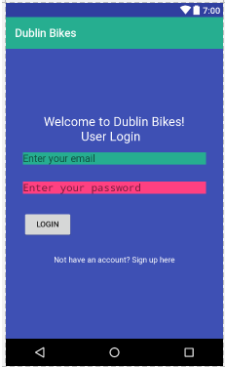
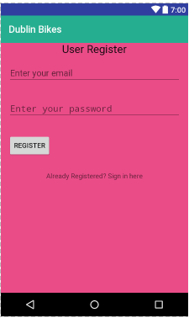
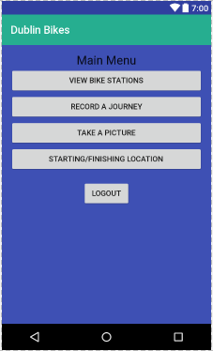
Screenshots/Flow of the app

Slide 6
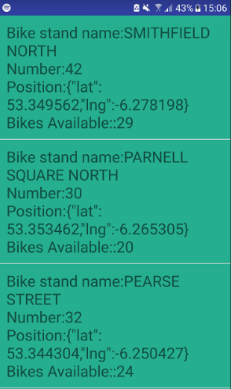
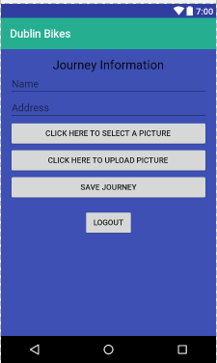
Screenshots/Flow of the app

Slide 7
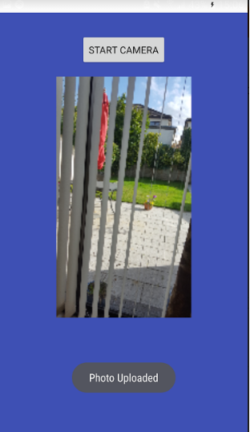
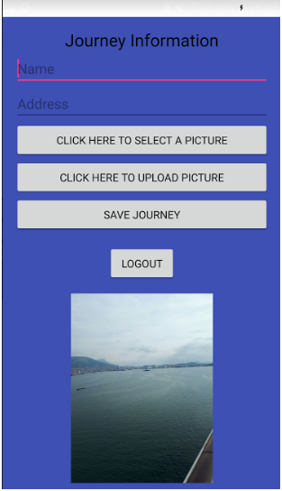
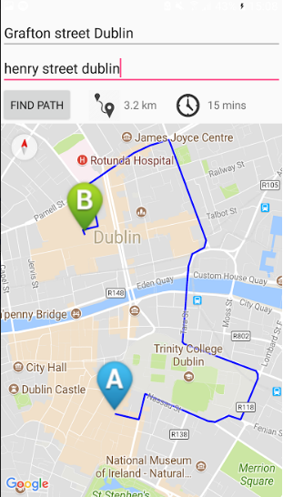
Screenshots/Flow of the app

Slide 8
Strengths/Weaknesses & Final thoughts
Strengths: Easy to use, no superfluous activities
Weaknesses: Not attractive UI, google map integration/Dublin Bike API use not ideal
Outcome: Learned a lot. Struggled for a lot of it. Did not accomplish as much as I could have but satisfied to produce something

